Slide 1


Slide 2
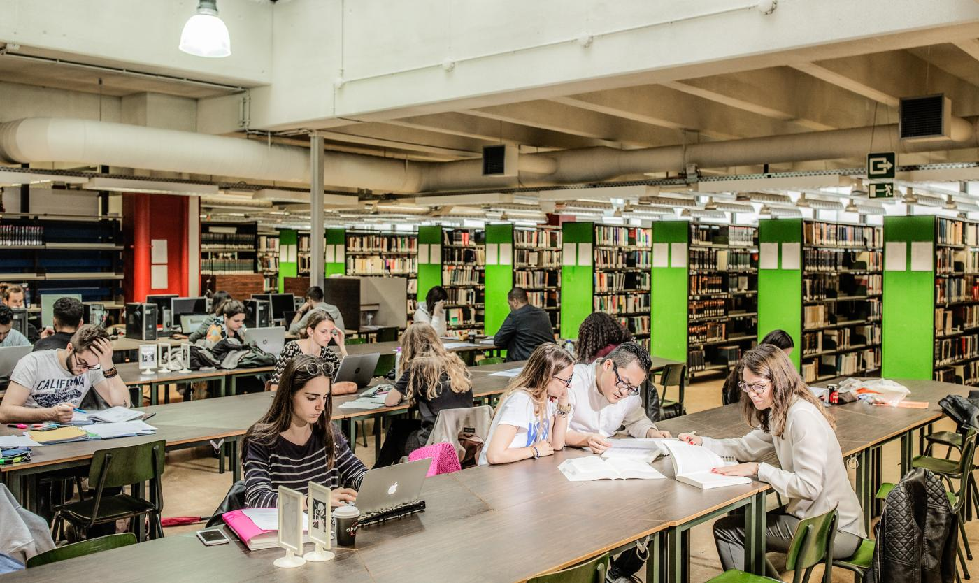
Library & Study Guidance
Target users
Requirements
What we learned from low fidelity prototype
User evaluation
Our opinion on high-fidelity prototype

Slide 3
Target users
People who need a place to study
People who need books from the library
New and older students

Slide 4
Requirements
General landing page
Post study needs
Join study group
Book a room
Become or ask help from a VUBuddy

Slide 5
Feedback from low fidelity
Breadcrumbs
Different shades of gray
Calendar

Slide 6
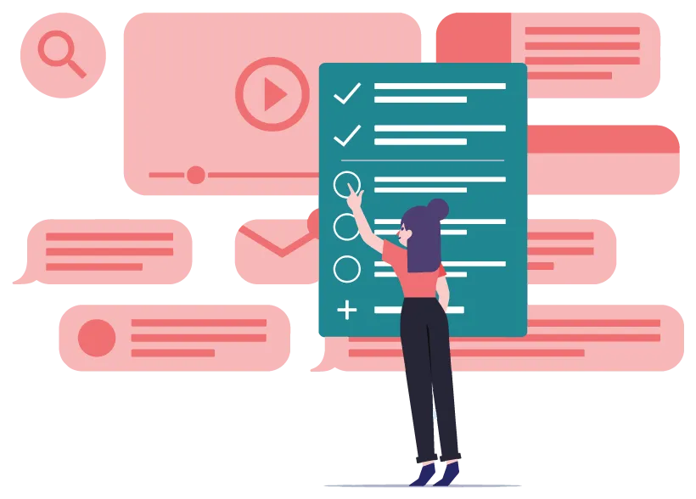
User evaluation

Slide 7
User Experience Questionnaire

Slide 8
User evaluation: Polls

Slide 9
User evaluation: Polls

Slide 10
User evaluation: Polls

Slide 11
User evaluation: usability test
We asked students to perform 3 tasks:
Reserve a book
Book a study place
Look for a VUBuddy
After analyzing their behavior, we found some issues they had

Slide 12
User evaluation: new issues
No possibility for the user to get to the home page via the breadcrumbs
No way back when logging in
Lack of use of images
For some parts it’s not clear if it’s clickable or not

Slide 13
User evaluation: discovering new requirements
A student can not only join a group, but also make a new group and consult the groups he is part of
What if a student doesn’t want to join a group but just want to join a room?
Student want that every functionality stays on the site

Slide 14
Our opinion
Very proud
Functional
Esthetic

Slide 15
Sources
Pictures:
VUB Logo
Picture dia 2-5
Picture dia 6

