Slide 1
Introduction to Machine Learning to Finance with Python

Slide 2
I. What you will learn in this class:
This class is less about maths, formulas, and technical background, and more about practical work experience
We will combine:
Machine Learning (theory)
Python programming (practice)
Finance application (real-case study)
Translate real-world problems into a machine learning problem to solve.
Create a robust approach in Machine Learning
Present and argue your results in front of stakeholders
… this is more about the process than the actual results ! (specially in a universe prone to randomness like Finance)

Slide 3
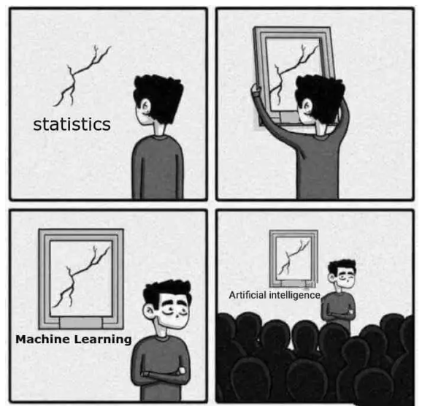
INTRODUCTION
Artificial intelligence has been trending in every industry
The world is only getting more digitalized: more and more data to study (growing demand for Quant/ML)
Why applying Machine Learning in Finance ?
Large amount of information available
All this information cannot be process by human
Human are too emotional and irrational when dealing with money
BUT, achieving good prediction on the financial market is hard

Slide 4
Exemple of application in Finance :
Investment in “memes” stock with NLP technics on social media
Credit risk analysis, Fraud detection etc…
Predict market returns with neural networks
Hedge a portfolio with supervised machine learning methods (today’s course)
Portfolio optimization with unsupervised machine learning algorithm.
Trading stocks using ML (your exam)

Slide 5
HOW TO HEDGE A PORTFOLIO WITH MACHINE LEARNING ?

Slide 6
I. How to hedge a portfolio
What is hedging, why investor hedge their portfolio and how is it done in practice?
Protect the downside of their portfolio
Hedging = Action of taking an offsetting position in a related security
How it is done in practice ? Short futures positions or buying put options
Exemple : A long-only US portfolio might sell 10% of its exposure through SPX futures to anticipate a potential market drawdown. It is much more cost efficient than selling directly stocks holdings (slippage and fees)
Very common among : hedge funds, pension funds.

Slide 7
I. CASE STUDY
Jim Cramer is an American institutional investor that has a US long-only portfolio that performed tremendously well last year. He is worried that next year the market is going to be hard to navigate : he wants to put in place an overlay (a systematic approach for hedging) to protect the downside of its US stocks portfolio. But, he doesn’t want to consume “too much” of the upside performance, and therefore do not want to be hedged most of the time. He wants us to hedge tactically 30% of its portfolio only if we are confident that the market crash is imminent.
Identify client’s needs.
Underly the most important part of the text.
Our objective : Transform this information into a suitable machine learning problem

Slide 8
I. CASE STUDY
Jim Cramer is an American institutional investor that has a US long-only portfolio that performed tremendously well last year and is worried that next year the market is going to be hard to navigate : he wants to put in place an overlay (a systematic approach for hedging) to protect the downside of its US stocks portfolio. But, he doesn’t want to consume “too much” of the upside performance, and therefore do not want to be hedged most of the time. He wants us to hedge tactically 30% of its portfolio only if we are confident that the market crash is imminent.
Important information :
American : clients will be more comfortable to hedge with index they are familiar with : use S&P500 as underlying asset
doesn’t consume “too much” upside performance: Performance should be in line with index
not want to be hedged most of the time: Frequency of hedging should be low, as he mentioned it should be “tactic”,
hedge tactically 30% of its portfolio : For back-test purposes (hedge quote)
Market crash is imminent : How do you define a market crash?
How to translate all this information into a Machine learning algorithm ?

Slide 9
I. FRAME THE PROBLEM
What are your thoughts?
How to model the output/labels of the model?
What type of Machine learning algorithm is suited?
What algorithms would you use?
What data should you use as input ?
What objective function are you trying to maximize/minimize?
What metrics/statistical tools are you going to use to evaluate the performance of your model and how to make sure that it is line with what your clients expect?

Slide 10
Answers:
How to model the output/labels of the model? (=labelling)
Client wants to be hedge or not hedge: a binary output will define your labels: (0) market is up or flat, (1) market correction/market crash (categorical data)
What category of Machine learning algorithm are we dealing with ?
We know the output (=label) -> Supervised learning algorithm.
The output is not continuous -> Classification problem : 0 or 1
What algorithms could you use?
You can use any type of classifier : Logistic Regression, SVM, RandomForest, Neural net classifier, etc…
What data should you use as input ?
Raw data will be daily closing price of indices, but we could use volume, low, high or any alternative data. Transformation and features engineering that comes on top can improve the performance.

Slide 11
Answers:
What metrics are you going to pick to evaluate the performance of your model and how to make sure that it match the client’s needs?
Predictions
 | Market up (0) | Market down(1)
Market up (0) | True negative | False Positive
Market down(1) | False negative | True positive
In this confusion matrix:
Describe the areas of interest for our clients?
What score do you think would be most suitable for our ML algorithm?
Actual

Slide 12
Answers:
Predictions
 | Market up (0) | Market down(1)
Market up (0) | True negative | False Positive
Market down(1) | False negative | True positive
Areas of interest for our clients?
True positive: we hedge and market tank: GREAT!
False positive: we hedge and market do not tank: OKish
True Negative: we don’t hedge and market goes up: super.
False negative: we don’t hedge and market tank: that’s really bad.
Actual
⚠️
What score do you think would be most suitable for our ML algorithm?
Optimize for recall, or sensitivity (true positive rate): TP/(TP+FN), because you want to reduce the number of FN and increase TP.

Slide 13
Answers:
Predictions
Conclusion:
We care about :
True positive Rate (TPR) HIGH TP
We reduce False negative LOW FN
We care about Recall: TP/(TP+FN),
 | Market up (0) | Market down(1)
Market up (0) | True negative | False Positive
Market down(1) | False negative | True positive
Actual
We care less:
Precision TP/(TP+FP)
False Positive.
Accuracy
For every business problem, you get a different metric to optimize for (ex: stock-picking …)
“No Free Lunch” theorem : There is no such algorithm, that can suit every problem. Every case is different.

Slide 14
BUILD YOUR MODEL

Slide 15
FRAMEWORK
What framework should you follow when building a ML model?
Defined Input data : features
Defined Output data: target
Split your data between training/validation/test set.
Pick potential model that you think would fit the business logic
Hyperparameter tuning
Performance of your model on training, validation and test sets.
Analysis of the result, be critic about your model
Compare it to a benchmark model
Back-test your model “out of sample”

Slide 16
Features : Input data
Get your python environment ready:
Input data : closing price from indices (stocks, bonds, commodities)
From the folder, load the file: “features.csv”
Clean the data:
Look for missing data, and infinite values.
Build functions in a modular fashion so they can be re-used later-on during the class (and for your project!)
Use returns instead of closing price such that features are “naturally” more scaled and easier to interpret for the ML model

Slide 17

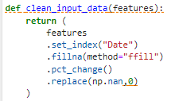

Features : Cleaning and Transformation
Exercise:
Create a function to load features from folder (file: “features.csv”)
Cleaning : Impute missing value (fillna method)
Transformation: get percentage instead of quotes

Slide 18
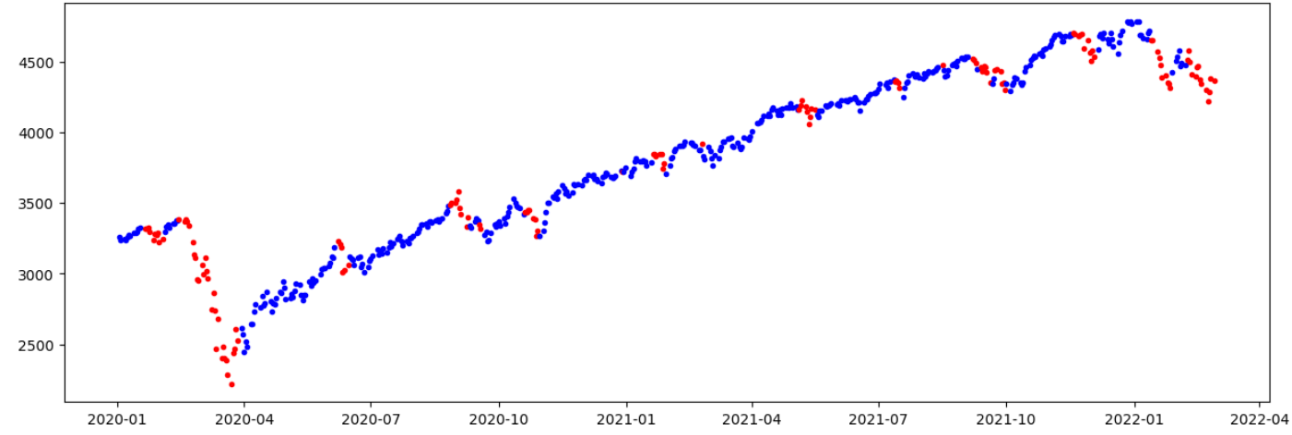
Labeling: Output Data
In supervised machine learning: you need a target (output data)
Labels: set of data that the model can learn from to make correct decisions.
Signal: 0 (blue for market up/flat), red for market crash/correction
Labelling seems coherent graphically with what we want to achieve
Always make sure that your labelling make sense before rushing to develop machine learning models

Slide 19
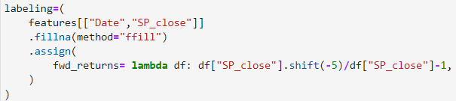
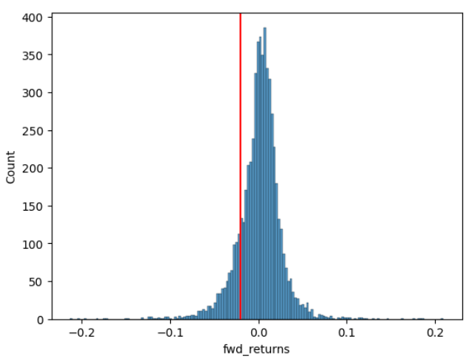

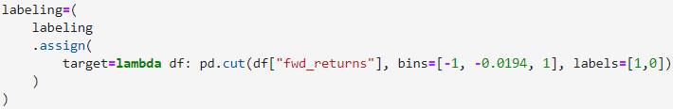
How to build your own labeling?
Step 1: Calculate forward returns, example : use weekly returns (5business days)
Step 2: Draw distribution, get statistics of the distribution, pick a threshold that would suit your problematic.
Step 3: Assign each weekly return to the corresponding class

Slide 20
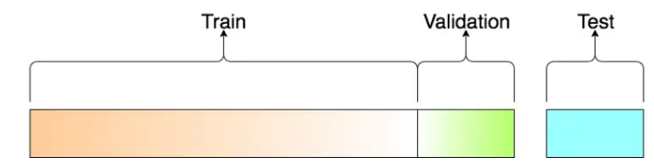
Split your data
Training set: Fit your model with the data you have
Validation set: Tune your model on the validation set where you can do some hyperparameter tuning
Test set: You can use it only once when you feel your model is ready -> Crash test

Slide 21
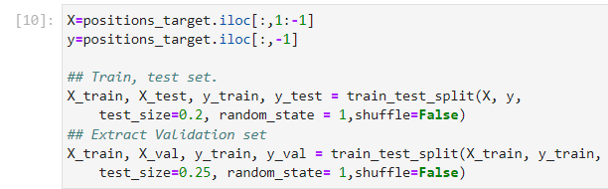
Split your data
Exercise:
Import data
Merge your features with the file “labels.csv” from the folder
Split data between training, validation, test set (Rule of thumb: 80/20)
Use train_test_split from sklearn recursively.
⚠️ Do not shuffle the data with TimeSeries

Slide 22
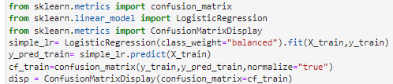
Train your model
Train a simple default classifier : LogisticRegression/ or RandomForestClassifier
Look for LogisticRegression on Sklearn and fit function.
Evaluate the model for different metrics on the training and validation set
Recall score
If you have time :
Classification report
Confusion matrix
ROC curve
Assess overall performance of the model
What needs to be improved ?

Slide 23
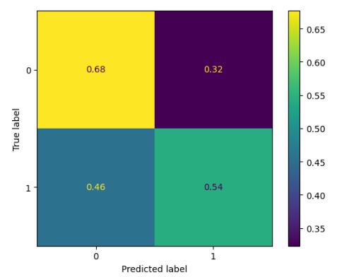
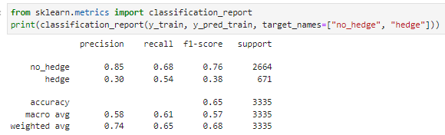
Confusion matrix
Already on the training set, the model fails to generalize : results are poor.
⚠️ There is no point to look at the result on the validation set, if we fail to generalize on the training sets ⚠️

Slide 24
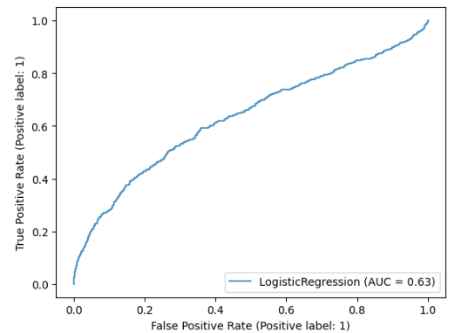



ROC Curve
ROC curve (receiver operating characteristic curve) show the performance of a classification model at all classification thresholds.
True Positive Rate:
False Positive Rate:
A simple LogisticRegression without regularization seems to perform “slightly” better than random.

Slide 25
Improve model
Why is the model performing so poorly?
Very naïve assumptions:
❌ Using daily return to predict future market move…
What can we do to create more meaningful features ?
❌ We use a default model
No comparisons between models, No hyperparameters tuning….
❌ We use a very simple : training, validation, tests split
We need a more robust approach! It is prone to overfitting after many iterations
Let’s improve these assumptions!

Slide 26
Improve model : Features engineering
Improve the performance by engineering new features : key element for successful model
You need to be creative to build features: what features could predict future price movement?
What transformation can be meaningful in Finance?
Detect extreme values: Z-score transformation (Close – avg(Close))/std(Close)
Trend approach: Moving average :Avg(Close)
Change of trend: Cross-over: short moving average crossing Long moving average
Regime : RSI (Relative Strength Index)
….
Exercise:
Start with closing price and build new features:
Apply Z-score transformation, pick a monthly rolling window
Check your new model’s performance on the training set and validation set.
“Remember: you want meaningful features, garbage IN, garbage OUT

Slide 27
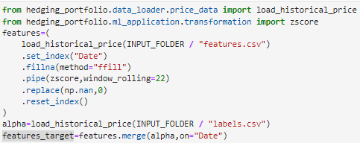
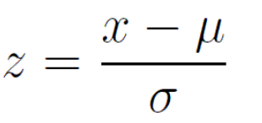

Improve model : Features engineering
Forward fill the missing value
Apply z-score
Replace missing with 0
Merge features and target on “Date” column
“Remember: you want meaningful features, garbage IN, garbage OUT

Slide 28
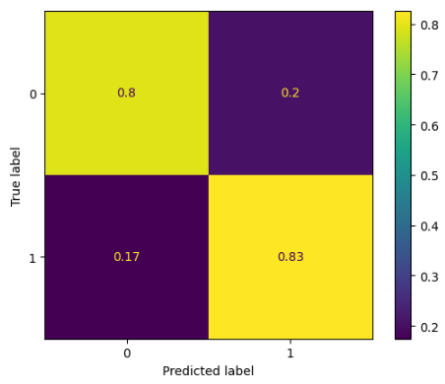
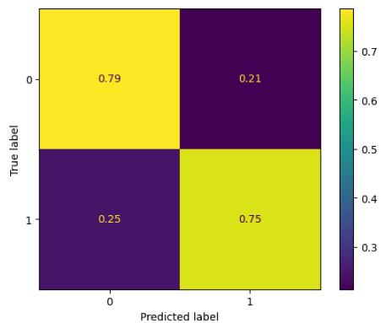
FEATURES ENGINEERING RESULT
Training set
Validation set
Simple transformation on raw data : clearly improved the performance of the model both on the training set and on the validation set.
On training set we went from 54% recall to 83% !!! ✅
“Remember: you want meaningful features, garbage IN, garbage OUT

Slide 29
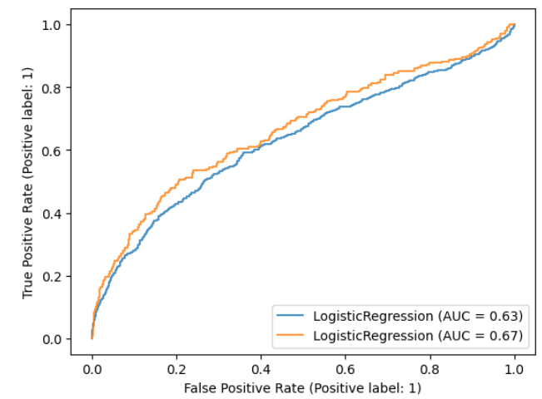
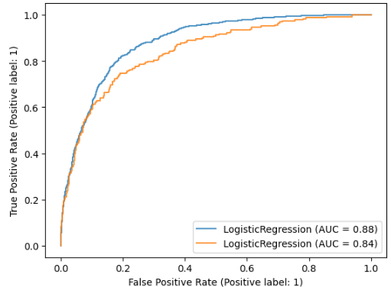


Logistic Regression
After transformation
Before transformation
✅
❌

Slide 30
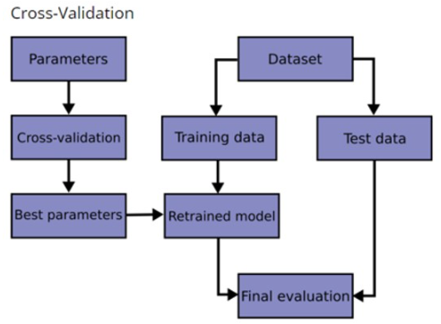
Improve model
NEW
Where do we stand ?
Assumptions to improve our performance:
✅ Improve input features through feature engineering.
❌ Improve splitting data for more robustness
Use a cross-validation schema
❌ Tune your hyperparameter
Use a method to tune your hyperparameters
❌ How do I know which model is best suited?
Use an optimization solution to compare models

Slide 31
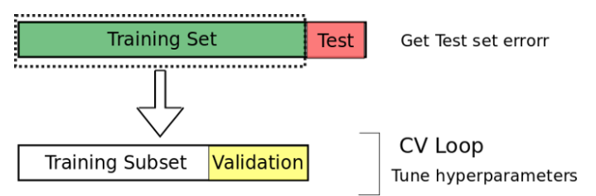
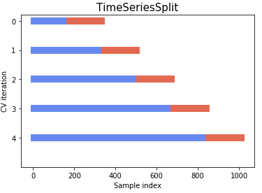
How to improve the split
Cross-validation is a technique for evaluating ML models by training your model on subsets of the available training data set in order detect overfitting and see if your model fail to generalize patterns.
General procedure:
Split the dataset into k groups
For each unique group:
Take the group as a hold out or test data set
Take the remaining groups as a training data set
Fit a model on the training set and evaluate it on the test set
Do not shuffle the data with Time Series or you might introduce look-ahead bias
“Remember: you want a model robust over time”

Slide 32
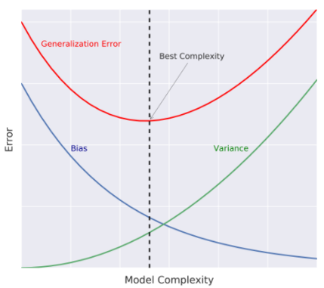
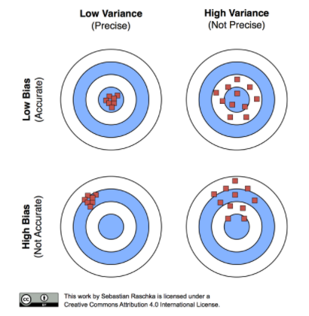
Overfitting
Objective : deliver a robust model that enable generalization.
Especially in finance where relationships change over time.
Increasing complexity of the model should in theory increase the score, but you need to be careful to not overfit
How to reduce overfitting? You can use regularization method. (In the case of randomForest: reduce the max_depth, in neural nets: reduce number of layers…)
How to check overfitting : compare metrics on the training set and validation set (if high divergence=overfit)

Slide 33
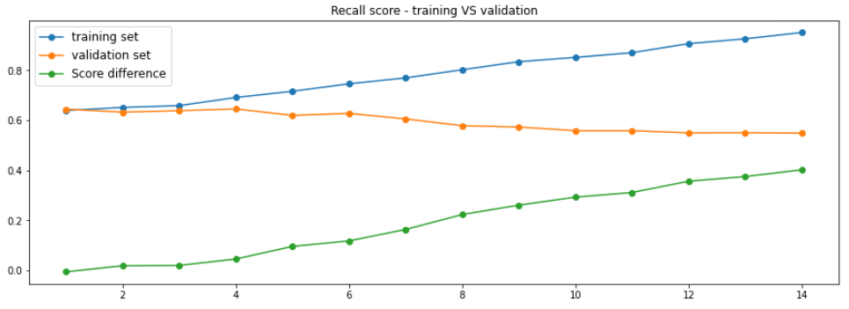
How to detect overfitting?
Clear overfitting:
⚠️ when complexity increase past 4 for the max_depth: important discrepancy between score on training and validation set (=overfitting) ⚠️
Increasing the complexity actually decrease the recall on the validation set
“Remember: you want a model robust over time”

Slide 34
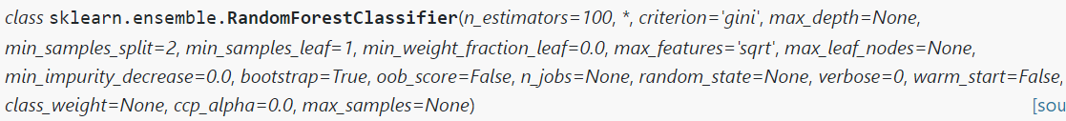
Improve model : Tune Hyperparameters
Hyperparameter tuning consists of searching for the set of optimal hyperparameters for the learning algorithm. Ultimate goal is to find an optimal combination of hyperparameters that optimize your objective function.
Parameters : are learned from data. (ex: intercept, slope, etc..)
Hyperparameters : are not learned from data ,must be set by you before training
Exemple for LogisticRegression:
Exemple for RandomForestClassifier:
“Remember: you want a model robust over time”

Slide 35
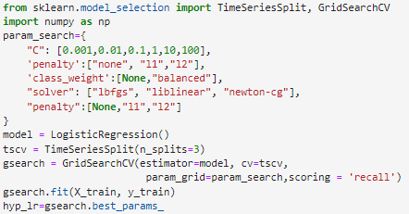
Improve model : Tune Hyperparameters
Apply an hyperparameter solution using a cross-validation schema
Use GridSearchCV and TimeSeriesSplit with 3 splits
Train your model and compare results on validation with/without hyperparameter tuning.

Slide 36
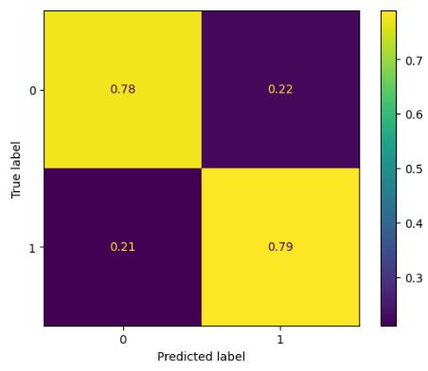
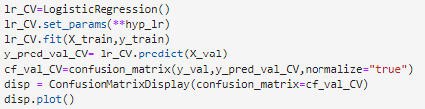
Hyperparameter tuning
Hyperparameter
Clear improvement of the recall on the validation set: from 75% to 79%

Slide 37
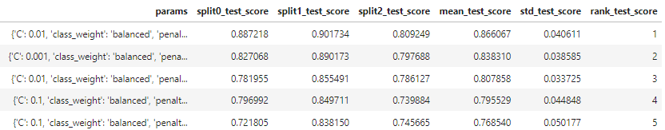
CROSS VALIDATION SCORE
Consistency on the different splits score (88%,90%,80%)
Std is relatively low 4%: results are encouraging
By splitting the training set in 3 distinct sets, we increase the robustness of the model, and decrease the risk of overfitting
“Remember: you want a model robust over time”

Slide 38
Improve model
Where do we stand ?
Assumptions to improve our performance:
✅ Improve input features through feature engineering.
✅ Improve splitting data for more robustness
Use a cross-validation schema
✅ Tune your hyperparameter
Use a method to tune your hyperparameters
❌ How do I know which model is best suited?
Use an optimization solution to compare models

Slide 39
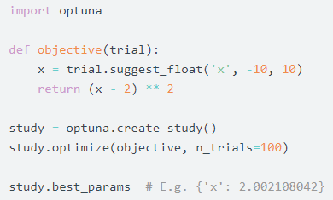
OPTUNA – THE SOLUTION ALL-AT-ONCE
Optuna is a hyperparameter optimization framework. Combine all previous methods all-at-once: training, cross-validation, tuning hyperparameters accross multiple models
What do you need?
An objective function to be optimized
In our situation: recall score
A direction : Maximize? Minimize?
Maximize recall score
Suggest categorical value, and range of value for different hyperparameters

Slide 40
OPTUNA – Automatic Hyperparameter Optimization
Exercise:
Pick different classifier methods and run multiple hyperparameters optimization :
Logistic Regression
SVC
Random Forest
KNeighborsClassifier
Apply different range of hyperparameters.
Hint: use conditions and trial.suggest_categorical for models, and trial.suggest_int for hyperparameters
Apply a cross-validation schema on the full training set with TimeSeriesSplit.
Hint: fit model on each sub training and calculate recall on each validation sets, store value in an array.
Return average recall score on the validation sets.
Create a study, specify direction and optimize the study
Hint:

Slide 41
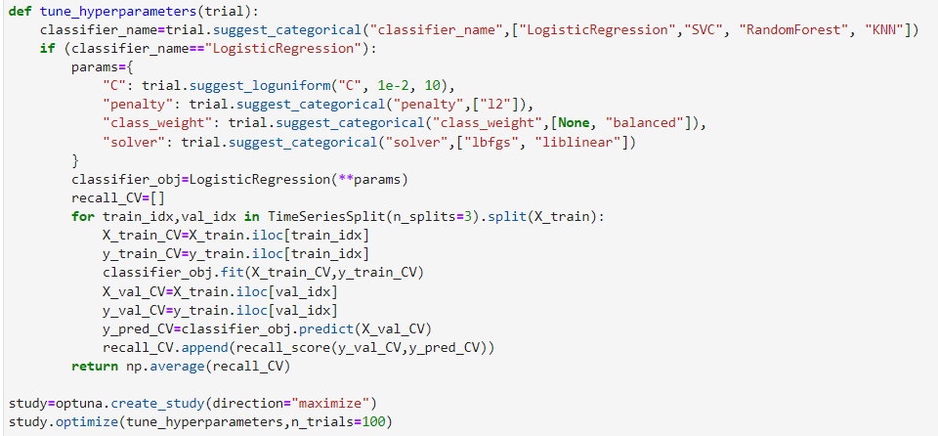
OPTUNA – Automatic Hyperparameter Optimization
Example with LogisticRegression
Pick models and hyperparameters
Cross-validation
Return the objective function to maximize

Slide 42
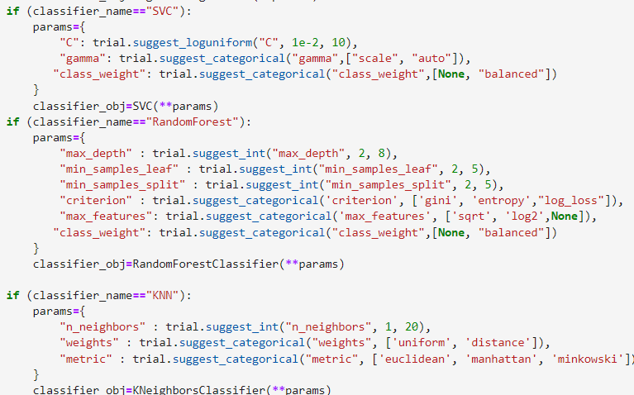
OPTUNA – Automatic Hyperparameter Optimization
Example expended to multiple classifier
For more information on hyperparameters you can visit the documentation of the different model on sklearn

Slide 43
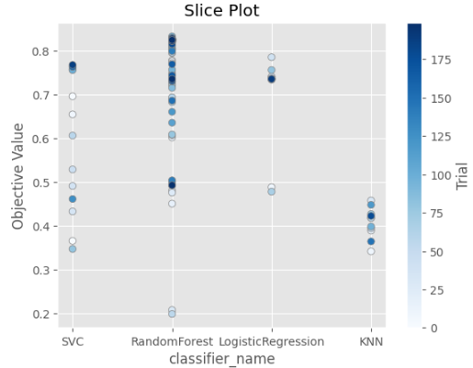
OPTUNA – VISUALIZATION
RandomForest offer the best results.
Regardless of hyperparameters tuning KNeighbours performed poorly.

Slide 44
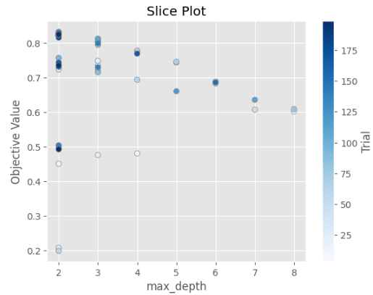
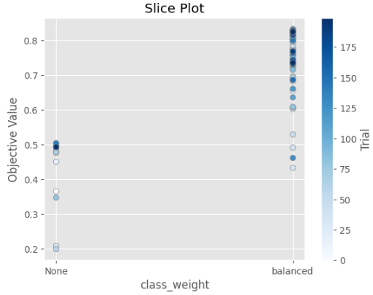
OPTUNA – VISUALIZATION
Show the importance of hyperparameter tuning on the final score (ex: using the default value None on class_weight)

Slide 45

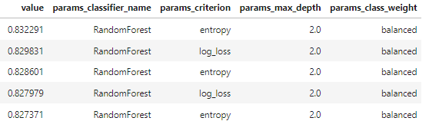

OPTUNA – Automatic Hyperparameter Optimization
Pick your best model and now we are going to see which features have the best predictive power to anticipate a market crash.

Slide 46
MODEL CHECKLIST
✅ Model overfitting (cross validation)
✅ Hyperparameters tuning and model selection
❌ Parsimony of the model (features reduction)
❌ Establish a baseline and comparing your model’s performance
❌ Back-test: Performance of your model in a trading environment

Slide 47

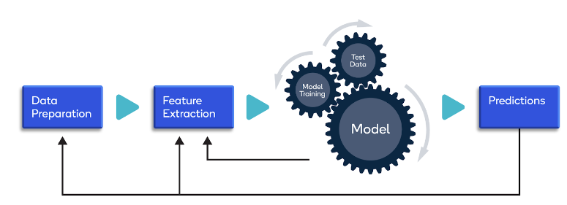



INTERPRETABILITY OF THE MODEL FEATURES IMPORTANCES FEATURES SELECTION
“Remember: Never look at your ML model as a black-box”

Slide 48
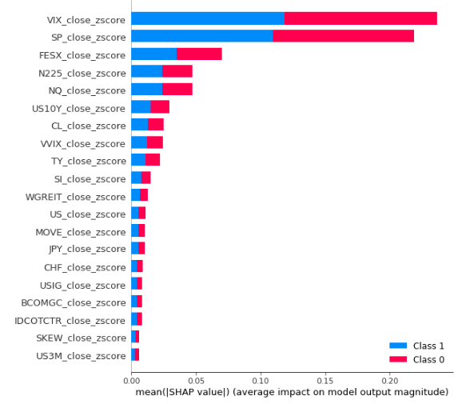

SHAP METHOD – GLOBAL INTERPRETABILITY
Model interpretability :
To comprehend why certain decisions or predictions have been made by the model
SHAP Method:
Based on game theory: quantifying the contribution that each player brings to the game
VIX and SP500 features seem to impact most the target
Many features have little or no predictive power (US3M, SKEW, …)
“Remember: Never look at your ML model as a black-box”

Slide 49
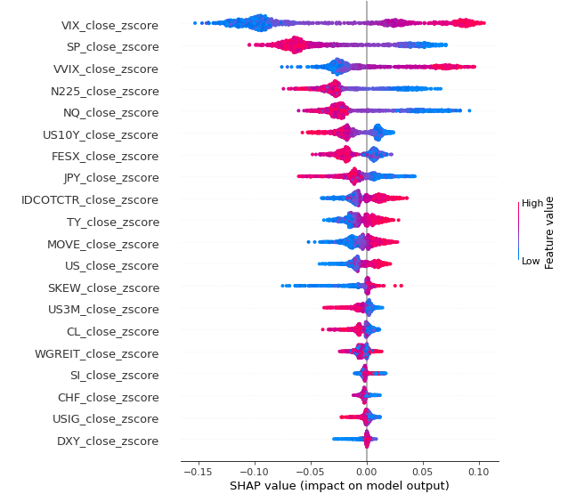
SHAP METHOD - INTERPRETABILITY OF THE MODEL
2. BOTTOM-UP APPROACH
Explain the graph
Example:
high VIX z-score tends to have a strong positive impact on market crash while very negative z score impact negatively market crash.
High VIX z-score ~ Low SP500 z-score = tension
Low VIX z-score ~ High SP500 z-score = market up
Features importance signal that high unusual level of volatility (market tension) tends to be follow by much higher level of volatility (= market crash) and low period of volatility are followed by lower period of volatility (=market flat/up)
-> Volatility seems to work as clusters
-> Tsunami effect… it is not the first wave that you should be afraid of… but the second one!
“Remember: Never look at your ML model as a black-box”

Slide 50
REDUCE THE NUMBER OF FEATURES
Occam’s Razor (also: parsimony’s principle):
A parsimonious model is a model that achieves a desired level of goodness of fit using as few explanatory variables as possible.
A model that has few parameters but achieves a satisfactory level of goodness of fit should be preferred over a model that has a ton of parameters and achieves only a slightly higher level of goodness of fit.
How to achieve this?
Elbow method
AIC/BIC
“jack-knifing”
Feature selection method (selectKBest, RFE, etc…)
Deliberate substraction: “less is more”
Selection of a model shouldn’t rely only on its performance but also on its complexity
⚠️ Features importances is model-specific. Don’t generalized based on that ⚠️
“Remember Occam’s razor: the simpler, the better”

Slide 51
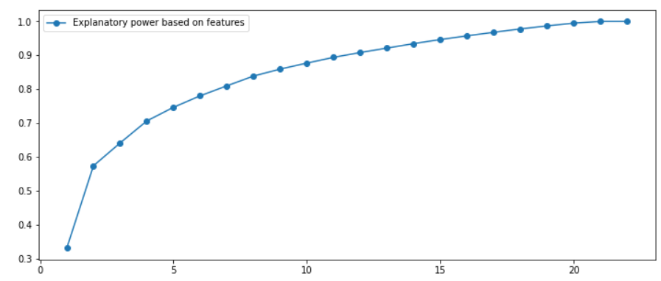
Example of the “Elbow method”
A more discretionary/qualitative approach: elbow method
As we saw earlier few variables contains most of the explanatory power.
With only 10 variables we can explain 90% of the explanatory power of the model
No need to increase the number of features past this number, as the marginal increase is not worth to sacrify the parsimony of a model.
“Remember Occam’s razor: the simpler, the better”

Slide 52
MODEL CHECKLIST
✅ Model overfitting (cross validation)
✅ Hyperparameters tuning and model selection
✅ Parsimony of the model (features reduction)
❌ Establish a baseline and comparing your model’s performance
❌ Back-test: Performance of your model in a trading environment

Slide 53

BENCHMARK MODEL
You need a reference point (=benchmark) that you can use to assess if your model is better than random.
In Machine learning, always use a benchmark model as sanity check for your model
Dummy Classifier: model that makes predictions without trying to find patterns in the data
Exercise: Use a dummy classifier, as the benchmark baseline (stratified, prior, or uniform) and answer the following question
Does my model do better than a random classifier on all the different sets? Training? Validation and test sets?

Slide 54
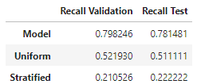

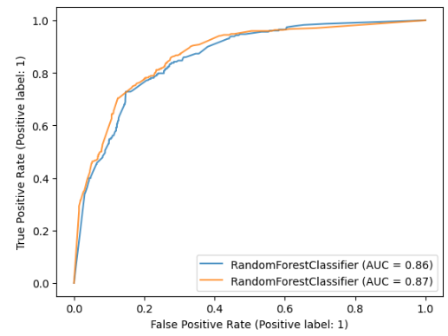
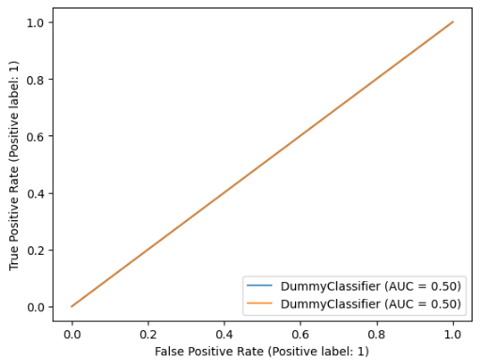
BENCHMARK MODEL
Performance on validation and test sets
Obviously your model seems much better in any sense than a random classifier.. Now let’s see how your model perform “out of sample” in a trading environment.

Slide 55
MODEL CHECKLIST
✅ Model overfitting (cross validation)
✅ Hyperparameters tuning and model selection
✅ Parsimony of the model (features reduction)
✅ Establish a baseline and comparing your model’s performance
❌ Back-test: Performance of your model in a trading environment

Slide 56
Back-testing out-of-sample
EXERCISE
Model has been approved, time to see how the model would perform “out-of-sample” in a trading environment.
Why?
You can have a great recall, let say 95%, but if is during the remaining 5% that the biggest crash occurs and you suffer the greatest loss, it is not efficient.
You need to account for slippage and trading fees
Steps:
Get the corresponding test set from the input data
Calculate daily predictions based on the model
Translate the signal prediction into a trading action (hedge)
Think about the time logic between signal prediction and execution on the market ⚠️
Calculate:
Daily performance of the overlay, SPX and both combined.
Equity curve of the overlay, SPX and both combined
Plot outputs and conclude : does it answer clients needs? Should the model go into production?

Slide 57
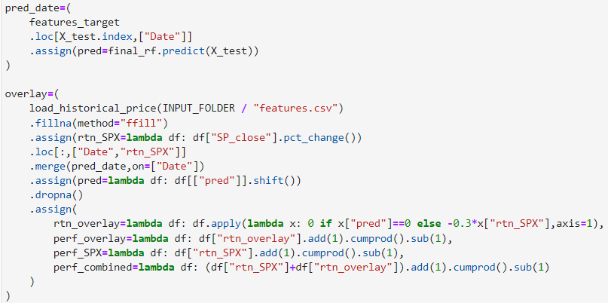
Back-testing out-of-sample
Build a back-test engine
Re-train your model on the whole training set
Get model predictions on test set
Merge predictions on “Date” with SP500 daily returns
Shift predictions (you get prediction after closing hence you get next day return!
Calculate equity curve for each asset

Slide 58
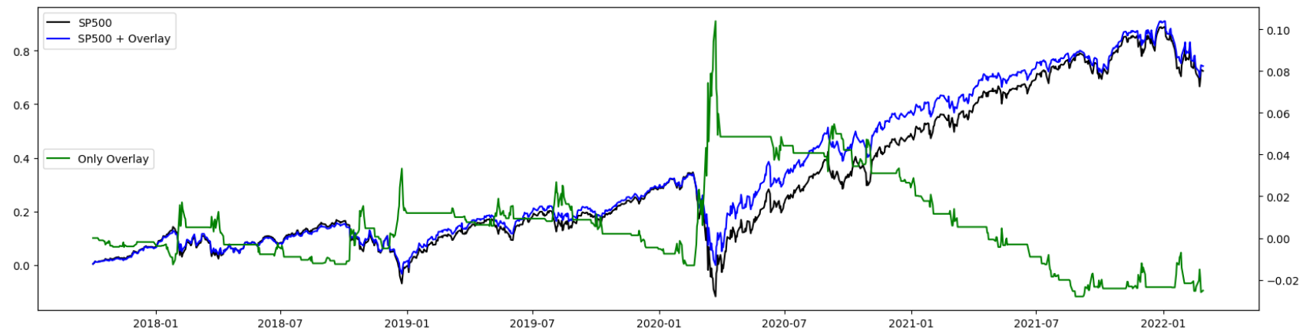
STAKEHOLDERS PRESENTATION
Present your results. Does it answer the clients needs? Should the model go into production?
Protect downside in a market crash (capture the Corona crisis 2020) : really good
Reduce volatility/portfolio drawdown and do not consume the “upside performance”: good
Strategy is “too” short during the 2021 bull run :⚠️not good BUT it is part of the trade-off ! Argue this point! ⚠️
Remember : your client want protection from downside (✅), to not consume “upside performance” (✅),to not be hedged all the time (✅). It is a “hedging strategy” it is not supposed to perform “well” in a bull-market environment and yet, the performance is still OK. Mission accomplished (✅)

Slide 59
CONCLUSION
Identify your goal and translate it into a suitable objective function.
Added-value come from features engineering (your « savoir-faire » in Finance).
Garbage IN, Garbage OUT
Occam-Razor: make the model as simple as possible, « less is more ».
Robust set-up through cross-validation and hyperparameter tuning.
There is no free-lunch in life, if your model is « too good to be true » : it probably is. Look for leakage, always be skeptic about your results.
⚠️ Finally: When working as Data Scientist/Quant, you need to be able to understand your model and convey ideas/results in a clear manner to stakeholders, this step is as important as the result itself ⚠️

Slide 60
PROJECT AS EXAM

