Slide 1

EcoDiscovery: Interactive Ecosystem Learning
Final Scrum Report
Team Name: Eco Explorers ( Group G)
Members: Rayansh, Chriss, Jeremiah, Abiranna
Course: ENSE 281 – Software Engineering Management
Date: 8 April 2026

Slide 2
Agenda
Project Overview
Scrum & Planning
Problem & Motivation
System Design (MVC) & MVP
Users
Reflection & Future
Vision & Approach
1

Slide 3

PROBLEM & MOTIVATION (Why)
Learners struggle to connect with ecosystems they have never explored
Low engagement leads to low retention and low conservation awareness
People care more when they discover, not when they are just told
2

Slide 4

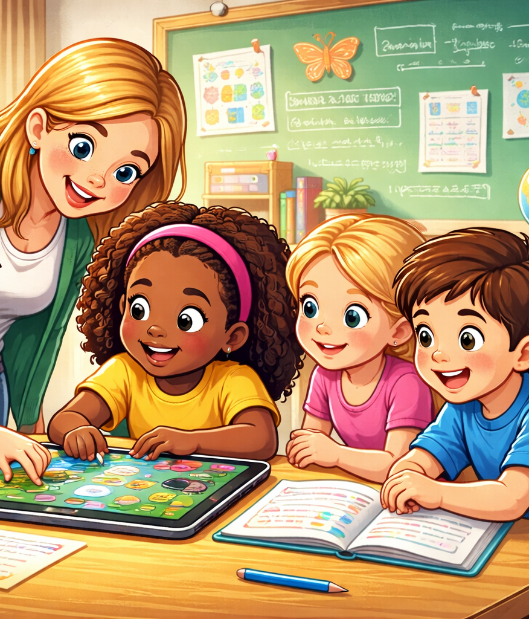
Target Users (Who)
Primary Users
Secondary Users
Grade 2–3 Students
Age: 7–9 years
Beginner learners of ecosystems
Teachers
Parents
3

Slide 5
Vision & Approach (How)
Create a fun and interactive learning experience
Use visual and discovery-based interaction
Design a simple, child-friendly interface
Focus on delivering a working MVP with core features
4

Slide 6
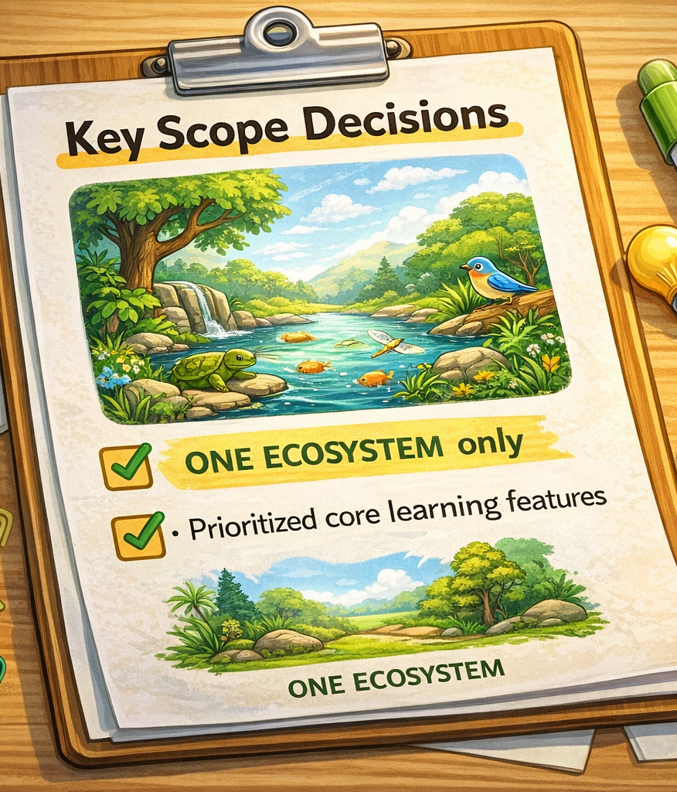
Key Decisions Guiding Our MVP
Scope Decisions
User Stories
Defined interactive learning flow
Guided development of click, discover, and learn features
Focused on one ecosystem only
Prioritized core learning features
5

Slide 7
Kanban Board
6

Slide 8
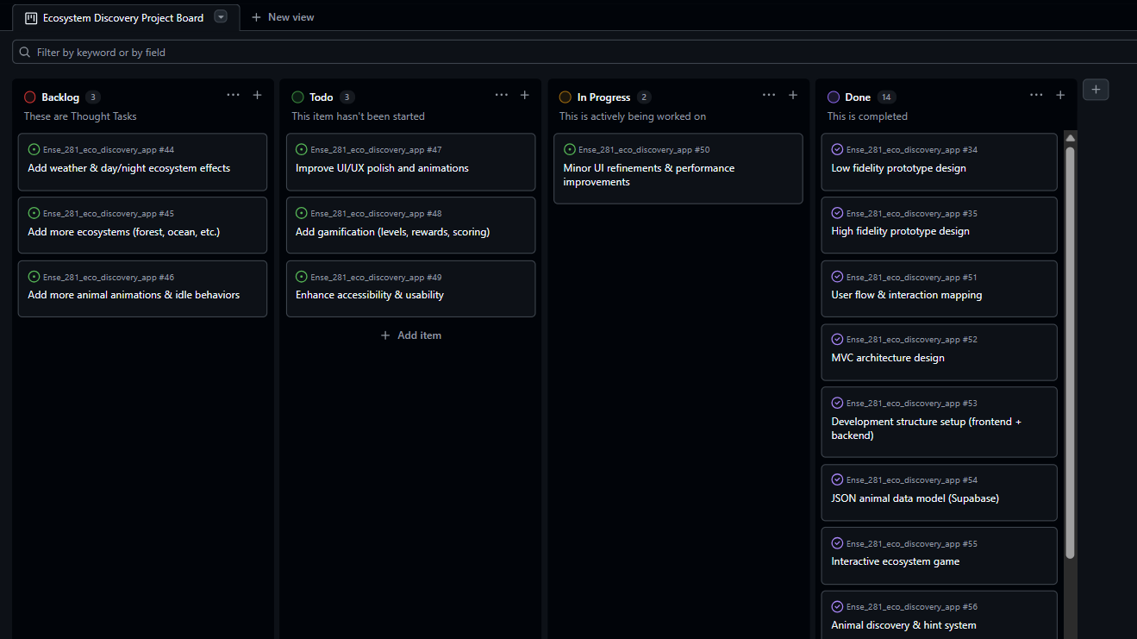

Slide 9
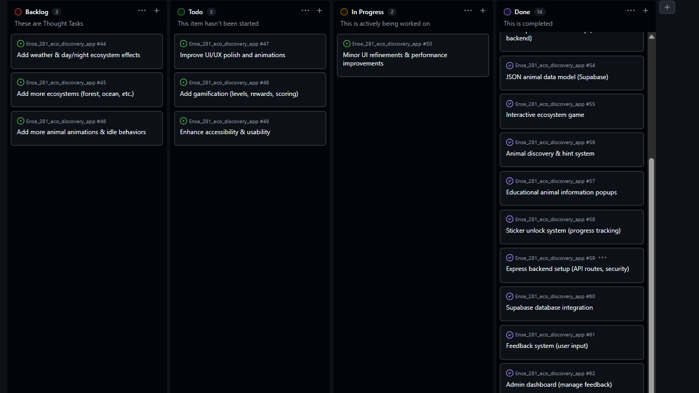

Slide 10
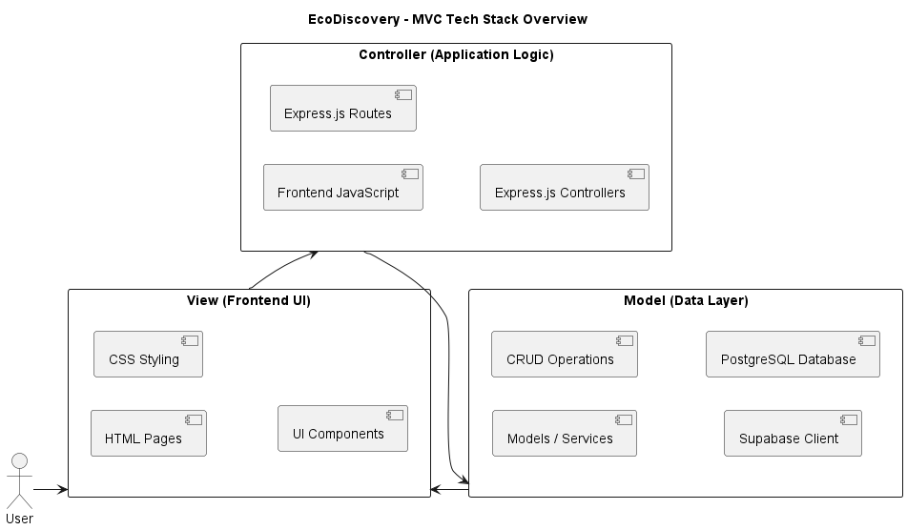
9

Slide 11
MVP Demo
10

Slide 12
Reflection & MVP Insights
What Makes It an MVP
What We Are Happy With
Focused on one ecosystem
Includes core features only
Delivers a working interactive experience
Simple and child-friendly design
Interactive learning experience
Successfully working prototype
What Can be Improved
Next MVP Vision
Add more ecosystems and content
Improve animations and interactions
Enhance engagement features
Expand to multiple ecosystems
Add gamification (rewards, levels)
Improve UI and performance
11

Slide 13
Thank You!
Any Questions ?
12

Slide 14
Image Credits
Child at Desk: https://aish.com/school-anxiety-in-children/
Children and Teacher in Class: https://www.istockphoto.com/photo/teacher-checking-pupil-notebooks-gm2160438108-580974135?searchscope=image%2Cfilm
13

