Slide 1
Activity-2 Scrum Report
EcoDiscovery – Interactive Ecosystem Learning Platform
ENSE-281: Software Engineering Management
Group G: Team Members: Rayansh, Jeremiah, Chriss, Abrianna
Project Sponsor: Dr. Tim Maciag

Slide 2
Problem Definition
Traditional learning methods often struggle to effectively teach complex ecological concepts to young students. Static diagrams and text-based materials do not always provide engaging ways for students to understand how ecosystems function.
There is a need for interactive educational tools that allow students to explore ecosystems visually and learn about environmental relationships and conservation in a more engaging and intuitive way.

Slide 3
Project Definition
EcoDiscovery is an interactive educational web application designed to help elementary school students explore freshwater ecosystems through discovery-based learning.
The system allows students to interact with a visual ecosystem environment, identify animals, and learn ecological facts through engaging gameplay mechanics.
This approach aims to improve understanding of ecosystems while encouraging curiosity and environmental awareness.

Slide 4
Key System Requirements
Functional Requirements
• Users can explore an ecosystem environment • Users can click animals to discover educational information • The system unlocks stickers when animals are correctly identified • The system tracks discovery progress and achievements
Non-Functional Requirements
• Simple and intuitive interface suitable for Grade 3 students • Visually engaging educational experience • Responsive interaction with minimal delay

Slide 5
Project Scope
In Scope
Out of Scope
• Interactive freshwater ecosystem exploration • Animal discovery and educational information display • Sticker book system for tracking discoveries • Progress tracking and visual feedback • Environmental awareness interaction (garbage cleanup feature)
• Multiplayer functionality • Complex ecological simulation systems • Integration with external educational platforms

Slide 6
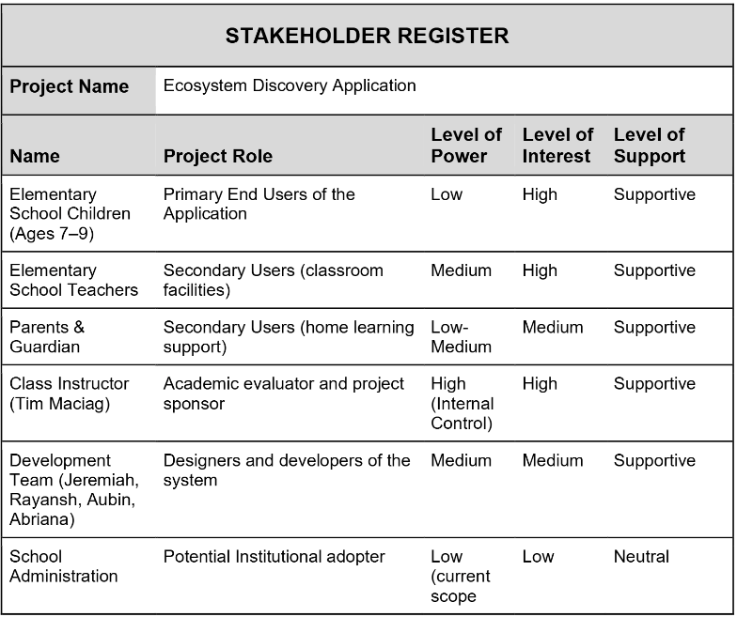
Stakeholder Engagement

Slide 7
System Architecture (MVC)
The system follows the Model-View-Controller (MVC) design pattern.
Model • Stores animal data and discovery progress
View • Displays the ecosystem interface and user interactions
Controller • Handles user actions and updates the system state

Slide 8
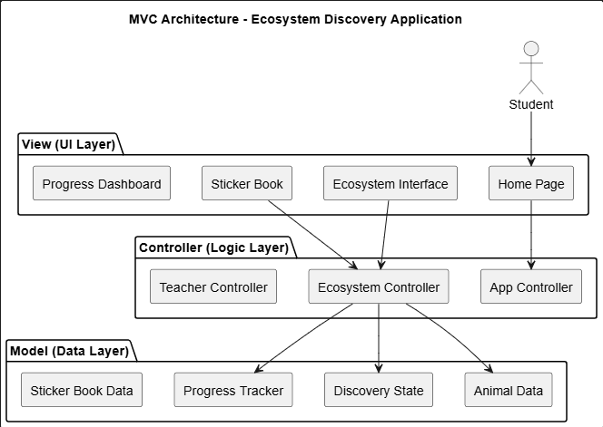

Slide 9
UML User Case Diagram
The Use Case Diagram illustrates how different users interact with the EcoDiscovery system and the main functionalities provided by the application.
Primary Actors
Student (Primary User) • Explores the ecosystem environment • Identifies animals within the ecosystem • Unlocks stickers after discovering animals • Views progress in the sticker book
Teacher (Secondary User) • Accesses teacher mode • Resets student progress • Reveals all animals for demonstration purposes

Slide 10
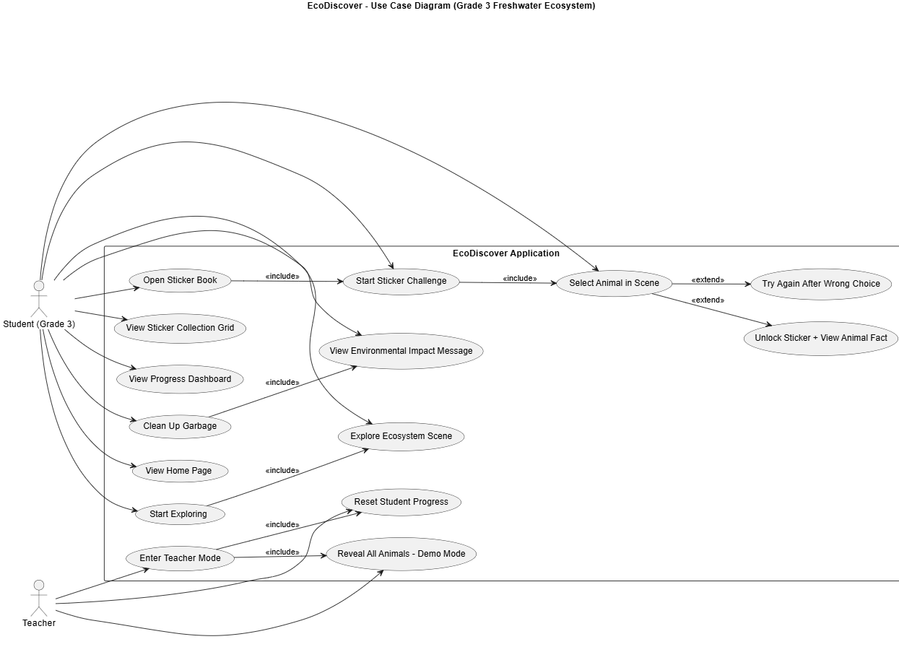

Slide 11
Data Flow Diagram
This diagram shows how information moves through the system when a user interacts with the ecosystem.
Example flow:
User Interaction ↓ Controller Processes Input ↓ Animal Data Retrieved ↓ Discovery Progress Updated ↓ Sticker Book and Interface Updated

Slide 12
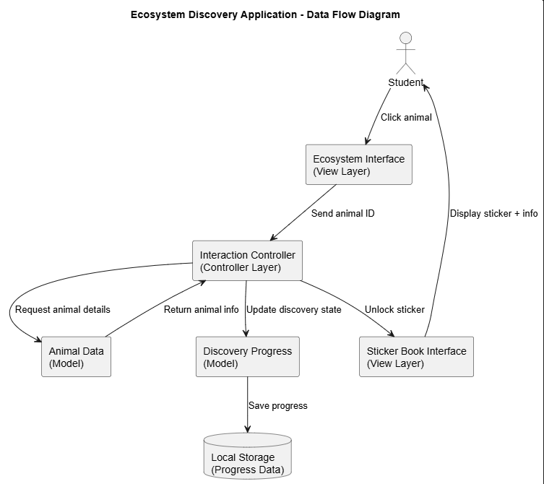

Slide 13
High Fidelity Prototype
Get Ready For User Experience through Figma !!

Slide 14
Team Reflections
This activity helped us understand how software engineering planning and system design are applied within a real-world project context.
We enjoyed designing an interactive educational concept and developing the high-fidelity prototype.
One challenge was ensuring consistency across documentation, system diagrams, and the interface design.
We are most proud of creating a clear system architecture along with a prototype that effectively demonstrates the intended user experience.
As a team, one of the most difficult tasks was making decisions when different opinions arose and finding a common ground.
In the future, we plan to continue applying Agile workflows, UML design techniques, and user-centered design approaches.
We would appreciate further guidance on how to transition from system design into full system implementation.

Slide 15
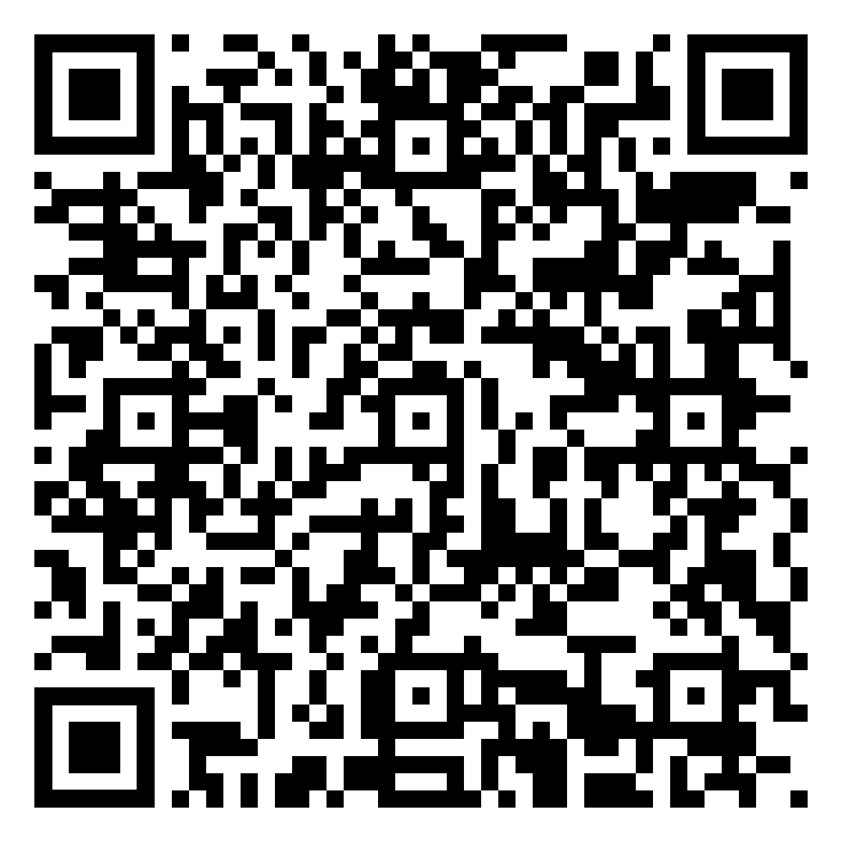
Feedback

Slide 16
Thank You

