Slide 1
Problem Statement-
Chatbot - Legal, Tax and Compliance
Gather millions of pages of information quickly and democratize legal, tax and compliance
Your application should allow users to ask questions to a bot and the bot should be capable of answering questions

Slide 2
Project covers
AI-Bot
Sentiment Extraction
Chat-bot

Slide 3

AI-BOT
It interact with user through voice and used its intelligence and deep learning to reply back
It tries to give best advice to user

Slide 4
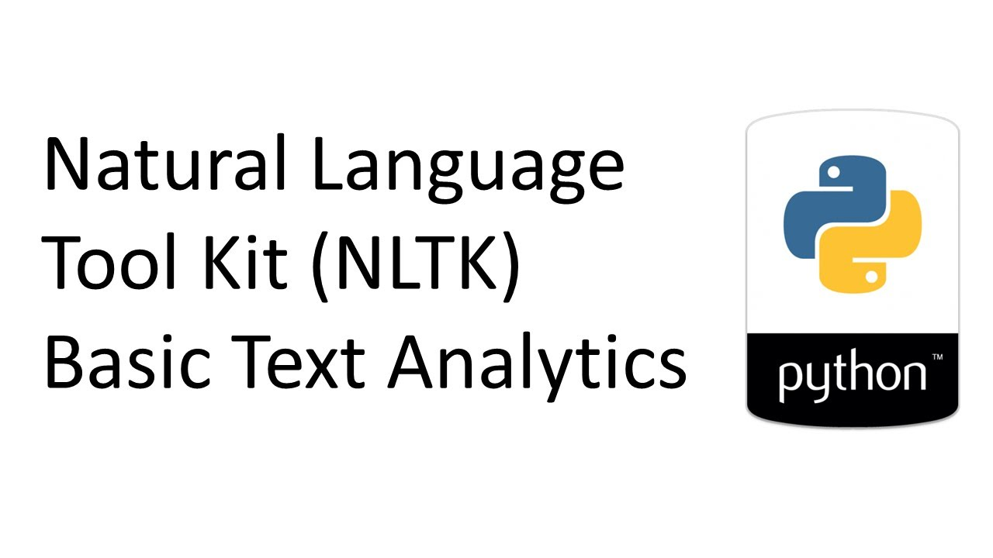

CURRENTLY I AM USING NLTK AND DIALOUGEFLOW

Slide 5
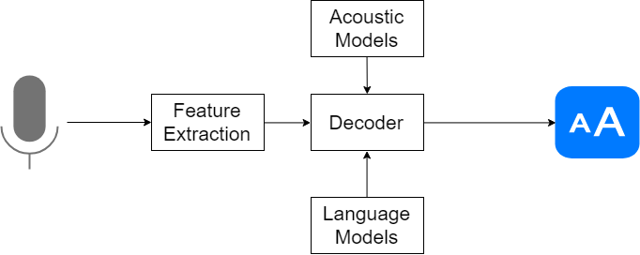
Currently our technology uses this model where-
Acoustic modeling, which represents the which phonemes were pronounced and what are the words these phonemes complete.
Pronunciation modeling, that analyzes the way phonemes are pronounced, is there any accent or other peculiarities of the vocal apparatus to capture the phonetic variability of speech.
Language modeling, which is aimed at finding contextual probabilities depending on what phonemes were captured.

Slide 6
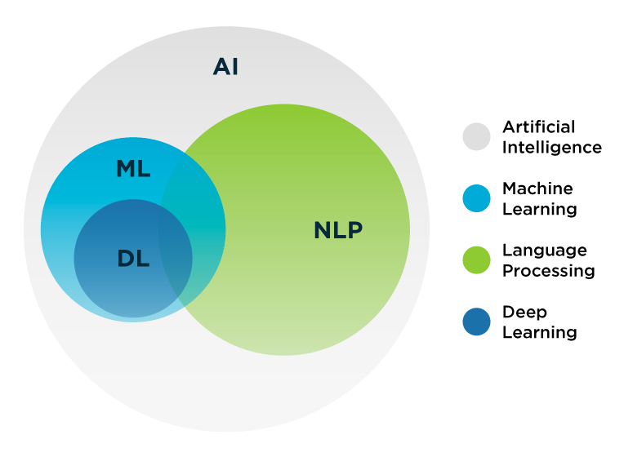
First, we use Automatic Speech Recognition to convert the user’s speech to text. Then we use Natural Language Processing to understand the transcribed text, take any appropriate actions, and formulate a text response.
In this stage we need to encompasses functionality for natural language understanding, dialogue management, and natural language generation. Speech processing and Natural Language Processing (NLP) using ML allow intelligent devices, such as smartphones, to interact with users via verbal language.
The “Hey Siri” detector uses a Deep Neural Network (DNN) to convert the acoustic pattern of your voice at each instant into a probability
Generative Adversarial Network (GAN)-based architectures have become more popular for discovering such cross-domain relationships.

Slide 7
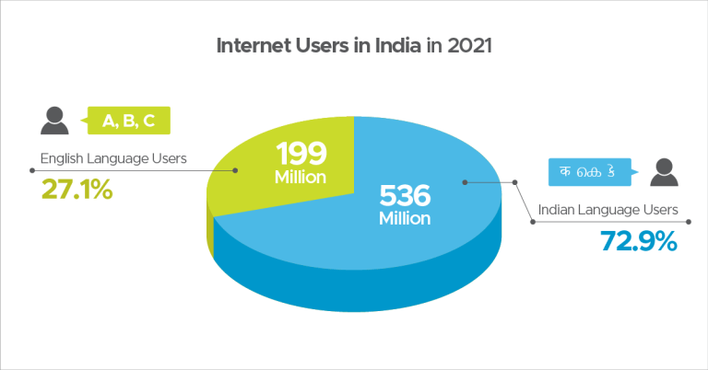

Slide 8
if you have some data available in the target language, use transfer learning i.e. finetune a pretrained language model for text classification.
if we don't have any available data in the target language. Find some data in any language but of the same domain that you want to build the system for, and use zero-shot multilingual transfer. For example, if you want to build a sentiment analyzer for NEWS domain, find a sentiment dataset of NEWS domain in English (could be any language). Finetune (feature based approach) a multilingual language model with this data, and it will work sufficiently well for any language for which the original language model was trained with.

Slide 9
Named Entity Recognition
Named Entity Recognition (NER) is a key component of our natural-language processing (NLP) application. It is what allows the bot to accurately identify entities in the inputted text such as date, time, location, quantities, names and product specifications.

