Slide 1

AI APSCHE 5 WEEKS INTERNSHIP
Name : RAYAPUDI PRIYANKA
Skill Build Email ID : priyankarayapudi85@gmail.com
College Name : TIRUMALA ENGINEERING COLLEGE
College State : ANDHRA PRADESH
Intership Domain : ARTIFICIAL INTELLIGENCE
Start Date : 05-06-2023
End Date : 23-07-2023

Slide 2
Project title
Employees Burnout Analysis and Prediction

Slide 3
AGENDA
Importing and Analyzing the dataset.
Performing Exploratory Data Analysis(EDA).
Implementation of Principal Component Analysis(PCA).
Implementation of Supervised Regression Algorithms.
Analyzing the accuracy rate for different regression techniques.

Slide 4
Project Overview
The Purpose of this Project is to predict continuous outcomes by investigating the relationship between independent variables or features and a dependent variable or outcome over a Dataset.
The objective is to analyze the dataset of employees by checking the null values, duplicate values, calculating the Average and Standard Deviations , correlation, and many more.
The objective of this employees burnout analysis project is to understand the problem statement.

Slide 5
WHO ARE END USERS:
In this aspect the end users will be the company .
Because the employers data is needed by the company .
And another end users are Investors.
Investors also require the data of employees before they invest in the company.
They will forsee the company details to Invest in that company.

Slide 6
How this is useful
This project is mainly based on Regression. Sometimes it becomes very difficult to identify the burnout among the employees for the organizations. They need some techinique to find the actual burnout rate of employees.
Linear regression is the most popular form of regression analysis because of its ease-of-use in predicting and forecasting.This regression techniques gives the accuracy rate among the data and makes sure the data is accurate.

Slide 7
Data analysis
In this dataset analysis I performed some operations like checking correlation, plot distribution of gender, company type, attributes and some basic operations like checking null values ,duplicate values, extracting the columns and calculating the mean values.
In this project, we also demonstrated the data visualization, label encoding , and model implementation.

Slide 8
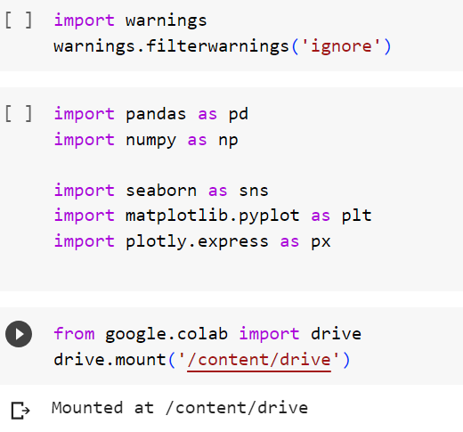
Importing and Analyzing the dataset.
I Have imported some libraries like Pandas and numpy.
import pandas as pd. It presents a diverse range of utilities, ranging from parsing multiple file formats to converting an entire data table into a Numpy matrix array. This makes pandas a trusted ally in data science and machine learning.
Similar NumPy, pandas deals primarily with data in 1-D and 2-D arrays.

Slide 9
Labeling data
Some operations performed on a dataset by Data Analyst are:
Finding the general information.
Showing number of rows and columns
Checking the null values in each attribute and duplicate values.
Showing the top 5 rows.
Showing each column
Finding the unique values.
Dropping of irrelevant columns
Checking the skewness of the attributes.
Showing the correlation.

Slide 10
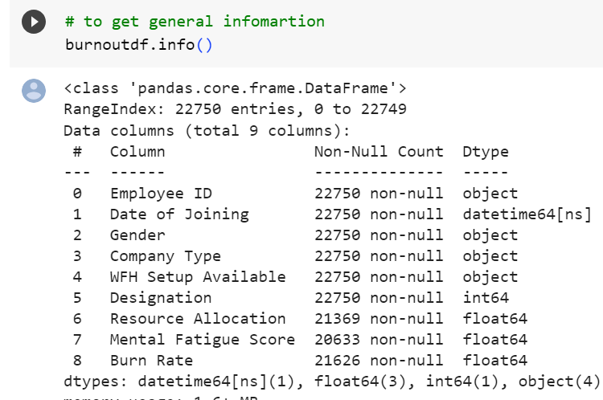
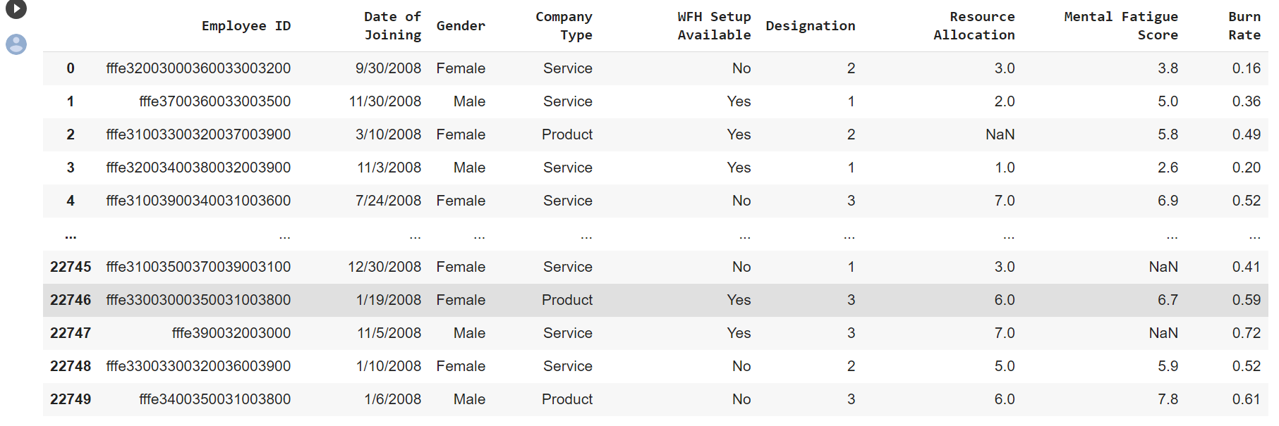
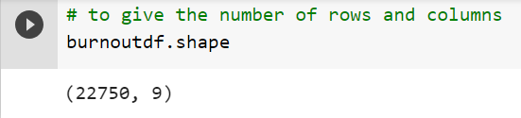
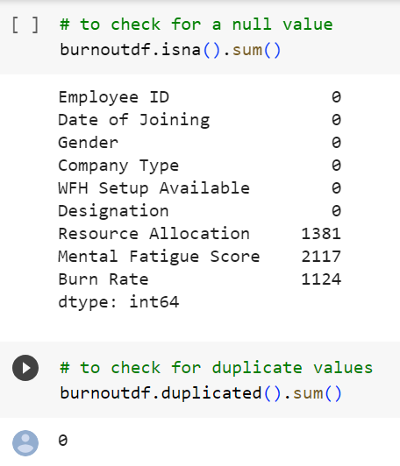
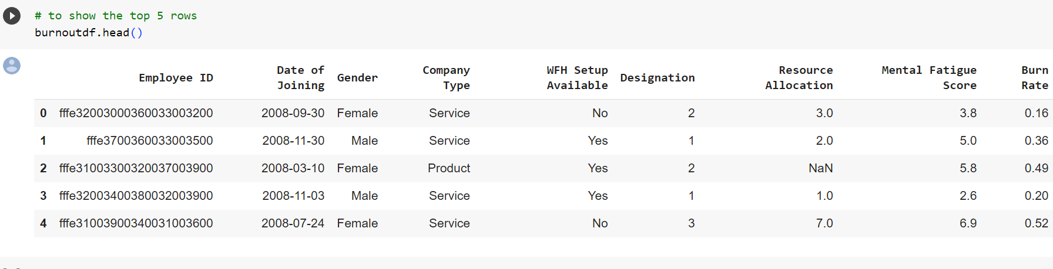
columns
General information
Showing number of rows and columns
Top 5 rows
Null value and duplicate values

Slide 11
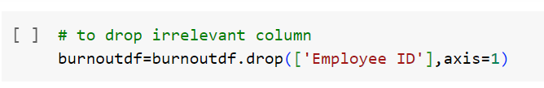
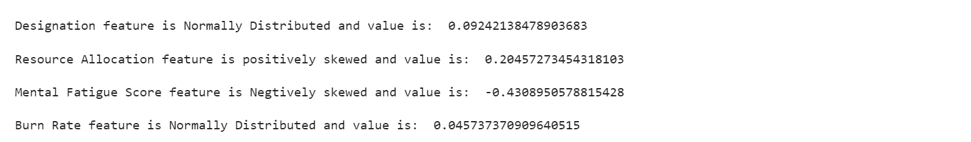
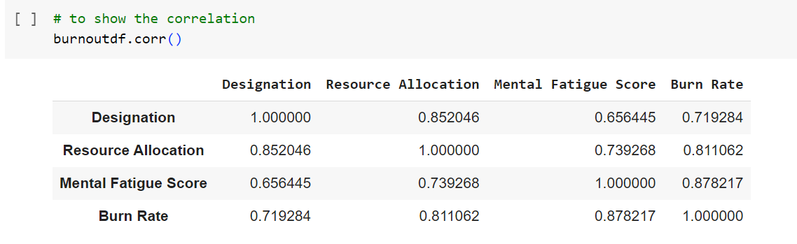
Dropping irrelevant column
Skewness of attributes
Correlation

Slide 12
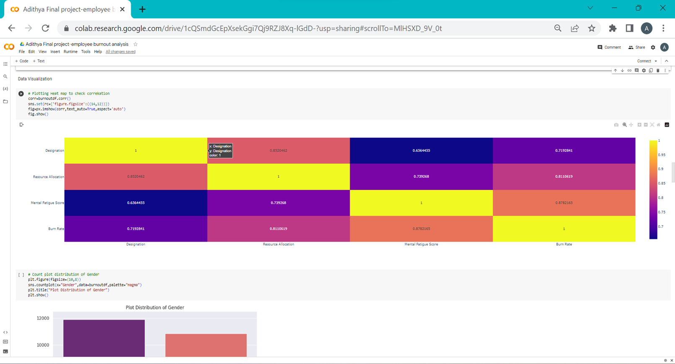
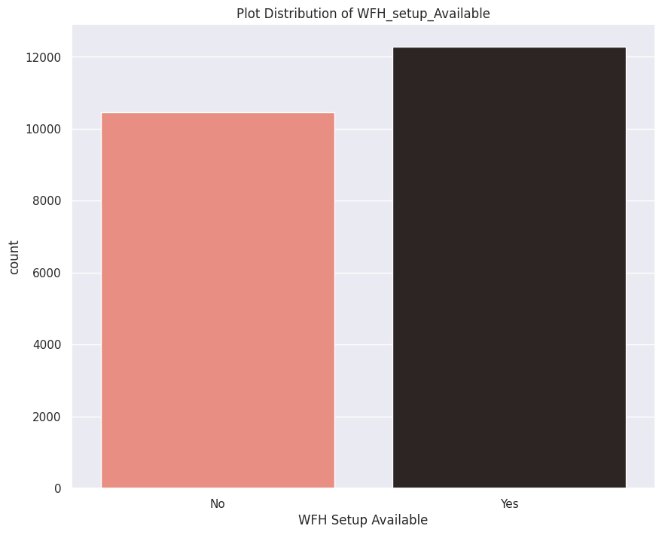
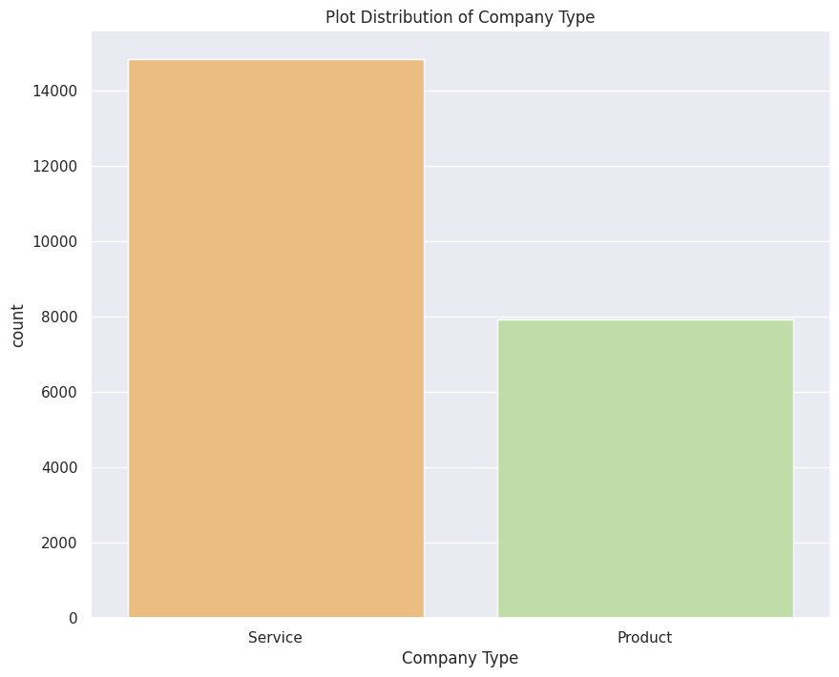
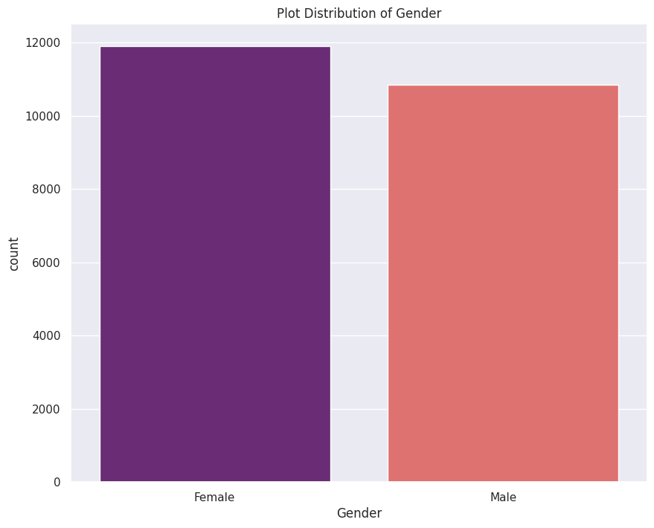
DATA Visualization
Correlation in heat map
WFH_ setup_Available
Distribution of company type
Distribution of Gender

Slide 13
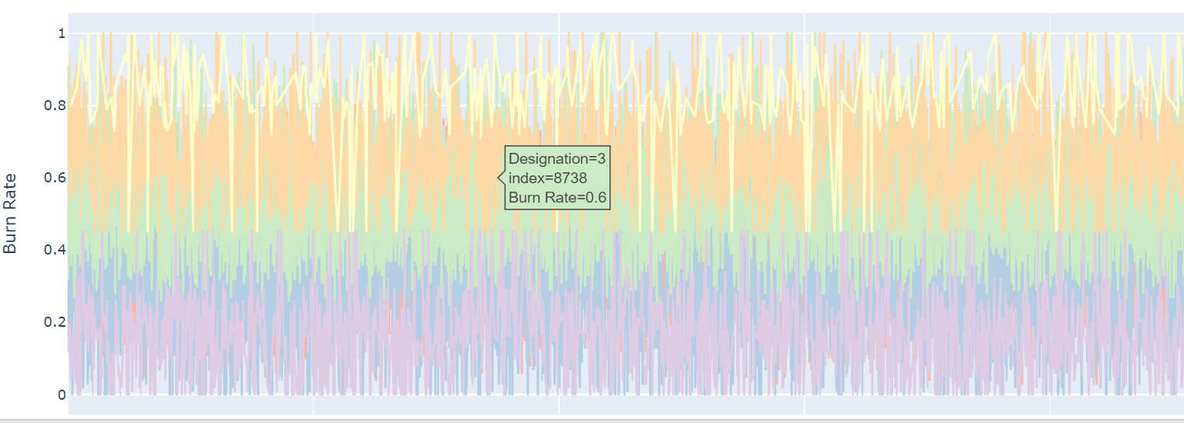
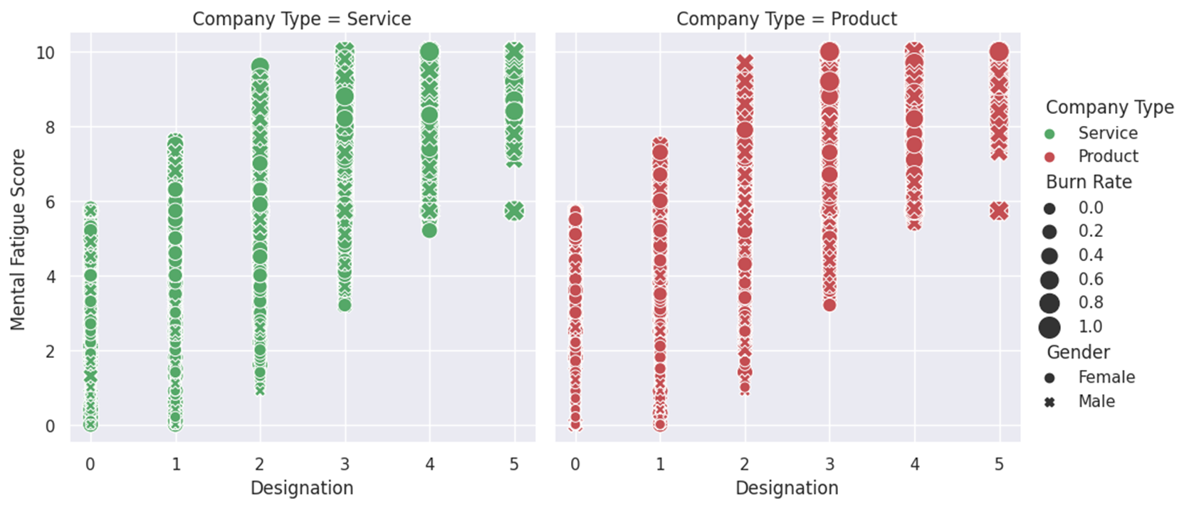
Burnout based on designation
Designation vs mental fatigue as per company type,Burn Rate and Gender

Slide 14
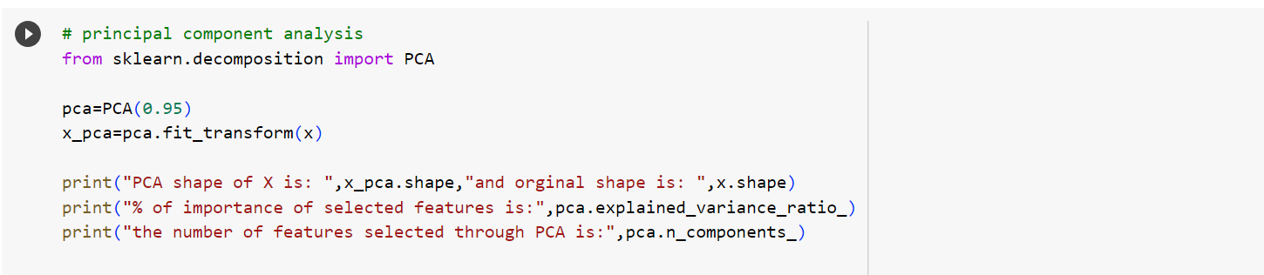
Principal Component Analysis(PCA):
Principal component analysis is an unsupervised learning algorithm which is used for the dimensionality reduction in machine learning.
Code:
Output

Slide 15
solution
To analyze of the data and to find the accuracy rate of the dataset, we use some regression algorithms. They are AdaBoost technique, randomforest regressing technique.
AdaBoost, also called as Adaptive Boosting which is a technique in machine learning used as an Ensemble Method.
Random forest is a machine learning algorithm used to combine the output of multiple decision trees to reach a single result.

Slide 16
Project customization
In this project, we used the algorithms like random forest regressor and AdaBoost regressor. These regression techniques in machine learning are vitally used techniques to find out the numeric value for the dataset(Burnout rate).
Hence, in this project I choose these regression techniques for finding the result. These techniques made the project more innovative with having major accuracy rate.

Slide 17
modelling:
In this project, I basically performed new operations like label encoding, PCA implementation, data splitting and performed regression algorithms.
Random Forest Regressor.
AdaBoost Regressor.

Slide 18
results
For Random Forest Regressor:
Accuracy score of train data: 91.186 %
Accuracy score of test data: 83.892 %
For AdaBoost Regressor:
Accuracy score of train data: 77.032 %
Accuracy score of test data: 76.4506 %

Slide 19
Links and References:
The below provided link is the final project I have done during this internship program.
LINK:
https://colab.research.google.com/drive/1KUiuzXkky8xyWBJI1KOzYiDiyZ7OKuva?usp=sharing
Github Link:-
https://github.com/RayapudiPriyanka/Employees-Burnout-Analysis-And-Prediction-Project
Video link :-
It is in my drive

Slide 20
Thank YOu

