Slide 1

ArticleTitle ArticleTitle ArticleTitle ArticleTitle ArticleTitle ArticleTitle ArticleTitle ArticleTitle ArticleTitle ArticleTitle
Hypothesis/Question [1 short sentence, e.g. modified from key point 1]
Methodology [either a very brief flowchart, or up to 3 bullet points < 6 words each]
Visual element/Image/Illustration/Graph
Patient cohort
Modality / organ
Single / Multi-center
Main finding/main result/ relevance statement
[1 short sentence < 20 words, e.g. modified from key point 3]
Eur Radiol (year) Authors names; DOI

Slide 2
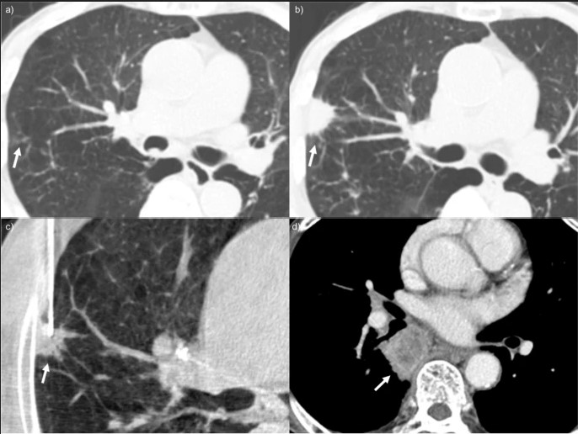
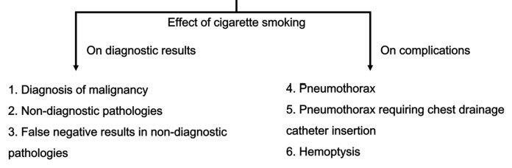
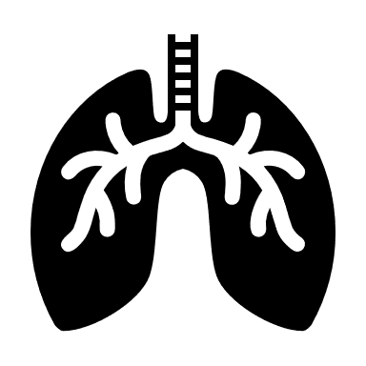

Effect of smoking on the diagnostic results and complication rates of percutaneous transthoracic needle biopsy
What is the association of smoking with the outcomes of percutaneous transthoracic needle biopsy (PTNB)?
Methodology: how
Visual element/Image/Illustration
Lung
Single
Smoking history was associated with the diagnostic results and complications of PTNB procedures. It is important to consider smoking history before PTNB procedures to predict and manage procedure-related complications.
Eur Radiol (2024) Lim WH, Lee JH, Park H et al.; DOI: 10.1007/s00330-024-10705-8

