Slide 1
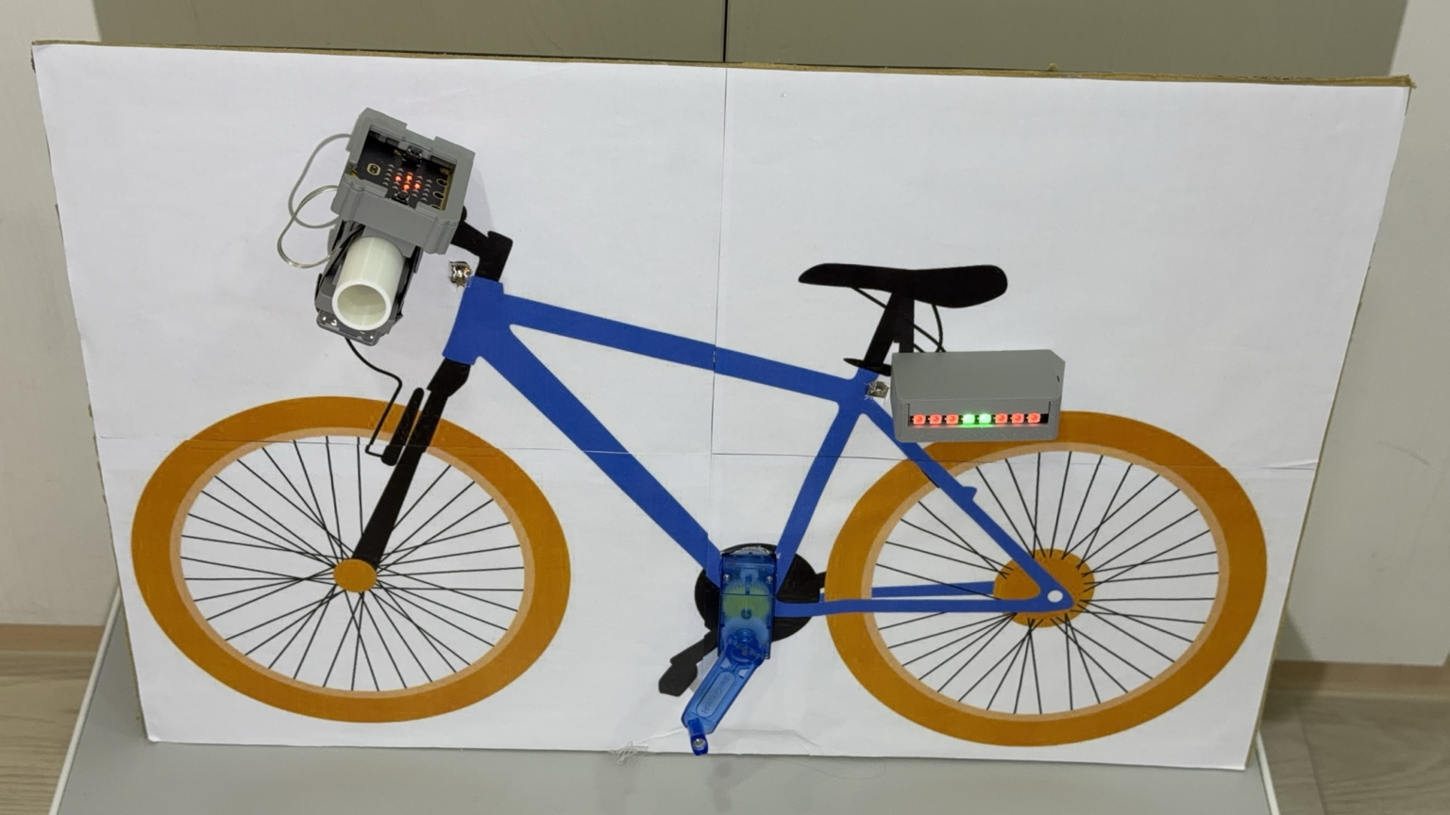
INVENTION EXHIBITION PRESENTATION
Smart Bicycle
Tail Light System
智慧自行車尾燈系統
Wireless control. Motion sensing.
Visible and audible warnings.
無線控制、動作感測與聲光警示
PHYSICAL DEMONSTRATION MODEL
Ray Chang · NYCU-affiliated Chu Pei Senior High School
Notes:
ENGLISH PRESENTER NOTES
This is a working prototype that connects a handlebar controller to a rear light. The goal is to make a cyclist’s intentions and emergency warnings easier for people behind to recognize. Introduce your name, school and exhibition after they are confirmed.
繁體中文講者備註
這是整合車頭控制器與尾燈的功能原型。目的是讓後方用路人更容易辨識騎士意圖及緊急警示。作者、學校、老師與正式展覽名稱確認後再補上。
SOURCES
Project specifications supplied by the inventor in this conversation, 19 October 2026. Original Canva poster: https://www.canva.com/design/DAHX5S5MpGc/aMWksRlMK7ZC09emLKPABA/edit . Updated specifications take precedence over the earlier poster. No measured performance data supplied.
Photo / video sources: IMG_9773.jpeg, supplied model photograph

Slide 2
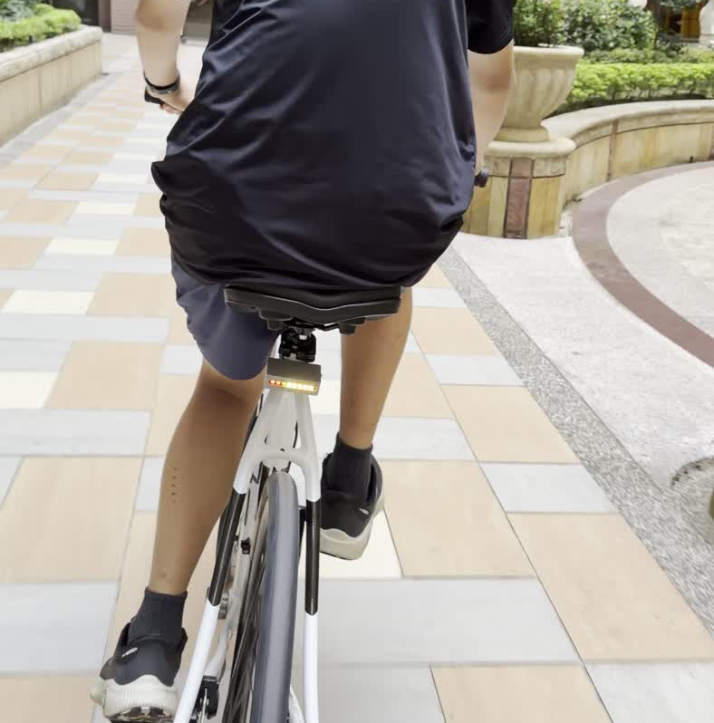
PURPOSE
The Problem and Our Goal
問題與設計目標
A rear light should communicate more than a bicycle’s presence.
除了讓人看見自行車，也希望清楚表達騎士的動作。
This prototype adds turn signals, braking alerts and a local SOS warning.
整合方向燈、煞車警示與現場 SOS 聲光警示。
SMART BICYCLE TAIL LIGHT SYSTEM
02
Notes:
ENGLISH PRESENTER NOTES
A person behind a bicycle may need to recognize a turn, a sudden stop or a rider who needs attention. Our project explores how a single tail light can communicate these conditions. We have not measured an accident reduction or a road-user recognition improvement.
繁體中文講者備註
後方用路人需要辨識轉彎、突然煞車，以及騎士可能需要協助的情況。這件作品探討如何用同一個尾燈傳達不同狀態。目前尚未量測事故減少效果或辨識能力提升。
SOURCES
Project specifications supplied by the inventor in this conversation, 19 October 2026. Original Canva poster: https://www.canva.com/design/DAHX5S5MpGc/aMWksRlMK7ZC09emLKPABA/edit . Updated specifications take precedence over the earlier poster. No measured performance data supplied.
Photo / video sources: IMG_9806.MOV, frame at 5.0 seconds, outdoor demonstration

Slide 3
PROTOTYPE
The Physical Prototype
實體模型與列印外殼
Front controller
micro:bit V2
車頭按鍵與感測器
Rear light
XIAO ESP32-C6
8 programmable LEDs
車尾燈與蜂鳴器
SMART BICYCLE TAIL LIGHT SYSTEM
03
Notes:
ENGLISH PRESENTER NOTES
The display model and custom 3D printed housings have been built. The sensor moves and tilts together with the model. This lets us demonstrate the relationship between an action, the sensor data, the decision and the rear-light response.
繁體中文講者備註
實體展示模型與 3D 列印外殼已完成。感測器固定在模型上，會跟模型一起移動與傾斜，因此可以展示操作、感測、判斷及尾燈反應之間的關係。
SOURCES
Project specifications supplied by the inventor in this conversation, 19 October 2026. Original Canva poster: https://www.canva.com/design/DAHX5S5MpGc/aMWksRlMK7ZC09emLKPABA/edit . Updated specifications take precedence over the earlier poster. No measured performance data supplied.
Photo / video sources: IMG_9773.jpeg, supplied model photograph

Slide 4
SYSTEM DESIGN
System Architecture
系統架構與訊號傳遞
Front controller | Wireless link | Rear unit
micro:bit V2 | Bluetooth Low Energy | XIAO ESP32-C6
Buttons, touch logo and acceleration | Native Button, Accelerometer and Event Services | State logic, LED output and buzzer output
Native micro:bit services, without UART
車頭傳送按鍵與感測資料，車尾依狀態控制燈光和聲音；不使用 UART。
SMART BICYCLE TAIL LIGHT SYSTEM
04
Notes:
ENGLISH PRESENTER NOTES
The micro:bit provides the inputs and acceleration data. BLE connects it to the ESP32-C6, which runs the state logic and drives the outputs. The design uses native micro:bit Button, Accelerometer and Event Services rather than UART. The phone settings webpage uses the ESP32-C6’s local Wi-Fi network.
繁體中文講者備註
micro:bit 提供操作與加速度資料，透過 BLE 傳至 ESP32-C6，再控制燈光與蜂鳴器。使用原生 Button、Accelerometer 及 Event Services，不使用 UART。手機設定頁則透過 ESP32-C6 提供的本地 Wi-Fi 連線。
SOURCES
Project specifications supplied by the inventor in this conversation, 19 October 2026. Original Canva poster: https://www.canva.com/design/DAHX5S5MpGc/aMWksRlMK7ZC09emLKPABA/edit . Updated specifications take precedence over the earlier poster. No measured performance data supplied.

Slide 5
SYSTEM DESIGN
Rider Controls
按鍵與手動警示
Input | Response
A / B | Left / right amber turn sequence with sound
Short A+B | Toggle synchronized amber hazard lights
Hold A+B for 3 seconds | Clear SOS after a continuous hold
Touch the gold logo | Switch demonstration / riding mode
Turn return detection and a timeout can cancel the turn signal.
方向動畫使用同側四顆燈，另一側保留原本照明；轉彎後可自動取消或超時關閉。
SMART BICYCLE TAIL LIGHT SYSTEM
05
Notes:
ENGLISH PRESENTER NOTES
Press A for a left turn and B for a right turn. The four LEDs on the turning side show an amber sequence, while the opposite side keeps its normal lighting. A short A+B press toggles hazard lights. To clear SOS, hold both buttons continuously for three seconds. The gold touch logo switches modes.
繁體中文講者備註
A 控制左轉，B 控制右轉。打燈側四顆燈呈現黃光流水，另一側維持原本照明。短按 A+B 切換雙黃警示。SOS 需要連續長按 A+B 三秒才能解除。觸碰金色標誌可切換兩種模式。不要沿用舊海報中尚未確認的固定取消秒數。
SOURCES
Project specifications supplied by the inventor in this conversation, 19 October 2026. Original Canva poster: https://www.canva.com/design/DAHX5S5MpGc/aMWksRlMK7ZC09emLKPABA/edit . Updated specifications take precedence over the earlier poster. No measured performance data supplied.

Slide 6
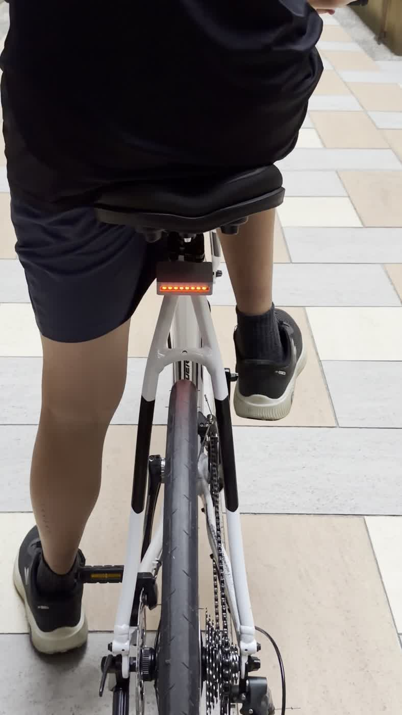
SYSTEM DESIGN
Braking Detection
以加速度變化判斷煞車
01
Start-up calibration
Record the starting sensor posture.
開機校正起始姿勢。
02
Signal processing
Average samples and slowly track the slope baseline.
移動平均濾波，緩慢追蹤坡度基準。
03
Light and sound alert
A braking trigger starts red flashes and the buzzer.
Rear installation, outdoor demonstration
SMART BICYCLE TAIL LIGHT SYSTEM
06
Notes:
ENGLISH PRESENTER NOTES
The algorithm looks for acceleration changes associated with braking. Calibration, moving-average filtering and slow baseline tracking aim to reduce the effects of vibration and mounting angle. This is a design intention that still needs physical testing. Calibration cannot identify the bicycle’s forward direction. The correct sensor axis and sign must be set. The photo shows installation, not verified braking detection.
繁體中文講者備註
煞車判斷利用加速度變化，搭配開機校正、移動平均與緩慢基準追蹤。目的是降低震動與安裝角度造成的影響，仍需要實測。校正只能記住起始姿勢，不能知道車子前進方向，因此感測軸及正負方向仍需設定。照片只呈現安裝狀態，不能當作煞車辨識成功證據。
SOURCES
Project specifications supplied by the inventor in this conversation, 19 October 2026. Original Canva poster: https://www.canva.com/design/DAHX5S5MpGc/aMWksRlMK7ZC09emLKPABA/edit . Updated specifications take precedence over the earlier poster. No measured performance data supplied.
Photo / video sources: IMG_9809.MOV, frame at 0.3 seconds

Slide 7
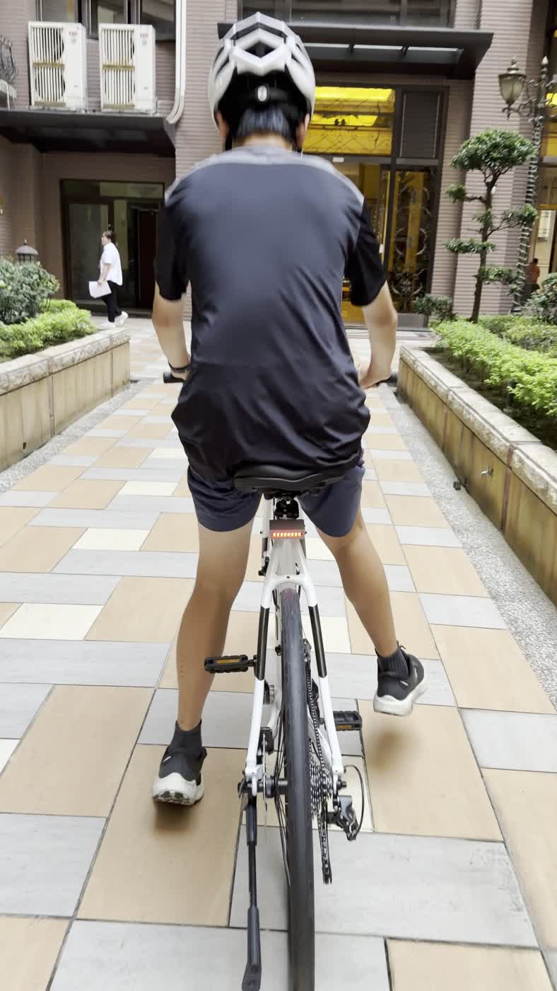
SYSTEM DESIGN
Riding, Parking and Standby
巡航、駐車與關燈待機
Riding
Soft red light with two green LEDs in the center.
巡航：紅燈柔和恆亮，中間兩顆綠燈亮起。
Parking
Steady red after a configured period without movement.
駐車：靜止一段設定時間後，全紅恆亮。
Standby: lights off after prolonged inactivity. Motion restores them.
待機是關燈，並非整套斷電；所有亮度皆受軟體上限限制。
SMART BICYCLE TAIL LIGHT SYSTEM
07
Notes:
ENGLISH PRESENTER NOTES
During riding, the light uses soft red with two green LEDs in the middle. After a configured time at rest, it changes to steady red. Longer inactivity turns the lights off. Motion restores the lighting. The electronics do not completely power down. Brightness is limited in software. We have not measured battery life.
繁體中文講者備註
騎乘時紅燈柔和恆亮，中間兩顆為綠燈；靜止一段時間後切換全紅。更長時間沒有移動就關燈，移動後恢復。這是關燈待機，並不是整套系統斷電。亮度受軟體設定上限限制，續航尚未量測。
SOURCES
Project specifications supplied by the inventor in this conversation, 19 October 2026. Original Canva poster: https://www.canva.com/design/DAHX5S5MpGc/aMWksRlMK7ZC09emLKPABA/edit . Updated specifications take precedence over the earlier poster. No measured performance data supplied.
Photo / video sources: IMG_9804.MOV, frame at 5.5 seconds

Slide 8
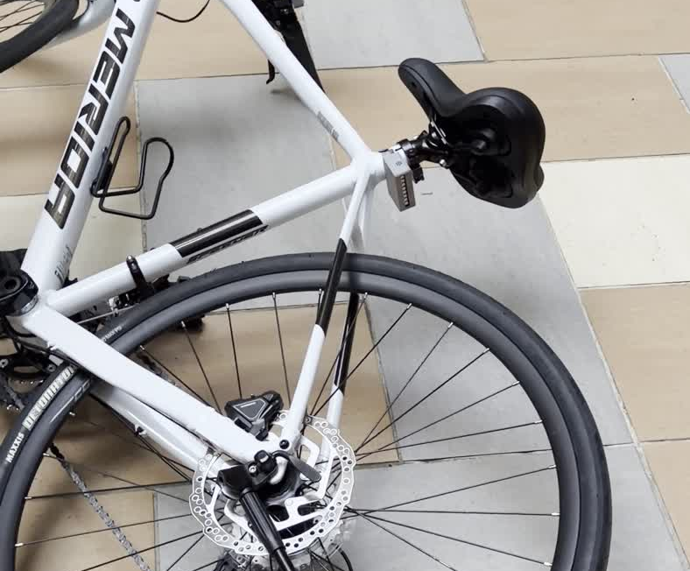
SYSTEM DESIGN
SOS Emergency Warning
SOS 現場緊急聲光警示
Red / white flashes
with an audible alarm
Sustained tilt can trigger SOS in demonstration mode.
展示模式：超過設定傾角並維持指定時間，可觸發 SOS。
Hold A+B for 3 seconds to clear SOS.
Tilt demonstration
解除方式：連續長按 A+B 三秒。
SMART BICYCLE TAIL LIGHT SYSTEM
08
Notes:
ENGLISH PRESENTER NOTES
SOS alternates red and white light and plays an alarm to attract nearby attention. In demonstration mode, a tilt beyond the configured angle for the required time can trigger it. Riding mode uses different impact and tilt parameters. SOS does not include GPS, automatic emergency calling, SMS or remote rescue notification. It cannot be claimed to detect every crash. The photograph shows a tilt scenario, not a complete validation of SOS detection.
繁體中文講者備註
SOS 會紅白交替閃光並發出求救警報，目的是引起附近的人注意。展示模式可以用超過角度並維持指定時間的傾倒觸發。騎乘模式使用不同的撞擊與傾倒參數。沒有 GPS、自動報警、簡訊或遠端救援通報，也不能宣稱能偵測所有摔車。照片呈現傾倒情境，不代表已完成 SOS 辨識驗證。
SOURCES
Project specifications supplied by the inventor in this conversation, 19 October 2026. Original Canva poster: https://www.canva.com/design/DAHX5S5MpGc/aMWksRlMK7ZC09emLKPABA/edit . Updated specifications take precedence over the earlier poster. No measured performance data supplied.
Photo / video sources: IMG_9811.MOV, frame at 4.5 seconds

Slide 9
SYSTEM DESIGN
Two Operating Modes
展示與騎乘模式
 | Mode 1: Demonstration | Mode 2: Riding
Purpose | Short movements on the model | Parameters for riding conditions
Sensitivity | More sensitive braking response | Different braking, impact and tilt settings
SOS demonstration | Sustained tilt after upright calibration | Impact and tilt logic require validation
Switch with the gold logo or the phone webpage.
騎乘模式以降低日常誤觸為目標，目前沒有道路使用認證。
SMART BICYCLE TAIL LIGHT SYSTEM
09
Notes:
ENGLISH PRESENTER NOTES
Mode 1 helps demonstrate the model with short movements. Start by holding it upright for calibration. Mode 2 changes braking, impact and tilt parameters to reduce unwanted triggers during ordinary use. We still need to validate this behavior. Selecting riding mode does not mean the prototype meets road-use certification. The gold logo and phone webpage both provide mode switching.
繁體中文講者備註
一號模式適合短距離模型展示，開機先扶正校正，煞車較靈敏，也能用持續傾倒展示 SOS。二號模式使用不同的煞車、撞擊與傾倒參數，以降低日常誤觸為目標，實際效果仍待驗證。切換成騎乘模式不代表通過道路使用認證。
SOURCES
Project specifications supplied by the inventor in this conversation, 19 October 2026. Original Canva poster: https://www.canva.com/design/DAHX5S5MpGc/aMWksRlMK7ZC09emLKPABA/edit . Updated specifications take precedence over the earlier poster. No measured performance data supplied.

Slide 10
SYSTEM DESIGN
Offline Phone Settings
手機離線設定
About 49
Sensitivity, timing and filtering
靈敏度、確認時間及濾波
adjustable parameters
Tilt angle, light and sound
約 49 項可調參數
傾倒角度、燈光與聲音
Standby time and operating mode
待機時間與操作模式
Local Wi-Fi webpage. No app installation or internet connection required.
SMART BICYCLE TAIL LIGHT SYSTEM
10
Notes:
ENGLISH PRESENTER NOTES
The ESP32-C6 provides a local Wi-Fi webpage. A phone connects to that network and opens the settings without installing an app or using the internet. About 49 parameters cover sensing, timing, filtering, tilt, lighting, sound and standby. This interface adjusts the prototype. It does not provide battery level or charging-complete detection.
繁體中文講者備註
ESP32-C6 提供本地 Wi-Fi 網頁，手機連上後即可設定，不需安裝 App，也不需要網際網路。約 49 項參數涵蓋感測、時間、濾波、傾角、燈光、聲音與待機。系統目前沒有電量或充飽狀態的軟體感測功能。
SOURCES
Project specifications supplied by the inventor in this conversation, 19 October 2026. Original Canva poster: https://www.canva.com/design/DAHX5S5MpGc/aMWksRlMK7ZC09emLKPABA/edit . Updated specifications take precedence over the earlier poster. No measured performance data supplied.

Slide 11
TEST METHOD
Repeatable Braking Tests
可重複的煞車測試排程
1–100 rounds
Default: 30 rounds
01
Prepare and observe
Each round has preparation and observation periods.
每輪包含準備時間與觀察時間。
02
Record and confirm
Log triggers and acceleration, then confirm actual braking manually.
記錄觸發及加速度後，人工確認是否確實做了煞車。
SMART BICYCLE TAIL LIGHT SYSTEM
11
Notes:
ENGLISH PRESENTER NOTES
The user chooses between one and one hundred rounds, with thirty as the default. Each round includes a preparation period and an observation period. The system records whether its logic triggered and saves acceleration samples. Afterwards, the experimenter must confirm which rounds actually included braking. Trials without an actual braking action or without confirmation do not belong in the braking success-rate denominator.
繁體中文講者備註
可設定 1 到 100 次，預設 30 次。每輪先準備，再進入觀察時間。程式自動記錄有沒有觸發並保存加速度資料。測完仍需人工確認哪些輪次確實執行了煞車。未做或未確認的輪次，不能列入煞車成功率的分母。
SOURCES
Project specifications supplied by the inventor in this conversation, 19 October 2026. Original Canva poster: https://www.canva.com/design/DAHX5S5MpGc/aMWksRlMK7ZC09emLKPABA/edit . Updated specifications take precedence over the earlier poster. No measured performance data supplied.

Slide 12
TEST METHOD
Performance Evaluation
如何計算與呈現測試結果
Detection success rate
Triggered, confirmed braking rounds ÷ all confirmed braking rounds × 100%
Metric | Current evidence
Braking detection success rate | To be measured
False triggers during non-braking actions | To be measured in a separate test
Battery runtime and outdoor visibility | To be measured
程式觸發紀錄仍須搭配目視或影片，確認燈光確實輸出。
SMART BICYCLE TAIL LIGHT SYSTEM
12
Notes:
ENGLISH PRESENTER NOTES
The braking detection rate equals the number of triggered and manually confirmed braking rounds divided by all manually confirmed braking rounds, multiplied by one hundred percent. Exclude unperformed and unconfirmed rounds. If the denominator is zero, report not available. False triggers require a separate set of non-braking trials. A trigger log alone does not prove LED output, so verify it by observation or video. No formal measurements are supplied yet.
繁體中文講者備註
煞車偵測成功率等於「確實做了煞車且程式觸發的輪次」除以「人工確認確實做了煞車的全部輪次」，再乘百分之百。未執行或未確認者排除；分母為零就不計算。誤觸應另外安排非煞車試驗。紀錄只能證明程式觸發，實際燈光仍須目視或影片確認。目前沒有正式實測數據。
SOURCES
Project specifications supplied by the inventor in this conversation, 19 October 2026. Original Canva poster: https://www.canva.com/design/DAHX5S5MpGc/aMWksRlMK7ZC09emLKPABA/edit . Updated specifications take precedence over the earlier poster. No measured performance data supplied.

Slide 13
TEST METHOD
Records and Offline Reports
實驗紀錄與離線報告
Four CSV exports
Report outputs
Trial-by-trial results
Complete acceleration data
Settings used in the run
Success-rate summary
Trial outcome plots
Acceleration and threshold plots
Before / after comparisons
Data-quality prompts
逐次結果、完整加速度、本輪設定、成功率摘要
PNG, SVG, PDF or HTML with data
SMART BICYCLE TAIL LIGHT SYSTEM
13
Notes:
ENGLISH PRESENTER NOTES
Four CSV files preserve the trial outcomes, acceleration samples, settings and summary. An offline report tool can create trial plots, acceleration and threshold plots, and comparisons before and after tuning. It can also flag data-quality issues. Export formats include PNG, SVG, PDF and HTML with data. The availability of these tools is not evidence of a particular performance result.
繁體中文講者備註
四份 CSV 分別保留逐次結果、完整加速度、當輪設定及成功率摘要。離線報告工具能產生結果圖、加速度與門檻圖、調整前後比較及資料品質提示，並輸出 PNG、SVG、PDF 或含資料的 HTML。工具功能本身不能代表系統已達到特定成功率。
SOURCES
Project specifications supplied by the inventor in this conversation, 19 October 2026. Original Canva poster: https://www.canva.com/design/DAHX5S5MpGc/aMWksRlMK7ZC09emLKPABA/edit . Updated specifications take precedence over the earlier poster. No measured performance data supplied.

Slide 14
ASSESSMENT
Design Strengths and Current Limits
設計特色與目前限制
Design strengths
Current limits
Manual signals and automatic warnings
Light and sound feedback
Adjustable settings with test records
False triggers remain possible
Battery runtime is unmeasured
SOS alerts nearby people only
整合操作、感測、回饋與可檢查的紀錄
尚未完成道路認證，不能保證避免事故
SMART BICYCLE TAIL LIGHT SYSTEM
14
Notes:
ENGLISH PRESENTER NOTES
The design contribution is the integration of rider controls, motion-based alerts, audible feedback and an adjustable experiment workflow. We do not claim that every individual function is new or that the design is patentable without a prior-art review. False detections remain possible. Runtime is unmeasured. SOS has no remote notification. The prototype is not road certified and cannot guarantee crash prevention.
繁體中文講者備註
特色是將騎士操作、自動感測、聲光回饋及可調整的測試流程整合起來。未做前案檢索前，不宣稱每項功能都具新穎性或一定能取得專利。仍可能誤觸，續航未量測，SOS 沒有遠端通報。作品沒有道路使用認證，也不能保證避免事故。
SOURCES
Project specifications supplied by the inventor in this conversation, 19 October 2026. Original Canva poster: https://www.canva.com/design/DAHX5S5MpGc/aMWksRlMK7ZC09emLKPABA/edit . Updated specifications take precedence over the earlier poster. No measured performance data supplied.

Slide 15
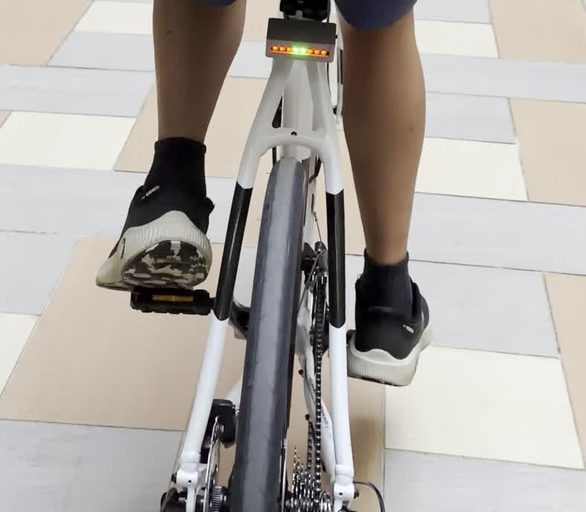
NEXT STEPS
Next Steps and Live Demonstration
後續驗證與現場展示
Compare settings using confirmed braking and non-braking trials.
以人工確認的煞車與非煞車試驗，比較調整前後結果。
Measure runtime and verify light visibility in different conditions.
量測續航，並在不同環境確認燈光可見度。
Thank you
SMART BICYCLE TAIL LIGHT SYSTEM
15
Notes:
ENGLISH PRESENTER NOTES
The next step is to measure what the prototype actually does: confirmed braking detection, non-braking false triggers, output behavior, battery runtime and visibility. During a live demonstration, show turns and hazards first, then braking, and finish with tilt SOS. Hold A+B for three seconds to clear SOS. Thank the judges and invite questions.
繁體中文講者備註
下一步是實際量測煞車辨識、非煞車誤觸、聲光輸出、續航與可見度。現場展示可先方向燈及雙黃，再展示煞車，最後展示傾倒 SOS。解除時持續長按 A+B 三秒。最後感謝評審並接受提問。
SOURCES
Project specifications supplied by the inventor in this conversation, 19 October 2026. Original Canva poster: https://www.canva.com/design/DAHX5S5MpGc/aMWksRlMK7ZC09emLKPABA/edit . Updated specifications take precedence over the earlier poster. No measured performance data supplied.
Photo / video sources: IMG_9809.MOV, frame at 10 seconds

Slide 16
APPENDIX
Appendix: Hardware Reference
附錄：硬體與接線重點
Component | Specification / role
Front controller | micro:bit V2: buttons, touch logo, accelerometer, 5×5 LEDs
Rear controller | Seeed Studio XIAO ESP32-C6
Light output | 8 × WS2812B LEDs, data input on D1
Sound output | Buzzer on D3
Rear power | 400 mAh lithium battery; runtime not yet measured
蜂鳴器接 D3。校正無法自動判斷前進方向，感測軸與正負方向須設定正確。
SMART BICYCLE TAIL LIGHT SYSTEM
16
Notes:
ENGLISH PRESENTER NOTES
This reference follows the latest project specifications. The LED data input is D1 and the buzzer is D3. The rear unit uses a 400 mAh lithium battery. No software battery-level or charge-complete sensing is implemented. Micro:bit calibration records the starting posture but does not determine the bicycle’s forward direction.
繁體中文講者備註
本頁依最新專案規格整理。LED 資料線接 D1，蜂鳴器接 D3，尾燈使用 400mAh 鋰電池。目前沒有軟體電量或充飽偵測。micro:bit 校正記住起始姿勢，感測軸及正負方向仍要正確設定。
SOURCES
Project specifications supplied by the inventor in this conversation, 19 October 2026. Original Canva poster: https://www.canva.com/design/DAHX5S5MpGc/aMWksRlMK7ZC09emLKPABA/edit . Updated specifications take precedence over the earlier poster. No measured performance data supplied.

Slide 17
APPENDIX
Appendix: Planned Test Matrix
附錄：後續測試規劃
Test condition | What to record | Status
Actual braking | Manual confirmation, trigger, light / sound | Pending
Movement without braking | Unwanted triggers and trial conditions | Pending
Tilt and impact scenarios | Mode, angle / duration, trigger, reset | Pending
Stillness and wake-up | Parking delay, lights off, motion recovery | Pending
Runtime and visibility | Settings, run duration, viewing conditions | Pending
Keep mounting, test actions and observation periods consistent when comparing settings.
SMART BICYCLE TAIL LIGHT SYSTEM
17
Notes:
ENGLISH PRESENTER NOTES
This is a proposed test plan, not a table of completed results. Keep the mounting position, axis settings, action instructions and observation windows comparable between parameter sets. Record the software version and settings for each run. Use separate non-braking trials to examine false triggers, and verify real light and sound outputs.
繁體中文講者備註
這是後續建議的測試規劃，不是已完成成績。比較不同參數時，要盡量固定安裝位置、感測軸、操作方法與觀察時間，也要保留軟體版本與設定。非煞車試驗用來檢查誤觸，所有試驗都應確認實際聲光輸出。
SOURCES
Project specifications supplied by the inventor in this conversation, 19 October 2026. Original Canva poster: https://www.canva.com/design/DAHX5S5MpGc/aMWksRlMK7ZC09emLKPABA/edit . Updated specifications take precedence over the earlier poster. No measured performance data supplied.

Slide 18
APPENDIX
Appendix: Questions from Judges
附錄：評審問答重點
What is the main contribution?
An integrated prototype with rider controls, motion alerts and inspectable test records.
How do you know braking detection works?
We will compare confirmed braking actions with trigger logs and observed light output.
What happens when SOS starts?
Nearby people receive a light-and-sound warning. Hold A+B for 3 seconds to clear it.
SMART BICYCLE TAIL LIGHT SYSTEM
18
Notes:
ENGLISH PRESENTER NOTES
Q: What is new? A: Our contribution is the integration of manual controls, sensing, local feedback and an experiment workflow. Prior-art research is needed before making a patent novelty claim. Q: How accurate is it? A: We have not supplied formal measurement results yet. We will use confirmed actions and output observation, and exclude unconfirmed trials from the braking denominator. Q: Does SOS call for help remotely? A: No. It warns people nearby with light and sound. Q: Can the battery last four to five hours? A: We have not measured runtime, so we cannot make that claim. Q: Is it ready for road use? A: It is a prototype requiring further testing and certification assessment.
繁體中文講者備註
問：特色是什麼？答：整合手動控制、感測、聲光回饋與測試紀錄。專利新穎性仍需前案檢索。問：成功率多少？答：尚無正式數據，會用人工確認的動作、觸發紀錄及實際燈光驗證，未確認輪次不列入煞車分母。問：SOS 會通知救援嗎？答：目前只提供現場聲光警示。問：400mAh 可以用四到五小時嗎？答：續航尚未量測，不能這樣宣稱。問：可以直接上路嗎？答：目前為原型，仍須實測及確認適用規範。
SOURCES
Project specifications supplied by the inventor in this conversation, 19 October 2026. Original Canva poster: https://www.canva.com/design/DAHX5S5MpGc/aMWksRlMK7ZC09emLKPABA/edit . Updated specifications take precedence over the earlier poster. No measured performance data supplied.

