Slide 1

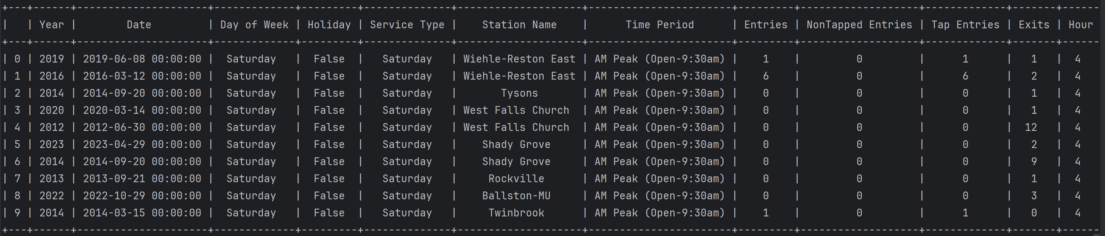

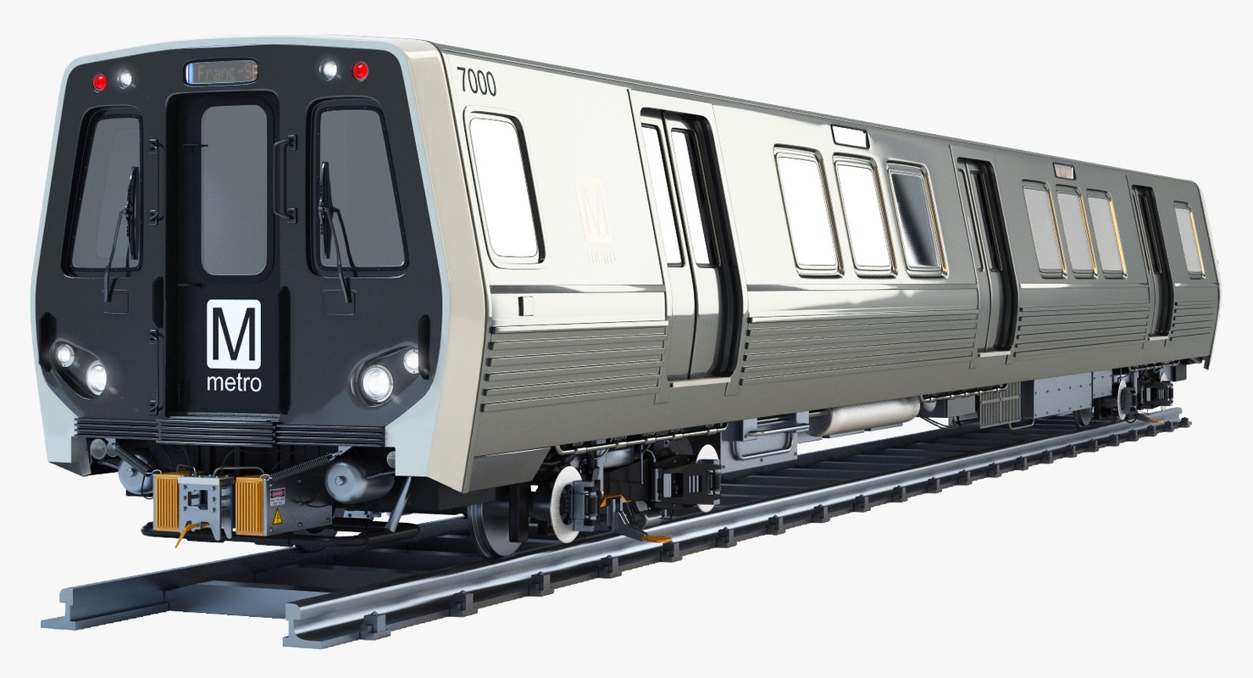
WMATA RIDERSHIP DATA
Metrorail Ridership Summary | WMATA
2 GB
1,000,000+ Rows 13 features
Jan 2012- Jun 2025

Slide 2
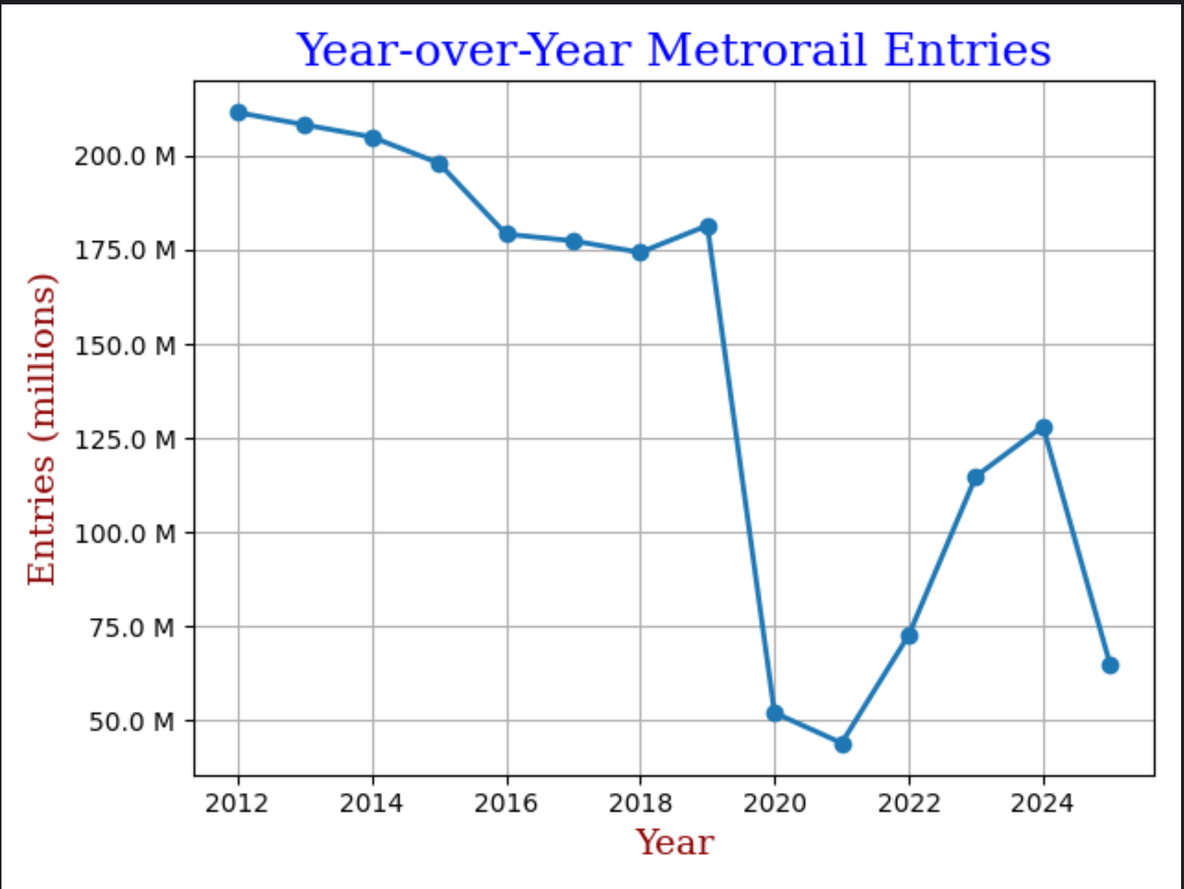
Line Plot over Time

Slide 3
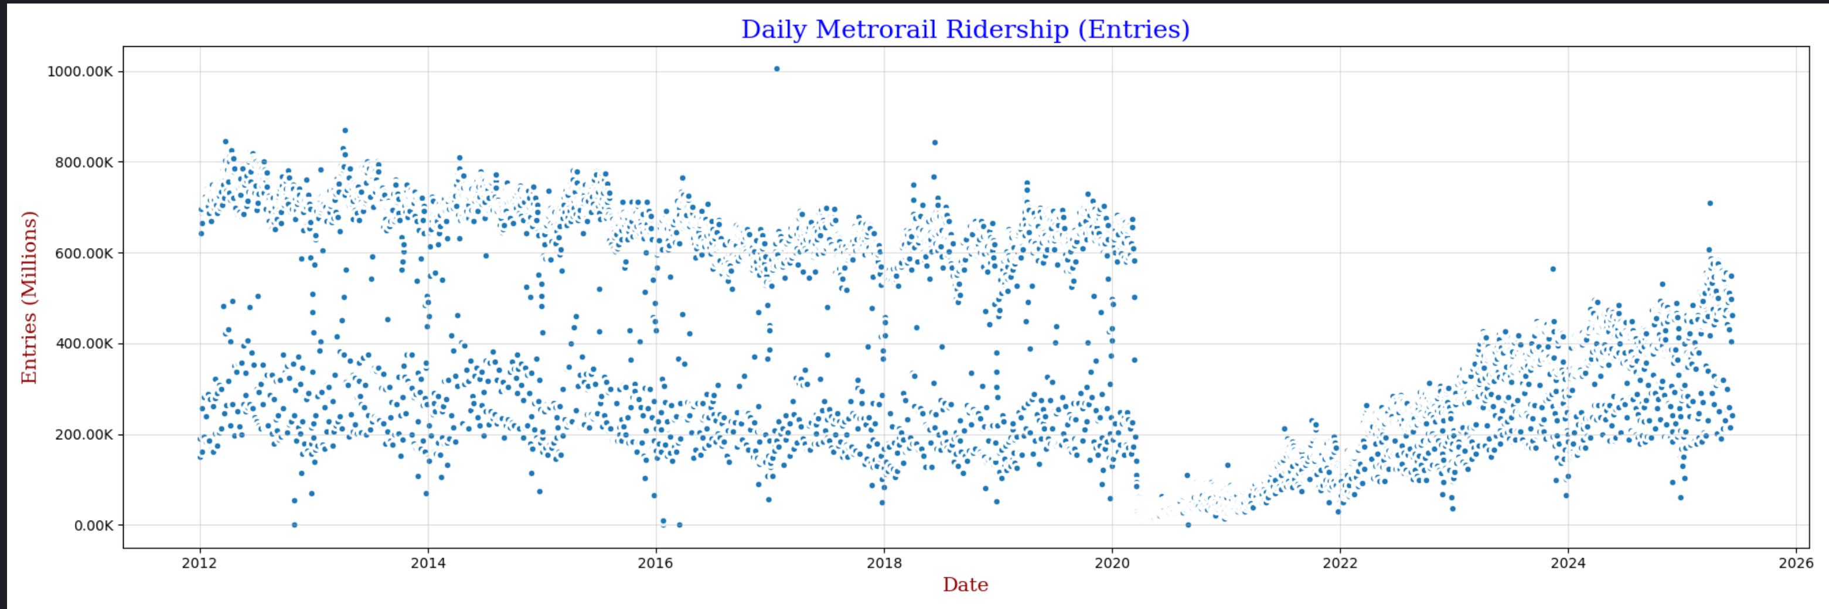
Effect of Historical Dates
2017 Women's March
2012 Hurricane Sandy
2016 DC Blizard
Covid-19

Slide 4
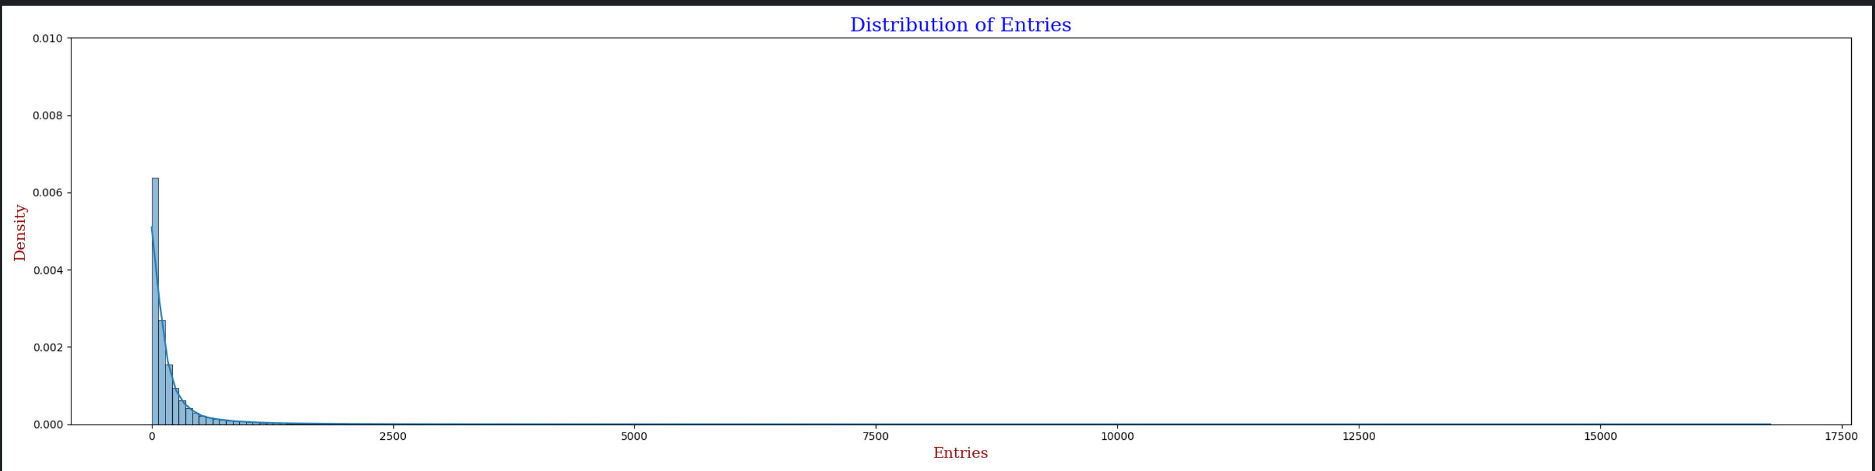
Effect of Historical Dates

Slide 5
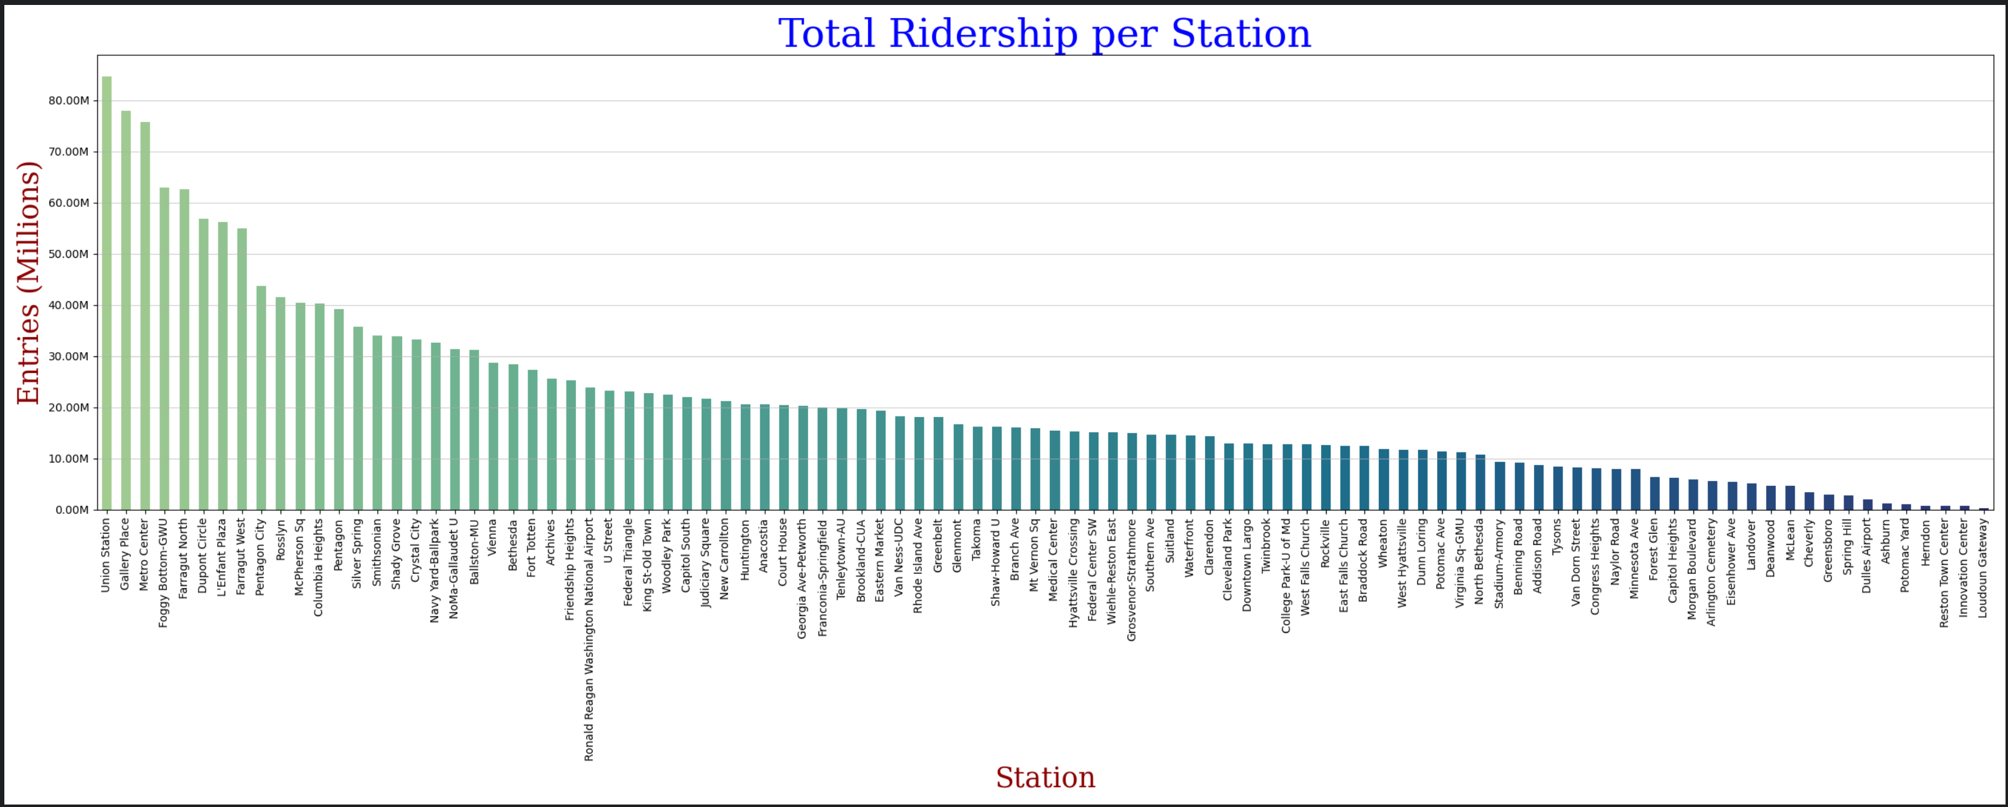
Ridership by Station 2012-2025

Slide 6
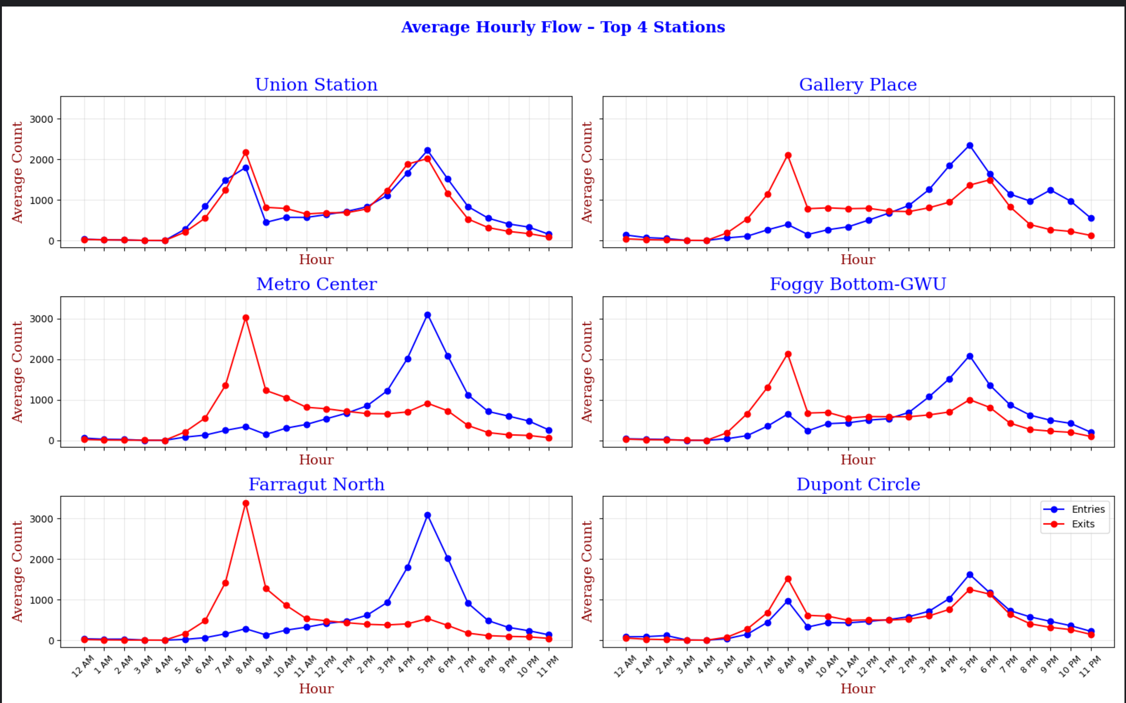
Busy stations vs Commuter Stations

Slide 7
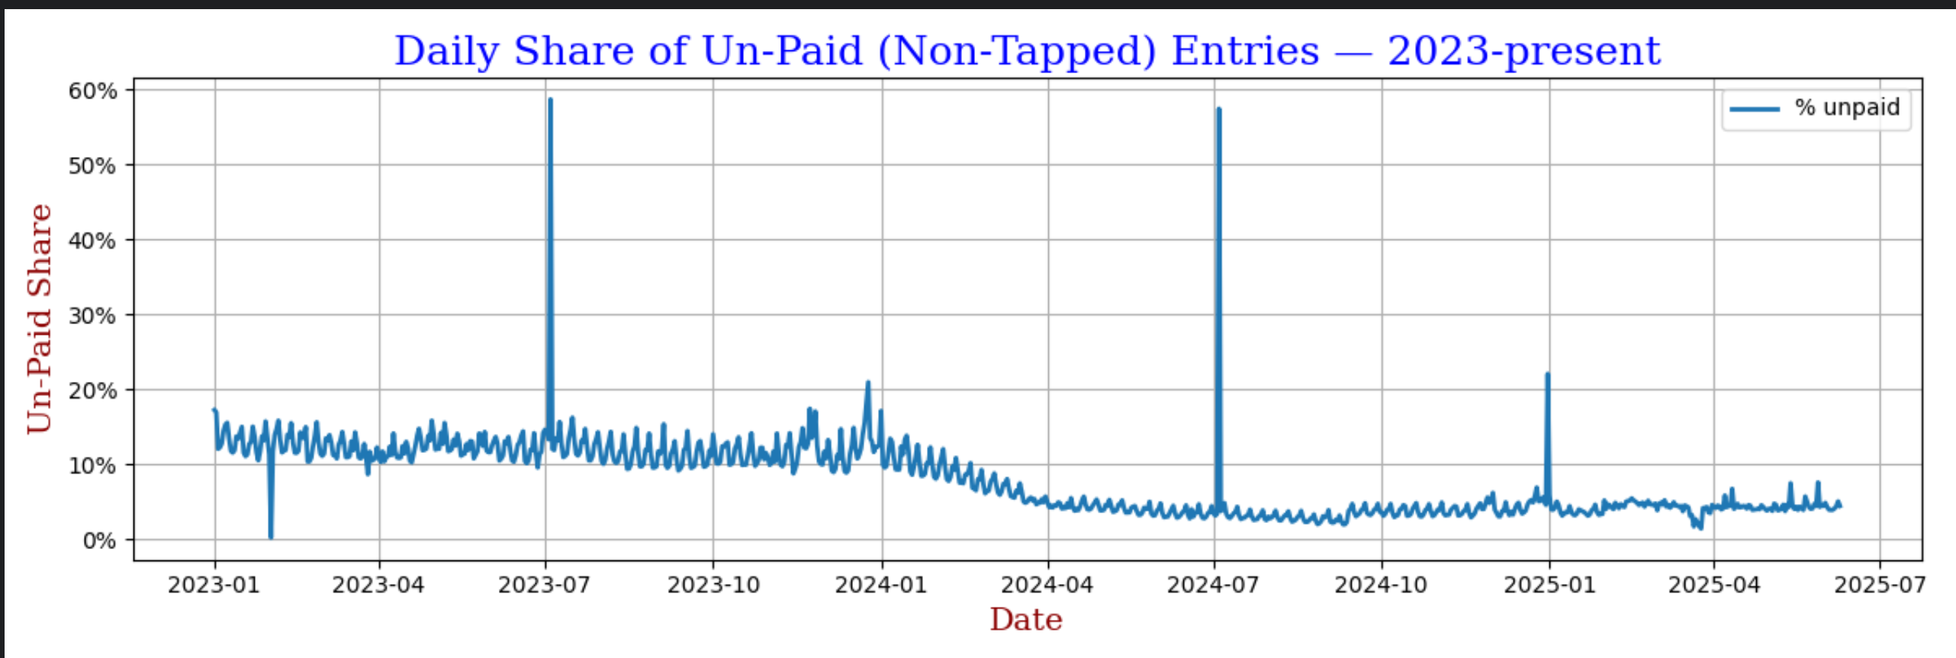
Percent of Fare Evasion 2023-2025

Slide 8
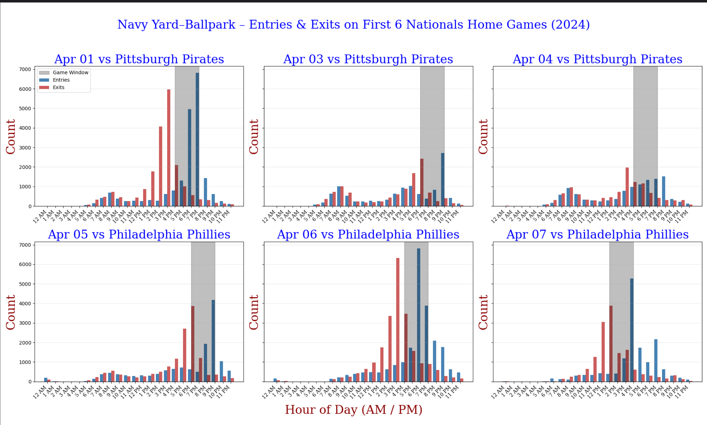
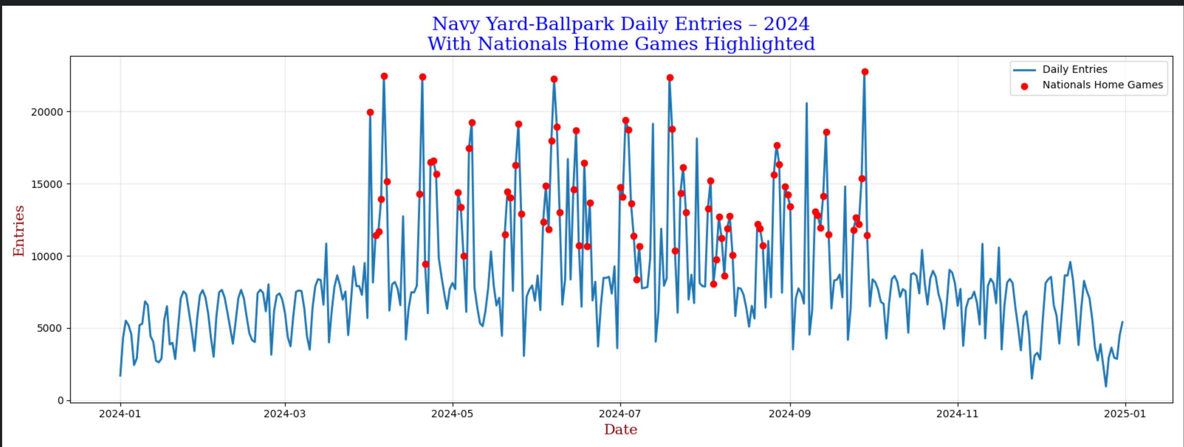
Sporting Events Effects on Metro Ridership

Slide 9
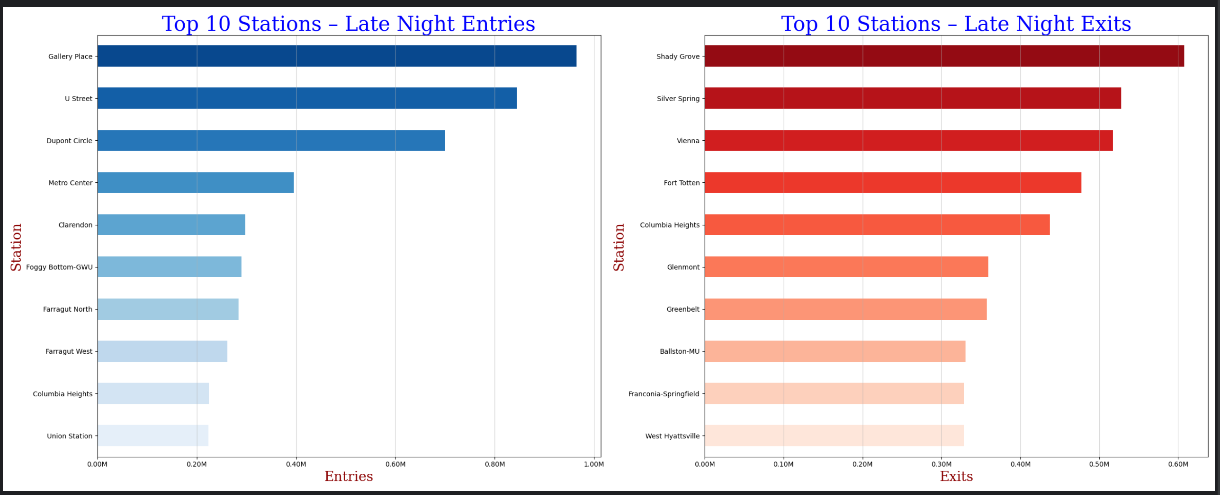
Percent of Fare Evasion 2023-2025
Gallery Place: Capital One Arena
U Street: Popular bar spot in DC
Dupont Circle: Popular bar spot in DC
Clarendon: Popular bar spot in Arlington
Shady Grove: End of Red Line and massive parking lot
Silvar Spring: Massive parking lot
Vienna: End of Orange Line w/ massive parking lot
Fort Totten: One of the few parking lot metros in dc and at the connection of 3 lines

Slide 10
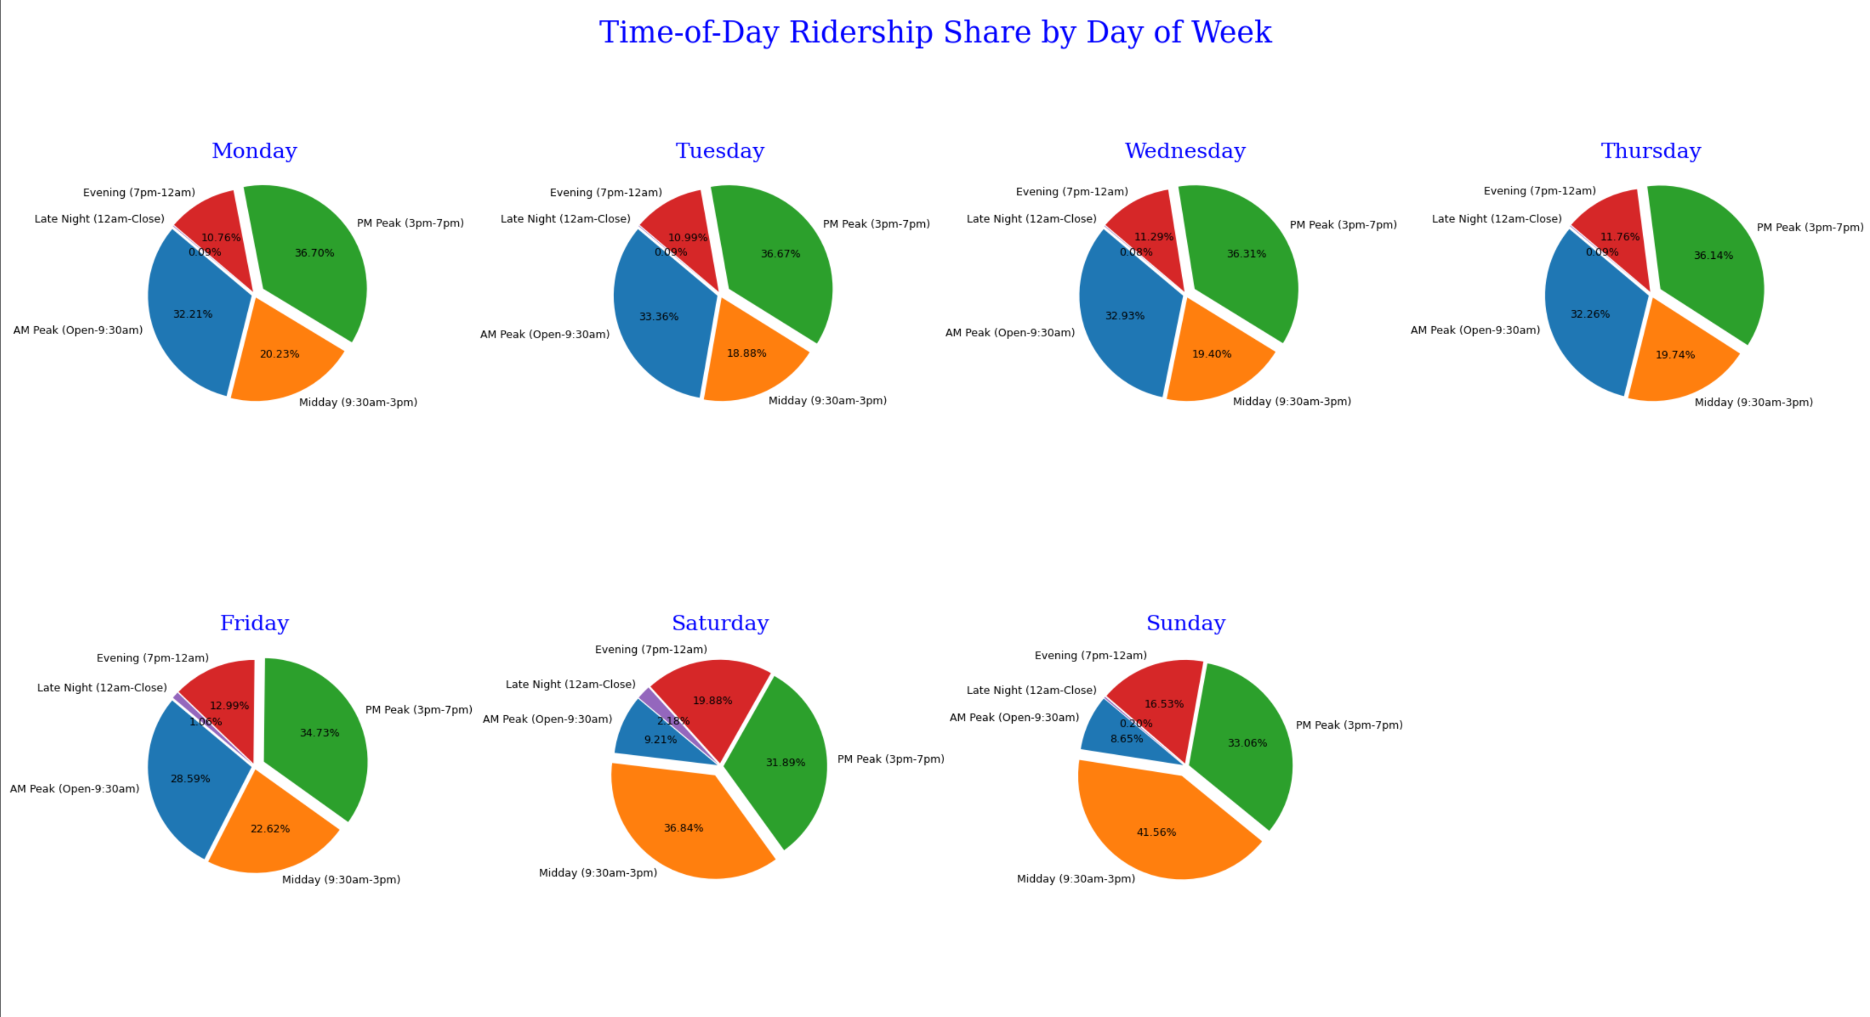
Busy stations vs Commuter Stations

