Slide 1
Portfolio
RAJARSHI BISWAS
https://github.com/Raydir27 | www.linkedin.com/in/rajarshi-biswas-rb27

Slide 2
List of Projects/Internships
Internships:
Corporate IT Intern — Larsen & Toubro (L&T)
ELC Summer Intern — Thapar Institute of Engineering & Technology
Academic / Major Projects:
VisAd — Real-Time Vision-Driven Advertisement System (Ongoing)
Remote Sensing Image Captioning using BLIP (RSICD Dataset)
Rock–Paper–Scissors with NVIDIA JetBot (Edge AI)
Mini-RAG: Lightweight Retrieval-Augmented Generation System
Sentiment Analysis for Movie Reviews

Slide 3
INTERNSHIPS

Slide 4
CORPORATE IT INTERN | LARSEN & TOUBRO
Role Overview
Corporate IT Intern, Larsen & Toubro
Duration: June 2025 – August 2025
Domain: Construction Site Safety Automation
Problem Statement
Manual safety monitoring from CCTV is error-prone and non-scalable
Need for automated detection of unsafe events in real time

Slide 5
L&T: SYSTEM ARCHITECTURE
End-to-End Pipeline:
CCTV streams ingested via RTSP
YOLOv11 for real-time object detection
Vision Transformers for contextual understanding
LLaVA for vision–language reasoning
Rule engine for safety violation classification
API outputs for alerts and monitoring systems

Slide 6
L&T: SYSTEM ARCHITECTURE
Input: RTSP Stream
Sample frames @2fps
Apply basic Object Detection using YOLO
Apply Rules Engine on detected Workers and Machines
Escalate to VLM when unable to determine the situation through Rules Engine
Export results to Structured JSON
Create alerts for the connected application from the JSON files
End Loop

Slide 7
L&T: ENGINEERING & DATA
Key Engineering Contributions:
Designed multi-stage inference pipeline
Built rule-based event classification logic
Developed APIs for real-time video processing
Data & Training
Prepared domain-specific datasets
Used COCO-style annotations and Roboflow pipelines
Applied industrial-specific augmentations for robustness

Slide 8
L&T: IMPACT & LEARNINGS
Impact
Automated detection of safety violations
Reduced dependency on manual monitoring
Scalable design for multiple camera feeds
Key Learnings
Designing CV systems beyond model accuracy
Handling noisy, real-world video streams
Integrating perception with decision logic

Slide 9
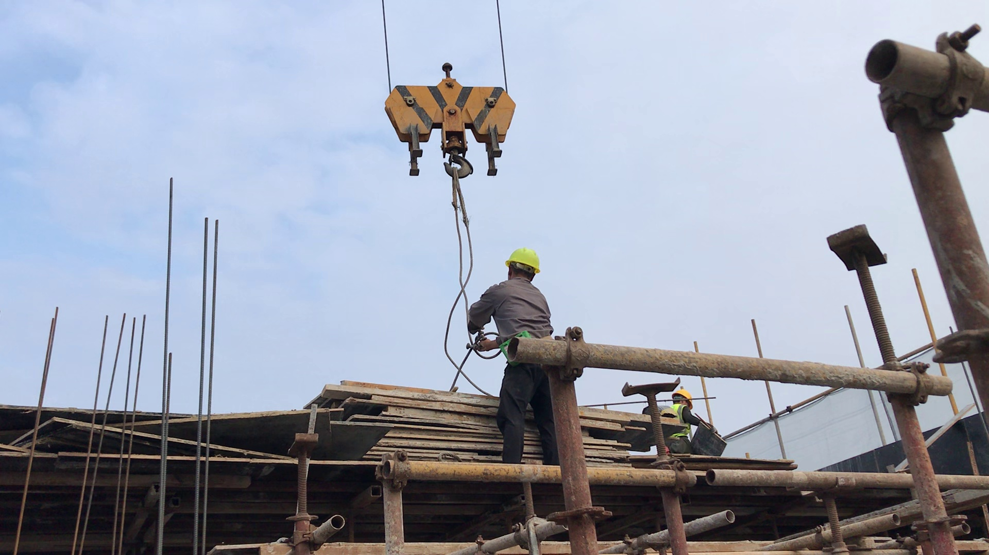
Example Output
"detections": [
{ "name": "Tower_Crane",
"class": 8,
"confidence": 0.64131,
"box": {
"x1": 67.24586,
"y1": 17.08594,
"x2": 205.90646,
"y2": 1560
}},
{ "name": "person",
"class": 1,
"confidence": 0.8211,
"box": {……… ‘person bbox co-ordinates’
}}],
"rules_results": [ "PPE non-compliance": "harness",
“Fall”: “ Worker is close to edge” ],
"vlm_description": { "role": "assistant",
"summary": “Worker PPE compliance: all required equipment detected except safety harness. Caution advised due to proximity to edges and cranes –- fall risk present."}

Slide 10
ELC SUMMER INTERN | THAPAR INSTITUTE Of Engineering And Technology
Role Overview
ELC Summer Intern, TIET
Duration: June 2024 – July 2024
Project Goal
Real-time helmet detection for traffic safety monitoring

Slide 11
ELC: MODELING & DEPLOYMENT
Technical Work
Helmet detection using YOLOv8
Compared CNNs and Vision Transformers
  ResNet50
  VGG19
  Vision Transformer
Deployment
Deployed model on POE surveillance cameras
Achieved 63.5% mAP in real-world testing

Slide 12
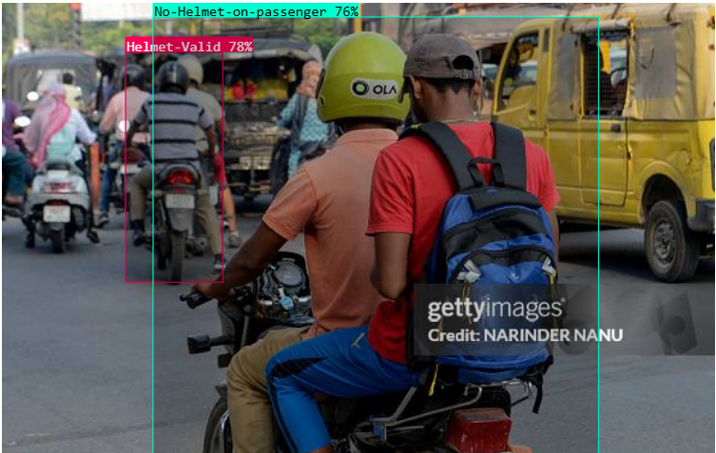
Example Output
{ "predictions": [{ "x": 143.5,
"y": 137,
"width": 81,
"height": 192,
"confidence": 0.781,
"class": "Helmet-Valid",
"class_id": 0,
"detection_id": "e641838d-4f70-443b-ae84-960c58afaa9d"
},
{ "x": 311.5,
"y": 204,
"width": 371,
"height": 384,
"confidence": 0.765,
"class": "No-Helmet-on-passenger",
"class_id": 3,
"detection_id": "86c20b55-e52a-485d-b7fc-a4b885ba9dd6"
}]}

Slide 13
ACADEMIC & PERSONAL PROJECTS

Slide 14
VISAD: REAL-TIME VISION-DRIVEN AD SYSTEM
Project Overview
Lead Computer Vision Developer (4-member team)
End-to-end CV + ML system
System Design
Pedestrian detection and attribute extraction
CV outputs fed into ML recommender model
Automated ad category selection
CSV-based logging for analytics
Cloud-deployed inference pipeline

Slide 15
REMOTE SENSING IMAGE CAPTIONING (BLIP)
Objective
Generate natural-language captions for satellite imagery
Technical Details
Fine-tuned BLIP on RSICD dataset
Learned vision–language alignment in non-natural images
Addressed domain shift between satellite and ground images
Key Takeaway
Captioning as semantic understanding, not object listing
(Satellite image + generated caption)

Slide 16
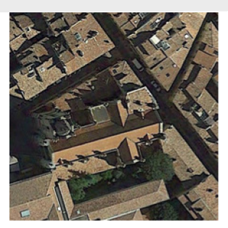
REMOTE SENSING IMAGE CAPTIONING (BLIP)
Image | Ground Truth / Base Model Output / Fine-Tuned Model Output
Ground Truth: Along a street are buildings with brick red roofs among which there is a church with a cross-shaped roof.
Finetuned Model Predicted: **A church is close to several green trees.**
Base Model Predicted: **An aerial view of a small town**

Slide 17
REMOTE SENSING IMAGE CAPTIONING (BLIP)
Project Overview
Edge AI project using NVIDIA JetBot
Technical Contributions
Dataset collection and curation (Roboflow)
YOLOv8 model selection based on latency and accuracy
TensorRT INT8 optimization on Jetson
Physical robot interaction logic
Performance
Precision: 0.946
Recall: 0.933
mAP@50: 0.917

Slide 18
REMOTE SENSING IMAGE CAPTIONING (BLIP)
Technical Details
Fine-tuned BLIP on RSICD dataset
Learned vision–language alignment in non-natural images
Addressed domain shift between satellite and ground images
Key Takeaway
Captioning as semantic understanding, not object listing
(Satellite image + generated caption)

Slide 19
MINI-RAG: RETRIEVAL-AUGMENTED GENERATION
Purpose:
Personal project to understand RAG fundamentals
Pipeline
Document ingestion and chunking
Embedding generation
Vector-based retrieval
Context injection into LLM prompt
Focus
Grounding responses
Reducing hallucinations
Understanding RAG internals beyond frameworks

Slide 20
SENTIMENT ANALYSIS FOR MOVIE REVIEWS
Project Summary
NLP-based sentiment classification system
Implementation
Text preprocessing and feature extraction
Classification model for sentiment prediction
Local deployment with database integration
Outcome
End-to-end NLP application experience

Slide 21
TECHNICAL SKILLS
Core Skills
Programming: Python, C, C++
Computer Vision, Deep Learning, Machine Learning
CNNs, Vision Transformers, Vision-Language Models
Tools & Frameworks
PyTorch, TensorFlow, OpenCV
Ultralytics, Hugging Face
CUDA, TensorRT, NVIDIA Jetson

Slide 22
THANK YOU

