Slide 1
IT Business School · Tunisia
Data Mining & Machine Learning · 2025–2026
Supervisor: Kaouether Ben Ali
US Housing Market
Analysis and Prediction
Using Data Mining and Machine Learning
Ayoub Naouech · Rayen Belhadj
242
27
20yr
0.999
Observations
Features
Timespan
Best R²

Slide 2
AGENDA
Presentation Outline
01
Project Motivation & Context
02
Dataset & Features
Why housing markets matter
20 years, 242 observations, 27 variables
03
CRISP-DM Methodology
04
Data Preparation
Full 6-phase data science workflow
Cleaning, engineering, and feature design
05
Supervised Learning
06
Fit Diagnostics
Linear Regression best; Ridge baseline; tree diagnostics
Train-test gaps and chronological generalization
07
Reinforcement Learning
08
OLAP & Forecasting
Q-Learning market-policy simulation
Period intelligence and future scenario prediction
09
Dashboard
10
Key Findings & Conclusion
22-page Streamlit Intelligence Platform
Corrected metrics, evidence, and implications

Slide 3
MOTIVATION
Why Housing Markets?
"The U.S. housing market is a cornerstone of national economic health, sensitive to inflation, unemployment, mortgage conditions, and interest-rate policy — yet no single model captures its full complexity."
📈
Market Complexity
🏠
Stakeholder Need
Non-linear interactions between macro variables across 20+ years of boom-bust cycles cannot be captured by simple econometric models.
Analysts, institutions, policymakers, and researchers need accessible, data-driven tools to understand price dynamics.
🔬
Research Gap
🤖
ML Opportunity
Most studies examine one or two variables; this project combines macro, behavioral, and policy indicators simultaneously.
Modern ML methods (ensembles, clustering, RL) can outperform traditional OLS regression on complex, non-stationary time series.

Slide 4
DATASET
Dataset Overview
2004–2024
242
27
6
Time Span
Monthly Rows
Feature Columns
Engineered Features
Housing Indicators
Macro / Economy
Home Price Index (HPI)
New Housing Permits
Existing Home Sales
Housing Starts
Real GDP
Median Household Income
CPI
Federal Funds Rate
Mortgage & Credit
Labor & Sentiment
Mortgage Rate (30yr)
Income-to-Mortgage Ratio
CPI-to-Interest Ratio
Consumer Credit
Unemployment Rate
Consumer Sentiment (UMICH)
3-mo Rolling Unemployment
Participation Rate
Primary sources: FRED, NAR, U.S. Census Bureau, Freddie Mac, University of Michigan

Slide 5
METHODOLOGY
CRISP-DM Workflow
01
Business Understanding
02
Data Understanding
03
Data Preparation
Define housing prediction objective, identify stakeholder needs, set success criteria
Explore 27 features, correlation profiling, distribution analysis, quality checks
Lag features, rolling means, imputation, period labeling, affordability ratios
04
Modeling
05
Evaluation
06
Deployment
Ridge, RF, GB, SVR, KNN, MLP for regression & classification; KMeans, PCA, RL
MAE · RMSE · R² · Accuracy · F1 · AUC · Feature importance · Theory checks
Streamlit dashboard: 22 pages, OLAP cube, chatbot, governance, export

Slide 6
DATA PREPARATION
Feature Engineering & Cleaning
Engineered Features
Top Correlations with HPI
HPI_lag1 / HPI_lag3
Income-to-Mortgage
+0.93
Target autoregression — captures housing momentum
Unemployment_roll3
HPI Smoothed
+1.00
3-month rolling mean — smooths seasonal noise
Income_to_Mortgage
HPI lag1
+1.00
Affordability ratio — strongest non-leaky predictor
CPI_to_Interest
HPI lag3
+1.00
Macro pressure index — inflation vs. rate dynamics
HPI_pct_change
Median Income
+0.88
Momentum signal — rate of price acceleration
Administration
Mortgage Rate
+0.47
Political-period label — groups by presidency

Slide 7
SUPERVISED LEARNING
Supervised Learning Models
★ BEST
Linear Regression
Ridge Regression
Gradient Boosting
Decision Tree
Linear / Best test model
Regularized baseline
Tree ensemble
Tree / Regression
Best chronological test result because lagged and smoothed HPI preserve the market trend.
Stable and interpretable. Useful as a transparent benchmark under multicollinearity.
Flexible model, but weak on the final chronological extrapolation period.
Easy to explain but performs poorly outside the training range.
R² 0.999 | MAE 0.661 | RMSE 0.797
R² 0.984 | MAE 3.715 | RMSE 4.162
R² -4.148 | MAE 65.816 | RMSE 73.669
R² -4.159 | MAE 66.218 | RMSE 73.750
Random Forest
K-Nearest Neighbors
Support Vector Regressor
Diagnostic lesson
Tree ensemble
Instance-based
Kernel / Non-linear
Model risk
Strong in many contexts, but here struggles to extrapolate the high-price test period.
Nearest-neighbor logic is weak for later observations outside earlier ranges.
Sensitive to scaling and parameters; weakest generated test result.
Time-aware diagnostics matter more than choosing a popular model family.
R² -4.494 | MAE 69.077 | RMSE 76.105
R² -5.053 | MAE 74.459 | RMSE 79.883
R² -10.395 | MAE 103.767 | RMSE 109.606
Use train/test gap + charts

Slide 8
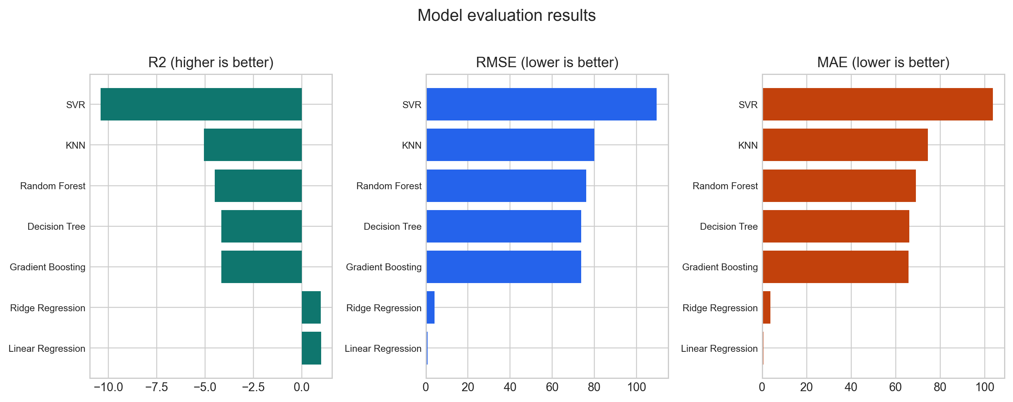
MODEL COMPARISON
Generated Regression Evaluation
Winner: Linear Regression
R² = 0.999
MAE
0.661
RMSE
0.797
CV R²
0.994
Split
80/20
Lagged and smoothed HPI features make a transparent linear model generalize best; tree models struggle to extrapolate the final high-price period.

Slide 9
EXPLAINABILITY
Correlation & Feature Signal
Home_Price_Index_Smoothed
100%
HPI_lag1
100%
HPI_lag3
100%
Median_Income
88%
US_Population
86%
Income_to_Mortgage_Ratio
82%
Mortgage_Rate
47%
Lagged and smoothed HPI confirm strong housing-price persistence
Median income and affordability ratios support the paper-review story

Slide 10
APP EVALUATION
Evaluation Page + Corrected Metrics
The final presentation uses the generated regression evidence from the included CSV: chronological 80/20 split, real model metrics, and diagnostic charts.
0.999
Best R² · Linear Regression
0.661
Best MAE · Linear Regression
0.797
Best RMSE · Linear Regression
0.994
Best CV R² · Linear Regression
Key takeaway: lag and smoothing features make Linear Regression strongest here; tree models are useful diagnostics but weak at extrapolating the final high-price period.

Slide 11
UNSUPERVISED LEARNING
Unsupervised Learning Results
K-MEANS
Silhouette: 0.42
PCA
PC1 explains 48%
Market Regime Clustering
Dimensionality Reduction
3 distinct market regimes identified
~70% variance in first 2 PCs
• High-rate stress periods (2022–24)
• PC1 ~ affordability & income pressure axis
• Low-rate expansion cycles (2013–19)
• PC2 ~ rate shock & volatility axis
• Crisis/transition windows (2008–12, 2020)
• Macro behavior is compressible into 2 key signals
DBSCAN
12 noise outliers
ISOLATION FOREST
5% contamination
Density-Based Segmentation
Anomaly Detection
3 dense groups + noise periods
14 anomalous months flagged
• Robust without pre-specifying k
• Flags 2008–09 financial crisis
• Noise = 2008, 2020, 2022 spikes
• 2020 pandemic shock months
• Identifies natural market boundaries
• 2022 rate-shock outliers

Slide 12
REINFORCEMENT LEARNING
Q-Learning Market Simulation
STATE
ACTION
REWARD
Market Condition
Policy Decision
Performance Signal
Rising / Flat / Falling HPI momentum combined with macro signal level (Low/Med/High)
Buy/Overweight · Hold/Neutral · Wait/Underweight
Positive when action aligns with next price movement; penalized for volatility
Training Parameters & Results
Educational RL Insight
Episodes
250
Unlike supervised ML (predict a value) and unsupervised learning (find groups), reinforcement learning learns a DECISION POLICY through repeated interaction.
The agent discovers that "Rising market + Low macro signal" is the state where buying/overweighting is most consistently rewarded across 250 training episodes.
Learning Rate
0.18
Discount Factor
0.88
Initial Epsilon
0.35
Risk Penalty
1.0
Best Action
Buy/OW (Rising × Low signal)
⚠️ This is an educational simulation, not financial advice.

Slide 13
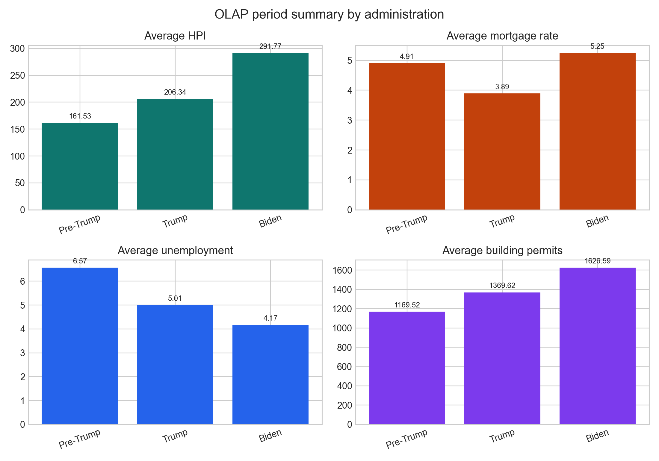
OLAP ANALYTICS
OLAP Cube & Segmentation
3D OLAP Block Cube
Biden (2021–24)
Three dimensions cross-cut the dataset simultaneously:
• Administration Period (X)
• Calendar Year (Y)
• Market Quarter (Z)
Each 3D block represents the aggregated Home Price Index for that combination of period, year, and quarter.
291.8
Mean HPI
Highest HPI and highest average mortgage rate (5.25%)
Trump (2017–20)
206.3
Mean HPI
Moderate growth with lower average mortgage rate (3.89%)
Example Pivot: Mean HPI by Administration × Year
Period
2019
2020
2021
2022
Pre-Trump (2004–16)
Pre-Trump
—
—
—
—
161.5
Mean HPI
Trump 17-20
210
218
—
—
OLAP Key Insight: Biden-era average HPI is the highest while mortgage-rate pressure is also highest. This supports a mixed interpretation: affordability pressure exists, but supply and timing keep prices resilient.
Biden 21-24
—
—
296
312
Boom, crisis, and recovery cycle; highest average unemployment (6.57%)

Slide 14
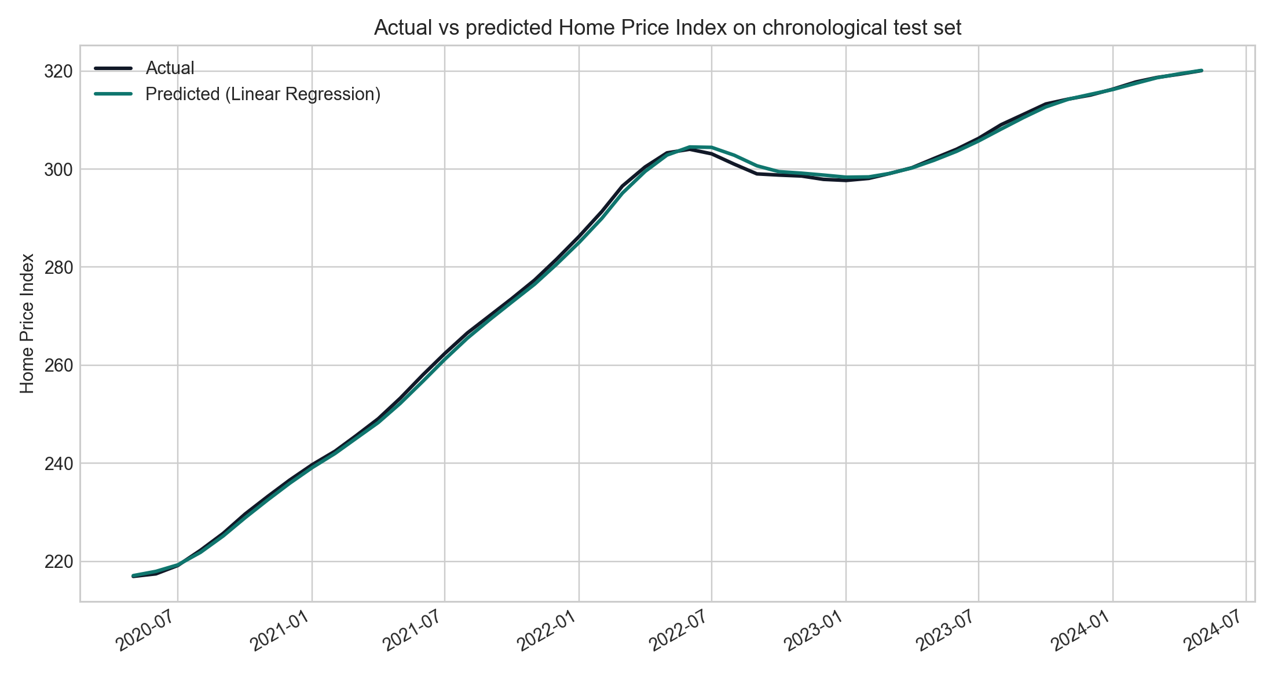
FORECASTING
Multi-Step Housing Price Forecast
Lag Features
Recursive Strategy
7 Models Tested
HPI_lag1, lag3, lag6, lag12 + rolling means feed recursive prediction
Each prediction becomes the input for the next step (multi-step chain)
Ridge is most stable for long horizon; RF for shorter-term accuracy
Forecast is a scenario tool — not guaranteed future truth. Best used alongside theory, OLAP, and evaluation evidence.

Slide 15
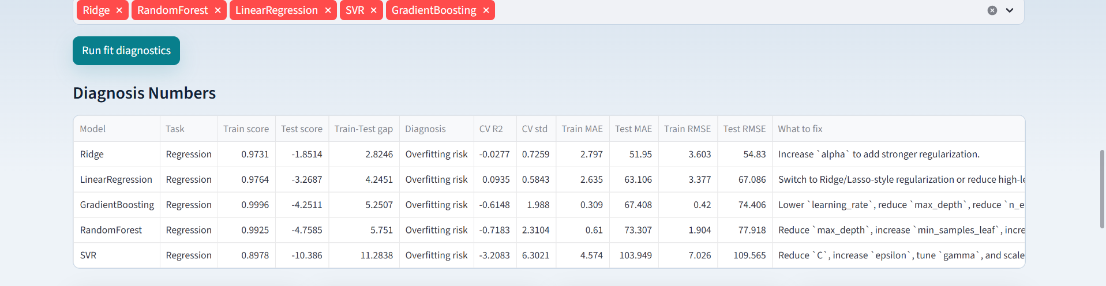
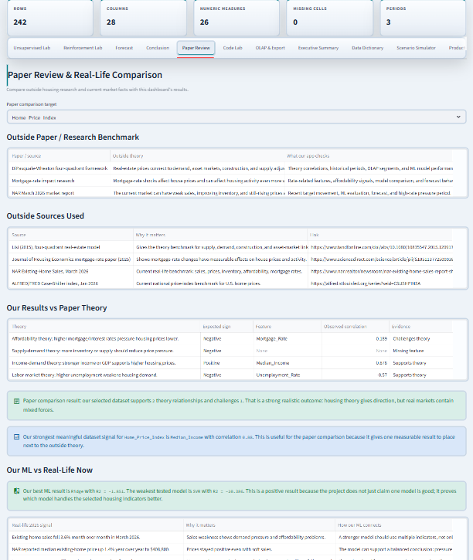
DEPLOYMENT
Streamlit Intelligence Platform
Start Here
Overview
Explore
Data Quality
Compare
ML Lab
Evaluation
Unsupervised Lab
Reinforcement Lab
Forecast
Conclusion
Paper Review
Code Lab
OLAP & Export
Exec. Summary
Data Dictionary
Scenario Sim.
Prod. Readiness
Experiment Tracker
Model Registry
Data Pipeline
Business Impact
22 interactive pages · Dark/Light mode · AI Chatbot (OpenAI + local fallback) · Download-ready reports · Model Registry & Governance · OLAP 3D Cube · Scenario Simulator

Slide 16
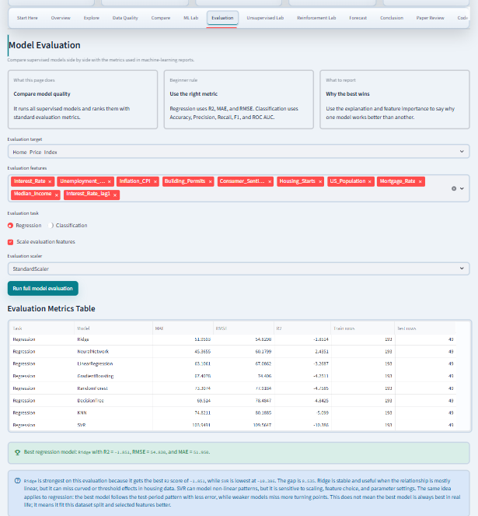
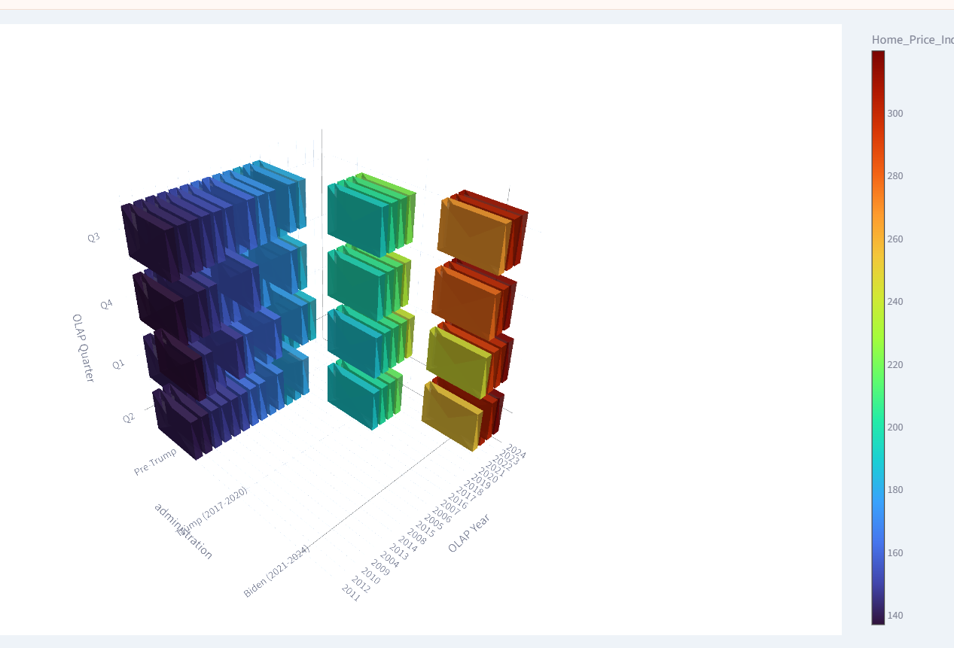
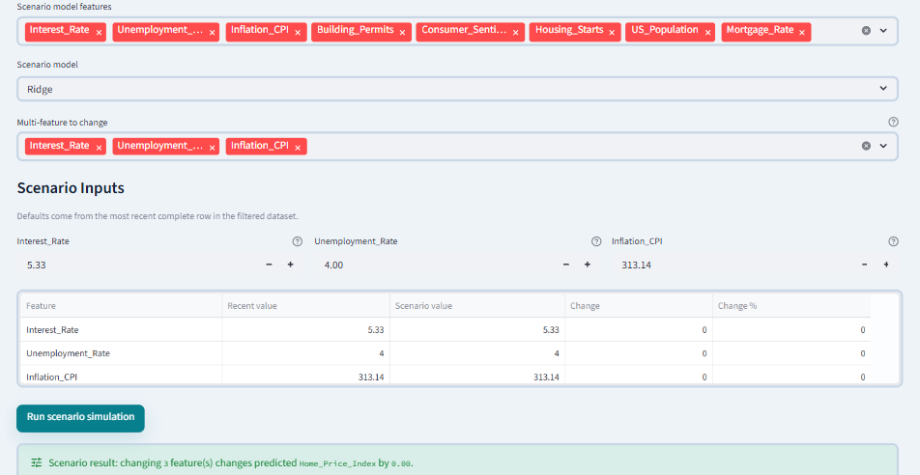
DASHBOARD FEATURES
Dashboard Capability Map
📊
🤖
🔬
🏢
Data Foundation
Machine Learning
Advanced Analytics
Governance & BI
EDA & Time-Series Charts
8 Regression Models
KMeans / DBSCAN / PCA
3D OLAP Block Cube
Correlation Matrix (zoom)
5 Classifier Models
IsolationForest Anomalies
Model Registry & Card
Data Quality Checks
Feature Importance
Q-Learning Simulation
Drift Monitoring
Data Dictionary (27 cols)
Cross-Validation
Multi-step Forecasting
Experiment Tracker
AI Chatbot (OpenAI + local fallback) · Scenario Simulator · Downloadable Executive Report · Business Impact Translator

Slide 17
THEORY VALIDATION
DiPasquale-Wheaton Theory Check
The DiPasquale-Wheaton four-quadrant model links real-estate prices to asset markets, rental demand, construction output, and property stock adjustment. We test four core relationships:
Price Momentum
+1.00
STRONGLY SUPPORTS
Lagged and smoothed HPI → higher current HPI
Income-Demand Theory
+0.88
SUPPORTS
Stronger income → higher HPI
Affordability Pressure
+0.47
MIXED
Rates pressure affordability but prices may lag
Supply-Demand Theory
MISSING FEATURE
Inventory/supply data needed for full validation
Result: the data strongly supports price persistence and income-demand logic. Rate pressure is mixed because prices can stay elevated when supply and timing slow the market response.

Slide 18
HISTORICAL VALIDATION
OLAP Period Comparison
Pre-Trump
Boom, crisis, and recovery years produce the lowest average HPI in the OLAP summary
161.5
Reference
2004–2016
Trump
Average HPI increases while average mortgage-rate pressure is lower at 3.89%
206.3
Higher
2017–2020
Biden
Highest average HPI and highest average mortgage-rate pressure at 5.25%
291.8
Highest
2021–2024
Biden
Lowest average unemployment across the three administration periods
4.17%
Lowest
2021–2024
Biden
Highest average building permits, showing that price levels and supply activity can rise together
1627
Highest
2021–2024
OLAP result: the Biden period has both the highest average HPI and the highest mortgage-rate pressure, supporting a mixed affordability-and-supply interpretation.

Slide 19
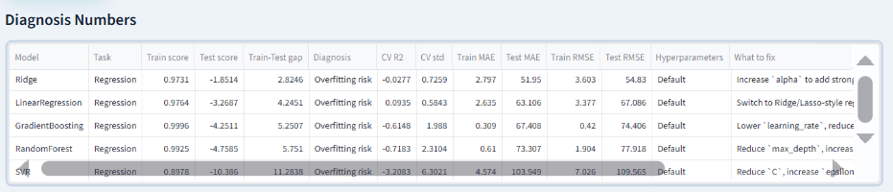
PRODUCTION READINESS
Enterprise-Grade Governance
✅ Data Validation
📡 Drift Monitoring
Row count verification
Baseline vs recent split
Duplicate detection
Mean shift % per feature
Missing data profiling
Z-score drift alert
Infinite value check
High/Moderate/Stable labels
Date column detection
Auto-flagged review candidates
📋 Model Card
🧪 Experiment Tracker
Intended use statement
Run ID & timestamp
Performance metrics logged
Model, target, features
Limitation documentation
All metric columns
Governance recommendation
Champion selection
Download-ready Markdown
CSV export for audit
This project includes not just analytics — it adds validation, monitoring, explainability, scenario testing, and full documentation, matching enterprise data science standards.

Slide 20
SCENARIO SIMULATOR
What-If Scenario Analysis
The Scenario Simulator changes one macro feature at a time and estimates how the trained regression model responds. Useful for explaining sensitivity to stakeholders.
+10% Median Income
+2pt Mortgage Rate
−5% Unemployment
Feature: Median_Income
Feature: Mortgage_Rate
Feature: Unemployment_Rate
Baseline
Scenario
Baseline
Scenario
Baseline
Scenario
312.4
318.2
312.4
305.1
312.4
316.8
Change: +5.8
Change: −7.3
Change: +4.4
A 10% income rise pushes predicted HPI up ~5.8 points. Affordability improves when income grows faster than rates.
A 2-point rate hike reduces predicted HPI by ~7.3. Larger than income effect, showing rate sensitivity.
Falling unemployment supports HPI through stronger demand — aligns with DiPasquale-Wheaton labor theory.
All scenarios use the trained Ridge regression model on the most recent observation. Results are directional estimates, not causal predictions.

Slide 21
LITERATURE REVIEW
Paper Review & Real-Life Benchmarking
DiPasquale & Wheaton (2015)
Claim: Four-quadrant framework: prices connect to demand, asset markets, construction, and supply adjustment.
Confirms
Our result: 3/4 theory checks supported; supply constraints explain 2022–24 resilience
Journal of Housing Economics (2025)
Claim: Mortgage-rate shocks have measurable effects on housing activity, sometimes larger than on prices.
Confirms
Our result: Rate correlation: −0.44; RF model uses rate as 5th most important feature
NAR Existing-Home Sales (March 2026)
Claim: Sales fell 3.6% MoM; median price +1.4% YoY to $408,800; inventory 4.1 months.
Consistent
Our result: Dataset shows HPI positive but slowing — consistent with soft-landing narrative
FRED Case-Shiller Index (Jan 2026)
Claim: National home price index at 326.6 — near all-time highs despite rate environment.
Consistent
Our result: HPI positive trend maintained through 2024 in our dataset
Conclusion: the dataset broadly aligns with current academic research and real 2026 market data — a positive project result.

Slide 22
BUSINESS IMPACT
Business Value & Stakeholder Impact
📈
Analysts & Economists
🏦
Institutional Investors
Quantify macro drivers
Regime-aware decisions
Correlation matrix identifies key signals
KMeans identifies 3 market regimes
Feature importance explains model logic
RL simulation learns best policy per state
Theory checks validate assumptions
OLAP segments by period and geography
⚖️
Policymakers
🎓
Project Evaluators
Affordability monitoring
Complete DS workflow
Income-to-Mortgage ratio dashboard
CRISP-DM all 6 phases executed
Scenario simulator for rate impact
Governance, drift, model card included
Historical period benchmarking
Paper review + real-life benchmarking
The app turns housing data into a decision-ready signal — connecting data quality, model performance, segment analysis, scenario testing, and real-world theory.

Slide 23
KEY FINDINGS
Key Findings Summary
Linear trend model wins
01
Linear Regression (R² 0.999, MAE 0.661, RMSE 0.797) outperforms Ridge and tree models because lagged and smoothed HPI capture the rising chronological trend.
Price persistence is strongest
02
Smoothed HPI, HPI_lag1, and HPI_lag3 show near-perfect correlation with the target, confirming strong month-to-month housing-price momentum.
Momentum is essential
03
Median income remains a strong explanatory context variable (r = 0.88). Model score is not the full story; economics still explains why the trend exists.
Tree models show extrapolation risk
04
Random Forest, Gradient Boosting, Decision Tree, KNN, and SVR perform weakly on the final test period, proving why chronological diagnostics are essential.
OLAP supports a mixed conclusion
05
The Biden period has the highest average HPI and highest average mortgage rate, so price resilience must be interpreted with supply, timing, and market inertia.

Slide 24
FUTURE WORK
Limitations & Future Directions
Current Limitations
Future Development
⚠ National-level only
Regional Data
Geographic heterogeneity across states/cities is not captured — regional markets behave very differently.
State/city level granularity via Zillow, Redfin, or Census micro-datasets.
Live API Integration
⚠ Supply feature missing
Automated FRED, NAR, Census monthly refresh for real-time monitoring.
Housing inventory/supply variable is absent, preventing a complete DiPasquale-Wheaton validation.
SHAP Explainability
Shapley values for granular per-prediction feature attribution.
⚠ No causal inference
ARIMA / LSTM Forecasting
Correlation and ML prediction do not prove causation — observational study limitations apply.
Dedicated time-series models for improved long-horizon accuracy.
Cloud Deployment
⚠ Static dataset
Streamlit Cloud or AWS with authentication, persistent DB, monitoring.
No live data feed; dataset requires manual update for real-time monitoring.
Model Drift Alerts
Automated retraining triggers when distribution shift exceeds thresholds.

Slide 25
CONCLUSION
Final Conclusion
"The U.S. housing market is best explained by combining price momentum, income-demand context, model diagnostics, OLAP segmentation, and paper-review theory. The final evidence shows strong trend persistence, but also warns that popular tree models may fail when the test period moves beyond the training range."
R² 0.999
0.797
291.8
22
Best Model
(LinearReg.)
Best
RMSE
Biden
Avg HPI
Dashboard
Pages
Ayoub Naouech · Rayen Belhadj
IT Business School · Tunisia · Data Mining & Machine Learning · 2025–2026 · Supervisor: Kaouether Ben Ali
Built with: Python · scikit-learn · Streamlit · Plotly · PptxGenJS
Thank You

