Slide 1
US Housing Intelligence
US Housing Intelligence Platform
Final report and Streamlit app defense
Data Mining and Machine Learning project
Ayoub Naouech and Rayen Belhadj
Data Mining and Machine Learning | Final Defense

Slide 2
US Housing Intelligence
Presentation Roadmap
Context, problem, and objectives
Dataset, preparation, and CRISP-DM
Streamlit app screenshots and modules
Evaluation, diagnostics, OLAP, and paper-review evidence
Limitations, future work, and conclusion

Slide 3
US Housing Intelligence
Project Context
Housing prices connect household wealth, credit conditions, inflation, construction, and employment
A useful analysis combines economic theory with data evidence
The project converts a macroeconomic dataset into an interactive intelligence platform

Slide 4
US Housing Intelligence
Problem Statement
How can data mining and machine learning analyze and predict U.S. housing-market trends?
The market is time-dependent and influenced by several interacting variables
The final result must be understandable for non-technical users

Slide 5
US Housing Intelligence
Project Objectives
Analyze historical Home Price Index behavior
Identify indicators associated with housing-price movement
Compare models with reproducible metrics
Build a Streamlit app for visualization, modeling, OLAP, export, and interpretation

Slide 6
US Housing Intelligence
Dataset Overview
242
27
2004-2024
Monthly observations
Dataset columns
Historical period
Target variable: Home_Price_Index
Main variables: mortgage rate, interest rate, unemployment, inflation, permits, income, population, and sentiment
The data supports both prediction and interpretation

Slide 7
US Housing Intelligence
Data Preparation
Parse and sort the date column chronologically
Convert numeric columns into model-ready values
Check missing values and duplicates
Create administration labels, lags, rolling features, ratios, and percentage changes

Slide 8
US Housing Intelligence
CRISP-DM Methodology
Business understanding defines the housing problem
Data understanding checks quality and temporal structure
Preparation builds usable analytical features
Modeling and evaluation compare algorithms
Deployment is delivered through Streamlit

Slide 9
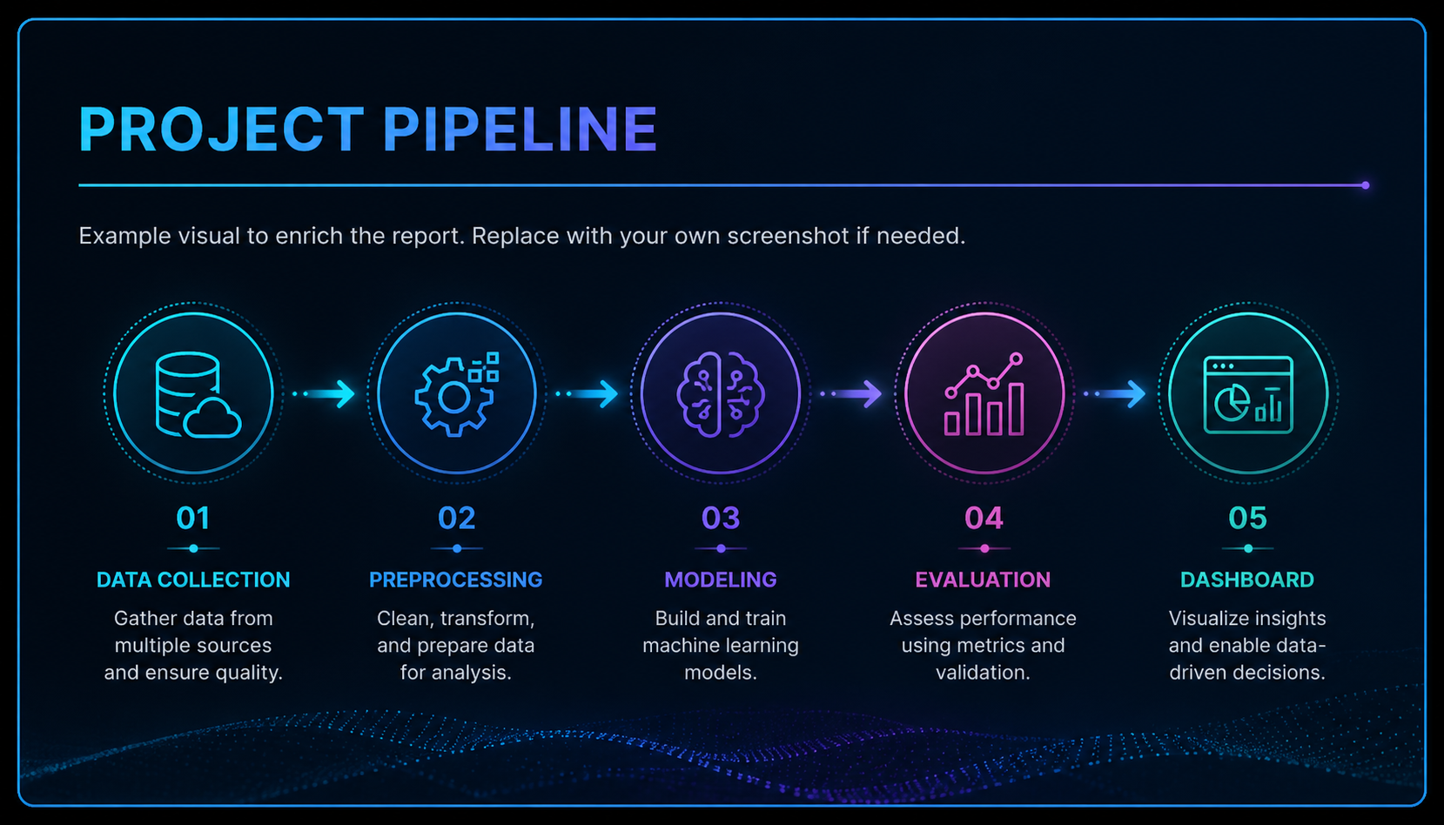
US Housing Intelligence
System Architecture
Data layer, analysis layer, modeling layer, interpretation layer, governance layer
The app connects raw data, models, charts, paper review, and reporting

Slide 10
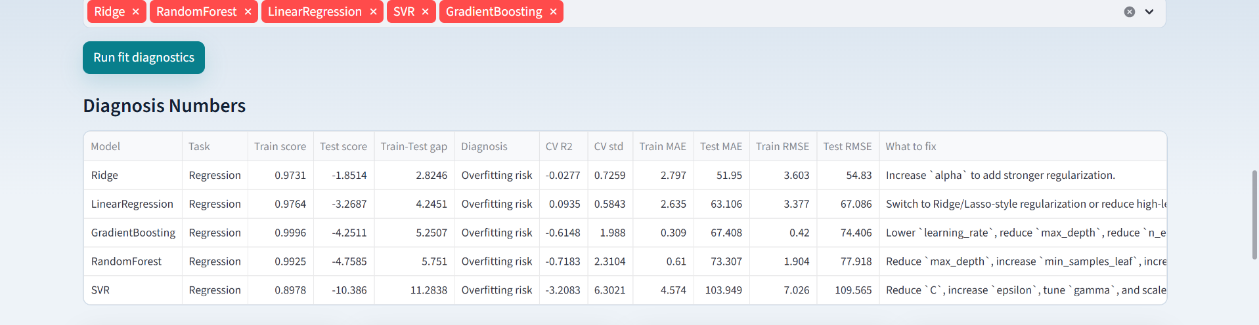
US Housing Intelligence
Streamlit App: Home And Workflow

Slide 11
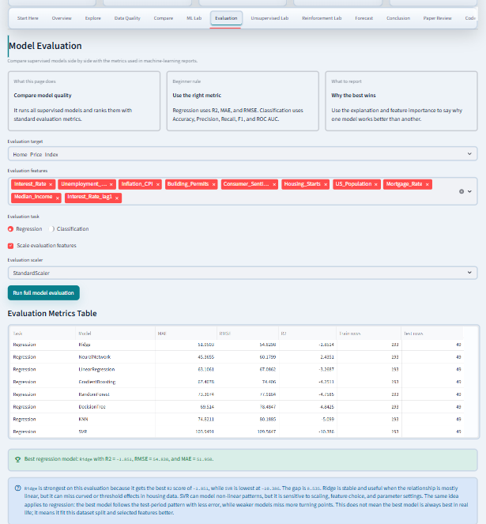
US Housing Intelligence
Streamlit App: ML Lab

Slide 12
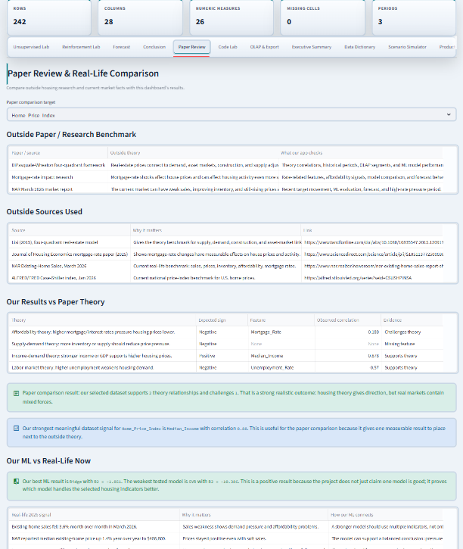
US Housing Intelligence
Streamlit App: Evaluation

Slide 13
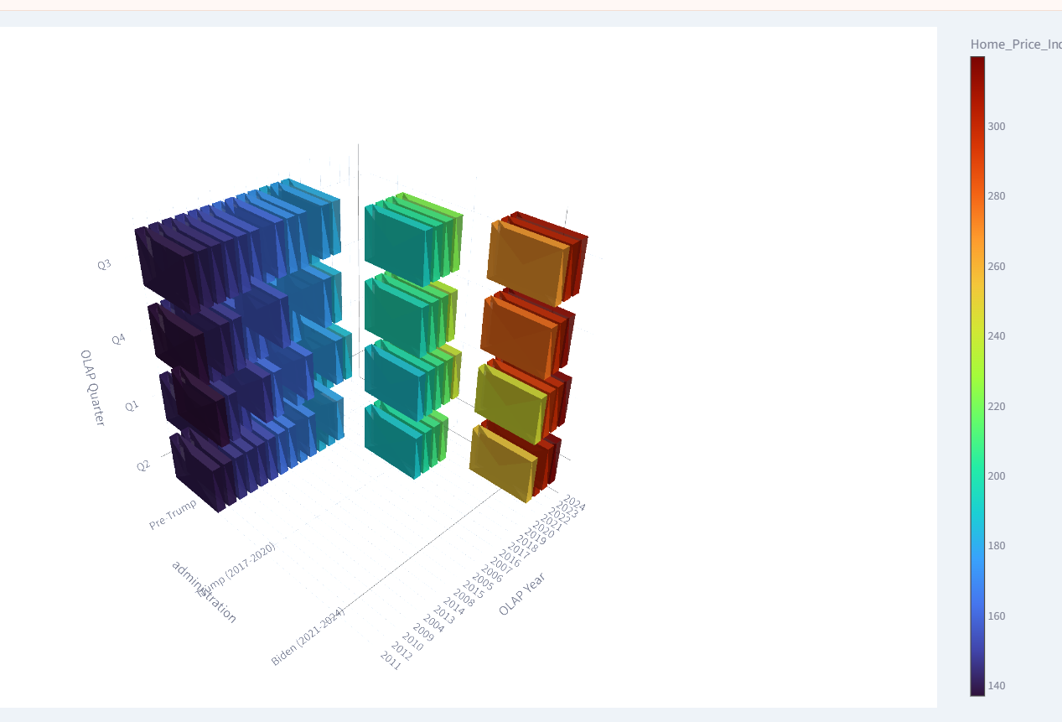
US Housing Intelligence
Streamlit App: OLAP And Export

Slide 14
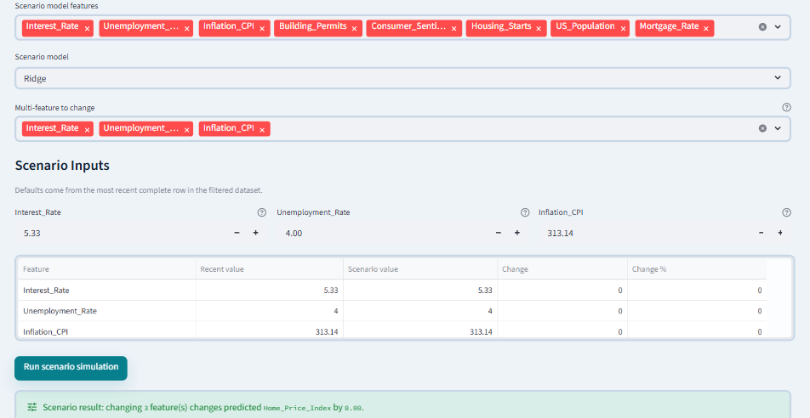
US Housing Intelligence
Streamlit App: Paper Review
Compares dashboard evidence with housing theory and market interpretation
Explains rates, supply, demand, timing, and affordability together

Slide 15
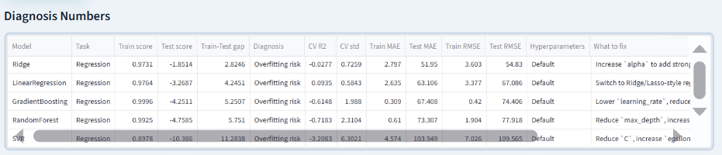
US Housing Intelligence
Streamlit App: Governance

Slide 16
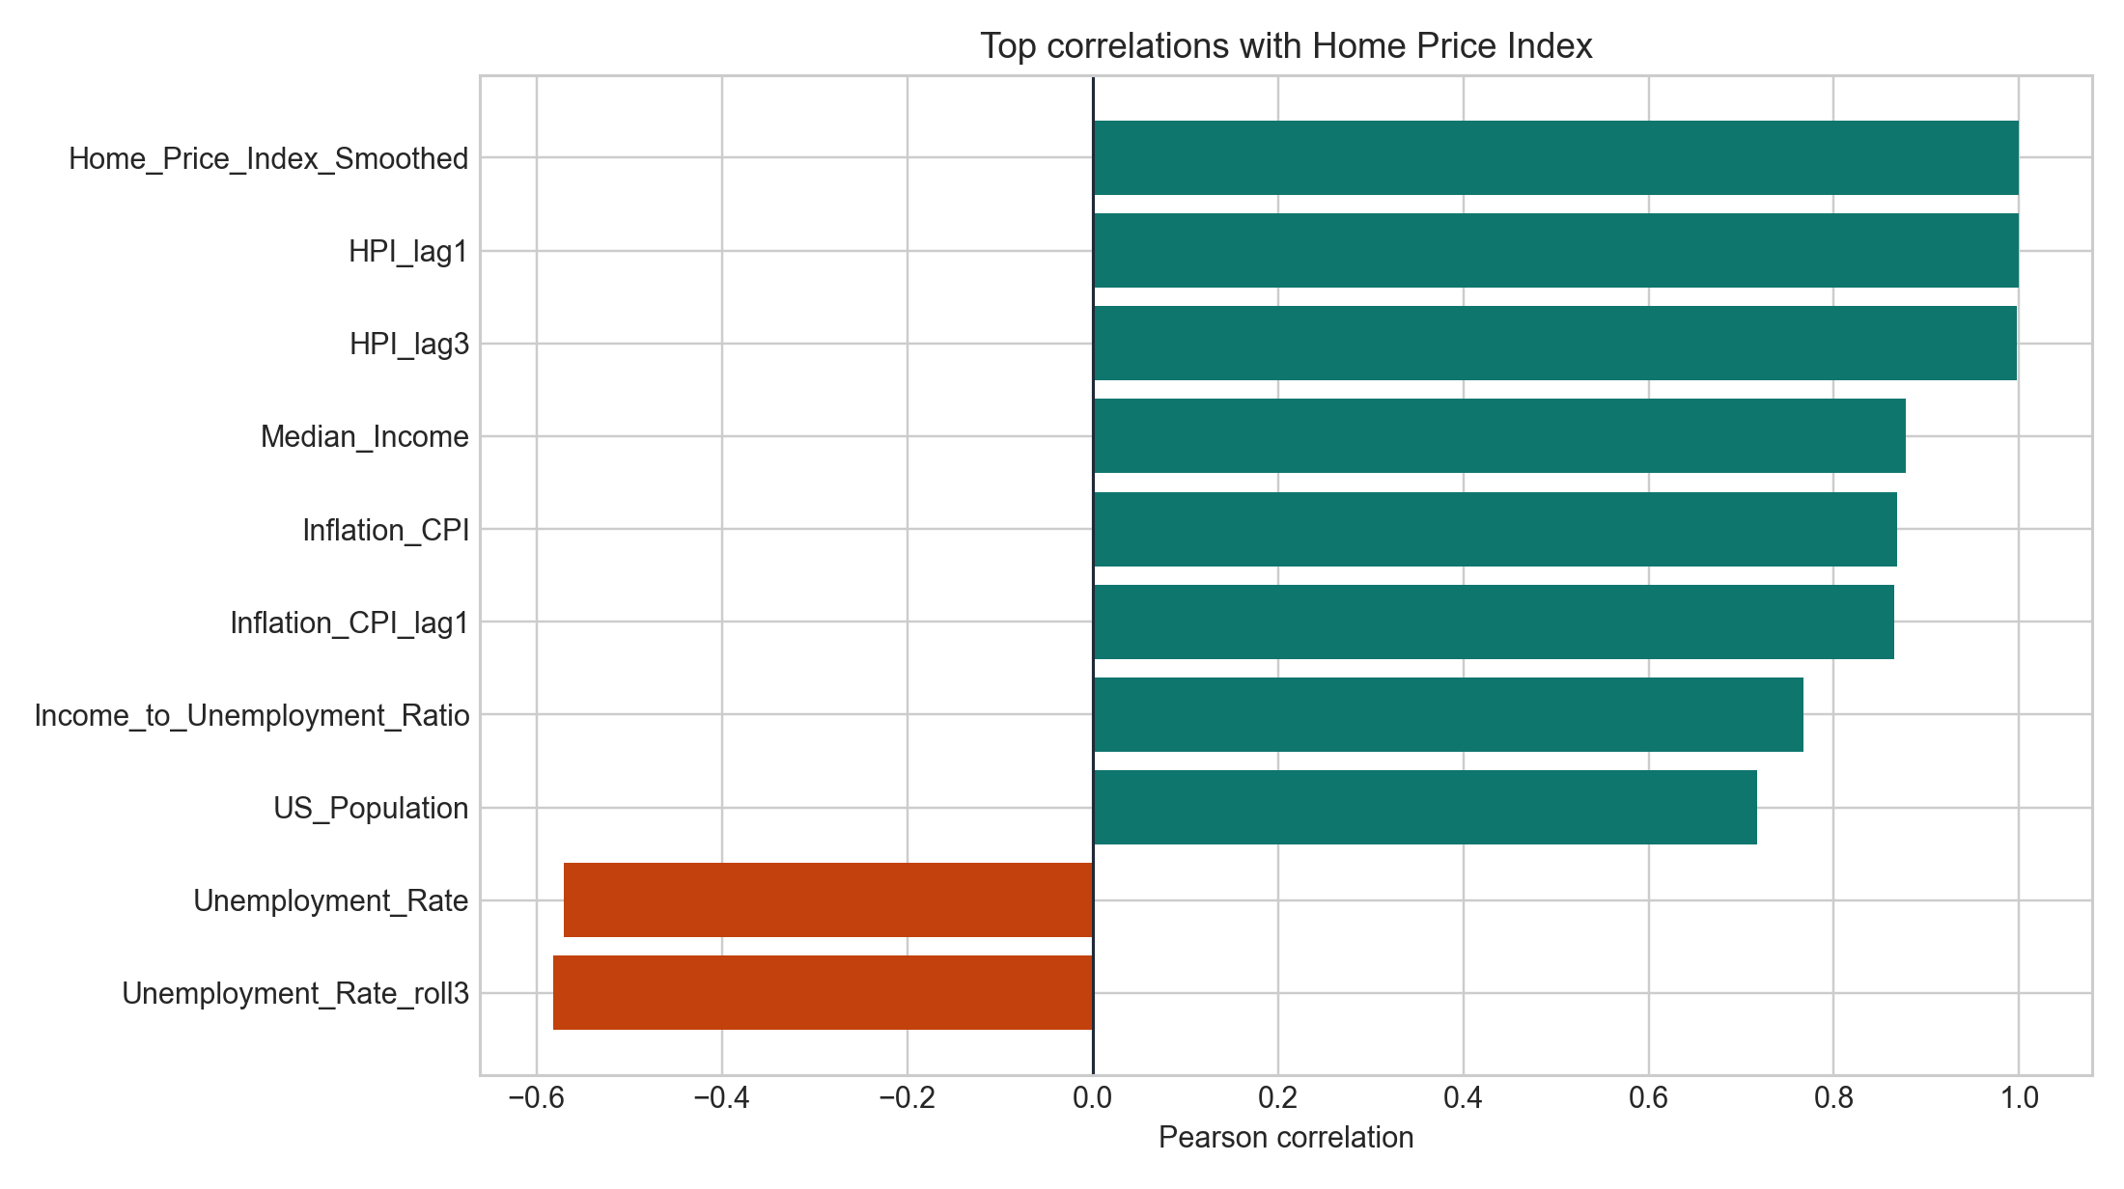
US Housing Intelligence
Correlation Results
Strong relationships appear around lagged HPI, smoothed HPI, and Median_Income
Correlation supports interpretation but does not prove causality
Housing prices are persistent and linked to broader economic context

Slide 17
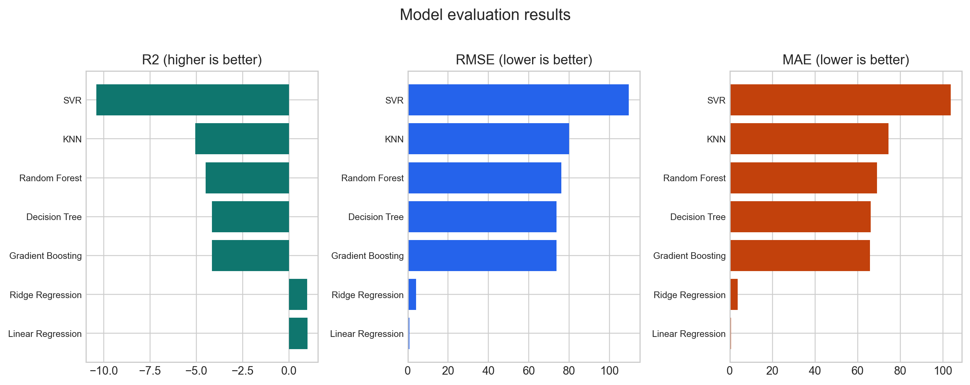
US Housing Intelligence
Model Evaluation Results
Compared models include Linear Regression, Ridge, Random Forest, Gradient Boosting, Decision Tree, KNN, and SVR
Best generated metrics: R2 = 0.999, RMSE = 0.797, MAE = 0.661

Slide 18
US Housing Intelligence
Regression Metrics Table
Linear Regression: MAE 0.661, RMSE 0.797, R2 0.999, CV R2 0.994
Ridge Regression: MAE 3.715, RMSE 4.162, R2 0.984
Tree-based models perform weaker on the final chronological test period
Evaluation must be time-aware, not based only on model popularity

Slide 19
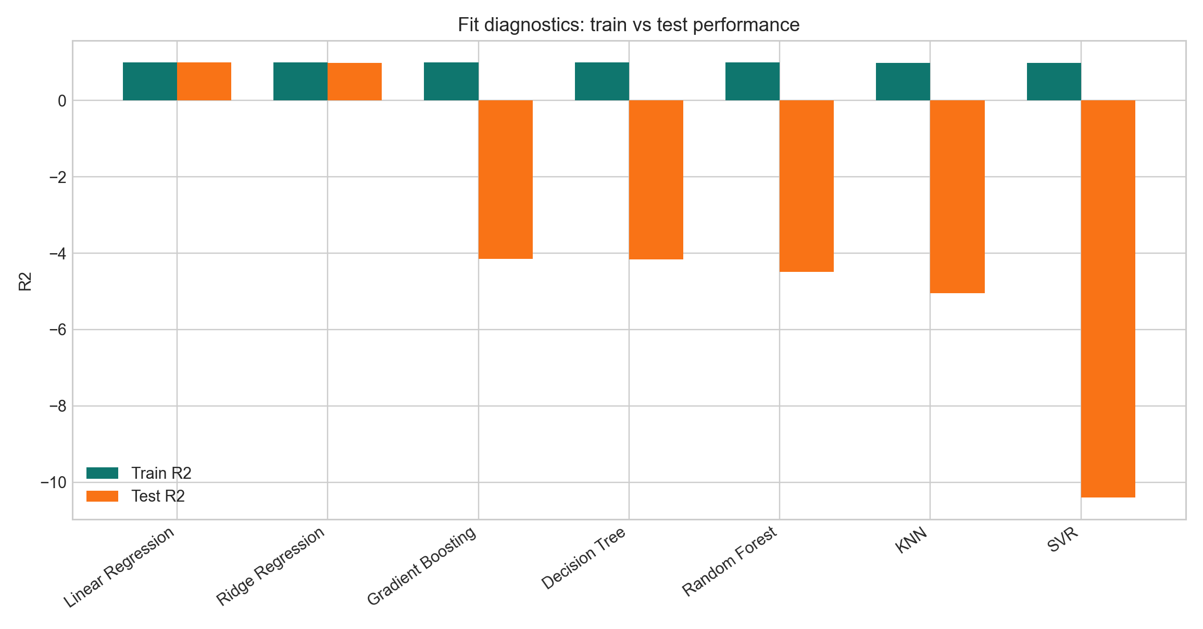
US Housing Intelligence
Fit Diagnostics
Diagnostics compare train and test performance
Large train-test gaps indicate weak generalization or overfitting risk
Tree models struggle when the final period moves beyond the training range

Slide 20
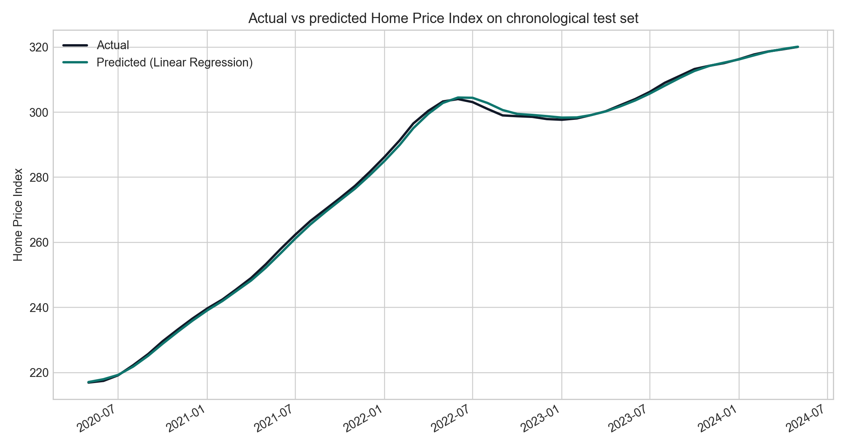
US Housing Intelligence
Actual Versus Predicted
The best model follows the chronological test period closely
Lagged and smoothed price features explain the strong predictive result
The visual is easier to defend than metrics alone

Slide 21
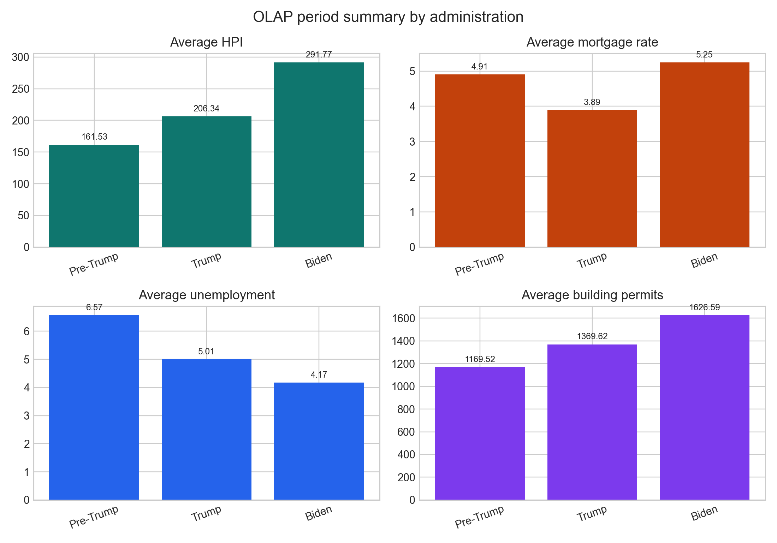
US Housing Intelligence
OLAP Period Results
Biden period has the highest average Home Price Index
Biden period also has the highest average mortgage-rate pressure
Prices and affordability pressure can rise together when supply and timing matter

Slide 22
US Housing Intelligence
Paper Review Message
Housing prices are shaped by demand, financing conditions, supply, construction, income, and timing
Higher mortgage rates reduce affordability, but prices may react slowly when supply is constrained
The strongest conclusion is multi-factor interpretation

Slide 23
US Housing Intelligence
Business Impact
Analytical impact: users understand which indicators move with housing prices
Decision-support impact: users compare models, periods, OLAP segments, and scenarios
Educational impact: the project demonstrates EDA, ML, forecasting, OLAP, paper review, and governance

Slide 24
US Housing Intelligence
Limitations And Future Work
National-level data hides regional differences
Forecasts are educational and not financial advice
Future work: regional data, live APIs, SHAP explainability, better chatbot grounding, monitoring, and authentication

Slide 25
US Housing Intelligence
Final Conclusion
The report, poster, and app now tell one consistent story
U.S. housing prices require theory, correlations, model evaluation, diagnostics, OLAP, and market context
The Streamlit dashboard is a housing intelligence platform, not only a collection of charts

