Slide 1
US HOUSING INTELLIGENCE
US Housing Intelligence Platform
Final report and Streamlit app defense
Data Mining and Machine Learning project
Ayoub Naouech and Rayen Belhadj
Data Mining and Machine Learning | Final Defense

Slide 2
US HOUSING INTELLIGENCE
Presentation Roadmap
Context, problem, and objectives
Dataset, preparation, and CRISP-DM methodology
Streamlit app screenshots and modules
Evaluation, diagnostics, OLAP, and paper-review evidence
Limitations, future work, and conclusion

Slide 3
US HOUSING INTELLIGENCE
Project Context
The U.S. housing market connects household wealth, credit conditions, inflation, construction, and employment.
Housing prices react to demand, supply, income, mortgage rates, expectations, and timing.
The project converts raw housing and macroeconomic data into an interactive intelligence platform.

Slide 4
US HOUSING INTELLIGENCE
Problem Statement
Main question: how can data mining and machine learning analyze and predict U.S. housing-market trends?
Analytical challenge: housing variables interact in non-linear and time-dependent ways.
Communication challenge: model results must be understandable for non-technical users.

Slide 5
US HOUSING INTELLIGENCE
Project Objectives
Analyze historical evolution of the Home Price Index.
Identify variables associated with U.S. housing-price behavior.
Train and compare machine learning models using reproducible metrics.
Build a Streamlit app for visualization, modeling, OLAP, export, and interpretation.

Slide 6
US HOUSING INTELLIGENCE
Dataset Overview
242
27
2004-2024
Monthly observations
Dataset columns
Historical period
Target variable: Home_Price_Index.
Main variables: mortgage rate, interest rate, unemployment, inflation, permits, income, population, and sentiment.
The dataset supports both prediction and interpretation.

Slide 7
US HOUSING INTELLIGENCE
Data Preparation
Parse and sort the date column chronologically.
Convert numeric columns into model-ready values.
Check missing values and duplicate rows before modeling.
Create administration labels, lag features, rolling features, ratios, and percentage changes.

Slide 8
US HOUSING INTELLIGENCE
CRISP-DM Methodology
Business understanding defines the housing problem.
Data understanding checks quality and temporal structure.
Data preparation builds usable analytical features.
Modeling and evaluation compare algorithms.
Deployment is delivered through Streamlit.

Slide 9
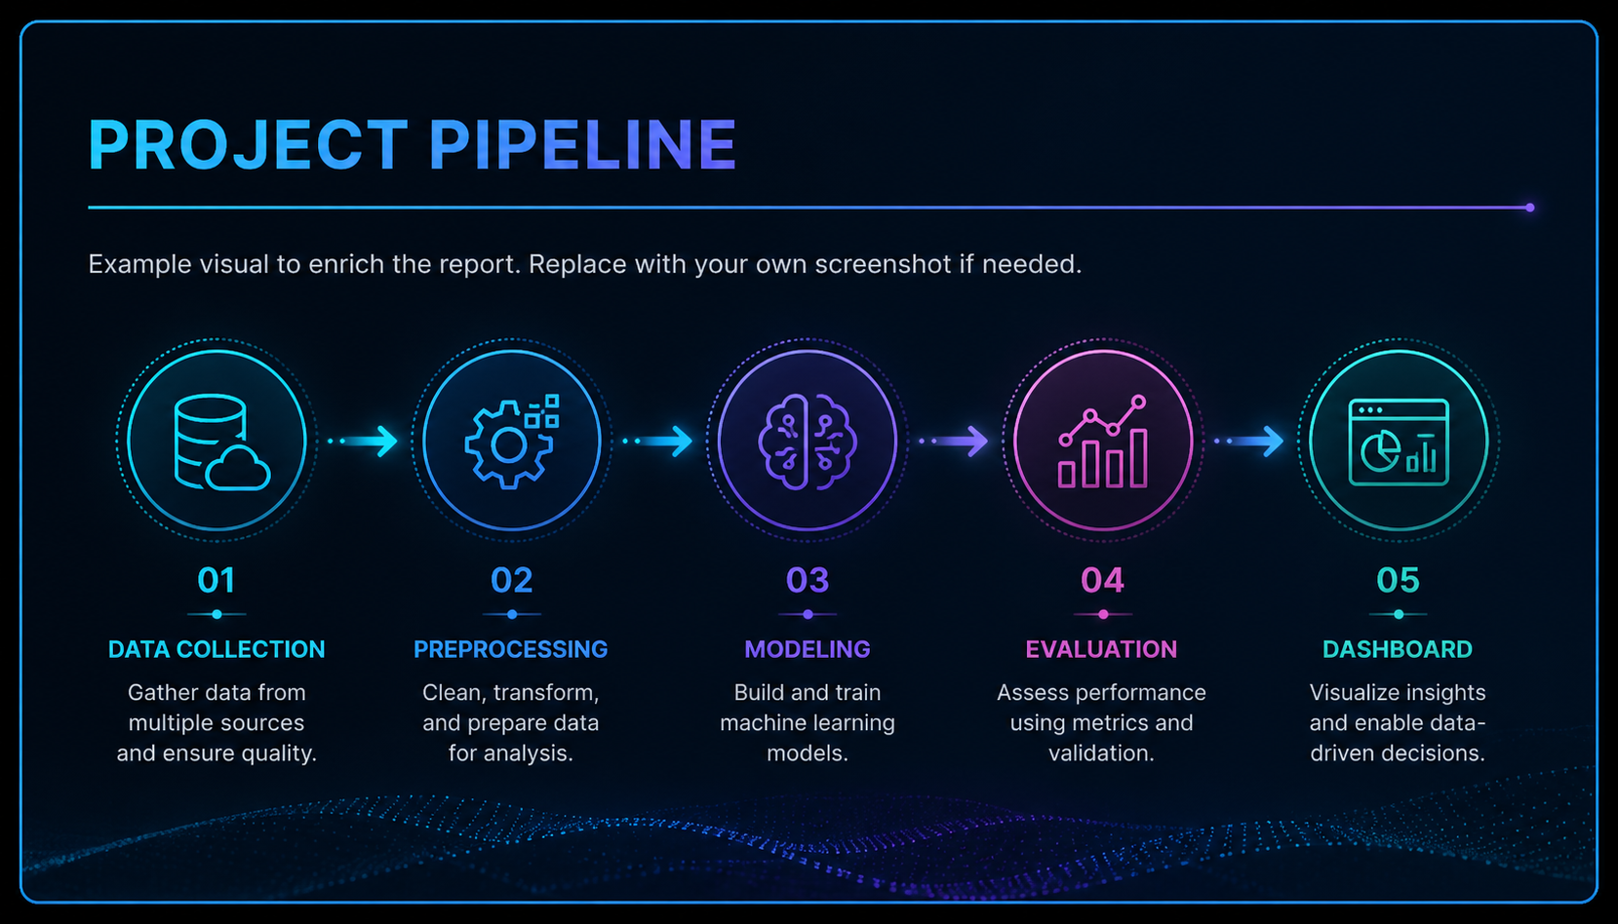
US HOUSING INTELLIGENCE
System Architecture
Data layer: loading, cleaning, validation, and features.
Analysis layer: EDA, correlations, OLAP, and period comparison.
Modeling layer: regression, classification, forecasting, and diagnostics.
Interpretation layer: paper review, conclusion, and export.

Slide 10
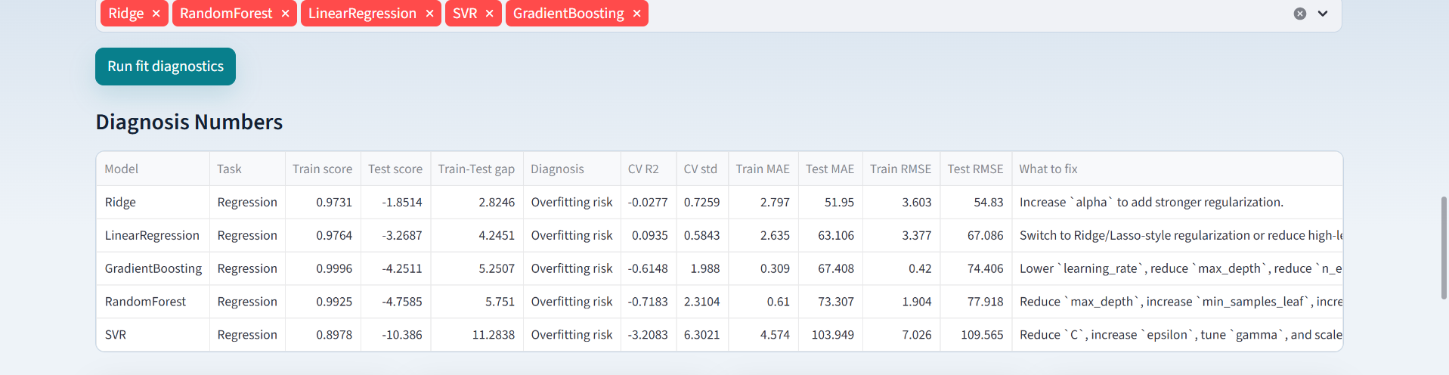
US HOUSING INTELLIGENCE
Streamlit App: Home And Workflow

Slide 11
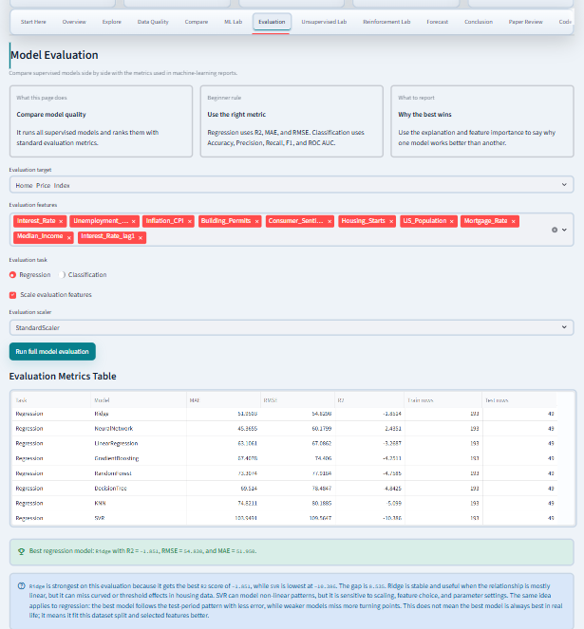
US HOUSING INTELLIGENCE
Streamlit App: ML Lab

Slide 12
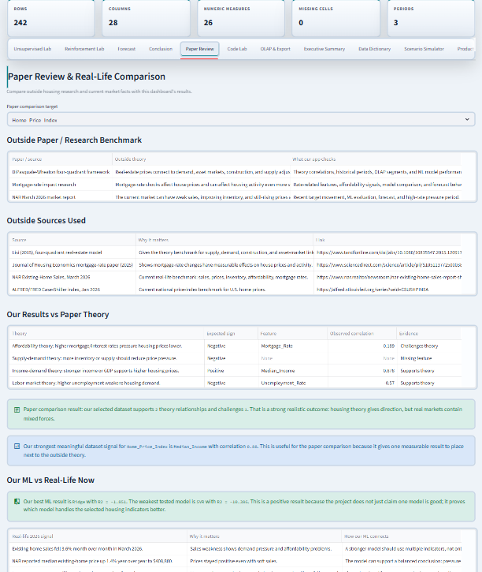
US HOUSING INTELLIGENCE
Streamlit App: Evaluation

Slide 13
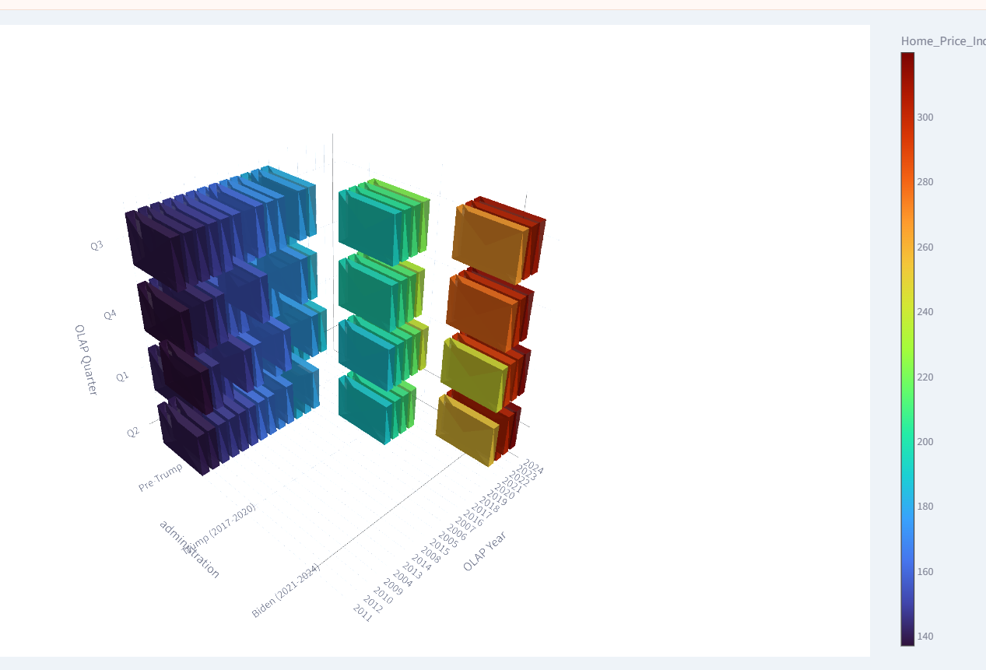
US HOUSING INTELLIGENCE
Streamlit App: OLAP And Export

Slide 14
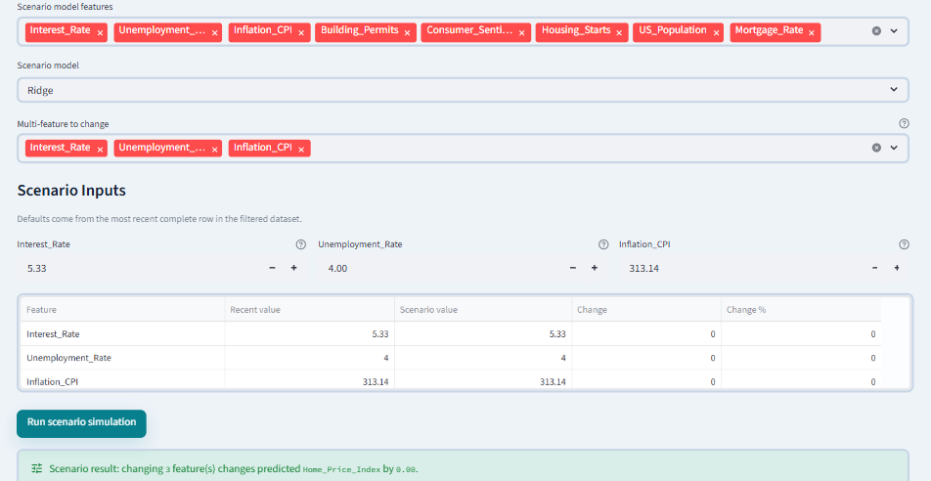
US HOUSING INTELLIGENCE
Streamlit App: Paper Review
Compares dashboard evidence with housing theory.
Explains rates, supply, demand, timing, and affordability together.
Makes the project academically stronger than a purely technical dashboard.

Slide 15
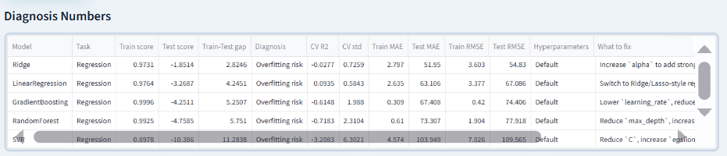
US HOUSING INTELLIGENCE
Streamlit App: Governance

Slide 16
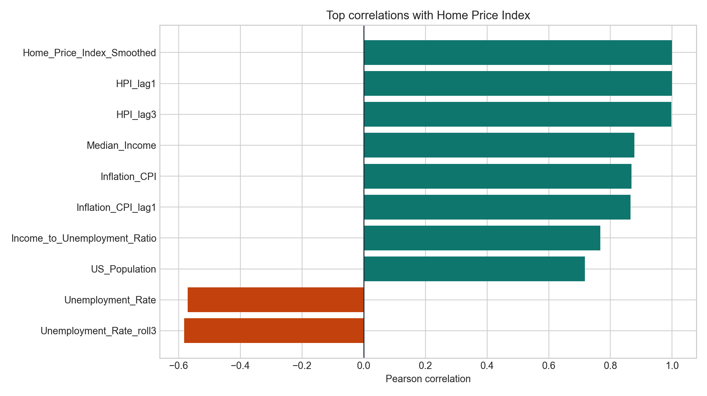
US HOUSING INTELLIGENCE
Correlation Results
Strong relationships appear around lagged HPI, smoothed HPI, and Median_Income.
Correlation supports interpretation but does not prove causality.
Housing prices are persistent and linked to broader economic context.

Slide 17
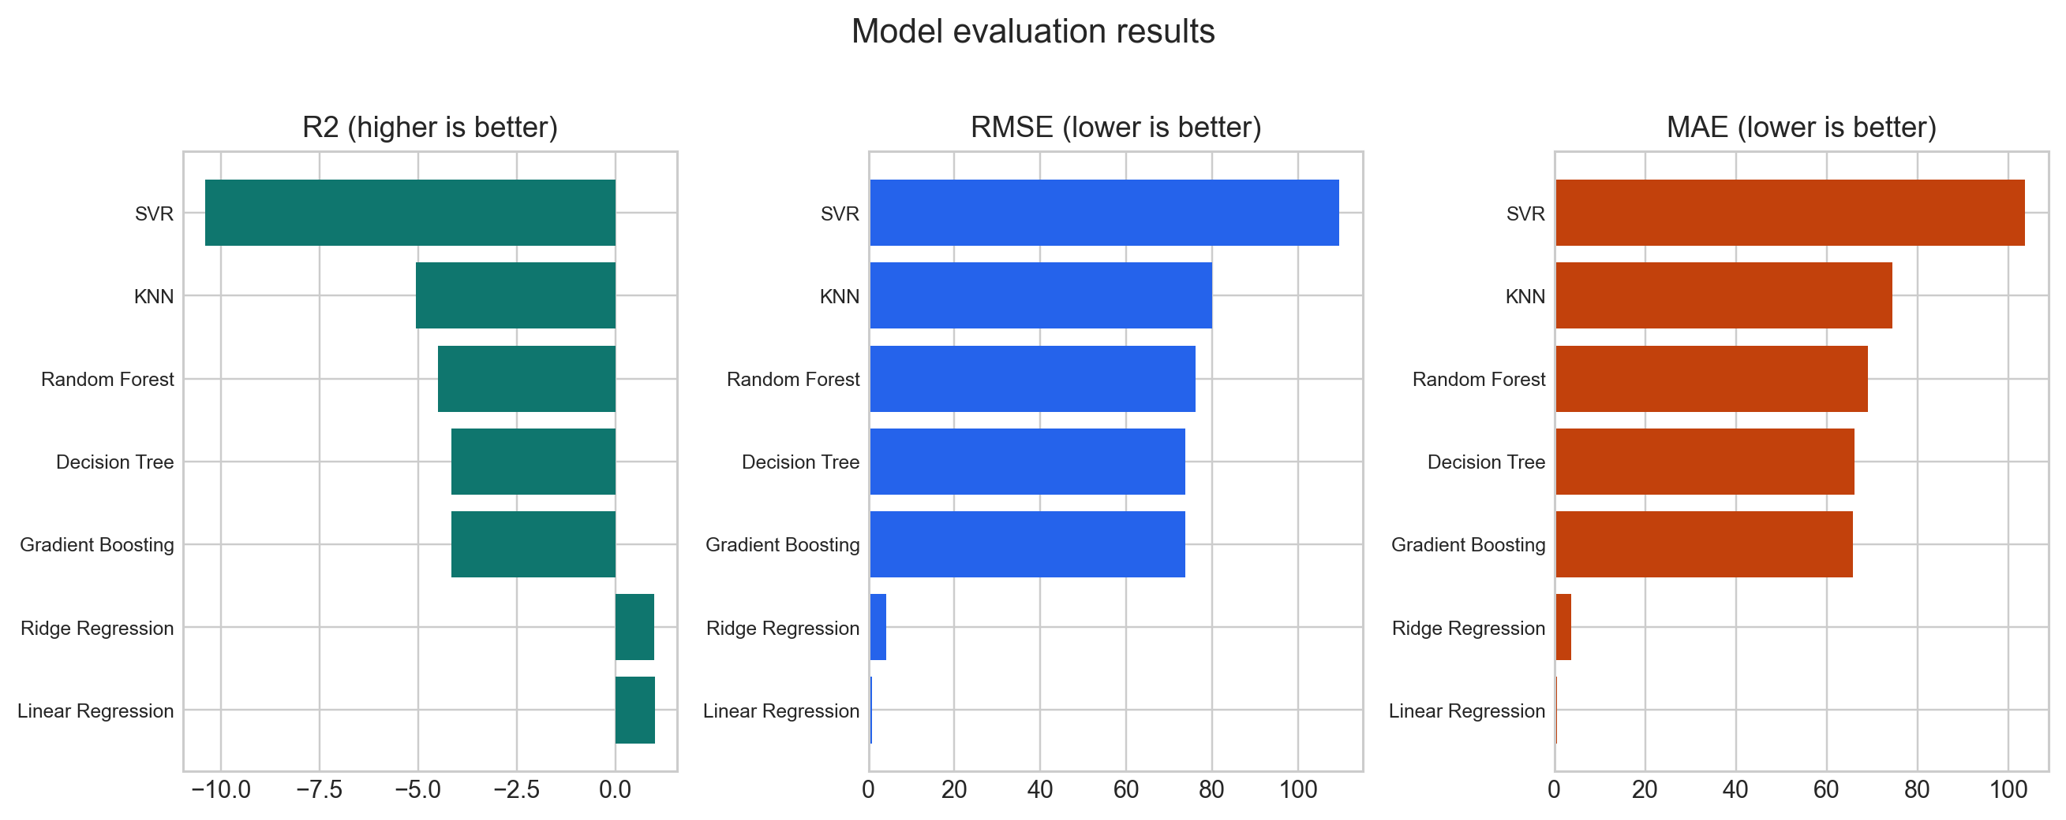
US HOUSING INTELLIGENCE
Model Evaluation Results
Compared models include Linear Regression, Ridge, Random Forest, Gradient Boosting, Decision Tree, KNN, and SVR.
Best generated metrics: R2 = 0.999, RMSE = 0.797, MAE = 0.661.

Slide 18
US HOUSING INTELLIGENCE
Regression Metrics Table
Linear Regression: MAE 0.661, RMSE 0.797, R2 0.999, CV R2 0.994.
Ridge Regression: MAE 3.715, RMSE 4.162, R2 0.984.
Tree-based models perform weaker on the final chronological test period.
Evaluation must be time-aware, not based only on model popularity.

Slide 19
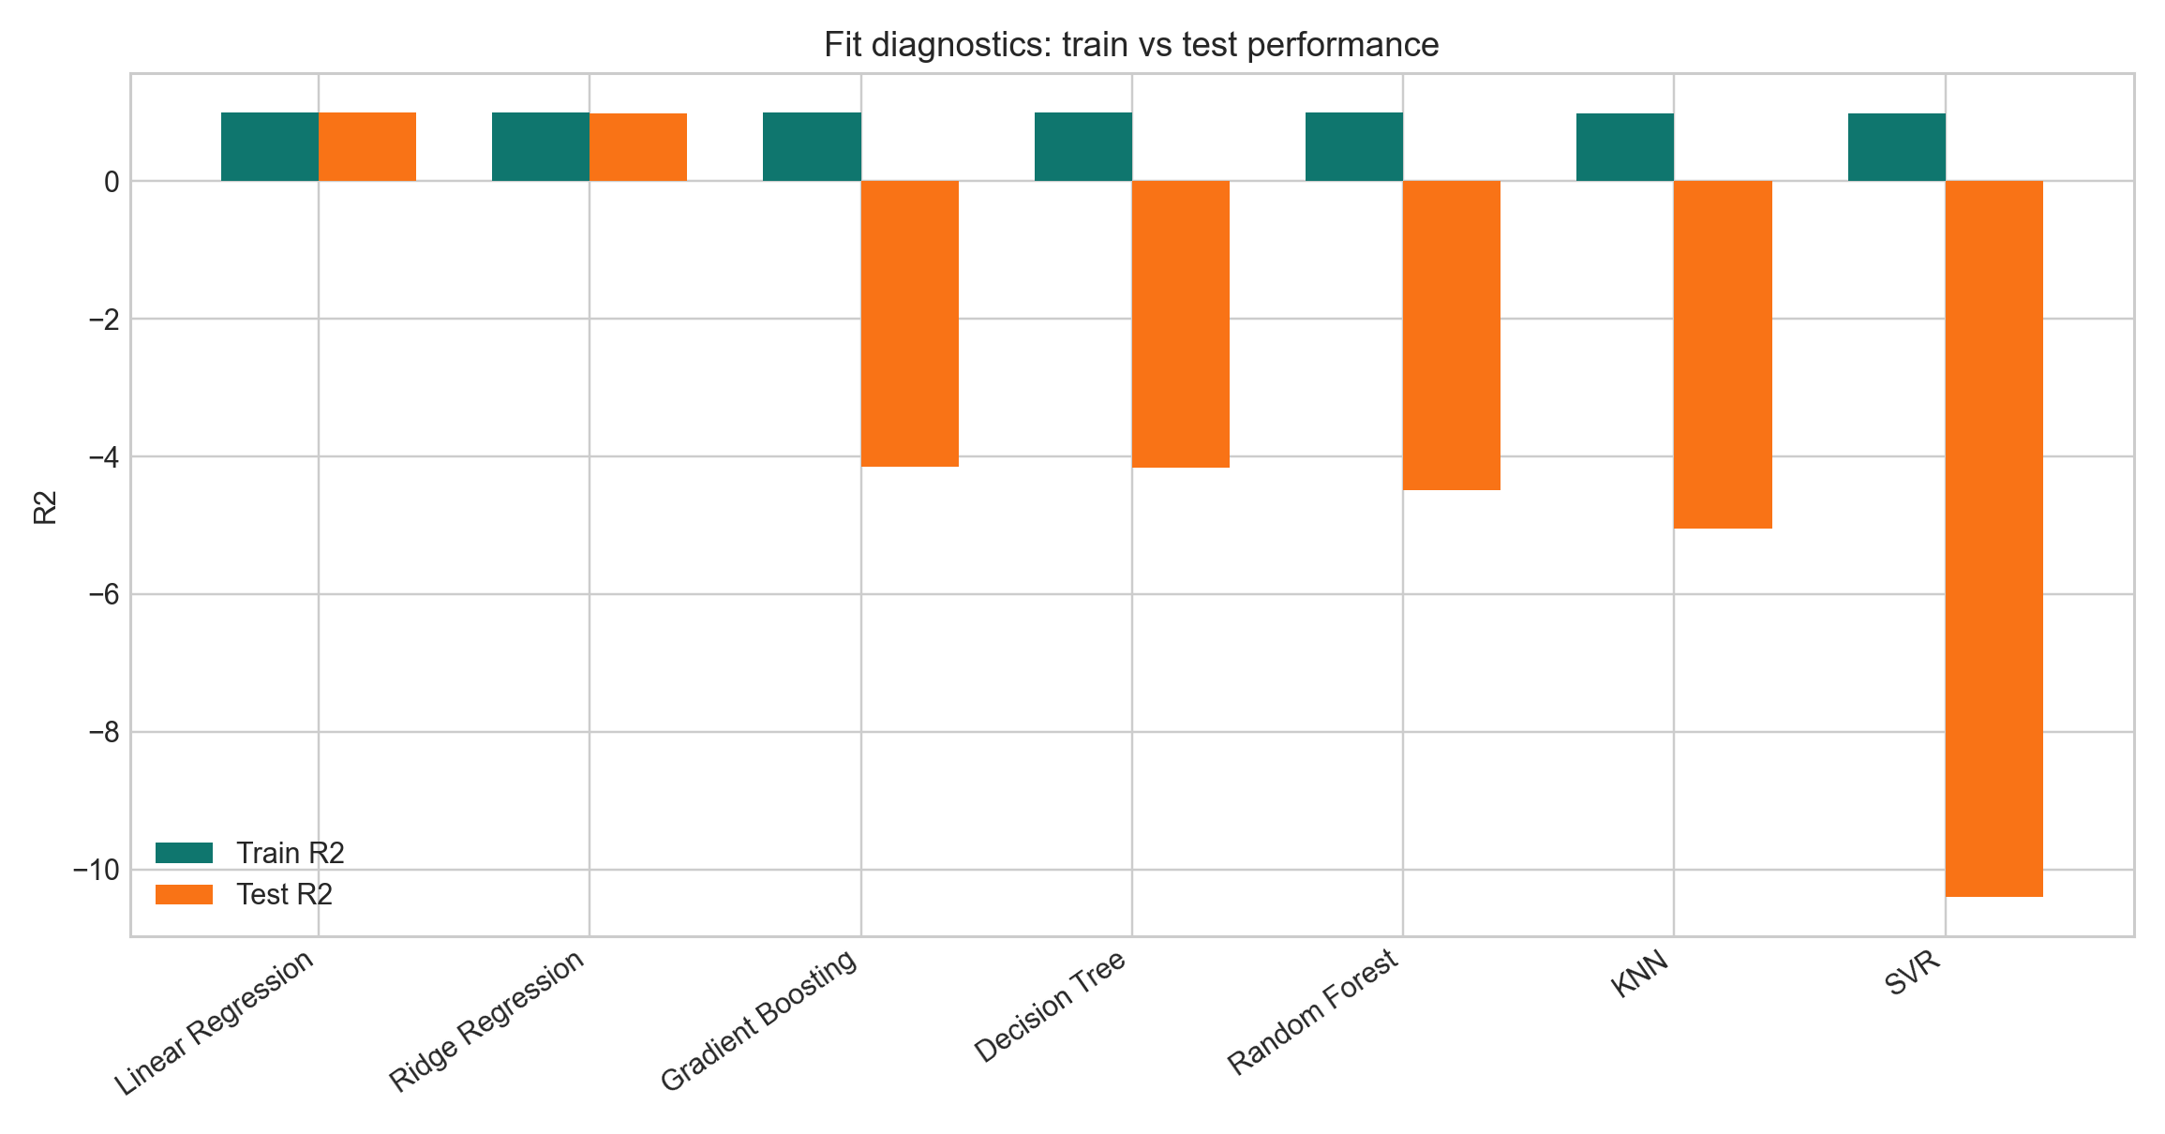
US HOUSING INTELLIGENCE
Fit Diagnostics
Diagnostics compare train and test performance.
Large train-test gaps indicate weak generalization or overfitting risk.
Tree models struggle when the final period moves beyond the training range.

Slide 20
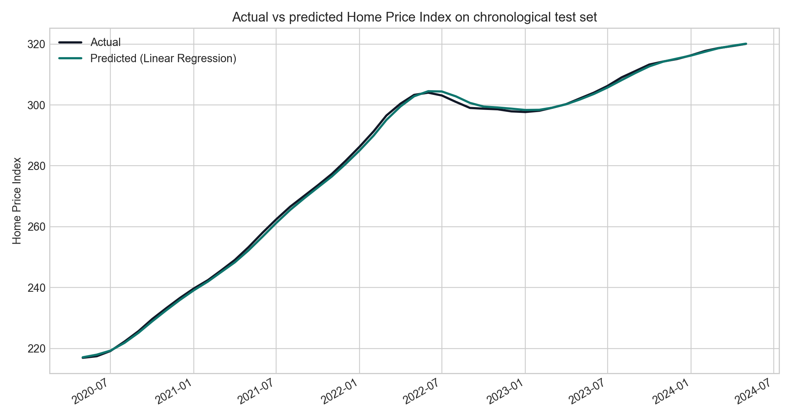
US HOUSING INTELLIGENCE
Actual Versus Predicted
The best model follows the chronological test period closely.
Lagged and smoothed price features explain the strong predictive result.
The visual is easier to defend than metrics alone.

Slide 21
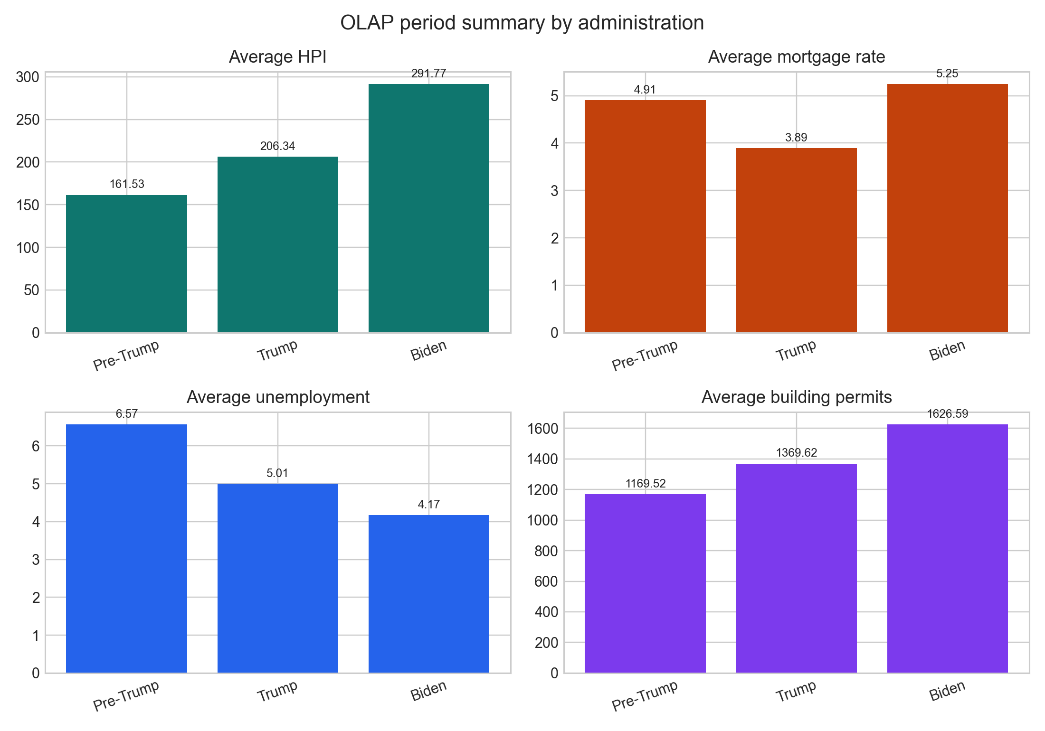
US HOUSING INTELLIGENCE
OLAP Period Results
Biden period has the highest average Home Price Index.
Biden period also has the highest average mortgage-rate pressure.
Prices and affordability pressure can rise together when supply and timing matter.

Slide 22
US HOUSING INTELLIGENCE
Paper Review Message
Housing prices are shaped by demand, financing conditions, supply, construction, income, and timing.
Higher mortgage rates reduce affordability, but prices may react slowly when supply is constrained.
The strongest conclusion is multi-factor interpretation rather than one-variable explanation.

Slide 23
US HOUSING INTELLIGENCE
Business Impact
Analytical impact: users understand which indicators move with housing prices.
Decision-support impact: users compare models, periods, OLAP segments, and scenarios.
Educational impact: the project demonstrates EDA, ML, forecasting, OLAP, paper review, and governance.

Slide 24
US HOUSING INTELLIGENCE
Limitations And Future Work
National-level data hides regional differences between states and cities.
Forecasts are educational and should not be treated as financial advice.
Future work: regional datasets, live APIs, SHAP explainability, better chatbot grounding, monitoring, and authentication.

Slide 25
US HOUSING INTELLIGENCE
Final Conclusion
The report, poster, and app now tell one consistent story.
U.S. housing prices require theory, correlations, model evaluation, diagnostics, OLAP, and market context.
The Streamlit dashboard is a housing intelligence platform, not only a collection of charts.

