Slide 1
The value of energy efficiency in Tunisia's power system
What each MWh saved avoids in 2030, under the 35% renewable target
Rayen Romdhani, Energy Engineering, ENIM (Monastir, Tunisia)
PyPSA-Earth capacity-expansion model, 2 nodes, 8,760 hours
Notes:
Tunisia generates almost all its electricity from gas and plans 35% renewables by 2030. This study asks what saving electricity, or moving it in time, is worth to that system.

Slide 2
Each MWh saved avoids about 60 EUR of system cost
Saving 15% of 2030 demand in every hour (S1-15 against the base case S0), per MWh saved:
60 EUR
0.91 MWh
0.18 t
449 MW
of system cost (investment + operation)
of gas burnt for power
of CO2
of new capacity per TWh saved per year
The avoided cost is close to the average power price (55 EUR/MWh) plus the gas turbines the saving makes unnecessary.
Source: own PyPSA-Earth model of Tunisia 2030; inputs in data/assumptions_register.xlsx
Notes:
The headline metric compares two least-cost 2030 systems that both meet the 35% target and a 10% reserve margin. The only difference is demand.

Slide 3
An open model, calibrated to 2024, then solved for 2030
1
2
3
4
Base network
2024 calibration
11 scenarios
Least-cost 2030
PyPSA-Earth builds Tunisia's grid, plants, solar and wind potential and hourly demand from open data
Official ONEM fleet; one efficiency factor fitted so gas burnt matches STEG within 0.4%
Demand cut 10%-20%, cooling-first saving, shiftable load, gas price x0.5 and x1.5
New solar, wind, batteries and gas; at least 35% renewable and 10% reserve in every run
Every input number has a row and a source in the assumptions register. All 11 runs pass the post-solve checks.
Source: own PyPSA-Earth model of Tunisia 2030; inputs in data/assumptions_register.xlsx
Notes:
Calibration matters because PyPSA-Earth's open plant list overstated combined-cycle capacity and missed the gas turbines. After the fix the 2024 model matches official capacity, gas burnt and peak.

Slide 4
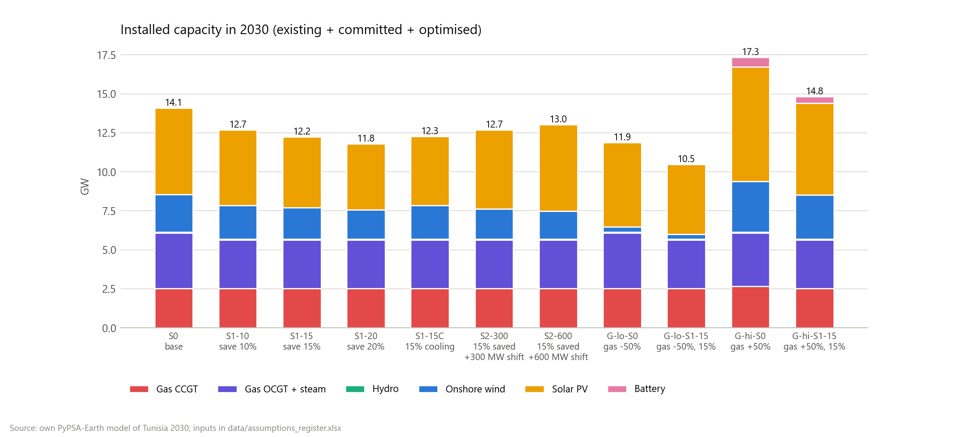
A 10% saving removes the need for new gas plant
423 MW
of new gas turbines in the base case, to keep a 10% reserve above the peak
Every efficiency scenario avoids all of it. Further savings then avoid mostly solar and wind that would otherwise be built.
Source: own PyPSA-Earth model of Tunisia 2030; inputs in data/assumptions_register.xlsx
Notes:
This is why the first 10% saved is worth the most per MWh: it carries all of the avoided gas capacity.

Slide 5
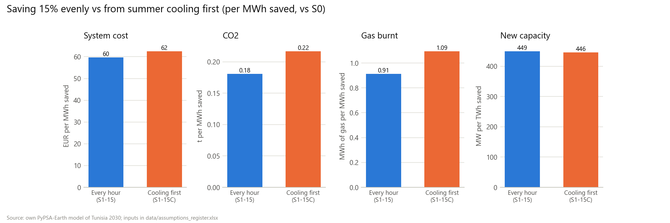
Saving during air-conditioning hours is worth more
Only 39% of the 15% saving fits on the summer cooling load, yet it avoids 20% more gas and CO2 per MWh than an even cut: those are the hours when gas runs.
Source: own PyPSA-Earth model of Tunisia 2030; inputs in data/assumptions_register.xlsx
Notes:
Cooling load is defined as summer load above the shoulder-month average for the same hour of day.

Slide 6
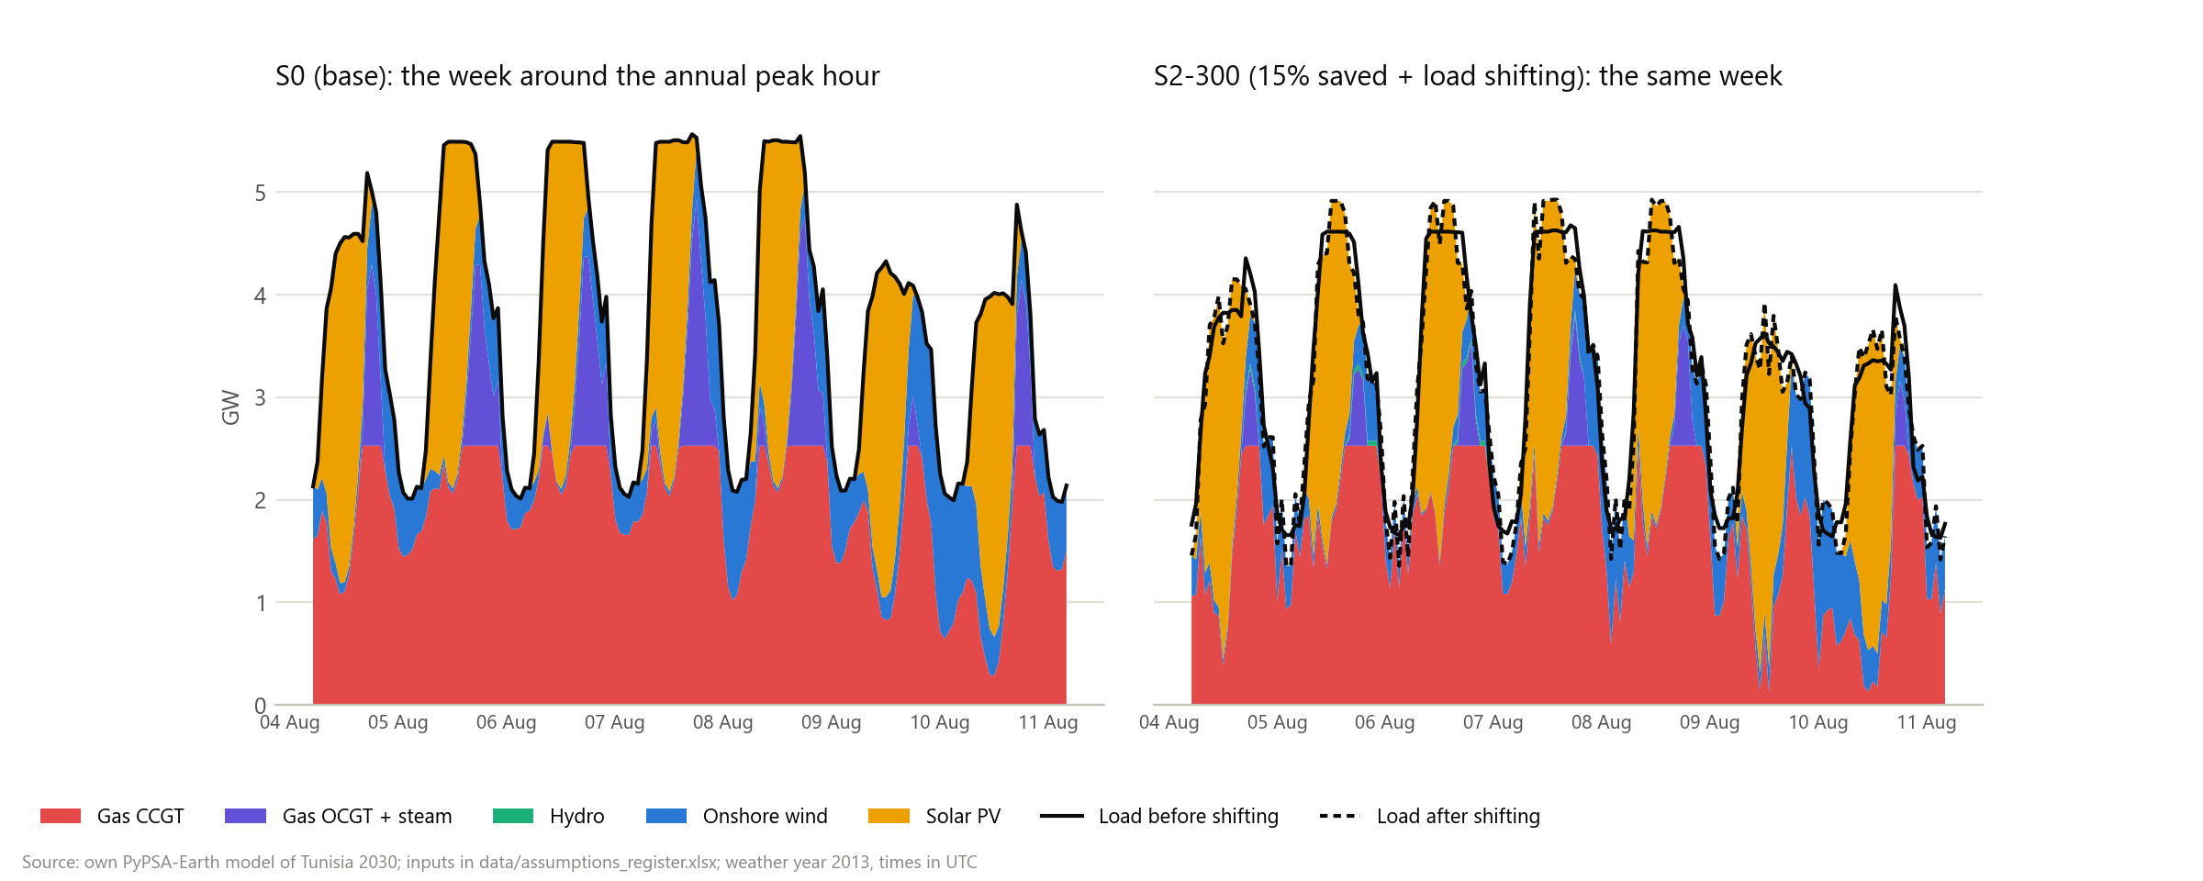
Shifting load by up to 3 hours adds to efficiency
300 MW of shiftable load saves another 22 M EUR and 0.24 Mt of CO2 per year, by moving morning and evening load into midday solar hours.
Source: own PyPSA-Earth model of Tunisia 2030; inputs in data/assumptions_register.xlsx
Notes:
That is about 74,000 EUR per MW per year. Under the reserve rule flexibility gets no capacity credit, so all of this value is energy.

Slide 7
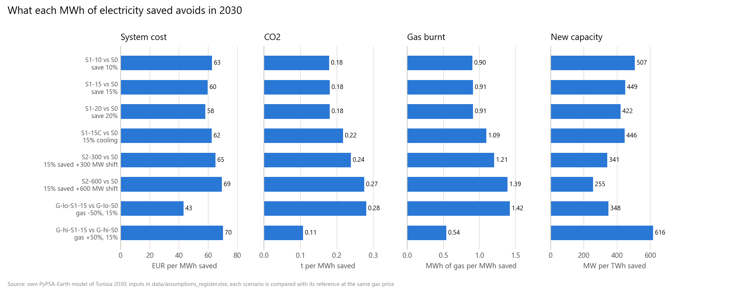
The gas price decides what a saved MWh displaces
Cheap gas: each MWh saved avoids 0.28 t of CO2. Expensive gas: the system is already 70% renewable, so it avoids only 0.11 t of CO2 but 70 EUR of cost.
Source: own PyPSA-Earth model of Tunisia 2030; inputs in data/assumptions_register.xlsx
Notes:
At the base gas price the least-cost system reaches 56% renewables, so the 35% target binds only in G-lo-S0, G-lo-S1-15.

Slide 8
What the numbers mean, and what comes next
Read with care
Next steps
Least cost, not a forecast: no limit on how fast renewables are built
Programme costs not modelled: the avoided cost is a ceiling on what a programme may cost
One weather year; imports flat at their 2024 level
Demand growth from STEG's forecast as quoted by JICA (2022)
Add the ELMED link to Italy as a scenario
Cap the yearly renewable build rate with a sourced limit
Compare the avoided cost with the cost of real efficiency programmes
Source: own PyPSA-Earth model of Tunisia 2030; inputs in data/assumptions_register.xlsx
Notes:
Code, data sources and full results are in the GitHub repository.

