Slide 1
The value of energy efficiency in Tunisia's power system
What each MWh saved avoids in 2030, under the 35% renewable target
Rayen Romdhani, Energy Engineering, ENIM (Monastir, Tunisia)
PyPSA-Earth capacity-expansion model, 2 nodes, 8,760 hours
Notes:
Tunisia generates almost all its electricity from gas and plans 35% renewables by 2030. This study asks what saving electricity, or moving it in time, is worth to that system.

Slide 2
Each MWh saved avoids about 60 EUR of system cost
Saving 15% of 2030 demand in every hour (S1-15 against the base case S0), per MWh saved:
60 EUR
0.91 MWh
0.18 t
449 MW
of system cost (investment + operation)
of gas burnt for power
of CO2
of new capacity per TWh saved per year
The avoided cost is close to the average power price (55 EUR/MWh) plus the gas turbines the saving makes unnecessary.
Source: own PyPSA-Earth model of Tunisia 2030; inputs in data/assumptions_register.xlsx
Notes:
The headline metric compares two least-cost 2030 systems that both meet the 35% target and a 10% reserve margin. The only difference is demand.

Slide 3
An open model, calibrated to 2024, then solved for 2030
1
2
3
4
Base network
2024 calibration
11 scenarios
Least-cost 2030
PyPSA-Earth builds Tunisia's grid, plants, solar and wind potential and hourly demand from open data
Official ONEM fleet; one efficiency factor fitted so gas burnt matches STEG within 0.4%
Demand cut 10%-20%, cooling-first saving, shiftable load, gas price x0.5 and x1.5
New solar, wind, batteries and gas; at least 35% renewable and 10% reserve in every run
Every input number has a row and a source in the assumptions register. All 11 runs pass the post-solve checks.
Source: own PyPSA-Earth model of Tunisia 2030; inputs in data/assumptions_register.xlsx
Notes:
Calibration matters because PyPSA-Earth's open plant list overstated combined-cycle capacity and missed the gas turbines. After the fix the 2024 model matches official capacity, gas burnt and peak.

Slide 4
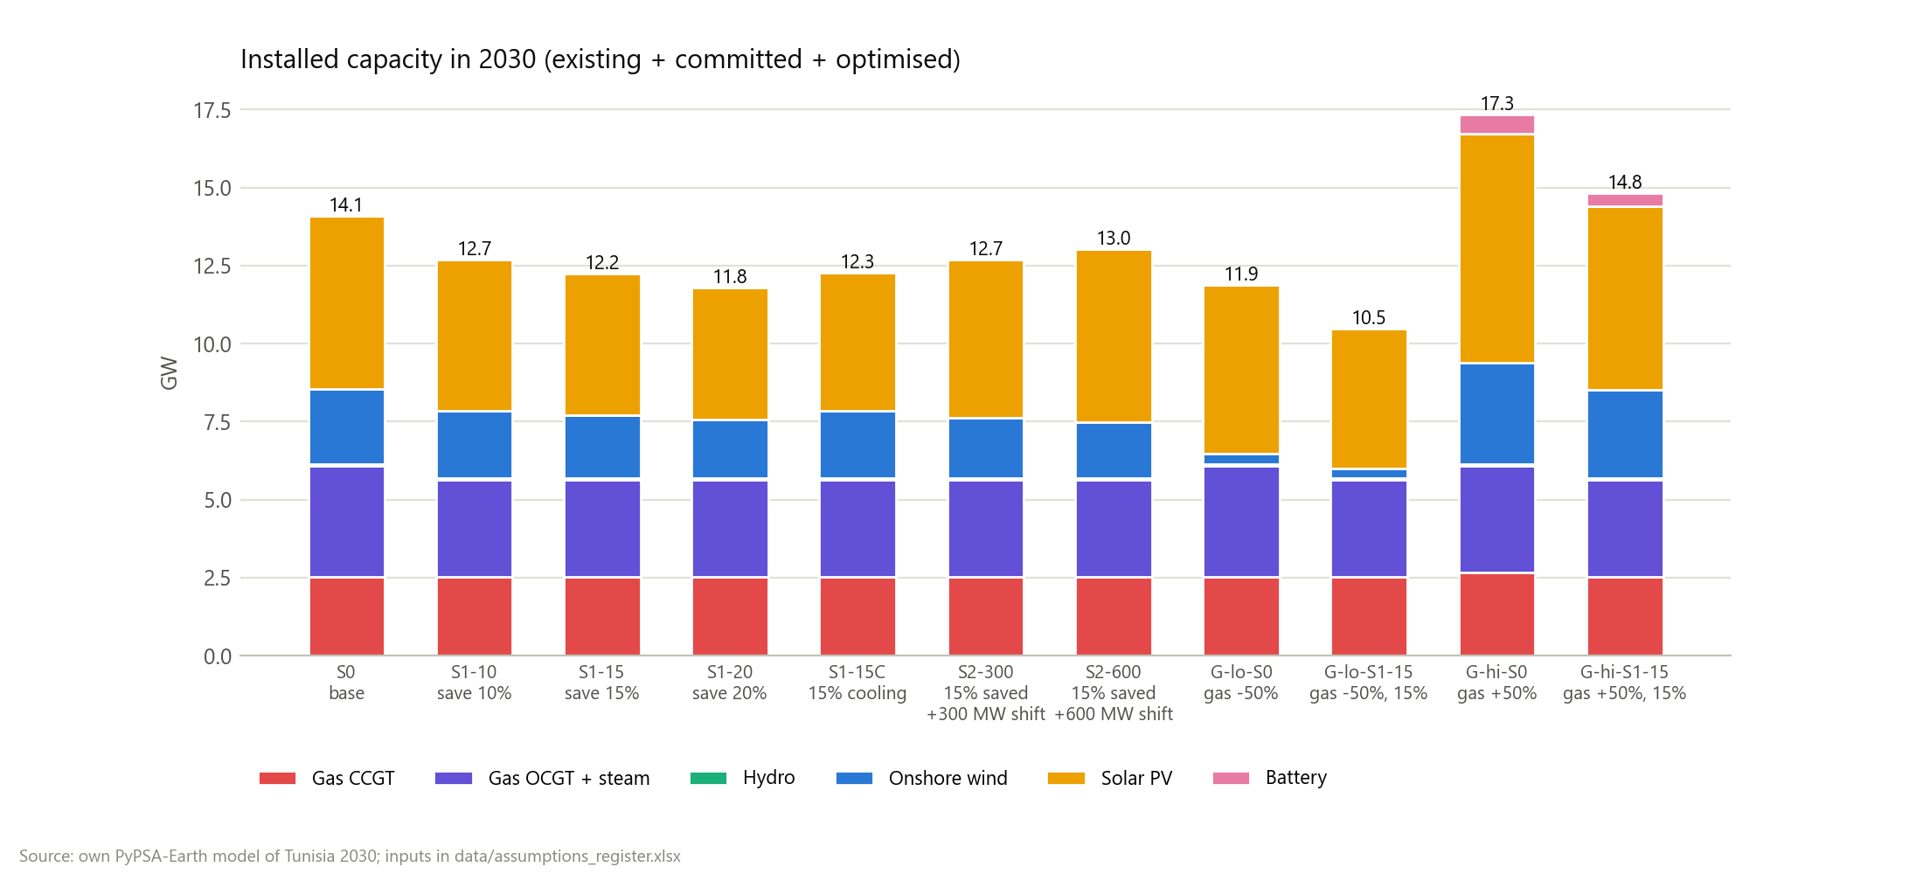
A 10% saving removes the need for new gas plant
423 MW
of new gas turbines in the base case, to keep a 10% reserve above the peak
Every efficiency scenario avoids all of it. Further savings then avoid mostly solar and wind that would otherwise be built.
Source: own PyPSA-Earth model of Tunisia 2030; inputs in data/assumptions_register.xlsx
Notes:
This is why the first 10% saved is worth the most per MWh: it carries all of the avoided gas capacity.

Slide 5
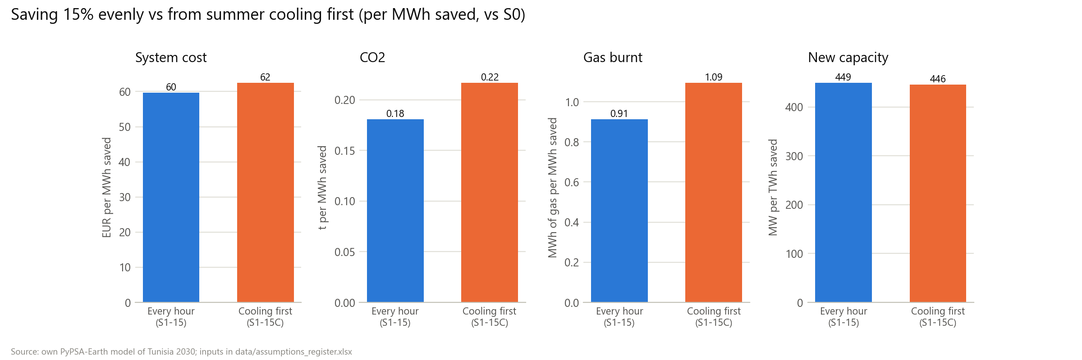
Saving during air-conditioning hours is worth more
Only 39% of the 15% saving fits on the summer cooling load, yet it avoids 20% more gas and CO2 per MWh than an even cut: those are the hours when gas runs.
Source: own PyPSA-Earth model of Tunisia 2030; inputs in data/assumptions_register.xlsx
Notes:
Cooling load is defined as summer load above the shoulder-month average for the same hour of day.

Slide 6
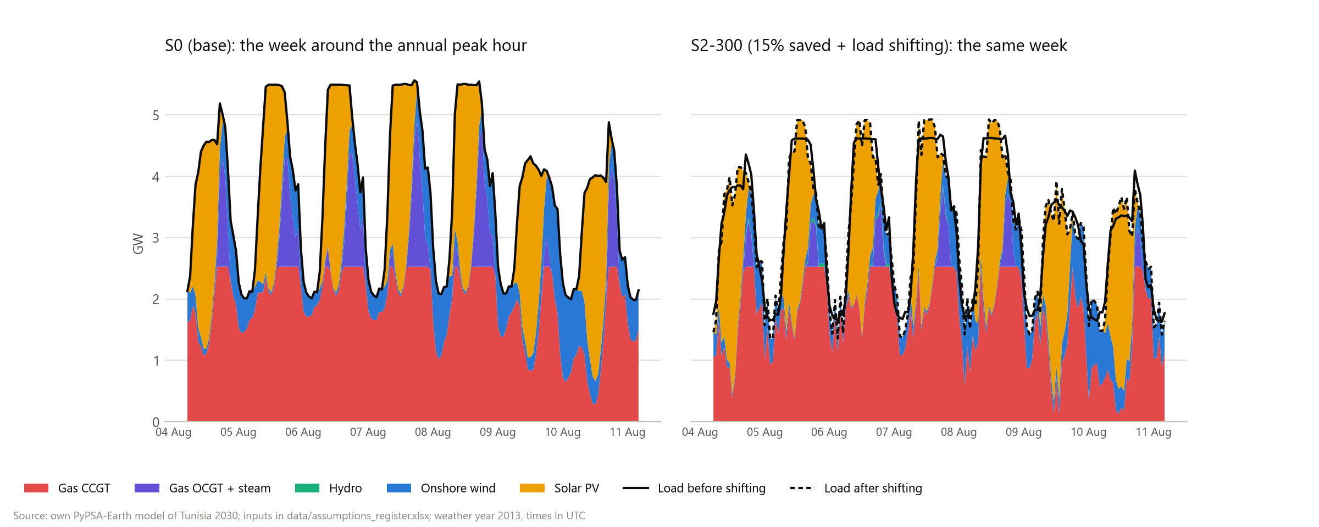
Shifting load by up to 3 hours adds to efficiency
300 MW of shiftable load saves another 22 M EUR and 0.24 Mt of CO2 per year, by moving morning and evening load into midday solar hours.
Source: own PyPSA-Earth model of Tunisia 2030; inputs in data/assumptions_register.xlsx
Notes:
That is about 74,000 EUR per MW per year. Under the reserve rule flexibility gets no capacity credit, so all of this value is energy.

Slide 7
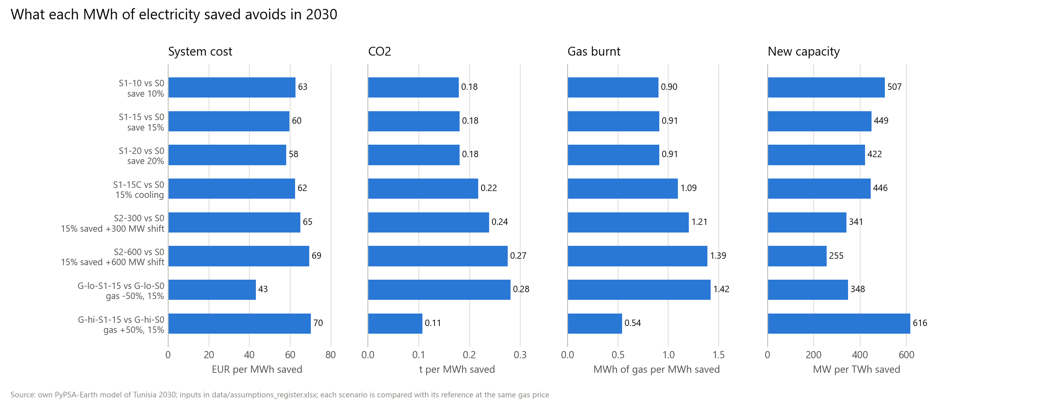
The gas price decides what a saved MWh displaces
Cheap gas: each MWh saved avoids 0.28 t of CO2. Expensive gas: the system is already 70% renewable, so it avoids only 0.11 t of CO2 but 70 EUR of cost.
Source: own PyPSA-Earth model of Tunisia 2030; inputs in data/assumptions_register.xlsx
Notes:
At the base gas price the least-cost system reaches 56% renewables, so the 35% target binds only in G-lo-S0, G-lo-S1-15.

Slide 8
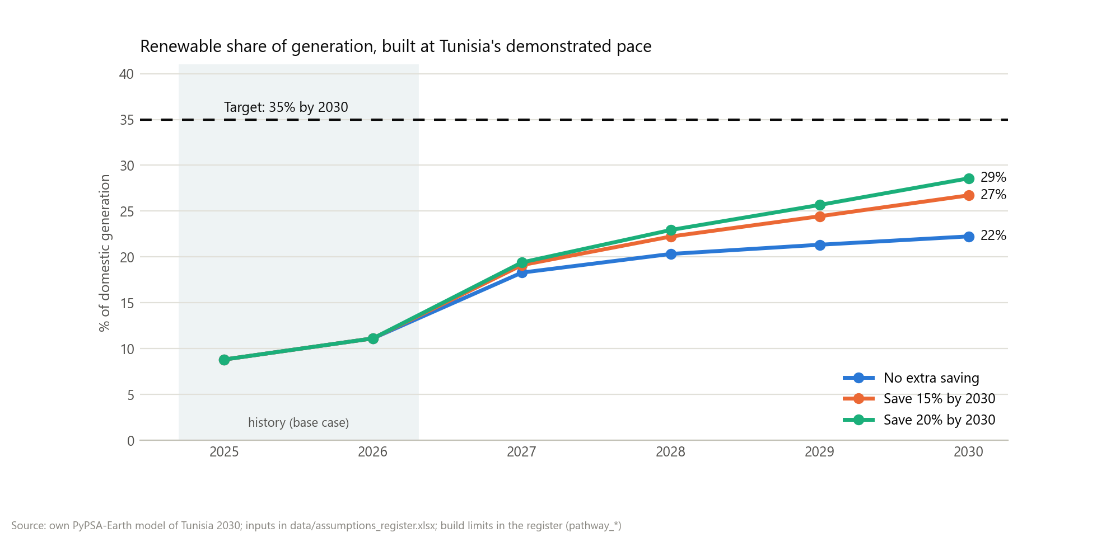
At Tunisia's real pace, 35% is out of reach
22%
renewables in 2030 without extra saving; 27% when saving 15%
Each MWh saved over 2027-2030 avoids 0.39 t of CO2 and 70 EUR: it comes off a gas plant.
Source: own PyPSA-Earth model of Tunisia 2030; inputs in data/assumptions_register.xlsx
Notes:
Each year from 2027 starts from the year before; committed projects arrive in their year; new solar is capped at 268 MW a year (Tunisia's best year, 2024), new wind starts in 2029 and batteries in 2029.

Slide 9
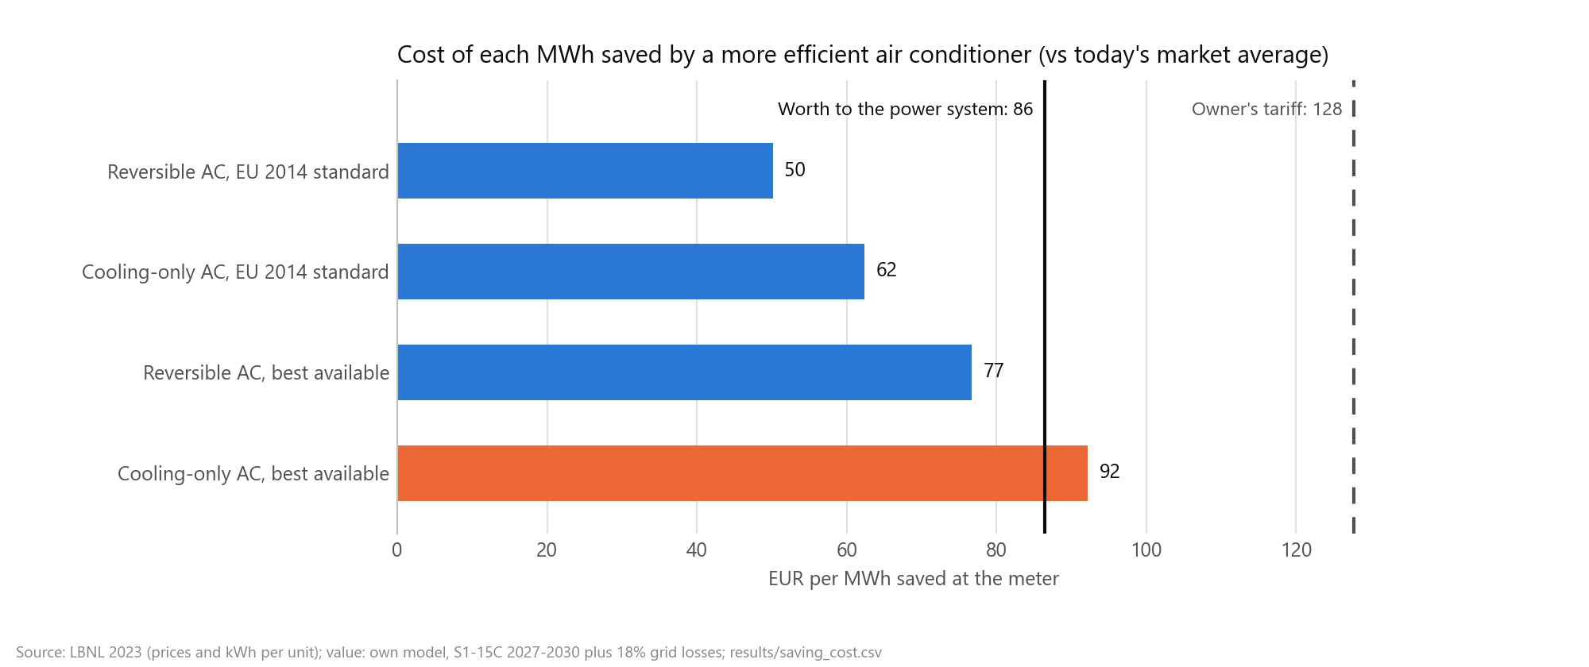
A stricter air-conditioner standard saves for less than it avoids
50-62 EUR
per MWh saved at the EU 2014 level, against 86 EUR avoided
It covers 9%-25% of the 15% saving; the other measures are not priced yet.
Source: own PyPSA-Earth model of Tunisia 2030; inputs in data/assumptions_register.xlsx
Notes:
Prices and yearly kWh from LBNL, Cost-Benefit Analysis for Air Conditioner in Tunisia (2023). The extra price is spread over 10.5 years at 7.1%. The value is the cooling-first saving on the pathway plus 18% grid losses; the owner's tariff is 128 EUR per MWh, so every level pays for the owner.

Slide 10
What the numbers mean, and what comes next
Read with care
Next steps
Not a forecast: 2030 alone has no build limit; the pathway's limits are judgements
Only air-conditioner standards are priced: the cost of the whole saving is unknown
One weather year; imports flat at their 2024 level
Demand growth from STEG's forecast as quoted by JICA (2022)
Add the ELMED link to Italy as a scenario
Test faster build rates as the 2 GW wind tenders progress
Price lighting, building and industry savings in Tunisia
Source: own PyPSA-Earth model of Tunisia 2030; inputs in data/assumptions_register.xlsx
Notes:
Code, data sources and full results are in the GitHub repository.

