Slide 1

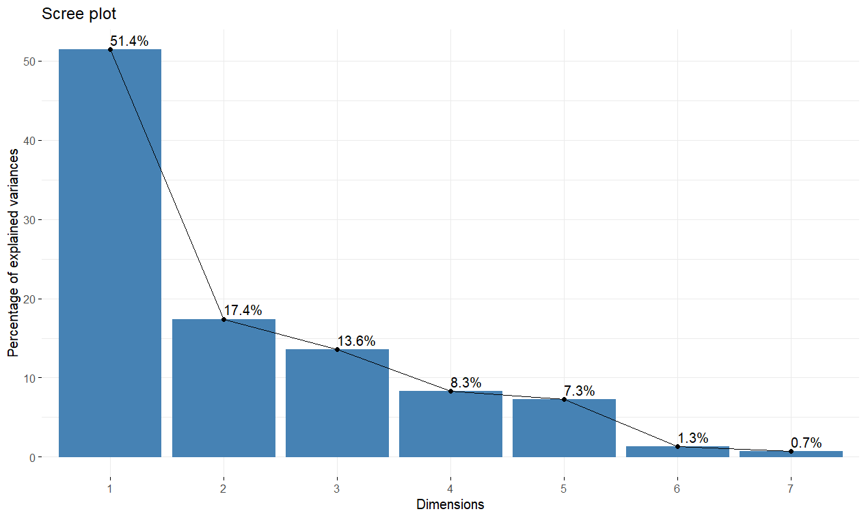
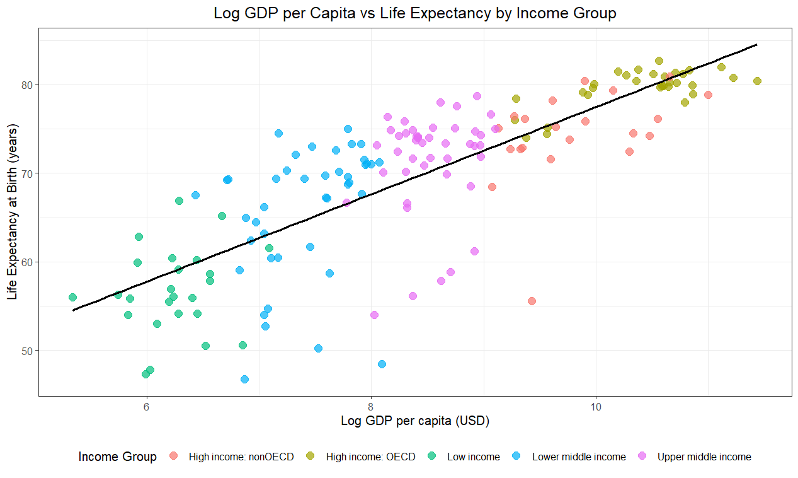
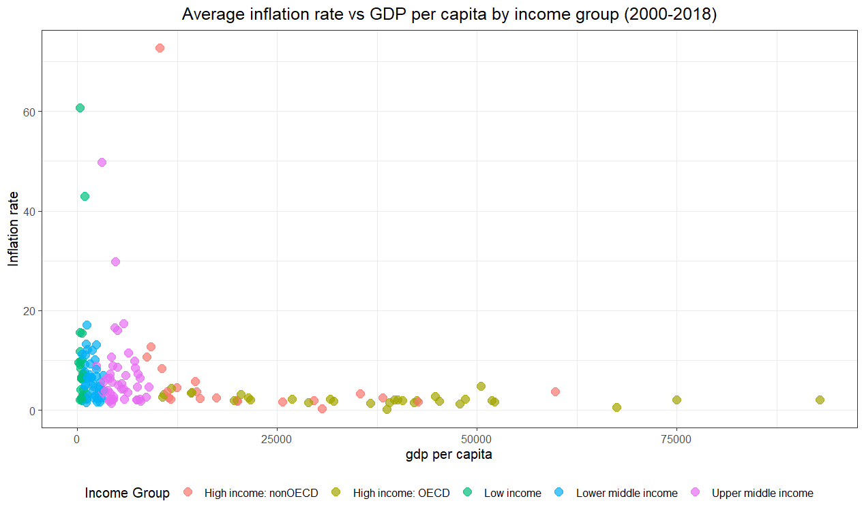
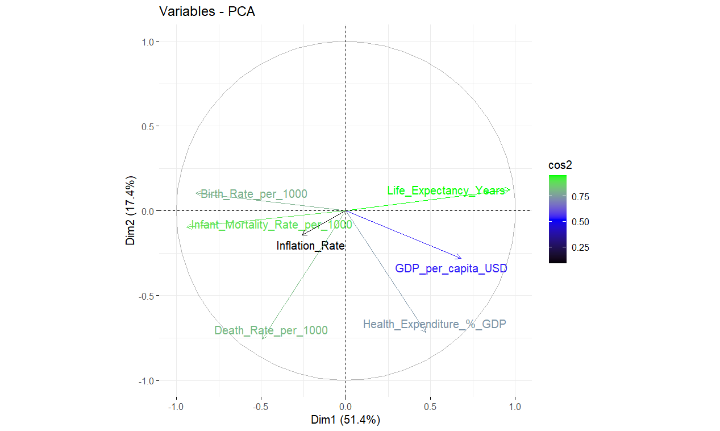
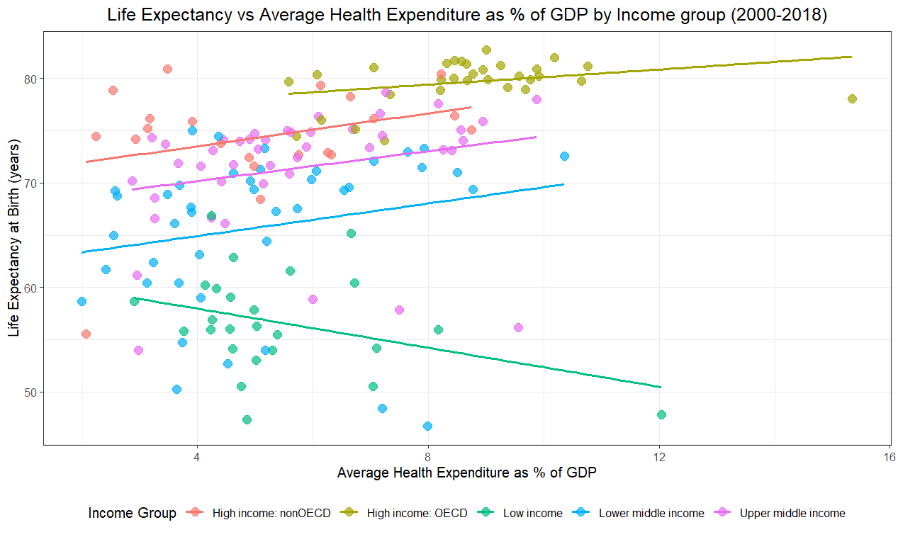
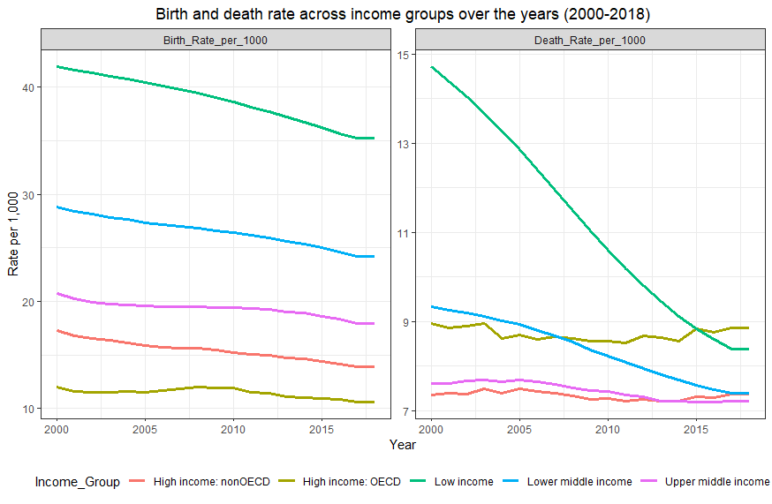
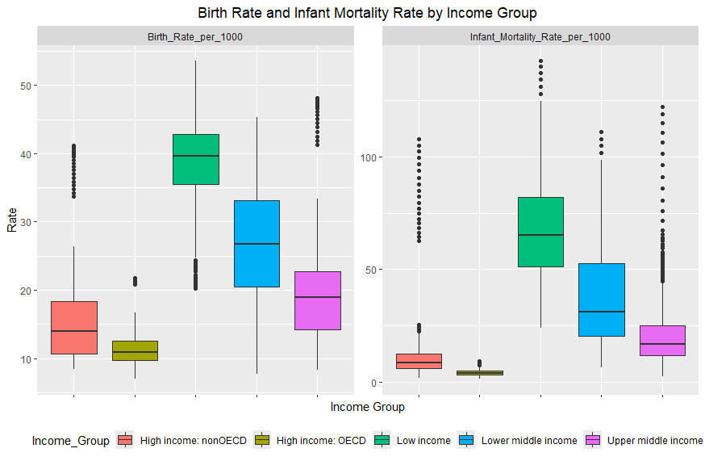
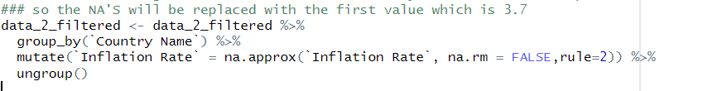
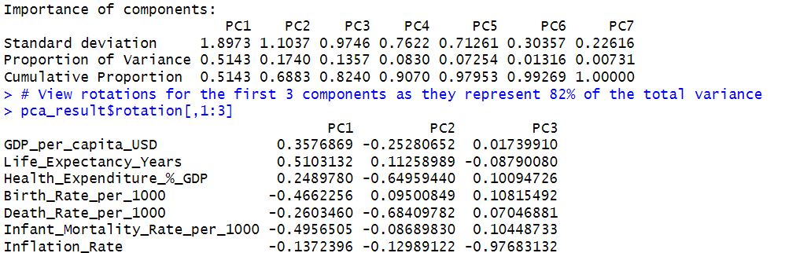
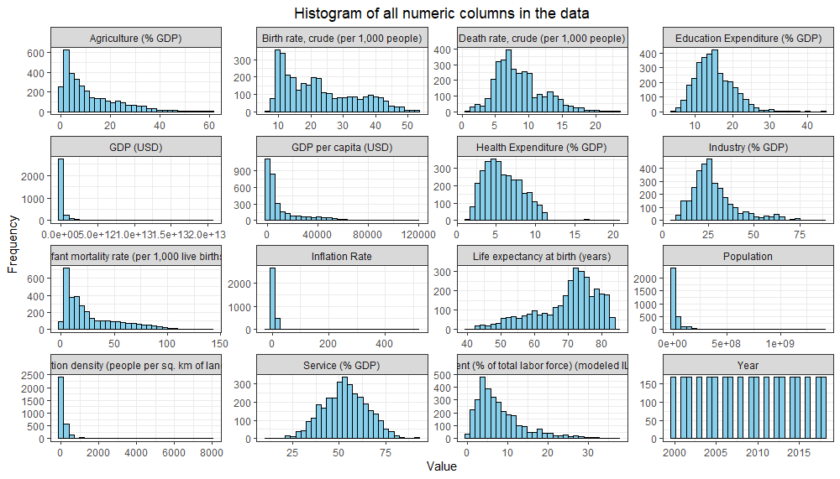
Socio-Economic factors across different income groups from 2000 to 2018
Rayen Bentemessek, CCT College Dublin, November 2024
Introduction
Exploratory Data Analysis
This research set out to dig into the socio-economic factors across different countries with different income groups and get insights from these factors. The analysis will allow to reveal two independent fields, economy and social development and show their relationship. Generally, high-income countries and low-income countries have different ways of dealing with these factors and they face different challenges and use different policies due to the gap of economy and economic models used, agriculture, services, Industrial etc.. In this analysis, we will break down some of these features and we will investigate the patterns between these variables based on the following research questions.
Q.1. How does GDP per capita correlate with life expectancy and its variance across different income groups ?
Q.4 What impact has the GDP per capita on the inflation rate across income groups ?
RESEARCH QUESTIONS
The five questions below represent the core focus of the entire study:
Q.1. How does GDP per capita correlate with life expectancy and its variance across different income groups ?
Q.2. How does life expectancy relate to health expenditure through different income groups ?
Q.3 What variations are in birth and infant mortality rates across different income groups ?
Q.4 What impact has the GDP per capita on the inflation rate across income groups ?
Q.5 What variations are in birth and death rate over time across different income levels ?
Purpose: Identify whether wealthier countries in log GDP per capita have higher life expectancy. Log was used to see the trend rather than seeing values because the data was skewed.
Key insights: Strong positive correlation, higher GDP per capita correlates with higher life expectancy.
Purpose: Identifies the impact of GDP per capita on the inflation rate
Key insights: Higher inflation rates are usually linked with lower GDP per capita, so lower income groups tend to have higher inflation rates.
Datasets Overview
Q.2. How does life expectancy relate to health expenditure through different income groups ?
Q.5 What variations are in birth and death rate over time across different income levels ?
Sources:
World Bank Data on Countries (Gülcan , 2023)
World economic indicators (Karayağız ,2021)
Challenges faced:
Data cleaning and merging.
Missing values and outliers because of real-world variability.
PCA Insights:
PC1: Represents socioeconomic development, with negative birth and infant mortality rate and high positive life expectancy and GDP per capita.
PC2: Healthcare related features (-0.68 death rate and -0.64 health expenditure ) revealing a link between death rate and health expenditure, just to clarify that they are not correlated but they have similar contribution to healthcare systems.
PC3: Highlights the independence of inflation rate as it represents a -0.97.
Data Preparation
Actions:
Cleaned each dataset on its own
For the sake of an accurate research, I dropped some columns with high null values or not useful, I’ve based this criteria on the GDP column and added a threshold of 0.2 missing values then reduced the time frame from 1990 at first.
Used interpolation shown in the code snippet below as most of my new missing values are on the edges of my time frame, mean and median were not useful because it will affect my results.
Once the first dataset is clean, I started working on the new dataset.
I used the same approach as in my first data, but I filled some null values with real world data this time from the internet for inflation rate column for example.
I changed the time frame to 2000-2018 and merged the two datasets by country name, country code and year where I ended up with 20 columns and 3211 rows that I feel confident to use in my research.
Code snippet:
Challenges:
The main challenge that I had was dealing with outliers as I had plenty of them in different highly skewed columns as shown below but I decided to retain them as they are part of real-world data because there is a huge gap between high income countries and low-income countries.
Purpose: Investigate if higher health investments result in higher life expectancy.
Key insights: Slightly positive relationship for most income groups except lower income where we see a negative trend.
CONCLUSIONS
Purpose: Tracks the changes in demographic indicators ( birth and death rate ) from 2000-2018.
Key insights: Higher income groups have almost a stable trend, lower income groups experience lower death rate over the years ( 15 in 2000 to almost 9 in 2018 ) and slight decrease in birth rate.
A summarised answer to the research questions are presented below:
Q.1. Higher GDP per capita correlates with longer life expectancy which is due to better life conditions in general and richer health care facilities.
Q.2. Increased Health investments can result in better health outcomes if it’s done the right way effective for most income groups except low income that showed an opposite trend that is worth more investigation.
Q.3 Lower income groups tend to have higher birth and infant mortality rates which can indicate the demographical structure of these groups that requires a young workforce (agricultural countries for example) linked with less access to healthcare.
Q.4 Inflation rate is more out of control with low-income countries where it can reach extremely high values compared to higher income countries where inflation rate is still reasonable.
Q.5 Stable birth and death rates for most income groups, variability and improvement for lower income countries due to improvement in the quality of life ( more healthcare access, less wars etc..) over the years.
Q.3 What variations are in birth and infant mortality rates across different income groups ?
PCA
I have used PCA only for relevant columns that I used in my analysis as shown in the figure above.
I standardized the values through scaling and retained only the first 3 components as they represent 82% of the variance ( PC1: 51.4%, PC2: 17.4%, PC3: 13.6%)
Future Work
Purpose: Explores the distribution of health indicators ( birth and infant mortality rate) by income groups.
Key insights: Higher income groups have lower birth and infant mortality rate compared to lower income groups.
This research can be deepened by adding valuable unused features such as region, population, unemployment, education expenditure which can provide a deeper insight and strengthen the analysis.
REFERENCES
Yusuf Gülcan,2023,World Bank Data on Countries. [online] Available at: https://www.kaggle.com/datasets/yusufglcan/country-data.
Kerem Karayağız (2021). World Economic Indicators. [online] Kaggle.com. Available at: https://www.kaggle.com/datasets/keremkarayaz/world-economic-indicators/data .
‌

