Slide 1
ADVANCING TO A NEW ERA.
PLANES NEW ERA 2024

Slide 2
OVERVIEW
Over time, we as Drizzle Airplane company have been using old and unupgraded planes for our business. After clear consideration we have decided to finally change and upgrade our planes to new and modified planes so as to enforce more profit for the company.
We have decided that the best way to start this project is by first checking and comparing the number of accidents that have happened over the past years and come up with a proposal.

Slide 3
Cont….
After careful analysation and consideration, we have come up with different statistical data showing the accidents and rates over the years from between 1962 and 2023.
Different factors may affect our final decision but through this we are 75% ready to change the fleet.

Slide 4
Data Analysis
After careful analysis, the data provided clearly shows the areas that are more prone to accidents and which planes are more likely to fail upon purchase.
Using the data provided,we were able to come up with different relationships that would aid in our analysis for the final speculation and decision making.

Slide 5
Data Provision
We were provided with data pertaining the number of accidentss that take place within different areas .
We have decided to drop unrequired columns especially those with null values.Some of the data we will use include:
Accident type against the make and for each area affected.
Number of people who were severely injured against the number of people who were minorly injured.
Accident cause against the make that goes through the different types of causes.

Slide 6
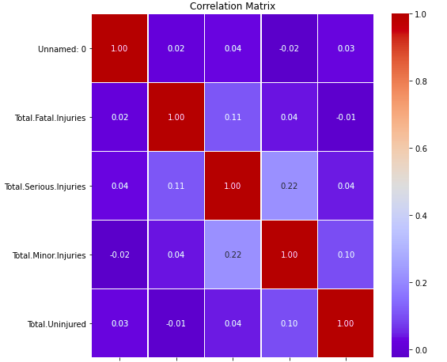
DATA VISUALIZATIONS
Using the various types of relationships we can come up with different visualizations that would clearly explain the severity of changing planes within the company.
We will use visualizations such as scatter plots,heat maps and even line and bar graphs to clearly explain the problem at hand.
An example of a visualization is shown in the screenshot below

