Slide 1
LeaveBy
A transition planner for workouts before class or work
Harvey Chowdhury
MTEC 3200 / Project 1
Notes:
Introduce the problem and the working prototype. Harvey Chowdhury, MTEC 3200 Project 1. Live app: https://leaveby.rayhanson.tech. Sources: https://github.com/Rayhanson-Git/Harvey-Chowdhury-MTEC3200/blob/main/PRD.md

Slide 2
The gym-to-class transition
The workout ends around 8:30 AM. Class begins at 10:00 AM.
Required time
Showering, changing and travel still need to fit.
Uncertainty
Equipment waits, locker rooms and transit can consume the buffer.
Focus: one recurring transition
Notes:
The starting routine comes from the What / How / Why exercise. Explain how a short fixed window connects the workout, getting ready and commute. Source: https://github.com/Rayhanson-Git/Harvey-Chowdhury-MTEC3200/blob/main/research/what_how_why.md

Slide 3
Three interview perspectives
Chris
Longer train commute. Equipment and transit delays can stack.
David
Short, predictable walk. Usually has more buffer and feels less rushed.
Selina
Preparation time varies. A fixed work start creates clock watching.
Notes:
Sources: https://github.com/Rayhanson-Git/Harvey-Chowdhury-MTEC3200/blob/main/interviews/Chris_2026-09-19.md ; https://github.com/Rayhanson-Git/Harvey-Chowdhury-MTEC3200/blob/main/interviews/David_2026-09-19.md ; https://github.com/Rayhanson-Git/Harvey-Chowdhury-MTEC3200/blob/main/interviews/Selina_2026-09-19.md . Records are dated September 19, 2026. They are self-reported accounts. Preserve David as a contrasting case.

Slide 4
What the research suggests
Transition time
Preparation and travel need explicit space before the commitment.
Different routines
Commute reliability and buffer change the pressure.
Existing boundaries
Hard stops and warning alarms already help participants decide when to stop.
Notes:
Sources: https://github.com/Rayhanson-Git/Harvey-Chowdhury-MTEC3200/blob/main/research/affinity_map.md ; https://github.com/Rayhanson-Git/Harvey-Chowdhury-MTEC3200/blob/main/research/insight_statements.md . The separate artifacts were organized retrospectively on October 20. Three interviews do not establish how common these patterns are or prove the app works.

Slide 5
User and point of view
A student or working commuter exercises before a fixed commitment.
Need
A clear boundary between workout time and transition time
Unexpected waits can consume a small buffer and force the person to shorten the routine or rush.
Notes:
The persona is a behavioral composite, not a fourth participant. Sources: https://github.com/Rayhanson-Git/Harvey-Chowdhury-MTEC3200/blob/main/research/persona.md ; https://github.com/Rayhanson-Git/Harvey-Chowdhury-MTEC3200/blob/main/research/point_of_view.md . Avoid fictional demographic details. The editable plan is a design response whose usability still needs peer feedback.

Slide 6
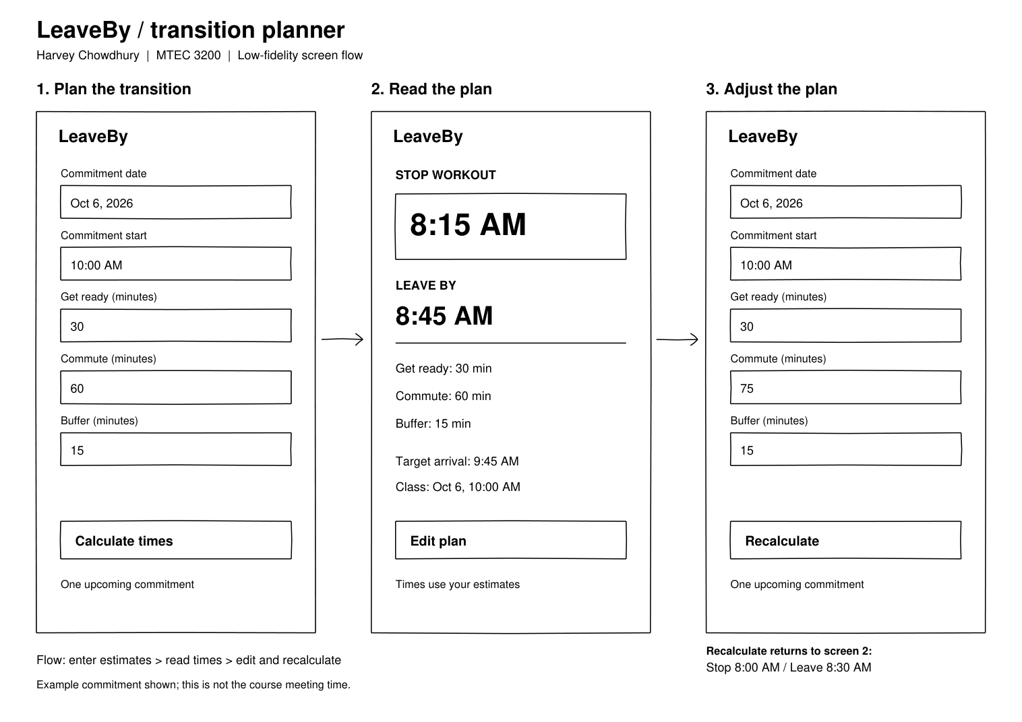
Three states, one plan
Notes:
Sources: https://github.com/Rayhanson-Git/Harvey-Chowdhury-MTEC3200/blob/main/Design/LeaveBy_Wireframes.png ; https://www.figma.com/design/o5HfqhQTqwBFK8nFTEWvx2 . The original October 6 wireframe date is an example. Calculate enters results. Edit preserves inputs. Recalculate returns to results.

Slide 7
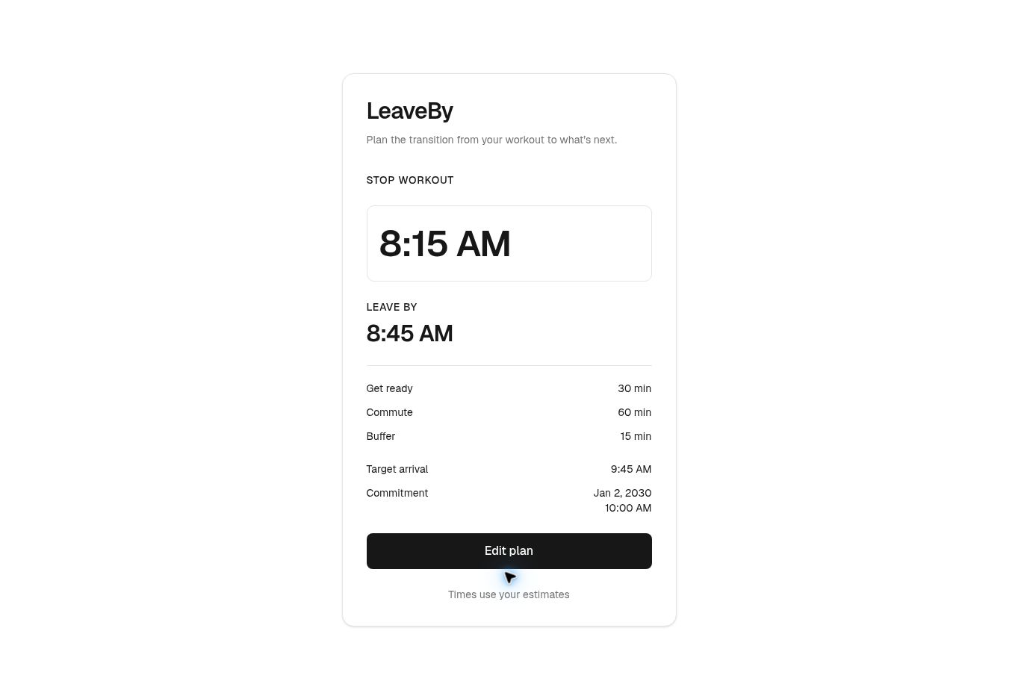
A working prototype
10:00 AM commitment
30 min preparation
60 min commute
15 min buffer
Stop 8:15 AM
Leave 8:45 AM
Arrive 9:45 AM
Notes:
Demonstrate the live app rather than implying this image is a usability study. Screenshot from the deployed app with a future January 2, 2030 example. Source: https://leaveby.rayhanson.tech and https://github.com/Rayhanson-Git/Harvey-Chowdhury-MTEC3200/blob/main/Presentation/media/result.jpg

Slide 8
Working backward from a deadline
Arrival
Commitment minus buffer
Departure
Arrival minus commute
Workout stop
Departure minus preparation
Buffer is deducted once. Full timestamps preserve dates.
Notes:
Source: https://github.com/Rayhanson-Git/Harvey-Chowdhury-MTEC3200/blob/main/lib/plan-input.ts . Every duration is multiplied by 60,000 to convert minutes to milliseconds. Use full timestamps so midnight can cross the date boundary. Source: https://github.com/Rayhanson-Git/Harvey-Chowdhury-MTEC3200/blob/main/Presentation/code-defense.md

Slide 9
Verification and recovery
Calculation
Eight acceptance tests cover arithmetic and edge cases.
Recovery
Errors identify fields, preserve input and move focus.
Hosted flow
Calculate, edit and recalculate work on the deployed app.
Peer usability feedback is still pending.
Notes:
Sources: https://github.com/Rayhanson-Git/Harvey-Chowdhury-MTEC3200/blob/main/tests/plan.test.mjs ; https://github.com/Rayhanson-Git/Harvey-Chowdhury-MTEC3200/blob/main/docs/verification.md . Eight Node acceptance tests, lint and production build passed. Hosted interaction checks include reference, edit, invalid inputs, midnight, zeros, past stop and reload. Phone-width/dark-mode visual testing is not established by these desktop checks.

Slide 10
Limits and the next evaluation
One commitment at a time. Times depend on the entered estimates. Reload starts a new plan.
Next evaluation
Can another person explain Stop workout versus Leave by and edit a plan without help?
leaveby.rayhanson.tech
Notes:
Sources: https://github.com/Rayhanson-Git/Harvey-Chowdhury-MTEC3200/blob/main/PRD.md ; https://github.com/Rayhanson-Git/Harvey-Chowdhury-MTEC3200/blob/main/docs/reflection.md ; https://github.com/Rayhanson-Git/Harvey-Chowdhury-MTEC3200/blob/main/docs/peer-feedback.md . Session memory resets on refresh. Calculations rely on estimates. No live transit, alarms or saved routines. Actual peer feedback and live defense remain human activities.

