Slide 1
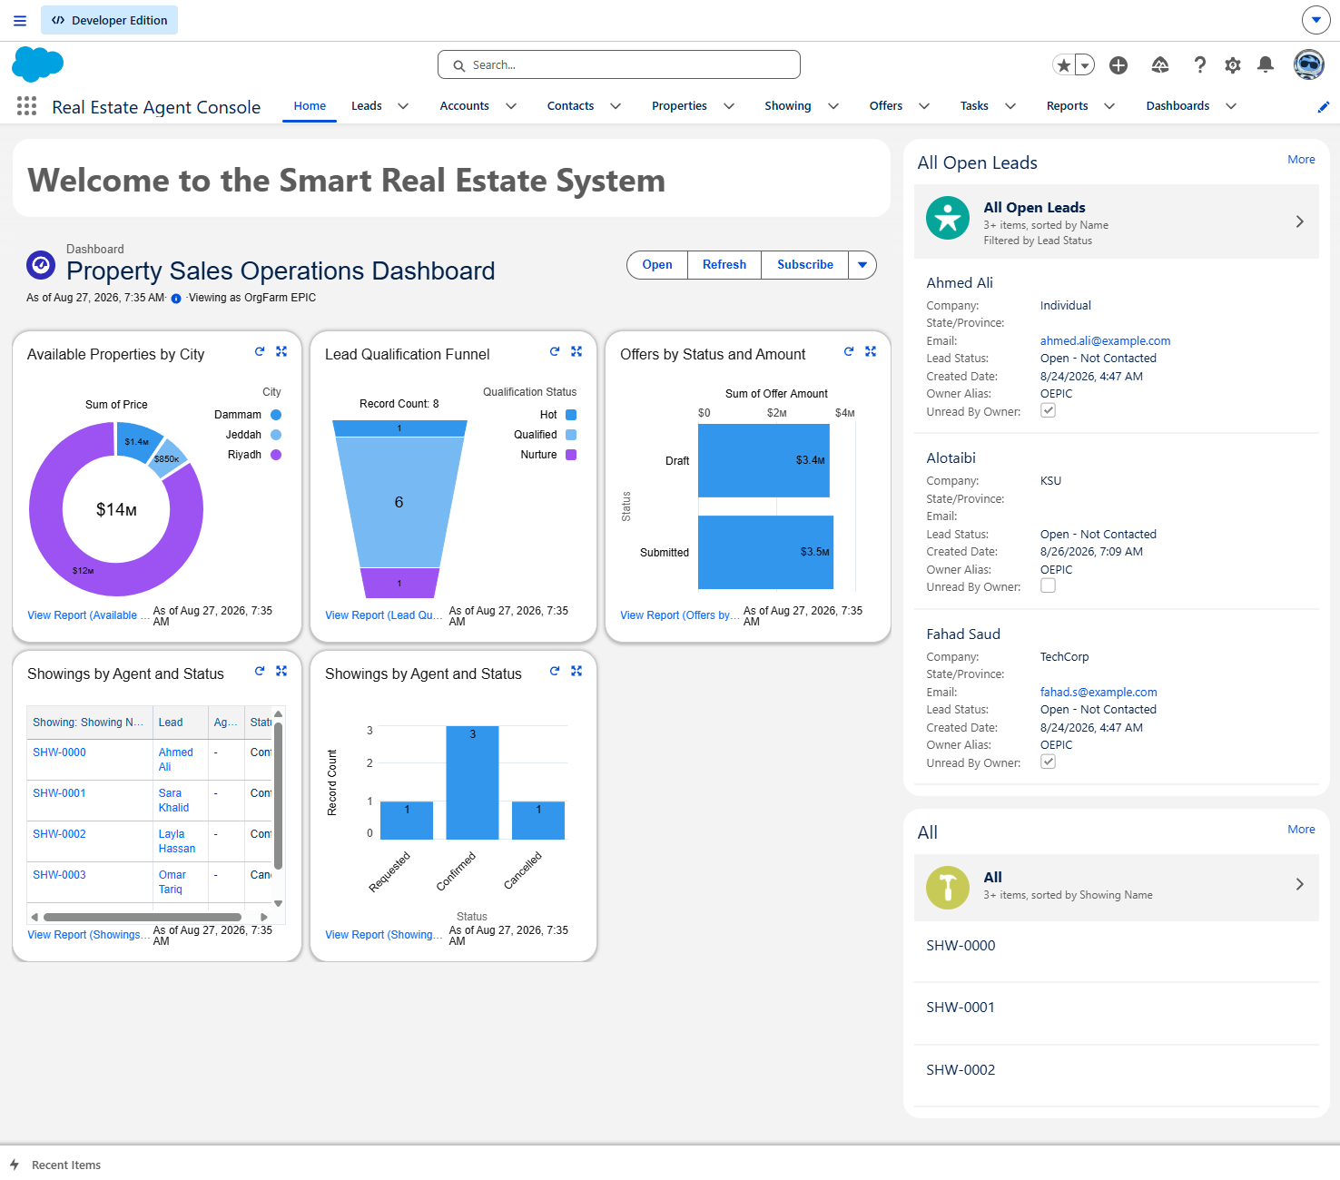
FINAL PROJECT PRESENTATION
Smart Real Estate System
Salesforce & Agentforce Implementation
A governed CRM solution for lead qualification, property discovery, and showing orchestration.
Rayian Hussain
August 28, 2026
SMART REAL ESTATE SYSTEM
01
Notes:
Open with the business outcome: one connected workspace that combines CRM operations, automation, Agentforce, and analytics.
[Sources]
- User-supplied Salesforce project screenshot and project metadata.

Slide 2
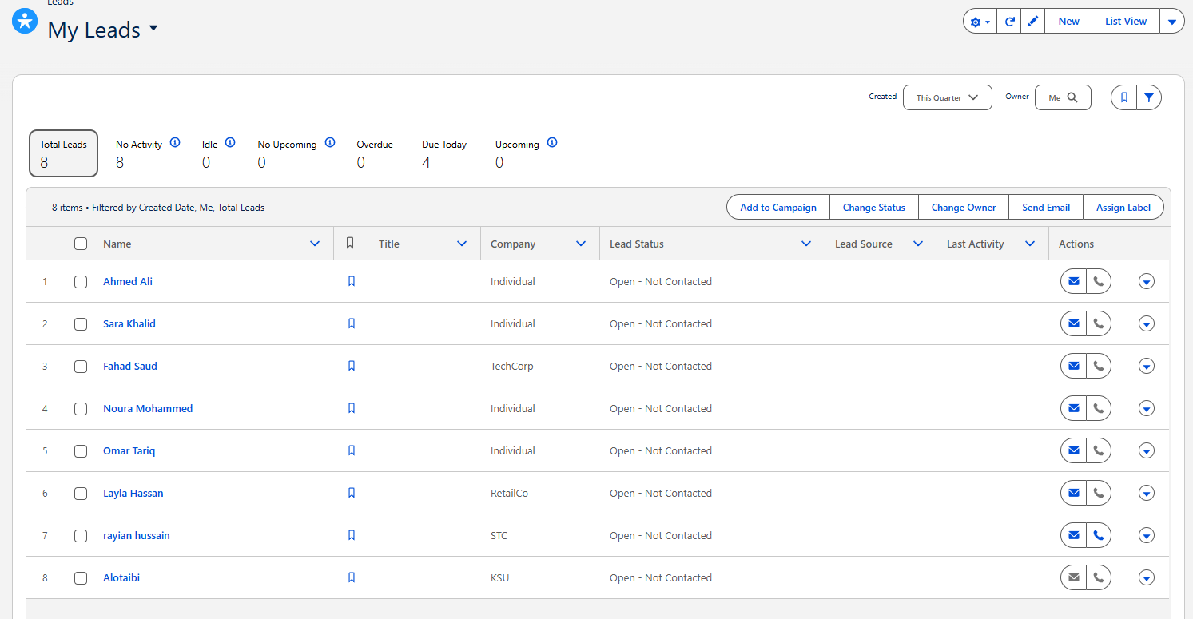
BUSINESS PROBLEM
Manual coordination slows the first response
1
Lead triage
Inbound leads require manual review before an agent can prioritize them.
2
Inventory checks
Property availability and fit must be searched across records.
3
Showing logistics
Missing details and time conflicts create avoidable back-and-forth.
Business consequence
Delayed engagement reduces buyer confidence and can weaken conversion performance.
SMART REAL ESTATE SYSTEM
02
Notes:
Connect the three manual tasks to the buyer experience: every delay happens before the highest-value agent work begins.
[Sources]
- User-supplied project problem statement.
- User-supplied Salesforce Leads screenshot.

Slide 3
OBJECTIVES AND SCOPE
Automation focuses agents on tours and closing
THREE PROJECT OBJECTIVES
Automate qualification
IN SCOPE
1
Agentforce conversational interface
Autolaunched and record-triggered Flows
Lightning App, record pages, Dynamic Forms
Responsive custom LWC
Role-based access and field-level security
Capture preferences, calculate qualification, and create follow-up work.
2
Enable guided self-service
Use Agentforce for property questions and confirmed showing requests.
3
Create operational visibility
OUT OF SCOPE
Centralize inventory, funnel, offer, and showing insights.
External customer website
Billing and invoicing
Post-sale maintenance tracking
SMART REAL ESTATE SYSTEM
03
Notes:
Clarify that the scope is deliberate: the project solves pre-sale real estate operations and does not claim end-to-end property lifecycle coverage.
[Sources]
- User-supplied objectives and scope statement.

Slide 4
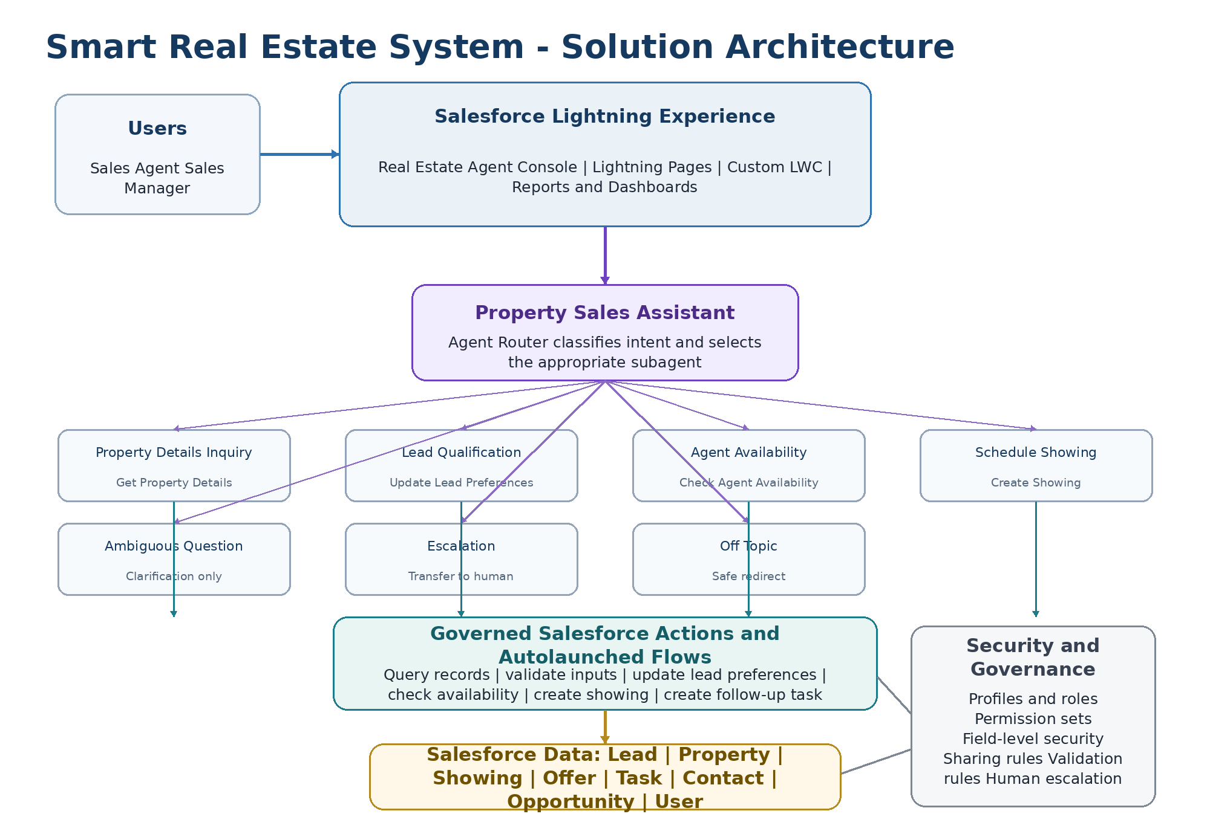
SOLUTION ARCHITECTURE
SMART REAL ESTATE SYSTEM
04
Notes:
Walk top to bottom: Lightning is the user experience, Agentforce classifies intent, governed actions invoke Flows, and Salesforce records remain the system of record.
[Sources]
- User-supplied project architecture derived from implemented Salesforce and Agentforce configuration.

Slide 5
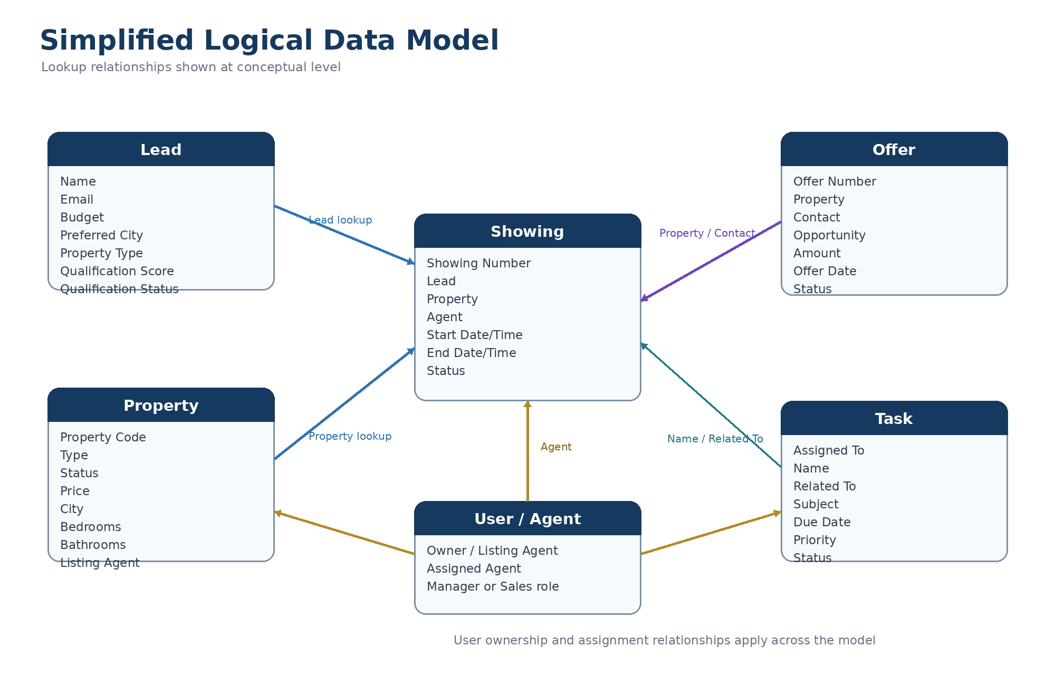
DATA MODEL
SMART REAL ESTATE SYSTEM
05
Notes:
Emphasize that Showing is the operational junction between Lead, Property, and User or Agent. Offer and Task extend the sales process without duplicating core data.
[Sources]
- User-supplied Salesforce Schema Builder evidence and simplified logical data model.

Slide 6
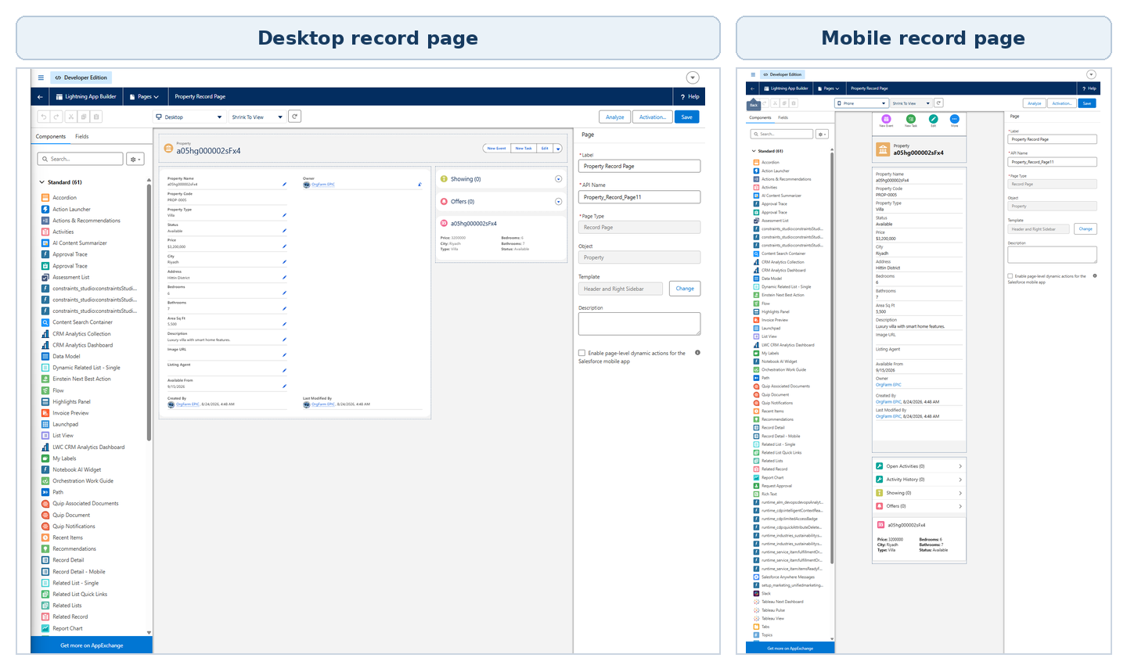
LIGHTNING APP AND UX
One workspace supports the full sales cycle
Responsive experience
Desktop and mobile layouts preserve record context and access to related Showings and Offers.
SMART REAL ESTATE SYSTEM
06
Notes:
Show that the console is not a standalone AI demo: it is a usable Salesforce application with navigation, records, dashboards, and responsive pages.
[Sources]
- User-supplied Real Estate Agent Console screenshot.
- User-supplied Lightning App Builder desktop and mobile screenshots.

Slide 7
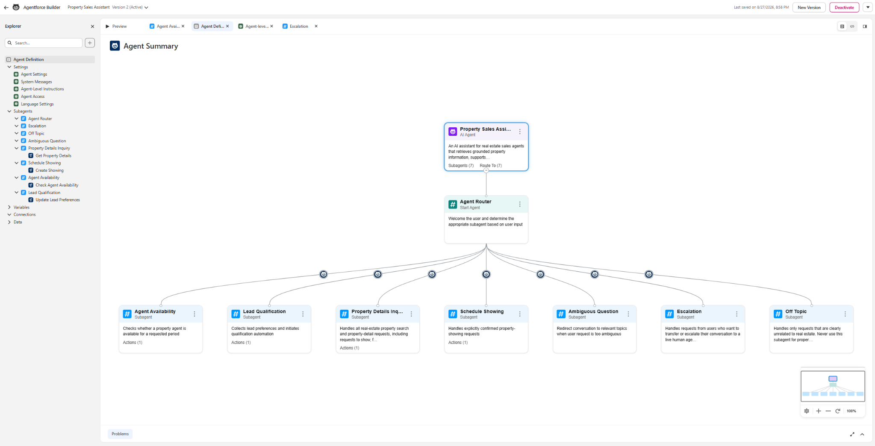
AGENTFORCE CONFIGURATION
Seven routed topics keep the assistant grounded
PROPERTY SALES ASSISTANT
01
Property Details Inquiry
Grounded property search
02
Lead Qualification
Capture and update preferences
03
Agent Availability
Check schedule conflicts
04
Schedule Showing
Create only after confirmation
05
Ambiguous Question
Request clarification
06
Escalation
Transfer to a human
07
Off Topic
Safe redirection
SMART REAL ESTATE SYSTEM
07
Notes:
Explain that Agent Router selects the correct subagent. Each topic has a narrow responsibility, reducing unsupported behavior and keeping actions auditable.
[Sources]
- User-supplied active Property Sales Assistant configuration screenshot.

Slide 8
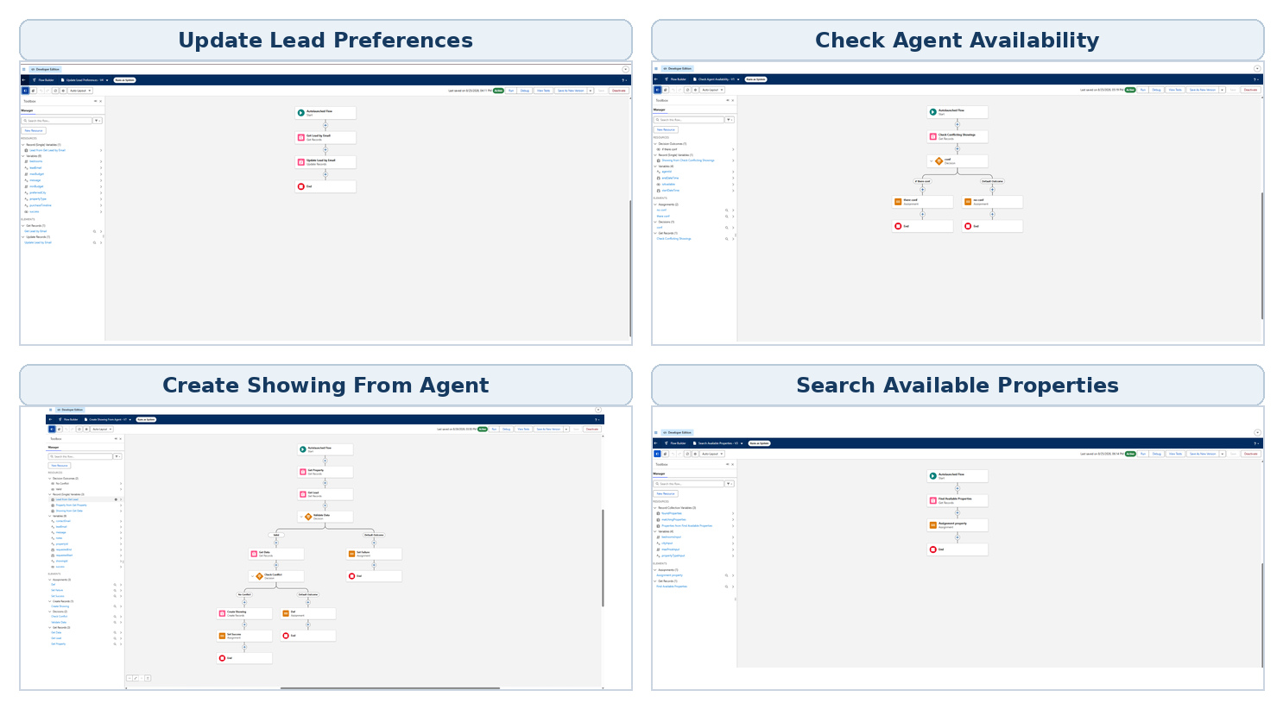
FLOW INTEGRATIONS
Four Agentforce actions connect conversation to CRM work
ACTION TO FLOW MAPPING
Get Property Details
Search Available Properties
Update Lead Preferences
Update Lead Preferences
Check Agent Availability
Check Agent Availability
Create Showing
Create Showing From Agent
Business failures are returned as structured messages through Decisions and Assignments where implemented.
SMART REAL ESTATE SYSTEM
08
Notes:
Point out that the flows are active Autolaunched Flows mapped directly to Agentforce actions. Mention that unexpected platform faults remain a future hardening item.
[Sources]
- User-supplied Flow Builder canvases.
- User-supplied Agentforce action definitions and Flow metadata.

Slide 9
CUSTOM LWC
A responsive property summary keeps key facts visible
Reusable component
Price, city, type, bedrooms, bathrooms, and status adapt across form factors.
SMART REAL ESTATE SYSTEM
09
Notes:
Use this slide to demonstrate front-end development beyond standard configuration. The component provides a compact property snapshot on both desktop and mobile.
[Sources]
- User-supplied LWC desktop and mobile screenshots.

Slide 10
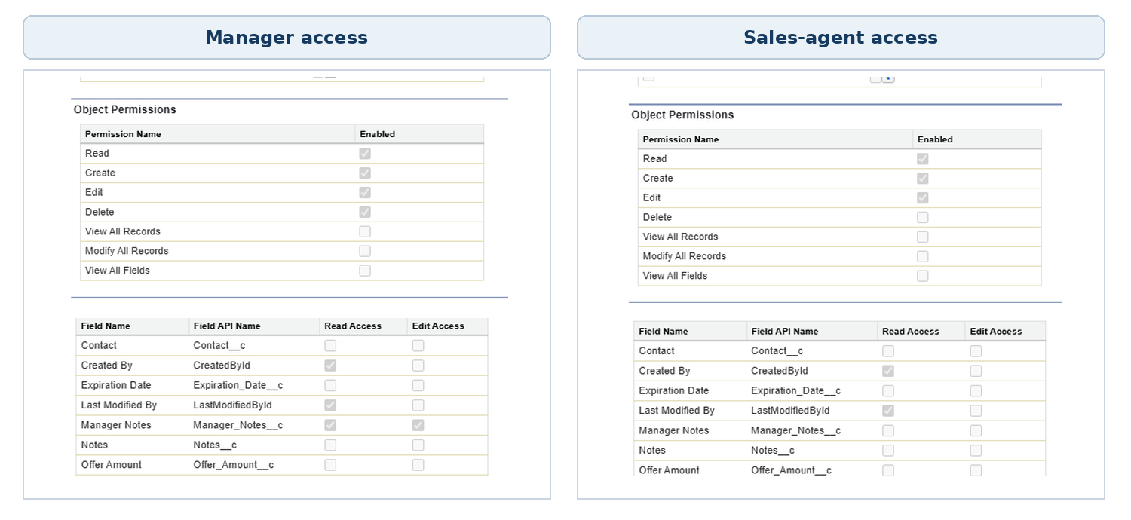
SECURITY AND GOVERNANCE
Access is role-based, field-aware, and least-privilege oriented
CONTROL LAYERS
01
Profiles and app access
02
Object permissions
03
Field-level security
04
Validation rules
05
Human escalation
Manager Notes
Editable for managers; unavailable to standard sales users.
Permission sets distinguish CRUD access without View All or Modify All privileges.
Flow execution mode is documented separately and should be reviewed during production hardening.
SMART REAL ESTATE SYSTEM
10
Notes:
Do not overclaim inherited sharing: the four Agentforce autolaunched flows run in system mode without sharing. Present this as a documented governance consideration for production hardening.
[Sources]
- User-supplied permission-set and field-level security screenshots.
- User-supplied Flow metadata.

Slide 11
REPORTS AND DASHBOARD
One dashboard aligns inventory, funnel, offers, and showings
VISIBLE OPERATING SIGNALS
1
Inventory
Available properties by city
2
Lead funnel
Hot, qualified, and nurture
3
Offer pipeline
Status and submitted amount
4
Showings
Agent workload and status
SMART REAL ESTATE SYSTEM
11
Notes:
Describe the dashboard as operational visibility, not predictive analytics. It consolidates current Salesforce records to support daily decisions.
[Sources]
- User-supplied Property Sales Operations Dashboard screenshot.

Slide 12
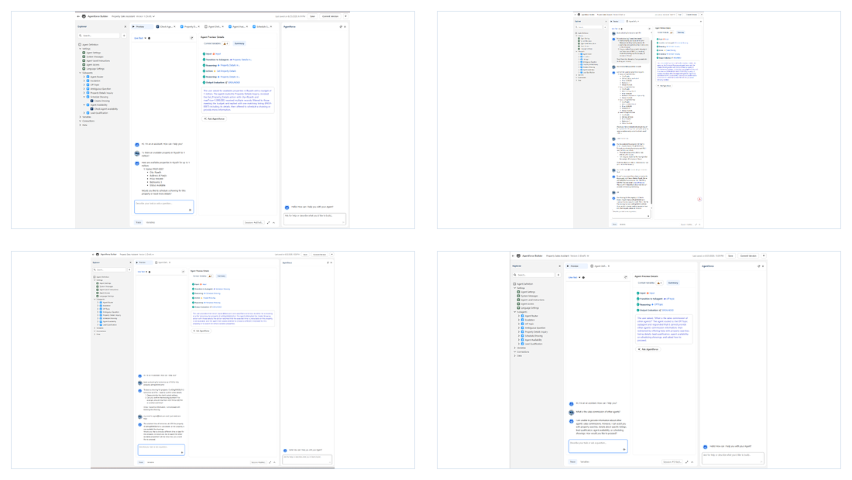
TESTING RESULTS
All 13 documented test cases passed
13 / 13
PASS
Coverage
Property search
Showing booking and conflicts
Lead qualification
Task automation
Role and field security
Mobile LWC
Sensitive-data refusal
Evidence uses screenshots and Pass/Fail status; Actual Result text is intentionally omitted.
Representative evidence: grounded search, valid booking, conflict handling, and sensitive-data refusal.
SMART REAL ESTATE SYSTEM
12
Notes:
State exactly what was verified: 13 documented cases are marked PASS in the test workbook, supported by screenshots. Avoid presenting this as production-scale performance or security certification.
[Sources]
- User-supplied Book1(1).xlsx test workbook.
- User-supplied TC-01 through TC-13 evidence screenshots.

Slide 13
BUSINESS VALUE
The solution shifts effort from administration to selling
BEFORE
AFTER
Manual lead review
TO
Consistent qualification and follow-up
Repeated property checks
TO
Grounded property discovery
Scheduling back-and-forth
TO
Guided booking with confirmation
Fragmented management view
TO
Centralized operational dashboard
Business outcome: faster, more consistent pre-sale operations with auditable human oversight.
SMART REAL ESTATE SYSTEM
13
Notes:
Keep value statements qualitative because the project did not measure production KPIs. The evidence supports workflow consistency and visibility, not a quantified revenue claim.
[Sources]
- User-supplied business objectives and implemented feature evidence.

Slide 14
FUTURE ENHANCEMENTS
Production hardening comes before broader scale
01
Complete query filtering
Apply city, budget, bedroom, and property-type inputs directly in Search Available Properties.
04
Tighten execution context
Review sharing mode, permission enforcement, and audit logging for production deployment.
02
Strengthen output contracts
Populate success and message consistently across every Agentforce-facing flow.
05
Expand channels and insight
Add technical fault paths
Add a customer portal or chatbot, notifications, and measured service KPIs.
03
Use Fault Connectors for unexpected query, DML, and platform failures.
SMART REAL ESTATE SYSTEM
14
Notes:
Frame these as deliberate next steps discovered during technical review. The first four are engineering hardening; channel expansion should follow after governance and observability are stronger.
[Sources]
- User-supplied Flow metadata and implementation review.
- User-supplied project future-enhancement direction.

Slide 15
CONCLUSION
Built, governed, tested, and extensible
The Smart Real Estate System demonstrates a coherent Salesforce implementation rather than isolated features.
01
Connected CRM
02
Governed Agentforce
Lead, Property, Showing, Offer, Task, and User records support one process.
Narrow topics and Salesforce-backed actions keep responses grounded.
03
Automated operations
04
Verified experience
Flows qualify leads, find properties, check conflicts, and create showings.
Thirteen documented test cases passed across functional and security scenarios.
Thank you
Questions and discussion
SMART REAL ESTATE SYSTEM
15
Notes:
Close by reinforcing the integration story: CRM data, Agentforce, Flow automation, responsive UX, security, analytics, and testing all support one business workflow.
[Sources]
- User-supplied project documentation, configuration evidence, and test results.

