Slide 1
ATLytiCS Data for Hope:
Porsche & Environmental Impact
Guide to Our Approach
December 11, 2019
Julia Raykin, Conner Bryan, Shashank Honavar, Neha Srivatsa

Slide 2
The Brief
Charging Stations
Pinpoint the ideal types (categories, attributes/ physical, geographic)?
Target Market
Describe the type of consumer more/less likely to purchase electric vehicles.
EV Marketing Strategy
Describe an optimal strategy for Porsche if they were to start offering electric vehicles (which consumers, where, what type of vehicle, etc)

Slide 3
Charging Stations

Slide 4
Data Assumptions
EV Charging Station data includes location, type, usage, one-time installation cost and ongoing maintenance costs
EV Sales by Model includes location of sales and multiple years of data (historical sales and if possible, a sales forecast)

Slide 5


Optimizing Charging Station Usage
Station usage:
determines cost of ownership
influences cost to consumer
helps define overall utility
Find attributes that can maximize usage to find best types of stations
Regression
Interpretable numeric coefficients
Random Forest Model
Simple importance scoring
Variables
Geography
Cars Sold in Geo
Charger Types
Pop. Density
Policy Incentives
..
Etc.
vs.
By weighing each attribute’s impact against its cost, we can maximize usage while staying within a budget!

Slide 6
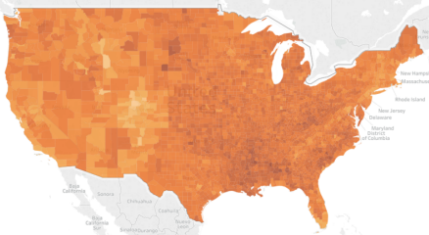
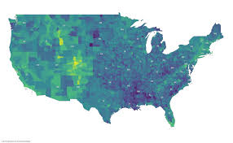

Predicting Station Location Candidates
Present-Day Usage
Visual Analysis: U.S. map showing areas of high usage
Future Usage
Time Series Analysis to predict future cars sold in each area
  Evaluate Regime Shift Analysis brought on by Policy Incentives
  Estimate usage based on model from previous slide
This approach allows us to determine both the best - and the worst - place to invest in charging stations.

Slide 7
Target Market

Slide 8
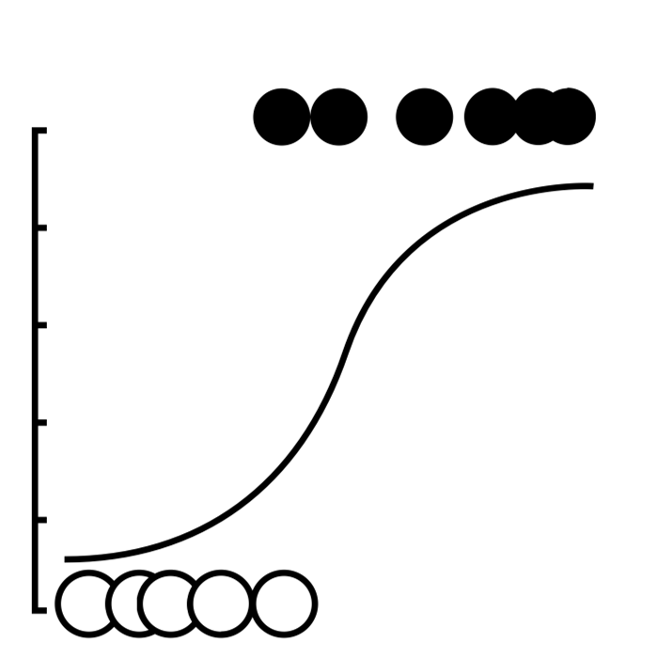
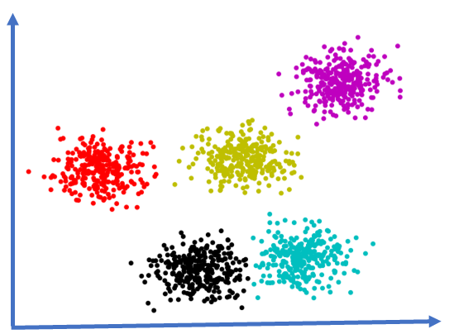
Describing the Target Market
Among EV purchasers, identify those most likely to purchase high end EV
Data Assumptions:
  Population Demographics data includes household income (including debt load), marital status, gender, children, race, education, general dwelling information, political affiliation
  EV Laws and Incentive Programs data includes incentive amount for each state
Predict future consumer base for high end EVs
Logistic Regression
Simply predict future consumers likely to purchase
Cluster Analysis
Create target market groups to pursue and avoid
Factors from Variable Reduction based on:
AND
EV Incentives
Political Affiliation
Pop. Demographics
Geography
This allows us to predict specific customers, as well as understand general traits of the market for high-end EVs.

Slide 9
Supplemental Datasets
Wealth by County in the U.S.
Consumer Sentiment Index (How are we feeling about the economy?)
Unemployment Rate (Historical and Forecasted)
Consumer Price Index (Inflation - Forecasted)

Slide 10
EV Marketing Strategy

Slide 11
Product + Market = Perfection
Use findings from Charging Station Analysis to:
  Optimize the mix of charging station attributes to maximize station use
  Predict the best (and worst) locations for future charging stations
Use Findings from Target Market Analysis to:
  Predict which specific consumers are likely to purchase a high-end EV (like Porsche)
  Identify groups who are likely to purchase a high-end EV
  Identify driving traits (irrespective of groups) that make one likely to a high-end EV

Slide 12





Positioning Porsche for Promotions
Urban
Goal: Create a perceptual map that outlines where Porsche stands relative to other EV makers in market
Utilitarian
Stylish
Supplemental Datasets:
  Brand Sentiment for most popular EV makers
Outdoorsy
This will inform future promotions for marketing, helping to position Porsche EVs in marketing materials.

Slide 13
Key Takeaways
Charging Station Analysis
Usage Optimization & Finding Strong Location Candidates
Target Market
Identify specific customers, general groups and traits that define target markets for high-end EVs
EV Marketing Strategy
Product + Market + Positioning via Perceptual Map

