Slide 1


荷塘雨课堂
播放ppt
腾讯会议
双向语音/视频交流
1. 开启荷塘雨课堂（请关闭音频输出，可以点名、白板、做题、弹幕等）
2. 开启腾讯会议（请保持静音，一般关闭摄像头，发言前解除静音）
雨课堂可以看ppt，腾讯会议可以看现场板书，
建议分别用两个终端打开。

Slide 2
Chapter 4 Continuous-Time Fourier Transform

Slide 3
Recall: Fourier Series for Periodic Signals
Continuous-time Fourier series for periodic signals
System function
Frequency response
Synthesis equation
Analysis equation
What about aperiodic signals?

Slide 4
Outline
Fourier Transform of Aperiodic Signal
Fourier Transform of Periodic Signal
Properties of Fourier Transform
Convolution Property of Fourier Transform
Multiplication Property of Fourier Transform
LTI System Characterized by Differential Equations

Slide 5
Fourier Series of Periodic Square Wave
§4.1 Fourier Transform of Aperiodic Signal
Fourier series of CT period square wave

Slide 6
Fourier Series of Periodic Square Wave (cont’)
§4.1 Fourier Transform of Aperiodic Signal
Duty cycle ratio

Slide 7
Another Explanation of FS coefficients
§4.1 Fourier Transform of Aperiodic Signal
Fix T₁
Envelope of Ta_{k}
FS coefficients are the samples of the envelope
What if T→∞ ?

Slide 8
Aperiodic Signal vs Periodic Signal
§4.1 Fourier Transform of Aperiodic Signal
signal with finite duration
Aperiodic signal can be viewed as the limit of a periodic signal with T→∞

Slide 9
From Fourier Series to Fourier Transform
§4.1 Fourier Transform of Aperiodic Signal
Fourier series of periodic signal
Fourier coefficients
Define the envelope of Ta_{k} as
Fourier Transform

Slide 10
From Fourier Series to Fourier Transform
§4.1 Fourier Transform of Aperiodic Signal
Recall: synthesis function
As T→∞,
On the other hand,
→
Q: How does summation become integral?
Inverse Fourier Transform

Slide 11
Fourier Transform Pair
§4.1 Fourier Transform of Aperiodic Signal
Fourier Transform, or Fourier Integral (analysis equation)
X(jω) is the spectrum of x(t)
Inverse Fourier Transform (synthesis function: linear combination of complex exponentials)

Slide 12
FS Coefficients and FT
§4.1 Fourier Transform of Aperiodic Signal
For the periodic signal , the FS coefficients {a_{k}}
{a_{k}}is the evenly spaced samples of the FT of one period of
Q: What’s the sampling space?
periodic ←→discrete

Slide 13
Convergence of Fourier Transform
§4.1 Fourier Transform of Aperiodic Signal
For any continuous-time signal x(t), define the error function e(t) of Fourier transform
Convergence: e(t) is equal to 0 for any t except the discontinuity points

Slide 14
Fourier Transform Convergence Conditions
§4.1 Fourier Transform of Aperiodic Signal
Condition set #1: square integrable
Conditions set #2 (Dirichlet Conditions)
x(t) is absolutely integrable
x(t) has a finite number maxima and minima within any finite interval
x(t) has a finite number of finite discontinuities within any finite interval
Both condition sets are sufficient for convergence, but not necessary
periodic impulse signal…

Slide 15
Fourier Transform of Impulse
§4.1 Fourier Transform of Aperiodic Signal
x(t)=δ(t)
The impulse signal is “white”
x(t)=u(t)
Q:correct?

Slide 16
Example 4.1
§4.1 Fourier Transform of Aperiodic Signal
1) a is real and a>0
2) a is complex and Re{a}>0, then x(t) is absolutely integrable, the above Fourier transform is valid

Slide 17
Example 4.2
§4.1 Fourier Transform of Aperiodic Signal

Slide 18
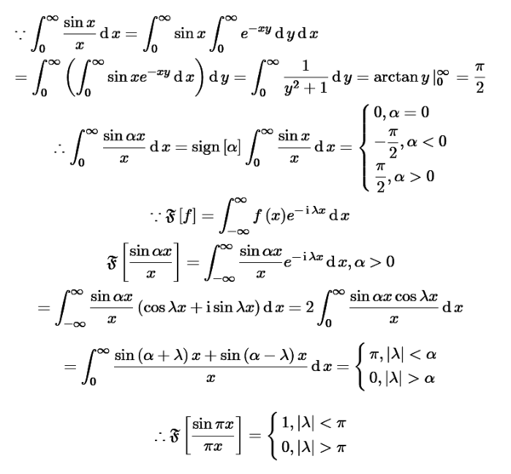
sinc() function and Sa() function
§4.1 Fourier Transform of Aperiodic Signal
Courtesy: https://www.zybang.com/

Slide 19
Rectangle Pulse
§4.1 Fourier Transform of Aperiodic Signal
Q1: check
Does it equals to x(t)? Yes, except t=T₁
Discontinuity point? 1/2
Q2: check
Overshoot always exists though W→∞
Duality Property

Slide 20
Fourier Transform of Complex Exponential
§4.2 Fourier Transform of Periodic Signal
Consider inverse Fourier transform instead

Slide 21
Fourier Transform of Periodic Signal
§4.2 Fourier Transform of Periodic Signal
FT of a periodic signal is a train of impulses (frequency domain) which are not zero at only the harmonically related frequencies
The amplitude of the impulses (frequency domain) is determined by the Fourier transform of the signal limited within one period
periodic ←→discrete

Slide 22
Fourier Transform of Periodic Square Wave
§4.2 Fourier Transform of Periodic Signal
Example: D=2T₁/T=0.5

Slide 23
Fourier Transform of Sinusoidal Signals
§4.2 Fourier Transform of Periodic Signal

Slide 24
Fourier Transform of Sinusoidal Signals (cont’)
§4.2 Fourier Transform of Periodic Signal

Slide 25
Fourier Transform of Periodic Impulse Train
§4.2 Fourier Transform of Periodic Signal
Periodic impulse train
--NOT absolutely integrable ！
Fourier series
Fourier transform
periodic ←→discrete

Slide 26
Extra Notation for Fourier Transform
§4.3 Fourier Transform Properties

Slide 27
Linearity of Fourier Transform
§4.3 Fourier Transform Properties

Slide 28
Time Shifting
§4.3 Fourier Transform Properties
Time shift does not change the magnitude of FT
Time shift only leads to phase shift

Slide 29
Example 4.9
§4.3 Fourier Transform Properties
For rectangle pulse

Slide 30
Conjugation and Conjugate Symmetry
§4.3 Fourier Transform Properties
Conjugation property:
If x(t) is real, X*(-jω)=X(jω) (Conjugate Symmetry)
Example:

Slide 31
Extra Discussion on Conjugate Symmetry
§4.3 Fourier Transform Properties
If x(t) is real, X*(-jω)=X(jω) (Conjugate Symmetry)
→If x(t) is real, the real part of X(jω) is even, and the imaginary part of X(jω) is odd
→If x(t) is real, the magnitude of X(jω) is even, and the phase of X(jω) is odd

Slide 32
Fourier Transform of Real Signal
§4.3 Fourier Transform Properties
If x(t) is real, X*(-jω)=X(jω) (Conjugate Symmetry)
If x(t) is real and even, then X(jω) is real and even
Example 4.2
If x(t) is real and odd, then X(jω) is purely imaginary and odd

Slide 33
Fourier Transform of Even and Odd Functions
§4.3 Fourier Transform Properties
Any signal is the summation of an even function and an odd function
If x(t) is real, then x_{e}(t) and x_{o}(t) are both real
is real and even, is purely imaginary and odd

Slide 34
Example 4.10
§4.3 Fourier Transform Properties

Slide 35
Differentiation and Integration
§4.3 Fourier Transform Properties
Differentiation property
Integral Property
Example 4.11
Q: Always valid?
A: Valid if NO dc component
Note that

Slide 36



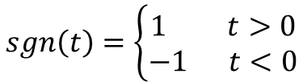
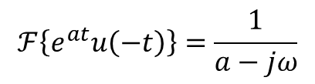
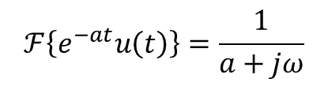


Fourier Transform of sgn(t)
§4.3 Fourier Transform Properties
signum function: no definition for t=0
double-side odd-symetric exponential function
FT of sgn(t)
$$sgn\left(t\right)=\left\{\begin{matrix}1 t>0 \\ −1 t<0\end{matrix}\right.$$
$$sgn\left(t\right)=u\left(t\right)−u(−t)$$
$$x\left(t\right)=e^{−at}u\left(t\right)−e^{at}u(−t)$$
$$ℱ\left\{e^{−at}u\left(t\right)\right\}=\frac{1}{a+jω}$$
$$ℱ\left\{e^{at}u\left(−t\right)\right\}=\frac{1}{a−jω}$$
$ℱ\left\{x\left(t\right)\right\}=\frac{1}{a+jω}−\frac{1}{a−jω}$=$\frac{−2jω}{a^{2}+ω^{2}}$
$$sgn\left(t\right)=\lim_{a→0}{x(t)}$$
$ℱ\left\{x\left(t\right)\right\}=\lim_{a→0}{\frac{−2jω}{a^{2}+ω^{2}}}$=$\frac{2}{jω}$

Slide 37
Fourier Transform of Constant Signal C and Step Signal
§4.3 Fourier Transform Properties
Q: Why cannot use differentiation property for u(t)?
A: There is dc component in u(t)

Slide 38
Scaling/Reversal
§4.3 Fourier Transform Properties
Scaling property
Time reversal

Slide 39
Duality of Fourier Transform
§4.3 Fourier Transform Properties
Duality #1: Symmetry (not identical) between the Fourier transform pair
Example:
Duality #2: If a certain operation in the time domain leads to some alternation on Fourier transform, then the same operation in the frequency domain implies the symmetry (not identical) alternation to the time domain signal
Example:
Correct?

Slide 40
Parseval’s Relation
§4.3 Fourier Transform Properties
Power density spectrum

Slide 41
Some Observation of Fourier Transform and Fourier Series
Fourier transform of aperiodic signal is usually continuous in the frequency domain
Fourier transform of periodic signal is an impulse train which is not zero only for the harmonically related frequencies
Fourier transform of a periodic signal can be viewed as the sampled version of the Fourier transform of its single-period signal
Fourier series of a periodic signal can be viewed as a special representation of its Fourier transform
periodic ←→discrete

Slide 42
System Response Based on Fourier Series
§4.4 Convolution Property of Fourier Transform
Inverse Fourier transform can be written as the limit of a sum (change integral to limit of sum)
LTI system response to eigen-function
system response to x(t) by superposition

Slide 43
System Response in Frequency-Domain Based on FS
§4.4 Convolution Property of Fourier Transform
LTI system response (change sum limit to integral)
Fourier transform of LTI system response
Convolution property: convolution in the time domain corresponds to multiplication in the frequency domain

Slide 44
Convolution Property of Fourier Transform -- Formal Derivation from Convolution Integral
§4.4 Convolution Property of Fourier Transform
Recall: convolution integral
Fourier transform of y(t)
Interchange the order of integration
By the time-shift property
Note that
Convolution property of Fourier transform
Property of FT
Property of system

Slide 45
System Function and System Response
§4.4 Convolution Property of Fourier Transform
Impulse response: h(t)
System function:
Frequency response of a system:
Time-domain response to any signal x(t)
Frequency-domain response to any signal x(t)
Time-domain response y(t)=F⁻¹{Y(jω)}

Slide 46
System Cascade
§4.4 Convolution Property of Fourier Transform
Associative property of convolution
→Response of cascaded systems
Frequency response of cascaded systems

Slide 47
Example 4.15
§4.4 Convolution Property of Fourier Transform
Impulse response: h(t)=δ(t-t₀)
Frequency response by the time-shift property
For any input x(t), Fourier transform of output y(t)
By the time-shift property

Slide 48
Differentiation/Integration Systems
§4.4 Convolution Property of Fourier Transform
Differentiation system
apply FT to both sides
 frequency response
Integration system

Slide 49
Ideal Lowpass Filter
§4.4 Convolution Property of Fourier Transform
Ideal Lowpass frequency response
Impulse response
☺ Pros: perfect frequency selectivity
☹ Cons: not causal, not easy to approximate, oscillatory behavior

Slide 50
Example 4.19
§4.4 Convolution Property of Fourier Transform
LTI, impulse response
Input signal
Output spectrum
Output signal y(t)=F⁻¹{Y(jω)}
① a≠b, ② a=b

Slide 51
Multiplication Property
§4.5 Multiplication Property of Fourier Transform
Convolution property: convolution in the time domain corresponds to multiplication in the frequency domain
Multiplication Property (Modulation Property): multiplication in the time domain corresponds to convolution in the frequency domain
Q: How to prove it?

Slide 52
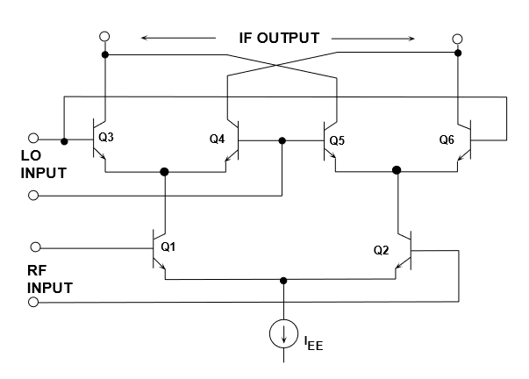
Example 4.21: Up-Conversion
§4.5 Multiplication Property of Fourier Transform
Sinusoidal signal
amplitude modulation: r(t)=p(t)s(t) (mixer)
Active mixer (courtesy: www.analog.com)

Slide 53
Spectrum Up-Conversion
§4.5 Multiplication Property of Fourier Transform

Slide 54
Spectrum Down-Conversion
§4.5 Multiplication Property of Fourier Transform
g(t)=p(t)r(t)
Q: How to recover original s(t)?

Slide 55
Exercise: Example 4.23
§4.5 Multiplication Property of Fourier Transform
(make sure to solve it by yourself after class)

Slide 56
Frequency Response of LTI Systems
§4.7 System Characterized by Linear DE
LTI system described by Nth-order linear constant-coefficient differential equation
Apply Fourier transform to both sides
By linear property
Frequency response of system

Slide 57
How to Find Time-Domain Response
§4.7 System Characterized by Linear DE
1. Find the system frequency response
2. For any input signal x(t), find its Fourier transform X(jω)
3. Calculate the spectrum of the output signal
Y(jω)=H(jω)X(jω)
4. Perform the inverse Fourier transform to find y(t)
y(t)=F⁻¹{Y(jω)}

Slide 58
Example 4.25: Impulse Response
§4.7 System Characterized by Linear DE
System differential equation
Frequency response
Impulse input
Output spectrum
Inverse Fourier transform gives
Actually, h(t) can be directly calculated by F⁻¹{H(jω)}

Slide 59
Example 4.26
§4.7 System Characterized by Linear DE
The same system as Eg. 4.25
Input signal
Output spectrum
Partial-fraction expansion with multiple-root
By inverse Fourier transform

Slide 60
Summary
How to relate FS and FT?
FT of Typical Signals
Properties of FT
Convolution Property and Multiplication Property
Frequency Response, Frequency-Domain Response and Time-Domain Response

Slide 61
Discussion
What’s the inverse Fourier transform of ?

