Slide 1


荷塘雨课堂
播放ppt
腾讯会议
双向语音/视频交流
1. 开启荷塘雨课堂（请关闭音频输出，可以点名、白板、做题、弹幕等）
2. 开启腾讯会议（请保持静音，一般关闭摄像头，发言前解除静音）
雨课堂可以看ppt，腾讯会议可以看现场板书，
建议分别用两个终端打开。

Slide 2
Chapter 9 The Laplace Transform

Slide 3
Limitation of Fourier Transform
§9.1 Laplace Transform
Recall: Fourier Transform
Convergence--Dirichlet Condition #1: absolutely integrable
What if x(t) and/or h(t) is not absolutely integrable? Unstable!
☹ The Fourier transform can not be used for unstable system/signals
The Laplace transform can be used to analyze unstable systems/signals
Not just to handle unstable systems/signals
The Laplace transform is more powerful in many ways

Slide 4
Outline
Laplace Transform
Region of Convergence for Laplace Transform
Inverse Laplace Transform
Laplace Transform Properties
LTI System Analysis Using Laplace Transform
System Block Diagram

Slide 5
Laplace Transform
§9.1 Laplace Transform
Recall: LTI system response to eigen-function
H(s) is the Laplace transform of h(t)
If s is purely imaginary, then H(s) is the Fourier Transform
Laplace transform:
Laplace transform operator

Slide 6
Relationship between Fourier Transform and Laplace Transform
§9.1 Laplace Transform
Fourier transform is a special case of Laplace transform when s is purely imaginary
Laplace transform of x(t) is the Fourier transform of x(t)e^{-σt}
This Fourier transform may NOT converge!
Q: Is the relationship really that simple?

Slide 7
Example 9.1
§9.1 Laplace Transform
signal x(t)=e^{-at}u(t)
Fourier transform converges only when a>0
Laplace transform
When

Slide 8
Example 9.2
§9.1 Laplace Transform
signal x(t)=-e^{-at}u(-t)
Fourier transform converges only when a<0
Laplace transform
When

Slide 9
Region of Convergence (ROC)
§9.1 Laplace Transform
Two different signals, the same expression for Laplace transform
Region of Convergence (ROC): the range of values of s for which the Laplace integral converges
?
Laplace transform = integral + ROC
Q: Laplace transform of δ(t)? ROC?

Slide 10
ROC on the s-plane
§9.1 Laplace Transform
Example 9.1
Example 9.2

Slide 11
Example of ROC (Example 9.3)
§9.1 Laplace Transform

Slide 12
ROC of Complex Exponential
§9.1 Laplace Transform
ROC is only dependent on the real part (a), but not on the imaginary part (jb)

Slide 13
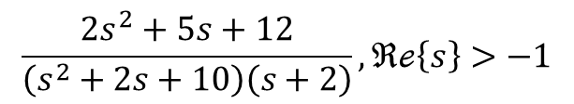
Poles/Zeros of Rational Laplace Transform
§9.1 Laplace Transform
Rational Laplace transform: ratio of rational functions (polynomials)
X(s) is rational if x(t) is a linear combination of real/complex exponentials
Zeros: roots of numerator polynomial N(s)
Poles: roots of denominator polynomial D(s)
pole-zero plot: representation of X(s) through its poles and zeros in the s-plane
Example:
$$\frac{2s^{2}+5s+12}{\left(s^{2}+2s+10\right)\left(s+2\right)}, ℜℯ\left\{s\right\}>−1$$

Slide 14
Pole-Zero Plot
§9.1 Laplace Transform
Q: How to define pole/zero of infinity?

Slide 15
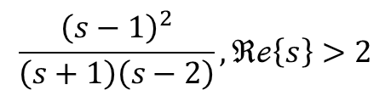
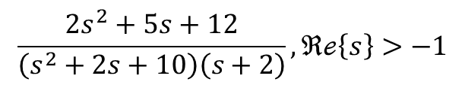
Laplace Transform Convergence vs. Fourier Transform Convergence
§9.1 Laplace Transform
If the Laplace transform ROC does not contain the jω-axis, then the Fourier transform does not converge
$$\frac{2s^{2}+5s+12}{\left(s^{2}+2s+10\right)\left(s+2\right)}, ℜℯ\left\{s\right\}>−1$$
$$\frac{{\left(s−1\right)}^{2}}{\left(s+1\right)\left(s−2\right)}, ℜℯ\left\{s\right\}>2$$

Slide 16
Properties of Laplace Transform ROC
§9.2 ROC for Laplace Transform
Property #2: The ROC does not contain the poles
Question: How to find X(s) for the poles? →Use L’hospital’s Rule
Property #3: If x(t) is of finite duration and absolutely integrable, then the ROC is the s-plane
Question: example?
δ(t)

Slide 17
Sided Signals
§9.2 ROC for Laplace Transform
Right-sided signal: There exists a finite time T₁, x(t)=0 for t<T₁
Property #4: Right-sided signal has an ROC (if exists) containing a right-sided plane
right-sided plane is not the half-plane right to jω axis
Left-sided signals: There exists a finite time T₁, x(t)=0 for t>T₁
Property #5: Left-sided signal has an ROC (if exists) containing a left-sided plane
Property #6: The ROC of a two-sided signal (if exists) contains a strip in parallel with the jω axis

Slide 18
Properties of Laplace Transform ROC
§9.2 ROC for Laplace Transform
Property #7: Rational Laplace transform X(s), ROC is bounded by poles or extended to infinity
entire s-plane
left-sided plane for left-side signals
right-sided plane for right-side signals
a single strip for two-sided signals

Slide 19
Inverse Laplace Transform
§9.3 Inverse Laplace Transform
Recall: Fourier transform pair
Laplace transform based on Fourier transform
Inverse FT
Change the integration variable to s
Inverse Laplace transform

Slide 20
How to Solve Inverse Laplace Transform
§9.3 Inverse Laplace Transform
Formal inverse Laplace transform requires contour integration in the complex plane
For rational Laplace transform, use partial-fraction expansion
If ROC is to the right of s=-a_{i}
If ROC is to the left of s=-a_{i}
Q: pole inside ROC?
A: See ROC property #8

Slide 21
Examples of Inverse Laplace Transform
§9.3 Inverse Laplace Transform

Slide 22
Linearity of Laplace Transform
§9.5 Laplace Transform Properties
Discussion:
If the intersection of R₁ and R₂ is empty, no Laplace transform
x₁(t)=x₂(t), and a=-b, then ROC becomes the entire s-plane

Slide 23
ROC Extension by Pole-Zero Cancellation
§9.5 Laplace Transform Properties

Slide 24
Time Shifting of Laplace Transform
§9.5 Laplace Transform Properties
Discussion: Laplace transform exists does not necessarily mean that X(s) is bounded

Slide 25
Time Scaling of Laplace Transform
§9.5 Laplace Transform Properties
Q: Is Eq. (9.90) correct?
Compression in the time domain ←→ Expansion in the s-domain
Time reversal

Slide 26

s-Domain Shifting
§9.5 Laplace Transform Properties
zero z→z+s₀, pole p→p+s₀
A special case: s₀=jω₀
frequency modulation → shift in the s-plane along the jω axis
$e^{jω_{0}t}x(t)\underset{↔}{ℒ}X(s−jω_{0})$, with ROC R₁=R

Slide 27
Conjugation
§9.5 Laplace Transform Properties
A useful observation: if x(t) is real, then any complex pole/zero must exist as a conjugate pair, i.e., if s₀ is complex and a pole/zero, then s₀* is also a pole/zero

Slide 28
Convolution Property of Laplace Transform
§9.5 Laplace Transform Properties
Discussion: the ROC of convolution might be larger than R₁∩R₂
Q: Any example?
Pole-Zero Cancellation

Slide 29
Differentiation in Time Domain
§9.5 Laplace Transform Properties
Recall: Inverse Laplace transform
Differentiate both sides w.r.t t
If X(s) has a first-order pole at s=0, then ROC of sX(s) may be larger than ROC of X(s)
Example: x(t)=u(t), X(s)=1/s, ROC=right half plane

Slide 30
Differentiation in s-Domain
§9.5 Laplace Transform Properties
Recall Laplace transform
Differentiate both sides w.r.t s
Q: Any problem with the new ROC?
A: The new ROC is correct if X(s) is rational. We can expand X(s) as the combination of first-order fractions.

Slide 31
Differentiation in s-Domain--Examples
§9.5 Laplace Transform Properties
Partial-fraction expansion

Slide 32
Integration in Time Domain
§9.5 Laplace Transform Properties
Integration ←→convolution
Convolution property +

Slide 33
Initial-Value and Final-Value Theorems
§9.5 Laplace Transform Properties
Assumption: x(t)=0 for t<0, and x(t) contains no impulses or higher order singularities
Initial-value theorem
Final-value theorem
Check Example 9.3
Homework: Prove them.

Slide 34
Laplace Transform Pairs
§9.6 Laplace Transform Pairs
Usually a signal is right-sided, and the corresponding ROC is the right-sided plane.
→ Usually we take the right-sided signals and right-sided plane ROC as the default

Slide 35
System Function / Transfer Function
§9.7 LTI System Analysis Using Laplace Transform
Recall convolution integral: LTI system with the impulse response: h(t), the time-domain response to any signal x(t)
Based on convolution property of L-transform
H(s) is called the system function or transfer function

Slide 36
System Causality
§9.7 LTI System Analysis Using Laplace Transform
Recall: A system is causal if the output at any time is not dependent on the input after that time
A LTI system is causal if and only if h(t)=0 for t<0
Statement #1: If a LTI system is causal, the ROC of the system function is a right-sided plane (sufficient, not necessary)
Statement #2: If a LTI system is causal with a rational H(s), causality is equivalent to that the ROC of the system function is a right-sided plane to the right of the rightmost pole (sufficient and necessary)
Q: How to prove? (convolution integral)

Slide 37
System Causality--Examples
§9.7 LTI System Analysis Using Laplace Transform
1st example of Statement #2 (rational, causal, ROC is a right-sided plane)
2nd example of Statement #2 (rational, not causal, ROC is not a right-sided plane)
An example that shows Statement #1 is sufficient but not necessary (not rational, ROC is a right-sided plane, not causal)
Q1: pole(s)?
Q2: How to do Laplace transform?
(Time Shifting)

Slide 38
System Stability
§9.7 LTI System Analysis Using Laplace Transform
Stability: (Chapter 1) A system is stable if any bounded input produces a bounded output.
A system is stable if and only if h(t) is absolutely integrable
Statement #1: A LTI system is stable if and only if the ROC of H(s) includes the entire jω axis
If the 2nd and 3rd conditions of Dirichlet Conditions are satisfied, then absolutely integrable ←→ Fourier transform convergence
Statement #2: A causal system with rational H(s) is stable if and only if all poles of H(s) are left-half-plane poles
causality → ROC is to the right of rightmost poles
Q: How to prove it ? (Problem 2.49)

Slide 39
System Stability—Example 9.20
§9.7 LTI System Analysis Using Laplace Transform
Q: Statement #2 valid?
Not causal!

Slide 40
System Stability—2nd Order System
§9.7 LTI System Analysis Using Laplace Transform
System function
If the system is causal
a) ζ<-1, 2 right-half-plane real poles
b) -1<ζ<0, 2 right-half-plane conjugate poles
c) 0<ζ<1, 2 left-half-plane conjugate poles
d) ζ>1, 2 left-half-plane real poles
Unstable
Unstable
Stable
Stable

Slide 41
System Function of LTI System
§9.7 LTI System Analysis Using Laplace Transform
LTI system described by Nth-order linear constant-coefficient differential equation
Apply Laplace transform to both sides
By linearity property
System function
Q1: Does DE itself specify the LTI system?
Q2： Causality→ROC?

Slide 42
System Function of RLC System
§9.7 LTI System Analysis Using Laplace Transform
Q1: ROC?
Q2: Stable?

Slide 43
Example 9.25
§9.7 LTI System Analysis Using Laplace Transform
LTI system
Apply Laplace transform
By definition
ROC of Y(s) must contain the intersection of ROC of X(s) and ROC of H(s) (Convolution Property)
Discussion: 3 possible choices of ROC of H(s)
ROC?

Slide 44
Example 9.26
§9.7 LTI System Analysis Using Laplace Transform
(1)
(2) eigen-value
(3)initial-value theorem

Slide 45
Interconnections of LTI Systems
§9.8 System Block Diagram
Series connection
Parallel connection

Slide 46
Feedback Connection
§9.8 System Block Diagram
Feedforward/Open-loop transfer function H₁(s)
Feedback transfer function H₂(s)
Loop transfer function H₁(s) H₂(s)
Closed-loop transfer function H₁(s) /[1+H₁(s) H₂(s)]
Q: How to derive it?

Slide 47
1st-order Integrator
§9.8 System Block Diagram
(a)
(b) Feedback connection

Slide 48
2nd-order Filter (no zero)
§9.8 System Block Diagram

Slide 49
2nd-order Filter (2 poles, 2 zeros)
§9.8 System Block Diagram

Slide 50
Summary
Why Laplace transform?
Laplace transform = integral + ROC
ROC and poles
Inverse Laplace transform—still keep watch on ROC

Slide 51
Unilateral Laplace Transform
§9.9 Unilateral Laplace Transform
Unilateral Laplace Transform
unilateral Laplace transform pair
Unilateral L-transform can be used to analyze causal systems, especially linear systems defined by constant-coefficient DEs
especially usefully for system response analysis with none-zero initial states

Slide 52



Unilateral L-Transform vs. Bilateral L-Transform
§9.9 Unilateral Laplace Transform
Unilateral Laplace Transform
$$𝒳\left(s\right)=\int_{0^{−}}^{+∞}{x\left(t\right)e^{−st}dt}$$
$$x\left(t\right)\underset{↔}{𝒳ℒ}𝒳\left(s\right)=𝒰ℒ\{x(t)\}$$
Bilateral Laplace Transform
$$X\left(s\right)=\int_{−∞}^{+∞}{x(t)e^{−st}dt}$$
$$x\left(t\right)\underset{↔}{ℒ}X\left(s\right)=ℒ\{x(t)\}$$
$$𝒳\left(s\right)=ℒ\{x\left(t\right)u(t)\}$$
Unilateral Laplace Transform: L-transform or right-sided signal → ROC: right-sided plane

Slide 53


Eg. 9.32
§9.9 Unilateral Laplace Transform
$x\left(t\right)=\frac{t^{n−1}}{\left(n−1\right)!}e^{−at}u(t)$
$X\left(s\right)=\frac{1}{{(s+a)}^{n}}, ℛe\left\{s\right\}>−a$
$x\left(t\right)=\frac{t^{n−1}}{\left(n−1\right)!}e^{−at}u(t)$
$𝒳\left(s\right)=\frac{1}{{(s+a)}^{n}}, ℛe\left\{s\right\}>−a$

Slide 54
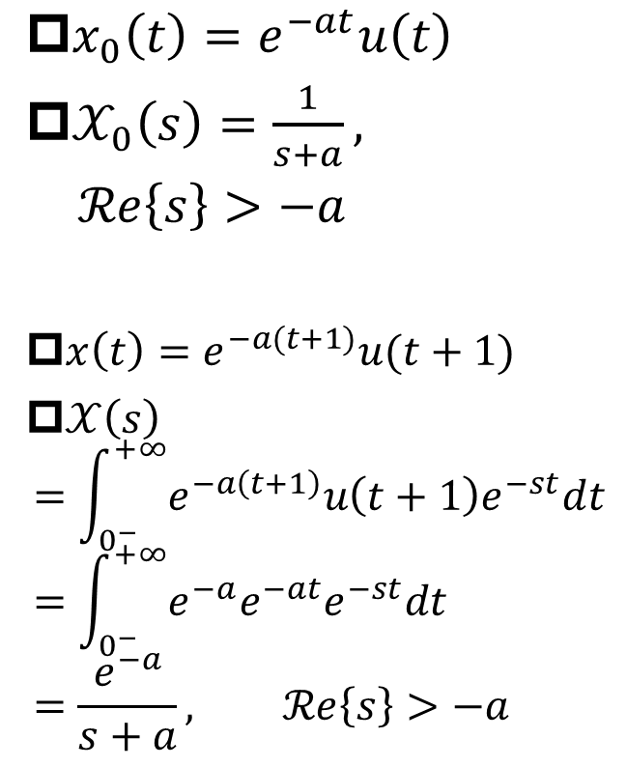
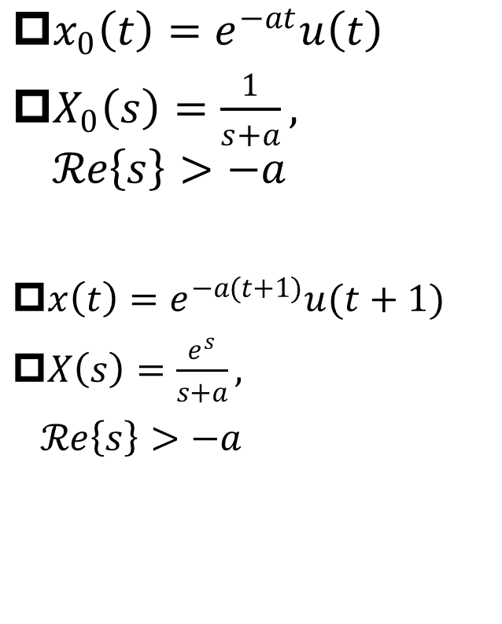
Eg. 9.33
§9.9 Unilateral Laplace Transform
$x_{0}\left(t\right)=e^{−at}u\left(t\right)$
$X_{0}\left(s\right)=\frac{1}{s+a}, ℛe\left\{s\right\}>−a$
$x\left(t\right)=e^{−a(t+1)}u(t+1)$
$X\left(s\right)=\frac{e^{s}}{s+a},$
$ℛe\left\{s\right\}>−a$
$x_{0}\left(t\right)=e^{−at}u\left(t\right)$
$𝒳_{0}\left(s\right)=\frac{1}{s+a},$
$ℛe\left\{s\right\}>−a$
$x\left(t\right)=e^{−a(t+1)}u(t+1)$
$𝒳\left(s\right)$
$$=\int_{0^{−}}^{+∞}{e^{−a\left(t+1\right)}u\left(t+1\right)e^{−st}dt}=\int_{0^{−}}^{+∞}{e^{−a}e^{−at}e^{−st}dt}=\frac{e^{−a}}{s+a}, ℛe\left\{s\right\}>−a$$

Slide 55
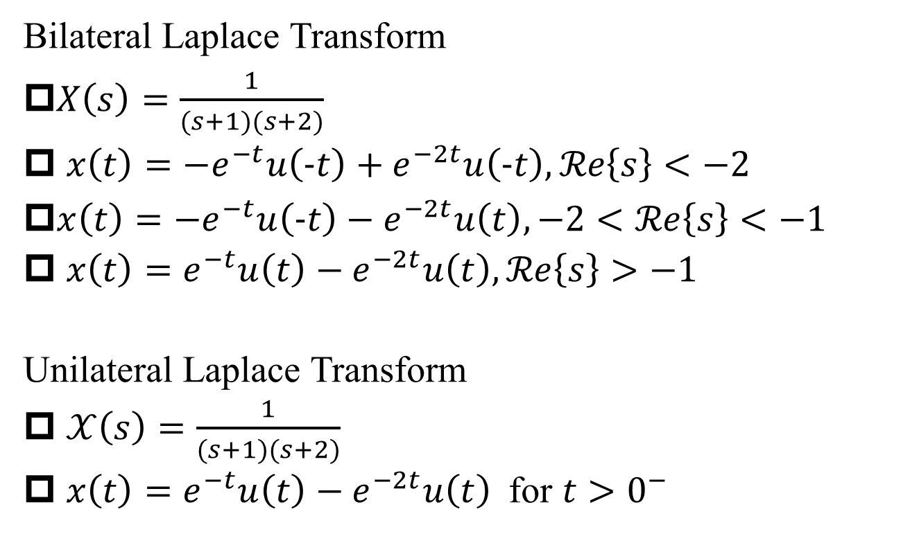
Eg. 9.35
§9.9 Unilateral Laplace Transform
Bilateral Laplace Transform
$X\left(s\right)=\frac{1}{(s+1)(s+2)}$
$x\left(t\right)={−e}^{−t}u\left(−t\right)+e^{−2t}u\left(−t\right), ℛe\left\{s\right\}<−2$
$x\left(t\right)=−e^{−t}u\left(−t\right)−e^{−2t}u\left(t\right), −2<ℛe\left\{s\right\}<−1$
$x\left(t\right)=e^{−t}u\left(t\right)−e^{−2t}u\left(t\right), ℛe\left\{s\right\}>−1$
Unilateral Laplace Transform
$𝒳\left(s\right)=\frac{1}{(s+1)(s+2)}$
$x\left(t\right)=e^{−t}u\left(t\right)−e^{−2t}u\left(t\right) \text{for} t>0^{−}$
Q: How about t<0?
A: Not specified!

Slide 56

Convolution Property of Unilateral L-Transform
§9.9 Unilateral Laplace Transform
for all t<0, x₁(t)=0, x₂(t)=0
$$x_{1}(t)∗x_{2}(t)\underset{↔}{𝒰ℒ}𝒳_{1}(s)∙𝒳_{2}(s)$$
If either x₁(t) or x₂(t) is nonzero for t<0, the convolution property does NOT hold

Slide 57
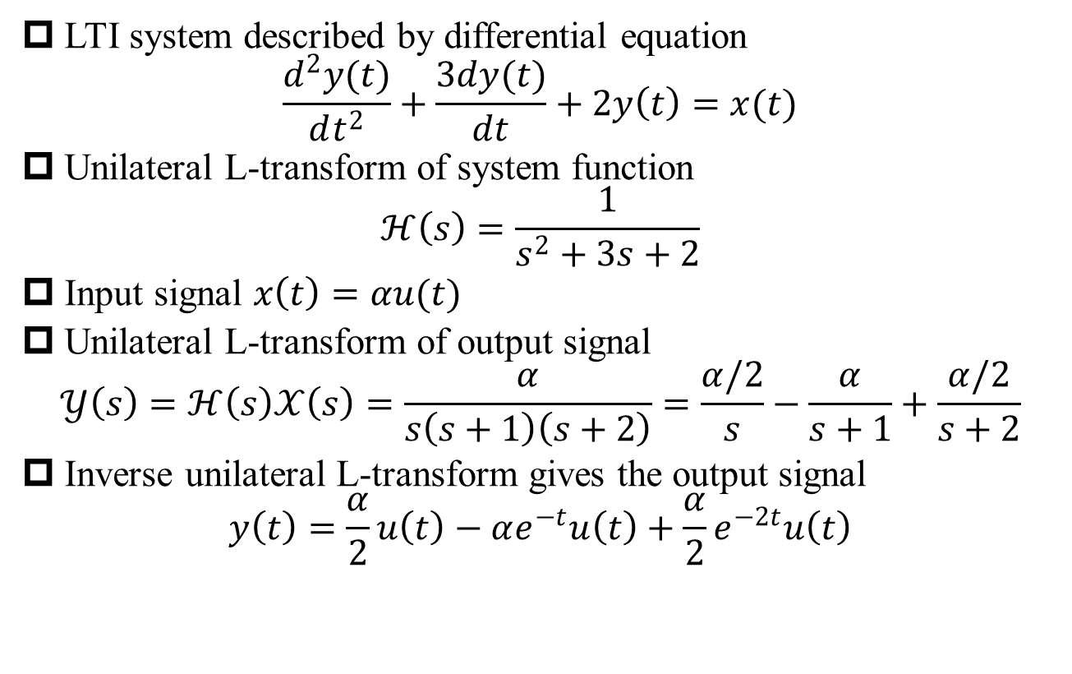
Eg. 9.37
§9.9 Unilateral Laplace Transform
LTI system described by differential equation
$$\frac{d^{2}y(t)}{dt^{2}}+\frac{3dy(t)}{dt}+2y\left(t\right)=x(t)$$
Unilateral L-transform of system function
$$ℋ\left(s\right)=\frac{1}{s^{2}+3s+2}$$
Input signal $x\left(t\right)=αu(t)$
Unilateral L-transform of output signal
$$𝒴\left(s\right)=ℋ\left(s\right)𝒳\left(s\right)=\frac{α}{s\left(s+1\right)\left(s+2\right)}=\frac{α/2}{s}−\frac{α}{s+1}+\frac{α/2}{s+2}$$
Inverse unilateral L-transform gives the output signal
$$y\left(t\right)=\frac{α}{2}u\left(t\right)−αe^{−t}u\left(t\right)+\frac{α}{2}e^{−2t}u\left(t\right)$$

Slide 58
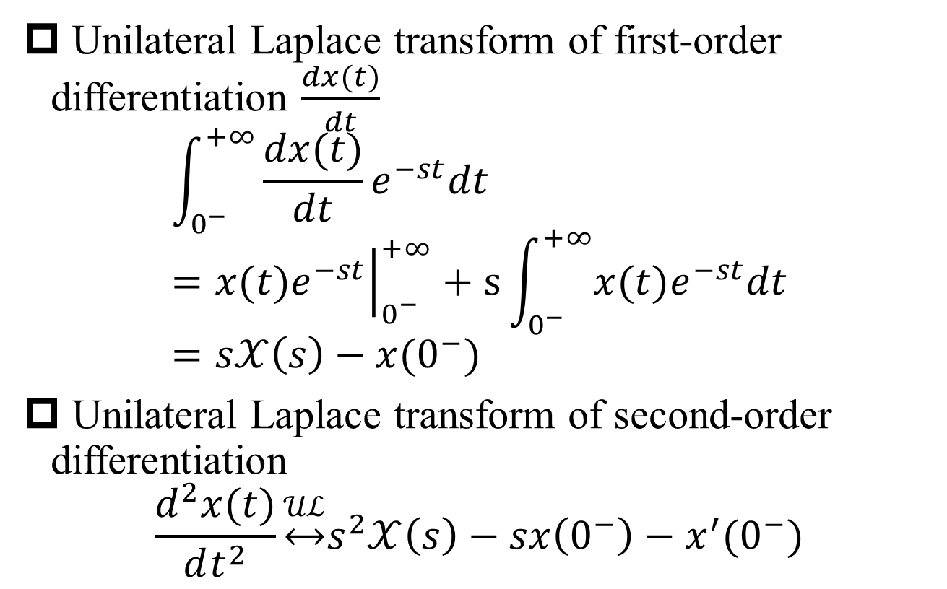
Differentiation Property
§9.9 Unilateral Laplace Transform
Unilateral Laplace transform of first-order differentiation $\frac{dx(t)}{dt}$
$$\int_{0^{−}}^{+∞}{\frac{dx(t)}{dt}e^{−st}dt}={\left.x(t)e^{−st}\right|}_{0^{−}}^{+∞}+s\int_{0^{−}}^{+∞}{x(t)e^{−st}dt}=s𝒳\left(s\right)−x(0^{−})$$
Unilateral Laplace transform of second-order differentiation
$$\frac{d^{2}x(t)}{dt^{2}}\underset{↔}{𝒰ℒ}s^{2}𝒳\left(s\right)−sx\left(0^{−}\right)−x^{′}(0^{−})$$
Different from bilateral L-transform case

Slide 59
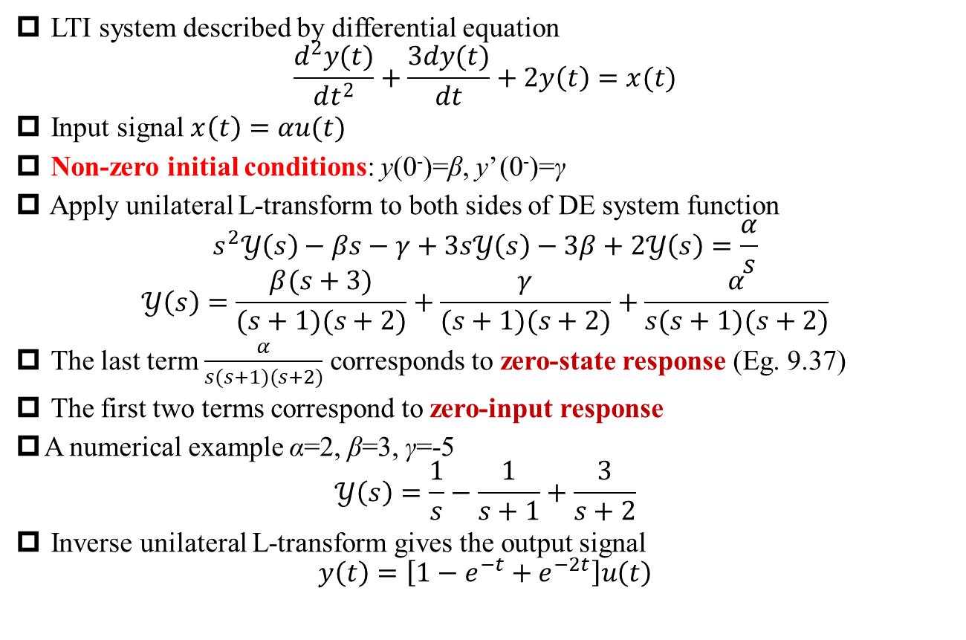
Eg. 9.38
§9.9 Unilateral Laplace Transform
LTI system described by differential equation
$$\frac{d^{2}y(t)}{dt^{2}}+\frac{3dy(t)}{dt}+2y\left(t\right)=x(t)$$
Input signal $x\left(t\right)=αu(t)$
Non-zero initial conditions: y(0⁻)=β, y’ (0⁻)=γ
Apply unilateral L-transform to both sides of DE system function
$$s^{2}𝒴\left(s\right)−βs−γ+3s𝒴\left(s\right)−3β+2𝒴\left(s\right)=\frac{α}{s}$$
$$𝒴\left(s\right)=\frac{β(s+3)}{(s+1)(s+2)}+\frac{γ}{(s+1)(s+2)}+\frac{α}{s(s+1)(s+2)}$$
The last term $\frac{α}{s(s+1)(s+2)}$ corresponds to zero-state response (Eg. 9.37)
The first two terms correspond to zero-input response
A numerical example α=2, β=3, γ=-5
$$𝒴\left(s\right)=\frac{1}{s}−\frac{1}{s+1}+\frac{3}{s+2}$$
Inverse unilateral L-transform gives the output signal
$$y\left(t\right)=\left[1−e^{−t}+e^{−2t}\right]u\left(t\right)$$

