Slide 1


荷塘雨课堂
播放ppt
腾讯会议
双向语音/视频交流
1. 开启荷塘雨课堂（请关闭音频输出，可以点名、白板、做题、弹幕等）
2. 开启腾讯会议（请保持静音，一般关闭摄像头，发言前解除静音）
雨课堂可以看ppt，腾讯会议可以看现场板书，
建议分别用两个终端打开。

Slide 2
Chapter 7 Sampling

Slide 3
Outline
Sampling Theorem
Impulse sampling
Nyquist sampling theorem
Reconstruction Using Interpolation
Undersampling and Aliasing

Slide 4
Why Sampling?
§7.1 Sampling Theorem
Continuous-time signal: x(t)
Discrete-time signal: x[n]
Advantages of processing discrete-time signals compared to processing continuous-time signals?
low cost, programmable, reproducible, by using CPU/DSP/GPU/NPU…
Samples: the values of a continuous-time signal at points equally spaced in time
Sampling theorem
Defines the conditions with which a continuous-time signal can be completely reconstructed from a sequence of its samples
the bridge between continuous-time signals and discrete-time signals

Slide 5
What if Sampling Theorem NOT Satisfied
§7.1 Sampling Theorem
Without certain constraints, an arbitrary continuous-time signal can NOT be reconstructed from its samples
x₁(kT)=x₂(kT)=x₃(kT)

Slide 6
Necessary Conditions for Signal Reconstruction
§7.1 Sampling Theorem
To completely reconstruct a continuous-time signal from a sequence of its samples
The signal is band limited: its Fourier transform is zero outside a finite band of frequencies
The sampling space is sufficiently small in comparison with the highest frequency
Sampling theorem: if the above conditions are satisfied, the samples uniquely specify the original signal
What is a “sufficiently small” sampling space?

Slide 7
Impulse-Train Sampling
§7.1 Sampling Theorem
Impulse-train sampling: continuous-time signal x(t) multiplied by a periodic impulse train p(t)
sampling function: p(t)
sampling period: the period of sampling function
sampling frequency:
Q: Is impulse-train sampling time-invariant?
A: Generally not time-invariant. But…

Slide 8

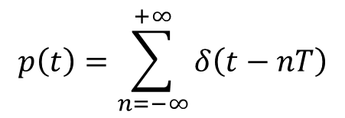
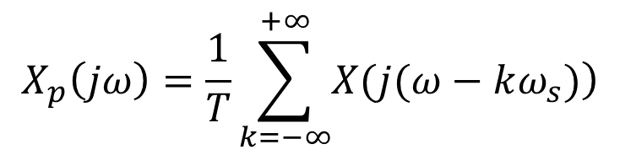
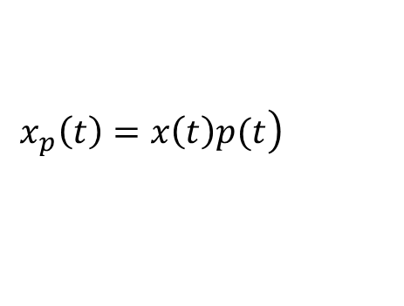
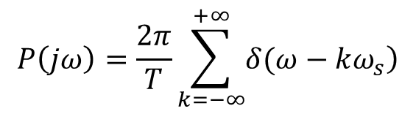
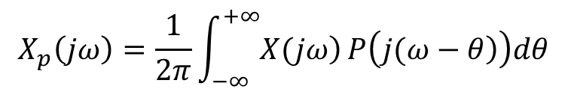

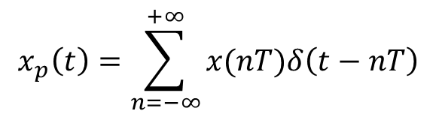

Signals in Impulse-Train Sampling
§7.1 Sampling Theorem
Time domain
Frequency domain
$$\left.x_{p}\left(t\right)=x\left(t\right)p(t\right)$$
$$\underset{⇒}{ℱ}$$
$$X_{p}\left(jω\right)=\frac{1}{2π}\int_{−∞}^{+∞}{\left.X(jω\right)}P\left(\left.j(ω−θ\right)\right)dθ$$
$$p\left(t\right)=\sum_{n=−∞}^{+∞}{δ\left(t−nT\right)}$$
$$\underset{⇒}{ℱ}$$
$$P\left(jω\right)=\frac{2π}{T}\sum_{k=−∞}^{+∞}{\left.δ(ω−kω_{s}\right)}$$
$$x_{p}\left(t\right)=\sum_{n=−∞}^{+∞}{x(nT)δ\left(t−nT\right)}$$
$$\underset{⇒}{ℱ}$$
$$X_{p}\left(jω\right)=\frac{1}{T}\sum_{k=−∞}^{+∞}{\left.X(j(ω−kω_{s})\right)}$$
X_{p}(jω) is also periodic, period ω_{s} =2π/T

Slide 9
Sampling Effect in Frequency Domain (1)
§7.1 Sampling Theorem
x(t) is band-limited
case I: ω_{s}>2ω_{M}
X(jω) can be recovered from X_{p}(jω) by a lowpass filter

Slide 10
Sampling Effect in Frequency Domain (2)
§7.1 Sampling Theorem
x(t) is band-limited
case II: ω_{s}<2ω_{M}
Aliasing happens: overlap in spectrum
X(jω) can not be recovered from X_{p}(jω) by a lowpass filter

Slide 11
Sampling Theorem
§7.1 Sampling Theorem
Nyquist Sampling Theorem: x(t) is a band-limited signal with X(jω)=0 for |ω|>ω_{M}, then x(t) is uniquely determined by its samples x(nT), n = 0, ±1, ±1, ±2, …, if ω_{s}>2ω_{M}, in which ω_{s}=2π/T.
Nyquist rate: 2ω_{M}
Nyquist frequency: ω_{s}/2
The original signal can be reconstructed from x(nT) by passing the impulse train, for which the impulses have the amplitudes of x(nT), through an ideal lowpass filter

Slide 12
Reconstruction Using Ideal Lowpass Filter
§7.1 Sampling Theorem
cut-off frequency of ideal lowpass filter ω_{C}: ω_{M}<ω_{C} < ω_{s} - ω_{M}

Slide 13
Sampling with a Zero-Order Hold
§7.1 Sampling Theorem

Slide 14
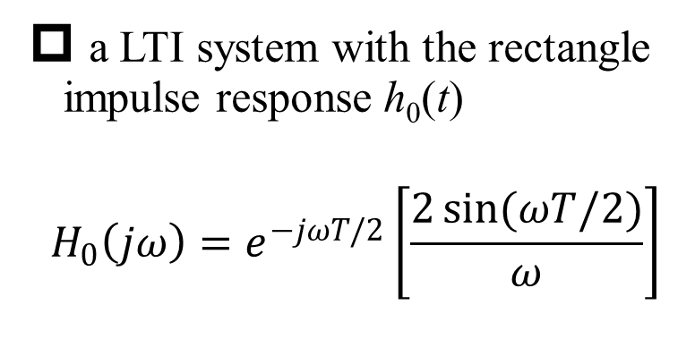
Equivalent Model of Sampling with Zero-Order Hold
§7.1 Sampling Theorem
a LTI system with the rectangle impulse response h₀(t)
$$H_{0}\left(jω\right)=e^{−jωT/2}\left[\frac{2\sin{(ωT/2)}}{ω}\right]$$
Q: Is zero-order hold sampling time-invariant?

Slide 15
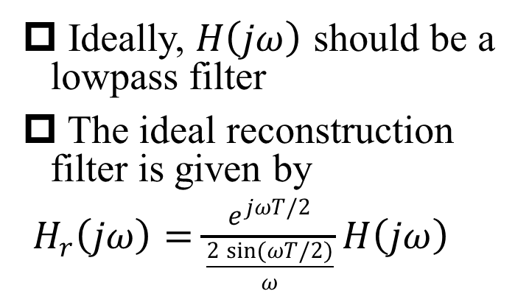
How to Reconstruct from Zero-Order Hold?
§7.1 Sampling Theorem
Ideally, $H\left(jω\right)$ should be a lowpass filter
The ideal reconstruction filter is given by
$H_{r}\left(jω\right)=\frac{e^{jωT/2}}{\frac{2\sin{(ωT/2)}}{ω}}H\left(jω\right)$
?
Discussion: What if no reconstruction filter?

Slide 16
Interpolation
§7.2 Reconstruction Using Interpolation
Interpolation: fitting of a continuous-time signal to a set of sample values
Linear interpolation: adjacent points are connected by straight lines
High-order interpolation: adjacent points are connected by high-order polynomials or other mathematical functions
Matlab function interp1()
Q: How to differentiate between CT and DT signals in Matlab?

Slide 17
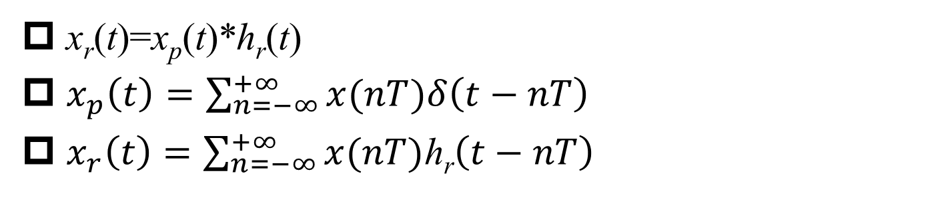
Reconstruction = Interpolation
§7.2 Reconstruction Using Interpolation
x_{r}(t)=x_{p}(t)*h_{r}(t)
$x_{p}\left(t\right)=\sum_{n=−∞}^{+∞}{x(nT)δ\left(t−nT\right)}$
$x_{r}\left(t\right)=\sum_{n=−∞}^{+∞}{x(nT)\text{h}\text{r}\left(t−nT\right)}$
-- interpolation

Slide 18
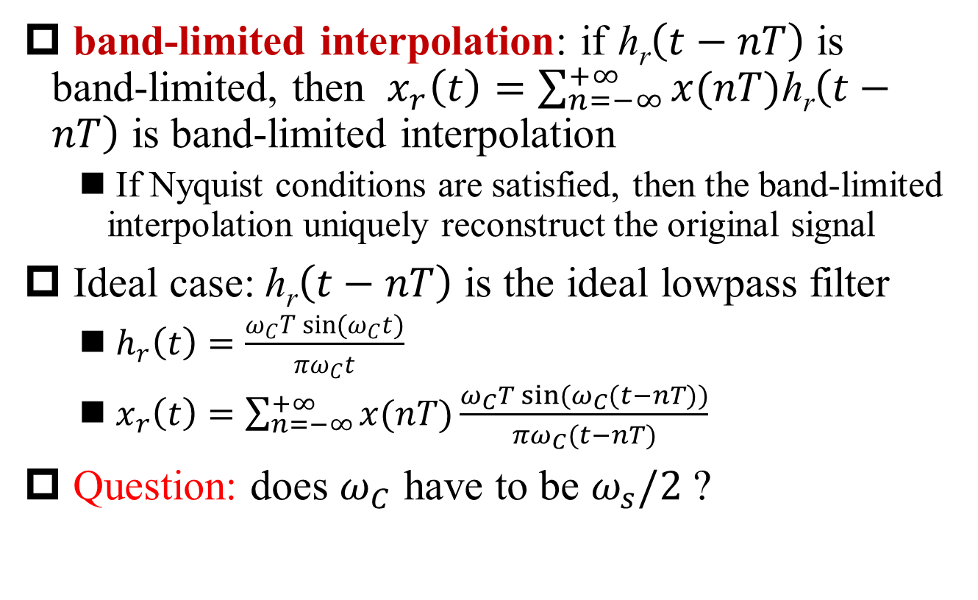
Band-Limited Interpolation
§7.2 Reconstruction Using Interpolation
band-limited interpolation: if $\text{h}\text{r}\left(t−nT\right)$ is band-limited, then $x_{r}\left(t\right)=\sum_{n=−∞}^{+∞}{x(nT)\text{h}\text{r}\left(t−nT\right)}$ is band-limited interpolation
If Nyquist conditions are satisfied, then the band-limited interpolation uniquely reconstruct the original signal
Ideal case: $\text{h}\text{r}\left(t−nT\right)$ is the ideal lowpass filter
$h_{r}\left(t\right)=\frac{ω_{C}T\sin{(ω_{C}t)}}{{πω}_{C}t}$
$x_{r}\left(t\right)=\sum_{n=−∞}^{+∞}{x(nT)\frac{ω_{C}T\sin{(ω_{C}(t−nT))}}{{πω}_{C}(t−nT)}}$
Question: does $ω_{C}$ have to be $ω_{s}/2$ ?

Slide 19
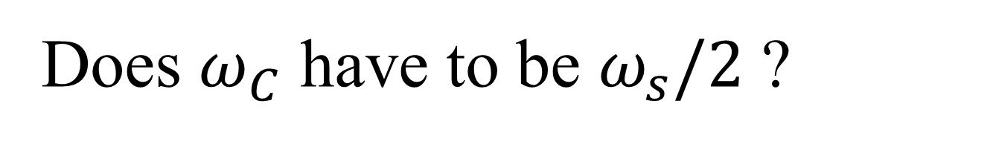
Does $ω_{C}$ have to be $ω_{s}/2$ ?
§7.2 Reconstruction Using Interpolation
x(t)=sin (2π·1·t+ π/3)+ sin (2π·1.75·t+ π/4), f_{M}=1.75
T=1/4, f_{s}=4
f_{c}=2
f_{c}=2.2
f_{c}=1.8

Slide 20

Non-Ideal Interpolation – Zero-Order Hold
§7.2 Reconstruction Using Interpolation
Ideal interpolation vs. Non-ideal interpolation
$h_{r}\left(t\right)=\frac{ω_{C}T\sin{(ω_{C}t)}}{{πω}_{C}t}$ vs. $h_{r}\left(t\right)=u\left(t\right)−u(t−T)$
zero-order hold is a rough approximation of the ideal lowpass filter, but in some applications it is sufficient
Not continuous at the sampling points
Example: current steering digital-to-analog converter (DAC) without reconstruction filter
Q: Why does a low-resolution look smoother at a distance?
A: Lowpass effect of human eyes

Slide 21

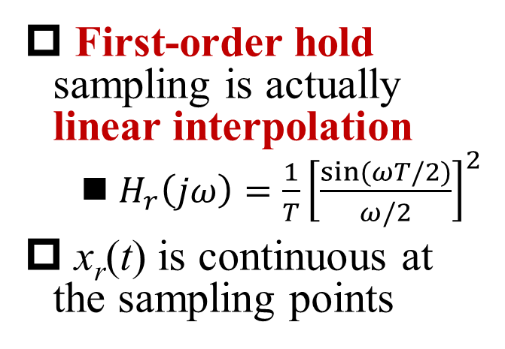
Non-Ideal Interpolation – First-Order Hold
§7.2 Reconstruction Using Interpolation
First-order hold sampling is actually linear interpolation
$H_{r}\left(jω\right)=\frac{1}{T}{\left[\frac{\sin{(ωT/2)}}{ω/2}\right]}^{2}$
x_{r}(t) is continuous at the sampling points
$$x_{r}\left(t\right)=\sum_{n=−∞}^{+∞}{x(nT)\text{h}\text{r}\left(t−nT\right)}$$

Slide 22
Undersampling
§7.3 Aliasing Effect of Undersampling
Undersampling: sampling frequency lower than the Nyquist rate 2ω_{M}, or signal frequency higher than the Nyquist frequency ω_{s}/2.
Undersampling leads to aliasing

Slide 23
Aliasing Effect on Sinusoidal Signals -- Frequency Domain
§7.3 Aliasing Effect of Undersampling
without aliasing
with aliasing

Slide 24

Aliasing Effect on Sinusoidal Signals -- Time Domain
§7.3 Aliasing Effect of Undersampling
f₀= f_{s}/6
f_{r}= f_{s}/6
f₀= 2f_{s}/6
f_{r}= 2f_{s}/6
f₀= 4f_{s}/6
f_{r}= 2f_{s}/6
f₀= 5f_{s}/6
f_{r}= f_{s}/6
f_{s}=6, x(t)=sin (2π·f₀·t+ π/3)
reconstruction/interpolation using ideal lowpass filter
Q1: How about f₀= f_{s}?
Q2: Only frequency folded? How about phase?

Slide 25
Aliasing Effect on Phase of Sinusoidal Signals
§7.3 Aliasing Effect of Undersampling
Aliasing → frequency folded + phase reversal
x(t)=cos(ω₀t+φ) → x_{r}(t)=cos((ω_{s}-ω₀)t-φ)
Q1: How to explain the rotors of a helicopter rotate “reversely” or stay still?
https://www.bilibili.com/video/av4953251?from=search&seid=13023715312627628363

Slide 26
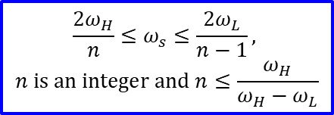
Supplementary: Bandpass Sampling
§7.3 Aliasing Effect of Undersampling
Bandpass sampling theorem: band-limited signal which has energy in the frequency range of (ω_{L}, ω_{H}), can be uniquely reconstructed from its samples if
$$\frac{{2ω}_{H}}{n}≤ω_{s}≤\frac{{2ω}_{L}}{n−1},$$
$$n is an integer and n≤\frac{ω_{H}}{ω_{H}−ω_{L}}$$

Slide 27
Summary
Two conditions of sampling theorem
band-limited !!!
sampling frequency sufficiently high
Reconstruction
Using ideal lowpass filter
zero-order and first-order hold
Aliasing: how does it happen?

