Slide 1
Chapter 5 Discrete-Time Fourier Transform

Slide 2
Discrete-Time Fourier Transform ≠ Discrete Fourier Transform (DFT)

Slide 3
Outline
From Discrete-Time Fourier Series to Discrete-Time Fourier Transform
DT FT of Periodic Sequences
DT Fourier Transform Properties
System Characterized by Difference Equations
Discrete-Time Processing of Continuous-Time Signals (Chapter 7)
Sampling of Discrete-time Signals (Chapter 7)

Slide 4
Recall: DT LTI System Response to
§5.1 DT FS to DT FT
Assume LTI system with impulse response h[n]
Recall sum convolution:
System response to
Let
z^{n} eigenfunction, H(z) eigenvalue
If , then

Slide 5
Recall: Fourier Series of DT Periodic Signals
§5.1 DT FS to DT FT
Recall: x[n] is periodic if x[n]=x[n+N]
Fundamental period: the smallest positive N
Fundamental frequency: ω₀=2π/N
DT complex exponential signals with period N
Only N distinct signals in the above set
linear combination of x[n]

Slide 6
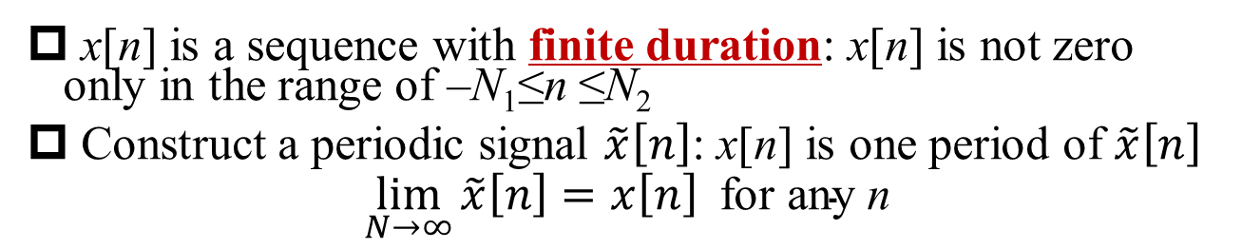
From DT FS to DT FT (1)
§5.1 DT FS to DT FT
x[n] is a sequence with finite duration: x[n] is not zero only in the range of –N₁≤n ≤N₂
Construct a periodic signal $\tilde{x}\left[n\right]$: x[n] is one period of $\tilde{x}\left[n\right]$
$$\lim_{N→∞}{\tilde{x}\left[n\right]=x\left[n\right] \text{for} \text{any} \text{n}}$$

Slide 7
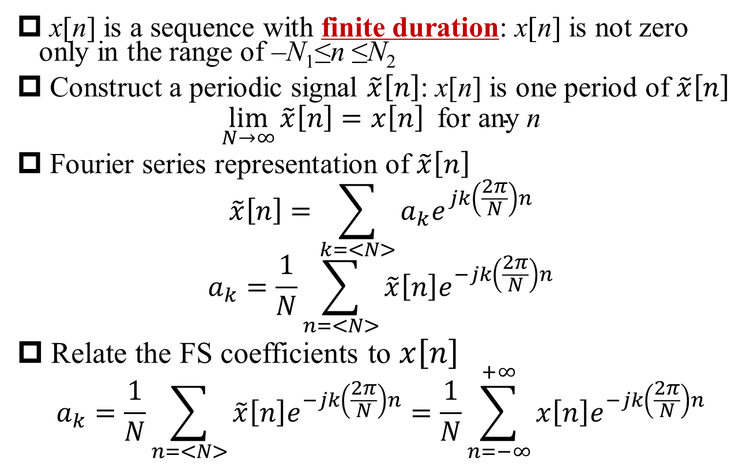
From DT FS to DT FT (1)
§5.1 DT FS to DT FT
x[n] is a sequence with finite duration: x[n] is not zero only in the range of –N₁≤n ≤N₂
Construct a periodic signal $\tilde{x}\left[n\right]$: x[n] is one period of $\tilde{x}\left[n\right]$
$$\lim_{N→∞}{\tilde{x}\left[n\right]=x\left[n\right] \text{for} \text{any} \text{n}}$$
Fourier series representation of $\tilde{x}\left[n\right]$
$$\tilde{x}\left[n\right]=\sum_{k=<N>}{a_{k}e^{jk\left(\frac{2π}{N}\right)n}}$$
$$a_{k}=\frac{1}{N}\sum_{n=<N>}{\tilde{x}\left[n\right]e^{−jk\left(\frac{2π}{N}\right)n}}$$
Relate the FS coefficients to $x\left[n\right]$
$$a_{k}=\frac{1}{N}\sum_{n=<N>}{\tilde{x}\left[n\right]e^{−jk\left(\frac{2π}{N}\right)n}}=\frac{1}{N}\sum_{n=−∞}^{+∞}{x\left[n\right]e^{−jk\left(\frac{2π}{N}\right)n}}$$

Slide 8
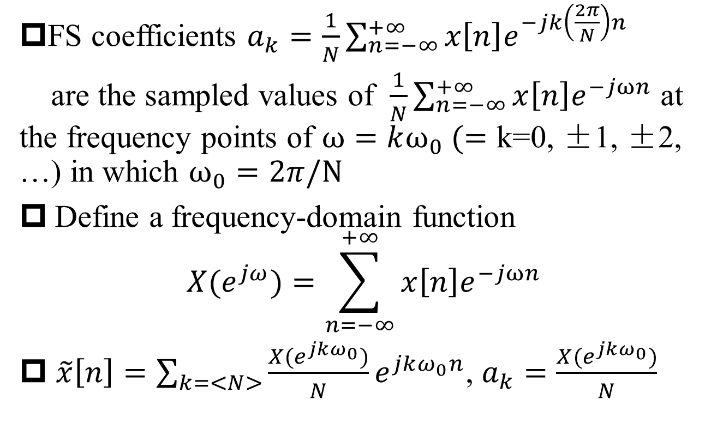
From DT FS to DT FT (2)
§5.1 DT FS to DT FT
FS coefficients $a_{k}=\frac{1}{N}\sum_{n=−∞}^{+∞}{x\left[n\right]e^{−jk\left(\frac{2π}{N}\right)n}}$
are the sampled values of $\frac{1}{N}\sum_{n=−∞}^{+∞}{x\left[n\right]e^{−jωn}}$ at the frequency points of $ω=kω_{0} (=\text{k}\text{=0, ±1, ±2, …)}$ in which $ω_{0}=2π/N$
Define a frequency-domain function
$$X(e^{jω})=\sum_{n=−∞}^{+∞}{x\left[n\right]e^{−jωn}}$$
$\tilde{x}\left[n\right]=\sum_{k=<N>}{\frac{X(e^{jkω_{0}})}{N}e^{jkω_{0}n}}$, $a_{k}=\frac{X(e^{jkω_{0}})}{N}$
Q: Why not use X(ω) or X(jω)?

Slide 9
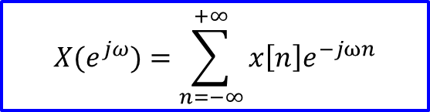
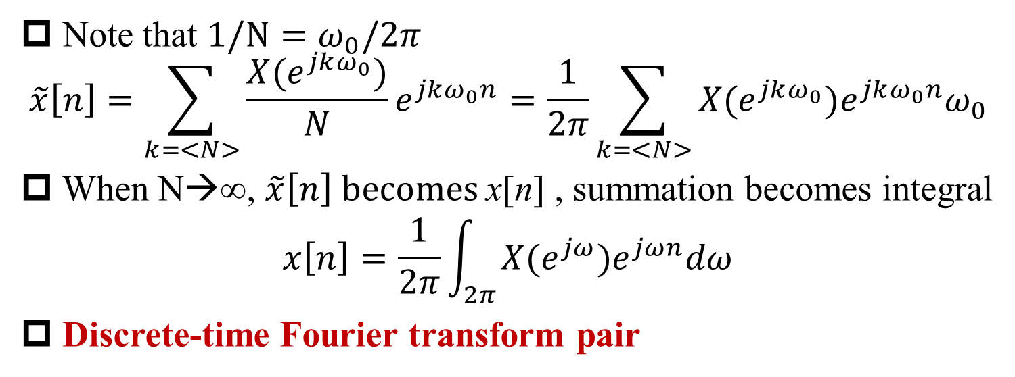
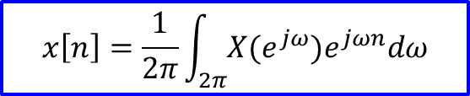
From DT FS to DT FT (3)
§5.1 DT FS to DT FT
Note that ${1/N=ω}_{0}/2π$
$$\tilde{x}\left[n\right]=\sum_{k=<N>}{\frac{X(e^{jkω_{0}})}{N}e^{jkω_{0}n}=\frac{1}{2π}\sum_{k=<N>}{{X(e^{jkω_{0}})e}^{jkω_{0}n}ω_{0}}}$$
When N→∞, $\tilde{x}\left[n\right] becomes$x[n] , summation becomes integral
$$x\left[n\right]=\frac{1}{2π}\int_{2π}{{X(e^{jω})e}^{jωn}dω}$$
Discrete-time Fourier transform pair
$$X(e^{jω})=\sum_{n=−∞}^{+∞}{x\left[n\right]e^{−jωn}}$$
Analysis equation
Q: x[n] has to be finite duration?
Synthesis equation
$$x\left[n\right]=\frac{1}{2π}\int_{2π}{{X(e^{jω})e}^{jωn}dω}$$
A: No.

Slide 10
DT FT Example
§5.1 DT FS to DT FT

Slide 11

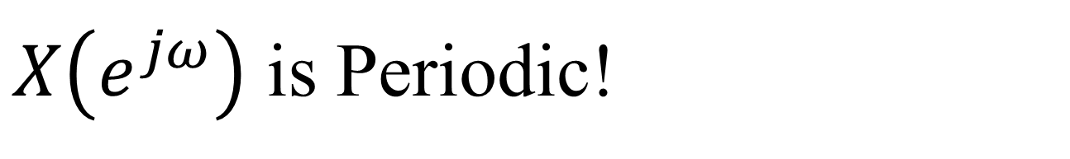
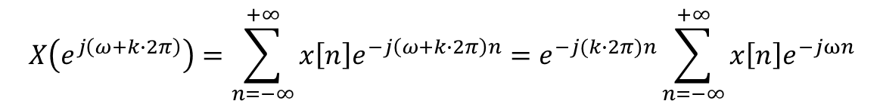

$X\left(e^{jω}\right)$ is Periodic!
§5.1 DT FS to DT FT
Q1: What is the period of X(jω)?
$$X(e^{jω})=\sum_{n=−∞}^{+∞}{x\left[n\right]e^{−jωn}}$$
$$X\left(e^{j\left(ω+k∙2π\right)}\right)=\sum_{n=−∞}^{+∞}{x\left[n\right]e^{−j\left(ω+k∙2π\right)n}}=e^{−j(k∙2π)n}\sum_{n=−∞}^{+∞}{x\left[n\right]e^{−jωn}}$$
The fundamental period of $X\left(e^{jω}\right)$ is 2π
Q2: The real meaning of 2π in the horizontal axis of X(jω) plot?

Slide 12
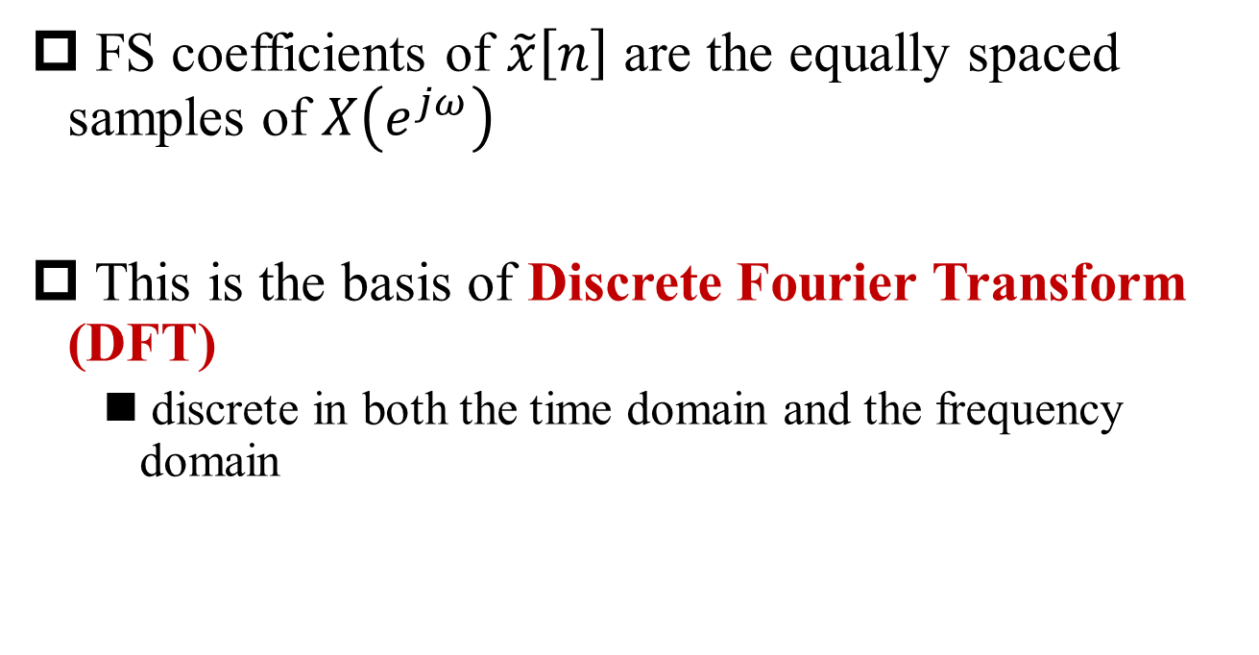
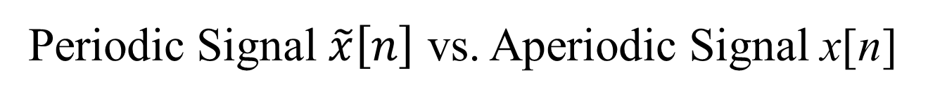
Periodic Signal $\tilde{x}\left[n\right]$ vs. Aperiodic Signal x[n]
§5.1 DT FS to DT FT
FS coefficients of $\tilde{x}\left[n\right]$ are the equally spaced samples of $X\left(e^{jω}\right)$
This is the basis of Discrete Fourier Transform (DFT)
discrete in both the time domain and the frequency domain

Slide 13

Examples of DT FT
§5.1 DT FS to DT FT
Example 5.1, $x\left[n\right]=a^{n}u\left[n\right], \left|a\right|<1$
$$X\left(e^{jω}\right)=\sum_{n=0}^{+∞}{a^{n}e^{−jωn}}=\frac{1}{1−ae^{−jω}}$$
Example 5.2 $x\left[n\right]=a^{\left|n\right|}, \left|a\right|<1$
Q1: How to find magnitude and phase of X(jω)?
A: Draw the complex plane
a=0.5
a=-0.5
real + even ←→ even + real

Slide 14
DT FT of Rectangle Pulse
§5.1 DT FS to DT FT

Slide 15

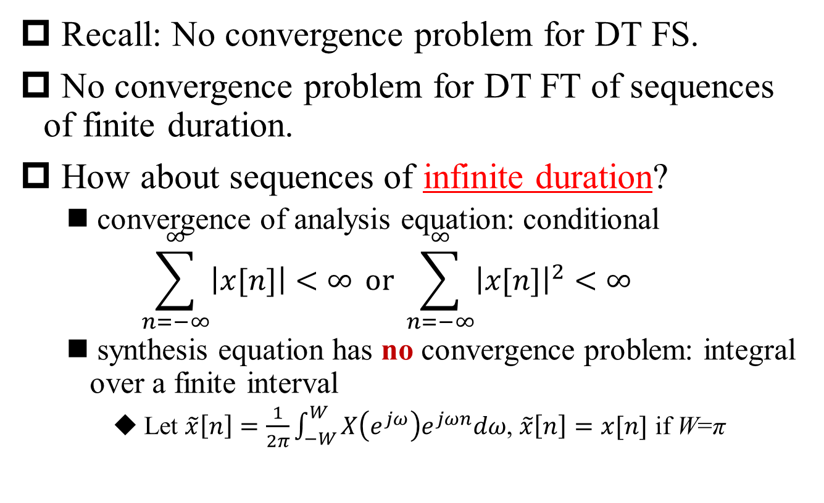
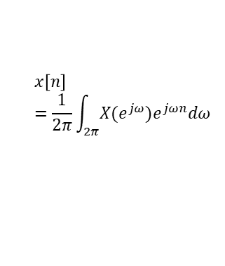
Convergence of DT FT
§5.1 DT FS to DT FT
Recall: No convergence problem for DT FS.
No convergence problem for DT FT of sequences of finite duration.
How about sequences of infinite duration?
convergence of analysis equation: conditional
$$\sum_{n=−∞}^{∞}{\left|x[n]\right|<∞} \text{or} \sum_{n=−∞}^{∞}{{\left|x[n]\right|}^{2}<∞}$$
synthesis equation has no convergence problem: integral over a finite interval
Let $\tilde{x}\left[n\right]=\frac{1}{2π}\int_{−W}^{W}{X\left(e^{jω}\right)e^{jωn}dω}$, $\tilde{x}\left[n\right]=x[n]$ if W=π
Q1: Why?
Q2: Why?
$$X(e^{jω})=\sum_{n=−∞}^{+∞}{x\left[n\right]e^{−jωn}}$$
$$x\left[n\right]=\frac{1}{2π}\int_{2π}{{X(e^{jω})e}^{jωn}dω}$$

Slide 16
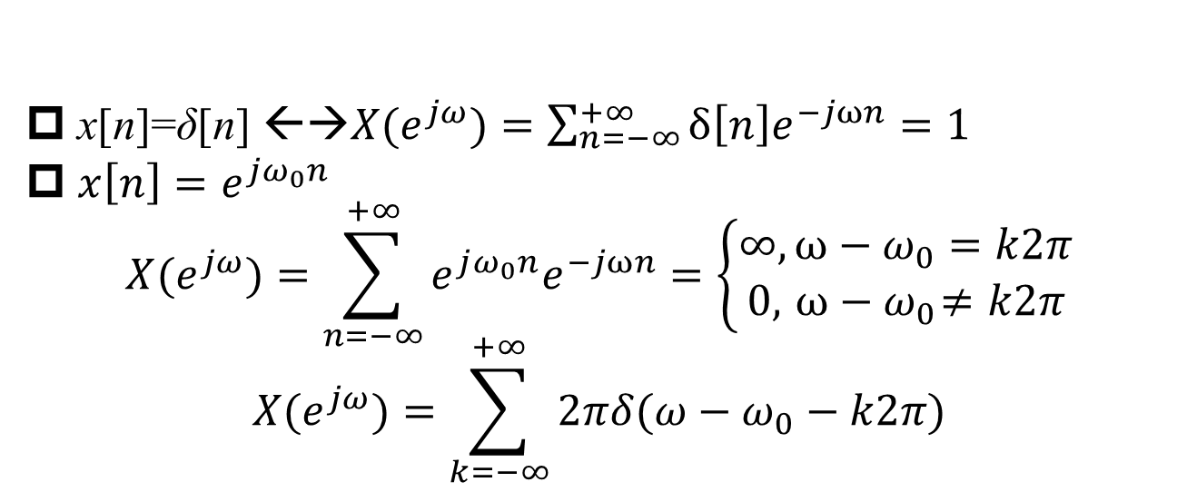
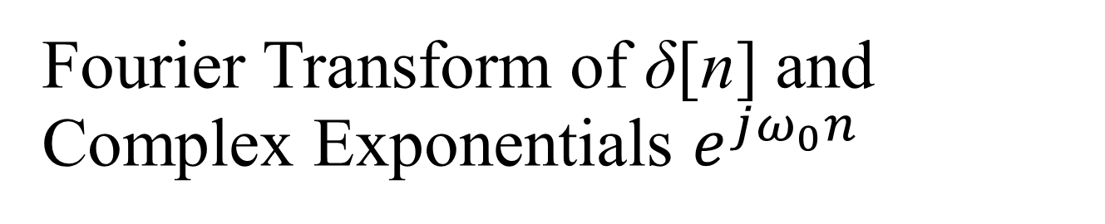
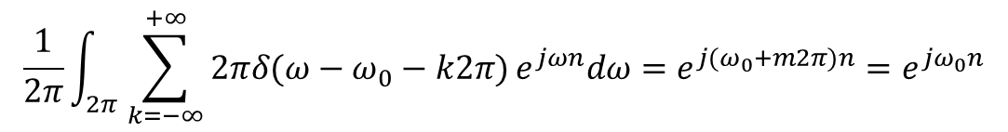
Fourier Transform of δ[n] and Complex Exponentials $e^{jω_{0}n}$
§5.2 DT FT of Periodic Sequence
x[n]=δ[n] ←→$X(e^{jω})=\sum_{n=−∞}^{+∞}{δ\left[n\right]e^{−jωn}=1}$
$x\left[n\right]=e^{jω_{0}n}$
$$X(e^{jω})=\sum_{n=−∞}^{+∞}{e^{jω_{0}n}e^{−jωn}=\left\{\begin{aligned}∞,{ω−ω}_{0}=k2π \\ 0,{ ω−ω}_{0}≠k2π\end{aligned}\right.}$$
$$X(e^{jω})=\sum_{k=−∞}^{+∞}{2πδ(ω−ω_{0}−k2π)}$$
Q1: Why the coefficient 2π?
A: Check the inverse FT
$$\frac{1}{2π}\int_{2π}{\sum_{k=−∞}^{+∞}{2πδ(ω−ω_{0}−k2π)}e^{jωn}dω=e^{{j(ω}_{0}+m2π)n}=e^{{jω}_{0}n}}$$
Only one impulse in any consecutive interval of 2π

Slide 17
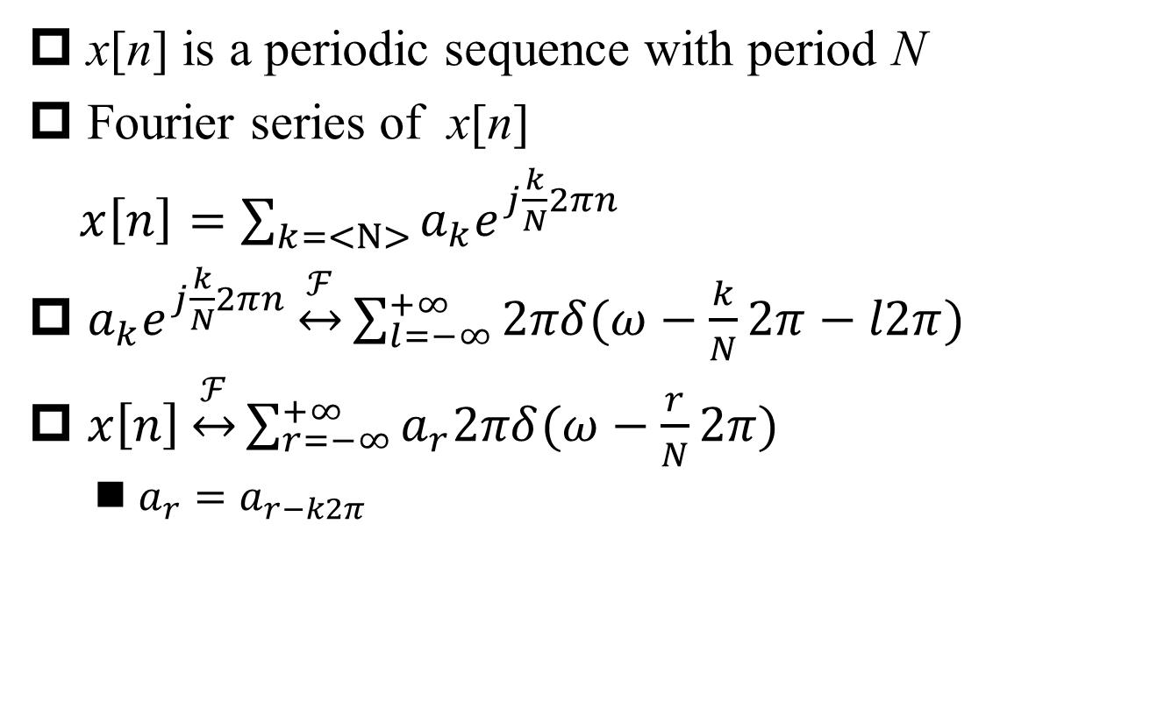
Fourier Transform of Periodic Sequence
§5.2 DT FT of Periodic Sequence
x[n] is a periodic sequence with period N
Fourier series of x[n]
$x\left[n\right]=\sum_{k=<N>}{a_{k}e^{j\frac{k}{N}2πn}}$
$a_{k}e^{j\frac{k}{N}2πn}\underset{↔}{ℱ}\sum_{l=−∞}^{+∞}{2πδ(ω−\frac{k}{N}2π−l2π)}$
$x\left[n\right]\underset{↔}{ℱ}\sum_{r=−∞}^{+∞}{a_{r}2πδ(ω−\frac{r}{N}2π)}$
$a_{r}=a_{r−k2π}$

Slide 18
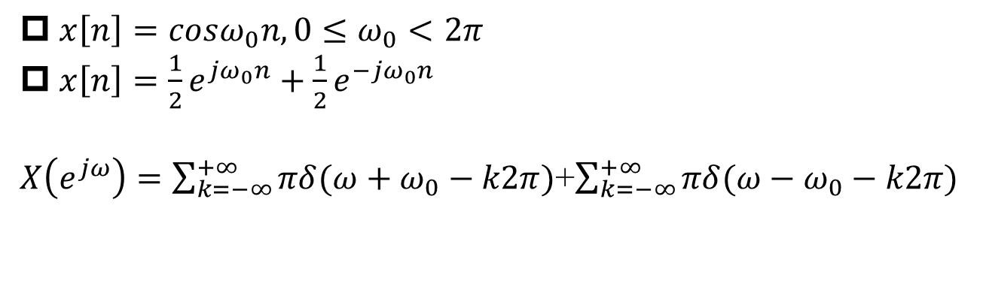
Fourier Transform of Sinusoidal Sequence
§5.2 DT FT of Periodic Sequence
$x\left[n\right]=cosω_{0}n, 0≤ω_{0}<2π$
$x\left[n\right]=\frac{1}{2}e^{jω_{0}n}+\frac{1}{2}e^{−jω_{0}n}$
$X\left(e^{jω}\right)=\sum_{k=−∞}^{+∞}{πδ(ω+ω_{0}−k2π)}$+$\sum_{k=−∞}^{+∞}{πδ(ω−ω_{0}−k2π)}$
Q1: Aliasing?

Slide 19
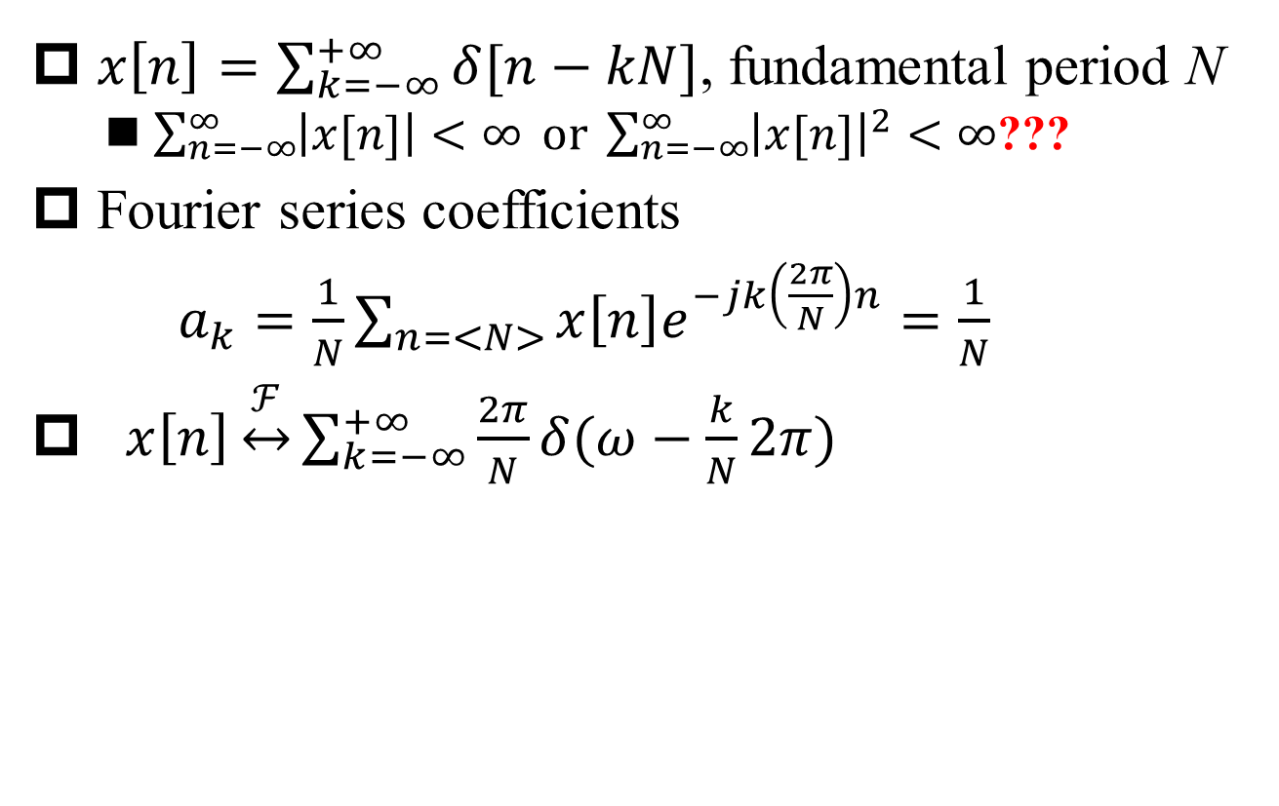
Fourier Transform of Periodic Impulse Train
§5.2 DT FT of Periodic Sequence
$x\left[n\right]=\sum_{k=−∞}^{+∞}{δ[n−kN]}$, fundamental period N
$\sum_{n=−∞}^{∞}{\left|x[n]\right|<∞} \text{or} \sum_{n=−∞}^{∞}{{\left|x[n]\right|}^{2}<∞}$???
Fourier series coefficients
$a_{k}=\frac{1}{N}\sum_{n=<N>}{x\left[n\right]e^{−jk\left(\frac{2π}{N}\right)n}}=\frac{1}{N}$
$x\left[n\right]\underset{↔}{ℱ}\sum_{k=−∞}^{+∞}{\frac{2π}{N}δ(ω−\frac{k}{N}2π)}$
Choose [0, N-1] as sum interval

Slide 20
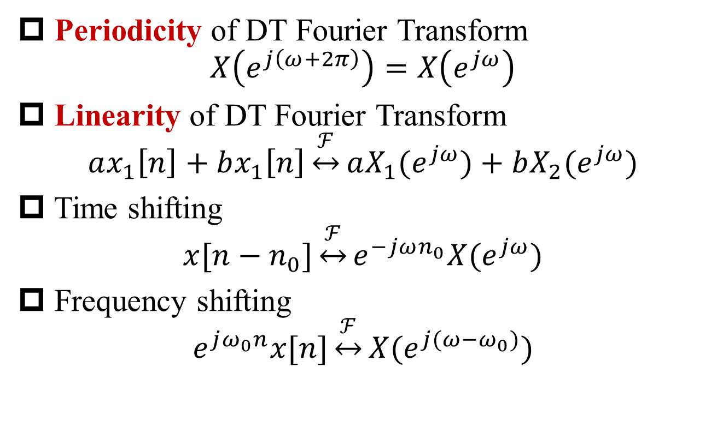
Properties of DT Fourier Transform
§5.3 DT FT Properties
Periodicity of DT Fourier Transform
$$X\left(e^{j\left(ω+2π\right)}\right)=X\left(e^{jω}\right)$$
Linearity of DT Fourier Transform
$$ax_{1}\left[n\right]+bx_{1}\left[n\right]\underset{↔}{ℱ}aX_{1}(e^{jω})+bX_{2}(e^{jω})$$
Time shifting
$$x[n−n_{0}]\underset{↔}{ℱ}e^{−jωn_{0}}X(e^{jω})$$
Frequency shifting
$$e^{jω_{0}n}x[n]\underset{↔}{ℱ}X(e^{j(ω−ω_{0})})$$
Most important!

Slide 21
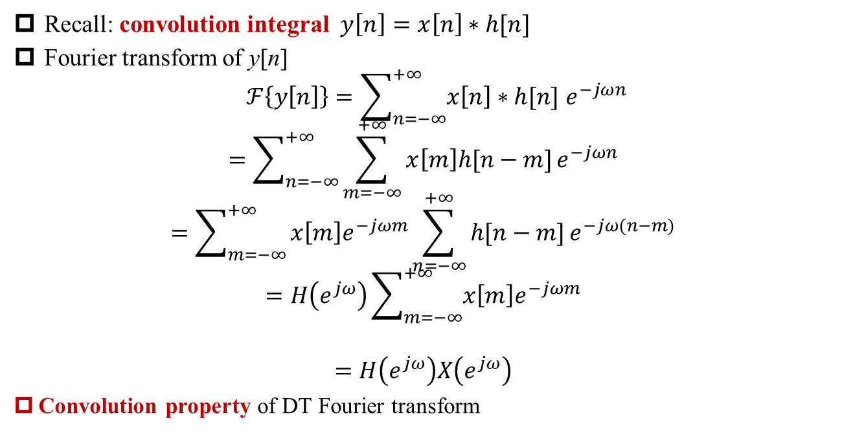
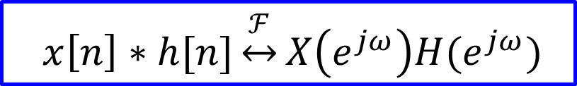
Convolution Property
§5.4 Convolution Property
Recall: convolution integral $y\left[n\right]=x\left[n\right]∗h[n]$
Fourier transform of y[n]
$$ℱ\left\{y\left[n\right]\right\}=\sum_{n=−∞}^{+∞}{x\left[n\right]∗h[n] e^{−jωn}}$$
$$=\sum_{n=−∞}^{+∞}{\sum_{m=−∞}^{+∞}{x\left[m\right]h[n−m]}e^{−jωn}}$$
$$=\sum_{m=−∞}^{+∞}{x\left[m\right]e^{−jωm}\sum_{n=−∞}^{+∞}{h[n−m]}e^{−jω(n−m)}}$$
$$=H\left(e^{jω}\right)\sum_{m=−∞}^{+∞}{x\left[m\right]e^{−jωm}}$$
$$=H\left(e^{jω}\right)X\left(e^{jω}\right)$$
Convolution property of DT Fourier transform
$$x\left[n\right]∗h[n]\underset{↔}{ℱ}X\left(e^{jω}\right)H(e^{jω})$$

Slide 22
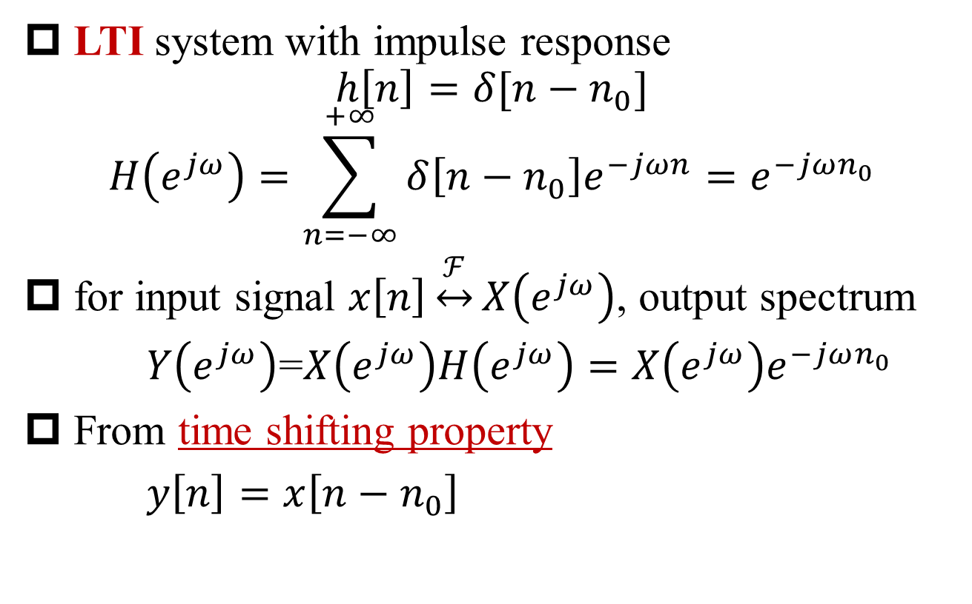
Response of Time-Shifting System
§5.4 Convolution Property
LTI system with impulse response
$$h\left[n\right]=δ[n−n_{0}]$$
$$H\left(e^{jω}\right)=\sum_{n=−∞}^{+∞}{δ\left[n−n_{0}\right]e^{−jωn}=e^{−jωn_{0}}}$$
for input signal $x\left[n\right]\underset{↔}{ℱ}X\left(e^{jω}\right)$, output spectrum
$Y\left(e^{jω}\right)$=$X\left(e^{jω}\right)H\left(e^{jω}\right)=X\left(e^{jω}\right)e^{−jωn_{0}}$
From time shifting property
$y\left[n\right]=x\left[n−n_{0}\right]$

Slide 23
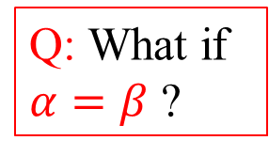
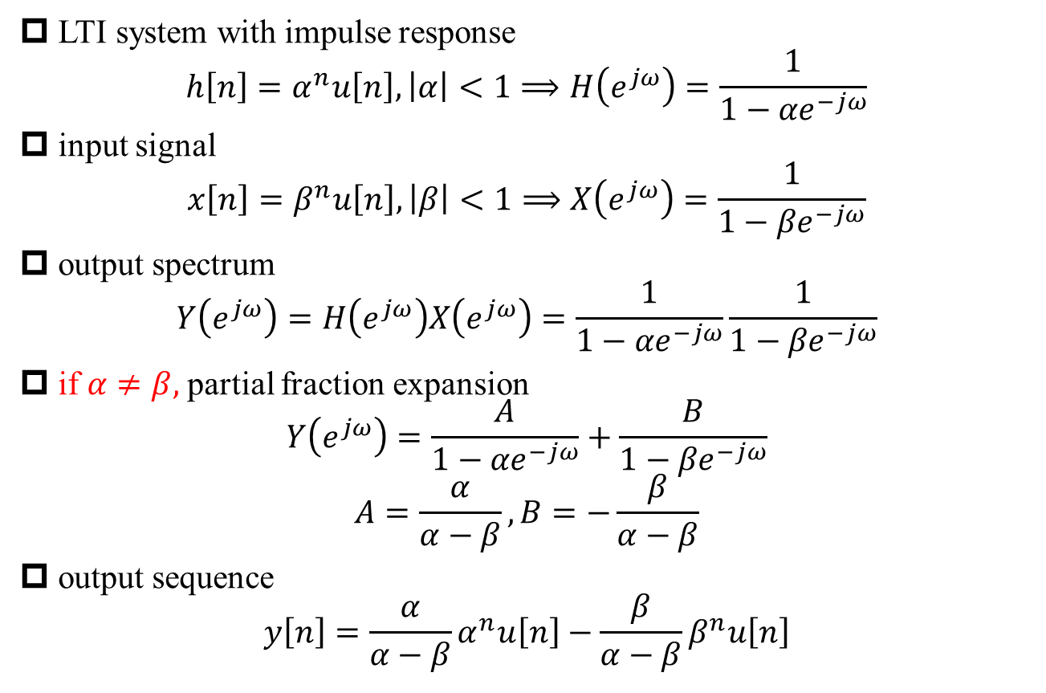
Example 5.13: LTI System Response
§5.4 Convolution Property
LTI system with impulse response
$$h\left[n\right]=α^{n}u\left[n\right], \left|α\right|<1⟹H\left(e^{jω}\right)=\frac{1}{1−{αe}^{−jω}}$$
input signal
$$x\left[n\right]=β^{n}u\left[n\right], \left|β\right|<1⟹X\left(e^{jω}\right)=\frac{1}{1−{βe}^{−jω}}$$
output spectrum
$$Y\left(e^{jω}\right)=H\left(e^{jω}\right)X\left(e^{jω}\right)=\frac{1}{1−{αe}^{−jω}}\frac{1}{1−{βe}^{−jω}}$$
if $α≠β,$partial fraction expansion
$$Y\left(e^{jω}\right)=\frac{A}{1−{αe}^{−jω}}+\frac{B}{1−{βe}^{−jω}}$$
$$A=\frac{α}{α−β}, B=−\frac{β}{α−β}$$
output sequence
$$y\left[n\right]=\frac{α}{α−β}α^{n}u\left[n\right]−\frac{β}{α−β}β^{n}u\left[n\right]$$
Q: What if $α=β$ ?

Slide 24
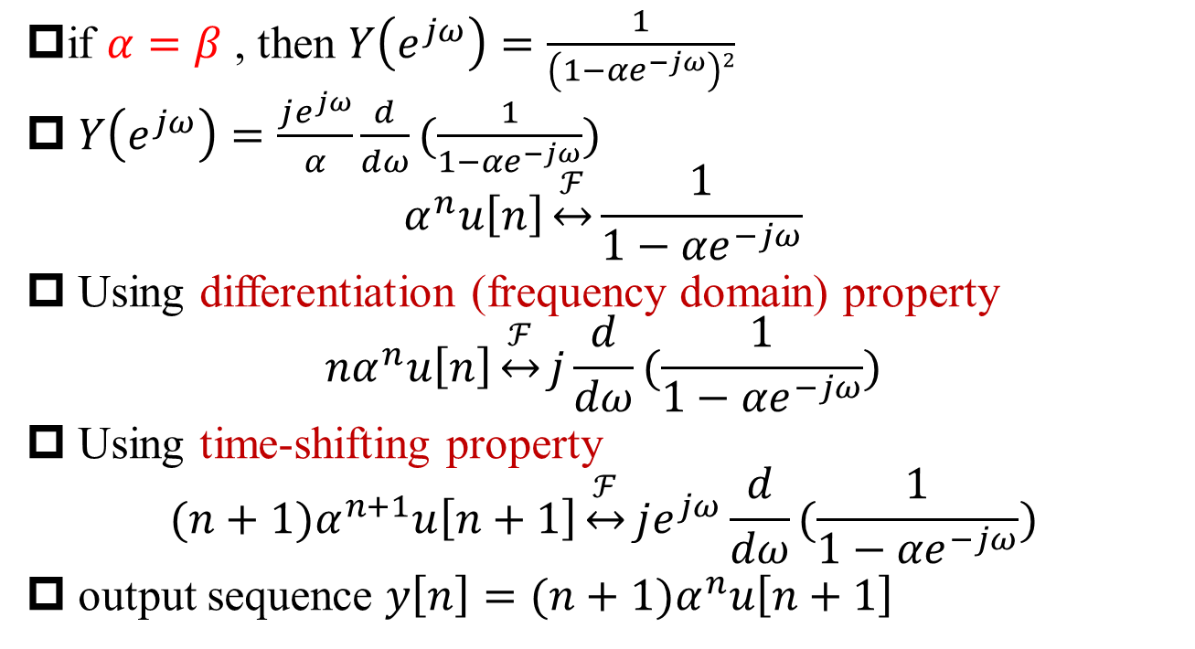

Example 5.13: LTI System Response (cont’)
§5.4 Convolution Property
if $α=β$ , then $Y\left(e^{jω}\right)=\frac{1}{\left(1−{αe}^{−jω}\right)2}$
$Y\left(e^{jω}\right)=\frac{je^{jω}}{α}\frac{d}{dω}(\frac{1}{1−{αe}^{−jω}})$
$$α^{n}u\left[n\right]\underset{↔}{ℱ}\frac{1}{1−{αe}^{−jω}}$$
Using differentiation (frequency domain) property
$${nα}^{n}u\left[n\right]\underset{↔}{ℱ}j\frac{d}{dω}(\frac{1}{1−{αe}^{−jω}})$$
Using time-shifting property
$${(n+1)α}^{n+1}u\left[n+1\right]\underset{↔}{ℱ}je^{jω}\frac{d}{dω}(\frac{1}{1−{αe}^{−jω}})$$
output sequence ${y\left[n\right]=(n+1)α}^{n}u\left[n+1\right]$
Q: n=-1? Causality？
$${y\left[n\right]=(n+1)α}^{n}u\left[n\right]$$

Slide 25




Example 5.14: Ideal Bandstop Filter
§5.4 Convolution Property
$${(−1)}^{n}=e^{−jπn}$$
$$w_{1}\left[n\right]=e^{−jπn}x\left[n\right]$$
$$W_{1}\left(e^{jω}\right)=X\left(e^{j(ω−π)}\right)$$
$$W_{2}\left(e^{jω}\right)=X\left(e^{j(ω−π)}\right)H_{lp}\left(e^{jω}\right)$$
$W_{3}\left(e^{jω}\right)=W_{2}\left(e^{j(ω−π)}\right)=X\left(e^{j(ω−2π)}\right)H_{lp}\left(e^{j(ω−π)}\right)$=$X\left(e^{jω}\right)H_{lp}\left(e^{j(ω−π)}\right)$
$$Y\left(e^{jω}\right)=X\left(e^{jω}\right)\left[H_{lp}\left(e^{j(ω−π)}\right)+H_{lp}\left(e^{jω}\right)\right]$$

Slide 26
Example 5.14: Ideal Bandstop Filter (cont’)
§5.4 Convolution Property
$$Y\left(e^{jω}\right)=X\left(e^{jω}\right)\left[H_{lp}\left(e^{j(ω−π)}\right)+H_{lp}\left(e^{jω}\right)\right]$$

Slide 27
Multiplication Property
§5.5 Multiplication Property
$x\left[n\right]y\left[n\right]\underset{↔}{ℱ}\frac{1}{2π}X\left(e^{jω}\right)∗Y(e^{jω})$=$\frac{1}{2π}\int_{2π}{X\left(e^{jθ}\right)Y\left(e^{j\left(ω−θ\right)}\right)dθ}$

Slide 28
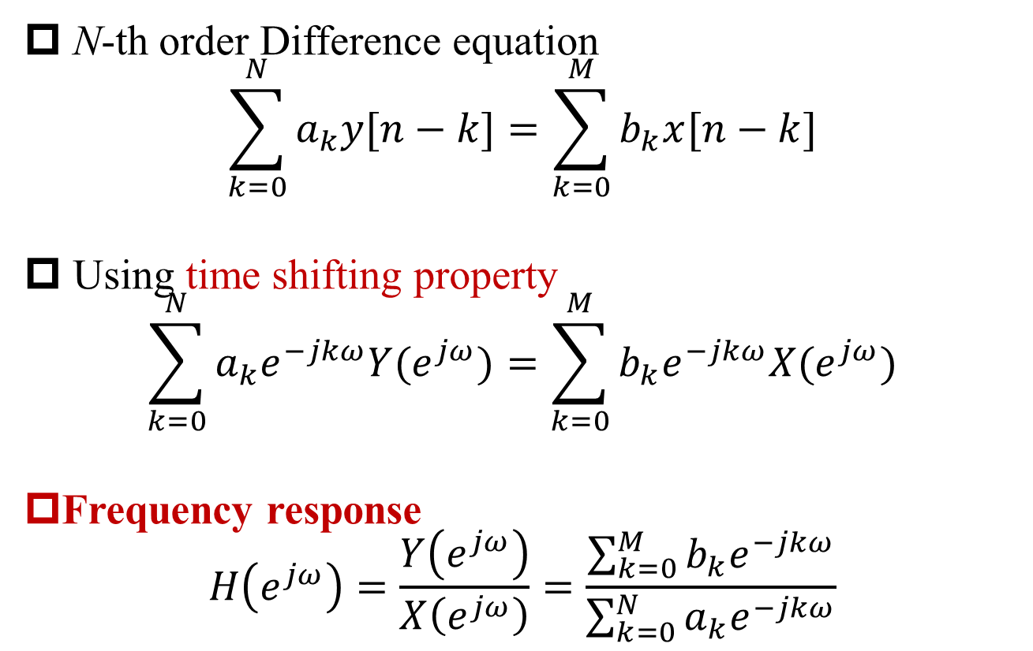
Linear Constant-Coefficient Difference Equation
§5.8 System Characterized by Difference Equations
N-th order Difference equation
$$\sum_{k=0}^{N}{a_{k}y[n−k]}=\sum_{k=0}^{M}{b_{k}x[n−k]}$$
Using time shifting property
$$\sum_{k=0}^{N}{a_{k}e^{−jkω}Y(e^{jω})}=\sum_{k=0}^{M}{b_{k}e^{−jkω}X(e^{jω})}$$
Frequency response
$$H\left(e^{jω}\right)=\frac{Y\left(e^{jω}\right)}{X\left(e^{jω}\right)}=\frac{\sum_{k=0}^{M}{b_{k}e^{−jkω}}}{\sum_{k=0}^{N}{a_{k}e^{−jkω}}}$$

Slide 29
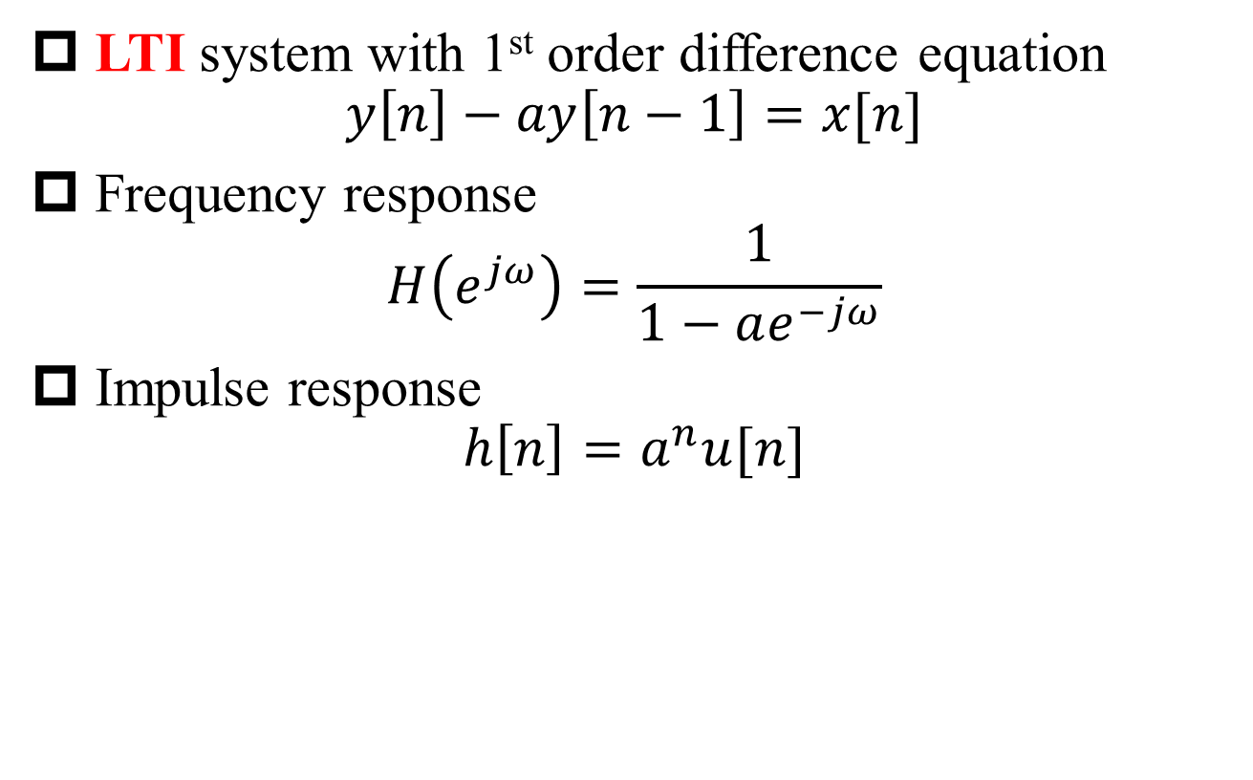
Example 5.18
§5.8 System Characterized by Difference Equations
LTI system with 1st order difference equation
$$y\left[n\right]−ay\left[n−1\right]=x[n]$$
Frequency response
$$H\left(e^{jω}\right)=\frac{1}{1−ae^{−jω}}$$
Impulse response
$$h\left[n\right]=a^{n}u[n]$$

Slide 30
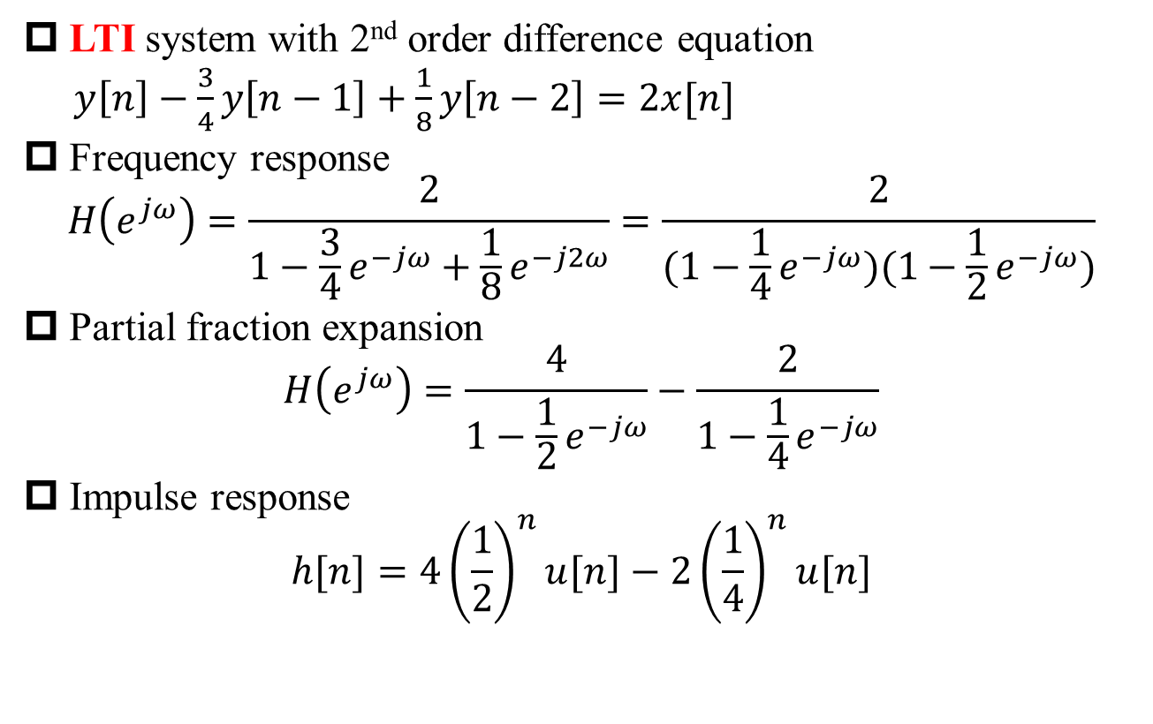
Example 5.19
§5.8 System Characterized by Difference Equations
LTI system with 2nd order difference equation
$y\left[n\right]−\frac{3}{4}y\left[n−1\right]+\frac{1}{8}y\left[n−2\right]=2x[n]$
Frequency response
$$H\left(e^{jω}\right)=\frac{2}{1−\frac{3}{4}e^{−jω}+\frac{1}{8}e^{−j2ω}}=\frac{2}{(1−\frac{1}{4}e^{−jω})(1−\frac{1}{2}e^{−jω})}$$
Partial fraction expansion
$$H\left(e^{jω}\right)=\frac{4}{1−\frac{1}{2}e^{−jω}}−\frac{2}{1−\frac{1}{4}e^{−jω}}$$
Impulse response
$$h[n]=4{\left(\frac{1}{2}\right)}^{n}u[n]−2{\left(\frac{1}{4}\right)}^{n}u[n]$$

Slide 31
DT Processing of CT Signals
§7.4 DT Processing of CT Signals
C/D conversion: continuous-time to discrete-time conversion x_{d}[n]=x_{c}[nT]
D/C conversion: discrete-time to continuous-time conversion y_{c}[nT] =y_{d}[n]

Slide 32
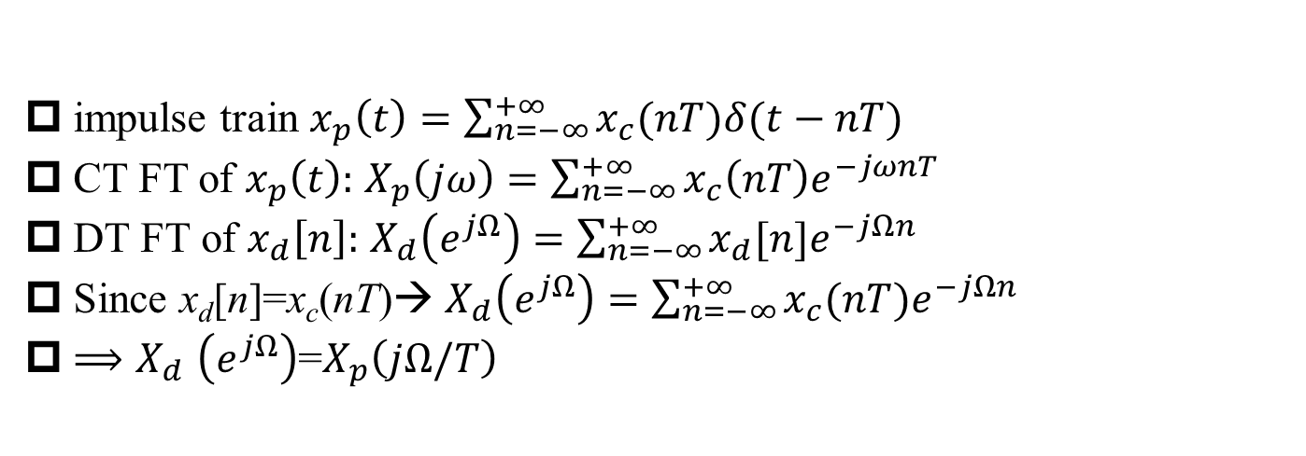
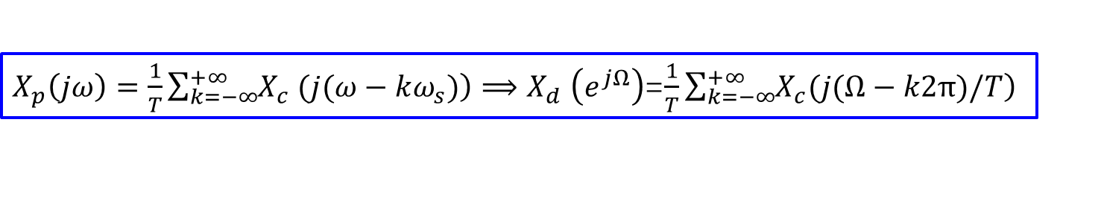
C/D Conversion
§7.4 DT Processing of CT Signals
x_{d}[n]=x_{c}(nT)
impulse train $x_{p}\left(t\right)=\sum_{n=−∞}^{+∞}{x_{c}(nT)δ(t−nT)}$
CT FT of $x_{p}\left(t\right):$ $X_{p}\left(jω\right)=\sum_{n=−∞}^{+∞}{x_{c}\left(nT\right)e^{−jωnT}}$
DT FT of $x_{d}\left[n\right]:$ $X_{d}\left(e^{jΩ}\right)=\sum_{n=−∞}^{+∞}{x_{d}[n]e^{−jΩn}}$
Since x_{d}[n]=x_{c}(nT)→ $X_{d}\left(e^{jΩ}\right)=\sum_{n=−∞}^{+∞}{x_{c}(nT)e^{−jΩn}}$
${⟹X}_{d}\left(e^{jΩ}\right)$=$X_{p}\left(jΩ/T\right)$
$X_{p}\left(jω\right)=\frac{1}{T}\sum_{k=−∞}^{+∞}{\left.X_{c} (j(ω−kω_{s})\right)}{⟹X}_{d}\left(e^{jΩ}\right)$=$\frac{1}{T}\sum_{k=−∞}^{+∞}{\left.X_{c}(j(Ω−k2π)/T\right)}$

Slide 33
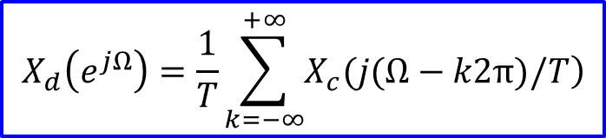
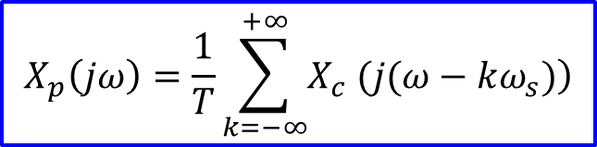
Spectrum of C/D Conversion
§7.4 DT Processing of CT Signals
$$X_{p}\left(jω\right)=\frac{1}{T}\sum_{k=−∞}^{+∞}{\left.X_{c} (j(ω−kω_{s})\right)}$$
$$X_{d}\left(e^{jΩ}\right)=\frac{1}{T}\sum_{k=−∞}^{+∞}{\left.X_{c}(j(Ω−k2π)/T\right)}$$

Slide 34
Impulse-Train Sampling of Discrete-Time Signals
§7.5 Sampling of DT Signals

Slide 35
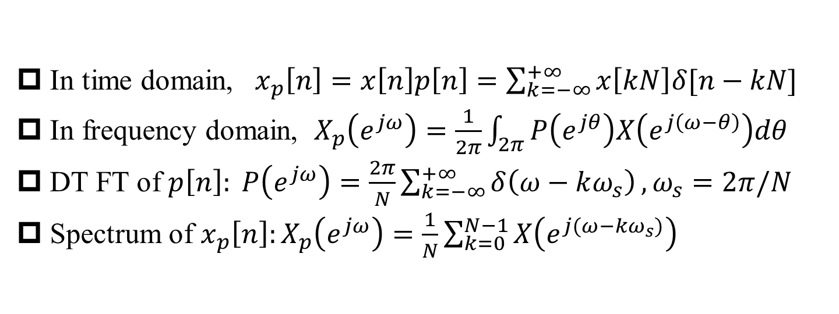
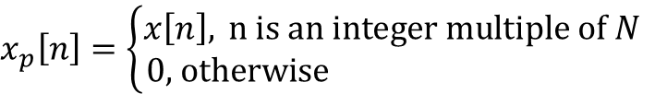
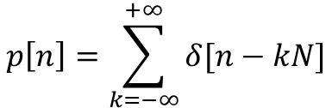
Impulse-Train Sampling of Discrete-Time Signals
§7.5 Sampling of DT Signals
$$p\left[n\right]=\sum_{k=−∞}^{+∞}{δ[n−kN]}$$
$$x_{p}\left[n\right]=\left\{\begin{aligned}x\left[n\right], \text{n} \text{is} \text{an} \text{integer} \text{multiple} \text{of} N \\ 0\text{, }\text{otherwise} \end{aligned}\right.$$
In time domain, $x_{p}\left[n\right]=x\left[n\right]p\left[n\right]=\sum_{k=−∞}^{+∞}{x\left[kN\right]δ[n−kN]}$
In frequency domain, $X_{p}\left(e^{jω}\right)=\frac{1}{2π}\int_{2π}{P\left(e^{jθ}\right)X\left(e^{j\left(ω−θ\right)}\right)dθ}$
DT FT of $p\left[n\right]: P\left(e^{jω}\right)=\frac{2π}{N}\sum_{k=−∞}^{+∞}{δ\left(ω−kω_{s}\right)},ω_{s}=2π/N$
Spectrum of $x_{p}\left[n\right]:X_{p}\left(e^{jω}\right)=\frac{1}{N}\sum_{k=0}^{N−1}{X\left(e^{j(ω−kω_{s})}\right)}$

Slide 36

Sampling of DT Signals without Aliasing
§7.5 Sampling of DT Signals
$$ω_{s}>{2ω}_{M}$$

Slide 37

Sampling of DT Signals with Aliasing
§7.5 Sampling of DT Signals
$$ω_{s}<{2ω}_{M}$$

Slide 38
Decimation
§7.5 Sampling of DT Signals
sampling
Decimation: operation of extracting every Nth sample

Slide 39
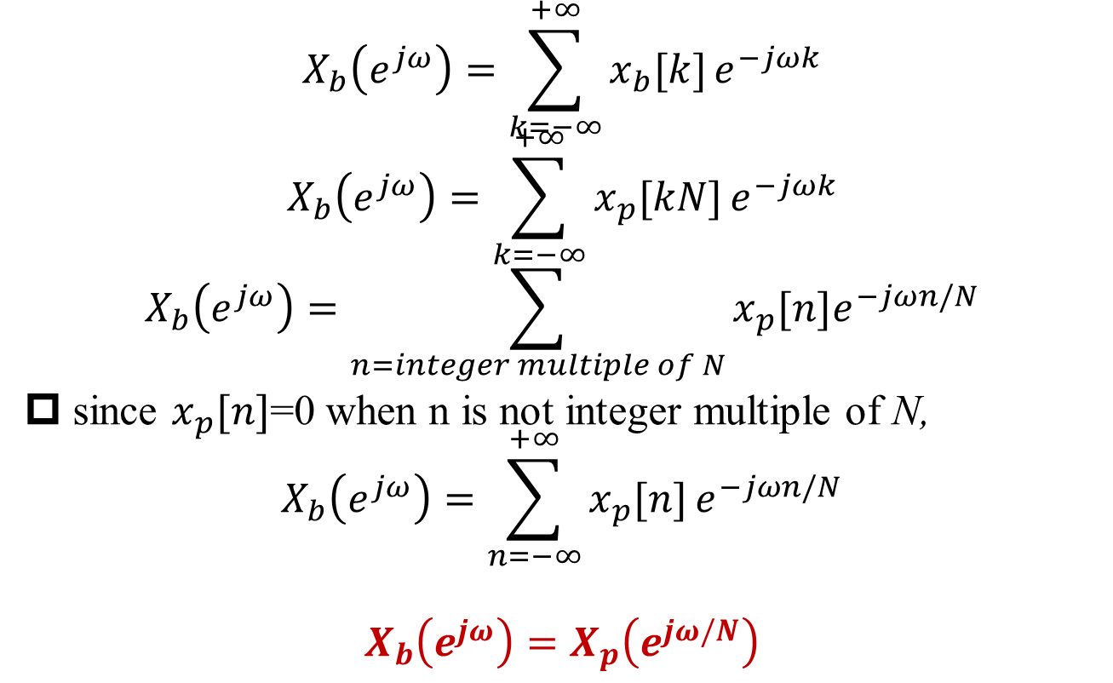
Spectrum of Decimation
§7.5 Sampling of DT Signals
$$X_{b}\left(e^{jω}\right)=\sum_{k=−∞}^{+∞}{x_{b}[k]}e^{−jωk}$$
$$X_{b}\left(e^{jω}\right)=\sum_{k=−∞}^{+∞}{x_{p}[kN]}e^{−jωk}$$
$$X_{b}\left(e^{jω}\right)=\sum_{n=integer multiple of N}{x_{p}[n]e^{−jωn/N}}$$
since $x_{p}[n]$=0 when n is not integer multiple of N,
$$X_{b}\left(e^{jω}\right)=\sum_{n=−∞}^{+∞}{x_{p}[n]}e^{−jωn/N}$$
$$X_{b}\left(e^{jω}\right)=X_{p}\left(e^{jω/N}\right)$$

Slide 40
Spectrum of Decimation
§7.5 Sampling of DT Signals
Decimation is often called downsampling
If there is no aliasing in downsampling, then the original sequence is oversampled

Slide 41
Interpolation
§7.5 Sampling of DT Signals
upsampling (reverse of decimation) + lowpass filter

Slide 42
Summary
From DT FS to DT FT
FT of Periodic Sequence
DT Fourier Transform Properties
Periodicity
Convolution
Spectrum of Sampling, Decimation and Interpolation

Slide 43
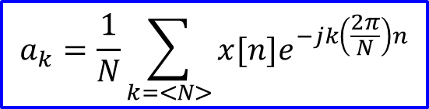
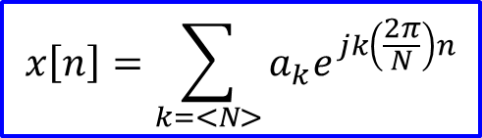
Duality Learned So Far
§5.7 Duality
continuous-time Fourier transform: synthesis equation vs. analysis equation
discrete-time Fourier series: synthesis equation vs. analysis equation
$$x\left[n\right]=\sum_{k=<N>}{a_{k}e^{jk\left(\frac{2π}{N}\right)n}}$$
$$a_{k}=\frac{1}{N}\sum_{k=<N>}{x[n]e^{−jk\left(\frac{2π}{N}\right)n}}$$

Slide 44
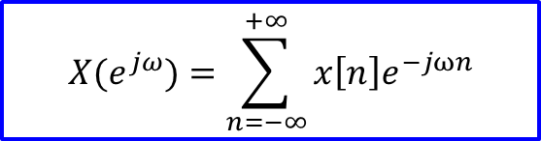

No Duality between Synthesis Function and Analysis Function of DT FT
§5.7 Duality
Summation vs. Integration: No duality in DT FT
No duality in CT FS
$$X(e^{jω})=\sum_{n=−∞}^{+∞}{x\left[n\right]e^{−jωn}}$$
Analysis equation
Synthesis equation
$$x\left[n\right]=\frac{1}{2π}\int_{2π}{{X(e^{jω})e}^{jωn}dω}$$
Synthesis equation
Analysis equation

Slide 45
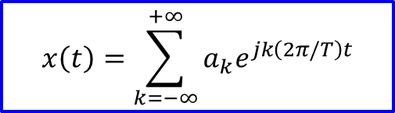
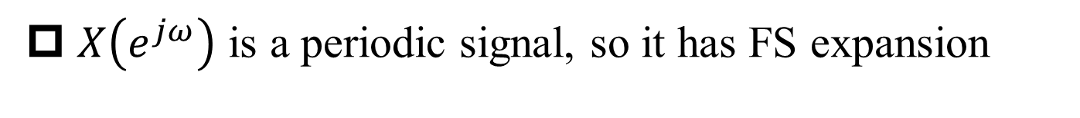


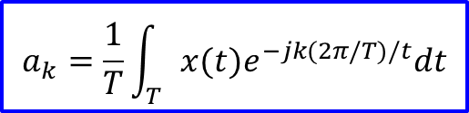
Duality between DT FT and CT FS
§5.7 Duality
Discrete-time
Fourier Transform
Continuous-time
Fourier Series
Synthesis equation
$$x\left[n\right]=\frac{1}{2π}\int_{2π}{{X(e^{jω})e}^{jωn}dω}$$
$$x\left(t\right)=\sum_{k=−∞}^{+∞}{a_{k}e^{jk\left(2π/T\right)t}}$$
Analysis equation
$$X(e^{jω})=\sum_{n=−∞}^{+∞}{x\left[n\right]e^{−jωn}}$$
$$a_{k}=\frac{1}{T}\int_{T}{x(t)e^{−jk(2π/T)/t}dt}$$
$X\left(e^{jω}\right)$ is a periodic signal, so it has FS expansion

Slide 46
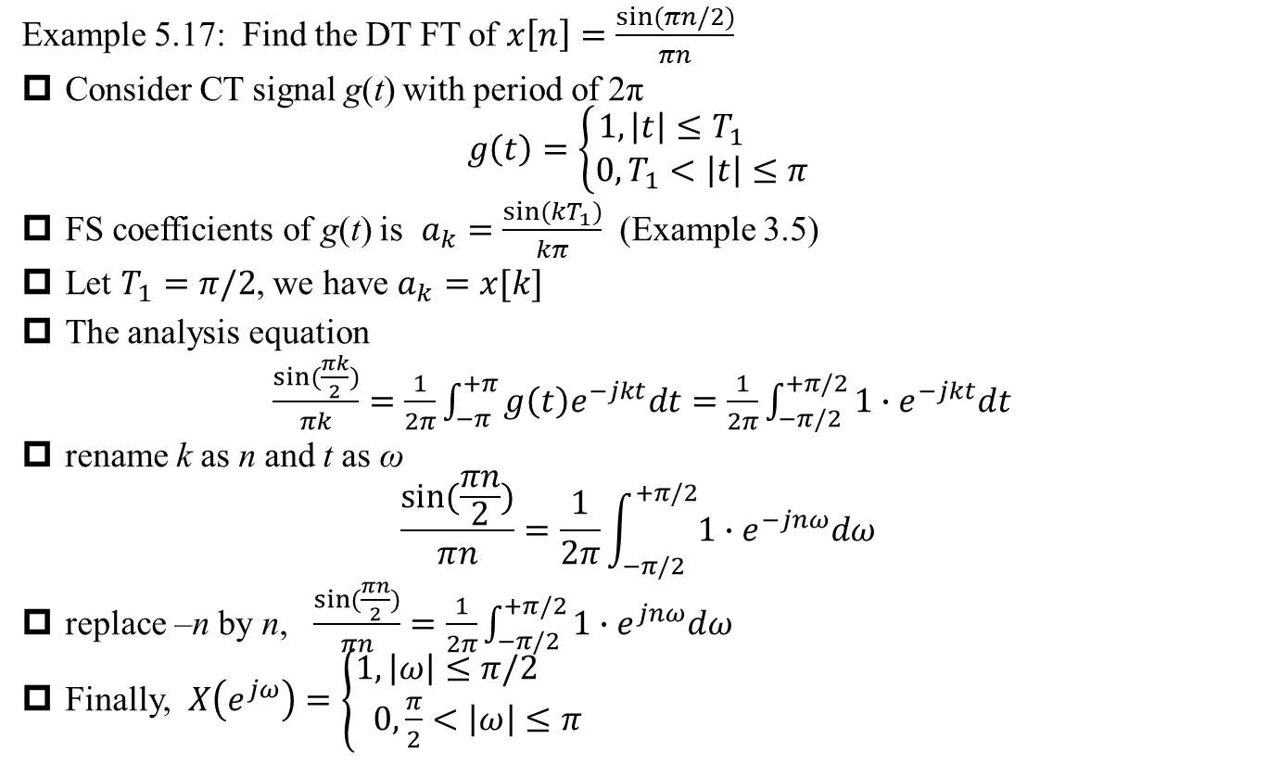
Example 5.17
§5.7 Duality
Example 5.17: Find the DT FT of $x\left[n\right]=\frac{sin⁡(πn/2)}{πn}$
Consider CT signal g(t) with period of 2π
$$g\left(t\right)=\left\{\begin{aligned}1, \left|t\right|≤T_{1} \\ 0, T_{1}<\left|t\right|≤π\end{aligned}\right.$$
FS coefficients of g(t) is $a_{k}=\frac{sin⁡(kT_{1})}{kπ}$ (Example 3.5)
Let $T_{1}=π/2$, we have $a_{k}=x[k]$
The analysis equation
$\frac{sin⁡(\frac{πk}{2})}{πk}=\frac{1}{2π}\int_{−π}^{+π}{g\left(t\right)e^{−jkt}dt}=\frac{1}{2π}\int_{−π/2}^{+π/2}{1∙e^{−jkt}dt}$
rename k as n and t as ω
$$\frac{sin⁡(\frac{πn}{2})}{πn}=\frac{1}{2π}\int_{−π/2}^{+π/2}{1∙e^{−jnω}dω}$$
replace –n by n, $\frac{sin⁡(\frac{πn}{2})}{πn}=\frac{1}{2π}\int_{−π/2}^{+π/2}{1∙e^{jnω}dω}$
Finally, $X\left(e^{jω}\right)=\left\{\begin{aligned}1, \left|ω\right|≤π/2 \\ 0,\frac{π}{2}<\left|ω\right|≤π\end{aligned}\right.$

Slide 47
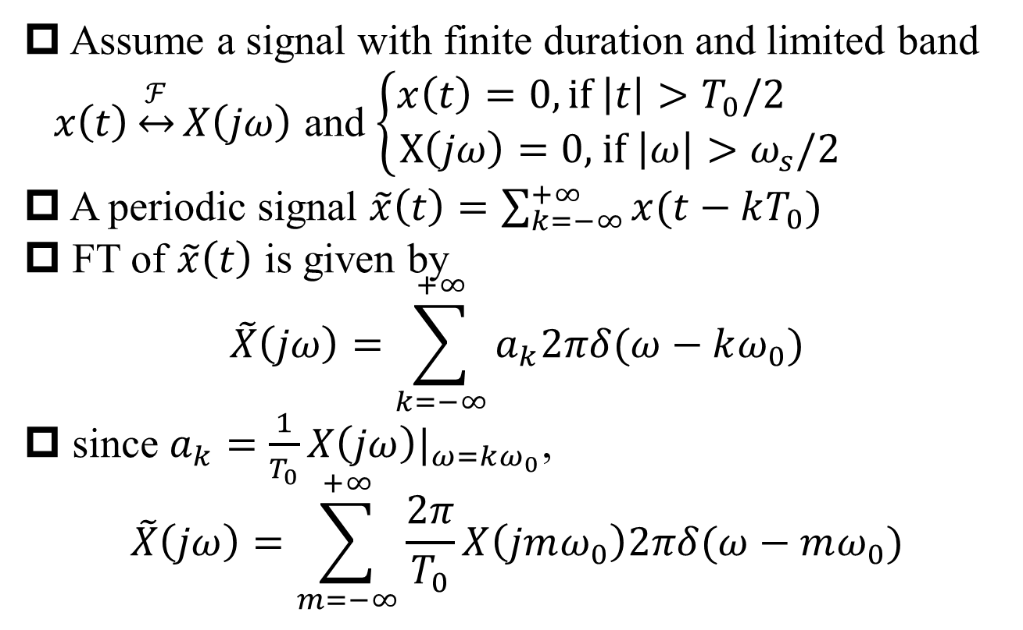
Basis for Discrete Fourier Transform (DFT)
Assume a signal with finite duration and limited band $x\left(t\right)\underset{↔}{ℱ}X\left(jω\right)$ and $\left\{\begin{aligned}x\left(t\right)=0, if \left|t\right|>T_{0}/2 \\ X\left(jω\right)=0\text{, }\text{if} \left|ω\right|>ω_{s}/2\end{aligned}\right.$
A periodic signal $\tilde{x}\left(t\right)=\sum_{k=−∞}^{+∞}{x(t−kT_{0})}$
FT of $\tilde{x}\left(t\right)$ is given by
$$\tilde{X}\left(jω\right)=\sum_{k=−∞}^{+∞}{a_{k}2πδ(ω−kω_{0})}$$
since $a_{k}=\frac{1}{T_{0}}X\left(jω\right)|_{ω=kω_{0}}$,
$$\tilde{X}\left(jω\right)=\sum_{m=−∞}^{+∞}{\frac{2π}{T_{0}}X\left(jmω_{0}\right)2πδ(ω−mω_{0})}$$
Q: Possible?

Slide 48
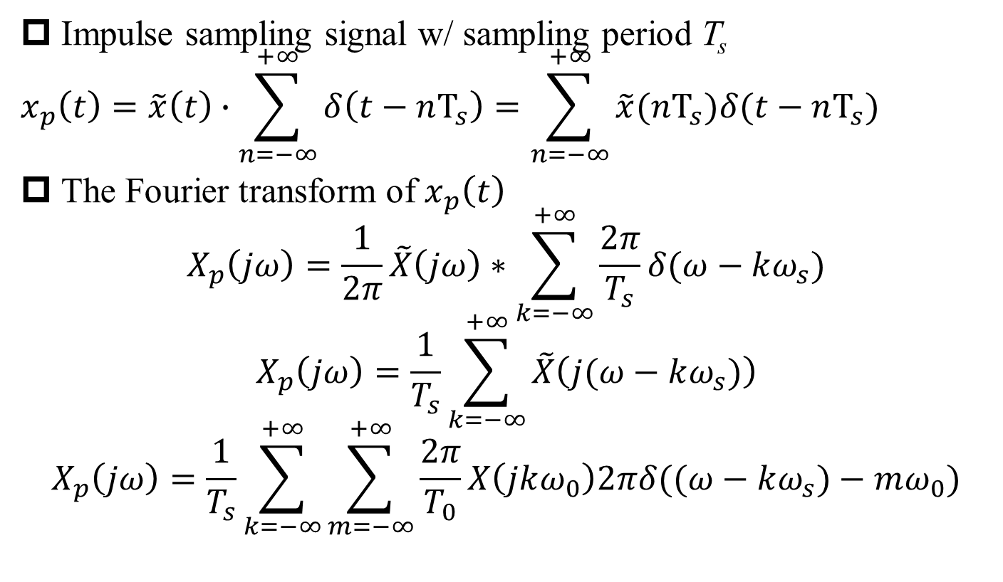
Basis for Discrete Fourier Transform (DFT) (2)
Impulse sampling signal w/ sampling period T_{s}
$$x_{p}\left(t\right)=\tilde{x}\left(t\right)∙\sum_{n=−∞}^{+∞}{δ\left(t−nT_{s}\right)}=\sum_{n=−∞}^{+∞}{\tilde{x}(nT_{s})δ(t−nT_{s})}$$
The Fourier transform of $x_{p}\left(t\right)$
$$X_{p}\left(jω\right)=\frac{1}{2π}\tilde{X}\left(jω\right)∗\sum_{k=−∞}^{+∞}{\frac{2π}{T_{s}}δ(ω−kω_{s})}$$
$$X_{p}\left(jω\right)=\frac{1}{T_{s}}\sum_{k=−∞}^{+∞}{\tilde{X}\left(j(ω−kω_{s})\right)}$$
$$X_{p}\left(jω\right)=\frac{1}{T_{s}}\sum_{k=−∞}^{+∞}{\sum_{m=−∞}^{+∞}{\frac{2π}{T_{0}}X\left(jkω_{0}\right)2πδ((ω−kω_{s})−mω_{0})}}$$

Slide 49
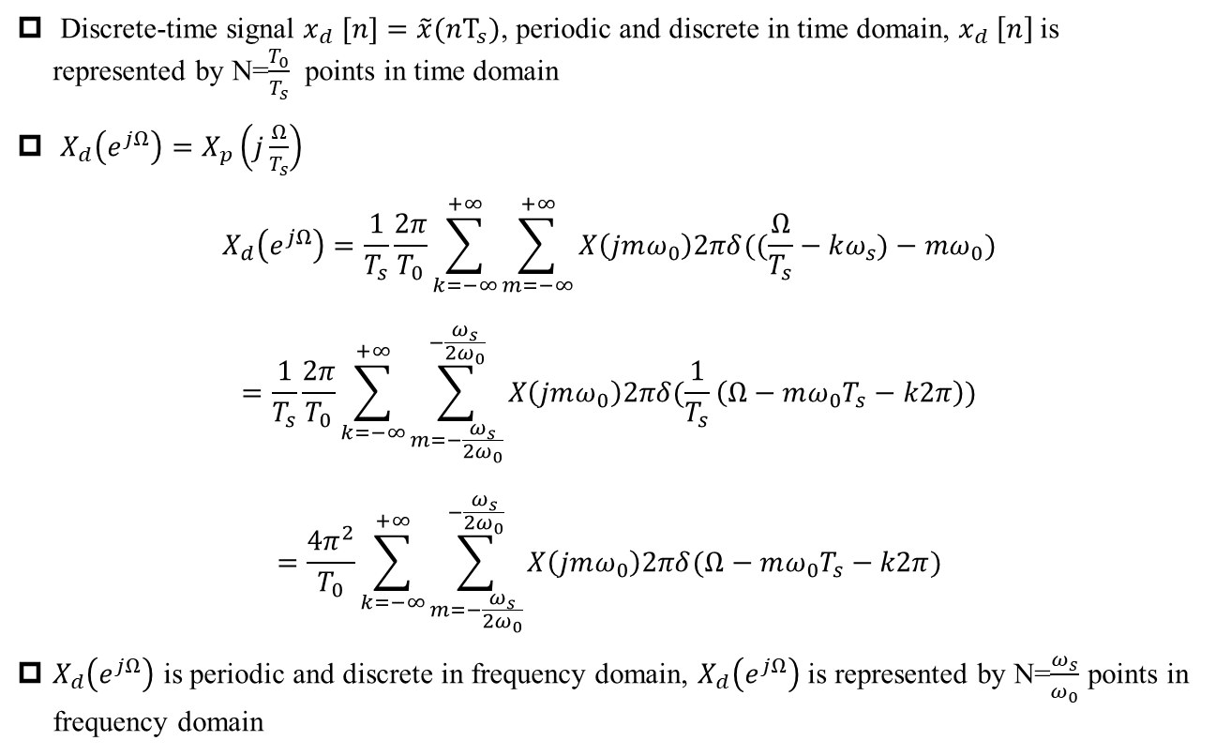
Basis for Discrete Fourier Transform (DFT) (3)
Discrete-time signal $x_{d} [n]=\tilde{x}(nT_{s})$, periodic and discrete in time domain, $x_{d} \left[n\right]$ is represented by N=$\frac{T_{0}}{T_{s}}$ points in time domain
$X_{d}\left(e^{jΩ}\right)=X_{p}\left(j\frac{Ω}{T_{s}}\right)$
$$X_{d}\left(e^{jΩ}\right)=\frac{1}{T_{s}}\frac{2π}{T_{0}}\sum_{k=−∞}^{+∞}{\sum_{m=−∞}^{+∞}{X\left(jmω_{0}\right)2πδ((\frac{Ω}{T_{s}}−kω_{s})−mω_{0})}}$$
$$=\frac{1}{T_{s}}\frac{2π}{T_{0}}\sum_{k=−∞}^{+∞}{\sum_{m=−\frac{ω_{s}}{2ω_{0}}}^{−\frac{ω_{s}}{2ω_{0}}}{X\left(jmω_{0}\right)2πδ(\frac{1}{T_{s}}\left(Ω−mω_{0}T_{s}−k2π\right))}}$$
$$=\frac{4π^{2}}{T_{0}}\sum_{k=−∞}^{+∞}{\sum_{m=−\frac{ω_{s}}{2ω_{0}}}^{−\frac{ω_{s}}{2ω_{0}}}{X\left(jmω_{0}\right)2πδ(Ω−mω_{0}T_{s}−k2π)}}$$
$X_{d}\left(e^{jΩ}\right)$ is periodic and discrete in frequency domain, $X_{d}\left(e^{jΩ}\right)$ is represented by N=$\frac{ω_{s}}{ω_{0}}$ points in frequency domain

