Slide 1


荷塘雨课堂
播放ppt
腾讯会议
双向语音/视频交流
1. 开启荷塘雨课堂（请关闭音频输出，可以点名、白板、做题、弹幕等）
2. 开启腾讯会议（请保持静音，一般关闭摄像头，发言前解除静音）
雨课堂可以看ppt，腾讯会议可以看现场板书，
建议分别用两个终端打开。

Slide 2
Chapter 10 The z-Transform

Slide 3
Outline
Definition of z-Transform
Region of Convergence of z-Transform
Inverse z-Transform
Geometric Evaluation of z-Transform
z-Transform Properties
LTI System Analysis Using z-Transform
System Block Diagram

Slide 4
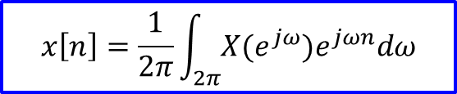
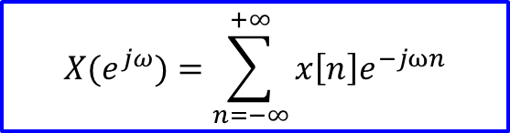
Recall: Discrete-time Fourier transform
§10.1 Definition of z-Transform
Discrete-time Fourier transform pair
$$X(e^{jω})=\sum_{n=−∞}^{+∞}{x\left[n\right]e^{−jωn}}$$
Analysis equation
Synthesis equation
$$x\left[n\right]=\frac{1}{2π}\int_{2π}{{X(e^{jω})e}^{jωn}dω}$$

Slide 5

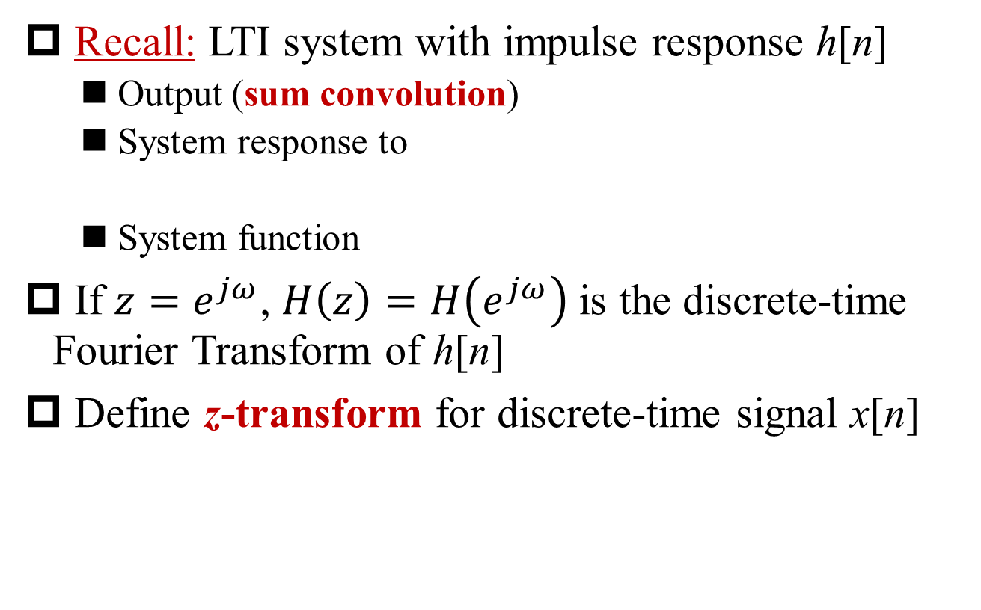
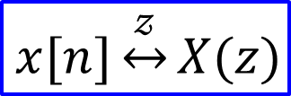
Definition of z-Transform
§10.1 Definition of z-Transform
Recall: LTI system with impulse response h[n]
Output (sum convolution)
System response to
System function
If $z=e^{jω}$, $H\left(z\right)=H\left(e^{jω}\right)$is the discrete-time Fourier Transform of h[n]
Define z-transform for discrete-time signal x[n]
$$X(z)≜\sum_{n=−∞}^{+∞}{x\left[n\right]z^{−n}}$$
$$x[n]\underset{↔}{𝓏}X(z)$$

Slide 6
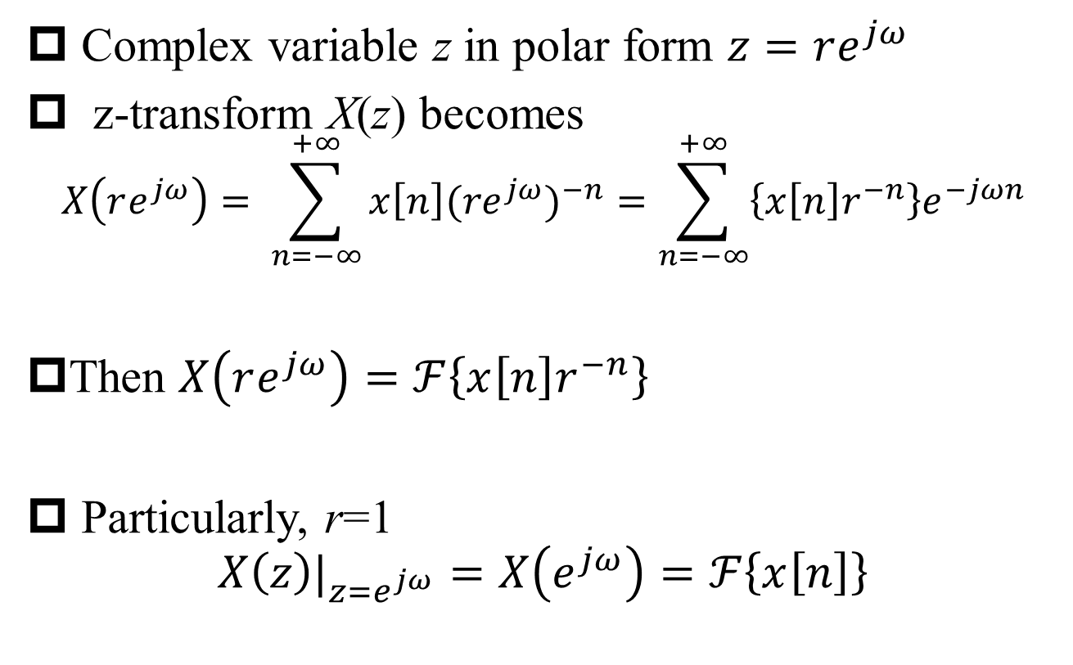
DT Fourier transform vs. z-Transform
§10.1 Definition of z-Transform
Complex variable z in polar form $z=re^{jω}$
z-transform X(z) becomes
$$X\left(re^{jω}\right)= \sum_{n=−∞}^{+∞}{x\left[n\right]{(re^{jω})}^{−n}}=\sum_{n=−∞}^{+∞}{\left\{x\left[n\right]r^{−n}\right\}e^{−jωn}}$$
Then $X\left(re^{jω}\right)=ℱ\left\{x\left[n\right]r^{−n}\right\}$
Particularly, r=1
$${X\left(z\right)|}_{z=e^{jω}}=X\left(e^{jω}\right)=ℱ\left\{x\left[n\right]\right\}$$

Slide 7

DT FT vs. z-Transform (cont’)
§10.1 Definition of z-Transform
Q: What in the s-plane is equivalent to the unit cycle in z-plane?
$${X\left(z\right)|}_{z=e^{jω}}=X\left(e^{jω}\right)=ℱ\left\{x\left[n\right]\right\}$$

Slide 8
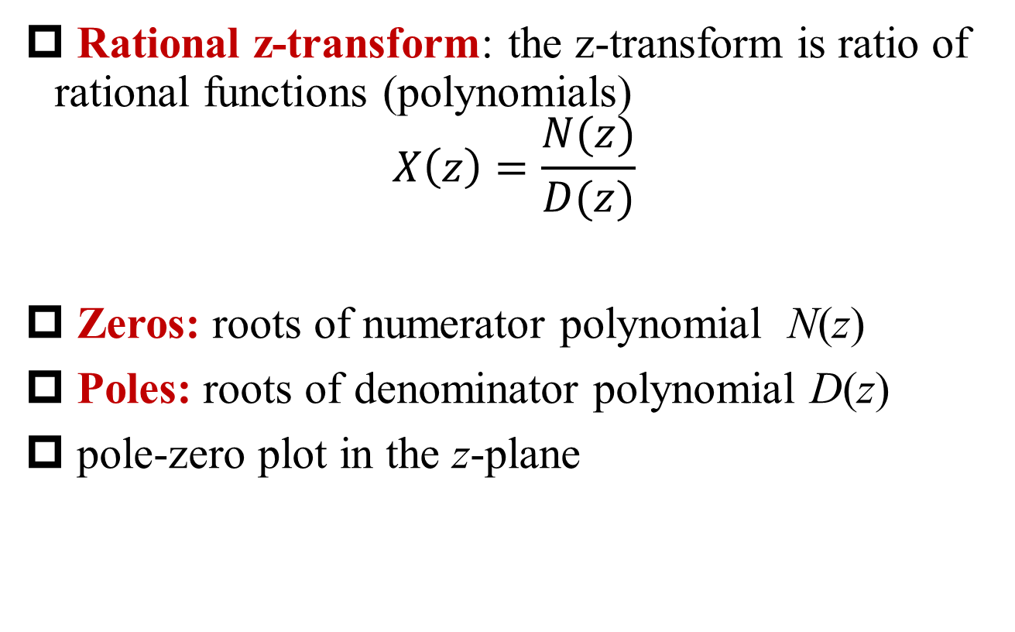
Rational z-Transform
§10.1 Definition of z-Transform
Rational z-transform: the z-transform is ratio of rational functions (polynomials)
$$X\left(z\right)=\frac{N(z)}{D(z)}$$
Zeros: roots of numerator polynomial N(z)
Poles: roots of denominator polynomial D(z)
pole-zero plot in the z-plane

Slide 9
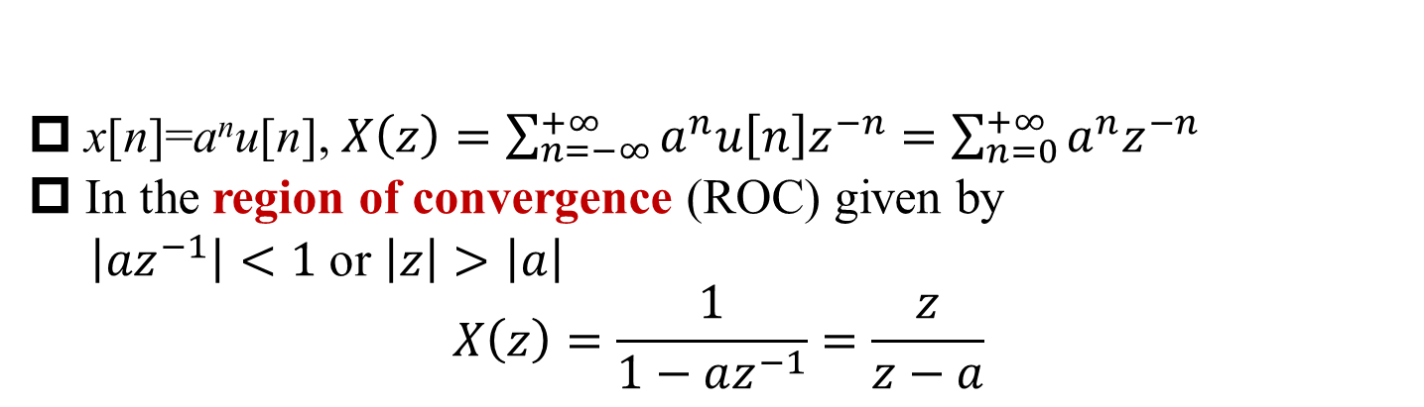
Example 10.1
§10.1 Definition of z-Transform
x[n]=a^{n}u[n], $X\left(z\right)=\sum_{n=−∞}^{+∞}{a^{n}u\left[n\right]z^{−n}}=\sum_{n=0}^{+∞}{a^{n}z^{−n}}$
In the region of convergence (ROC) given by
$\left|az^{−1}\right|<1$or $\left|z\right|>\left|a\right|$
$$X\left(z\right)=\frac{1}{1−az^{−1}}=\frac{z}{z−a}$$
Q: What’s the condition that DT FT converges?
pole-zero plot
A: The ROC includes the unit cycle.

Slide 10
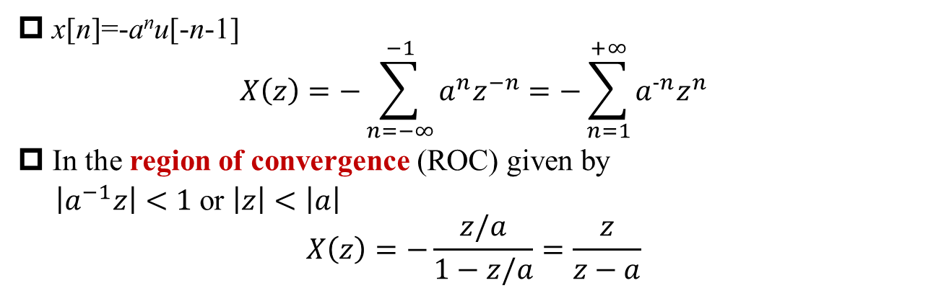
Example 10.2
§10.1 Definition of z-Transform
x[n]=-a^{n}u[-n-1]
$$X\left(z\right)=−\sum_{n=−∞}^{−1}{a^{n}z^{−n}=−\sum_{n=1}^{+∞}{a^{−n}z^{n}}}$$
In the region of convergence (ROC) given by
$\left|a^{−1}z\right|<1$or $\left|z\right|<\left|a\right|$
$$X\left(z\right)=−\frac{z/a}{1−z/a}=\frac{z}{z−a}$$
Q: How to make DT FT converge?

Slide 11
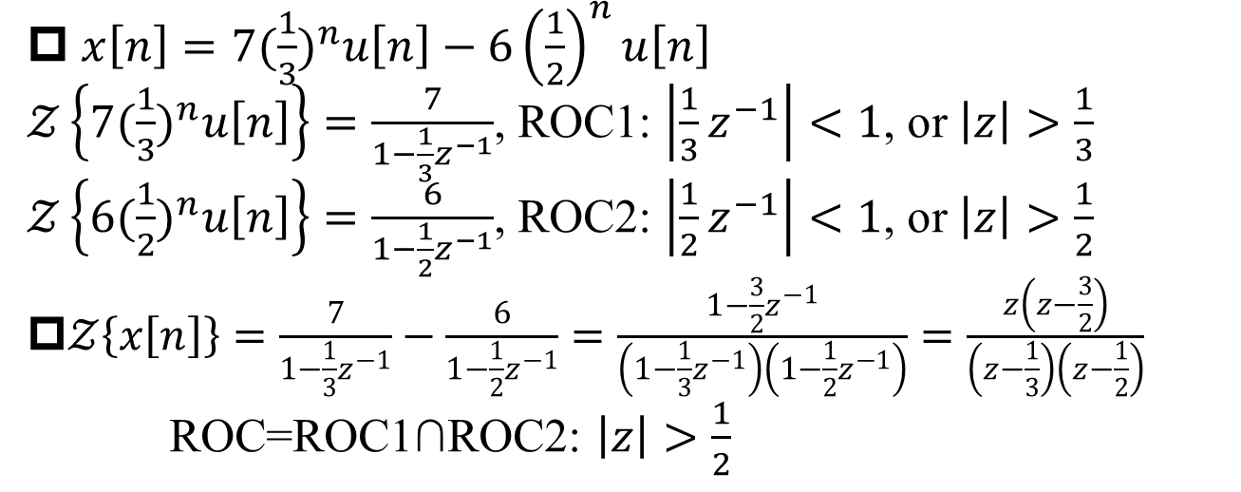
Example 10.3
§10.1 Definitionof z-Transform
$x\left[n\right]=7{(\frac{1}{3})}^{n}u\left[n\right]−6{\left(\frac{1}{2}\right)}^{n}u\left[n\right]$
$𝒵\left\{7{(\frac{1}{3})}^{n}u\left[n\right]\right\}=\frac{7}{1−\frac{1}{3}z^{−1}}$, ROC1: $\left|\frac{1}{3}z^{−1}\right|<1$, or $\left|z\right|>\frac{1}{3}$
$𝒵\left\{6{(\frac{1}{2})}^{n}u\left[n\right]\right\}=\frac{6}{1−\frac{1}{2}z^{−1}}$, ROC2: $\left|\frac{1}{2}z^{−1}\right|<1$, or $\left|z\right|>\frac{1}{2}$
$𝒵\left\{x\left[n\right]\right\}=\frac{7}{1−\frac{1}{3}z^{−1}}−\frac{6}{1−\frac{1}{2}z^{−1}}=\frac{1−\frac{3}{2}z^{−1}}{\left(1−\frac{1}{3}z^{−1}\right)\left(1−\frac{1}{2}z^{−1}\right)}=\frac{z\left(z−\frac{3}{2}\right)}{\left(z−\frac{1}{3}\right)\left(z−\frac{1}{2}\right)}$
ROC=ROC1∩ROC2: $\left|z\right|>\frac{1}{2}$

Slide 12
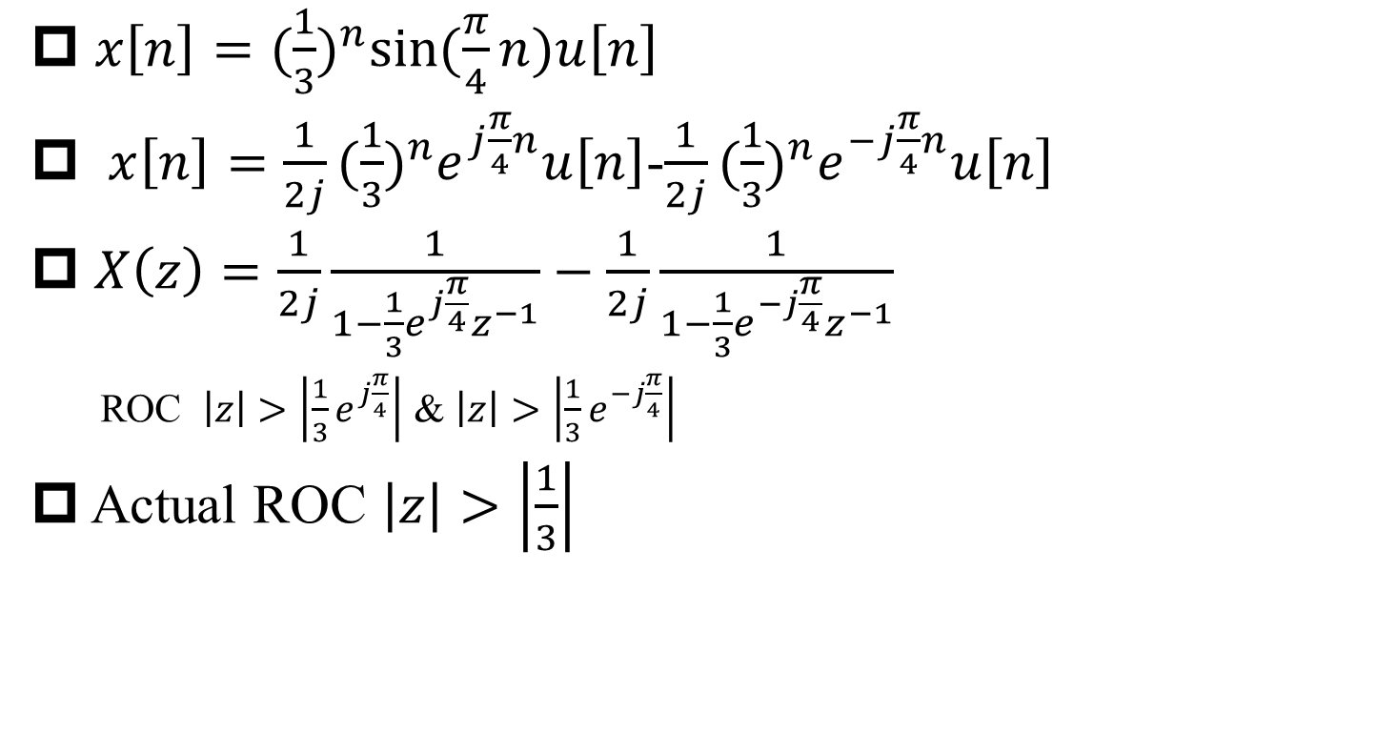
Example 10.4
§10.1 Definition of z-Transform
$x\left[n\right]={(\frac{1}{3})}^{n}sin⁡(\frac{π}{4}n)u\left[n\right]$
$x\left[n\right]={\frac{1}{2j}(\frac{1}{3})}^{n}e^{j\frac{π}{4}n}u\left[n\right]$-${\frac{1}{2j}(\frac{1}{3})}^{n}e^{−j\frac{π}{4}n}u\left[n\right]$
$X\left(z\right)=\frac{1}{2j}\frac{1}{1−\frac{1}{3}e^{j\frac{π}{4}}z^{−1}}−\frac{1}{2j}\frac{1}{1−\frac{1}{3}e^{−j\frac{π}{4}}z^{−1}}$
ROC $\left|z\right|>\left|\frac{1}{3}e^{j\frac{π}{4}}\right|$ & $\left|z\right|>\left|\frac{1}{3}e^{−j\frac{π}{4}}\right|$
Actual ROC $\left|z\right|>\left|\frac{1}{3}\right|$
Q: The rational expression? Zero(s)?

Slide 13
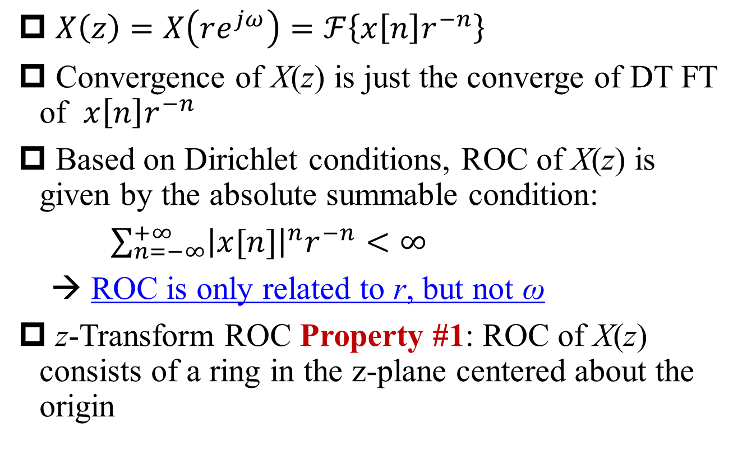
z-Transform ROC Property (1)
§10.2 ROC Properties of z-Transform
$X\left(z\right)=X\left(re^{jω}\right)=ℱ\left\{x\left[n\right]r^{−n}\right\}$
Convergence of X(z) is just the converge of DT FT of $x\left[n\right]r^{−n}$
Based on Dirichlet conditions, ROC of X(z) is given by the absolute summable condition:
$\sum_{n=−∞}^{+∞}{{\left|x[n]\right|}^{n}r^{−n}<∞}$
→ ROC is only related to r, but not ω
z-Transform ROC Property #1: ROC of X(z) consists of a ring in the z-plane centered about the origin

Slide 14
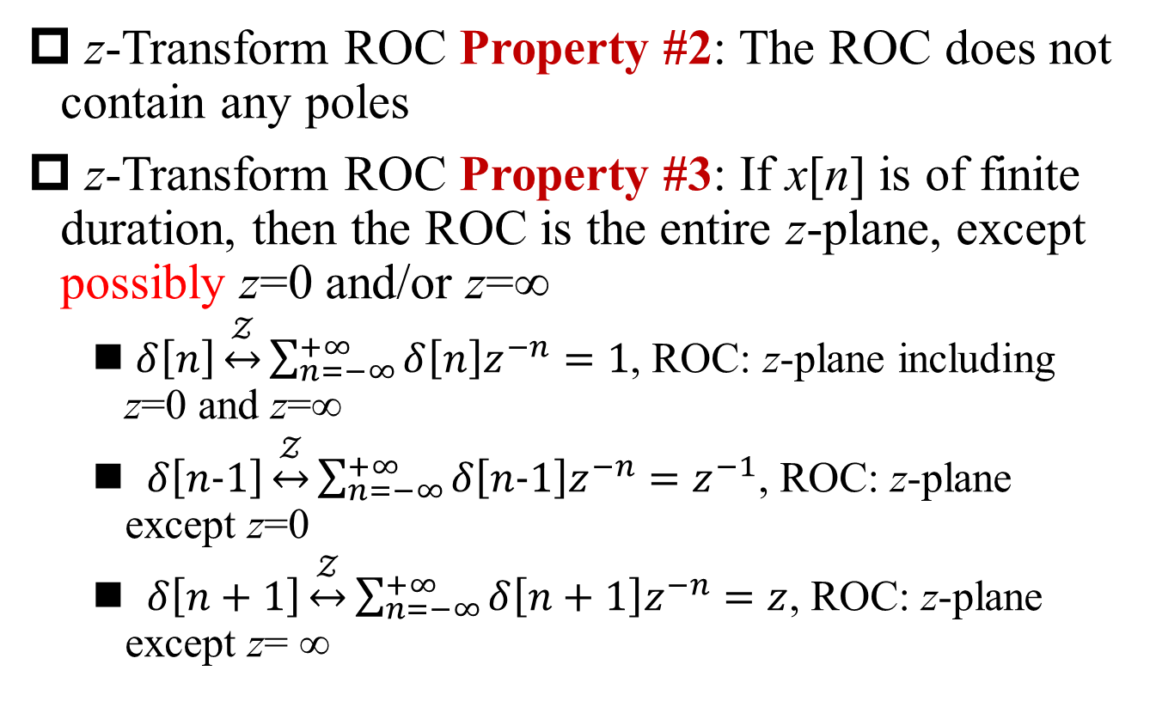
z-Transform ROC Property (2)
§10.2 ROC Properties of z-Transform
z-Transform ROC Property #2: The ROC does not contain any poles
z-Transform ROC Property #3: If x[n] is of finite duration, then the ROC is the entire z-plane, except possibly z=0 and/or z=∞
$δ\left[n\right]\underset{↔}{𝒵}\sum_{n=−∞}^{+∞}{δ\left[n\right]z^{−n}}=1$, ROC: z-plane including z=0 and z=∞
$δ\left[n−1\right]\underset{↔}{𝒵}\sum_{n=−∞}^{+∞}{δ\left[n−1\right]z^{−n}}=z^{−1}$, ROC: z-plane except z=0
$δ\left[n+1\right]\underset{↔}{𝒵}\sum_{n=−∞}^{+∞}{δ\left[n+1\right]z^{−n}}=z$, ROC: z-plane except z= ∞

Slide 15
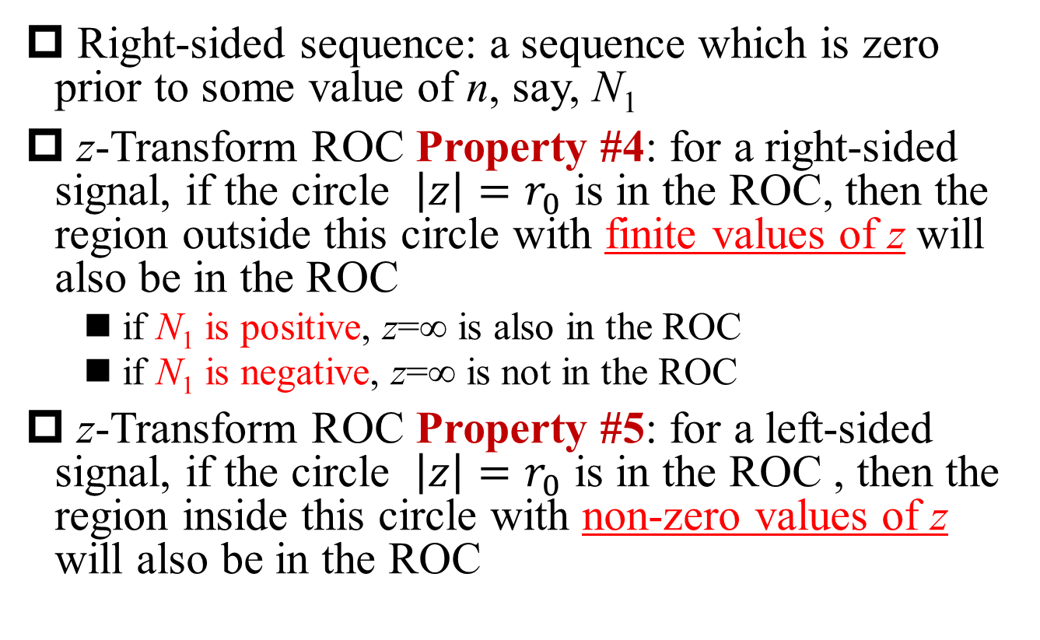
z-Transform ROC Property (3)
§10.2 ROC Properties of z-Transform
Right-sided sequence: a sequence which is zero prior to some value of n, say, N₁
z-Transform ROC Property #4: for a right-sided signal, if the circle $\left|z\right|=r_{0}$ is in the ROC, then the region outside this circle with finite values of z will also be in the ROC
if N₁ is positive, z=∞ is also in the ROC
if N₁ is negative, z=∞ is not in the ROC
z-Transform ROC Property #5: for a left-sided signal, if the circle $\left|z\right|=r_{0}$ is in the ROC , then the region inside this circle with non-zero values of z will also be in the ROC
Q: How about z=0?

Slide 16
z-Transform ROC of Sided Sequences
§10.2 ROC Properties of z-Transform
right-sided sequence
left-sided sequence
two-sided sequence

Slide 17
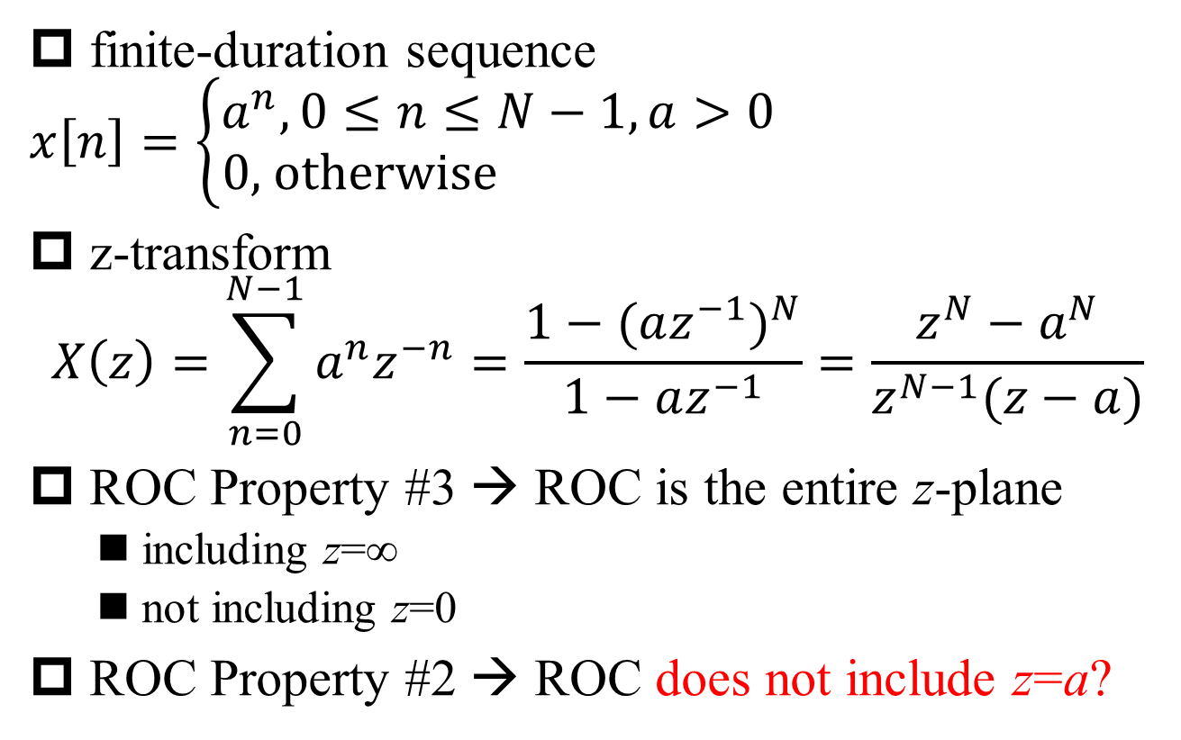
Example 10.6
§10.2 ROC Properties of z-Transform
finite-duration sequence
$$x\left[n\right]=\left\{\begin{aligned}a^{n}, 0≤n≤N−1, a>0 \\ 0\text{, }\text{otherwise} \end{aligned}\right.$$
z-transform
$$X\left(z\right)=\sum_{n=0}^{N−1}{a^{n}z^{−n}=\frac{1−{(az^{−1})}^{N}}{1−az^{−1}}}=\frac{z^{N}−a^{N}}{z^{N−1}(z−a)}$$
ROC Property #3 → ROC is the entire z-plane
including z=∞
not including z=0
ROC Property #2 → ROC does not include z=a?
Q: Why?
Q: Why?
Q: True or false?

Slide 18
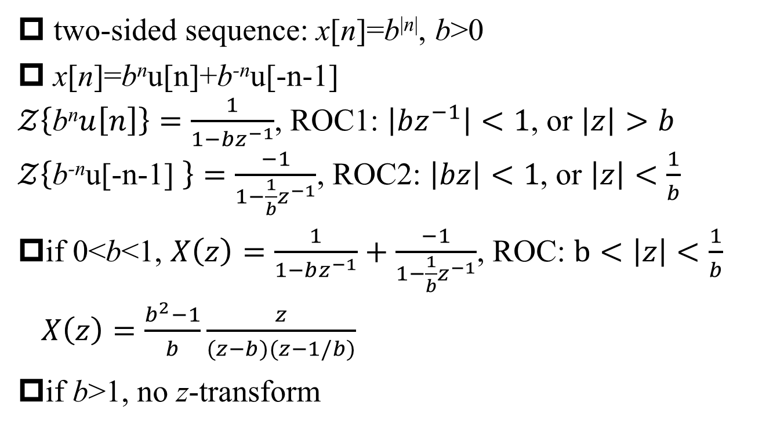
Example 10.7: Two-Sided Sequence
§10.2 ROC Properties of z-Transform
two-sided sequence: x[n]=b^{|n|}, b>0
x[n]=b^{n}u[n]+b^{-n}u[-n-1]
$𝒵\left\{\text{b}\text{n}u\left[n\right]\right\}=\frac{1}{1−bz^{−1}}$, ROC1: $\left|bz^{−1}\right|<1$, or $\left|z\right|>b$
$𝒵\left\{\text{b}\text{−}\text{n}\text{u}\text{[−}\text{n}\text{−1] }\right\}=\frac{−1}{1−\frac{1}{b}z^{−1}}$, ROC2: $\left|bz\right|<1$, or $\left|z\right|<\frac{1}{b}$
if 0<b<1, $X\left(z\right)=\frac{1}{1−bz^{−1}}+\frac{−1}{1−\frac{1}{b}z^{−1}}$, ROC: $b<\left|z\right|<\frac{1}{b}$
$X\left(z\right)=\frac{b^{2}−1}{b}\frac{z}{(z−b)(z−1/b)}$
if b>1, no z-transform
Q: Relationship between ROC an poles?

Slide 19
z-Transform ROC Property (4)
§10.2 ROC Properties of z-Transform
z-Transform ROC Property #7: ROC of rational z-transform is bounded by poles or extends to ∞
z-Transform ROC Property #8: ROC of rational z-transform for left-sided sequence is the region inside the origin-centered circle with the radius equal to the smallest amplitude of poles, possibly including z=0.
If anti-causal, then ROC includes z=0.
z-Transform ROC Property #9: ROC of rational z-transform for right-sided sequence
……?

Slide 20
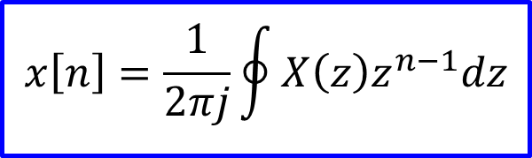
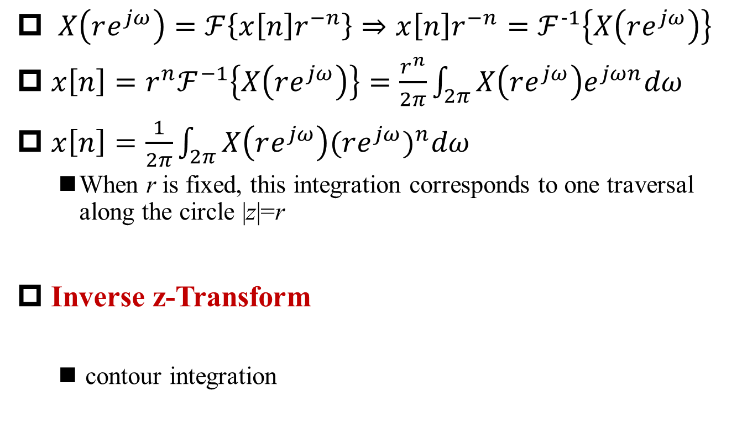
Inverse z-Transform
§10.3 Inverse z-Transform
$X\left(re^{jω}\right)=ℱ\left\{x\left[n\right]r^{−n}\right\}⇒x\left[n\right]r^{−n}=ℱ^{−1}\left\{X\left(re^{jω}\right)\right\}$
$x\left[n\right]={r^{n}ℱ}^{−1}\left\{X\left(re^{jω}\right)\right\}=\frac{r^{n}}{2π}\int_{2π}{X\left(re^{jω}\right)e^{jωn}dω}$
$x\left[n\right]=\frac{1}{2π}\int_{2π}{X\left(re^{jω}\right){(re^{jω})}^{n}dω}$
When r is fixed, this integration corresponds to one traversal along the circle |z|=r
Inverse z-Transform
contour integration
$$x\left[n\right]=\frac{1}{2πj}\oint{X\left(z\right)z^{n−1}dz}$$

Slide 21
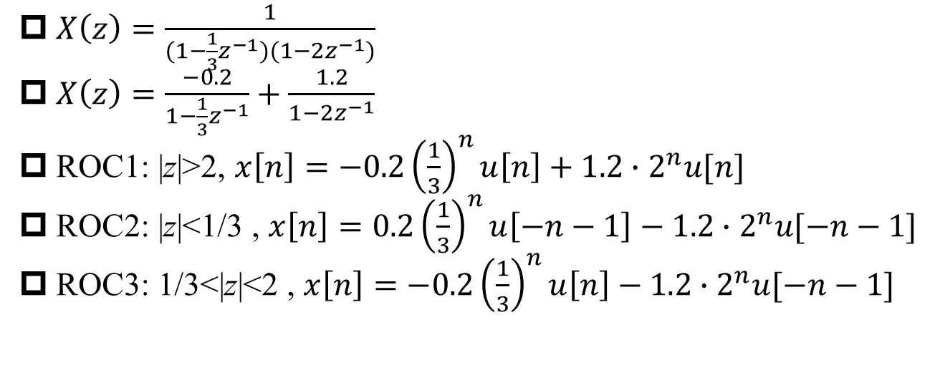
Example 10.8
§10.3 Inverse z-Transform
$X\left(z\right)=\frac{1}{(1−\frac{1}{3}z^{−1})(1−2z^{−1})}$
$X\left(z\right)=\frac{−0.2}{1−\frac{1}{3}z^{−1}}+\frac{1.2}{1−2z^{−1}}$
ROC1: |z|>2, $x\left[n\right]=−0.2{\left(\frac{1}{3}\right)}^{n}u\left[n\right]+1.2∙2^{n}u[n]$
ROC2: |z|<1/3 , $x\left[n\right]=0.2{\left(\frac{1}{3}\right)}^{n}u\left[−n−1\right]−1.2∙2^{n}u[−n−1]$
ROC3: 1/3<|z|<2 , $x\left[n\right]=−0.2{\left(\frac{1}{3}\right)}^{n}u\left[n\right]−1.2∙2^{n}u[−n−1]$
Q1: z=∞?
Q2: z=0?

Slide 22
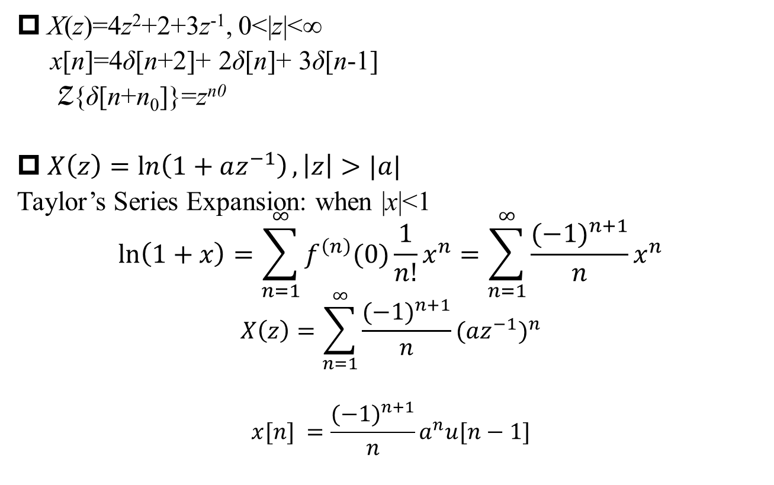
Other Examples
§10.3 Inverse z-Transform
X(z)=4z²+2+3z⁻¹, 0<|z|<∞
x[n]=4δ[n+2]+ 2δ[n]+ 3δ[n-1]
Z{δ[n+n₀]}=z^{n0}
$X\left(z\right)=\ln\left(1+az^{−1}\right), \left|z\right|>|a|$
Taylor’s Series Expansion: when |x|<1
$$\ln\left(1+x\right)=\sum_{n=1}^{∞}{f^{\left(n\right)}(0)\frac{1}{n!}x^{n}}=\sum_{n=1}^{∞}{\frac{{(−1)}^{n+1}}{n}x^{n}}$$
$$X\left(z\right)=\sum_{n=1}^{∞}{\frac{{(−1)}^{n+1}}{n}{(az^{−1})}^{n}}$$
$$x[n] =\frac{{(−1)}^{n+1}}{n}a^{n}u[n−1]$$

Slide 23
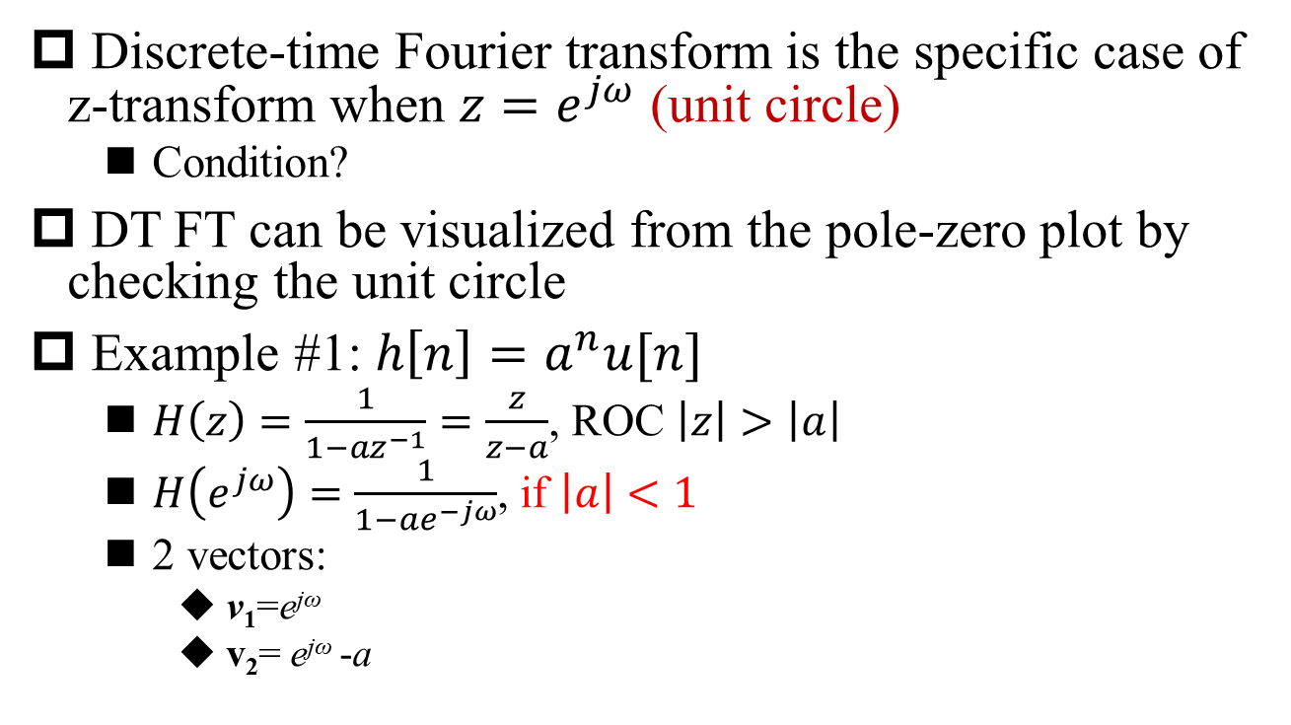
Geometric Evaluation of DT FT on Pole-Zero Plot
§10.4 Geometric Evaluation of DT FT on Pole-Zero Plot
Discrete-time Fourier transform is the specific case of z-transform when $z=e^{jω}$ (unit circle)
Condition?
DT FT can be visualized from the pole-zero plot by checking the unit circle
Example #1: $h\left[n\right]=a^{n}u[n]$
$H\left(z\right)=\frac{1}{1−az^{−1}}=\frac{z}{z−a}$, ROC $\left|z\right|>\left|a\right|$
$H\left(e^{jω}\right)=\frac{1}{1−ae^{−jω}}$, if $\left|a\right|<1$
2 vectors:
v₁=e^{jω}
v₂= e^{jω} -a
ROC includes the unit circle

Slide 24
Geometric Evaluation of DT FT from Pole-Zero Plot (Example #1: a=0.5)
§10.4 Geometric Evaluation of DT FT on Pole-Zero Plot
a=0.5

Slide 25
Geometric Evaluation of DT FT from Pole-Zero Plot (Example #1: a=0.95)
§10.4 Geometric Evaluation of DT FT on Pole-Zero Plot
a=0.95

Slide 26
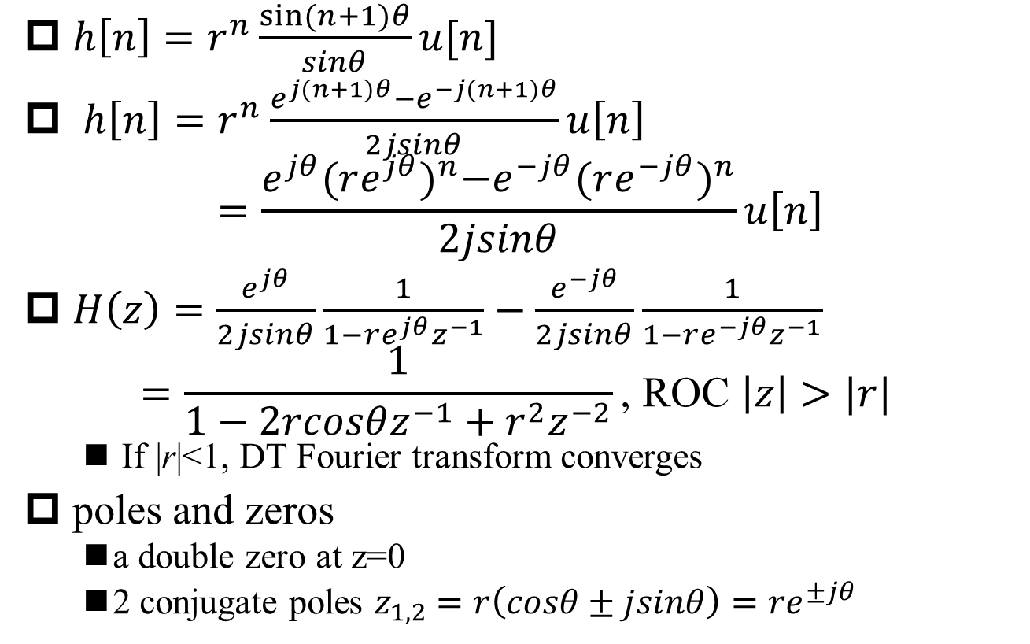
Geometric Evaluation of DT FT from Pole-Zero Plot (Example #2)
§10.4 Geometric Evaluation of DT FT on Pole-Zero Plot
$h\left[n\right]=r^{n}\frac{sin⁡(n+1)θ}{sinθ}u[n]$
$h\left[n\right]=r^{n}\frac{e^{j(n+1)θ}−e^{−j(n+1)θ}}{2jsinθ}u\left[n\right]$
$$=\frac{e^{jθ}{(re^{jθ})}^{n}−e^{−jθ}{(re^{−jθ})}^{n}}{2jsinθ}u\left[n\right]$$
$H\left(z\right)=\frac{e^{jθ}}{2jsinθ}\frac{1}{1−re^{jθ}z^{−1}}−\frac{e^{−jθ}}{2jsinθ}\frac{1}{1−re^{−jθ}z^{−1}}$
$$=\frac{1}{1−2rcosθz^{−1}+r^{2}z^{−2}}\text{, }\text{ROC} \left|z\right|>|r|$$
If |r|<1, DT Fourier transform converges
poles and zeros
a double zero at z=0
2 conjugate poles $z_{1,2}=r\left(cosθ±jsinθ\right)=re^{±jθ}$

Slide 27
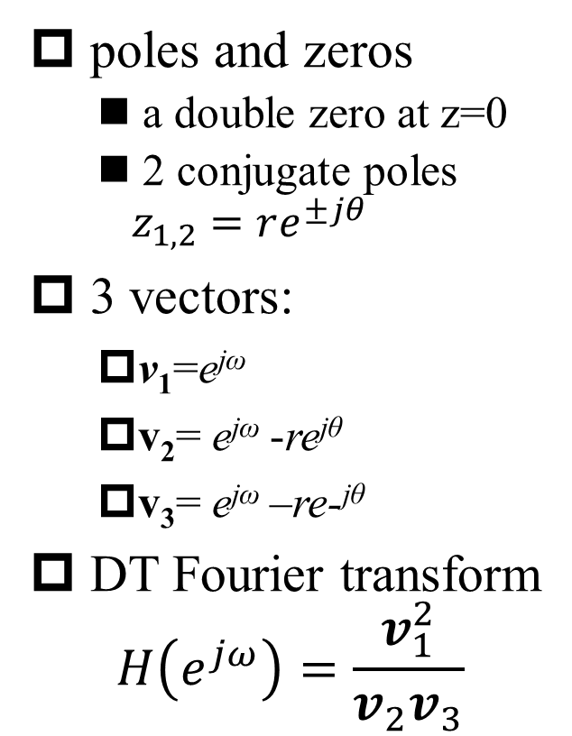
Geometric Evaluation of DT FT from Pole-Zero Plot (Example #2, Cont’)
§10.4 Geometric Evaluation of DT FT on Pole-Zero Plot
poles and zeros
a double zero at z=0
2 conjugate poles $z_{1,2}=re^{±jθ}$
3 vectors:
v₁=e^{jω}
v₂= e^{jω} -re^{jθ}
v₃= e^{jω} –re-^{jθ}
DT Fourier transform
$$H\left(e^{jω}\right)=\frac{v_{1}^{2}}{v_{2}v_{3}}$$

Slide 28
Geometric Evaluation of DT FT from Pole-Zero Plot (Example #2, r=0.8, θ=π/4)
§10.4 Geometric Evaluation of DT FT on Pole-Zero Plot
Q: What’s the frequency corresponding to the peaks?
r=0.8
θ=π/4

Slide 29

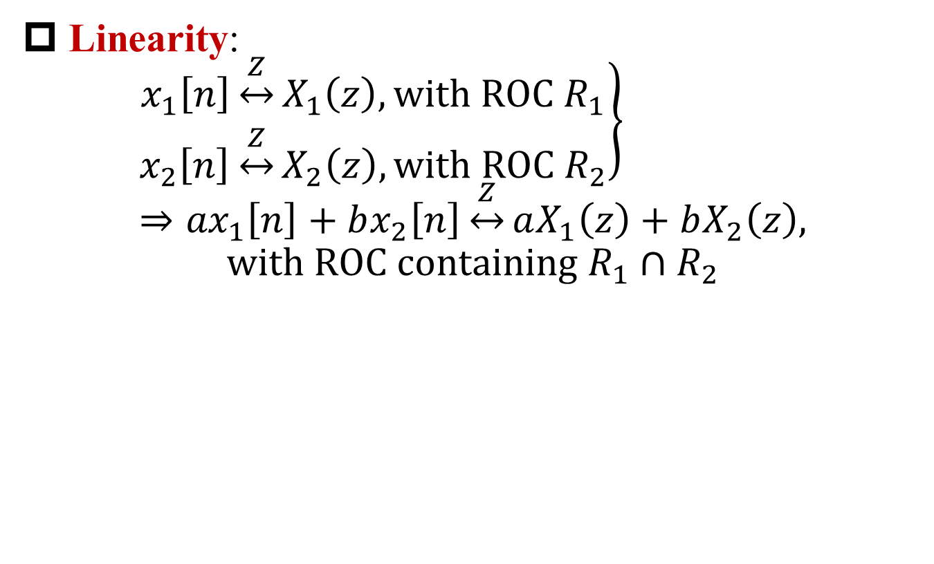
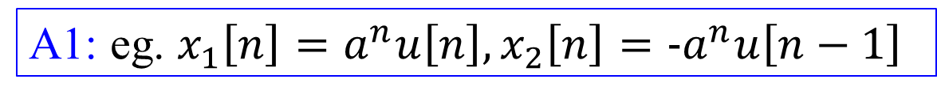
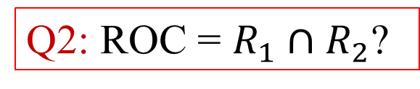
z-Transform Properties - Linearity
§10.5 z-Transform Properties
Linearity:
$$\left.\begin{aligned}x_{1}\left[n\right]\underset{↔}{Z}X_{1}\left(z\right), with ROC R_{1} \\ x_{2}\left[n\right]\underset{↔}{Z}X_{2}\left(z\right), with ROC R_{2}\end{aligned}\right\}⇒{ax}_{1}\left[n\right]+bx_{2}\left[n\right]\underset{↔}{Z}aX_{1}\left(z\right)+bX_{2}\left(z\right),$$
$$with ROC containing R_{1}∩R_{2}$$
Q1: ROC larger than $R_{1}∩R_{2}$?
A1: eg. $x_{1}\left[n\right]=a^{n}u\left[n\right],x_{2}\left[n\right]=−a^{n}u\left[n−1\right]$
Q2: ROC = $R_{1}∩R_{2}$?
A2: no pole/zero cancellation

Slide 30
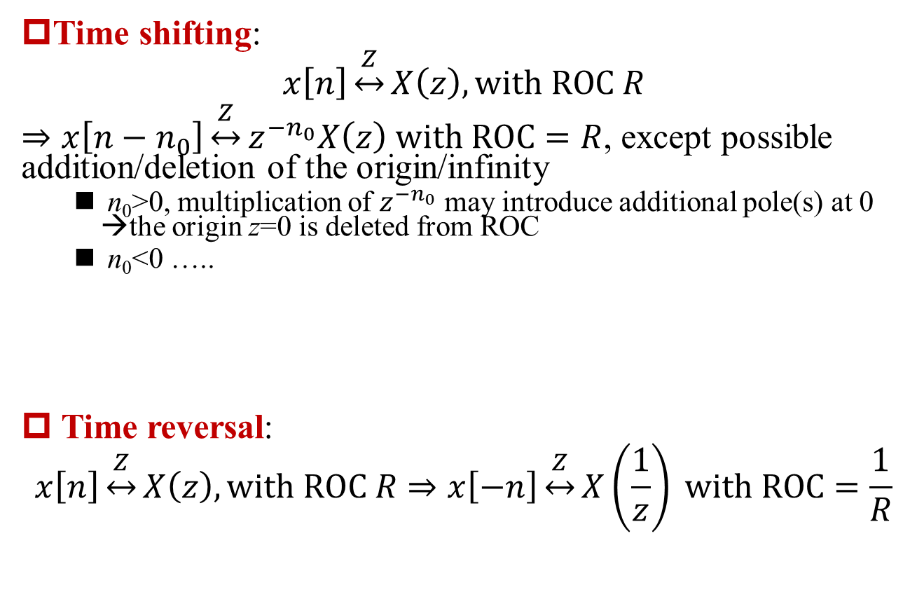
z-Transform Properties – Time Shifting and Time Reversal
§10.5 z-Transform Properties
Time shifting:
$$x\left[n\right]\underset{↔}{Z}X\left(z\right), with ROC R$$
$⇒x\left[n−n_{0}\right]\underset{↔}{Z}z^{−n_{0}}X\left(z\right) with ROC=R$, except possible addition/deletion of the origin/infinity
n₀>0, multiplication of $z^{−n_{0}}$ may introduce additional pole(s) at 0 →the origin z=0 is deleted from ROC
n₀<0 …..
Time reversal:
$$x\left[n\right]\underset{↔}{Z}X\left(z\right), with ROC R⇒x\left[−n\right]\underset{↔}{Z}X\left(\frac{1}{z}\right) with ROC=\frac{1}{R}$$

Slide 31
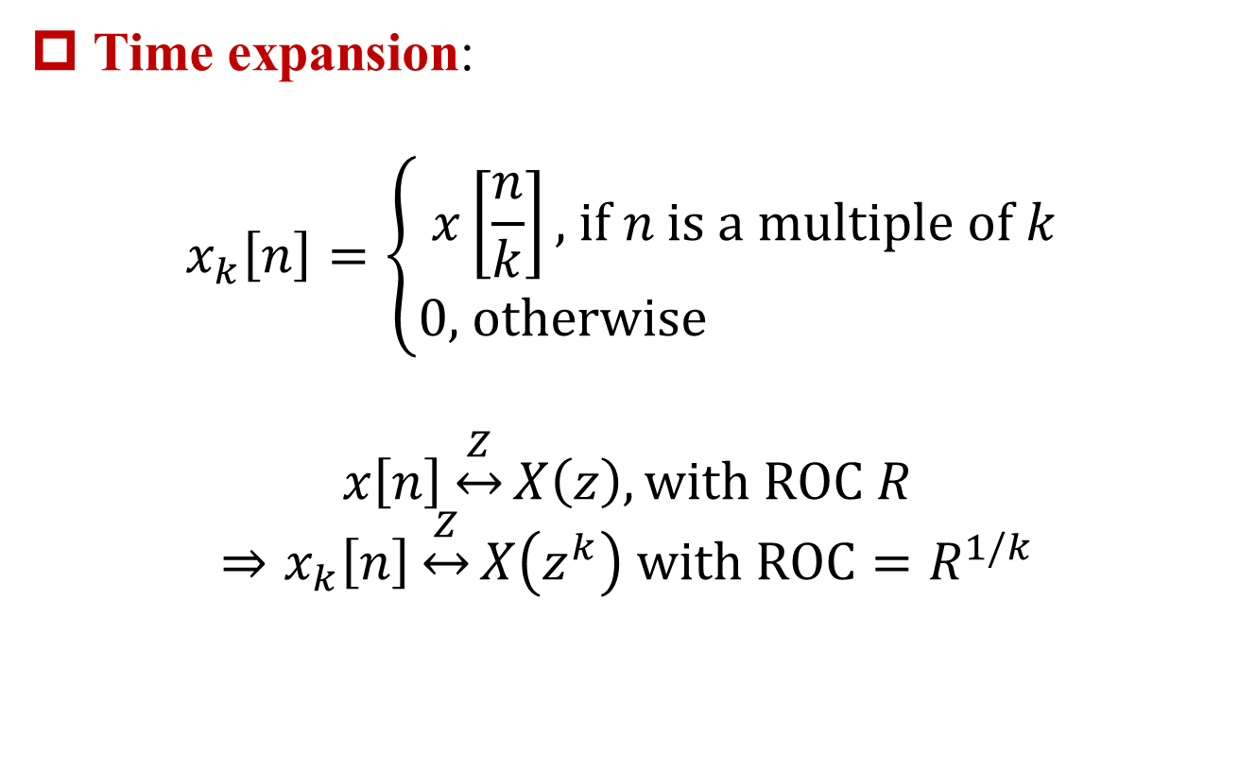
z-Transform Properties – Time Expansion
§10.5 z-Transform Properties
Time expansion:
$$x_{k}\left[n\right]=\left\{\begin{aligned}x\left[\frac{n}{k}\right]\text{, }\text{if} n \text{is} \text{a} \text{multiple} \text{of} k \\ 0\text{, }\text{otherwise} \end{aligned}\right.$$
$$x\left[n\right]\underset{↔}{Z}X\left(z\right), with ROC R$$
$$⇒x_{k}\left[n\right]\underset{↔}{Z}X\left(z^{k}\right) with ROC=R^{1/k}$$

Slide 32
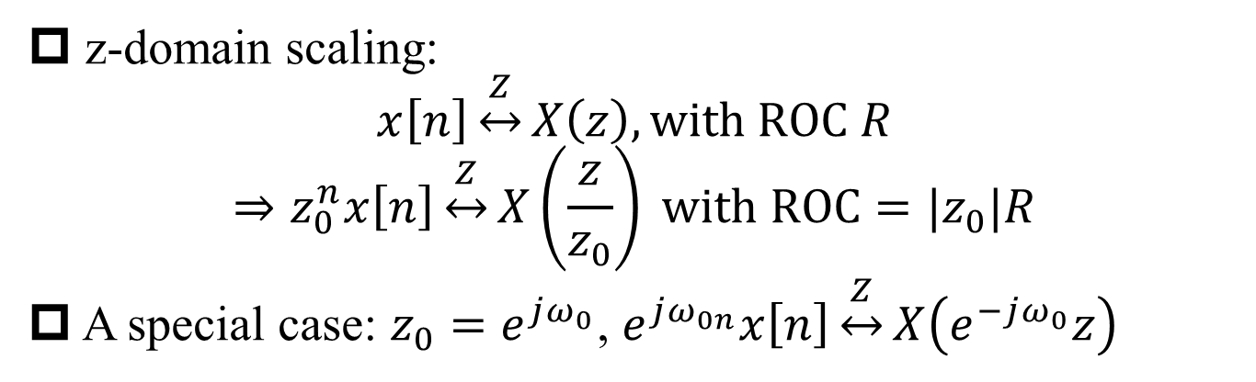
z-Transform Properties – z-Domain Scaling
§10.5 z-Transform Properties
z-domain scaling:
$$x\left[n\right]\underset{↔}{Z}X\left(z\right), with ROC R$$
$$⇒z_{0}^{n}x\left[n\right]\underset{↔}{Z}X\left(\frac{z}{z_{0}}\right) with ROC=|z_{0}|R$$
A special case: $z_{0}=e^{jω_{0}}$, $e^{jω_{0n}}x\left[n\right]\underset{↔}{Z}X\left(e^{−jω_{0}}z\right)$

Slide 33
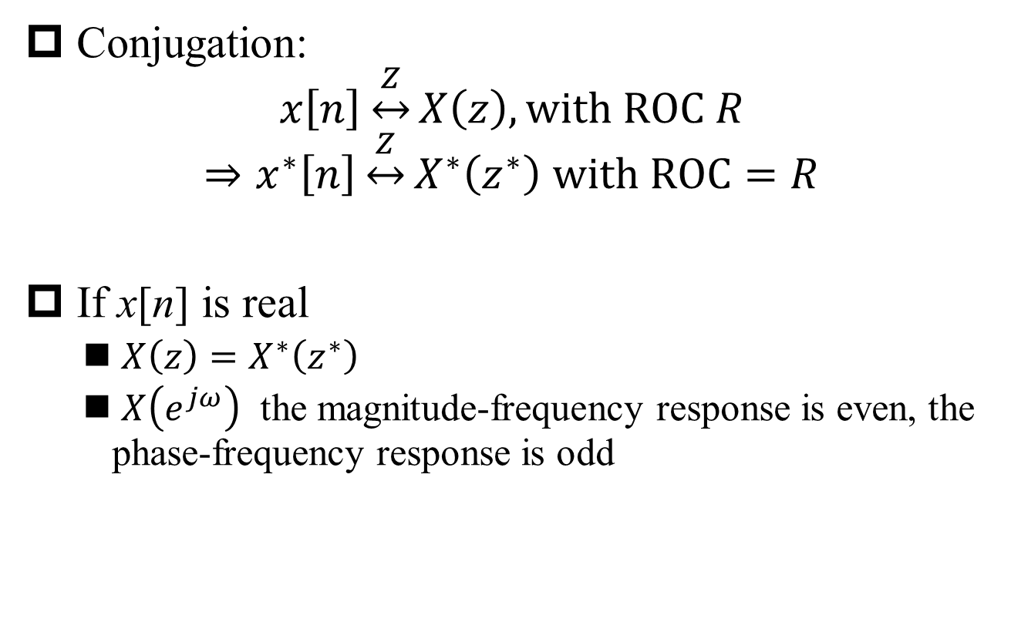
z-Transform Properties – Conjugation
§10.5 z-Transform Properties
Conjugation:
$$x\left[n\right]\underset{↔}{Z}X\left(z\right), with ROC R$$
$$⇒x^{∗}\left[n\right]\underset{↔}{Z}X^{∗}\left(z^{∗}\right) with ROC=R$$
If x[n] is real
${X\left(z\right)=X}^{∗}\left(z^{∗}\right)$
$X\left(e^{jω}\right)$ the magnitude-frequency response is even, the phase-frequency response is odd

Slide 34
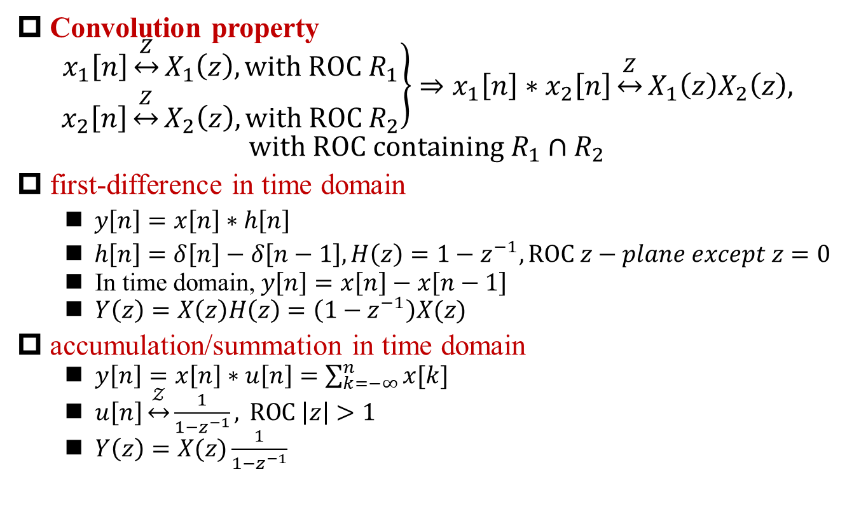
z-Transform Properties – Convolution
§10.5 z-Transform Properties
Convolution property
$$\left.\begin{aligned}x_{1}\left[n\right]\underset{↔}{Z}X_{1}\left(z\right), with ROC R_{1} \\ x_{2}\left[n\right]\underset{↔}{Z}X_{2}\left(z\right), with ROC R_{2}\end{aligned}\right\}⇒x_{1}\left[n\right]∗x_{2}\left[n\right]\underset{↔}{Z}X_{1}\left(z\right)X_{2}\left(z\right),$$
$$with ROC containing R_{1}∩R_{2}$$
first-difference in time domain
$y\left[n\right]=x\left[n\right]∗h\left[n\right]$
$h\left[n\right]=δ\left[n\right]−δ\left[n−1\right], H\left(z\right)=1−z^{−1}, ROC z−plane except z=0$
In time domain, $y\left[n\right]=x\left[n\right]−x\left[n−1\right]$
$Y\left(z\right)=X\left(z\right)H\left(z\right)=\left(1−z^{−1}\right)X(z)$
accumulation/summation in time domain
$y\left[n\right]=x\left[n\right]∗u\left[n\right]=\sum_{k=−∞}^{n}{x[k]}$
$u\left[n\right]\underset{↔}{𝒵}\frac{1}{1−z^{−1}}, \text{ROC} \left|z\right|>1$
$Y\left(z\right)=X(z)\frac{1}{1−z^{−1}}$
Q1: How to prove?
Q2: How?
Q3: ROC?
Q4: How?
Q5: ROC?

Slide 35
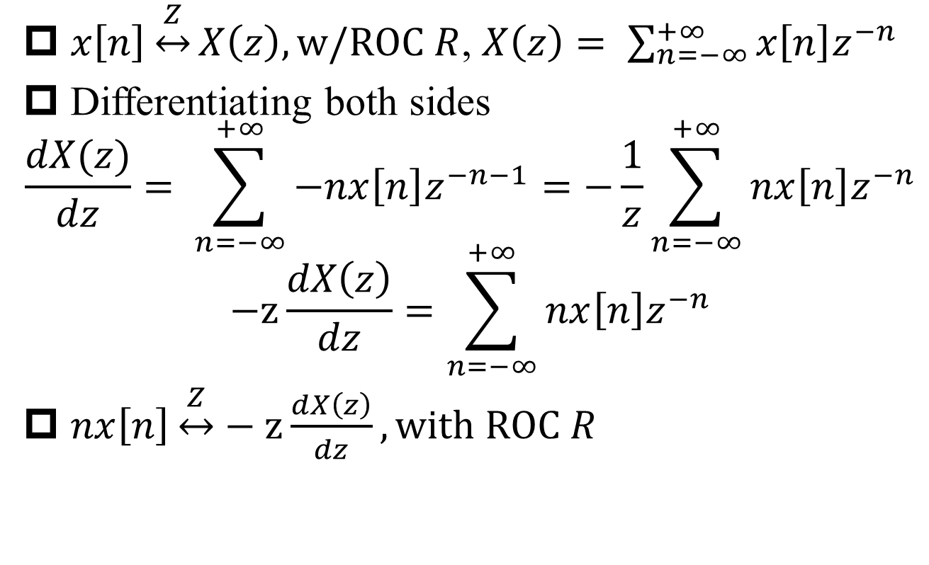
z-Transform Properties – Differentiation in z-Domain
§10.5 z-Transform Properties
$x\left[n\right]\underset{↔}{Z}X\left(z\right), w/ROC R$, $X\left(z\right)= \sum_{n=−∞}^{+∞}{x\left[n\right]z^{−n}}$
Differentiating both sides
$$\frac{dX(z)}{dz}= \sum_{n=−∞}^{+∞}{−nx\left[n\right]z^{−n−1}}=−\frac{1}{z}\sum_{n=−∞}^{+∞}{nx\left[n\right]z^{−n}}$$
$$−z\frac{dX\left(z\right)}{dz}=\sum_{n=−∞}^{+∞}{nx\left[n\right]z^{−n}}$$
$nx\left[n\right]\underset{↔}{Z}−z\frac{dX\left(z\right)}{dz}, \text{with} \text{ROC} R$
Q1: ROC the same?
A1: No additional poles with differentiation

Slide 36
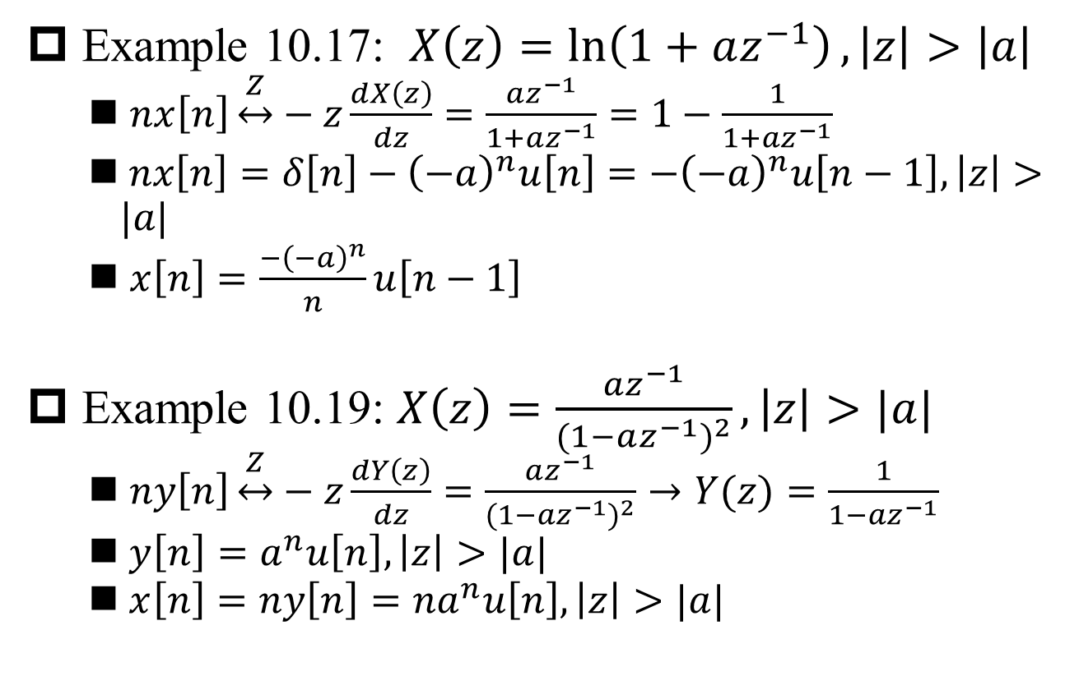
Example 10.17 & 10.18
§10.5 z-Transform Properties
Example 10.17: $X\left(z\right)=\ln\left(1+az^{−1}\right), \left|z\right|>\left|a\right|$
$nx\left[n\right]\underset{↔}{Z}−z\frac{dX\left(z\right)}{dz}=\frac{az^{−1}}{1+az^{−1}}=1−\frac{1}{1+az^{−1}}$
$nx\left[n\right]=δ\left[n\right]−{\left(−a\right)}^{n}u\left[n\right]={−\left(−a\right)}^{n}u\left[n−1\right], \left|z\right|>|a|$
$x\left[n\right]=\frac{{−\left(−a\right)}^{n}}{n}u\left[n−1\right]$
Example 10.19: $X\left(z\right)=\frac{az^{−1}}{{(1−az^{−1})}^{2}}, \left|z\right|>|a|$
$ny\left[n\right]\underset{↔}{Z}−z\frac{dY\left(z\right)}{dz}=\frac{az^{−1}}{{(1−az^{−1})}^{2}}→Y(z)=\frac{1}{1−az^{−1}}$
$y\left[n\right]=a^{n}u\left[n\right], \left|z\right|>|a|$
$x\left[n\right]=ny\left[n\right]={na}^{n}u\left[n\right], \left|z\right|>|a|$

Slide 37
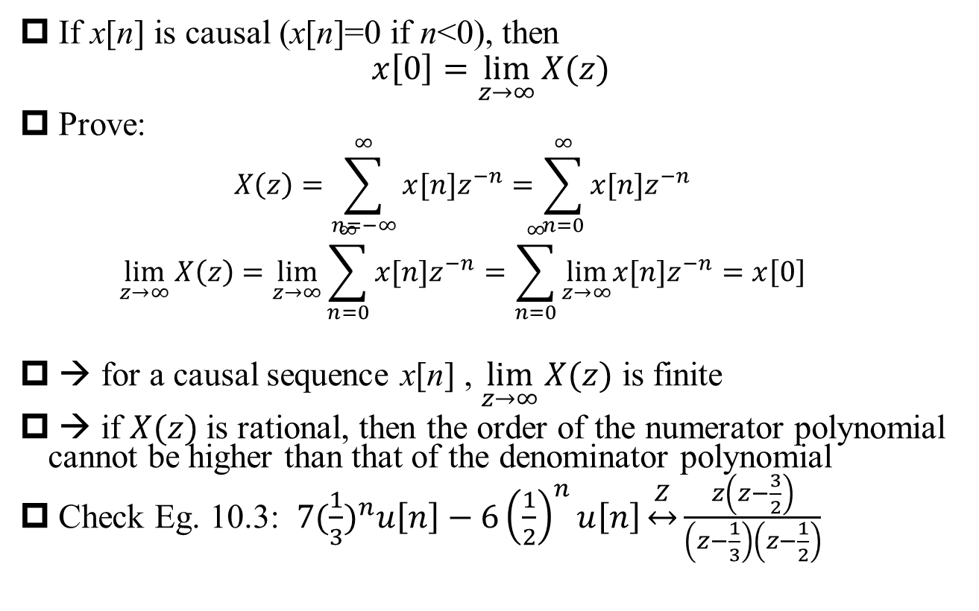
Initial-Value Theorem
§10.5 z-Transform Properties
If x[n] is causal (x[n]=0 if n<0), then
$$x\left[0\right]=\lim_{z→∞}{X(z)}$$
Prove:
$$X\left(z\right)=\sum_{n=−∞}^{∞}{x[n]z^{−n}}=\sum_{n=0}^{∞}{x[n]z^{−n}}$$
$$\lim_{z→∞}{X\left(z\right)}=\lim_{z→∞}{\sum_{n=0}^{∞}{x[n]z^{−n}}}=\sum_{n=0}^{∞}{\lim_{z→∞}x[n]z^{−n}}=x\left[0\right]$$
→ for a causal sequence x[n] , $\lim_{z→∞}{X(z)}$ is finite
→ if $X(z)$is rational, then the order of the numerator polynomial cannot be higher than that of the denominator polynomial
Check Eg. 10.3: $7{(\frac{1}{3})}^{n}u\left[n\right]−6{\left(\frac{1}{2}\right)}^{n}u\left[n\right]\underset{↔}{Z}\frac{z\left(z−\frac{3}{2}\right)}{\left(z−\frac{1}{3}\right)\left(z−\frac{1}{2}\right)}$

Slide 38

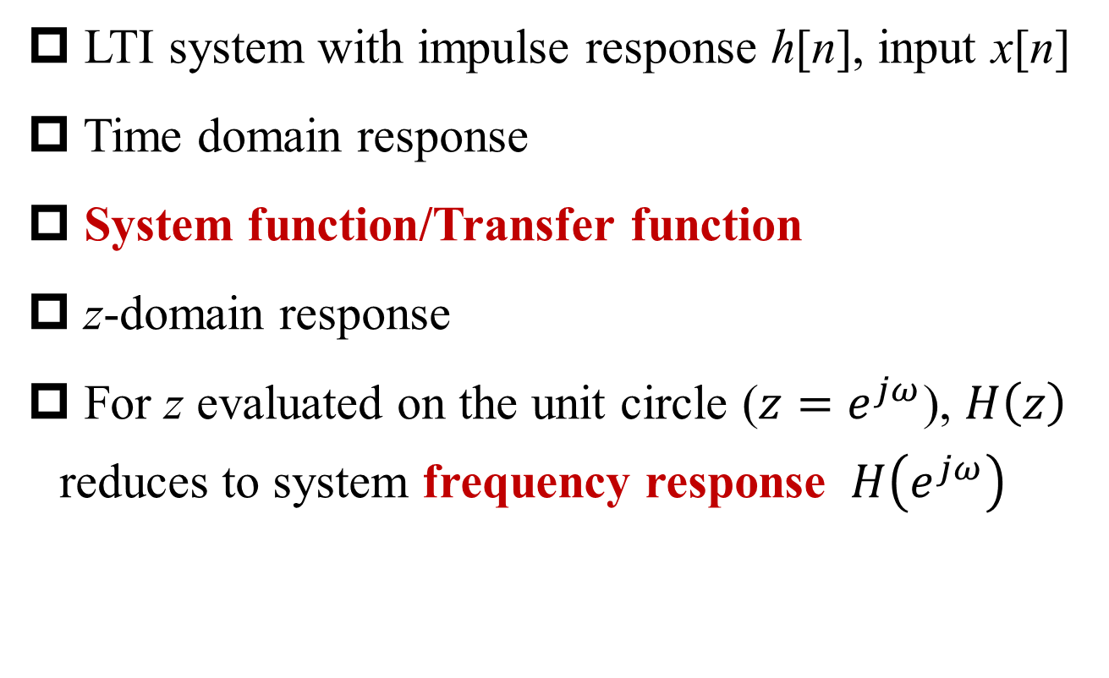
LTI System Characterized Using z-Transform
§10.7 LTI System Analysis Using z-Transform
LTI system with impulse response h[n], input x[n]
Time domain response
System function/Transfer function
z-domain response
For z evaluated on the unit circle ($z=e^{jω}$), $H\left(z\right)$ reduces to system frequency response $H\left(e^{jω}\right)$
$$Y\left(z\right)=H\left(z\right)X(z)$$

Slide 39
Causality
§10.7 LTI System Analysis Using z-Transform
A LTI system is causal if and only if its impulse response h[n]=0 for all n<0 (Chapter 2)
A LTI system is causal if and only if the ROC of its system function is the exterior of a circle, including ∞
right-sided sequence ←→ ROC is the exterior of a circle (may or may not include ∞)
h[n]=0 for all n<0 ←→ H(z) converges at ∞
A LTI system with rational system function H(z) is causal if and only if (i) the ROC of its system function is the exterior of a circle outside the outermost pole; and (ii) the order of the numerator polynomial is not higher than that of the denominator
rational H(z) → ROC decided by poles
initial-value theorem

Slide 40

Example 10.20, 10.21
§10.7 LTI System Analysis Using z-Transform
Example 10.20, $H\left(z\right)=\frac{z^{3}−2z^{2}+z}{z^{2}+\frac{1}{4}z+\frac{1}{8}}$
Example 10.21, $H\left(z\right)=\frac{1}{1−{\frac{1}{2}z}^{−1}}+\frac{1}{1−{2z}^{−1}}, \left|z\right|>2$
$H\left(z\right)=\frac{2z^{2}−\frac{5}{2}z}{z^{2}−\frac{5}{2}z+1}$

Slide 41
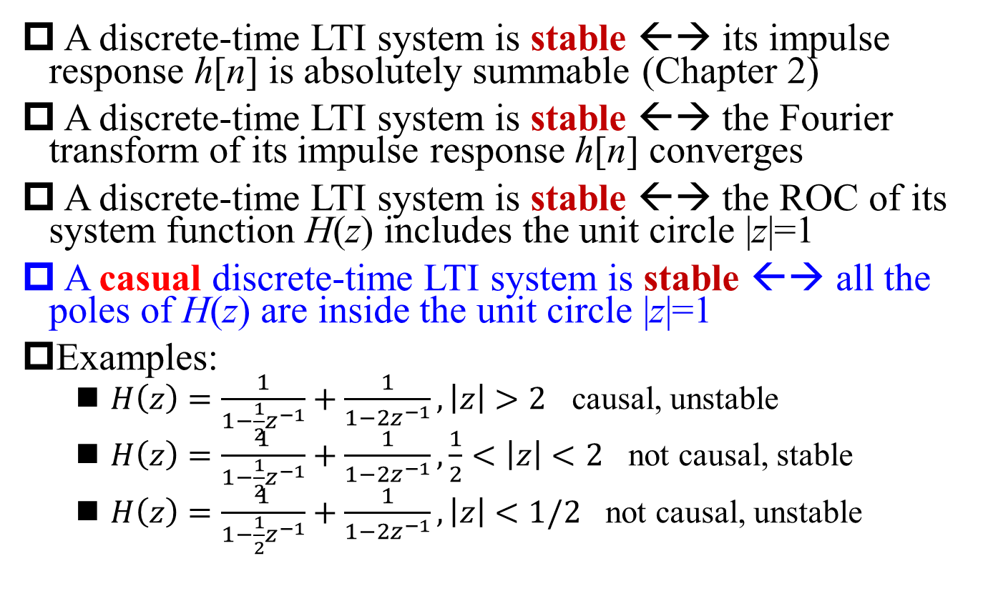
Stability
§10.7 LTI System Analysis Using z-Transform
A discrete-time LTI system is stable ←→ its impulse response h[n] is absolutely summable (Chapter 2)
A discrete-time LTI system is stable ←→ the Fourier transform of its impulse response h[n] converges
A discrete-time LTI system is stable ←→ the ROC of its system function H(z) includes the unit circle |z|=1
A casual discrete-time LTI system is stable ←→ all the poles of H(z) are inside the unit circle |z|=1
Examples:
$H\left(z\right)=\frac{1}{1−{\frac{1}{2}z}^{−1}}+\frac{1}{1−{2z}^{−1}}, \left|z\right|>2$ causal, unstable
$H\left(z\right)=\frac{1}{1−{\frac{1}{2}z}^{−1}}+\frac{1}{1−{2z}^{−1}},\frac{1}{2}<\left|z\right|<2$ not causal, stable
$H\left(z\right)=\frac{1}{1−{\frac{1}{2}z}^{−1}}+\frac{1}{1−{2z}^{−1}}, \left|z\right|<1/2$ not causal, unstable

Slide 42
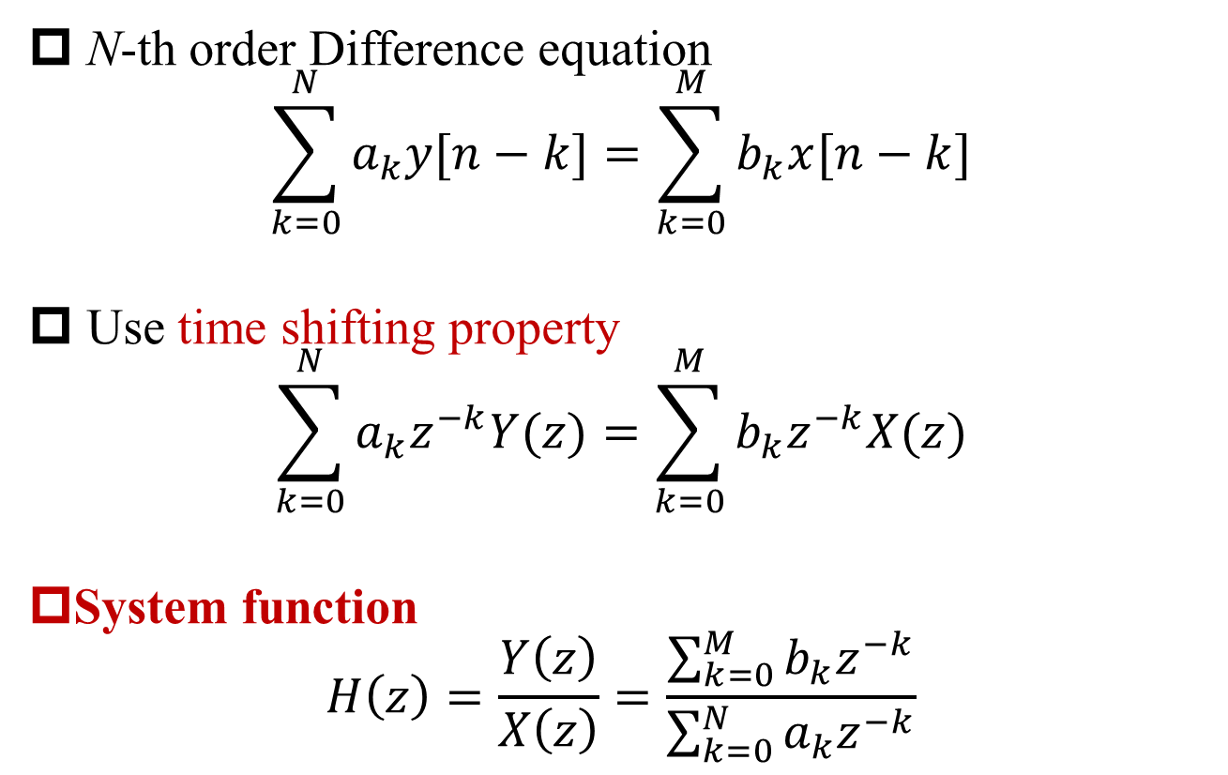
LTI Systems with Linear Constant-Coefficient Difference Equations
§10.7 LTI System Analysis Using z-Transform
N-th order Difference equation
$$\sum_{k=0}^{N}{a_{k}y[n−k]}=\sum_{k=0}^{M}{b_{k}x[n−k]}$$
Use time shifting property
$$\sum_{k=0}^{N}{a_{k}z^{−k}Y(z)}=\sum_{k=0}^{M}{b_{k}z^{−k}X(z)}$$
System function
$$H\left(z\right)=\frac{Y\left(z\right)}{X\left(z\right)}=\frac{\sum_{k=0}^{M}{b_{k}z^{−k}}}{\sum_{k=0}^{N}{a_{k}z^{−k}}}$$

Slide 43
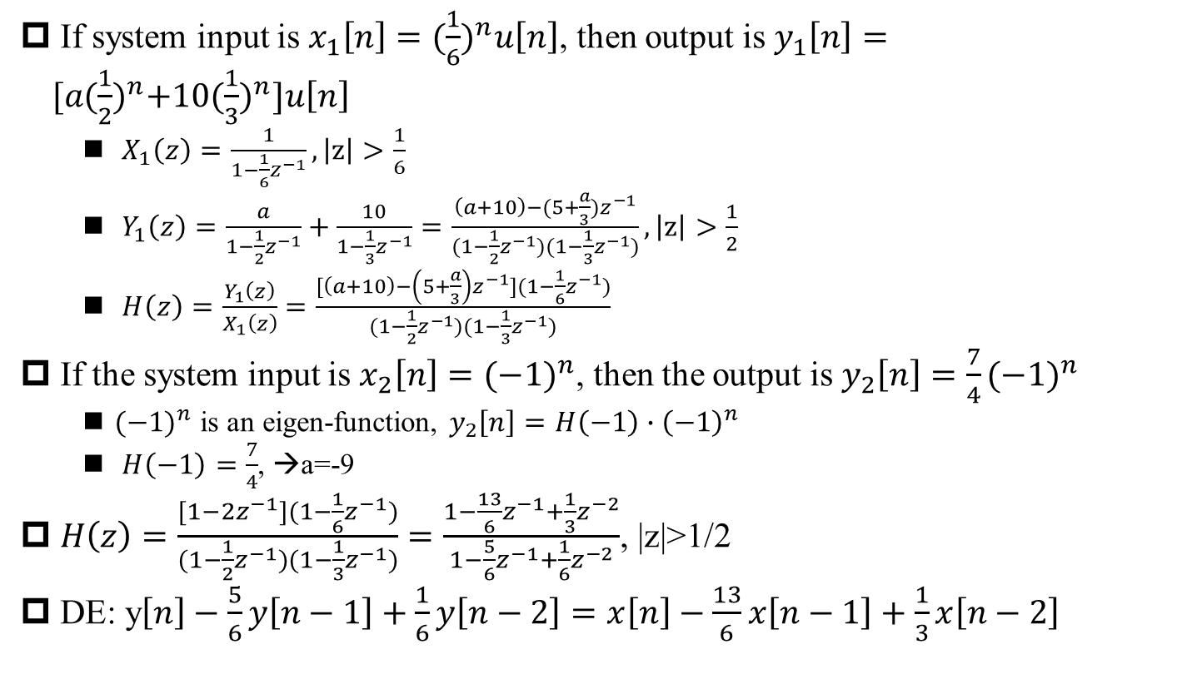
Example 10.26
§10.7 LTI System Analysis Using z-Transform
If system input is $x_{1}\left[n\right]={(\frac{1}{6})}^{n}u\left[n\right]$, then output is $y_{1}\left[n\right]={[a(\frac{1}{2})}^{n}+10{(\frac{1}{3})}^{n}]u\left[n\right]$
$X_{1}\left(z\right)=\frac{1}{1−\frac{1}{6}z^{−1}}, \left|z\right|>\frac{1}{6}$
$Y_{1}\left(z\right)=\frac{a}{1−\frac{1}{2}z^{−1}}+\frac{10}{1−\frac{1}{3}z^{−1}}=\frac{\left(a+10\right)−(5+\frac{a}{3})z^{−1}}{(1−\frac{1}{2}z^{−1})(1−\frac{1}{3}z^{−1})}, \left|z\right|>\frac{1}{2}$
$H\left(z\right)=\frac{Y_{1}\left(z\right)}{X_{1}\left(z\right)}=\frac{[\left(a+10\right)−\left(5+\frac{a}{3}\right)z^{−1}](1−\frac{1}{6}z^{−1})}{(1−\frac{1}{2}z^{−1})(1−\frac{1}{3}z^{−1})}$
If the system input is $x_{2}\left[n\right]={(−1)}^{n}$, then the output is $y_{2}\left[n\right]=\frac{7}{4}{(−1)}^{n}$
${(−1)}^{n}$ is an eigen-function, $y_{2}\left[n\right]=H\left(−1\right)∙{\left(−1\right)}^{n}$
$H\left(−1\right)=\frac{7}{4}$, →a=-9
$H\left(z\right)=\frac{[1−2z^{−1}](1−\frac{1}{6}z^{−1})}{(1−\frac{1}{2}z^{−1})(1−\frac{1}{3}z^{−1})}=\frac{1−\frac{13}{6}z^{−1}+\frac{1}{3}z^{−2}}{1−\frac{5}{6}z^{−1}+\frac{1}{6}z^{−2}}$, |z|>1/2
DE: y$\left[n\right]−\frac{5}{6}y\left[n−1\right]+\frac{1}{6}y\left[n−2\right]=x\left[n\right]−\frac{13}{6}x\left[n−1\right]+\frac{1}{3}x\left[n−2\right]$
Q1: Why choose this ROC for H(z)?
A1: ROC of Y₁(z) must include intersections of ROCs of X₁(z) & H(z)

Slide 44
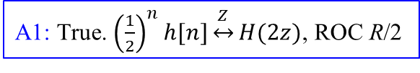
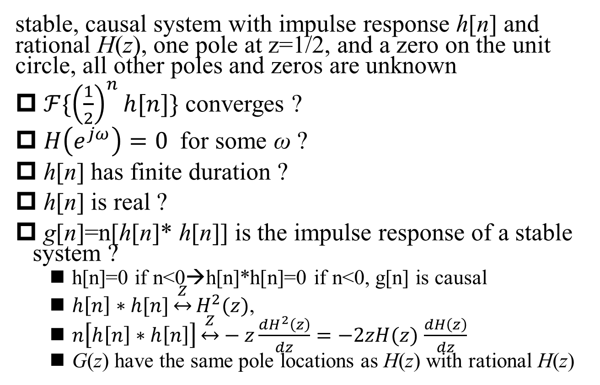
Example 10.27
§10.7 LTI System Analysis Using z-Transform
stable, causal system with impulse response h[n] and rational H(z), one pole at z=1/2, and a zero on the unit circle, all other poles and zeros are unknown
$ℱ\{{\left(\frac{1}{2}\right)}^{n}h[n]\}$ converges ?
$H\left(e^{jω}\right)=0$ for some ω ?
h[n] has finite duration ?
h[n] is real ?
g[n]=n[h[n]* h[n]] is the impulse response of a stable system ?
h[n]=0 if n<0→h[n]*h[n]=0 if n<0, g[n] is causal
$h\left[n\right]∗h[n]\underset{↔}{Z}H^{2}(z)$,
$n\left[h\left[n\right]∗h\left[n\right]\right]\underset{↔}{Z}−z\frac{dH^{2}\left(z\right)}{dz}=−2zH(z)$ $\frac{dH\left(z\right)}{dz}$
G(z) have the same pole locations as H(z) with rational H(z)
A1: True. ${\left(\frac{1}{2}\right)}^{n}h[n]\underset{↔}{Z}H(2z)$, ROC R/2
A2: True. At least one zero is e^{jω}
A3: False. Finite duration means ROC=z-plane except 0/∞ vs. ROC can not include z=1/2(pole)
A4: Insufficient information. h[n] is real ←→H(z）=H*(z*)

Slide 45
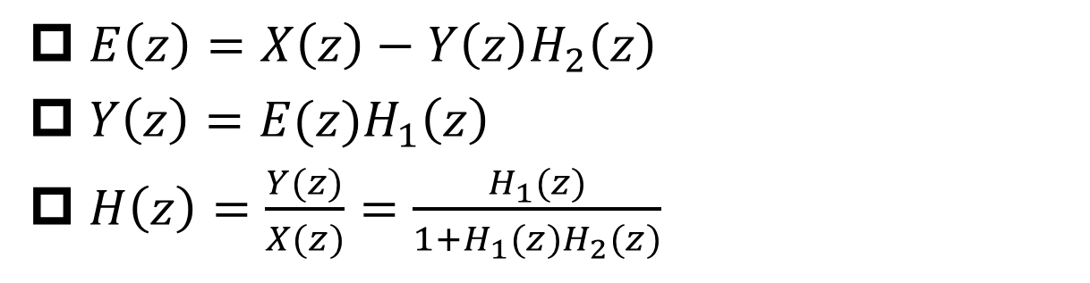
Block Diagram of Feedback
§10.8 Block Diagram
$E\left(z\right)=X\left(z\right)−Y\left(z\right)H_{2}\left(z\right)$
$Y\left(z\right)=E(z)H_{1}\left(z\right)$
$H\left(z\right)=\frac{Y(z)}{X(z)}=\frac{H_{1}(z)}{1+H_{1}(z)H_{2}(z)}$

Slide 46

Block Diagram of 1st Order System (1)
§10.8 Block Diagram
$H\left(z\right)=\frac{1}{1+az^{−1}}$
$y\left[n\right]+ay\left[n−1\right]=x\left[n\right]$
$y\left[n\right]=x\left[n\right]−ay\left[n−1\right]$

Slide 47
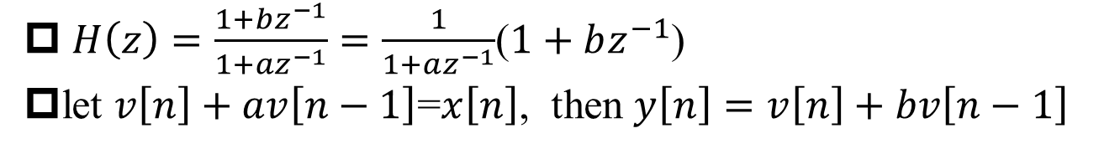
Block Diagram of 1st Order System (2)
§10.8 Block Diagram
$H\left(z\right)=\frac{1+bz^{−1}}{1+az^{−1}}=\frac{1}{1+az^{−1}}$($1+bz^{−1}$)
let $v\left[n\right]+av\left[n−1\right]$=$x\left[n\right]$, then $y\left[n\right]=v\left[n\right]+bv\left[n−1\right]$

Slide 48

Block Diagram of 2nd Order System (1)
§10.8 Block Diagram
$H\left(z\right)=\frac{1}{1+a_{1}z^{−1}+a_{2}z^{−2}}$
$y\left[n\right]+a_{1}y\left[n−1\right]{+a}_{2}y\left[n−2\right]=x[n]$
$y\left[n\right]=x\left[n\right]−a_{1}y\left[n−1\right]{−a}_{2}y\left[n−2\right]$

Slide 49
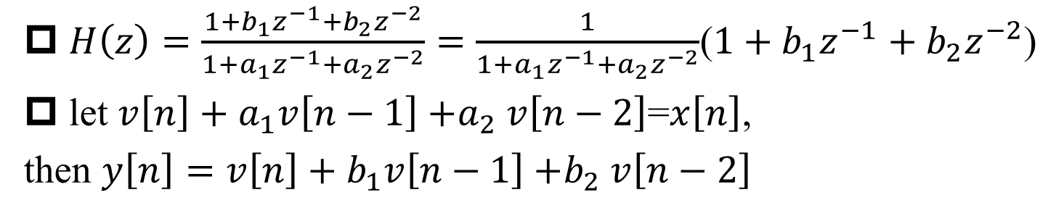
Block Diagram of 2nd Order System (2)
§10.8 Block Diagram
$H\left(z\right)=\frac{1+b_{1}z^{−1}+b_{2}z^{−2}}{1+a_{1}z^{−1}+a_{2}z^{−2}}=\frac{1}{1+a_{1}z^{−1}+a_{2}z^{−2}}$($1+b_{1}z^{−1}+b_{2}z^{−2}$)
let $v\left[n\right]+a_{1}v\left[n−1\right]{+a}_{2}v\left[n−2\right]$=$x\left[n\right]$,
then $y\left[n\right]=v\left[n\right]+b_{1}v\left[n−1\right]{+b}_{2}v\left[n−2\right]$

Slide 50
Summary
Summary
From DT Fourier Transform to z-Transform
z-plane vs. s-plane
DT FT convergence
Region of Convergence of z-Transform
relationship between ROC and poles
sided sequence
z=0, z=∞
Inverse z-Transform
typical z-Transform pairs
z-Transform Properties
LTI System Analysis
system function/transfer function
causality
stability
Block Diagram

