Slide 1


荷塘雨课堂
播放ppt
腾讯会议
双向语音/视频交流
1. 开启荷塘雨课堂（请关闭音频输出，可以点名、白板、做题、弹幕等）
2. 开启腾讯会议（请保持静音，一般关闭摄像头，发言前解除静音）
雨课堂可以看ppt，腾讯会议可以看现场板书，
建议分别用两个终端打开。

Slide 2
Chapter 6 Time and Frequency Characterization of Signals and Systems

Slide 3
Outline
Magnitude-Phase Representation of Frequency Response
Time/Frequency Domain Analysis of 1st Order and 2nd Order Continuous-Time Systems
Example of Time/Frequency Domain Analysis
Supplementary: Transfer Function of Typical Circuits

Slide 4
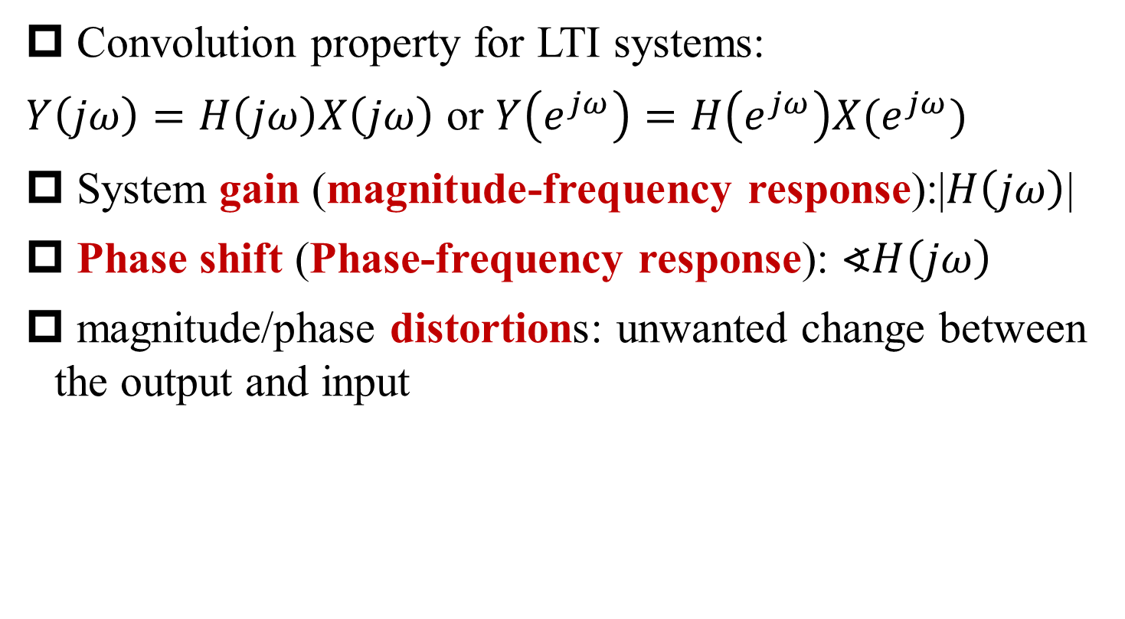
Magnitude and Phase Response
§6.2 Mag and Pha Frequency Response
Convolution property for LTI systems:
$Y\left(jω\right)=H\left(jω\right)X\left(jω\right)$ or $Y\left(e^{jω}\right)=H\left(e^{jω}\right)X(e^{jω})$
System gain (magnitude-frequency response):|$H\left(jω\right)$|
Phase shift (Phase-frequency response): $∢H\left(jω\right)$
magnitude/phase distortions: unwanted change between the output and input

Slide 5
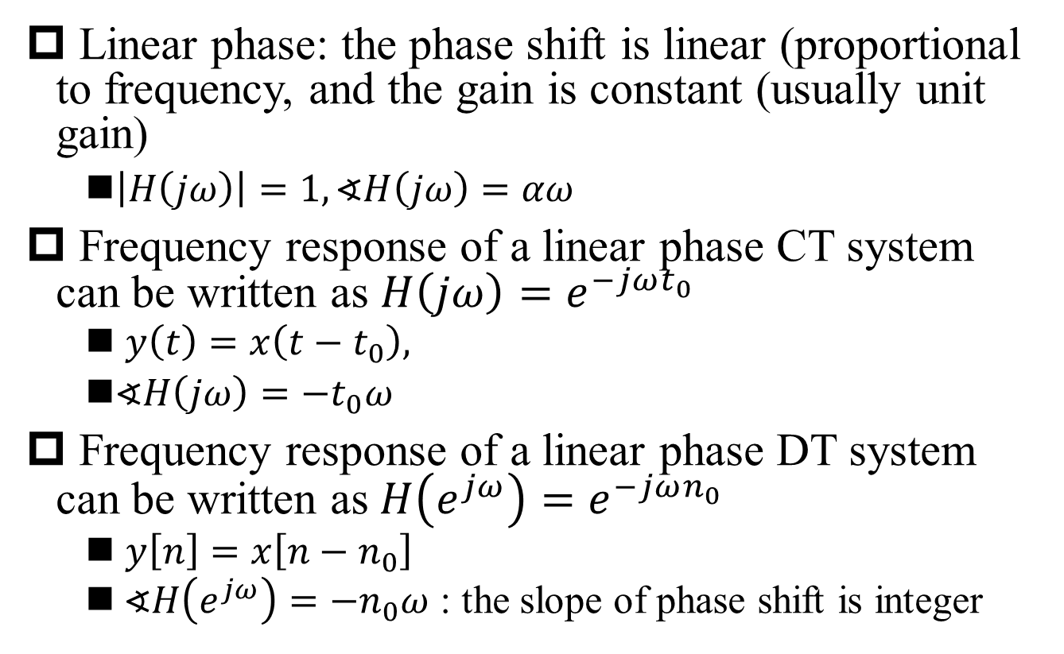
Linear Phase
§6.2 Mag and Pha Frequency Response
Linear phase: the phase shift is linear (proportional to frequency, and the gain is constant (usually unit gain)
$\left|H\left(jω\right)\right|=1, ∢H\left(jω\right)=αω$
Frequency response of a linear phase CT system can be written as $H\left(jω\right)=e^{−jωt_{0}}$
$y\left(t\right)=x\left(t−t_{0}\right),$
$∢H\left(jω\right)=−t_{0}ω$
Frequency response of a linear phase DT system can be written as$H\left(e^{jω}\right)=e^{−jωn_{0}}$
$y\left[n\right]=x\left[n−n_{0}\right]$
$∢H\left(e^{jω}\right)=−n_{0}ω$ : the slope of phase shift is integer

Slide 6
Linear Phase Shift = Time Shift
§6.2 Mag and Pha Frequency Response

Slide 7
All-Pass System
§6.2 Mag and Pha Frequency Response
All-pass system: the magnitude of the input spectrum is passed through unchanged by the system
CT all-pass system: the poles and zeros exist as pairs mirrored along the jω axis

Slide 8
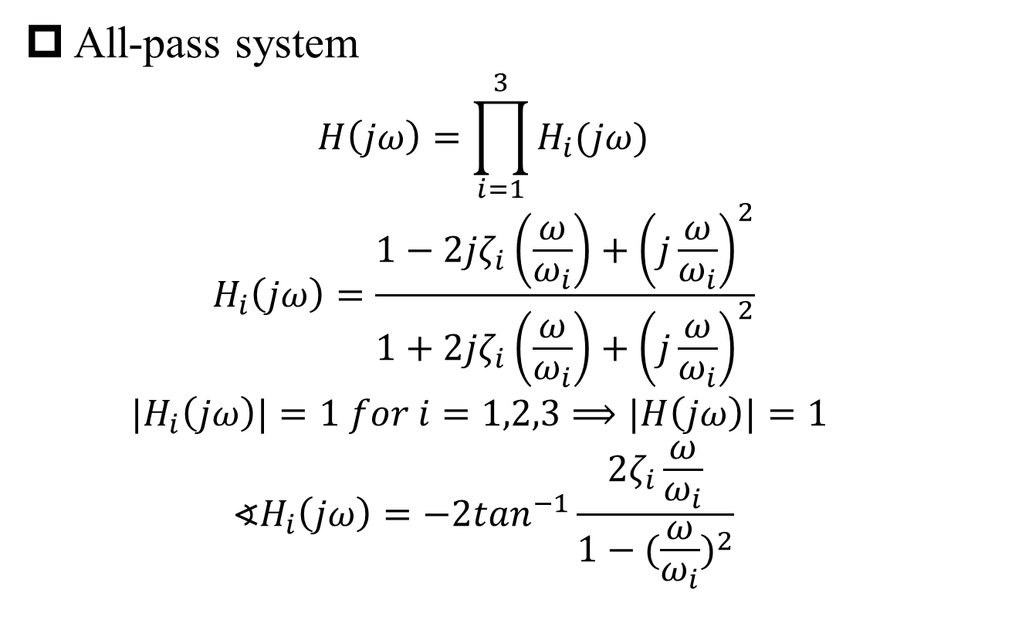
Example 6.1
§6.2 Mag and Pha Frequency Response
All-pass system
$$H\left(jω\right)=\prod_{i=1}^{3}{H_{i}(jω)}$$
$$H_{i}\left(jω\right)=\frac{1−2jζ_{i}\left(\frac{ω}{ω_{i}}\right)+{\left(j\frac{ω}{ω_{i}}\right)}^{2}}{1+2jζ_{i}\left(\frac{ω}{ω_{i}}\right)+{\left(j\frac{ω}{ω_{i}}\right)}^{2}}$$
$${|H}_{i}\left(jω\right)|=1 for i=1,2,3⟹|H\left(jω\right)|=1$$
$$∢H_{i}\left(jω\right)=−2\tan^{−1}\frac{2ζ_{i}\frac{ω}{ω_{i}}}{1−{(\frac{ω}{ω_{i}})}^{2}}$$

Slide 9
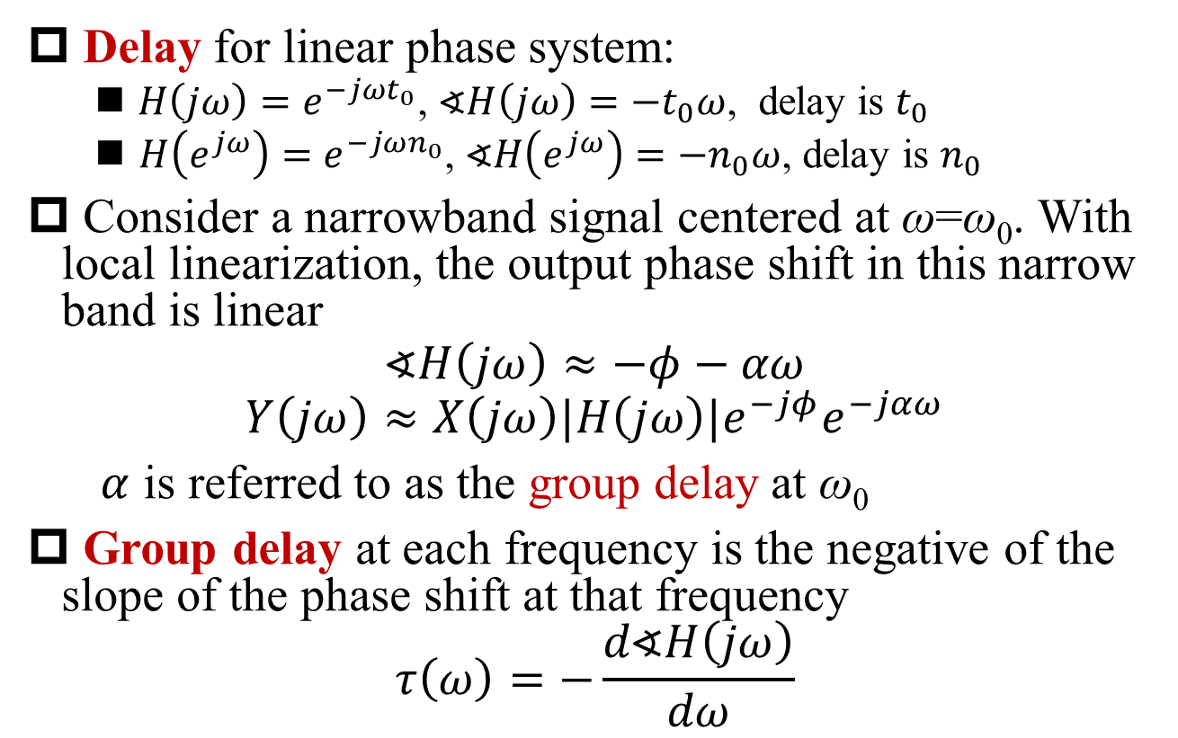
Group Delay
§6.2 Mag and Pha Frequency Response
Delay for linear phase system:
$H\left(jω\right)=e^{−jωt_{0}}$, $∢H\left(jω\right)=−t_{0}ω$, delay is $t_{0}$
$H\left(e^{jω}\right)=e^{−jωn_{0}}$, $∢H\left(e^{jω}\right)=−n_{0}ω$, delay is $n_{0}$
Consider a narrowband signal centered at ω=ω₀. With local linearization, the output phase shift in this narrow band is linear
$$∢H\left(jω\right)≈−φ−αω$$
$$Y\left(jω\right)≈X\left(jω\right)|H\left(jω\right)|e^{−jφ}e^{−jαω}$$
$α$ is referred to as the group delay at ω₀
Group delay at each frequency is the negative of the slope of the phase shift at that frequency
$$τ\left(ω\right)=−\frac{d∢H\left(jω\right)}{dω}$$

Slide 10
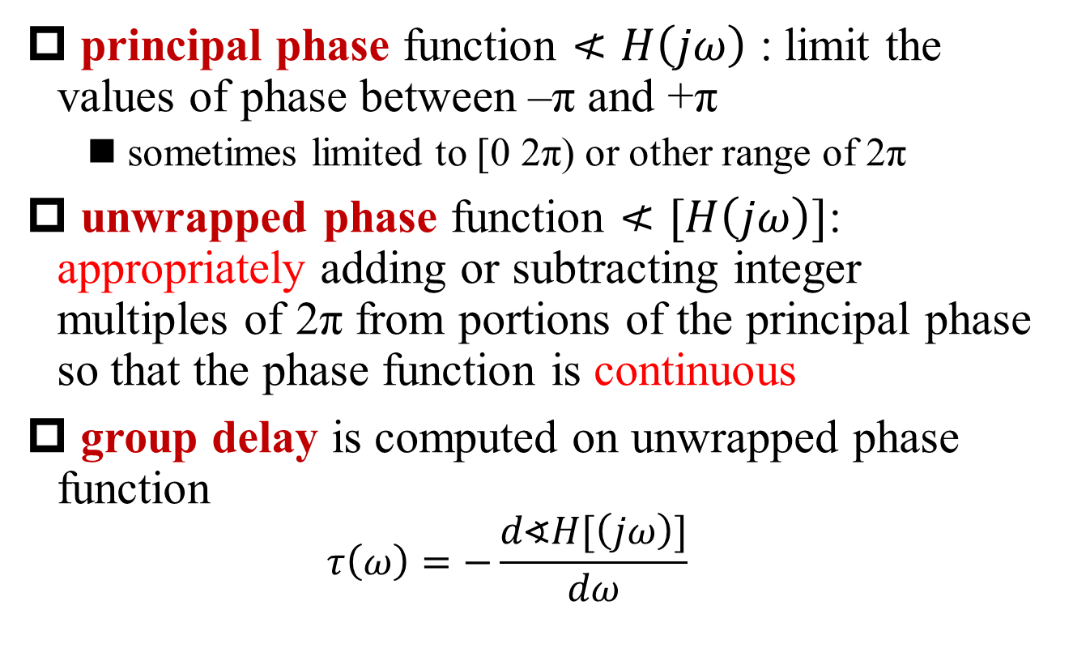
Principal vs. Unwrapped Phase
§6.2 Mag and Pha Frequency Response
principal phase function $≮H\left(jω\right)$ : limit the values of phase between –π and +π
sometimes limited to [0 2π) or other range of 2π
unwrapped phase function $≮[H\left(jω\right)]$: appropriately adding or subtracting integer multiples of 2π from portions of the principal phase so that the phase function is continuous
group delay is computed on unwrapped phase function
$$τ\left(ω\right)=−\frac{d∢H[\left(jω\right)]}{dω}$$

Slide 11
Principal vs. Unwrapped Phase (cont’)
§6.2 Mag and Pha Frequency Response

Slide 12
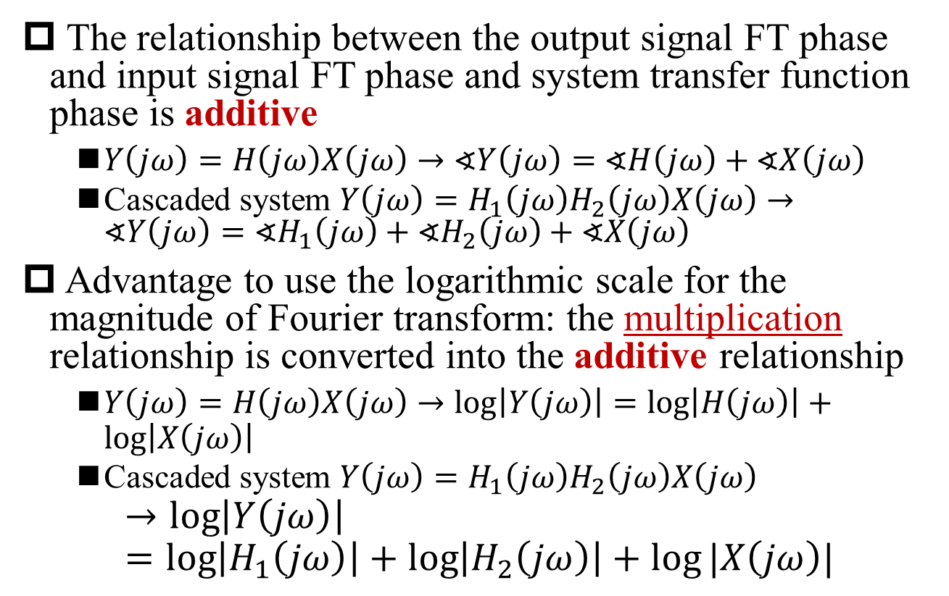
Additive Relationship
§6.2 Mag and Pha Frequency Response
The relationship between the output signal FT phase and input signal FT phase and system transfer function phase is additive
$Y\left(jω\right)=H\left(jω\right)X\left(jω\right)→∢Y\left(jω\right)=∢H\left(jω\right)+∢X\left(jω\right)$
Cascaded system $Y\left(jω\right)=H_{1}\left(jω\right)H_{2}\left(jω\right)X\left(jω\right)→∢Y\left(jω\right)=∢H_{1}\left(jω\right)+∢H_{2}\left(jω\right)+∢X\left(jω\right)$
Advantage to use the logarithmic scale for the magnitude of Fourier transform: the multiplication relationship is converted into the additive relationship
$Y\left(jω\right)=H\left(jω\right)X\left(jω\right)→\log\left|Y\left(jω\right)\right|=\log\left|H\left(jω\right)\right|+\log\left|X\left(jω\right)\right|$
Cascaded system $Y\left(jω\right)=H_{1}\left(jω\right)H_{2}\left(jω\right)X\left(jω\right)$
$$→\log\left|Y\left(jω\right)\right|=\log\left|H_{1}\left(jω\right)\right|+\log\left|H_{2}\left(jω\right)\right|+log⁡|X\left(jω\right)|$$

Slide 13
Unit of Decibel (dB)
§6.2 Mag and Pha Frequency Response
System gain ←→logarithmic system gain: A ←→ 20logA, with unit of decibel (dB)
0 dB ←→ gain=1
gain of -20 dB ←→ gain = 0.1 (attenuation of 20 dB)
gain of 20 dB ←→ gain = 10
dBV: logarithmic voltage referenced to 1 Volt
B Volt ←→ 20logB dBV
output voltage (dBV) = input voltage (dBV) + gain (dB)
output voltage = input voltage  system gain
Example: input voltage 2V, system gain 20, output voltage 40V ←→ 6 dBV + 26 dB = 32 dBV
logarithmic power gain: G ←→ 10logG, with unit of decibel (dB)
dBm: logarithmic power referenced to 1 mW
P mW ←→ 10logP dBm
Q: What’s the difference between voltage gain and power gain?

Slide 14
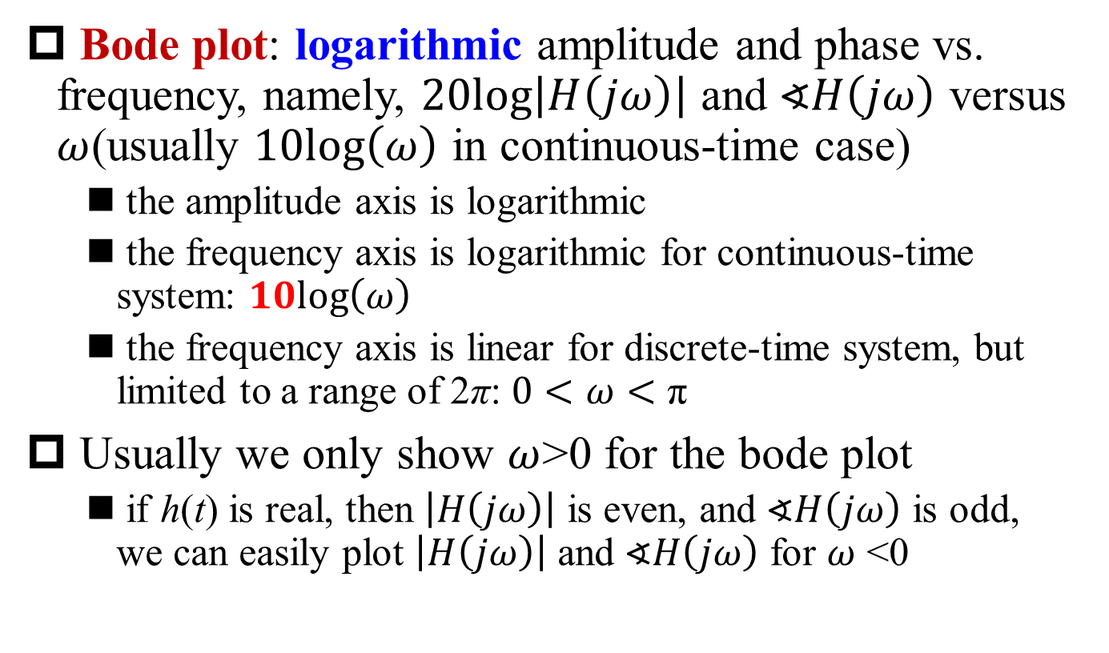
Bode Plot
§6.2 Mag and Pha Frequency Response
Bode plot: logarithmic amplitude and phase vs. frequency, namely, $20log\left|H\left(jω\right)\right|$ and $∢H\left(jω\right)$ versus $ω$(usually $10log\left(ω\right)$ in continuous-time case)
the amplitude axis is logarithmic
the frequency axis is logarithmic for continuous-time system: $10log\left(ω\right)$
the frequency axis is linear for discrete-time system, but limited to a range of 2π: $0<ω<\text{π}$
Usually we only show $ω$>0 for the bode plot
if h(t) is real, then $\left|H\left(jω\right)\right|$ is even, and $∢H\left(jω\right)$ is odd, we can easily plot $\left|H\left(jω\right)\right|$ and $∢H\left(jω\right)$ for $ω$ <0
Q: Why?
Q: Is the axis label in the phase-frequency plots correct in Fig. 6.8 & 6.9?

Slide 15
Typical Bode Diagram
§6.2 Mag and Pha Frequency Response
Bode Plot
Frequency Response

Slide 16
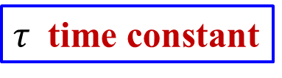
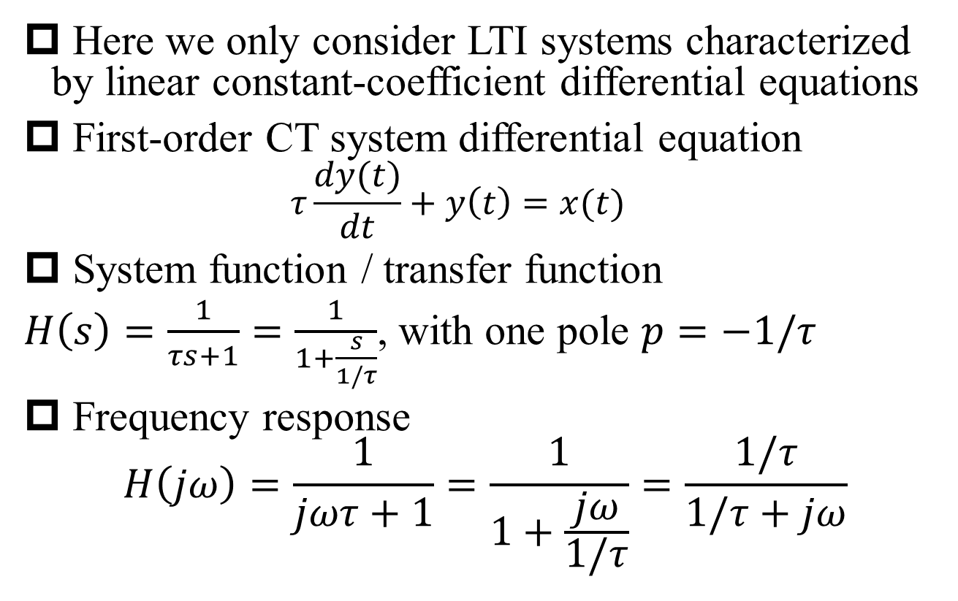
First-Order Continuous-Time System
§6.5 1st and 2nd Order CT Systems
Here we only consider LTI systems characterized by linear constant-coefficient differential equations
First-order CT system differential equation
$$τ\frac{dy(t)}{dt}+y\left(t\right)=x(t)$$
System function / transfer function
$H\left(s\right)=\frac{1}{τs+1}=\frac{1}{1+\frac{s}{1/τ}}$, with one pole $p=−1/τ$
Frequency response
$$H\left(jω\right)=\frac{1}{jωτ+1}=\frac{1}{1+\frac{jω}{1/τ}}=\frac{1/τ}{1/τ+jω}$$
$τ$ time constant

Slide 17
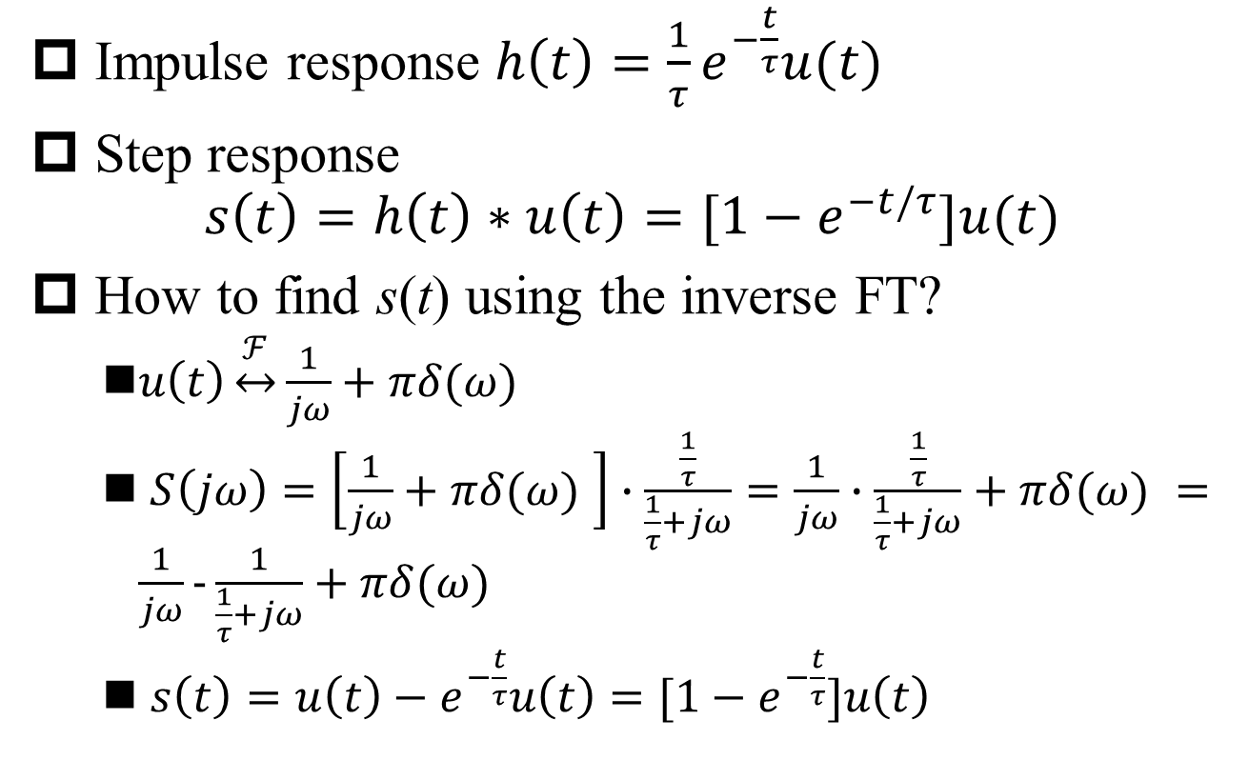
System Response of First-Order Continuous-Time System
§6.5 1st and 2nd Order CT Systems
Impulse response $h\left(t\right)=\frac{1}{τ}e^{−\frac{t}{τ}}u(t)$
Step response
$$s\left(t\right)=h\left(t\right)∗u\left(t\right)=[1−e^{−t/τ}]u(t)$$
How to find s(t) using the inverse FT?
$u\left(t\right)\underset{↔}{ℱ}\frac{1}{jω}+πδ(ω)$
$S\left(jω\right)=\left[\frac{1}{jω}+πδ(ω) \right]∙\frac{\frac{1}{τ}}{\frac{1}{τ}+jω}=\frac{1}{jω}∙\frac{\frac{1}{τ}}{\frac{1}{τ}+jω}+πδ(ω) =\frac{1}{jω}−\frac{1}{\frac{1}{τ}+jω}+πδ(ω)$
$s\left(t\right)=u\left(t\right)−e^{−\frac{t}{τ}}u\left(t\right)=[1−e^{−\frac{t}{τ}}]u\left(t\right)$

Slide 18
System Response of First-Order Continuous-Time System (Cont’)
§6.5 1st and 2nd Order CT Systems
1/τ
h(t)
1/eτ
τ
2τ
4τ
5τ
6τ
0
3τ
τ/1
τ/1
τ/1
t
s(t)
1-1/e
τ
2τ
4τ
5τ
6τ
0
3τ
τ/1
τ/1
t

Slide 19
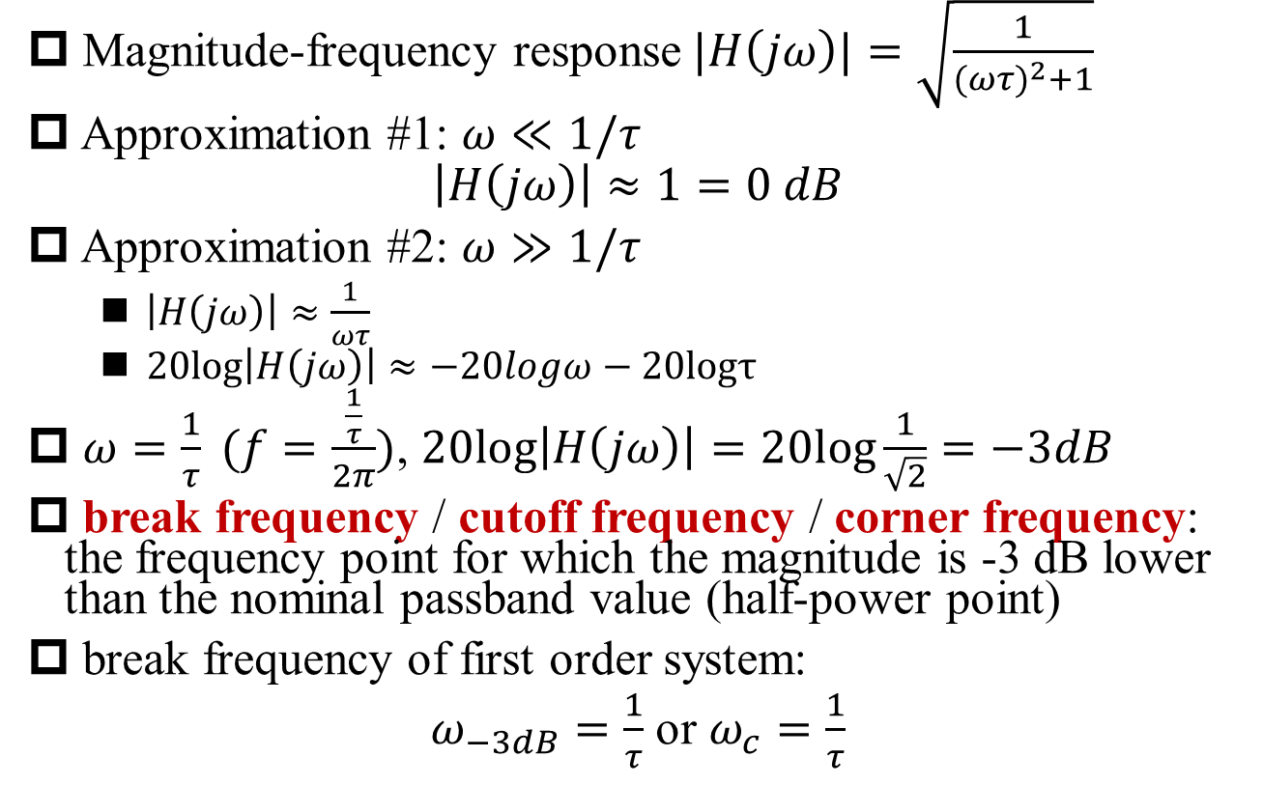
Asymptotic Approximation of Magnitude-Frequency Response of 1st Order System
§6.5 1st and 2nd Order CT Systems
Magnitude-frequency response$|H\left(jω\right)|=\sqrt{\frac{1}{{(ωτ)}^{2}+1}}$
Approximation #1: $ω≪1/τ$
$$\left|H\left(jω\right)\right|≈1=0 dB$$
Approximation #2: $ω≫1/τ$
$\left|H\left(jω\right)\right|≈\frac{1}{ωτ}$
$20log\left|H\left(jω\right)\right|≈−20logω−20logτ$
$ω=\frac{1}{τ} (f=\frac{\frac{1}{τ}}{2π})$, $20log\left|H\left(jω\right)\right|=20log\frac{1}{\sqrt{2}}=−3dB$
break frequency / cutoff frequency / corner frequency: the frequency point for which the magnitude is -3 dB lower than the nominal passband value (half-power point)
break frequency of first order system:
$ω_{−3dB}=\frac{1}{τ}$ or $ω_{c}=\frac{1}{τ}$
-20 dB per decade

Slide 20
Asymptotic Approximation of Magnitude-Frequency Response of 1st Order System (cont’)
§6.5 1st and 2nd Order CT Systems
|H(jω)|
(dB)
3dB
— magnitude response
---Asymptotic Approximation
0
-20
-40
-60
ω_{c}
0.1/τ
1/τ
10/τ
100/τ
ω

Slide 21
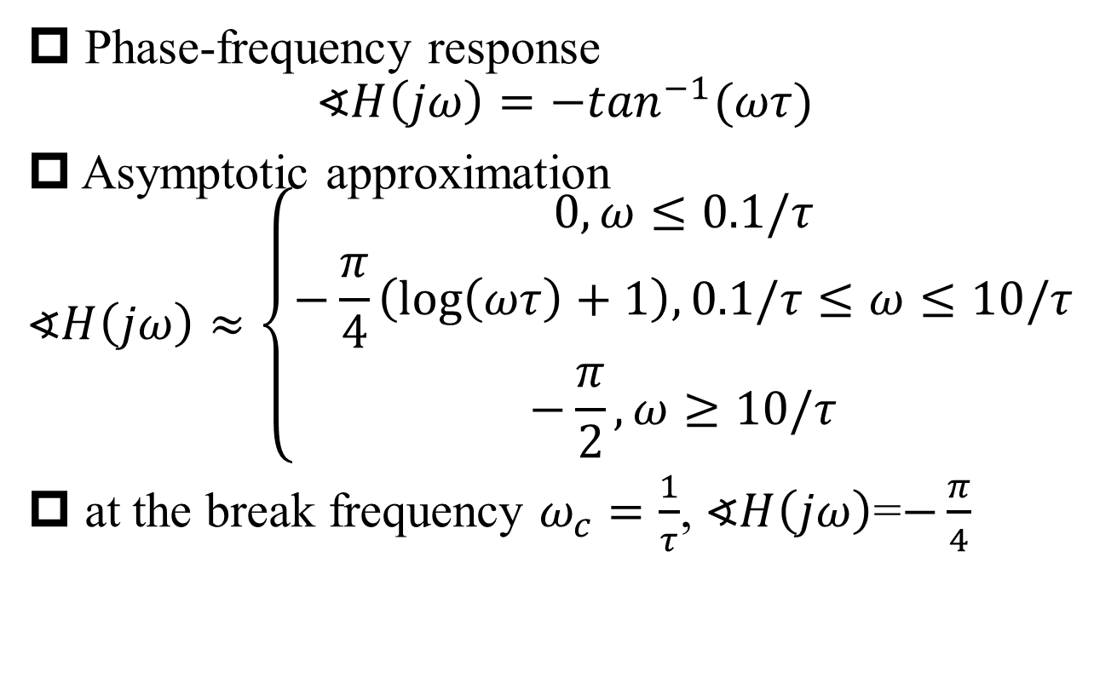
Asymptotic Approximation of Phase-Frequency Response of 1st Order System
§6.5 1st and 2nd Order CT Systems
Phase-frequency response
$$∢H\left(jω\right)={−tan}^{−1}(ωτ)$$
Asymptotic approximation
$$∢H\left(jω\right)≈\left\{\begin{aligned}0, ω≤0.1/τ \\ −\frac{π}{4}\left(\log\left(ωτ\right)+1\right),0.1/τ≤ω≤10/τ \\ −\frac{π}{2}, ω≥10/τ\end{aligned}\right.$$
at the break frequency $ω_{c}=\frac{1}{τ}$, $∢H\left(jω\right)$=$−\frac{π}{4}$
-π/2 phase shift for each left half-plane pole
Q: Valid for complex pole?

Slide 22

Asymptotic Approximation of Phase-Frequency Response of 1st Order System (cont’)
§6.5 1st and 2nd Order CT Systems
$$∢H\left(jω\right)$$
— frequency response
---Asymptotic Approximation
0
-π/4
-π/2
0.1/τ
1/τ
10/τ
100/τ
ω

Slide 23
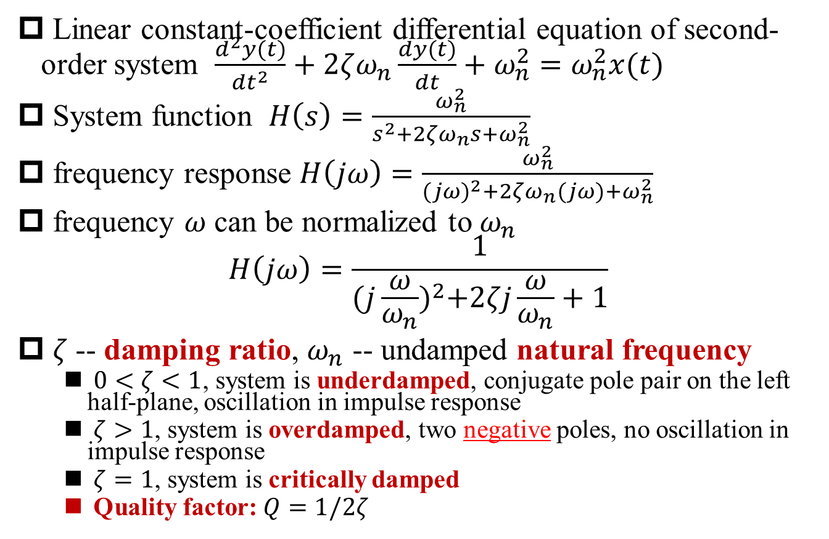
Second-Order CT Systems
§6.5 1st and 2nd Order CT Systems
Linear constant-coefficient differential equation of second-order system $\frac{d^{2}y(t)}{{dt}^{2}}+2ζω_{n}\frac{dy(t)}{dt}+ω_{n}^{2}=ω_{n}^{2}x(t)$
System function $H\left(s\right)=\frac{ω_{n}^{2}}{s^{2}+2ζω_{n}s+ω_{n}^{2}}$
frequency response $H\left(jω\right)=\frac{ω_{n}^{2}}{{(jω)}^{2}+2ζω_{n}(jω)+ω_{n}^{2}}$
frequency $ω$ can be normalized to $ω_{n}$
$$H\left(jω\right)=\frac{1}{{(j\frac{ω}{ω_{n}})}^{2}+2ζj\frac{ω}{ω_{n}}+1}$$
$ζ$-- damping ratio, $ω_{n}$ -- undamped natural frequency
$0<ζ<1$, system is underdamped, conjugate pole pair on the left half-plane, oscillation in impulse response
$ζ>1$, system is overdamped, two negative poles, no oscillation in impulse response
$ζ=1$, system is critically damped
Quality factor: $Q=1/2ζ$
Q1: Form of h(t)?
Q2: Form of h(t)?

Slide 24
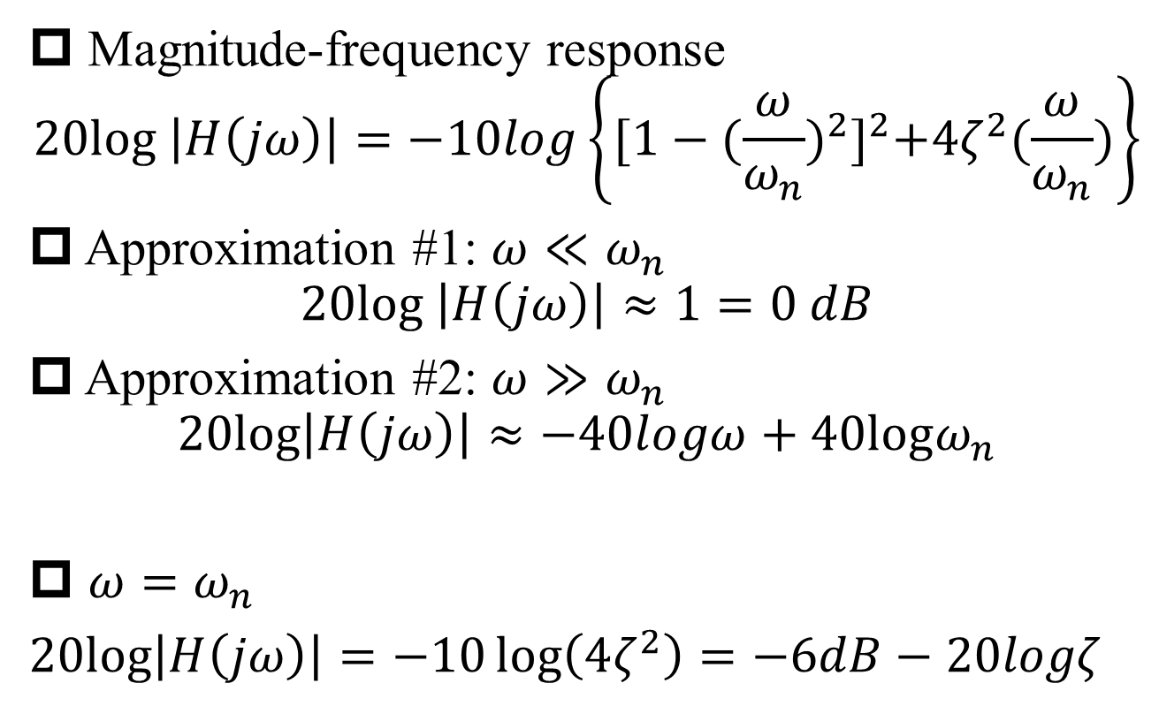
Asymptotic Approximation of Magnitude-Frequency Response of 2nd Order System
§6.5 1st and 2nd Order CT Systems
Magnitude-frequency response
$$20log \left|H\left(jω\right)\right|=−10log\left\{{[1−{(\frac{ω}{ω_{n}})}^{2}]}^{2}+4ζ^{2}(\frac{ω}{ω_{n}})\right\}$$
Approximation #1: $ω≪ω_{n}$
$$20log \left|H\left(jω\right)\right|≈1=0 dB$$
Approximation #2: $ω≫ω_{n}$
$$20log\left|H\left(jω\right)\right|≈−40logω+40logω_{n}$$
$ω=ω_{n}$
$20log\left|H\left(jω\right)\right|=−10\log\left(4ζ^{2}\right)=−6dB−20logζ$
-40 dB per decade for 2 poles!

Slide 25
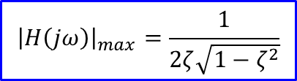




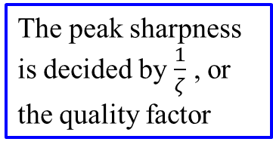


Asymptotic Approximation of Magnitude-Frequency Response of 2nd Order System (cont’)
§6.5 1st and 2nd Order CT Systems
$${\left|H\left(jω\right)\right|}_{max}=\frac{1}{2ζ\sqrt{1−ζ^{2}}}$$
|H(jω)|
(dB)
The peak sharpness is decided by $\frac{1}{ζ}$ , or the quality factor
0
-20
6dB
Asymptotic Approximation
$ζ>\frac{1}{\sqrt{2}}$, no peak
-40
Q: What’s the optimal ζ?
-60
-80
ω
$${0.01ω}_{n}$$
$${0.1ω}_{n}$$
$$ω_{n}$$
$$10ω_{n}$$
$${100ω}_{n}$$

Slide 26







Asymptotic Approximation of Phase-Frequency Response of 2nd Order System
§6.5 1st and 2nd Order CT Systems
$$∢H\left(jω\right)$$
0
$$∢H\left(jω_{n}\right)=−π/2$$
-π phase shift for two left half-plane poles
-π/2
Asymptotic Approximation
-π
ω
$${0.01ω}_{n}$$
$${0.1ω}_{n}$$
$$ω_{n}$$
$$10ω_{n}$$
$${100ω}_{n}$$

Slide 27
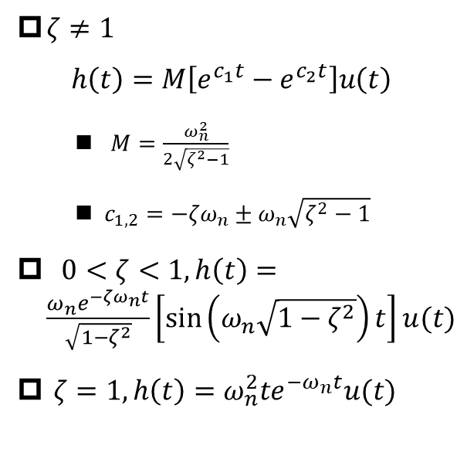





Impulse Response of Second-Order CT System
§6.5 1st and 2nd Order CT Systems
$${h(t)/ω}_{n}$$
$ζ≠1$
$$h\left(t\right)=M\left[e^{c_{1}t}−e^{c_{2}t}\right]u\left(t\right)$$
$M=\frac{ω_{n}^{2}}{2\sqrt{ζ^{2}−1}}$
${{c_{1,2}=−ζω}_{n}±ω}_{n}\sqrt{ζ^{2}−1}$
$0<ζ<1, h\left(t\right)=\frac{ω_{n}e^{−ζω_{n}t}}{\sqrt{1−ζ^{2}}}\left[\sin\left(ω_{n}\sqrt{1−ζ^{2}}\right)t\right]u(t)$
$ζ=1, h\left(t\right)=ω_{n}^{2}te^{−ω_{n}t}u(t)$
$$t$$
Q: What’s the optimal ζ?
$$\frac{1}{ω_{n}}$$
$$\frac{2}{ω_{n}}$$
$$\frac{3}{ω_{n}}$$

Slide 28
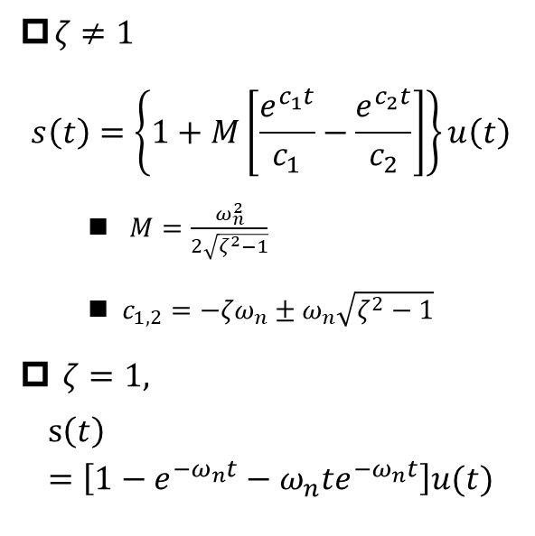

Step Response of Second-Order CT System
§6.5 1st and 2nd Order CT Systems
$$s(t)$$
$ζ≠1$
$$s\left(t\right)=\left\{1+M\left[\frac{e^{c_{1}t}}{c_{1}}−\frac{e^{c_{2}t}}{c_{2}}\right]\right\}u\left(t\right)$$
$M=\frac{ω_{n}^{2}}{2\sqrt{ζ^{2}−1}}$
${{c_{1,2}=−ζω}_{n}±ω}_{n}\sqrt{ζ^{2}−1}$
$ζ=1,$
$$s\left(t\right)=\left[1−e^{−ω_{n}t}−ω_{n}te^{−ω_{n}t}\right]u(t)$$
$$t$$
Q: What’s the optimal ζ?
$$\frac{1}{ω_{n}}$$
$$\frac{2}{ω_{n}}$$
$$\frac{3}{ω_{n}}$$

Slide 29
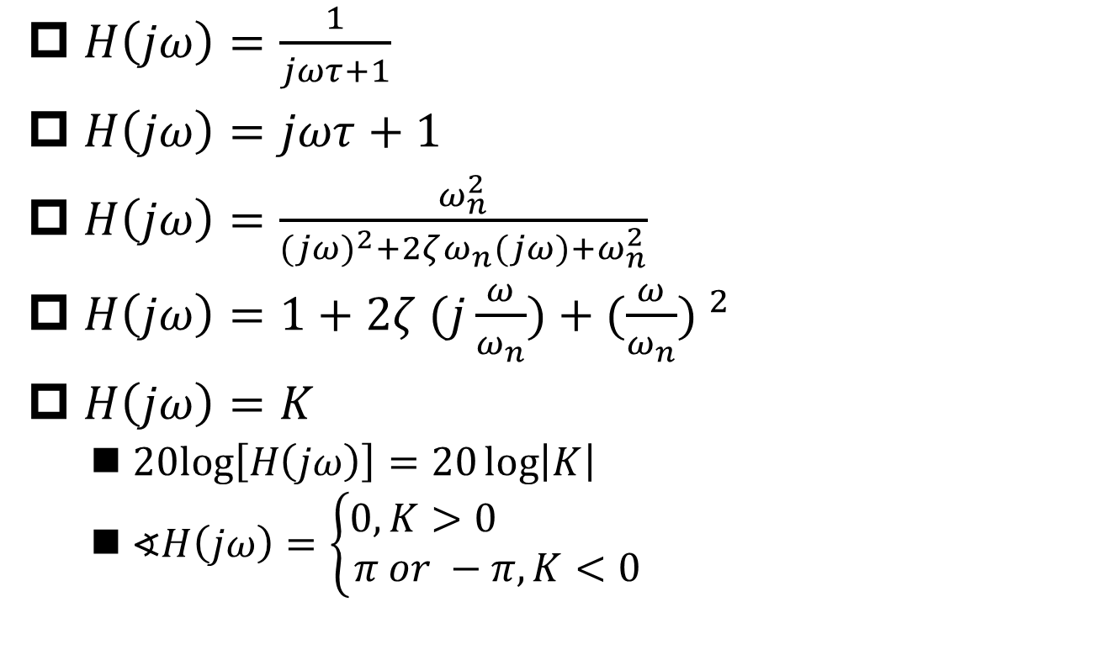
Bode Plots of Basic Rational Frequency Responses
§6.5 1st and 2nd Order CT Systems
$H\left(jω\right)=\frac{1}{jωτ+1}$
$H\left(jω\right)=jωτ+1$
$H\left(jω\right)=\frac{ω_{n}^{2}}{{(jω)}^{2}+2ζω_{n}(jω)+ω_{n}^{2}}$
$H\left(jω\right)=1+2ζ (j\frac{ω}{ω_{n}})+{(\frac{ω}{ω_{n}}) }^{2}$
$H\left(jω\right)=K$
$20log\left[H\left(jω\right)\right]=20\log\left|K\right|$
$∢H\left(jω\right)=\left\{\begin{aligned}0, K>0 \\ π or −π, K<0\end{aligned}\right.$

Slide 30
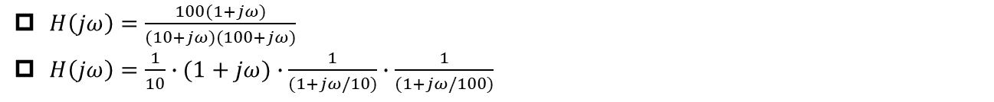
Example 6.5 -- Part A
§6.5 1st and 2nd Order CT Systems
$H\left(jω\right)=\frac{100(1+jω)}{(10+jω)(100+jω)}$
$H\left(jω\right)=\frac{1}{10}∙(1+jω)∙\frac{1}{(1+jω/10)}∙\frac{1}{(1+jω/100)}$
|H(jω)|
(dB)
ω

Slide 31

Example 6.5 – Part B
§6.5 1st and 2nd Order CT Systems
$H\left(jω\right)=\frac{100(1+jω)}{(10+jω)(100+jω)}$
$H\left(jω\right)=\frac{1}{10}∙(1+jω)∙\frac{1}{(1+jω/10)}∙\frac{1}{(1+jω/100)}$
$$∢H\left(jω\right)$$
π/2
0
-π/2
ω

Slide 32
Example 6.5: Bode Plot vs. Asymptotic Approximation
§6.5 1st and 2nd Order CT Systems

Slide 33
Automobile Suspension System
§6.7 Examples of Time/Frequency Domain Analysis
variation of x(t) represents roughness of road surface
Requirement #1: filter out rapid variations → lowpass filter
Requirement #2: no sharp division between frequencies to be passed or rejected → gradual transition passband and stopband
Requirement #3: no oscillatory response when encountering a bump or curb → no ringing in impulse response or step response

Slide 34
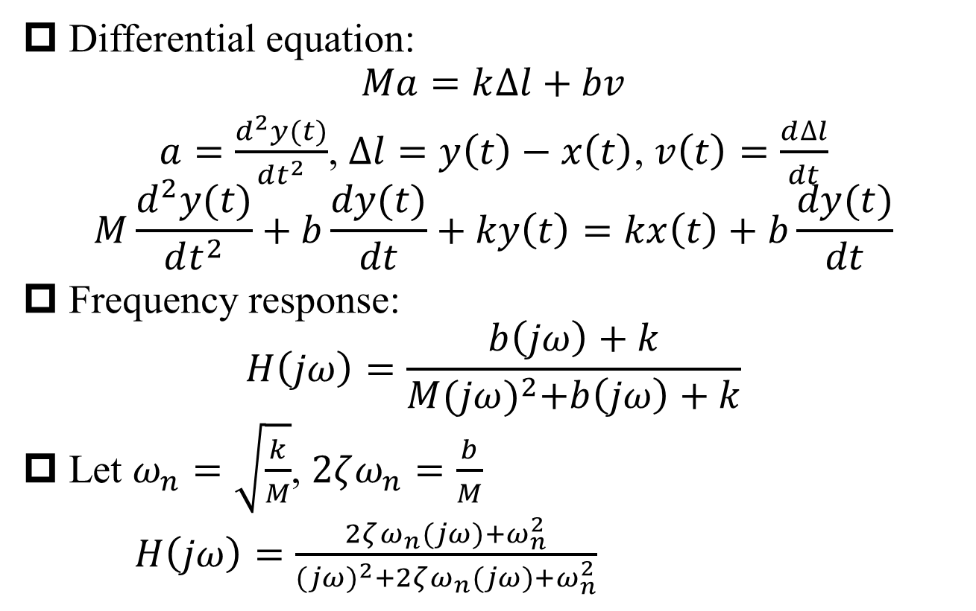
Equations of Automobile Suspension System
§6.7 Examples of Time/Frequency Domain Analysis
Differential equation:
$$Ma=k∆l+bv$$
$a=\frac{d^{2}y(t)}{dt^{2}}$, $∆l=y\left(t\right)−x\left(t\right)$, $v\left(t\right)=\frac{d∆l}{dt}$
$$M\frac{d^{2}y(t)}{dt^{2}}+b\frac{dy(t)}{dt}+ky\left(t\right)=kx\left(t\right)+b\frac{dy(t)}{dt}$$
Frequency response:
$$H\left(jω\right)=\frac{b\left(jω\right)+k}{M{(jω)}^{2}+b\left(jω\right)+k}$$
Let $ω_{n}=\sqrt{\frac{k}{M}}$, $2ζω_{n}=\frac{b}{M}$
$H\left(jω\right)=\frac{2ζω_{n}(jω)+ω_{n}^{2}}{{(jω)}^{2}+2ζω_{n}(jω)+ω_{n}^{2}}$

Slide 35



Magnitude-Frequency Response of Automobile Suspension System
§6.7 Examples of Time/Frequency Domain Analysis
|H(jω)|
(dB)
20
0
More closer to TF of a single-pole system
-20
-40
ω
$${0.1ω}_{n}$$
$$ω_{n}$$
$$10ω_{n}$$

Slide 36





Step Response of Automobile Suspension System
§6.7 Examples of Time/Frequency Domain Analysis
Conflict requirement:
Lowpass filtering → small ω_{n}
Rapid response → large ω_{n}
Trade-off of ζ
Too small ζ → ringing (uncomfortable)
Large ζ helps to speeding up settling
(Figure 6.34 is not correct)
$$t$$
$$\frac{2}{ω_{n}}$$
$$\frac{4}{ω_{n}}$$
$$\frac{6}{ω_{n}}$$
$$\frac{8}{ω_{n}}$$
$$\frac{10}{ω_{n}}$$

Slide 37
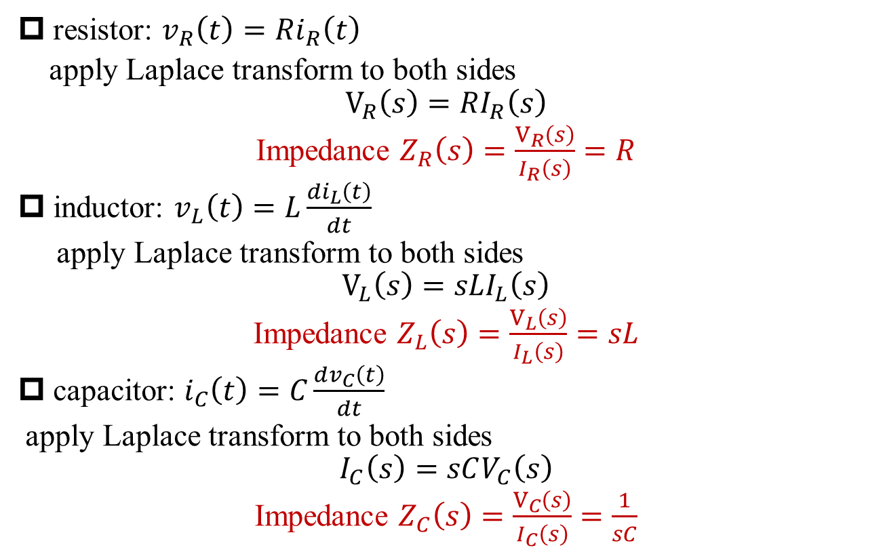
s-Domain Modeling of RLC
S: Transfer Function of Typical Circuits
resistor: $v_{R}\left(t\right)=Ri_{R}\left(t\right)$
apply Laplace transform to both sides
$$V_{R}\left(s\right)=RI_{R}\left(s\right)$$
Impedance $Z_{R}\left(s\right)=\frac{V_{R}\left(s\right)}{I_{R}\left(s\right)}=R$
inductor: $v_{L}\left(t\right)=L\frac{di_{L}\left(t\right)}{dt}$
apply Laplace transform to both sides
$$V_{L}\left(s\right)=sLI_{L}\left(s\right)$$
Impedance $Z_{L}\left(s\right)=\frac{V_{L}\left(s\right)}{I_{L}\left(s\right)}=sL$
capacitor: $i_{C}\left(t\right)=C\frac{dv_{C}\left(t\right)}{dt}$
apply Laplace transform to both sides
$$I_{C}\left(s\right)=sCV_{C}\left(s\right)$$
Impedance $Z_{C}\left(s\right)=\frac{V_{C}\left(s\right)}{I_{C}\left(s\right)}=\frac{1}{sC}$

Slide 38
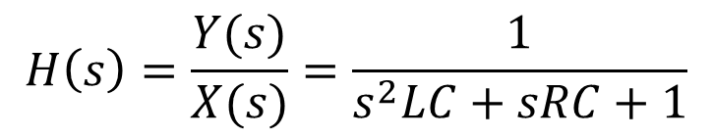
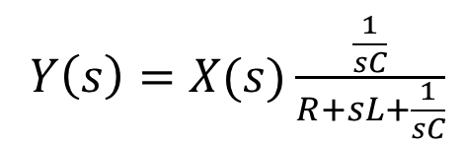
System Function of RLC System
S: Transfer Function of Typical Circuits
$Y\left(s\right)=X(s)\frac{\frac{1}{sC}}{R+sL+\frac{1}{sC}}$
sL
X(s)
1/sC
Y(s)
$$H\left(s\right)=\frac{Y(s)}{X(s)}=\frac{1}{s^{2}LC+sRC+1}$$

Slide 39
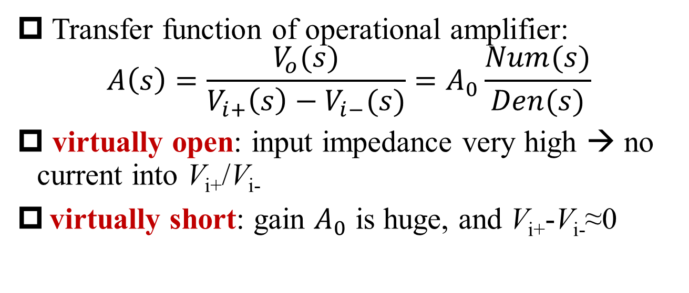
Modeling of Operational Amplifier
S: Transfer Function of Typical Circuits
Transfer function of operational amplifier:
$$A\left(s\right)=\frac{V_{o}(s)}{V_{i+}\left(s\right)−V_{i−}(s)}=A_{0}\frac{Num(s)}{Den(s)}$$
virtually open: input impedance very high → no current into V_{i+}/V_{i-}
virtually short: gain $A_{0}$ is huge, and V_{i+}-V_{i-}≈0

Slide 40
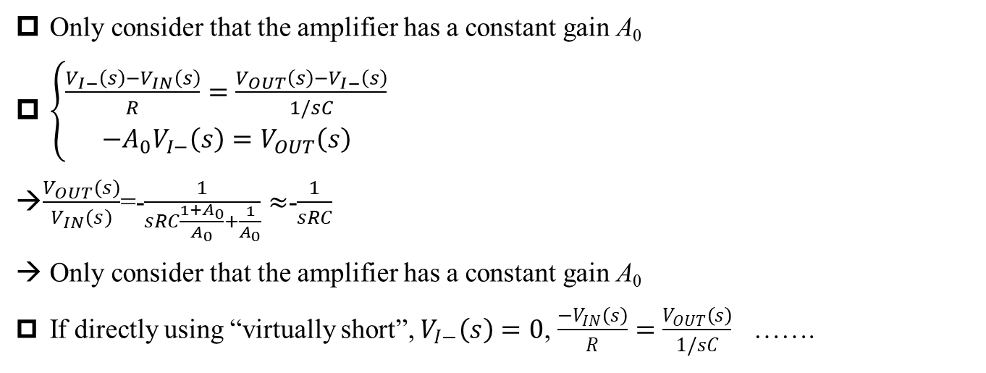

Active RC Filter (Integrator)
S: Transfer Function of Typical Circuits
Only consider that the amplifier has a constant gain A₀
$\left\{\begin{aligned}\frac{V_{I−}\left(s\right)−V_{IN}\left(s\right)}{R}=\frac{V_{OUT}\left(s\right)−V_{I−}\left(s\right)}{1/sC} \\ {−A_{0}V}_{I−}\left(s\right)=V_{OUT}\left(s\right)\end{aligned}\right.$
$\frac{V_{OUT}\left(s\right)}{V_{IN}\left(s\right)}$=-$\frac{1}{sRC\frac{1+A_{0}}{A_{0}}+\frac{1}{A_{0}}}≈$-$\frac{1}{sRC}$
Only consider that the amplifier has a constant gain A₀
If directly using “virtually short”, $V_{I−}\left(s\right)=0$, $\frac{−V_{IN}\left(s\right)}{R}=\frac{V_{OUT}\left(s\right)}{1/sC}$ …….
Q: What if $A\left(s\right)=A_{0}\frac{Num(s)}{Den(s)}$?

Slide 41
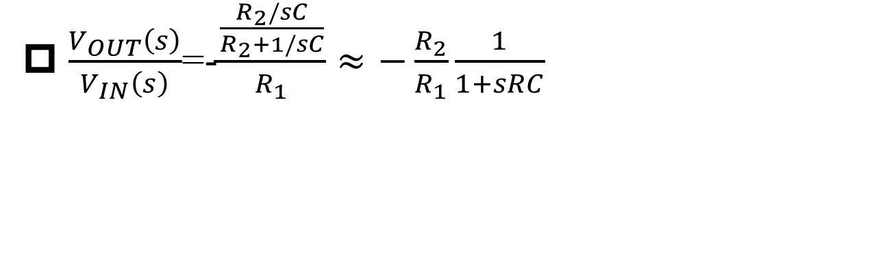
Active RC Filter (Lowpass)
S: Transfer Function of Typical Circuits
$\frac{V_{OUT}\left(s\right)}{V_{IN}\left(s\right)}$=-$\frac{\frac{R_{2}/sC}{R_{2}+1/sC}}{R_{1}}≈−\frac{R_{2}}{R_{1}}\frac{1}{1+sRC}$

Slide 42
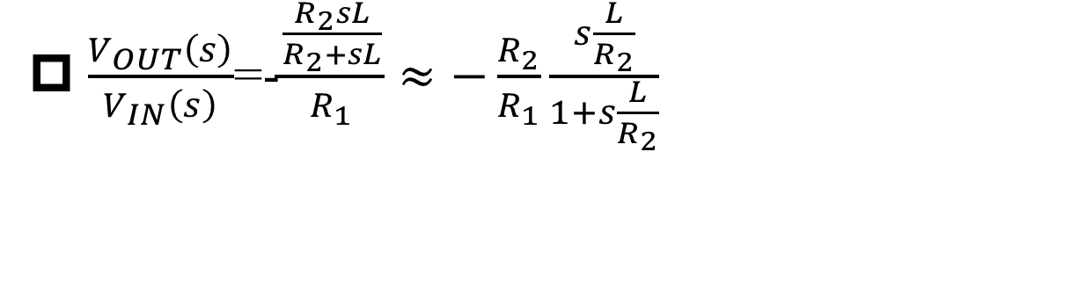
Active RC Filter (Highpass)
S: Transfer Function of Typical Circuits
$\frac{V_{OUT}\left(s\right)}{V_{IN}\left(s\right)}$=-$\frac{\frac{R_{2}sL}{R_{2}+sL}}{R_{1}}≈−\frac{R_{2}}{R_{1}}\frac{s\frac{L}{R_{2}}}{1+s\frac{L}{R_{2}}}$

Slide 43
Active RC Filter (Highpass)
S: Transfer Function of Typical Circuits
Transfer Function?

Slide 44
Active RC Filter (Lowpass with Finite Attenuation)
S: Transfer Function of Typical Circuits
Transfer Function?

Slide 45
Summary
Definition of Bode plot
Bode plots of 1st order and 2nd order system
Transfer functions of simple circuits
s-domain modeling
transfer function analysis

