Slide 1


荷塘雨课堂
播放ppt
腾讯会议
双向语音/视频交流
1. 开启荷塘雨课堂（请关闭音频输出，可以点名、白板、做题、弹幕等）
2. 开启腾讯会议（请保持静音，一般关闭摄像头，发言前解除静音）
雨课堂可以看ppt，腾讯会议可以看现场板书，
建议分别用两个终端打开。

Slide 2
Chapter 8 Communication Systems

Slide 3
Outline
Amplitude Modulation
Sinusoidal AM Demodulation
Frequency-Division Multiplexing
Single Sideband Modulation
Frequency Modulation

Slide 4
Basic Definitions
§8.1 Amplitude Modulation
Modulation: to embed an information-bearing signal into a second signal
Modulating signal: the information-bearing signal
Carrier signal: usually high frequency
Modulated signal:
Demodulation: to extract the information-bearing signal from the modulated signal
Why modulation?
To shift the frequency of information-bearing signal to higher frequency for transmission
the antenna dimension to transmit a frequency signal is at least 1/10 of the signal wavelength
To simultaneously transmit multiple signals over the same channel → multiplexing
Modem=Modulation + Demodulation

Slide 5
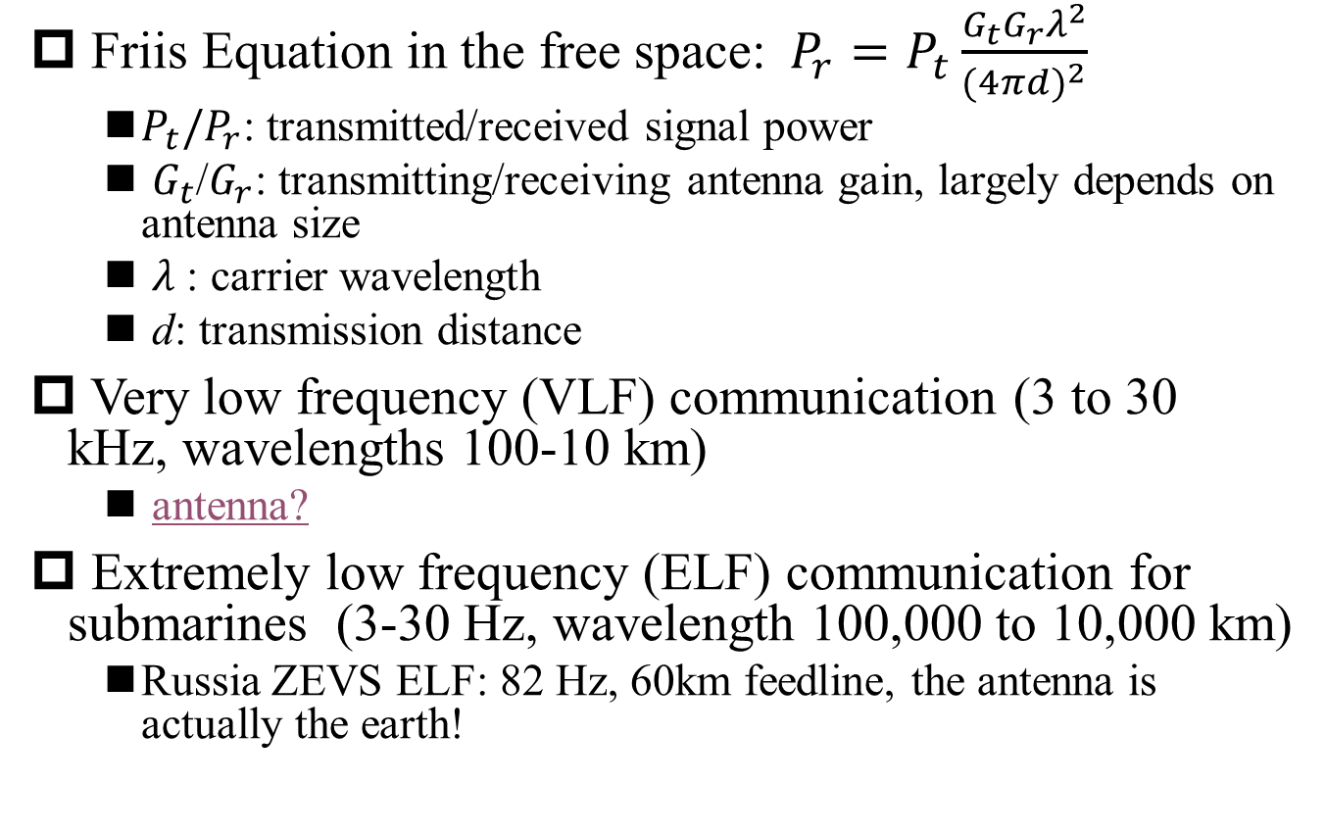
Why Modulation?
§8.1 Amplitude Modulation
Friis Equation in the free space:$P_{r}=P_{t}\frac{G_{t}G_{r}λ^{2}}{{(4πd)}^{2}}$
$P_{t}{/P}_{r}$: transmitted/received signal power
$G_{t}$/$G_{r}$: transmitting/receiving antenna gain, largely depends on antenna size
$λ$: carrier wavelength
d: transmission distance
Very low frequency (VLF) communication (3 to 30 kHz, wavelengths 100-10 km)
antenna?
Extremely low frequency (ELF) communication for submarines (3-30 Hz, wavelength 100,000 to 10,000 km)
Russia ZEVS ELF: 82 Hz, 60km feedline, the antenna is actually the earth!
Q: Communication distance of mm-wave?

Slide 6
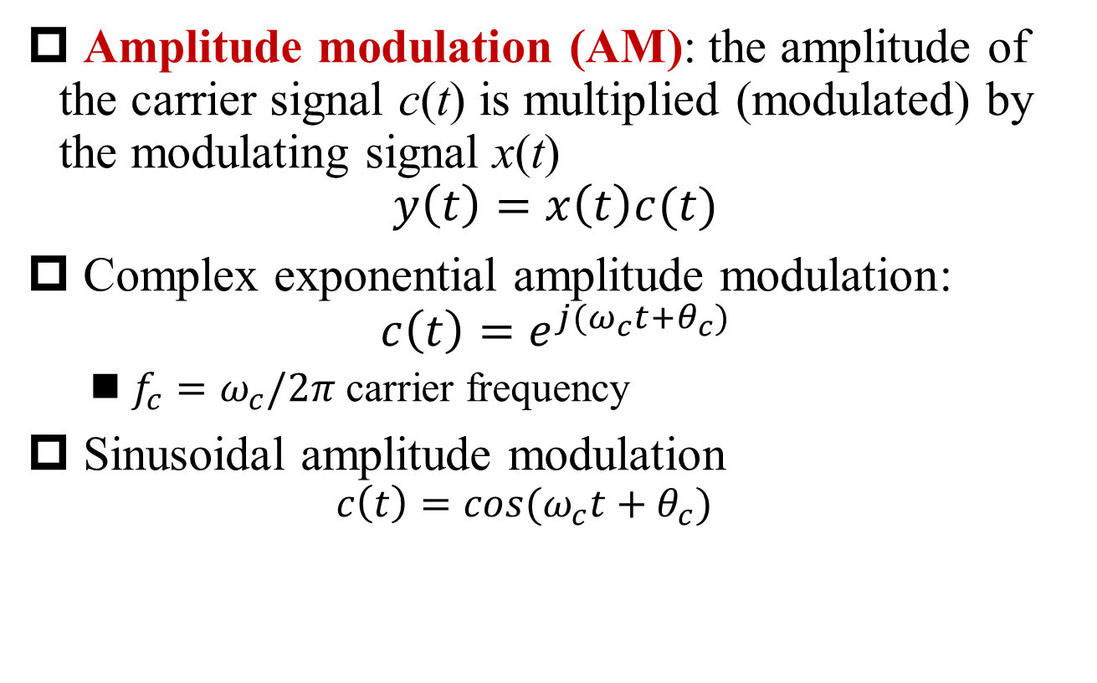
Amplitude Modulation
§8.1 Amplitude Modulation
Amplitude modulation (AM): the amplitude of the carrier signal c(t) is multiplied (modulated) by the modulating signal x(t)
$$y\left(t\right)=x\left(t\right)c(t)$$
Complex exponential amplitude modulation:
$$c\left(t\right)=e^{j(ω_{c}t+θ_{c})}$$
$f_{c}=ω_{c}/2π$ carrier frequency
Sinusoidal amplitude modulation
$$c\left(t\right)=cos(ω_{c}t+θ_{c})$$

Slide 7
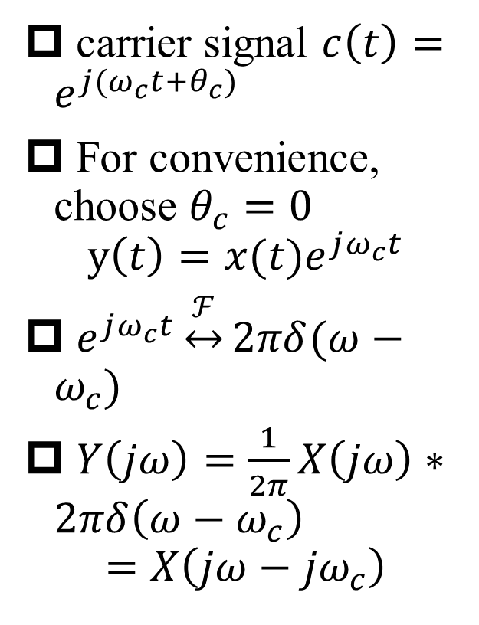
Complex Exponential Amplitude Modulation
§8.1 Amplitude Modulation
carrier signal $c\left(t\right)=e^{j(ω_{c}t+θ_{c})}$
For convenience, choose $θ_{c}=0$
$$y\left(t\right)=x(t)e^{jω_{c}t}$$
$e^{jω_{c}t}\underset{↔}{ℱ}2πδ(ω−ω_{c})$
$Y\left(jω\right)=\frac{1}{2π}X\left(jω\right)∗2πδ\left(ω−ω_{c}\right)$
$$=X\left(jω−{jω}_{c}\right)$$
Q: Frequency spectrum efficiency?

Slide 8

Complex Exponential AM Demodulation
§8.1 Amplitude Modulation
Demodulation: $x(t)=y(t)e^{−jω_{c}t}$
Local oscillation signal (LO): $e^{−jω_{c}t}$

Slide 9

How to Generate Complex Signals?
§8.1 Amplitude Modulation
Use two signals to represent the complex signals
$$e^{jω_{c}t}=cosω_{c}t+jsinω_{c}t$$
$$y\left(t\right)=x\left(t\right)e^{jω_{c}t}=x\left(t\right)cosω_{c}t+jx\left(t\right)sinω_{c}t$$
Use one modulated sinusoidal signal to represent the complex signal
$$y\left(t\right)=r(t)cos(ω_{c}t+θ(t))$$

Slide 10
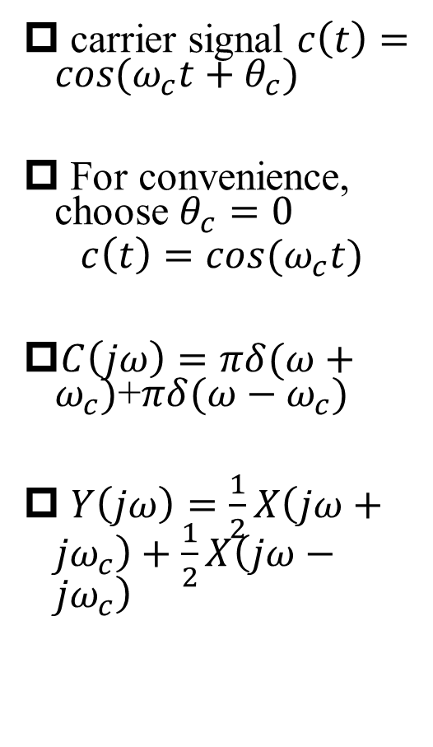
Sinusoidal Amplitude Modulation
§8.1 Amplitude Modulation
carrier signal $c\left(t\right)=cos(ω_{c}t+θ_{c})$
For convenience, choose $θ_{c}=0$
$$c\left(t\right)=cos(ω_{c}t)$$
$C\left(jω\right)=πδ(ω+ω_{c})$+$πδ(ω−ω_{c})$
$Y\left(jω\right)=\frac{1}{2}X\left(jω+{jω}_{c}\right)+\frac{1}{2}X\left(jω−{jω}_{c}\right)$

Slide 11
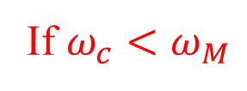

Requirement on Carrier Frequency
§8.1 Amplitude Modulation
It is required that
If $ω_{c}<ω_{M}$
$$ω_{c}>ω_{M}$$

Slide 12
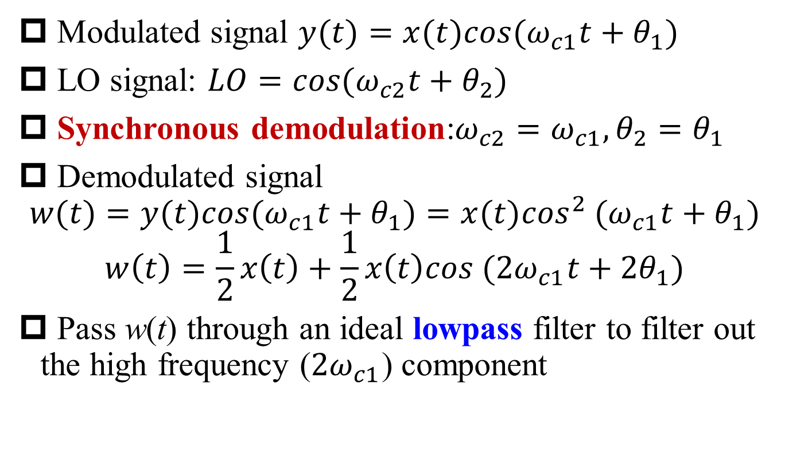
Synchronous Demodulation
§8.2 Demodulation for Sinusoidal AM
Modulated signal $y(t)=x(t)cos(ω_{c1}t+θ_{1})$
LO signal: $LO=cos(ω_{c2}t+θ_{2})$
Synchronous demodulation:$ω_{c2}=ω_{c1},θ_{2}=θ_{1}$
Demodulated signal
$$w(t)=y(t)cos(ω_{c1}t+θ_{1})=x(t)\cos^{2} (ω_{c1}t+θ_{1})$$
$$w\left(t\right)=\frac{1}{2}x\left(t\right)+\frac{1}{2}x\left(t\right)cos (2ω_{c1}t+{2θ}_{1})$$
Pass w(t) through an ideal lowpass filter to filter out the high frequency ($2ω_{c1}$) component

Slide 13
Block Diagram of Synchronous Demodulation
§8.2 Demodulation for Sinusoidal AM
Sinusoidal AM
Sinusoidal AM Demodulation

Slide 14
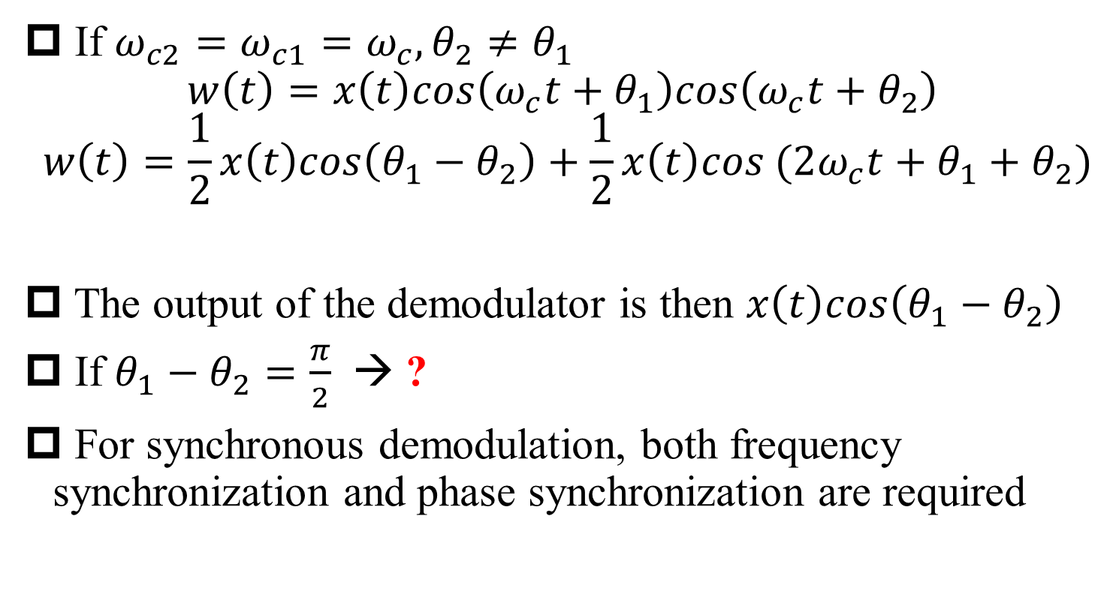
What if Phase is NOT Synchronized?
§8.2 Demodulation for Sinusoidal AM
If $ω_{c2}=ω_{c1}=ω_{c},θ_{2}≠θ_{1}$
$$w\left(t\right)=x\left(t\right)cos\left(ω_{c}t+θ_{1}\right)cos\left(ω_{c}t+θ_{2}\right)$$
$$w\left(t\right)=\frac{1}{2}x\left(t\right)cos\left(θ_{1}−θ_{2}\right)+\frac{1}{2}x\left(t\right)cos (2ω_{c}t+θ_{1}+θ_{2})$$
The output of the demodulator is then $x\left(t\right)cos\left(θ_{1}−θ_{2}\right)$
If $θ_{1}−θ_{2}=\frac{π}{2}$ → ?
For synchronous demodulation, both frequency synchronization and phase synchronization are required

Slide 15
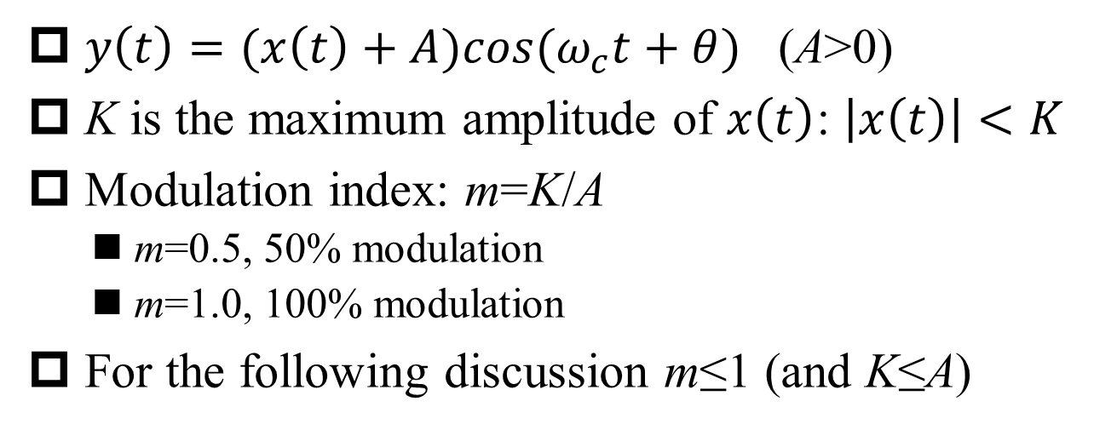
Percent Modulation
§8.2 Demodulation for Sinusoidal AM
$y\left(t\right)=(x\left(t\right)+A)cos(ω_{c}t+θ)$ (A>0)
K is the maximum amplitude of $x\left(t\right)$: $\left|x\left(t\right)\right|<K$
Modulation index: m=K/A
m=0.5, 50% modulation
m=1.0, 100% modulation
For the following discussion m≤1 (and K≤A)

Slide 16
Percent Modulation (m=0.5, m=1)
§8.2 Demodulation for Sinusoidal AM
envelope
m=0.5
envelope
m=1.0
envelope: smooth curve connecting the peaks of modulated signal

Slide 17
Percent Modulation (m=0.5, m=3)
§8.2 Demodulation for Sinusoidal AM
envelope
m=1.0
envelope
m=3.0
m cannot be larger than 1, because the envelope cannot tell if m is larger or smaller than 1

Slide 18
Asynchronous Demodulation—Envelope Detector
§8.2 Demodulation for Sinusoidal AM
Schottky diode as half rectifier
RC network for lowpass filtering

Slide 19
Modulated Signal in Synchronous/Asynchronous Systems
§8.2 Demodulation for Sinusoidal AM
AM spectra for synchronous demodulation
AM spectra for envelope detection
There must exist the carrier component for envelope detection

Slide 20
Frequency-Division Multiplexing
§8.3 Frequency-Division Multiplexing
Frequency-division multiplexing (FDM): multiple modulating signals are modulated on different carrier frequencies, and the modulated signals are summed and transmitted simultaneously over the same communication channel

Slide 21
Spectra of FDM
§8.3 Frequency-Division Multiplexing

Slide 22
Demodulation of FDM
§8.3 Frequency-Division Multiplexing
Bandpass filter
Lowpass filter
Demultiplexing
Demodulation
Channel selection filter at RF frequency is difficult to implement!

Slide 23
Demodulation of FDM with Intermediate-Frequency Down-Conversion
§8.3 Frequency-Division Multiplexing
Bandpass filter
Lowpass filter
Down Conversion
Intermediate-Frequency (IF) Filter
(channel selection filter)
Demodulation

Slide 24
Superheterodyne Receiver
§8.3 Frequency-Division Multiplexing

Slide 25
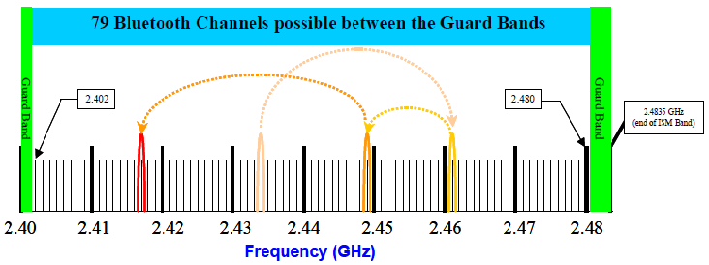
Bluetooth 2.1 Frequency Channels
§8.3 Frequency-Division Multiplexing

Slide 26
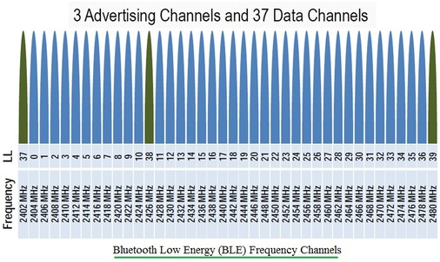
Bluetooth Low-Energy (BLE) Frequency Channels
§8.3 Frequency-Division Multiplexing

Slide 27
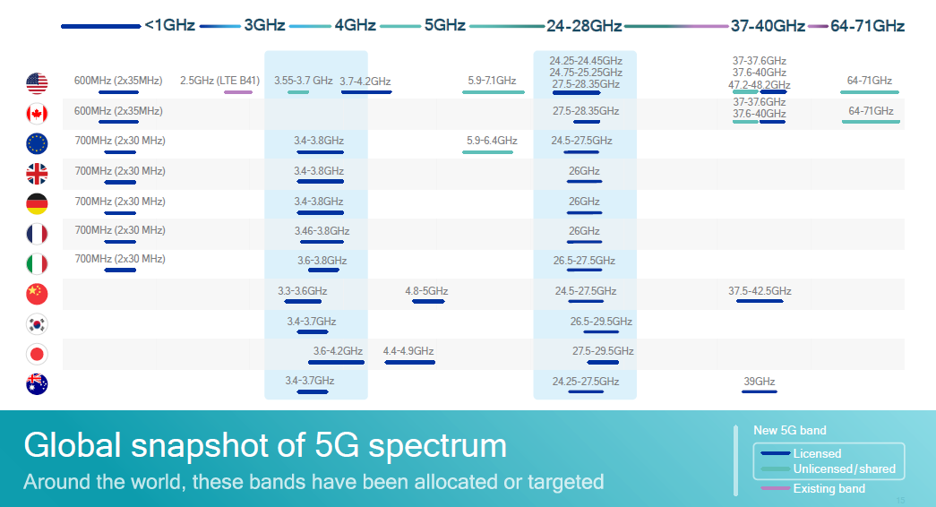
5G Spectrum
§8.3 Frequency-Division Multiplexing

Slide 28
Double-Sideband Modulation vs. Single-Sideband Modulation
§8.4 SSB Modulation
Q1: Frequency bandwidth?
Double-sideband modulation (DSB)
Q2: Frequency bandwidth?
Single-sideband modulation (SSB)

Slide 29
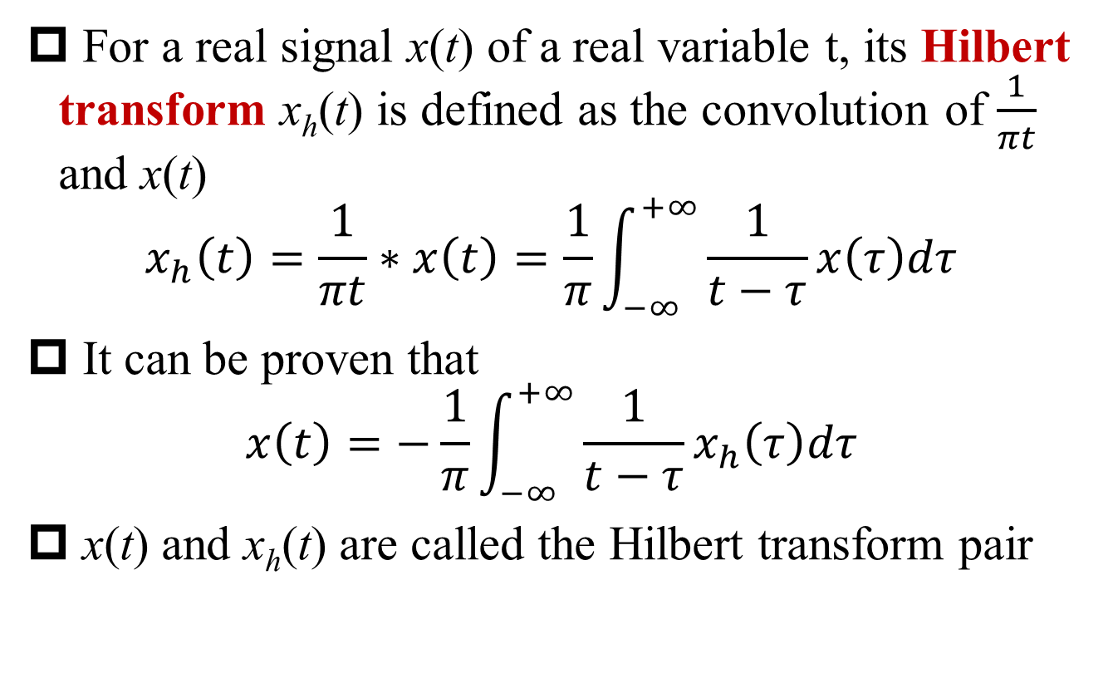
Hilbert Transform
§8.4 SSB Modulation
For a real signal x(t) of a real variable t, its Hilbert transform x_{h}(t) is defined as the convolution of $\frac{1}{πt}$ and x(t)
$$x_{h}\left(t\right)=\frac{1}{πt}∗x\left(t\right)=\frac{1}{π}\int_{−∞}^{+∞}{\frac{1}{t−τ}x\left(τ\right)dτ}$$
It can be proven that
$$x\left(t\right)=−\frac{1}{π}\int_{−∞}^{+∞}{\frac{1}{t−τ}x_{h}\left(τ\right)dτ}$$
x(t) and x_{h}(t) are called the Hilbert transform pair

Slide 30
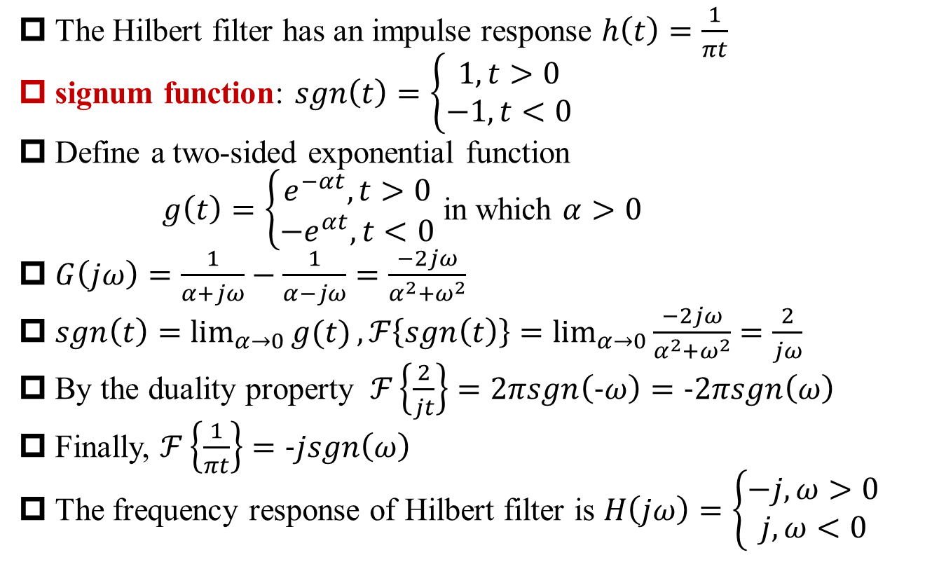
Hilbert Filter
§8.4 SSB Modulation
The Hilbert filter has an impulse response $h\left(t\right)=\frac{1}{πt}$
signum function: $sgn\left(t\right)=\left\{\begin{aligned}1, t>0 \\ −1, t<0\end{aligned}\right.$
Define a two-sided exponential function
$g\left(t\right)=\left\{\begin{aligned}e^{−αt}, t>0 \\ −e^{αt}, t<0\end{aligned}\right.$ in which $α>0$
$G\left(jω\right)=\frac{1}{α+jω}−\frac{1}{α−jω}=\frac{−2jω}{α^{2}+ω^{2}}$
$sgn\left(t\right)=\lim_{α→0}{g(t)}, ℱ\left\{sgn\left(t\right)\right\}=\lim_{α→0}{\frac{−2jω}{α^{2}+ω^{2}}}=\frac{2}{jω}$
By the duality property $ℱ\left\{\frac{2}{jt}\right\}=2πsgn\left(−ω\right)=−2πsgn\left(ω\right)$
Finally, $ℱ\left\{\frac{1}{πt}\right\}=−jsgn\left(ω\right)$
The frequency response of Hilbert filter is $H\left(jω\right)=\left\{\begin{aligned}−j,ω>0 \\ j,ω<0\end{aligned}\right.$

Slide 31
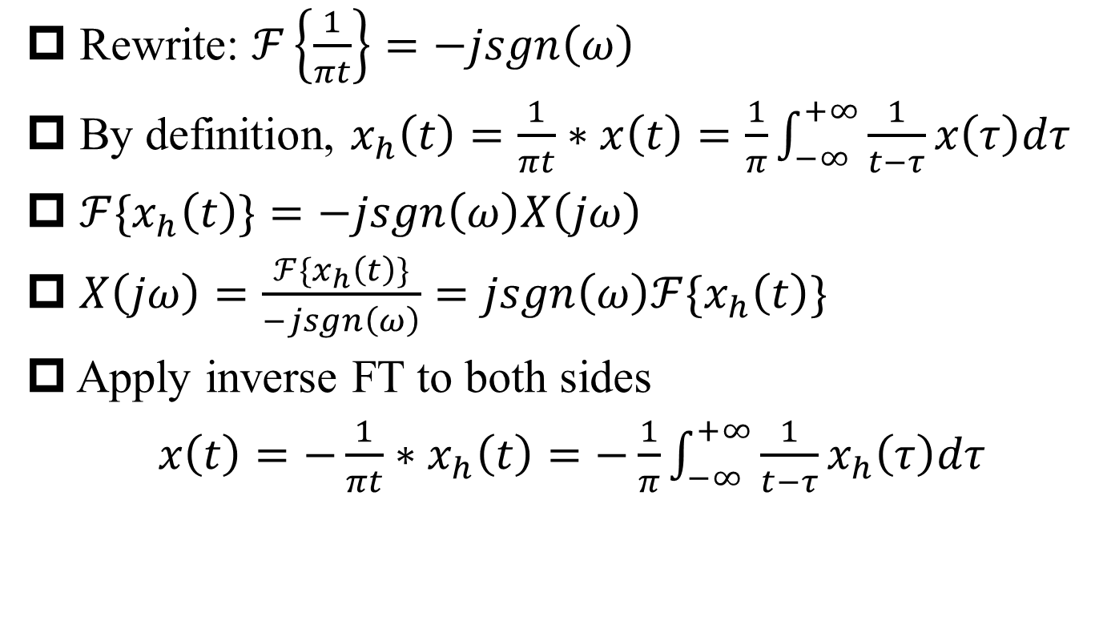
Proof of Hilbert Transform Pair*
§8.4 SSB Modulation
Rewrite: $ℱ\left\{\frac{1}{πt}\right\}=−jsgn\left(ω\right)$
By definition, $x_{h}\left(t\right)=\frac{1}{πt}∗x\left(t\right)=\frac{1}{π}\int_{−∞}^{+∞}{\frac{1}{t−τ}x\left(τ\right)dτ}$
${ℱ\{x}_{h}\left(t\right)\}=−jsgn\left(ω\right)X\left(jω\right)$
$X\left(jω\right)=\frac{{ℱ\{x}_{h}\left(t\right)\}}{−jsgn\left(ω\right)}=jsgn\left(ω\right){ℱ\{x}_{h}\left(t\right)\}$
Apply inverse FT to both sides
$x\left(t\right)=−\frac{1}{πt}∗x_{h}\left(t\right)=−\frac{1}{π}\int_{−∞}^{+∞}{\frac{1}{t−τ}x_{h}\left(τ\right)dτ}$

Slide 32


Single Sideband Modulation Using Hilbert Filter
§8.4 SSB Modulation
$$X_{h}\left(jω\right)=−jsgn\left(ω\right)X(jω)$$
$Y_{2}\left(jω\right)=\frac{1}{j}[\frac{X_{h}(jω−jω_{c})}{2}$-$\frac{X_{h}(jω+jω_{c})}{2}$]
Q: How to get Y_{u}(jω)?

Slide 33
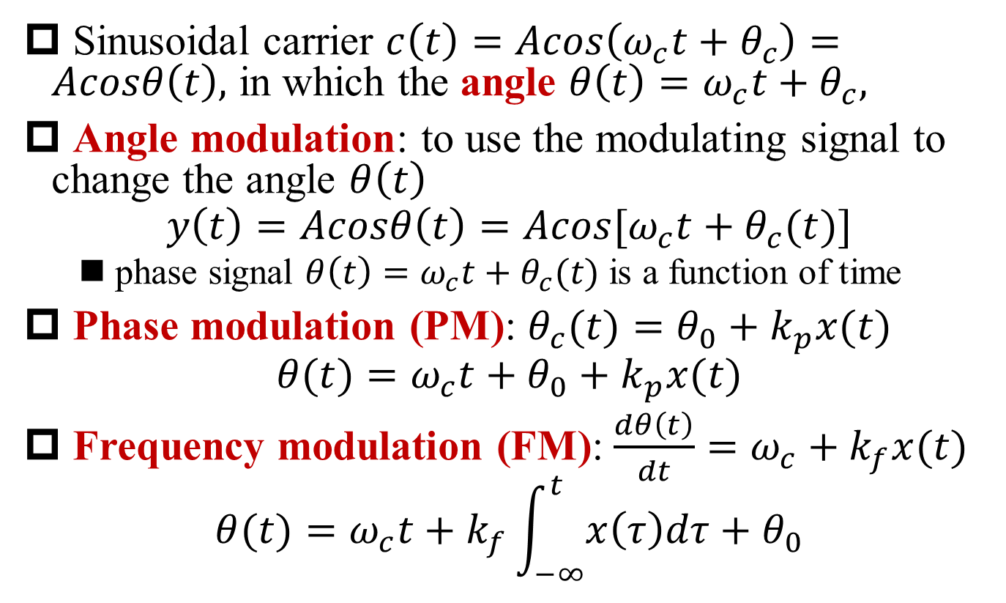
Angle Modulation
§8.7 Frequency Modulation
Sinusoidal carrier $c\left(t\right)=Acos\left(ω_{c}t+θ_{c}\right)=Acosθ\left(t\right),$ in which the angle $θ\left(t\right)=ω_{c}t+θ_{c},$
Angle modulation: to use the modulating signal to change the angle $θ\left(t\right)$
$$y\left(t\right)=Acosθ\left(t\right)=Acos[ω_{c}t+θ_{c}(t)]$$
phase signal $θ\left(t\right)=ω_{c}t+θ_{c}(t)$ is a function of time
Phase modulation (PM): $θ_{c}(t)=θ_{0}+k_{p}x(t)$
$$θ(t)=ω_{c}t+θ_{0}+k_{p}x(t)$$
Frequency modulation (FM): $\frac{dθ\left(t\right)}{dt}=ω_{c}+k_{f}x(t)$
$$θ(t)=ω_{c}t+k_{f}\int_{−∞}^{t}{x\left(τ\right)dτ}+θ_{0}$$

Slide 34
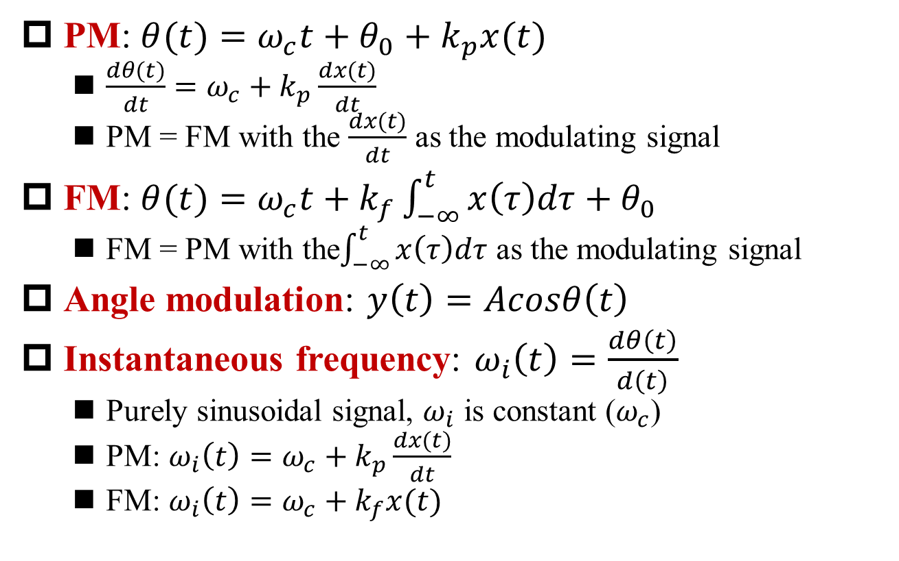
PM vs. FM
§8.7 Frequency Modulation
PM: $θ(t)=ω_{c}t+θ_{0}+k_{p}x(t)$
$\frac{dθ(t)}{dt}=ω_{c}+k_{p}\frac{dx(t)}{dt}$
PM = FM with the $\frac{dx(t)}{dt}$ as the modulating signal
FM: $θ(t)=ω_{c}t+k_{f}\int_{−∞}^{t}{x\left(τ\right)dτ}+θ_{0}$
FM = PM with the$\int_{−∞}^{t}{x\left(τ\right)dτ}$ as the modulating signal
Angle modulation: $y\left(t\right)=Acosθ\left(t\right)$
Instantaneous frequency: $ω_{i}\left(t\right)=\frac{dθ\left(t\right)}{d\left(t\right)}$
Purely sinusoidal signal, $ω_{i}$ is constant ($ω_{c}$)
PM: $ω_{i}\left(t\right)=ω_{c}+k_{p}\frac{dx(t)}{dt}$
FM: $ω_{i}\left(t\right)=ω_{c}+k_{f}x(t)$

Slide 35
PM vs. FM (cont’)
§8.7 Frequency Modulation

Slide 36
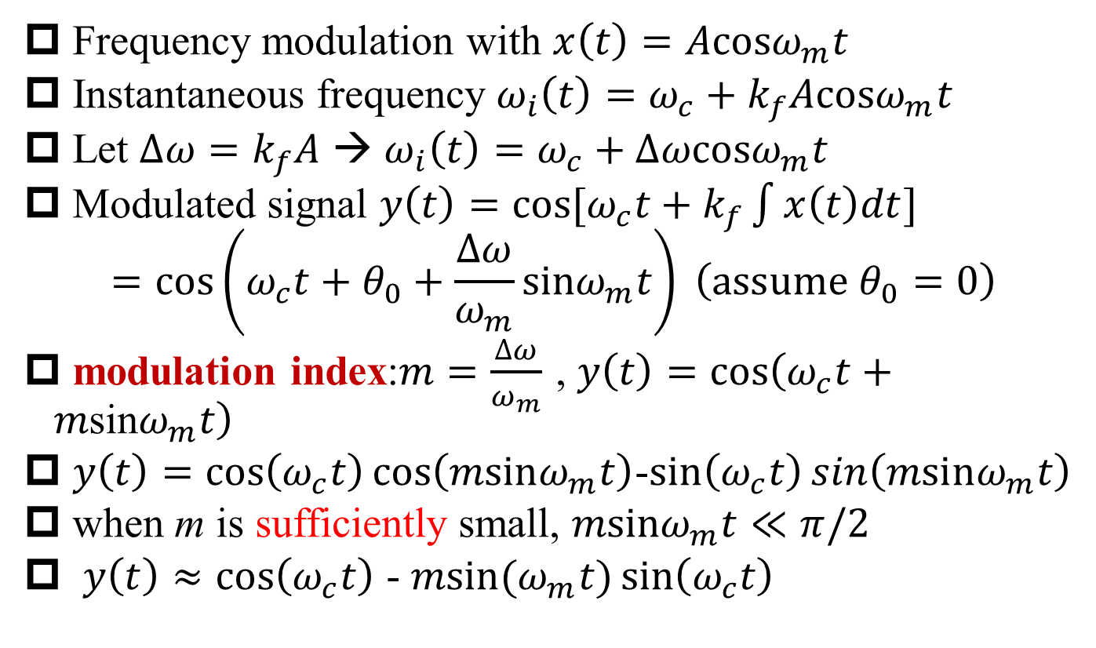
Narrowband Frequency Modulation
§8.7 Frequency Modulation
Frequency modulation with $x\left(t\right)=A\text{cos}ω_{m}t$
Instantaneous frequency $ω_{i}\left(t\right)=ω_{c}+k_{f}A\text{cos}ω_{m}t$
Let $∆ω=k_{f}A$ → $ω_{i}\left(t\right)=ω_{c}+∆ω\text{cos}ω_{m}t$
Modulated signal $y\left(t\right)=\text{cos}[ω_{c}t+k_{f}\int{x\left(t\right)dt}]$
$$=\cos\left(ω_{c}t+θ_{0}+\frac{∆ω}{ω_{m}}\text{sin}ω_{m}t\right) \left(assume θ_{0}=0\right)$$
modulation index:$m=\frac{∆ω}{ω_{m}}$ , $y\left(t\right)=\cos\left(ω_{c}t+m\text{sin}ω_{m}t\right)$
$y\left(t\right)=\cos\left(ω_{c}t\right)\cos\left(m\text{sin}ω_{m}t\right)$-$\sin\left(ω_{c}t\right)\sin\left(m\text{sin}ω_{m}t\right)$
when m is sufficiently small, $m\text{sin}ω_{m}t≪π/2$
$y\left(t\right)≈\cos\left(ω_{c}t\right)$ - $m\text{sin}(ω_{m}t)\sin\left(ω_{c}t\right)$

Slide 37
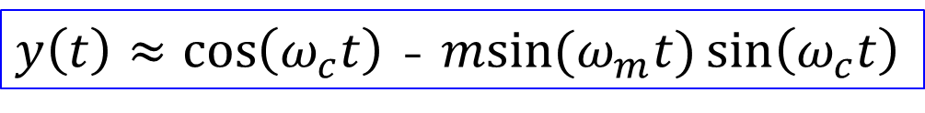
Spectrum of Narrowband FM
§8.7 Frequency Modulation
$y\left(t\right)≈\cos\left(ω_{c}t\right)$ - $m\text{sin}(ω_{m}t)\sin\left(ω_{c}t\right)$
Q: Bandwidth of modulated signal?
A: Equal to modulating signal bandwidth, independent of its amplitude

Slide 38
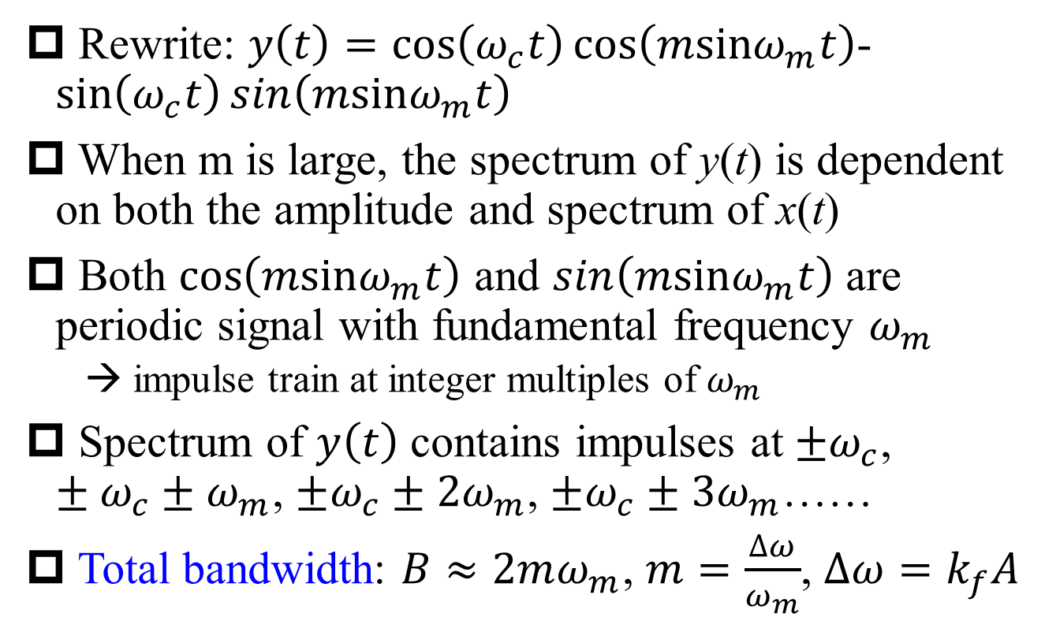
Wideband Frequency Modulation
§8.7 Frequency Modulation
Rewrite: $y\left(t\right)=\cos\left(ω_{c}t\right)\cos\left(m\text{sin}ω_{m}t\right)$-$\sin\left(ω_{c}t\right)\sin\left(m\text{sin}ω_{m}t\right)$
When m is large, the spectrum of y(t) is dependent on both the amplitude and spectrum of x(t)
Both $\cos\left(m\text{sin}ω_{m}t\right)$ and $\sin\left(m\text{sin}ω_{m}t\right)$ are periodic signal with fundamental frequency $ω_{m}$
→ impulse train at integer multiples of $ω_{m}$
Spectrum of $y\left(t\right)$ contains impulses at $±ω_{c}$, $±ω_{c}±ω_{m}$, $±ω_{c}±2ω_{m}$, $±ω_{c}±3ω_{m}$……
Total bandwidth: $B≈2mω_{m}$, $m=\frac{∆ω}{ω_{m}}$, $∆ω=k_{f}A$

Slide 39
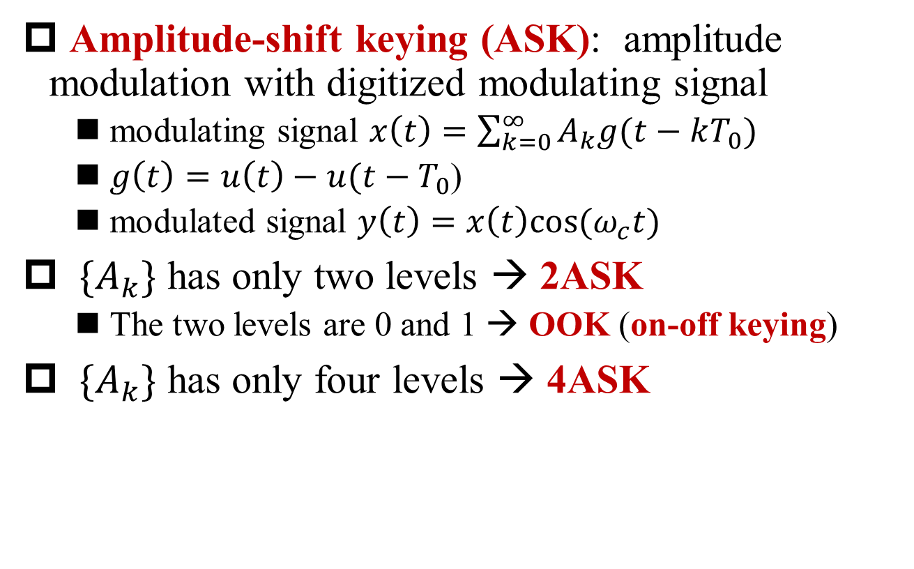
Digital Modulation: ASK
Amplitude-shift keying (ASK): amplitude modulation with digitized modulating signal
modulating signal $x\left(t\right)=\sum_{k=0}^{∞}{A_{k}g(t−kT_{0})}$
$g\left(t\right)=u\left(t\right)−u(t−T_{0}$)
modulated signal $y\left(t\right)=x\left(t\right)cos⁡(ω_{c}t)$
${\{A}_{k}\}$ has only two levels → 2ASK
The two levels are 0 and 1 → OOK (on-off keying)
${\{A}_{k}\}$ has only four levels → 4ASK

Slide 40
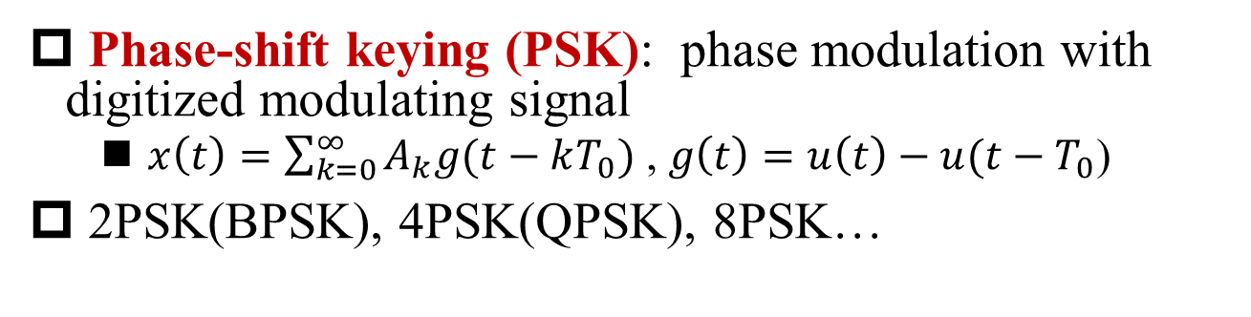
Digital Modulation: PSK
Phase-shift keying (PSK): phase modulation with digitized modulating signal
$x\left(t\right)=\sum_{k=0}^{∞}{A_{k}g(t−kT_{0})}$ , $g\left(t\right)=u\left(t\right)−u(t−T_{0}$)
2PSK(BPSK), 4PSK(QPSK), 8PSK…
Example of 4PSK

Slide 41
Digital Modulation: FSK
Frequency-shift keying (FSK): frequency modulation with digitized modulating signal
Example of 4FSK

Slide 42
Quadrature Modulation for Angle Modulation
In-phase path and Quadrature path
Since the modulating signal is discrete, the initial phase of the output signal at the beginning of each symbol period has limited number of values → constellation diagram

Slide 43
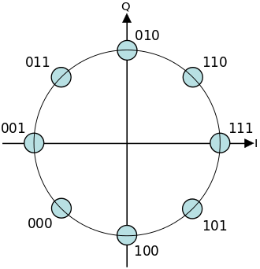
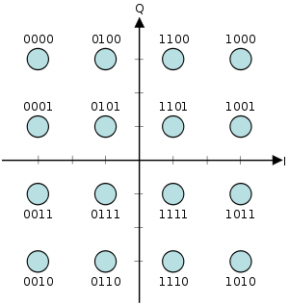
Constellation Diagram
constellation diagram of 16QAM (quadrature amplitude modulation)
AM+PM
constellation diagram of 8PSK

Slide 44
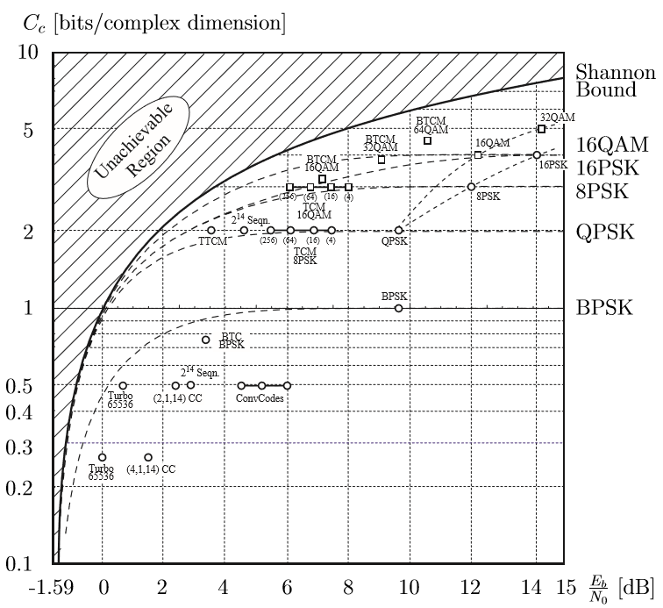
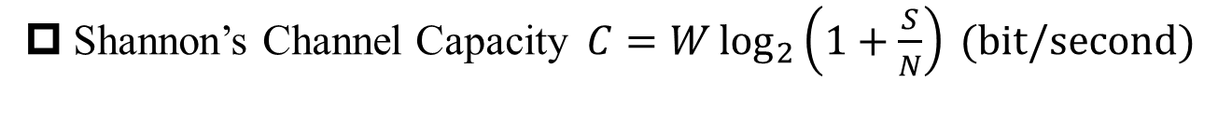
Channel Capacity
Shannon’s Channel Capacity$C=W\log_{2}\left(1+\frac{S}{N}\right) (\text{bit}\text{/}\text{second}\text{)}$
Courtesy: http://www.ece.ualberta.ca/~hcdc/Library/MIMOchClass/ChannelCapacity.pdf

Slide 45
Rapid Development in Wireless Communication
4G:150 Mbps peak rate currently provided by 4G
4.5G: peak data rate of 1.2 Gbps with a total of 70 MHz bandwidth by HKT in 2015
256 QAM
4 x 4 MIMO
4 CC(component carrier) CA (carrier aggregation)
In 2017, Huawei tested 20Gbps in 5G dual-connectivity test
3.5GHz base station + 28GHz base station

Slide 46
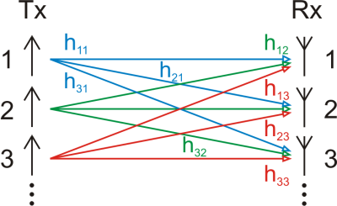
Multiple-Input Multiple-Output (MIMO)
MIMO: To use multiple transmit and receive antennas to exploit multipath propagation to multiply the capacity of a radio link
send and receive more than one data signal simultaneously over the same radio channel
Courtesy: wikipedia

Slide 47
Summary
Spectrum shifting in AM
How to build SSB?
Frequency division multiplexing
Relationship between phase modulation and frequency modulation

Slide 48

Can Shannon’s Channel Capacity$C=W\log_{2}\left(1+\frac{S}{N}\right)$ be extended to infinity by improving SNR?

