Slide 1


荷塘雨课堂
播放ppt
腾讯会议
双向语音/视频交流
1. 开启荷塘雨课堂（请关闭音频输出，可以点名、白板、做题、弹幕等）
2. 开启腾讯会议（请保持静音，一般关闭摄像头，发言前解除静音）
雨课堂可以看ppt，腾讯会议可以看现场板书，
建议分别用两个终端打开。

Slide 2
Chapter 2 Brief: Convolution
#1 Linear
#2 Time invariant
#3 (Sampling) property of unit impulse

Slide 3
Supplementary Material 1 Time-Domain Response
2020-09-30

Slide 4
Outline
Differential Equations
Homogeneous Solution and Particular Solution
Initial Conditions
Zero-Input and Zero-State Responses

Slide 5
System Description Using Differential Equations
§S1.1 Differential Equations
Constitutive definition of capacitors
Kirchhoff’s Voltage Law (KVL)
Reorder

Slide 6
System Description Using Differential Equations
§S1.1 Differential Equations
Total force on the vehicle
Newton’s Second Law of Motion
Combine them

Slide 7
System Description Using Differential Equations
§S1.1 Differential Equations
input i_{s}(t), output v(t)
KCL

Slide 8
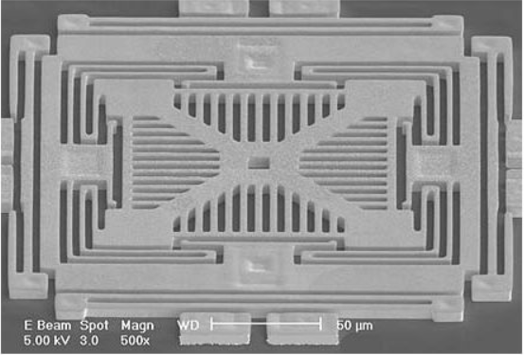
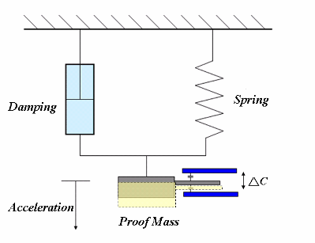
System Description Using Differential Equations
§S1.1 Differential Equations
MEMS accelerometer (http://www.memx.com）
Equivalent Model (https://wiki.metropolia.fi)
spring stiffness coefficient k, damping factor f, mass m, external force F_{s}(t), velocity of proof mass v(t)

Slide 9
Homogeneous Solution and Particular Solution
§S1.2 Homogeneous Solution and Particular Solution
Linear constant-coefficient differential equation
Complete solution y(t)=y_{p}(t)+y_{h}(t)
y_{h}(t) homogeneous solution, the solution when the right part of the differential equation is 0 (different from the zero-input response!) → natural response
y_{p}(t) particular solution, the solution dependent on the excitation function →forced response

Slide 10
Homogeneous Solution
§S1.2 Homogeneous Solution and Particular Solution
To find y_{h}(t), solve the characteristic equation
If no multiple roots
If multiple roots exist
the corresponding part in y_{h}(t)
Eg. Find y_{h}(t) for
How to find A_{k}?

Slide 11
Particular Solution
§S1.2 Homogeneous Solution and Particular Solution
Step #1: excitation function → particular solution (based on experience)
E (constant)→ B (constant)
t^{p} → B_{p}t^{p}+B_{p-1}t^{p-1}+…+B₁t+B₀
e^{at} → Be^{at}
cos(ωt) or sin(ωt) → B₁cos(ωt) + B₂sin (ωt)
t^{p}e^{at}cos(ωt) or t^{p}e^{at}sin(ωt)
→ (B_{p}t^{p}+B_{p-1}t^{p-1}+…+B₁t+B₀) e^{at}cos(ωt)
+ (D_{p}t^{p}+D_{p-1}t^{p-1}+…+D₁t+D₀) e^{at}sin (ωt)
……
Step #2: Find the unknown coefficients: B_{k}, D_{k}
How?

Slide 12
Examples to Find Particular Solution
§S1.2 Homogeneous Solution and Particular Solution
(1) x(t)=t²
the right side =t²+2t, try y(t)=B₂t²+B₁t+B₀
(2) x(t)=e^{t}
Try y(t)=Be^{t}, Be^{t} + 2Be^{t} + 3Be^{t} =e^{t}+e^{t},  B=1/3

Slide 13
How to Find Coefficients {A_{k}}
§S1.2 Homogeneous Solution and Particular Solution
Complete solution
N auxiliary conditions are required to find N coefficients {A_{k}} (k=N, N-1, …, 1)
Typical auxiliary conditions: for any time t₀, {y(t₀), dy(t₀)/dt, d²y(t₀)/dt², …, d^{N-1}y(t₀)/dt^{N-1}}
Usually, let t₀=0 since the excitation is effective for 0≤t<∞
Vandermonde Matrix

Slide 14
Steps to Find Complete Solution
§S1.2 Homogeneous Solution and Particular Solution
Step #1: Write the differential equation
Step #2: Find the homogeneous solution y_{h}(t) ({A_{k}} unknown)
Step #3: Find the particular solution y_{p}(t)
Step #4: Decide the auxiliary conditions (initial conditions
Step #5: Find {A_{k}} for y_{h}(t)
Step #5: Complete solution= y_{h}(t)+ y_{p}(t)

Slide 15
Initial Conditions (初始条件)
§S1.3 Initial Conditions
Initial states: y(t₀), y’(t₀), y’’(t₀), …
Usually we choose t₀=0, → y(0), y’(0), y’’(0), …
Pre-initial states: y(0⁻), y’(0⁻), y’’(0⁻), … (起始状态)
Post-initial states: y(0⁺), y’(0⁺), y’’(0⁺), … (初始状态)
Use the post-initial states as the initial conditions to find {A_{k}} , since the input is effective only after t₀
do not necessarily use the initial states as the initial conditions
Initial rest condition: y(t)=0 for t<0
→y(0⁻)=0, y’(0⁻)=0, y’’(0⁻)=0, …

Slide 16
Example: Initial Conditions with Initial Rest
§S1.3 Initial Conditions
input: v_{S}(t)=sin(2t)u(t)
Homogenous solution
Particular solution: try
Complete solution:
Initial Rest:
Anything Wrong?

Slide 17
Example: Initial Conditions with Initial Rest (cont’)
§S1.3 Initial Conditions
input: v_{S}(t)=sin(2t)u(t)
Complete solution:
Initial Rest:
Actually, initial rest only leads to v(0⁻)=0, v’(0⁻)=0, while it does NOT imply v(0⁺)=0, v’(0⁺)=0
We can analyze v(0⁺)=0, v’(0⁺)=0
voltage across C₂ cannot change instantly→ v(0⁺)= v(0⁻)=0
v_{C1}(0⁺)=0 → i_{R2}(0⁺)= i_{C2}(0⁺)=0 →v_{C2}’(0⁺)=0

Slide 18
Zero-Input Response and Zero-State Response
§S1.4 Zero-Input Response and Zero-State Response
Does the homogeneous solution have nothing to do with the input?
No! The homogeneous solution can be divided into two parts: the output due to the pre-initial states, the output due to the input (excitation)

Slide 19
Zero-Input Response and Zero-State Response
§S1.4 Zero-Input Response and Zero-State Response
Zero-Input Response: system response determined by the pre-initial states. It has nothing to do with the input/excitation
Zero-State Response: system response with all-zero pre-initial states. It is determined only by the external excitation
The previous examples all consider the zero-state response

Slide 20
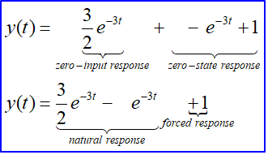
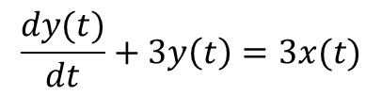

Example with non-zero pre-initial states
§S1.4 Zero-Input Response and Zero-State Response
$$\frac{dy(t)}{dt}+3y\left(t\right)=3x(t)$$
LTI system
Homogeneous solution
Particular solution
Complete solution
Zero-input response:
Zero-state response:
$$x\left(t\right)=u(t)$$

Slide 21
Impulse Response: Find Initial States by Matching the Singularity Equations (1)
§S1.3 Initial Conditions
Principle: the coefficients of singularity functions must be the same on the two sides of DE
Example: y’ (t)+3 y(t)= 3x’ (t) x(t)=δ(t) initial rest
t>0⁺, only homogeneous solution y’ (t)=Ae^{-3t}
There is 3δ’ (t) on the right side → there must be the term 3δ’ (t) in y’ (t) → there must be the term 3δ(t) in y(t)
there is no δ(t) on the right side → there must be the term -9δ(t) in y’ (t) → there is the term -9Δu(t) in y(t) (Δu(t) represents a jump function, not just a step)
→ y(0⁺)=y(0⁻)-9=-9 → A=-9, y(t)= -9e^{-3t} (t>0⁺)
The full impulse response is h(t)=3δ(t) -9e^{-3t}u(t) (-∞<t< ∞)

Slide 22

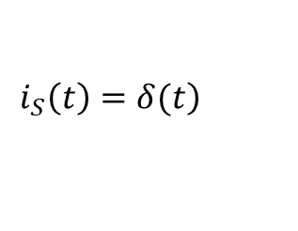
Impulse Response: Find Initial States by Matching the Singularity Equations (2)
§S1.3 Initial Conditions
Example: i_{S}(t)= δ(t) + initial rest
Particular response y_{p}(t)=0, since excitation=0 for t>0
Only homogeneous solution
Initial conditions:
i_{L}’’(t) must contain δ(t)/LC
→ i_{L}’(t) must contain a step with the magnitude equals to 1/LC → i_{L}’(0⁺)=i_{L}’(0⁻)+1/LC=1/LC
→ i_{L}’(0) is bounded → i_{L}(t) is continuous from t=0⁻ to t=0⁺ → i_{L} (0⁺)= i_{L} (0⁻)=0
$\frac{d^{2}i_{L}\left(t\right)}{dt^{2}}+\frac{1}{RC}\frac{di_{L}\left(t\right)}{dt}+\frac{1}{LC}i_{L}\left(t\right)=\frac{1}{LC}i_{S}\left(t\right)$
$$\left.i_{S}\left(t\right)=δ(t\right)$$
Q1: Output independent of input?
Q2: Physical Meaning?
A: Do not consider physical meaning here

Slide 23
Linear Constant-Coefficient Difference Equation
§2.4 Differential and Difference Equations
Nth-order
y[n]=y_{p}[n]+y_{h}[n]
y_{p}[n] particular solution, y_{h}[n] homogeneous solution
How to find y_{h}[n]
Solve the characteristic equation:
If no multiple roots,
If multiple roots exist, the corresponding part in y_{h}[n]
Eg. 2.15

Slide 24
Summary
S1. Time-Domain Response
The presented content in this document only focuses on t > 0⁺. It does not effectively give a comprehensive solution for -∞ <t < ∞
Natural response + Forced response
Natural response: homogeneous
Forced response: particular
Zero-input response + Zero-state response
Zero-input response: homogeneous
Zero-state response: homogeneous + particular

