Slide 1
Quick Report on 04/06/2018

Slide 2
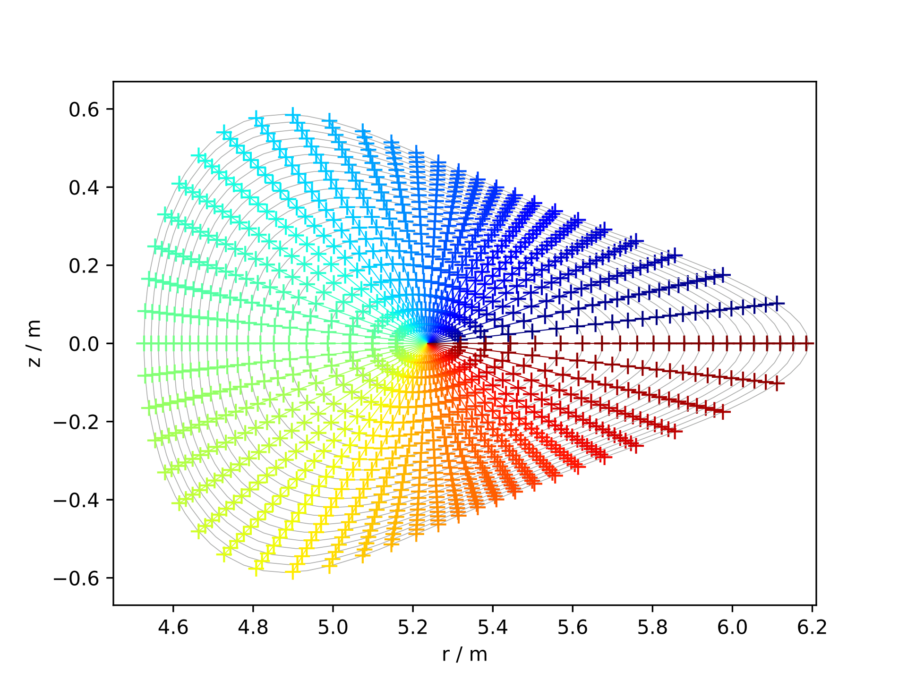
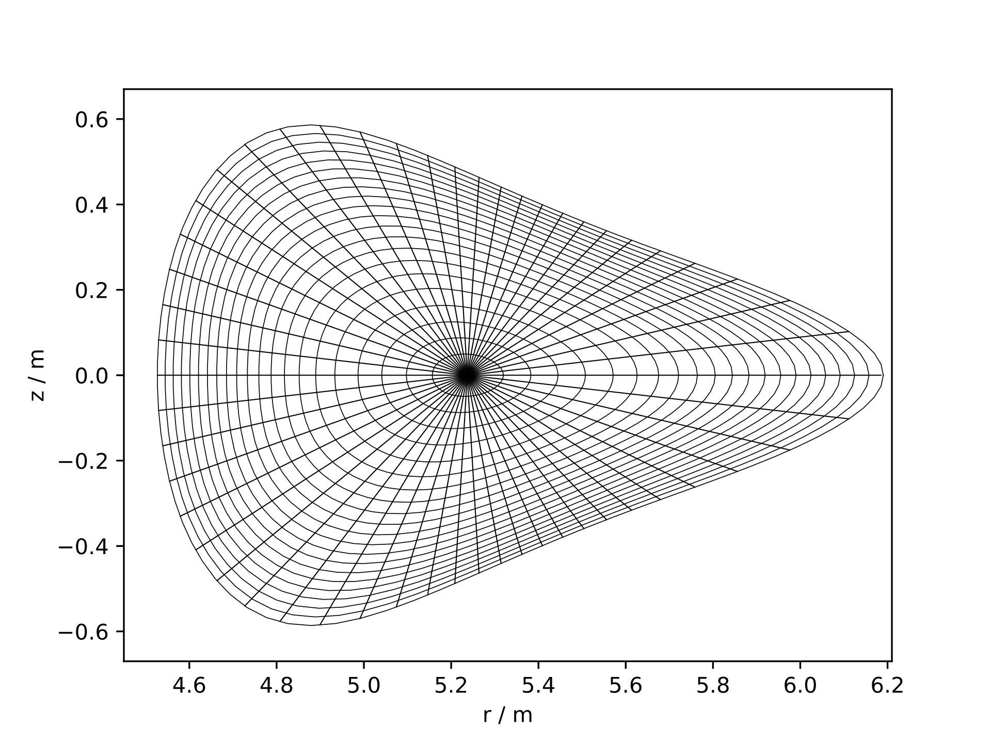
Mesh from fluxsurfaces (EIM/EJM)

Slide 3
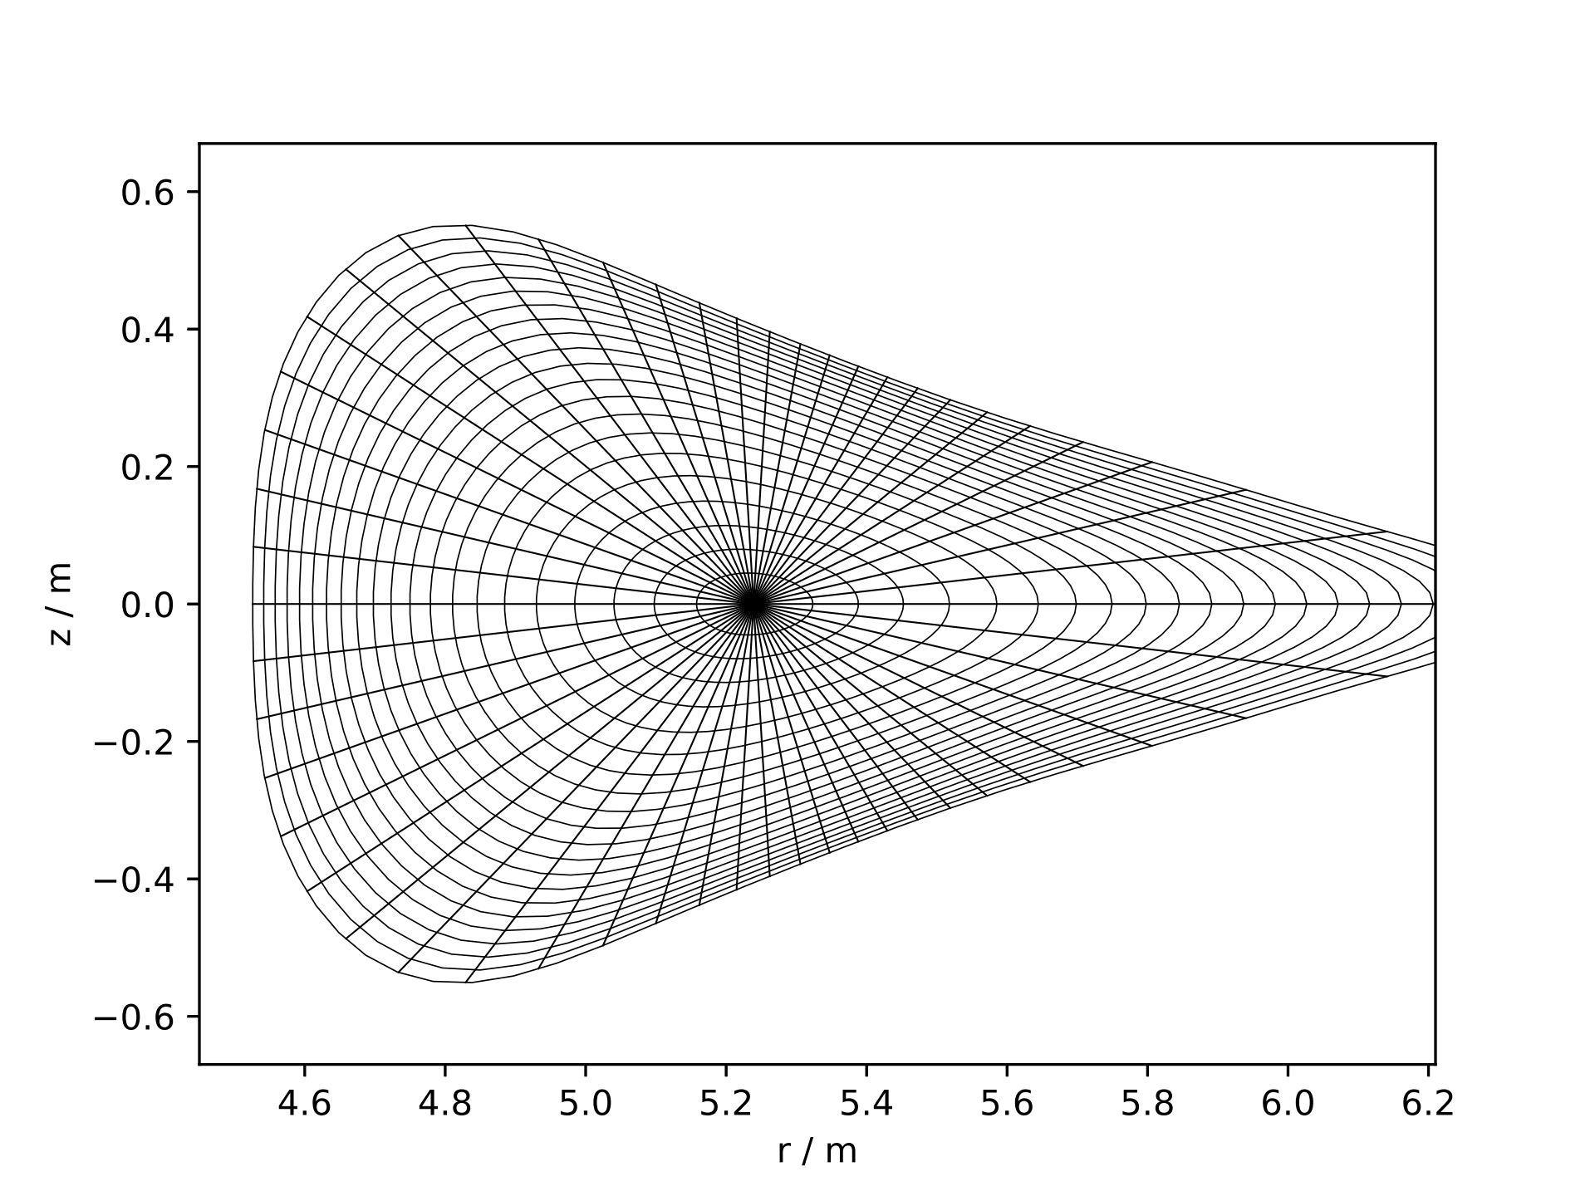
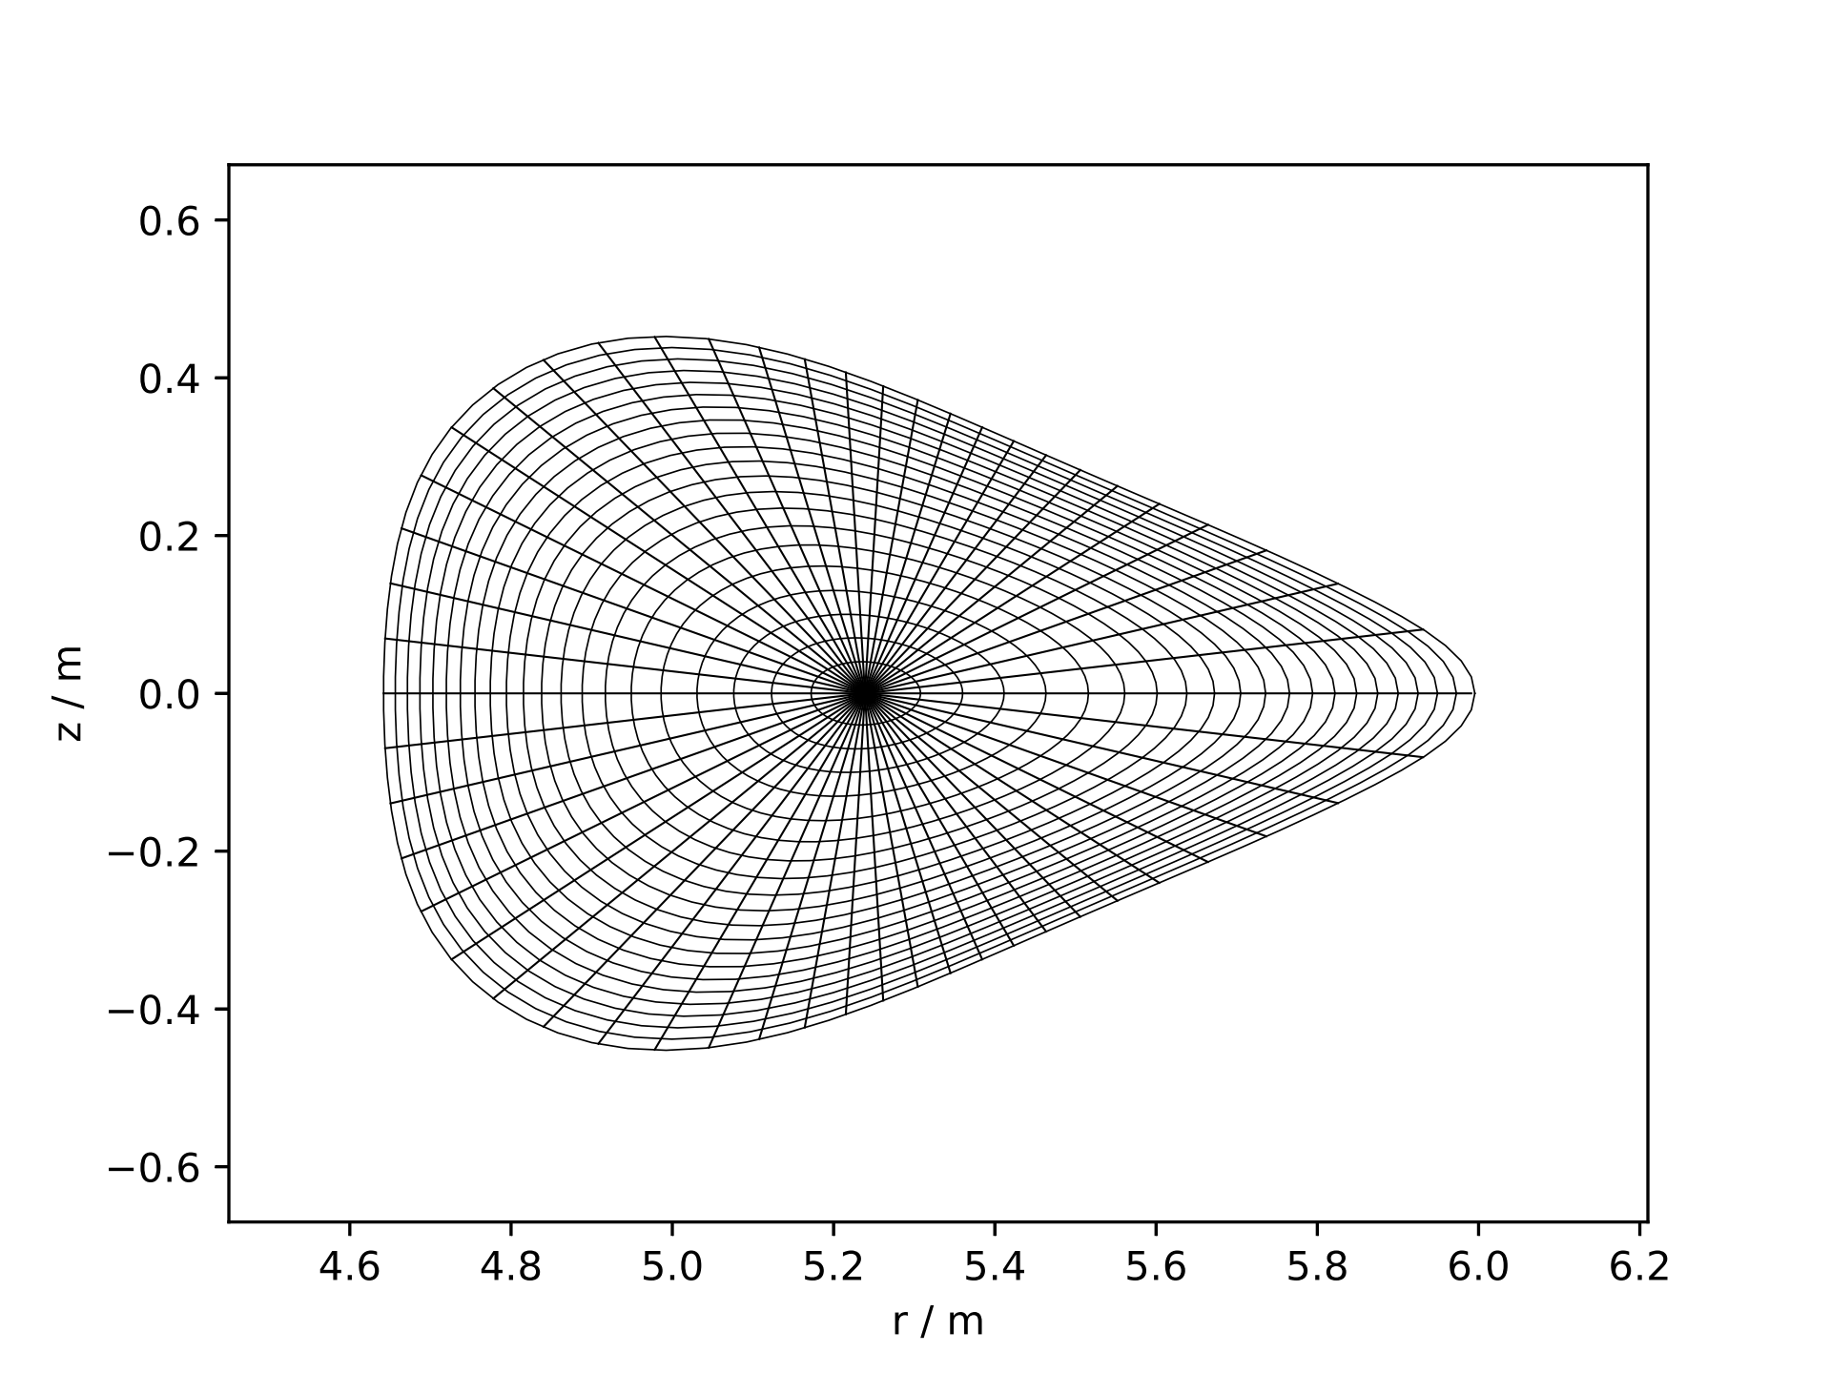
Mesh from fluxsurfaces for FTM/KJM

