Slide 1
Near Real Time Feedback on Plasma Radiation at W7-X
P. Hacker

Slide 2
Background & Motivation
Plasma radiation
Data acquisition & calibrations
FIFO multi/single LOS feedback
Plasma feedback
Fast valve of thermal helium beam
We try to use the Bolometer to control the plasma based off of information on the radiation distribution:
adjust heat loads, investigate radiation regimes, maybe improved detachment
investigate radiation, i.e. importance of intrinsic/extrinsic impurities and local + global power balance

Slide 3
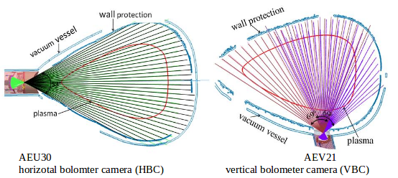
Feedback Evaluation
limited set of lines of sight possible for fast feedback calculations (e.g. 3-5 channels)
Multi-camera system with 113 channels combined: 32 horizontal, 2x24 vertical

Slide 4
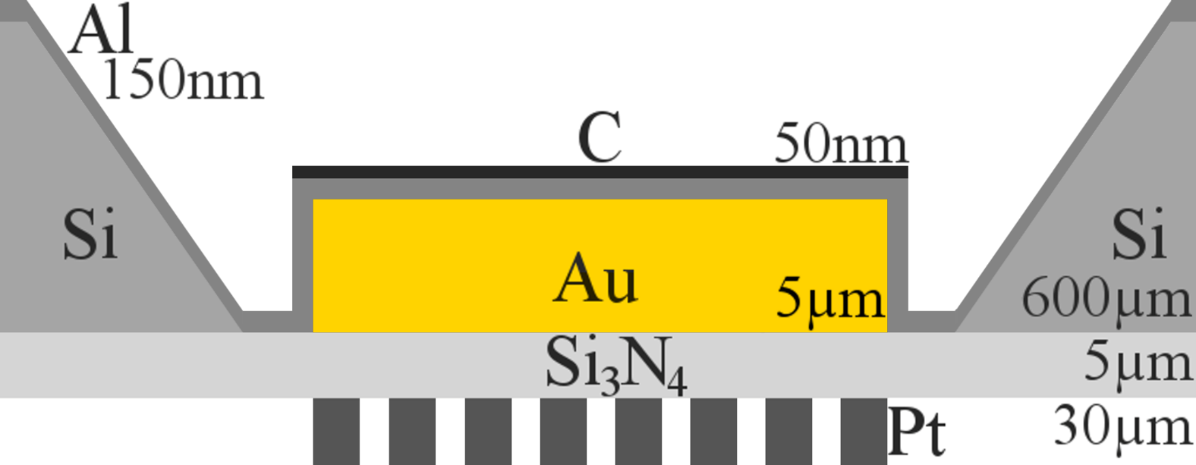
Detector
spatial resolution of 5cm & temporal resolution of 0.8ms to 6.4ms, spectral range between 600nm to 0.2nm
detectors of gold-foil absorbers with carbon coating on silicon-nitrate substrate and gold meander for 200nW resolution

Slide 5

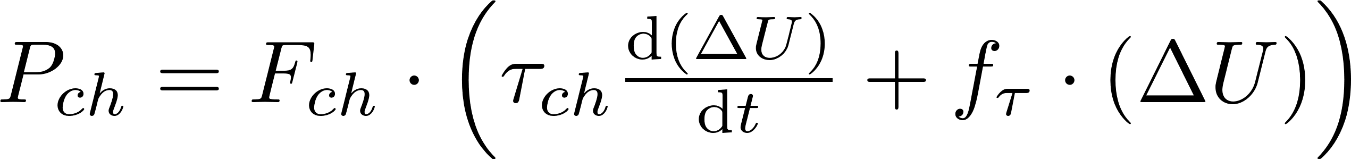
Equations
Plasma Radiation:
Bolometer Power:
Feedback Prediction:

Slide 6
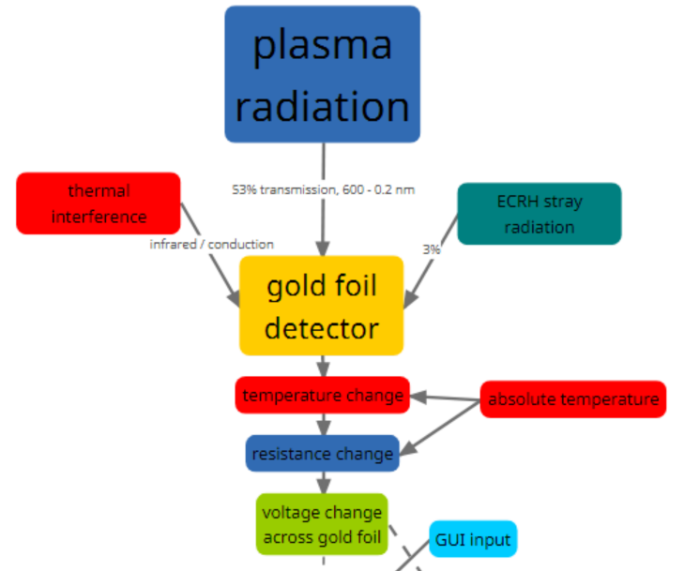
Work-/Dataflow: DAQ

Slide 7
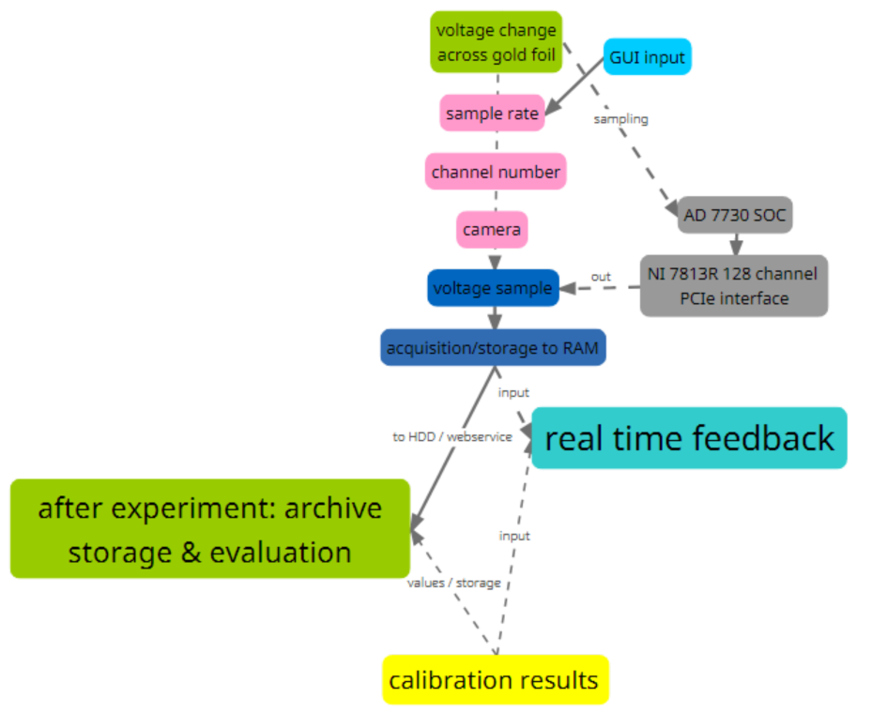
Work-/Dataflow: DAQ

Slide 8
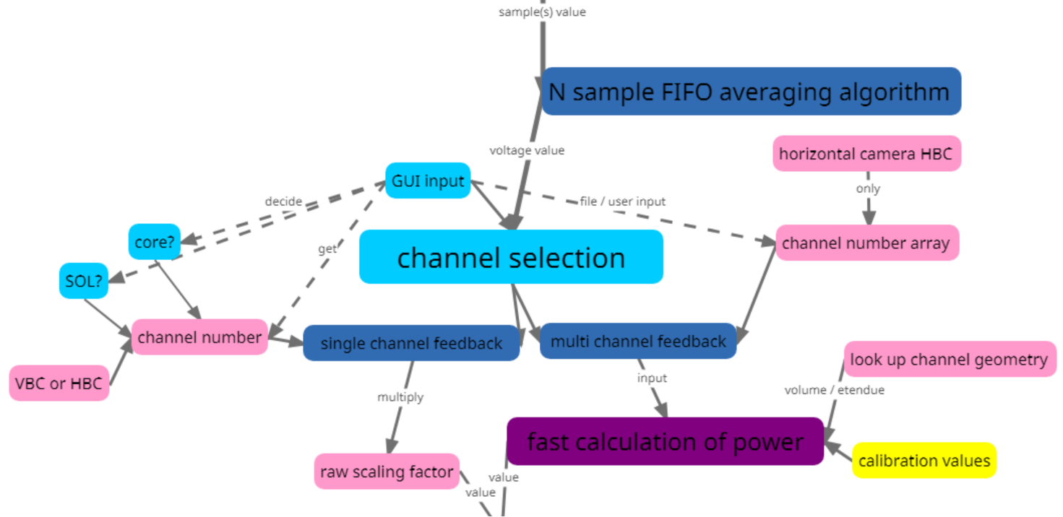
Work-/Dataflow: Feedback

Slide 9
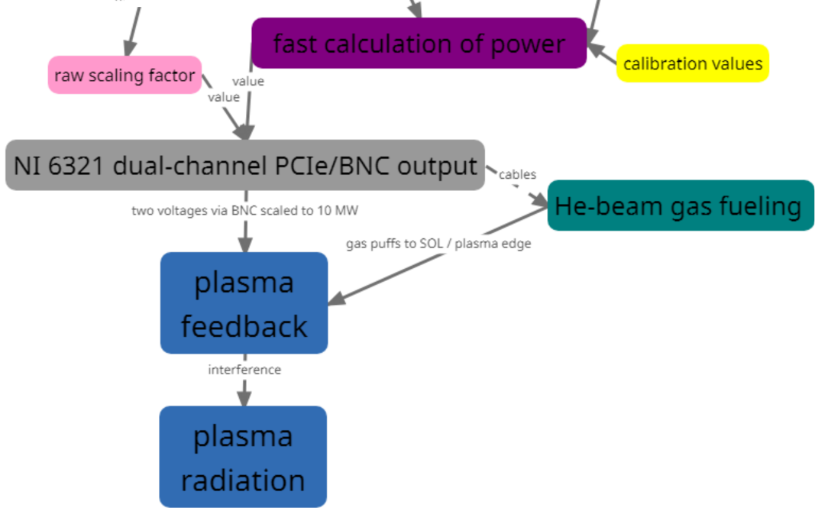
Work-/Dataflow: Feedback

Slide 10
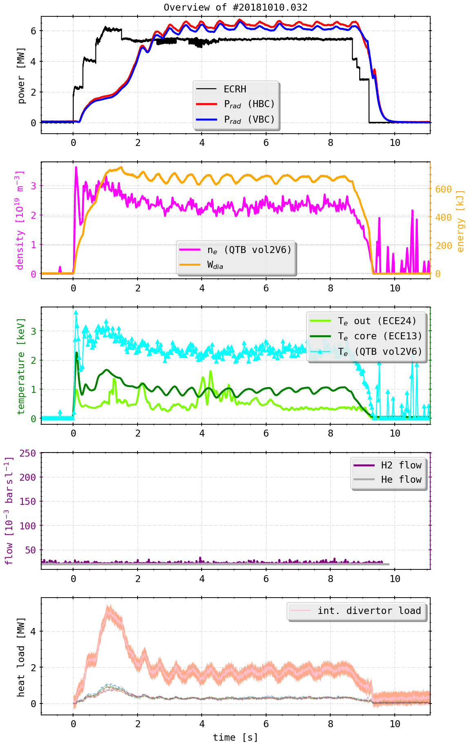
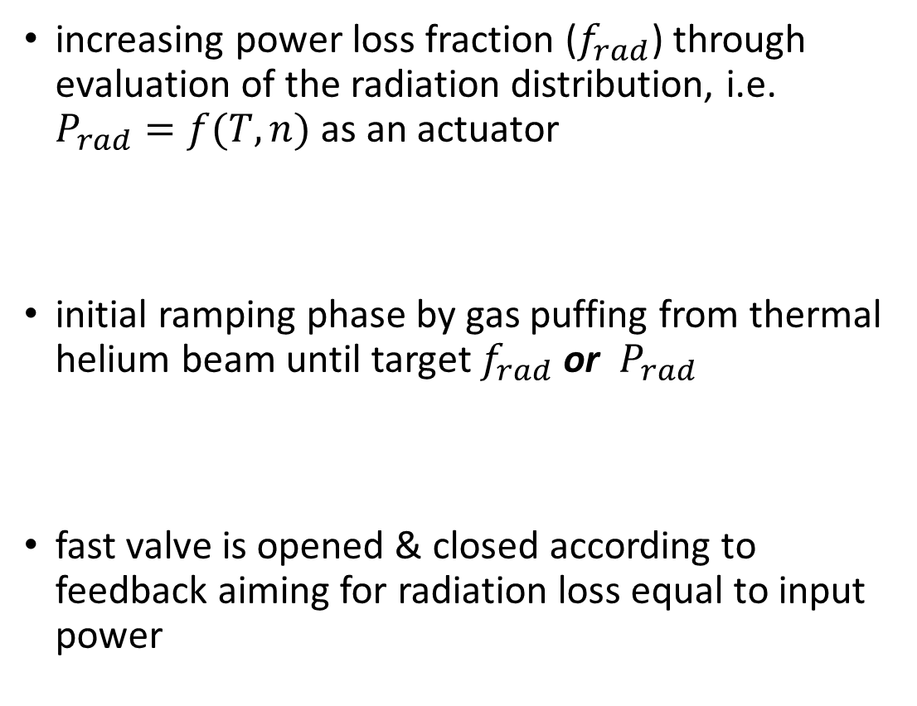
Example Experiment
increasing power loss fraction ($f_{rad}$) through evaluation of the radiation distribution, i.e. $P_{rad}=f(T,n)$ as an actuator
initial ramping phase by gas puffing from thermal helium beam until target $f_{rad}$ or $P_{rad}$
fast valve is opened & closed according to feedback aiming for radiation loss equal to input power

Slide 12
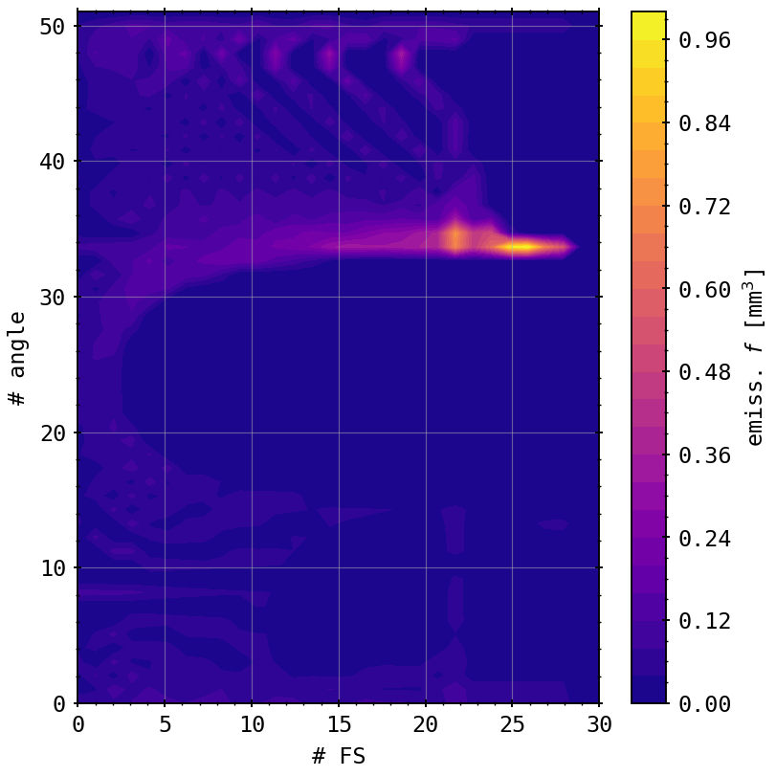
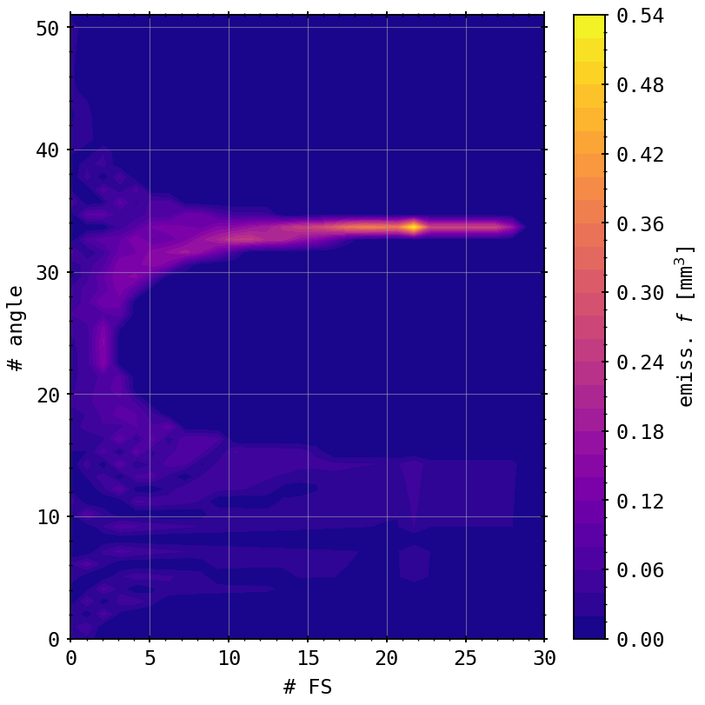
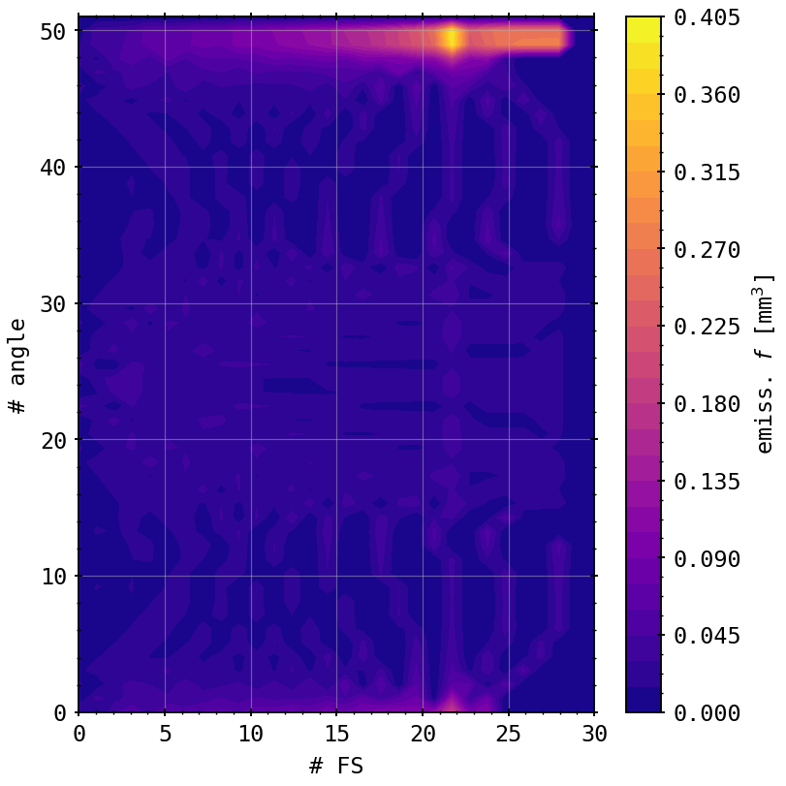
Appendix: Emissivity Factors
VBCr
VBCl
HBCm

