Slide 1
Report 05/24/2020
P. Hacker

Slide 2
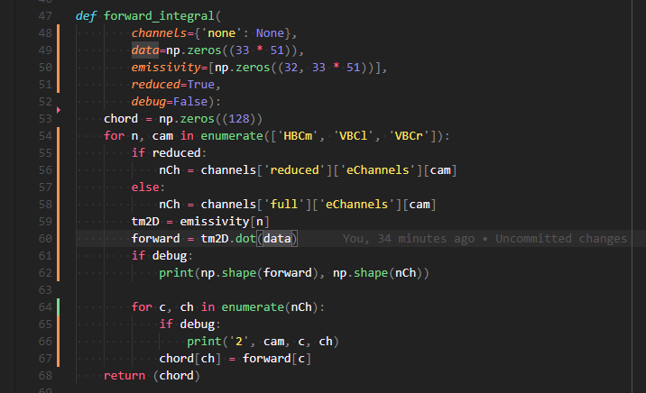
Improvement on Reconstruction and Chordal Profiles
forward and backward calculation now using the emissivity matrices themselves, instead of channel geometries individually, hence calculating directly to and from the tomogram/phantom
comparing to input chordal profiles rather than archived ones
also found error in channel selection and mapping that cause restrictions to zero where no data has been provided or excluded
deleted broken and unusable channels from script

Slide 3
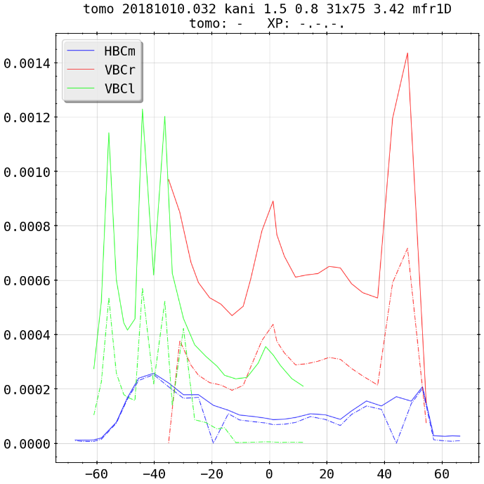
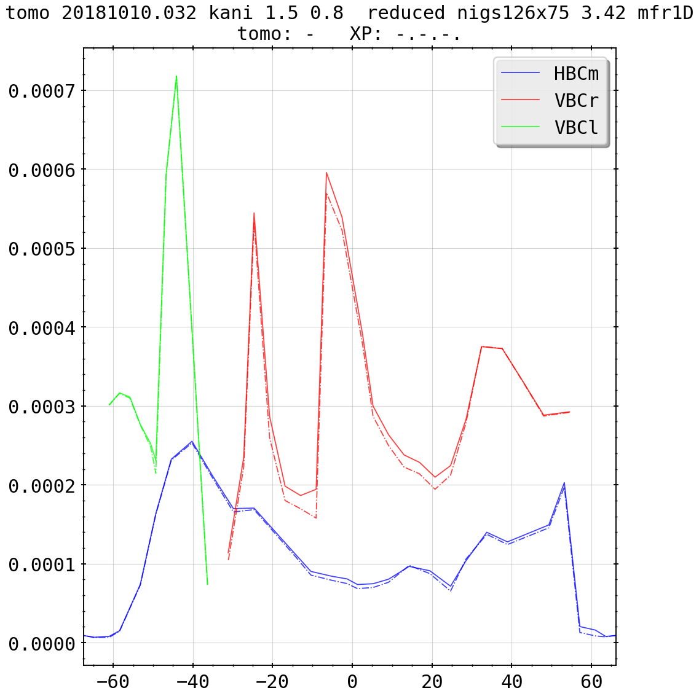
Improvement on Reconstruction and Chordal Profiles
(previously)
(current)

Slide 4
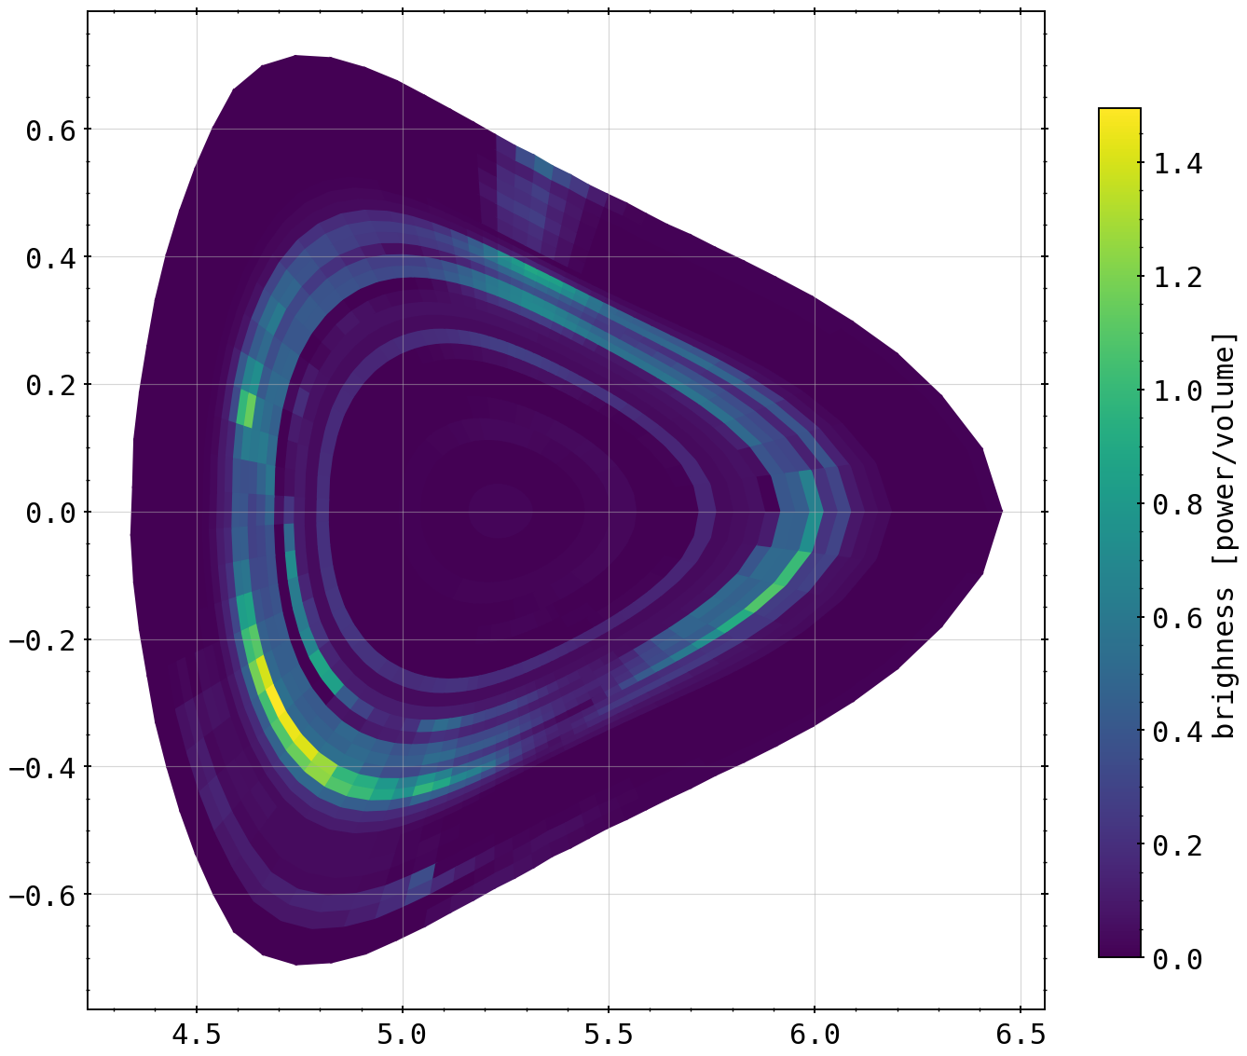
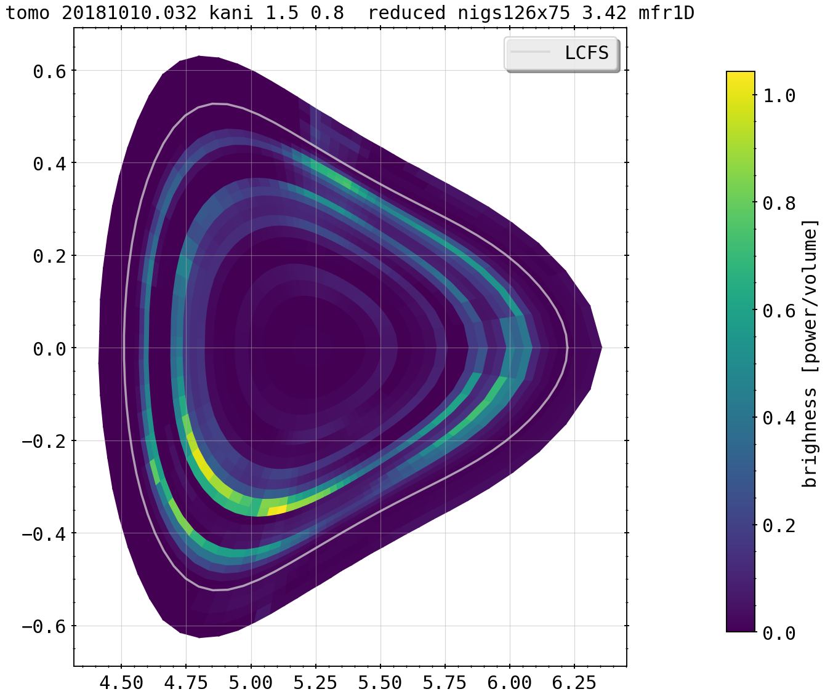
Improvement on Reconstruction and Chordal Profiles
(previously)
29x75
(current)
26x75

Slide 5
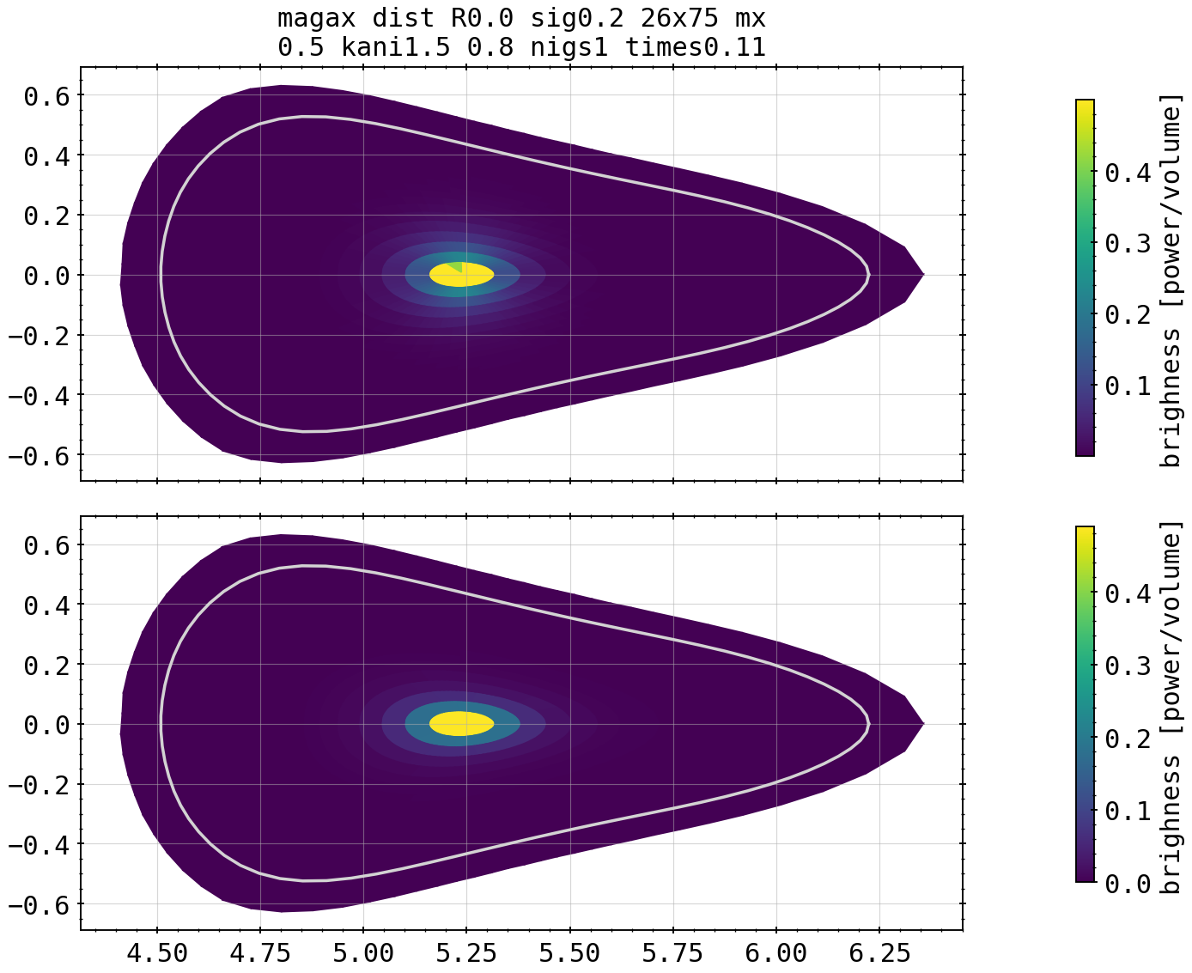
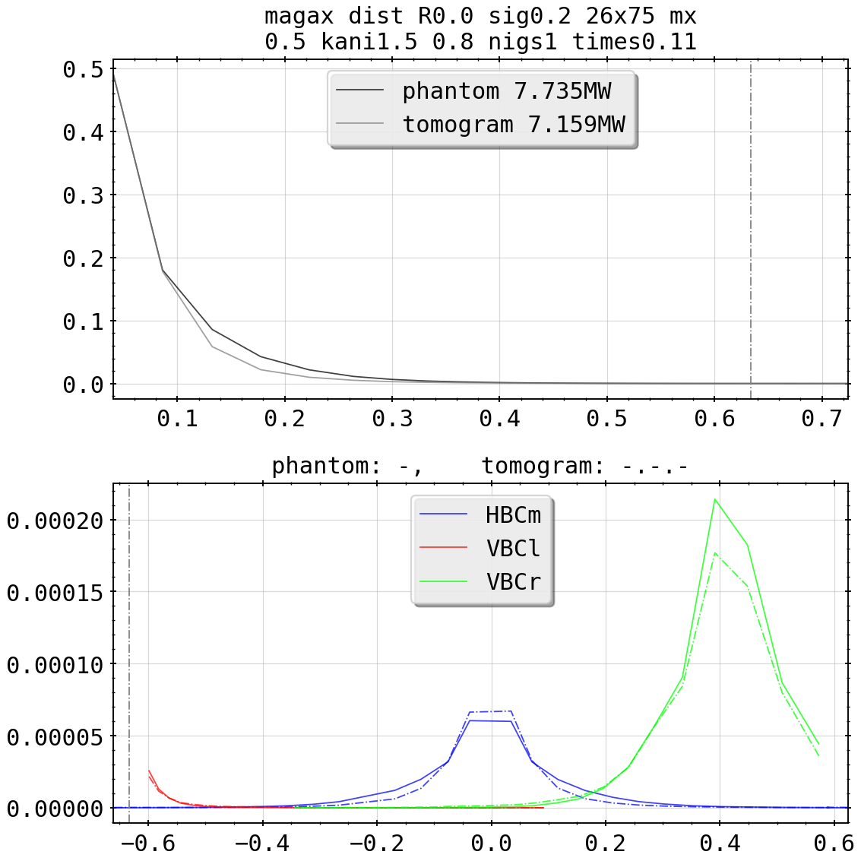
New Phantom Tests: Hot-Spot

Slide 6
Repositories
personal routines and procedures specifically for calculation in
https://git.ipp-hgw.mpg.de/pih/QSB_Bolometry/-/tree/master/libinversion/libcalc
private and/or locked git in
https://git.ipp-hgw.mpg.de/pih/bolometer_mfr
containing the MFR routines of D.Zhang, H.Thomsen

Slide 7
Repositories
now reading and writing the radial profile of anisotropy factors, investigation to be done
first tests of X² for 2D profile done, needs better math (divergent if one profile zero in cell, normalization?); implementing D.Zhang’s method?
still need to look at actual MFR routine for k_ani exceptions and (if) possible cartesian test

