Slide 1
Report 11/05/2020
P. Hacker

Slide 2
QSB LabVIEW Routine Review (see CHANGELOG.md)
PROS
added EPOCH timer to UI, timing mode that calculates EPOCH time at start
added T1-T4 timing input to UI, added T0-T1 timer to UI (should at least be 30s)
fixed wrong time base in calibration procedure
DAC range setting file load or input via the UI
selected channel feedback output, though with delay >10ms (single/multi channel)
performance for 1-10 selected channels in feedback is fine
overhaul of calibration parameter routines since detector response is more complex than a single peak and exponential decay
full P_rad routine added for after the data acquisition to access power loss quickly (same as IDL/python)
filter register settings fixed to match sample timings in milliseconds
improved/implemented local-storage-mode-only, so no crash at upload
upload of error corrected voltage input to archive as well (same as IDL/Python)

Slide 3
QSB LabVIEW Routine Review (see CHANGELOG.md)
CONS
DAQ routine now more prone to crashing, hiccups and slow processing causing sample timing errors
ADC bit settings not fully understood, potentially not intended setting here (wrong documentation?)
crashing with bad device status at memory overflow or uncompleted DAQ/upload, incosistent to recover
hardware needs warm-up time of ~30min (before?)
some small fixes needed to improve quality-of-life experience during experimental campaign (dials not working as intended, …)

Slide 4
Tomogram Statistics
collected MFR 2D inversion results from both phantom benchmarks and experimental data, including multiple experiments and parameter sets per target
experimental data inversion ‘limited’ to comparisons of power values from either chordal (linear) profile or 2D profile of emissivity matrices
phantom reconstruction results contain also radial profile information and error value characteristics (X², pearson coefficient, 2D deviation mean)

Slide 5
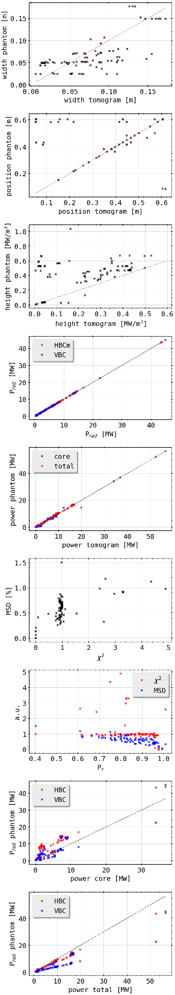
Tomogram Statistics: Phantom Reconstructions
radial profile positioning good, though width and height have small to large deviations
peak height comparison exhibits offset on phantom side: widened radial shape and longer decays (width)
P_rad and total/core power values match very well for phantom reconstructions
a slightly larger range of MSD values yields a ‘good’ X² of ~1.0
there seems to be an offset of MSD about 0.25% (minimum error between source and target to be expected?)

Slide 6
Tomogram Statistics: Phantom Reconstructions
MSD approaches 0.0 if pearson coefficient reaches 1.0, as expected, while X² is around 1.0
P_rad over core/total 2D integrated power yield constant offsets and slopes
core power matches P_rad vor VBC(?) though is lower for HBCm as expected
total power is larger for both P_rad estimates, though with different proportionalities

Slide 7
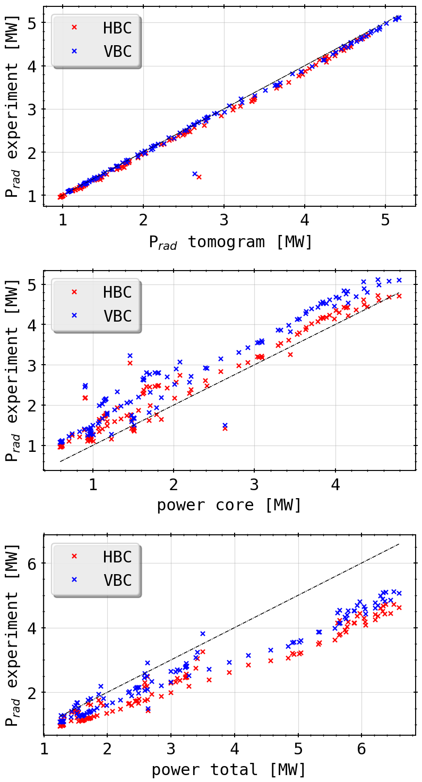
Tomogram Statistics: Experiment Reconstructions
same experience with P_rad(s) and total power comparison
now absolute offset in core power comparison is closely the same for both camera arrays
extra slope in P_rad vs. total power by cutting negative results from reconstruction when limiting to only physically meaningful numbers (P/m³>0)
increase of their impact as expected with overall higher radiation level to counteract errors in chordal profile
SUGGESTION

Slide 8
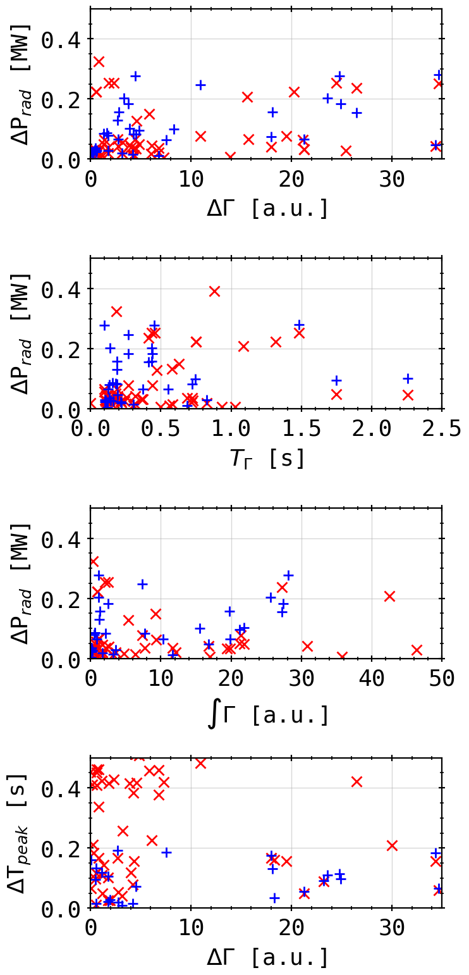
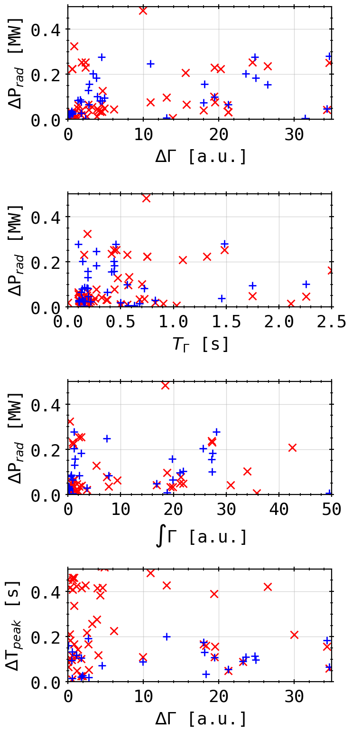
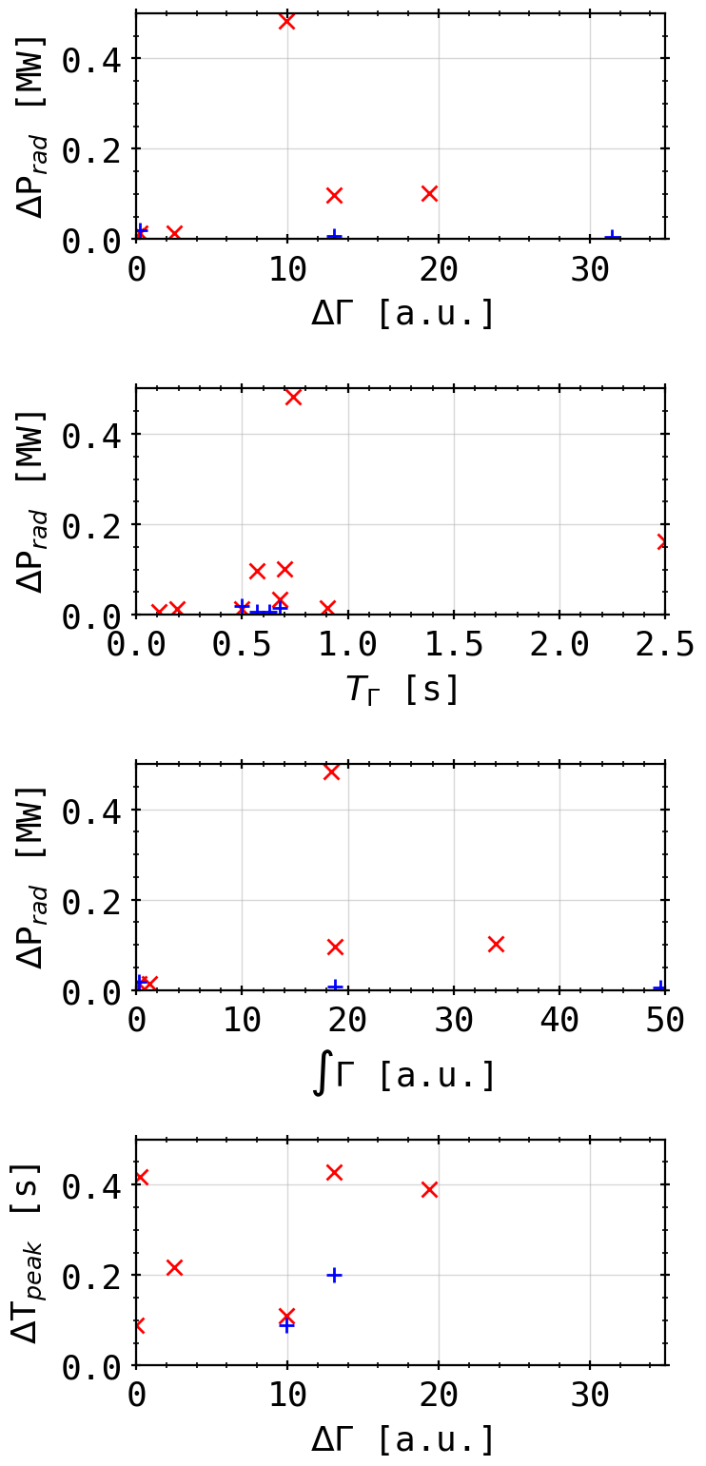
Peak Statistic: Methane Session with QSQ
HBC
VBC
H2
He
CH4
100 ms

Slide 9
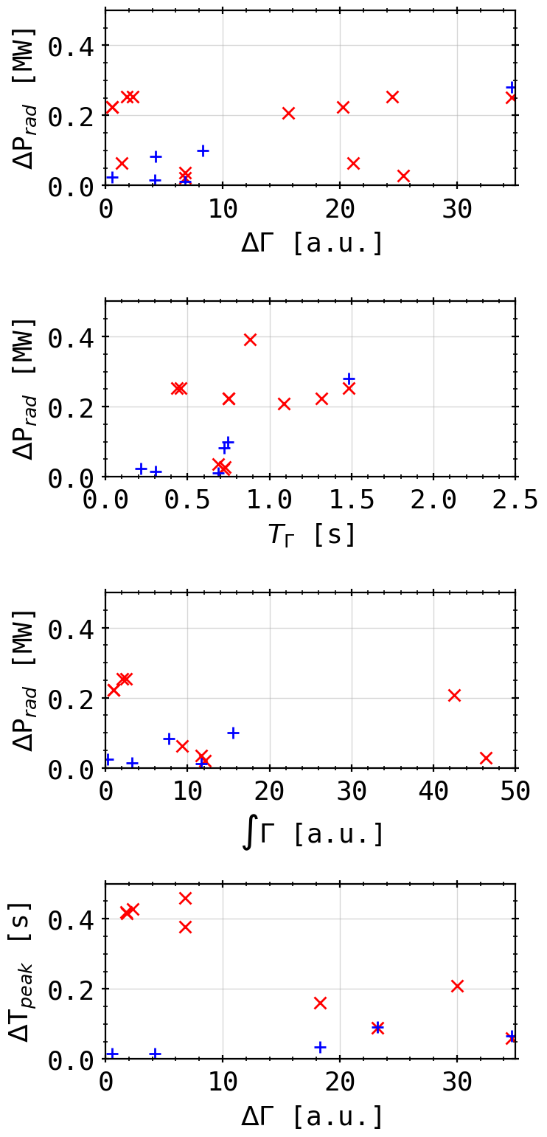
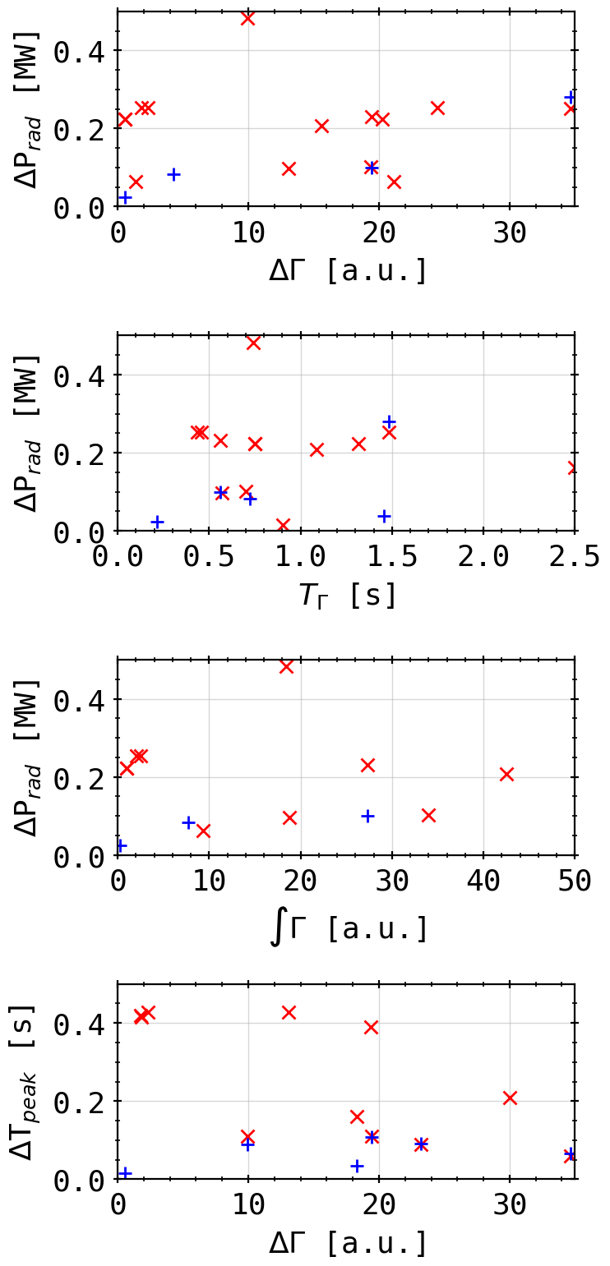
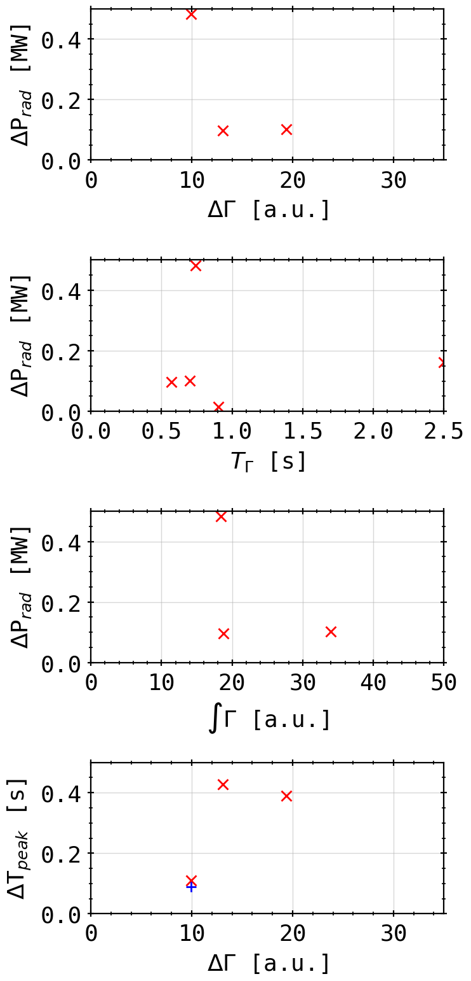
Peak Statistic: Methane Session with QSQ
HBC
VBC
H2
He
CH4
200 ms

Slide 10
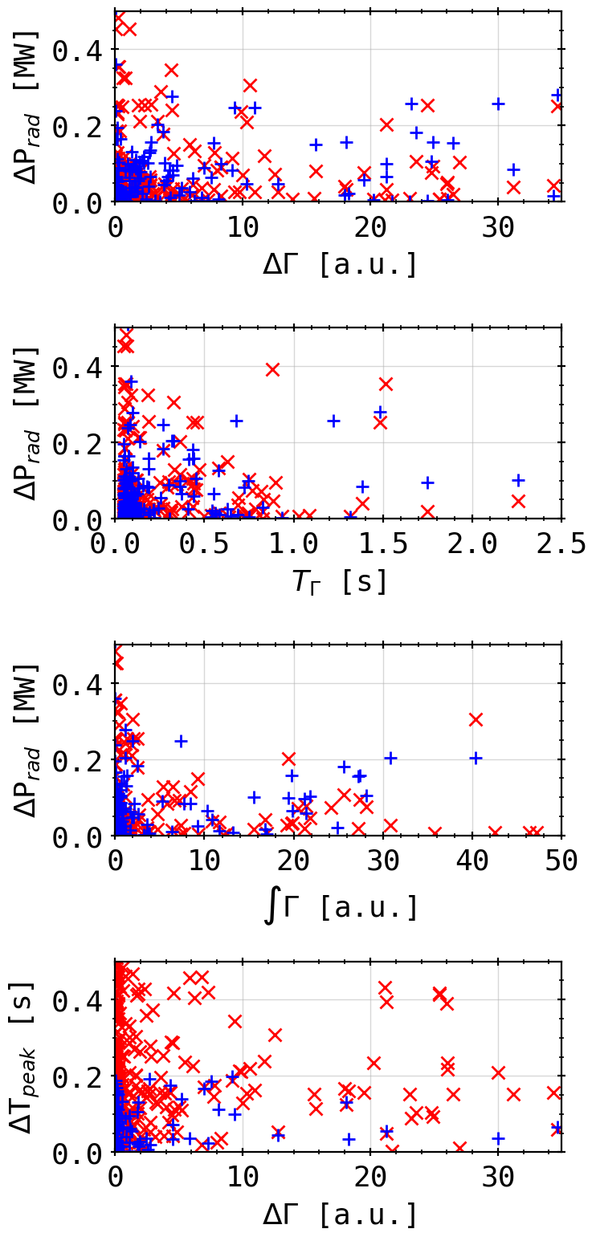
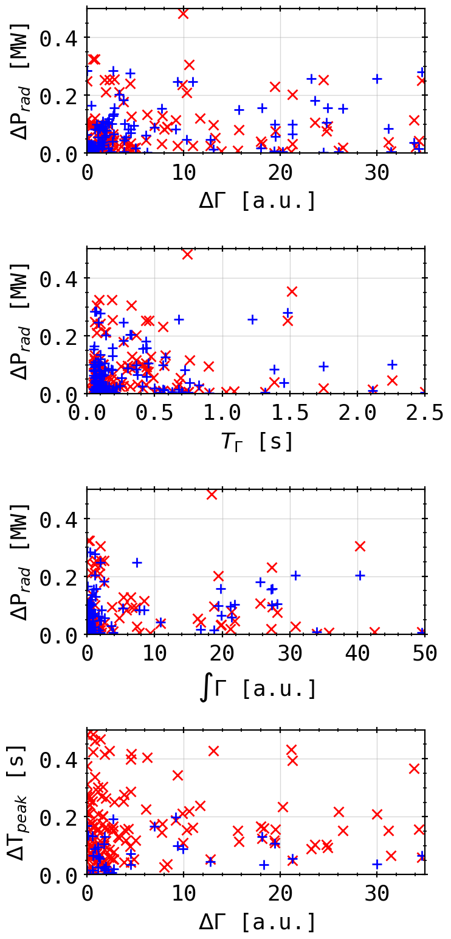
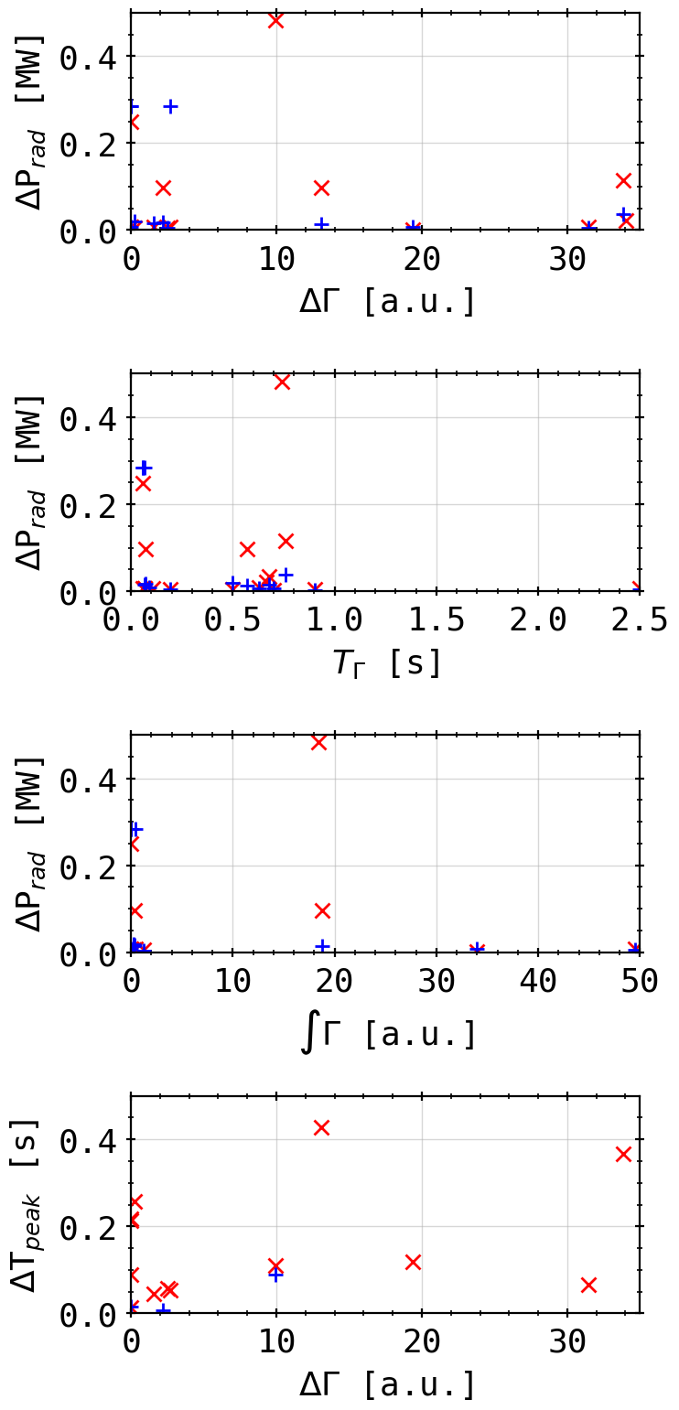
Peak Statistic: Methane Session with QSQ
HBC
VBC
H2
He
CH4
50 ms

Slide 11

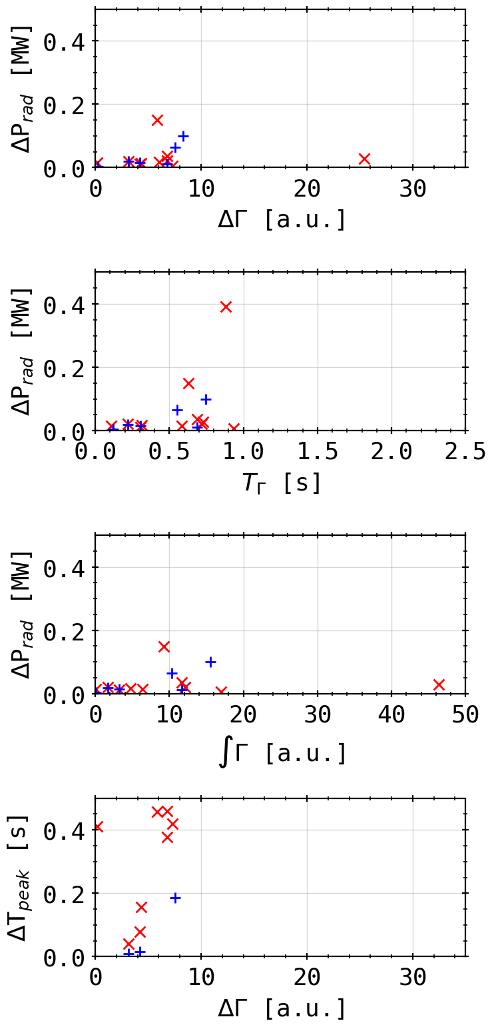
Peak Statistic: Methane Session with QSQ
HBC
VBC
Main Valve
QSQ
100 ms

