Slide 1
Report 11/19/2020
P. Hacker

Slide 2
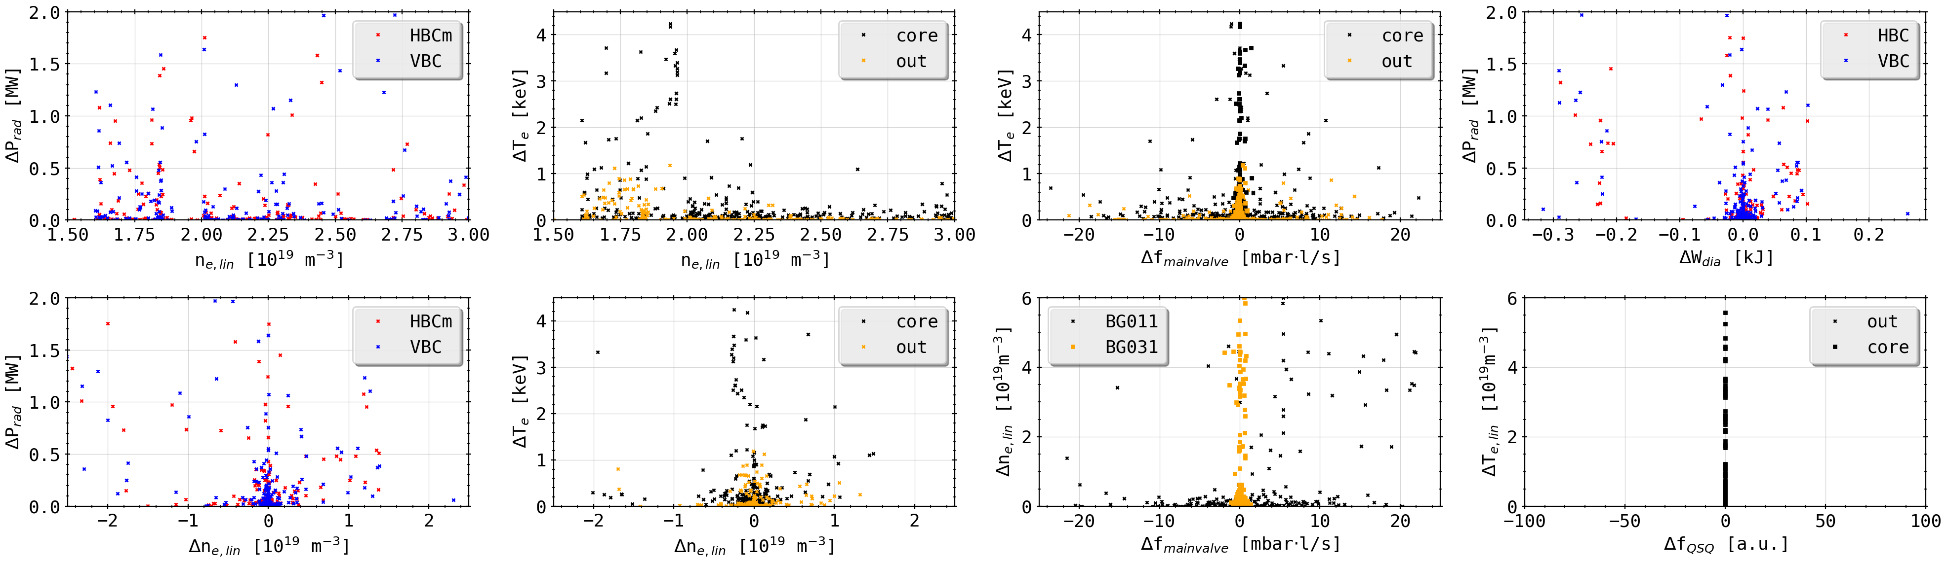
Peak Database: Plasma Parameters
looking up general plasma parameters, where possible, at time points of peak detection from previous database display
pre-filtered misleading results (spiking, digital glitching or missing data)
no obvious grouping of radiation increase over plasma density, i.e. continuous spectrum of set density for change in power loss
assuming at given density, larger range of radiation increase possible

Slide 3
Peak Database: Plasma Parameters
increase/decrease in plasma temperature over plasma density
similarly no grouping of parameters obvious
decreasing temperature delta at increasing density; relative puff to amount of plasma may lead to less of an impact on store energy?

Slide 4
Peak Database: Plasma Parameters
change of density and temperature in relation to change in gas flow from main gas valves (any gas)
larger decrease in temperature for core temperature (ECE) than outward
at flow change ~10 mbar l/s around 0.5 keV decrease in temperature to be expected consistently?
for larger flows from BG011 proportional response of density, though not BG031?

Slide 5
Peak Database: Plasma Parameters
change of radiation power loss in relation to QSQ feedback gas valve signal and plasma stored energy
Look-up for QSQ values fails because metric appears only to know on or off, i.e. 1 or 0, hence parallel search at given time mostly returns none
no grouping or distribution of data points for stored plasma energy like temperature

Slide 6
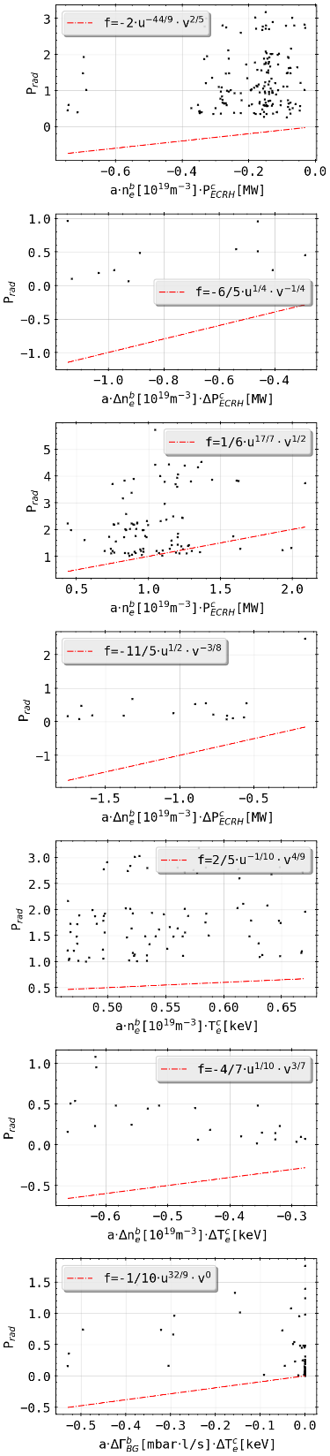
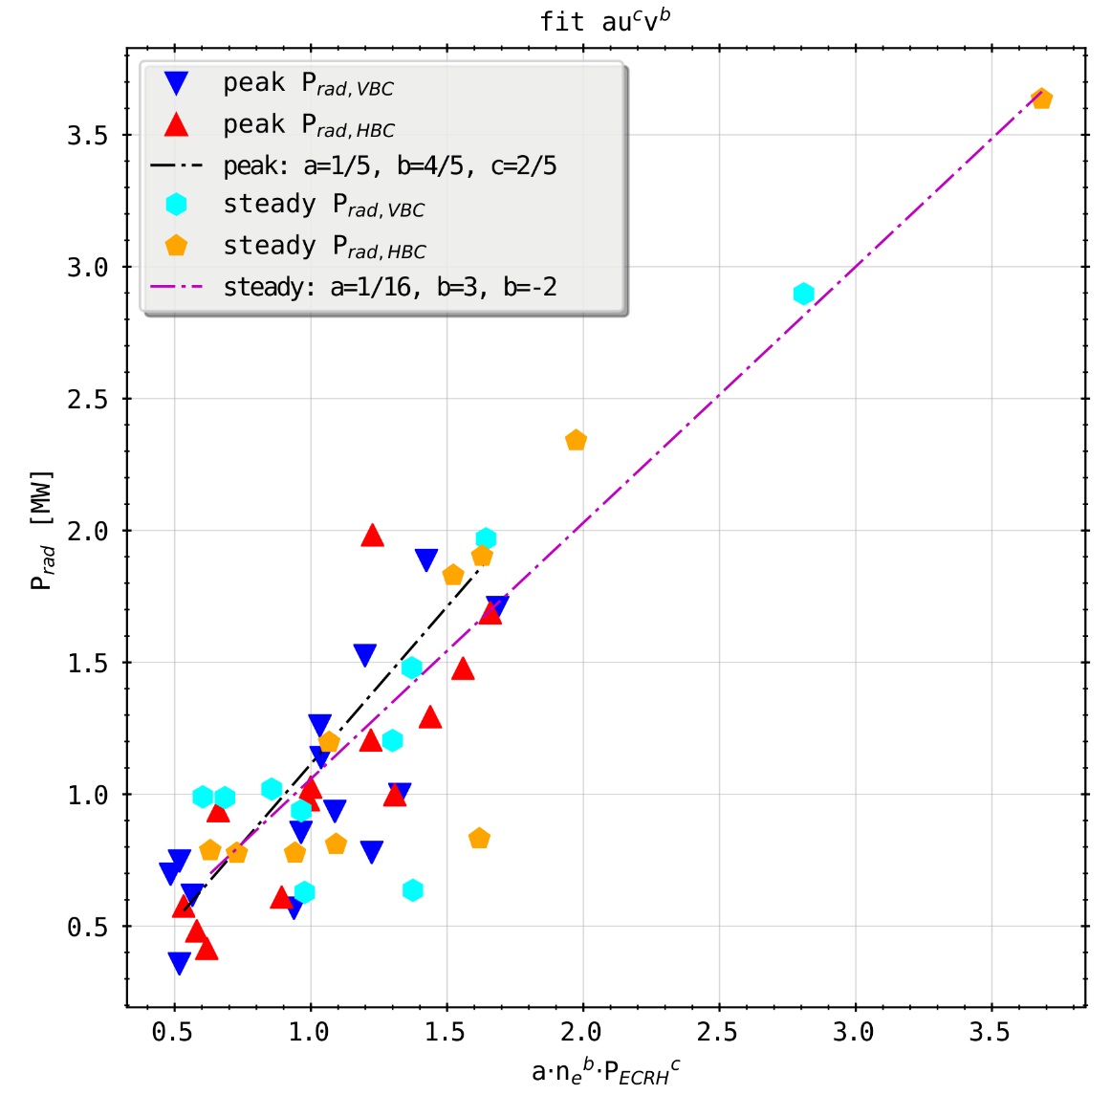
Peak Database: Plasma Parameters Fit
looking for applicable scaling/fit between found plasma parameters at gas puffs to potentially enhance feedback performance
see:

Slide 7
Peak Database: Plasma Parameters Fit
looking for applicable scaling/fit between found plasma parameters at gas puffs to potentially enhance feedback performance
grouping of points for arbitrary fit, no obvious relation without congruence
linear regression overall with poor results and ~100% error bar for return parameters

Slide 8
Peak Database: Plasma Parameters Fit
looking for applicable scaling/fit between found plasma parameters at gas puffs to potentially enhance feedback performance
grouping of points for arbitrary fit, no obvious relation without congruence
linear regression overall with poor results and ~100% error bar for return parameters

Slide 9
Peak Database: Plasma Parameters Fit
looking for applicable scaling/fit between found plasma parameters at gas puffs to potentially enhance feedback performance
grouping of points for arbitrary fit, no obvious relation without congruence
linear regression overall with poor results and ~100% error bar for return parameters

