Slide 1

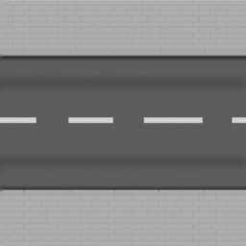
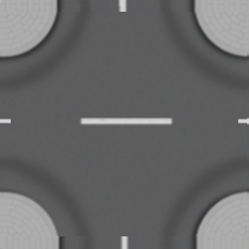
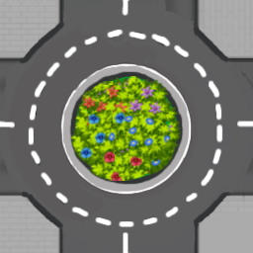
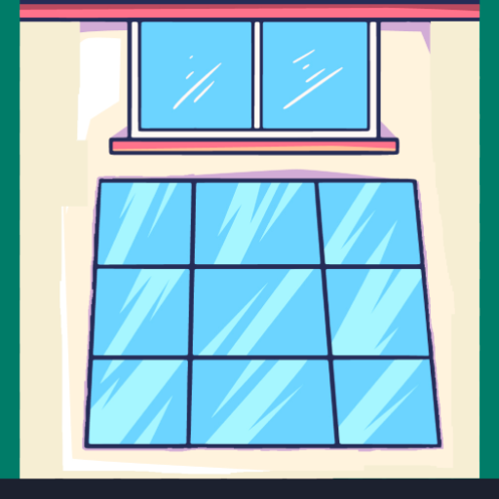

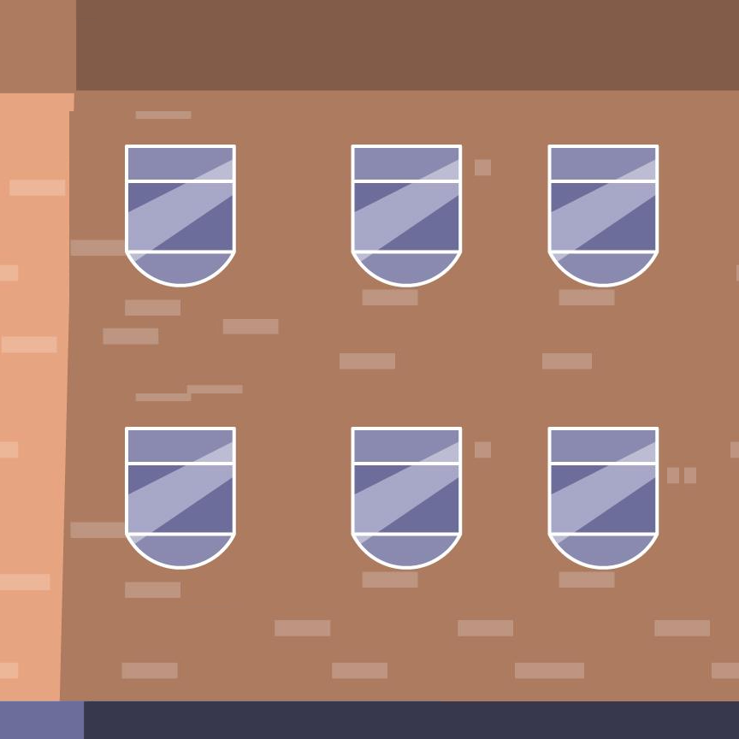
CitySmart
Smart city traffic simulation (C++ • OOP • raylib)
Grass
Road
Intersection
Roundabout
Hospital
Police
Fire station
What the project demonstrates
A 3D city grid (10×10 tiles) with road network + facilities (hospital, police, etc.)
Vehicles follow computed waypoint paths with lane offsets and smooth motion
Traffic lights cycle (Green → Yellow → Red) and can prioritize emergency vehicles
Traffic management: yielding, red-light stopping, following distance, deadlock recovery
CitySmart • Full project overview
Notes:
[Sources]
- raylib (graphics + input library): https://www.raylib.com/
[/Sources]

Slide 2
How to use the simulation (demo controls)
Quick keys + what to look for
Controls
Suggested demo scenario
Start the simulation (SPACE).
Click near a facility to generate a path preview.
Press G to dispatch the ambulance.
Observe: cars yield into their lane shoulder, traffic lights give green, and the ambulance returns to the hospital after reaching the incident.
Camera
A / D: rotate camera
W / S: zoom in/out
Mission
Left click: choose destination (preview path)
G: start mission (ambulance follows path)
SPACE: pause / resume the simulation
Preview
Dispatch
Yield +
lights
Return
CitySmart • C++ / raylib
Notes:
[Sources]
- raylib key input and camera utilities are provided by raylib: https://www.raylib.com/
[/Sources]

Slide 3
Project architecture
Who talks to who (high-level modules)
CityMap
Simulation
Tiles + facilities
Pathfinding
Driveable checks
main.cpp
(raylib loop)
Orchestrates gameplay logic:
input → routing → rules → updates
Creates CityMap + Simulation
Runs Update() + Draw()
Vehicles
Design idea
Vehicle (base)
EmergencyVehicle
Simulation is the “controller”: it coordinates rules, mission state, and updates each frame.
CityMap provides the world representation + shortest-path routing on the road graph.
Vehicles encapsulate motion (waypoints + lane offsets) and visuals.
TrafficLight encapsulates intersection timing + stop decisions (and emergency pre-emption).
TrafficLight
Light cycle
Stop logic
Emergency priority
CitySmart • C++ / raylib

Slide 4
CityMap module
World representation: tiles, facilities, textures
Data structures
Tile & facility examples
tileMap[10][10]: road/grass/intersection/roundabout tile types
facilityMap[10][10]: facilities placed on tiles (hospital, police, fire station, ...)
buildings: list of building meshes with position + facing directions
Textures: loaded once and reused for drawing tiles + buildings
ROAD
INTERSECTION
ROUNDABOUT
Key responsibilities
GRASS
HOSPITAL
POLICE
Convert between world coordinates and tile coordinates (worldToTile, tileCenter)
Decide whether a tile is driveable and clamp vehicles back to the road network
Compute fastest path on the road graph (findFastestPath)
FIRE
CitySmart • C++ / raylib

Slide 5
Routing & pathfinding
From click → waypoints (roads only)
findFastestPath() (CityMap)
Routing pipeline
Convert start/goal world positions to tile indices (worldToTile)
Run a shortest-path search on the 10×10 grid using a priority queue
Neighbors are the 4-connected tiles (up/down/left/right)
Only “drivable” tiles are expanded (roads/intersections/roundabouts)
Reconstruct path with prev[] and return as world-space waypoints (tileCenter)
Mouse click
(world pos)
worldToTile()
Shortest path
(priority queue)
Why this approach works well here
Small graph (100 nodes) → path is computed instantly during interaction
Implementation is extendable (tile weights / speed limits / emergency-only lanes)
Waypoints
(std::vector<Vector3>)
CitySmart • C++ / raylib
Notes:
[Sources]
- Dijkstra’s algorithm (reference): https://en.wikipedia.org/wiki/Dijkstra%27s_algorithm
[/Sources]

Slide 6
Vehicle (base class)
Path following + lane offsets + smooth motion
Core idea
Lane-offset concept
A vehicle stores a list of waypoints (path) and a current waypoint index
Each frame: compute a drive target (waypoint + right-vector × laneOffset)
Rotate toward the target, then move by speed × dt (frame-rate independent)
When close to a waypoint, advance to the next (and loop if enabled)
laneOffset
shift to shoulder
(when yielding)
Traffic-friendly controls inside Vehicle
setSpeedScale(scale, hold): smoothly slow down / stop temporarily
yieldTo(): shift laterally within lane (shoulder) without leaving the road
Lane offset smoothing continues even when forward motion is disabled
shoulder
centerline
CitySmart • C++ / raylib

Slide 7
EmergencyVehicle
Inheritance + siren behavior + mission routing
What makes it different from a normal Vehicle
Mission state machine
Inherits from Vehicle: reuses path following, lane behavior, drawing
Adds a siren mode: speed = baseSpeed × multiplier when active
Draws a flashing cube on the roof while siren is active
Can be dispatched to an incident: assignIncident(map, targetPos) sets a new path
G pressed
Idle
ToIncident
arrive at incident
Mission logic (implemented in Simulation)
arrive at hospital
ToHospital
State machine: Idle → ToIncident → ToHospital → Idle
After reaching the incident destination, a new path to the hospital is computed
Siren turns off after returning to the hospital (mission complete)
CitySmart • C++ / raylib

Slide 8
TrafficLight
Intersection timing + stop decision + emergency green
State machine
Visual cycle
LightState cycles: Green → Yellow → Red → Green
Each light starts with a randomized timer and sometimes a randomized initial color
shouldStop(vehiclePos, vehicleForward): red + close + “in front of vehicle”
Green
Yellow
Red
Randomized start → lights are not perfectly synchronized
Emergency priority
Emergency pre-emption
If an emergency vehicle is approaching and the light is in front of it, the light is forced green for a short time
This reduces intersection delays and creates a visible “priority corridor”
forceGreen(≈1.2s) when the ambulance is close and the light is ahead
reduces stop-and-go near intersections
CitySmart • C++ / raylib

Slide 9
Traffic management (Simulation rules)
Yielding, red lights, following distance, safety
Rules applied each frame (normal cars)
How “ahead” checks work
Yield to ambulance: shift laneOffset toward shoulder (and stop if fully yielded)
Intersection safety: stop cars near an intersection when ambulance is crossing
Red light stopping: if a red light is ahead and within stop distance → stop
Following distance: stop if another car is directly ahead in the same lane
Hard safety: after stepping, clamp position to nearest driveable tile
Most decisions use dot products:
dot(toTarget, forward) > 0 → target is in front
dot(vehicleDir, otherDir) ≈ 1 → same direction (ignore opposite traffic)
small lateral distance → “same lane”
if B is in front + close → follow distance stops A
forward
car B
car A
CitySmart • C++ / raylib

Slide 10
Robustness
Stuck detection + gentle recovery (anti-deadlock)
Problem: local deadlocks
Why it looks smooth
With multiple cars, simple rules can create stand-offs (nobody moves).
Example: two vehicles block each other while both are “trying to be safe”.
Vehicle::step() always updates laneOffset smoothing
Even when a vehicle is stopped, it can finish yielding smoothly
Speed scaling relaxes back to 1.0 gradually (no sudden jumps)
Solution implemented
Track last position + time without meaningful movement (lastPos, stuckTime)
If a car has moved < 0.01 units for > 2 seconds (and not waiting at red):
→ allow movement for a moment + nudge lane offset slightly to break symmetry
Keep all recovery gentle and always clamp back to driveable tiles
Key detail
We separate “forward motion” from
“lane & speed smoothing”.
That keeps behavior natural.
CitySmart • C++ / raylib

Slide 11
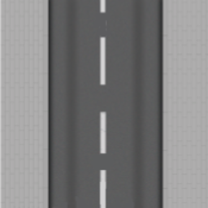
Rendering & visuals
What gets drawn each frame
Rendering pipeline
Visual assets (examples)
BeginMode3D(camera) → draw the city grid and buildings
Draw vehicles (cars + ambulance) and traffic lights
Draw UI overlay text (controls) after EndMode3D()
Optional: draw preview path as a flashing polyline (red/blue)
Tiles & facilities from the project assets folder
Preview path (flash)
Displayed after click
(before mission starts)
Visual modeling choices
Vehicles are simple 3D shapes (cubes) with clear orientation
Facilities are textured buildings placed from facilityMap
Tile textures make roads and intersections easy to read
CitySmart • C++ / raylib
Notes:
[Sources]
- raylib rendering pipeline concepts (BeginMode3D / EndMode3D): https://www.raylib.com/
[/Sources]

Slide 12
Engineering summary
What we focused on
Design goals achieved
Performance
Clean separation of concerns: CityMap (world), Vehicle (motion), TrafficLight (signals), Simulation (rules)
Interactive routing: click-to-preview then dispatch with G
Visible traffic behavior: red lights, following distance, yielding to ambulance
Robustness: clamp to road + gentle deadlock recovery
Map size: 10×10 tiles (100 nodes)
Shortest-path computed in milliseconds (small grid)
Per-frame updates are simple loops over vehicles and lights
Future improvements
Use weighted edges (speed limits) and A* for faster scaling
Multiple emergency vehicles + dispatch queue
More realistic intersections (lanes, turning rules, right-of-way)
Optional collision handling and pedestrian agents
Thank you • Questions

Slide 13
Code highlights
Key parts from Vehicle, EmergencyVehicle, and main.cpp
CitySmart • C++ / raylib

Slide 14
Vehicle.h — base class (OOP design)
class Vehicle {
protected:
Vector3 position;
Vector3 destination;
float speed;
float baseSpeed;
Color color;
bool looping;
// Pathfinding data
std::vector<Vector3> path;
int currentWp;
// Rotation for visuals
float rotation;
float laneOffset;
// Lane behavior
float laneOffsetDefault{0.8f};
float laneOffsetTarget{0.8f};
float laneOffsetMax{1.2f};
What this code does
Defines the shared data: position, destination, speed, lane offset, and a waypoint path.
Provides step(dt, allowForward) so cars can be stopped (red light) while still smoothing lane/orientation.
yieldTo(...) is the traffic rule that makes normal cars move aside for the ambulance.
CitySmart • C++ / raylib

Slide 15
vehicle.cpp — movement + stopping (Vehicle::step)
Vehicle::step(float dt, bool allowForward) {
// --- Yield / lane offset smoothing always runs ---
if (yieldHold > 0.0f) {
yieldHold -= dt;
if (yieldHold < 0.0f) yieldHold = 0.0f;
} else {
// Smoothly relax back to default instead of snapping (prevents "stuck
yielded" lanes)
laneOffsetTarget = laneOffsetTarget + (laneOffsetDefault -
laneOffsetTarget) * Clamp(dt * 6.0f, 0.0f, 1.0f);
}
laneOffsetTarget = Clamp(laneOffsetTarget, -laneOffsetMax, laneOffsetMax);
laneOffset = laneOffset + (laneOffsetTarget - laneOffset) * Clamp(dt *
10.0f, 0.0f, 1.0f);
// Speed scale relaxation
if (speedScaleHold > 0.0f) {
speedScaleHold -= dt;
if (speedScaleHold < 0.0f) speedScaleHold = 0.0f;
} else {
// Return to normal speed smoothly
speedScale = speedScale + (1.0f - speedScale) * Clamp(dt * 6.0f, 0.0f,
1.0f);
}
if (path.empty() || currentWp >= (int)path.size()) return;
Vector3 logicTarget = path[currentWp];
logicTarget.y = position.y;
// --- 1. Direction calculation (stable even when stopped) ---
Vector3 roadDir = {0,0,1};
if (currentWp == 0) {
float distToStart = Vector3Distance(path[0], position);
if (distToStart < 1.0f && path.size() > 1) roadDir =
Vector3Subtract(path[1], path[0]);
else { roadDir = Vector3Subtract(path[0], position); roadDir.y = 0; }
} else {
roadDir = Vector3
// ...
float moveAmount = speed * speedScale * dt;
if (moveAmount > distToTarget) moveAmount = distToTarget;
Vector3 stepv = Vector3Scale(moveDir, moveAmount);
position = Vector3Add(position, stepv);
}
void Vehic
What this code does
Lane offset and speedScale are smoothed every frame (no snapping).
Waypoint switching happens when the vehicle reaches the current target.
Movement is optional: if allowForward=false, the car keeps steering logic but does not advance.
CitySmart • C++ / raylib

Slide 16
vehicle.cpp — yielding rule (Vehicle::yieldTo)
Vehicle::yieldTo(Vector3 emergencyPos, Vector3 emergencyDir, float
yieldStrength, float yieldRadius) {
Vector3 toMe = Vector3Subtract(position, emergencyPos);
float d = Vector3Length(toMe);
if (d > yieldRadius || d < 0.001f) return;
Vector3 toMeNorm = Vector3Normalize(toMe);
if (Vector3DotProduct(toMeNorm, emergencyDir) < -0.2f) return;
Vector3 myForward = { sinf(rotation * DEG2RAD), 0.0f, cosf(rotation *
DEG2RAD) };
if (Vector3DotProduct(myForward, emergencyDir) < 0.0f) return;
What this code does
Uses distance + dot products to check: “am I near the ambulance and in front of it?”
Computes a target lane offset to move the car away from the ambulance.
Holds the yield for a short time (yieldHold) so traffic doesn’t instantly snap back.
CitySmart • C++ / raylib

Slide 17
EmergencyVehicle.cpp — siren + dispatch (speed & path)
void EmergencyVehicle::setSirenActive(bool on) {
isSirenActive = on;
speed = baseSpeed * (isSirenActive ? sirenMultiplier : normalMultiplier);
}
void EmergencyVehicle::toggleSiren(bool on) {
setSirenActive(on);
}
void EmergencyVehicle::assignIncident(CityMap* map, Vector3 targetPos) {
setSirenActive(true);
std::vector<Vector3> newPath = map->findFastestPath(position, targetPos,
true);
if (
What this code does
EmergencyVehicle inherits Vehicle, so it reuses the same movement + drawing code.
Siren toggling changes speed using a multiplier (baseSpeed × sirenMultiplier).
assignIncident() calls CityMap::findFastestPath(...) and then setPath(...) to start the mission.
CitySmart • C++ / raylib

Slide 18
EmergencyVehicle.cpp — drawing the siren (overlay)
void EmergencyVehicle::draw() const {
// 1. Call the base class draw to render the car body
// This is how you correctly call the parent function
Vehicle::draw();
// 2. Draw Siren on top
if (getSirenActive()) {
rlPushMatrix();
// Translate to the vehicle's world position
rlTranslatef(position.x, position.y, position.z);
rlRotatef(rotation, 0, 1, 0);
// Center the siren on the roof (0.5f height)
rlTranslatef(0, 0.5f, 0);
What this code does
Calls Vehicle::draw() first (base body), then draws extra siren graphics on top.
Uses a blink value from sin(GetTime()) to alternate colors for a flashing effect.
rlPushMatrix / rlTranslatef / rlRotatef keeps the siren aligned with the vehicle.
CitySmart • C++ / raylib

Slide 19
main.cpp — program setup + game loop
int main() {
SetConfigFlags(FLAG_WINDOW_RESIZABLE);
int w = (int)(GetMonitorWidth(0) * 0.85f);
int h = (int)(GetMonitorHeight(0) * 0.85f);
if (w < 1000) w = 1000;
if (h < 700) h = 700;
InitWindow(w, h, "Smart City - Synchronized Lane Simulation");
SetWindowMinSize(900, 600);
SetTargetFPS(60);
CityMap city;
Simulation sim(&city);
Camera3D cam = {0};
cam.target = {20, 0, 20};
cam.up = {0, 1, 0};
cam.fovy = 45;
cam.projection = CAMERA_PERSPECTIVE;
float camAngle = 45.0f;
float camRadius = 80.0f;
float camHeight = 40.0f;
while (!WindowShouldClose()) {
float rotationSpeed = 60.0f * GetFrameTime();
float zoomSpeed = 40.0f * GetFrameTime();
if (IsKeyDown(KEY_A)) camAngle -= rotationSpeed;
if (IsKeyDown(KEY_D)) camAngle += rotationSpeed;
if (IsKeyDown(KEY_W)) camRadiu
What this code does
Initializes the window + camera, then creates CityMap and Simulation.
Every frame: Update camera, then sim.Update(cam) (all logic).
Draw step is separated: city.draw() draws the map, sim.Draw() draws vehicles + UI.
CitySmart • C++ / raylib

