Slide 1
Brick Breaker
Computer programing project IN C PROGRAMING LANGUAGE
Authors: Viola Feleki, PÉTER KNOBLOCH- ESZTERGÁR, RAYMOND NÉMETH
1ST YEAR, AUTOMATION DEPARTMENT, 2019

Slide 2
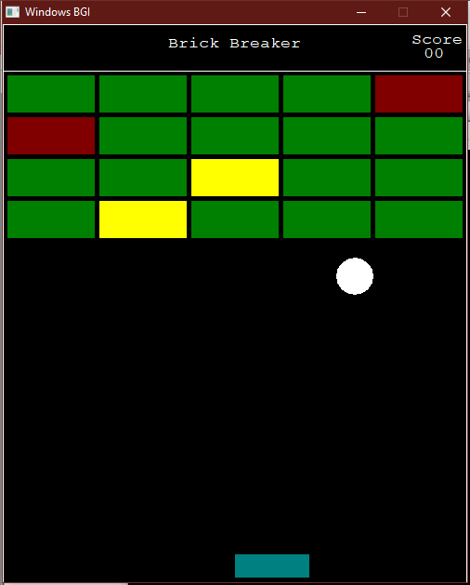
The aim of the game
3 parts: ball, platform, bricks
With the moving platform you have to catch the ball otherwise you lose
3 types of map(the player can chose from them)
3 types of brick:
Green(count==1), yellow(count==2), red(count==3)
Count==collision counting integer
When the ball touches a brick, it’s collision counting integer will decrease
When the count integer of a brick is 0, it will “break”, it will disappear from the screen
The player will win the game if he/she breaks all the given bricks

Slide 3
Modules
bcollisions.h – bcollisions.cpp
bball.h – bball.cpp
bplatform.h – bplatform.cpp
bbricks.h – bbricks.cpp
bscore.h – bscore.cpp
initwin.h – initwin.cpp
bmap.h – bmap.cpp
7 modules with 24 functions in total

Slide 4
Bcollisions
int touchcorner(s_ball ball, int x, int y);
int touchhorizontalline(s_ball ball, int x1, int y1, int x2, int y2);
int touchverticalline(s_ball ball, int x1, int y1, int x2, int y2);
int touchmapcorner(s_ball ball, int x, int y);
Made by RAYMOND NÉMETH

Slide 5
BBall
typedef struct{
int x, y, r;
int xspeed, yspeed;
} s_ball;
void drawball (s_ball ball);
void setspeed (s_ball *ball, int platformevent, int mapevent, int brickevent);
void moveball (s_ball *ball);
void initball (s_ball *ball);
Made by RAYMOND NÉMETH

Slide 6
platform
typedef struct
{
int left, top, right, bottom;
} s_platform;
void drawPlatform(s_platform platform);
void movePlatform(s_platform *platform, s_map map);
int touchPlatform(s_ball ball, s_platform platform);
Void initPlatform(s_platform);
Made by Viola Feleki

Slide 7
Bricks
brick2.h
drawbrick
drawwall
initwall
touchbrick
brick2.cpp
drawbrick
drawwall
initwall
touchbrick
touchcorner
touchverticalline
touchhorizontalline
Made by Peter knobloch

Slide 8
bscore
int getScore(s_brick wall[4][5]);
void drawScoreboard(s_brick wall[4][5], int s);
Made by RAYMOND NÉMETH

Slide 9
initwin
void startscreen();
void winScreen(int s);
void gameover(int s);
Made by Viola Feleki

Slide 10
bmap
typedef struct{
int left, top, right, bottom;
}s_map;
void drawMap(s_map map);
int touchMap(s_map map, s_ball ball);
void initMap(s_map *map, int wx, int wy);
Made by RAYMOND NÉMETH

Slide 11
Thank you for your attention!

