Slide 1

Eating to play football
Healthy, balanced eating scores a ten

Slide 2
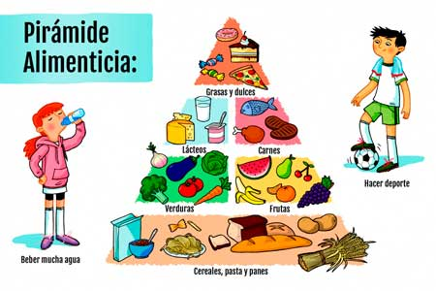
Eat… Eat… and Play…
When children take part in a sport such as football, food intake should increase to replace the energy used, as they are still growing.
Children aged 7 to 12 use approximately 2,000 kcal per day.
Provide half a litre of milk per day. Include fibre-rich foods and avoid animal fats. Avoid fried and ready-made foods. Minimise colourings and preservatives. Do not replace fresh fruit with juice. Homemade cakes and sweets are much better.
Food
Pyramid
Fats and sweets
Dairy
Meat
Exercise
Vegetables
Fruit
Drink plenty of water
Cereals, pasta and bread

Slide 3
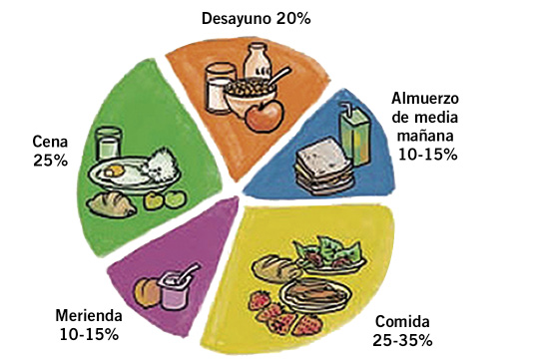
There should be five meals a day. Three should be more substantial because they provide energy and nutrients: breakfast, lunch and dinner. The other two meals are lighter and supportive. They should complement the main meals and can include foods that require more daily servings, such as milk, fruit and cereals.
Breakfast 20%
Mid-morning
snack
10–15%
Dinner
25%
Afternoon snack
10–15%
Lunch
25–35%

Slide 4

MY BREAKFAST
BREAKFASTS
Breakfast is very important for a good start to the day. For the best nutritional balance, it should include:
Dairy (milk with or without sugar or cocoa, yoghurt, and cheese, avoiding very high-fat varieties).
Bread, toast, cereal flakes, biscuits, muffins and cakes.
Fruit or fruit juice (any variety).
Jam and honey.
Added fat (olive oil, butter or margarine).
Ham or another cold cut (occasionally).
Mid-morning: fruit.
Lunch and dinner: lunch usually provides the largest amount of energy and nutrients, and dinner should complement it in a balanced way.
FOR CHILDREN!

Slide 5
My Breakfast and Lunch
Monday: Milk, bread with tomato, olive oil and Serrano ham.
Beef stew with potatoes, carrots and peas.
Manchego cheese.
Apple.
Tuesday: Milk, toast with jam and butter.
Juice.
Roast meat with chips, mushrooms and peas.
Lettuce, tomato and asparagus salad.
Apple.
Wednesday: Milk. Cereal flakes.
Juice.
Spanish stew and pear.
Thursday: Milk, wholemeal bread with honey or jam, and orange juice.
Pulses and vegetable stew: chickpeas, spinach, potatoes and carrots.
Minced-meat patties with salad.
Yoghurt.
Friday: Milk and toast with olive oil.
Fruit juice.
Minced-meat cannelloni.
Lettuce, tomato, onion, carrot and pepper salad.
Orange.
Saturday: Milk, wholemeal crackers with melted cheese.
Juice.
Cream of vegetable soup.
White rice with a fried egg and tomato sauce.
Banana.
Sunday: Chocolate with toast.
Juice.
Lentil stew with rice, potatoes and carrots.
Chicken salad.
Fruit salad.

Slide 6
My Afternoon Snack and Dinner
Monday: Yoghurt and a portion of fruit.
Vegetable purée.
Grilled fish with tomato slices.
A portion of fruit and a glass of milk.
Tuesday: Ham and cheese sandwich.
Baked hake with potatoes.
A portion of fruit and yoghurt.
Wednesday: Cake and juice.
Fried fish with lettuce, tomato and carrot.
Banana.
Thursday: Almonds and apple.
Noodle soup.
Fish fillet with salad.
A portion of fruit and milk.
Friday: Turkey sandwich and kiwi.
Spanish potato omelette with tomato sauce.
A portion of fruit and milk.
Saturday: A portion of fruit and a glass of milk.
Vegetable soup.
Plain omelette with salad.
Banana and milk.
Sunday: Fruit yoghurt.
Fish in sauce.
Fruit salad.
Yoghurt or a glass of milk.

