Slide 1
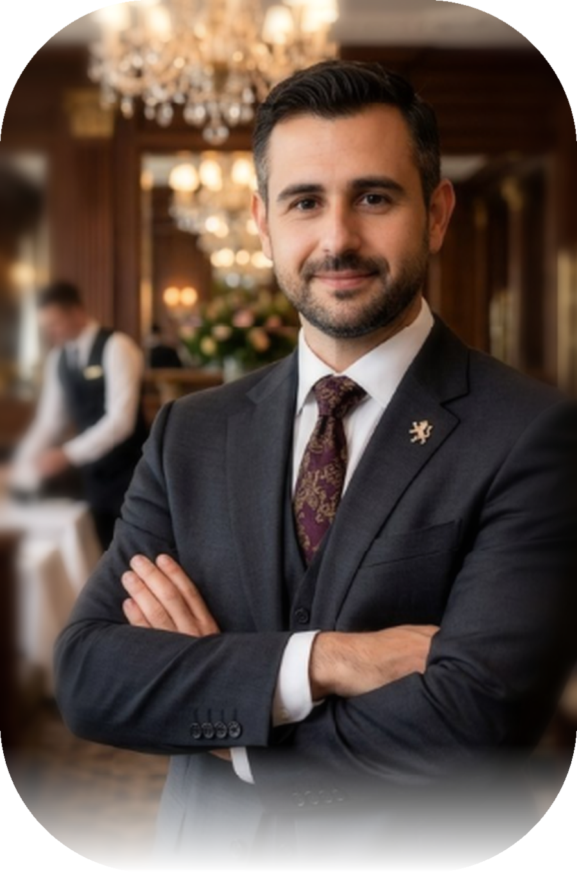
RAMÓN A. CURBALÁN VEGA
INTEGRATED
PROFESSIONAL
PROFILE
HOSPITALITY & OPERATIONS · TECHNOLOGY & SYSTEMS ·
SPORT, NUTRITION & PERFORMANCE
A multidisciplinary profile connecting operations management,
applied technology and human performance through one approach:
plan, execute, measure and optimise.
23+ years of professional experience | Mallorca, Spain
01
02
03
HOSPITALITY
TECHNOLOGY
SPORT
F&B · Events · Banqueting ·
Operations · KPIs
Systems · Networks · Security ·
AI · Automation
Training · Nutrition ·
Habits · Well-being

Slide 2
RAMÓN A. CURBALÁN VEGA
OVERVIEW
00
EXECUTIVE SUMMARY
Professional profile and career positioning
Overview
Ramón Alberto Curbalán Vega brings together three complementary specialisms: hospitality and F&B operations management, applied technology and systems, and sport, nutrition and performance. He connects people, processes, data and delivery to turn objectives into measurable results.
HOSPITALITY & OPERATIONS
TECHNOLOGY & SYSTEMS
SPORT & PERFORMANCE
23+ years of experience, including 5★ and 5★ Grand Luxury hotels. F&B, banqueting, events, restaurants, logistics, service, purchasing, inventory and team leadership.
Training and projects in systems, networks, security, databases, Big Data, AI, web development, automation and agile management.
Personal training, group classes, nutrition, swimming, well-being and the design of health and performance experiences.
CURRENT POSITIONING
Current role: FB Banquet Manager – Capvermell Gran Hotel S.L.U. (March 2025 – present). · Target areas: F&B management / Banqueting & Events / Operations; Sports management / Coordination; Applied technology and hybrid transformation roles.
Human · Systems · Performance | Mallorca, Spain
2

Slide 3
RAMÓN A. CURBALÁN VEGA
HOSPITALITY
01
HOSPITALITY, F&B AND EVENTS
Operations management, banqueting, restaurants and customer experience
Main specialism
An established career in premium hospitality, particularly F&B, banqueting and events. The focus is on reliable operations: precise planning, staffing matched to demand, consistent service, financial control and coordination across kitchen, reception, events, purchasing and operations.
Creating, interpreting and delivering BEOs.
Coordinating kitchen, service, events and reception.
Operations cycle for events and F&B
Layouts, setups, schedules and workflows.
Staffing for demand peaks and service ratios.
1. PLANNING: objectives, BEO, layout, timing, volumes and risks.
2. RESOURCES: team, equipment, purchasing, stations, bars and BOH.
3. DELIVERY: briefing, service sequence and real-time coordination.
4. MONITORING: quality, timing, consumption, incidents and guest experience.
5. CLOSE-OUT and 6. IMPROVEMENT: inventory, costs, KPIs and lessons learned.
Purchasing, inventory, equipment and logistics.
Customer service and incident resolution.
Supervising service and 5★ / 5★ GL standards.
Close-out, consumption, productivity and profitability.
Human · Systems · Performance | Mallorca, Spain
3

Slide 4
RAMÓN A. CURBALÁN VEGA
TECHNOLOGY
02
TECHNOLOGY, SYSTEMS AND AUTOMATION
Technical training, applied development and digital transformation
Applied technology profile
This specialism combines technical training with real projects that address specific needs: authentication, databases, automation, web applications, security, digital content and deployment.
SYSTEMS & NETWORKS
SECURITY
DATA & AI
Departmental networks, virtualisation, addressing, NAT/Bridged, VPN, monitoring and diagnostics.
IT security, Nmap, access best practices, OAuth, permission management and production environments.
Big Data and AI, databases, information analysis, automation and assistants integrated into applications.
Technologies and environments used
DEVELOPMENT: HTML, CSS, JavaScript, Python, FastAPI, SPA/PWA.
DATABASES: PostgreSQL / Supabase, SQLite / SQLAlchemy, MySQL, SQL Server, MongoDB.
INFRASTRUCTURE / CLOUD: Windows, Linux, Kali, virtual machines, Git, GitHub Pages, Vercel, domains and OAuth.
MANAGEMENT: Agile Project Management and Scrum.
Human · Systems · Performance | Mallorca, Spain
4

Slide 5
RAMÓN A. CURBALÁN VEGA
SPORT
03
SPORT, NUTRITION AND PERFORMANCE
Training, habits, well-being and support
Sports specialism
Experience and training in exercise, health and performance, working with individuals and groups of different ages. The approach combines exercise planning, nutrition, habits, progress tracking and motivation.
TRAINING
NUTRITION & HABITS
GROUPS & AQUATICS
Personal training, functional training, strength, group classes and goal-based planning.
Training as a nutrition technician, habit education, progress tracking and integrated plans.
Swimming across age groups, lifeguarding, Pilates, yoga, tai chi and activities for older adults.
Working model
ASSESS · PLAN · EXECUTE · TRACK · OPTIMISE. Chetesaí Fitness+ puts this specialism into practice through a private nutrition, training and habits platform with a client interface and professional dashboard.
Human · Systems · Performance | Mallorca, Spain
5

Slide 6
RAMÓN A. CURBALÁN VEGA
PROJECTS
04
PROJECTS AND DIGITAL ECOSYSTEM
Personal initiatives connecting the three specialisms
CHETESAÍ FITNESS+
OPOSTUDY
Sport + technology
Nutrition, training and habits platform with a professional dashboard, Supabase, OAuth, exercise library, multimedia content and AI assistant.
Technology + learning
TAI exam preparation app with mock exams, questions, practical exercises, error tracking, statistics and technical content.
FARMAGEND 24/7
CATERING MALLORCA
Innovation + automation
Hybrid physical and digital centre with automated dispensing, a robotic arm, app, e-commerce, AI and smart inventory.
Hospitality + events
Catering concept for private estates in Mallorca, covering teams, transport, equipment, menus, drinks and branding.
FITNESS BUS
PROFESSIONAL PORTFOLIOS
Sport + operations
Mobile functional training, Pilates, yoga and older-adult classes with booking, class passes and digital payments.
Personal brand + technology
Specialist technology, sport and hospitality portfolios, alongside the integrated Human – Systems – Performance portfolio.
6
Human · Systems · Performance | Mallorca, Spain

Slide 7
RAMÓN A. CURBALÁN VEGA
TRAINING
05
TRAINING AND CERTIFICATIONS
Technical foundations, project management, hospitality and sport
HOSPITALITY AND OPERATIONS
HOTR064PO. · HOTR040PO. · Training and equivalencies linked to HOTR0409. · Applied experience in banqueting management, restaurants, events and F&B operations.
TECHNOLOGY AND SYSTEMS
IFCT0410 – Departmental Networks. · IFCT101PO – IT Security. · IFCT159 – Big Data and Artificial Intelligence. · Training in networks, electronics, systems, databases and virtualised environments.
PROJECT MANAGEMENT AND DIGITALISATION
ADGD347PO – Agile Project Management. · ADG348PO – Agile Project Management / Scrum. · Generación Digital PYMES – EAE, 375 hours. · Academic work in strategic management, Scrum, Kanban and digital transformation.
SPORT, NUTRITION AND WELL-BEING
Training as a nutrition technician. · Personal trainer. · Fitness studio technician. · Pilates, yoga and tai chi instructor for older adults. · Lifeguard and swimming experience across age groups.
Human · Systems · Performance | Mallorca, Spain
7

Slide 8
RAMÓN A. CURBALÁN VEGA
METHOD
06
METHODOLOGY AND VALUE PROPOSITION
Connecting Human – Systems – Performance
One approach across three disciplines
The strength of this profile comes from applying a shared approach across different contexts: understanding people, designing working systems and measuring performance. The three areas of expertise support each other in solving practical problems.
HUMAN
SYSTEMS
PERFORMANCE
Leadership, communication, service, customer experience, coaching, motivation and adaptation to individuals and teams.
Processes, planning, data, technology, security, automation, documentation and control.
KPIs, productivity, profitability, quality, health, adherence, recovery and continuous improvement.
Working framework
1. ANALYSE · 2. DESIGN · 3. PLAN · 4. EXECUTE · 5. MEASURE · 6. OPTIMISE.
Applied by specialism: HOSPITALITY – consistent operations and premium service. TECHNOLOGY – useful systems and automation. SPORT – realistic programmes, progress tracking and sustainable habits.
Human · Systems · Performance | Mallorca, Spain
8

Slide 9

RAMÓN A. CURBALÁN VEGA
CLOSING
PEOPLE, PROCESSES AND TECHNOLOGY
WITH ONE SHARED DIRECTION.
Operations management, applied technology and human performance follow one approach: analyse, plan, execute, measure and improve. Customer experience, system reliability and team performance contribute to the same result.
Integrated portfolio
https://raymonchu48.github.io/human-systems-performance/en/ · Mallorca, Spain
Human · Systems · Performance | Mallorca, Spain
9

