Slide 1
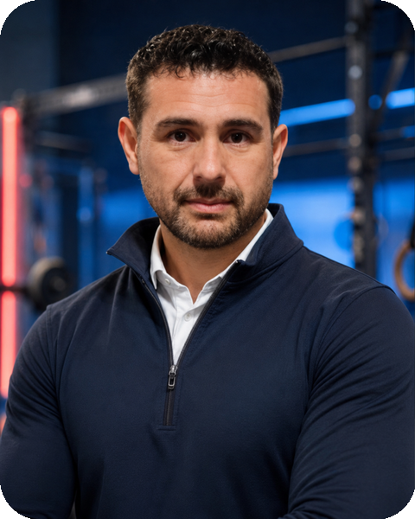
SPORTS PROFILE
Ramón Alberto
Curbalán Vega
Training, health
and physical performance
More than five years
of industry experience
Notes:
English edition of the supplied professional profile. The original Spanish file remains unchanged.

Slide 2
Professional profile
An integrated approach to sport
I have more than five years of experience in physical conditioning, group classes, personal training and lifeguarding.
My profile combines training and safety with knowledge of nutrition, sports psychology and sports facility management.
02
Notes:
Source: supplied Spanish professional portfolio. English translation preserves the stated experience, skills and objectives.

Slide 3
Experience in group classes
Planning and leading sessions
Body and movement
Pilates, yoga and tai chi
Physical conditioning
Functional training and cycling
Aquatic activities
Water-based activities
Sessions for people of different ages and abilities
03
Notes:
Source: supplied Spanish professional portfolio. English translation preserves the stated experience, skills and objectives.

Slide 4
Approach to work
Safety and prevention
Safe interventions that consider each person’s context
Adaptation
Inclusive activities tailored to each individual
Motivation
Clear communication and support
Follow-up
Monitoring progress and service quality
04
Notes:
Source: supplied Spanish professional portfolio. English translation preserves the stated experience, skills and objectives.

Slide 5
Training and skills
Training and physical activity
Functional training
Adapted physical activity
Safety, wellbeing and management
First aid and lifeguarding
Nutrition and dietetics
Sports psychology and sports management
05
Notes:
Source: supplied Spanish professional portfolio. English translation preserves the stated experience, skills and objectives.

Slide 6
Professional objective
Effective and inclusive
sports programmes
I aim to support sustainable programmes through technical knowledge and a commitment to service.
My professional focus is on health, wellbeing and improved physical performance.
06
Notes:
Source: supplied Spanish professional portfolio. English translation preserves the stated experience, skills and objectives.

