Slide 1
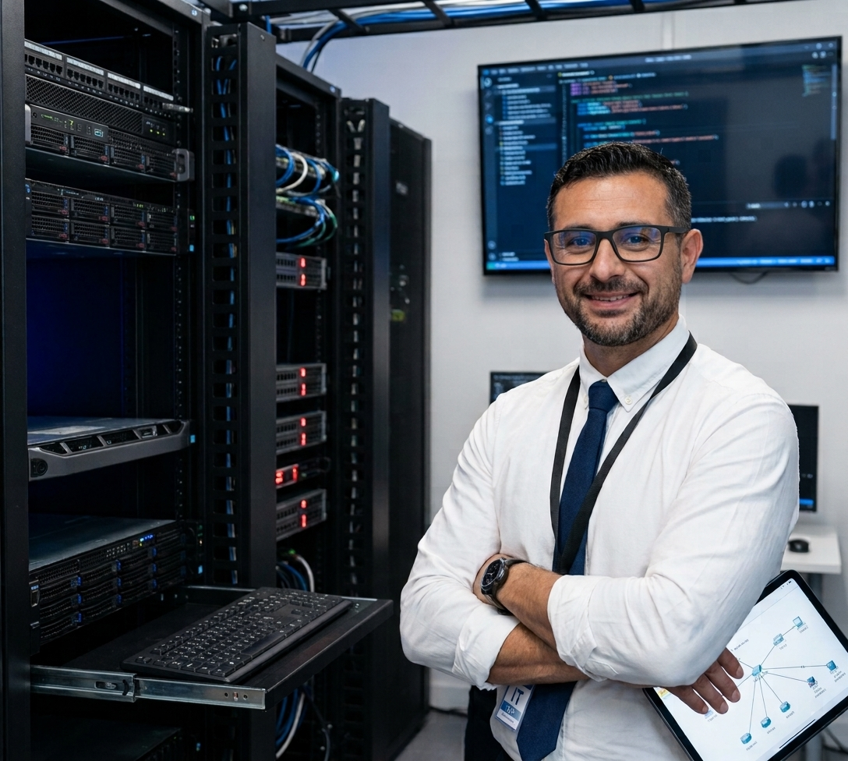
TECHNOLOGY PROFILE
Ramón Alberto
Curbalán Vega
Systems analyst
Networks, development and
digital transformation
Notes:
English edition of the supplied professional profile. The original Spanish file remains unchanged.

Slide 2
My professional profile
Technology that supports business processes
I am a systems analyst with training in network administration, cybersecurity, web development and data analysis.
My approach combines technical foundations with business insight to improve IT infrastructure and support process digitalisation.
02
Notes:
Source: supplied Spanish professional portfolio. English translation preserves the stated experience, skills and objectives.

Slide 3
Technical skills
Systems and networks
Administration and design of departmental networks
in Windows and Linux environments
Cybersecurity
Training in IT and OT security
Web development
HTML, CSS and PHP
Foundations of Java and ASP.NET
Data
SQL databases and analysis with Power BI
Project management
Agile and Scrum methodologies
03
Notes:
Source: supplied Spanish professional portfolio. English translation preserves the stated experience, skills and objectives.

Slide 4
Technology training
Administration and design
of departmental networks
Professional Certificate IFCT0410
Additional training
Advanced cybersecurity and web programming
Data analysis and applied artificial intelligence
Agile project management
04
Notes:
Source: supplied Spanish professional portfolio. English translation preserves the stated experience, skills and objectives.

Slide 5
Project: digital transformation
Digital Transformation Plan (PTD)
Generación Digital PYMES Programme
EAE Business School
Assessment
Digital maturity and SWOT analysis
Design
Action areas and digital transformation canvas
Action plan
KPIs, budget and change management
05
Notes:
Source: supplied Spanish professional portfolio. English translation preserves the stated experience, skills and objectives.

Slide 6
Professional objective
Systems and networks
Junior IT consulting
I aim to develop my career as a systems technician, network administrator or junior IT consultant.
I want to work on real projects and contribute through the efficient and secure use of technology.
06
Notes:
Source: supplied Spanish professional portfolio. English translation preserves the stated experience, skills and objectives.

