Slide 1
TCSS 342A Project 3 Graphs and Shortest Paths
Group Number: K
Members: Raymond, David, Walker
Date: 03 / 09 / 2017

Slide 2
Part 1: Graph Representation
- Used a HashMap from a Vertex to an ArrayList<Edge>
- Each Vertex maps to a list of its adjacent edges
- Hash maps (and java.util.HashMap) time complexities are:
- Average case O(1)
- Worst case O(n)
- Benefits:
- Easy and quick to find a vertex's edges
Avoids adding duplicate vertices
- Space complexity is O(|E|) - much better than an adjacency matrix
- Stored boolean known, Vertex prev, and int weight (used for a PriorityQueue) as fields in the Vertex class
- all used by Dijkstra’s algorithm
Running time analysis in this slide or next?

Slide 3
Part 2: Dijkstra’s algorithm
- Vertex implements the Comparable interface
- Compares vertices based on the distance variable associated with that vertex (prioritizes smallness)
- Distance variables are set to Integer.MAX_VALUE before every shortestPath() call.
- Vertex being Comparable allows a PriorityQueue to be used in shortestPath() in order to prioritize the smallest distances
Not sure what else to write here

Slide 4
How you tested your code
Our test code for the shortest path can be split in 2 categories
Valid Input:
-First we tested that the graph can find a very basic path from on to another node. Then we ran the test again with more and more nodes.
-Second we can a couple test to make sure the graph can select a path of with more nodes and less weight.
-Lastly we checked to make sure the the graph will return a
with just a single node and a weight of 0 when the same
node is passed twice.
Invalid Input:
-When an unreachable node is entered as the destination does the shortest path return null?
-Does shortest path return null when one or both nodes are null?
- Does it return null when one or both nodes are not part of the graph?

Slide 5
Real work application - Finding Paths Between Movies Via Filming Location
a) Raw movie database file is downloaded from IMDB.com
b) Database is truncated to movies starting with 'A ' because there are so many movies.
c) File is parsed and a digraph is created from movie and location data.
d) Edge and vertex files read by program as normal.
- It is technically an undirected graph because (movie1, movie2) implies the inverse
- It is also technically an unweighted shortest path problem (all edges have the same cost)
So, this isn't the most efficient way to solve this problem
But it's a good way to test our program

Slide 6
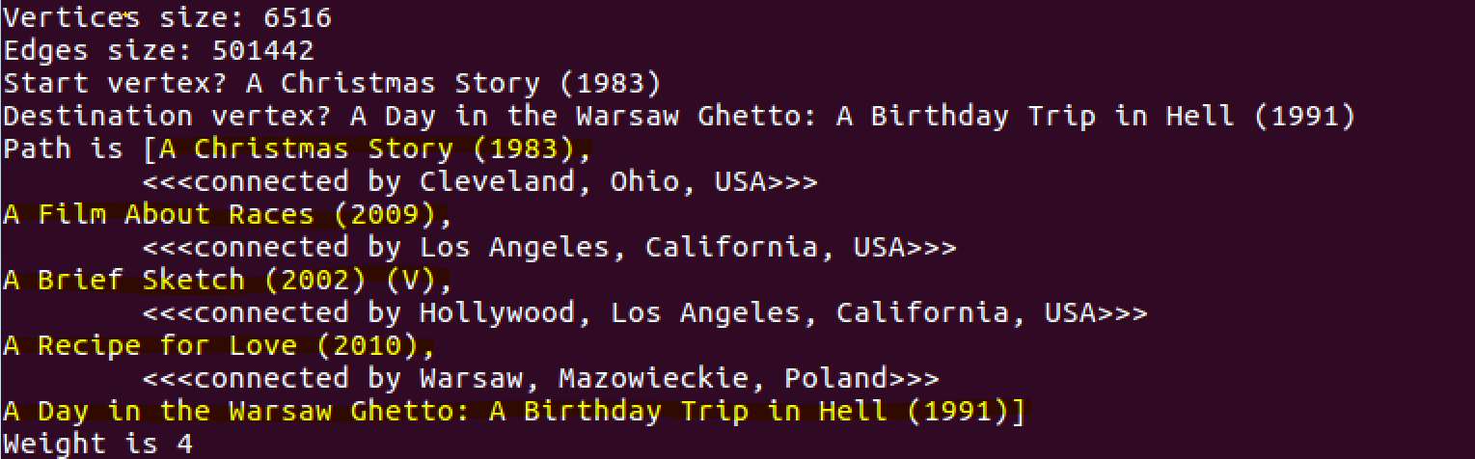
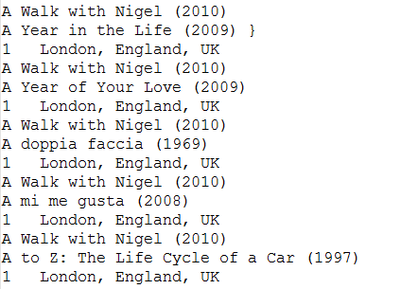
Results
Program successfully processes 6,516 movies with 501,442 edges.
Modified edge file format that adds an “edge description” which allows the program to show which location linked each movie pair.

Slide 7
Conclusion
What did you learn?
Any other insights?
Division of labor

