Slide 1

Modeling Single File Dynamics using the Generalized Langevin Equation
Raymond J Park
3rd year Chemical Engineering Student
University of Texas at Austin
Advised by Dr. Dmitrii E. Makarov

Slide 2

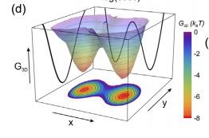
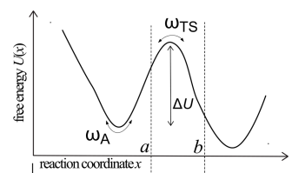
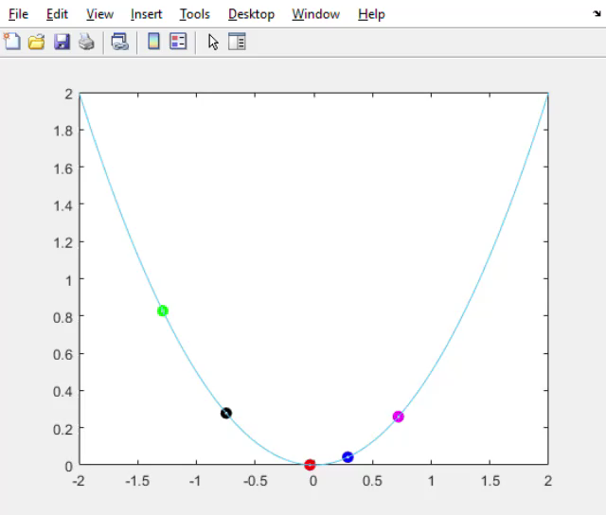
(a)
Problem Outline
Research on single molecule has been extensively performed.
Model description
Transition state theory
“Point of no return”
Kramer’s theory
Brownian motion
Langevin Equation
Generalized Langevin Equation
Markov Dynamics?
Projection of Multidimensional system leads to Non-Markov dynamics
Memory Kernel from Generalized Langevin Equation
Transition path times
Notes:
There has been a lot of research done on single molecule experiment, Dr. Makarov, my advisor has done extensive research on this topic. There are two interpareton in single molecule dynamics: transition state theory and kramers theory. Transtation state assumes that the molecule will precede to the product if it reaches the transtition state region. While kramers theory states that the dynamics should be Browian motion, where a friction term and a random gassuain term which is produced by thermal noise can cause the molecule to either go back to its reactant state or the produce state. This theory is what we investigated and Langevin equation was used. This is strictly a Markov process which means no memory is involved. The particle moves due to its current state and position at its current time. This can be described using the Langeqin equation’
We want to see if the GLE can be used to extract the memory that is involved in the trajectories.
After verifying the legitimacy of the trajectory, we can use the generalized langevin equation to extract the memory kernel. Instead of a constant friction coefficient that is exerpeince by the particle, there may be the memory attached to it. Friciton maybe related to friction in the past rather than the instaneous friction that is easily calculated.
Finally, distribution of the transition times are calculated to see if multidimensionality exists in the problem. Our problem that formulated is strictly 1-D dimensional. And this can be characterxzied by a coefficient ofvaration of the transiton times that is less than 1. This is proven by Makarov and his former PhD student Rohit Satija. However, a coefficient of varation that is greater than 1 (which signified a distribution that is broad), indicates multidimesioanlity in the system.
%% Why do we care about single molecule experiment> motivation behind? Slide 3. What kind of model can simulate the experimental model. -> Langevin? -> but memory? -> GLE.
%% talk about potential of mean force -> probability distribution.
%% Non-markovian -> multidimensional single file dynamics? -> want to investigate other models that contain similar non markovian dynamics.
%% one of the properties to study is transition paths. How broad it is?
%% repulsive potential -> describe data -> memory kernel, and correlation function.
%% put extra info at the end.

Slide 3
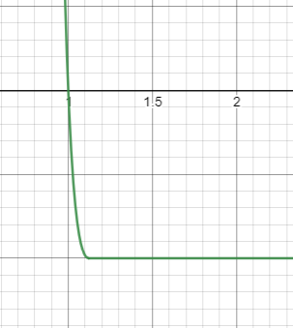
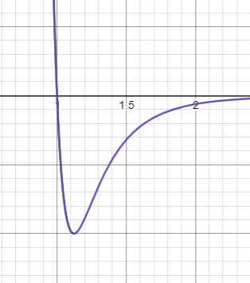
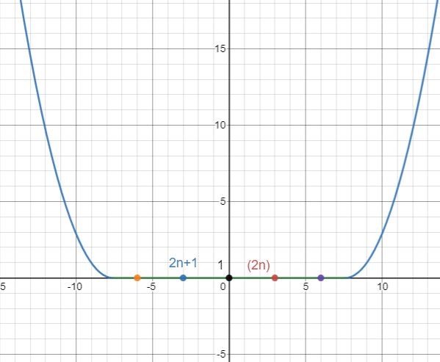



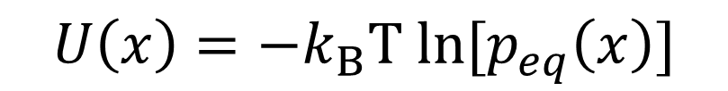
$$LJ=4ε∗[{\left(\frac{s}{r}\right)}^{12}−{\left(\frac{s}{r}\right)}^{6}] r<2^{\frac{1}{6}}∗s$$
$LJ=4ε∗[{\left(\frac{s}{r}\right)}^{12}−{\left(\frac{s}{r}\right)}^{6}$]
$$LJ=4ε∗\left(s^{−2}−s^{−1}\right) r≥2^{\frac{1}{6}}∗s$$
LJ potential
Piecewise systematic potential
Truncated LJ potential
$$U\left(x\right)={−k_{B}T ln⁡[p}_{eq}\left(x\right)]$$
Potential of mean force
Notes:
A piecewise systematic potential was chosen for this project hich involves a flat potential, with parabolic barriers at the sides. Even numbered particles are on the positive x-axis, while the odd numbered particles are on the negative x-axis. A parabolic potential, though simpler to code, was more difficult to deal with it. We first desire to find the equilibrium position of the particles before we can extract any transition times and memory. A truncated form of the Lenanrd Jone sponteial was used which is purely the repulsvive portion of the potential.

Slide 4
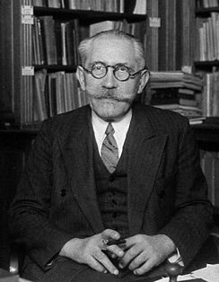
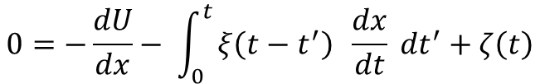
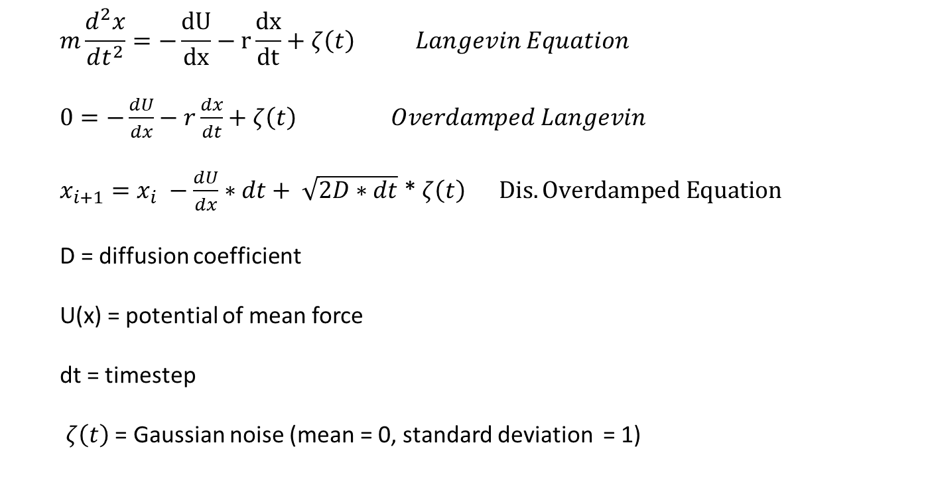
Langevin Equation and GLE
$$m\frac{d^{2}x}{dt^{2}}=−\frac{dU}{dx}−r\frac{dx}{dt}+ζ\left(t\right) Langevin Equation$$
$0=−\frac{dU}{dx}−r\frac{dx}{dt}+ζ\left(t\right) Overdamped Langevin$
$x_{i+1}=x_{i} −\frac{dU}{dx}∗dt+ \sqrt{2D∗dt}$ * $ζ\left(t\right) Dis. Overdamped Equation$
D = diffusion coefficient
U(x) = potential of mean force
dt = timestep
$ζ\left(t\right)$ = Gaussian noise (mean = 0, standard deviation = 1)
$$0=−\frac{dU}{dx}− \int_{0}^{t}{ξ\left(t−t^{′}\right) \frac{dx}{dt} dt^{′}+ζ\left(t\right)}$$
Overdamped Generalized Langevin Equation
Notes:
Langeqin equation contains a noise term, a potential term, and an inertial term. But if we take the overdamped limit, which neglects the ienrtail term, we get a much simpler term using the discretized version using finite difference. This discretized equatioonw as used to generate the trajectories. On the oterhand we see that the GLE contains a convolution term, which adds in the effect of memory rather thana constant drag coefficient.

Slide 5

$$5 particle p_{eq}(x)$$
5
4
3
2
1
Notes:
Boltzmann ditrbution allows us t calculate the positional equiailibrium distbrition. However, ana nalytical result cannot be obtained as the function does not have aelemtnary form and e U(x) is a multivraible function and requires integration of N-1 particles to determine the probability distribution. I have also tried numerical integration using matlab. It took too much time.

Slide 6

$$7 particle p_{eq}(x)$$
7
6
5
4
3
1
2

Slide 7

$$9 particle p_{eq}(x)$$
9
8
7
6
5
4
3
1
2

Slide 8
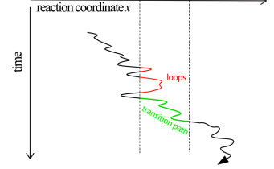
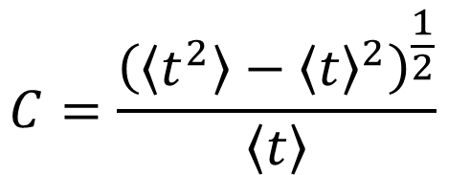
Transition path times
$$C=\frac{{\left(\left\langle t^{2}\right\rangle −{\left\langle t\right\rangle }^{2}\right)}^{\frac{1}{2}}}{\left\langle t\right\rangle }$$
Coefficient of Variation
Notes:
The equilibrium position histogram was needed to find the maximum likelihood position in order to create the transition region. Then, coefficient of varaiton, which is the ratio between the standard deviation of the transition times to the mean of the transition times can be calculated. The C values indicates how broad the distribution of the transition paths are. No 1D dimensional model can have a coefficient of variation that exceeds one. This has been extensively proven. A C value that is greater than 1 is an indication of multidiemsnailty in the dynamics, though a C value less than 1 does not necessarily mean that the dynamic is 1D. Nonethelsee, a C value greater than 1 is an interesting result.

Slide 9
Notes:
A transition regions of width of 4 was used, with a particle size of 1 based on the Lennard jones parameters. With the given C constants

Slide 10
Notes:
C is similar to single particle in a flat potential.

Slide 12
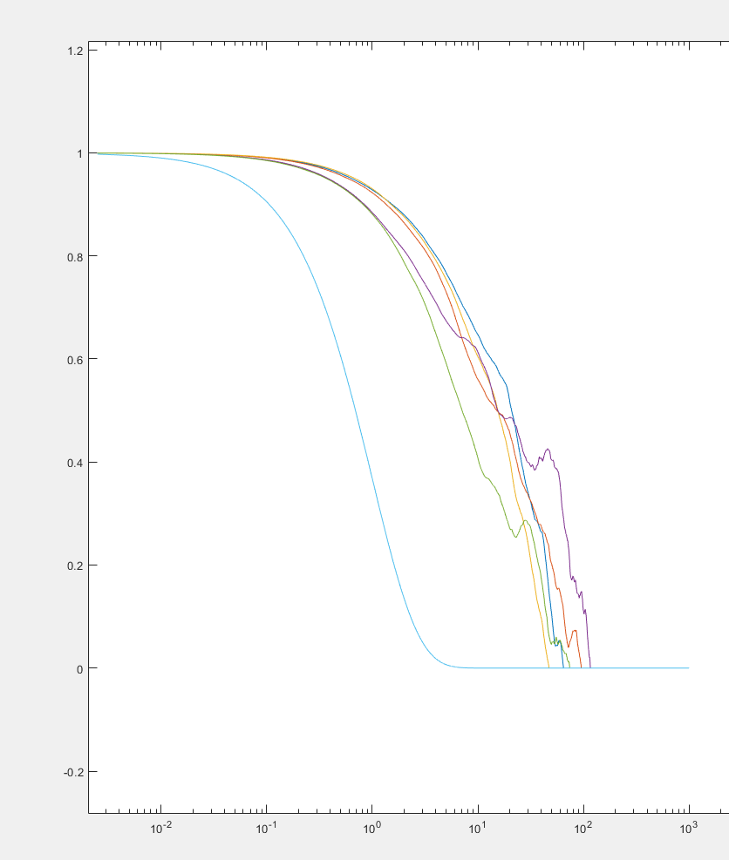
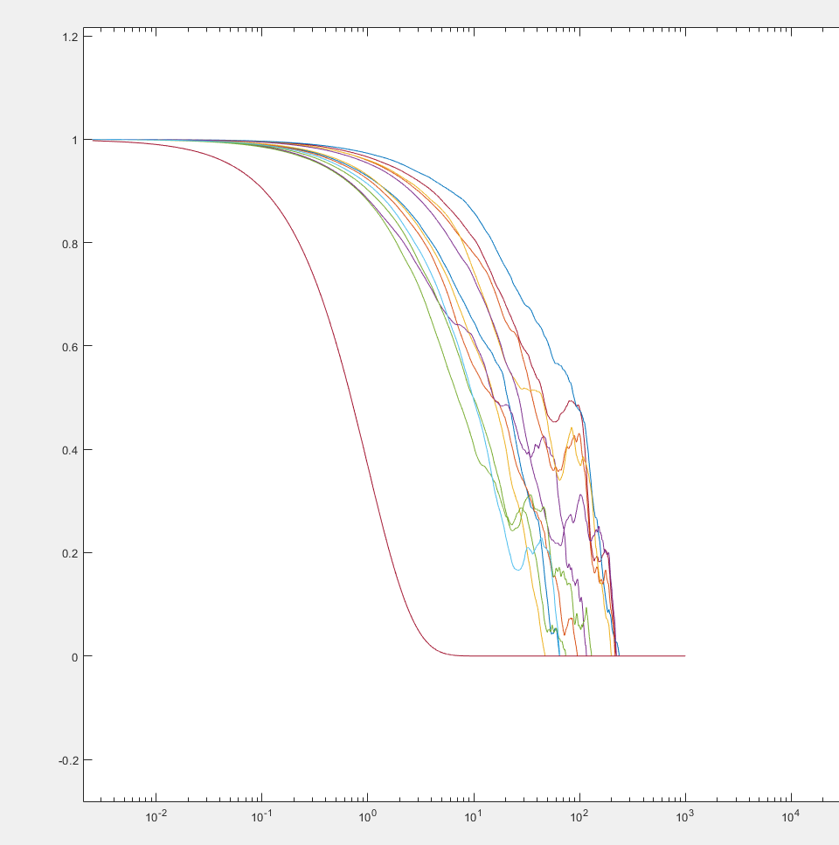
Autocorrelation
Single particle
Notes:
Positional autocorrelation function of a 1 particle without memory, is strictly a decaying exponential. As more particles are added, the position that is explored by each of the particles becomes more confined causing the correlation function to decay at more different timescales.

Slide 13
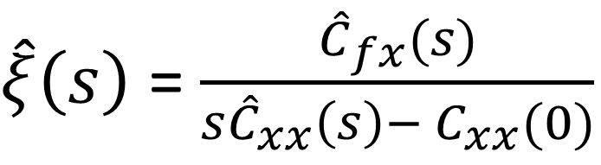
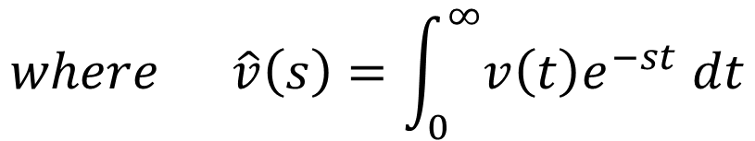
Working Progress
1. Memory Kernel
$\hat{ξ}\left(s\right)$= $\frac{{\hat{C}}_{fx}(s)}{s{\hat{C}}_{xx}\left(s\right)− C_{xx}(0)}$
$$where \hat{v}\left(s\right)=\int_{0}^{∞}{v\left(t\right)e^{−st} dt}$$
2. More particles (50+)
3. Different systematic potential
Notes:
It can be shown that using the GLE, the memory kernel can be extracted using the following equation where the hat represents the laplace transform of the given function

Slide 15
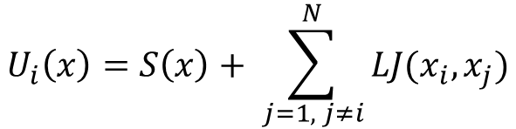


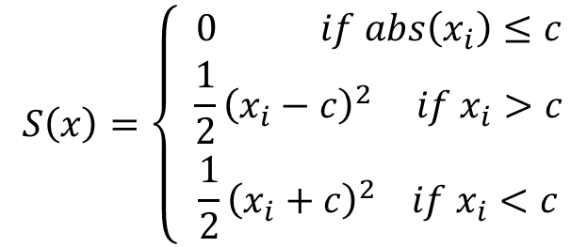
Potential of Mean Force
$$U_{i}\left(x\right)=S\left(x\right)+ \sum_{j=1, j≠i}^{N}{LJ(x_{i}, x_{j})}$$
$$S\left(x\right)=\left\{ \begin{aligned}0 if abs\left(x_{i}\right)≤c \\ \frac{1}{2}{\left(x_{i}−c\right)}^{2} if x_{i}>c \\ \frac{1}{2}{\left(x_{i}+c\right)}^{2} if x_{i}<c\end{aligned}\right.$$
$$i=1, 2, 3….. N−1, N$$
$$N=total number of particles$$
Notes:
It can be shown that using the GLE, the memory kernel can be extracted using the following equation where the hat represents the laplace transform of the given function

