Slide 1
Comets and Spectrography
Raymond Byczko
EPS 530
Planetary Physics
Fall 2015

Slide 2
Definition of Terms
Recovery – the first sighting of a comet predicted to appear from its previous appearances.
Apparition – the sighting of a comet
Kirchhoff's Laws - radiative emission and absorption by a material body in thermodynamic equilibrium

Slide 3
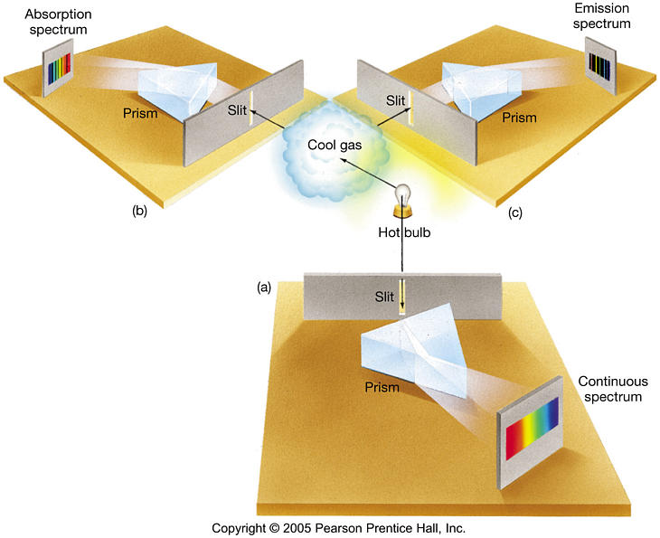
Kirchhoff's Laws
Notes:
Bottom:Solid, liquid, high density gas produces a continuous thermal spectrum
Left: Low density gas directly between hotter source and observer produces absorption spectrum.
Right: When such a gas is viewed from the side, then only emission is observed.

Slide 4

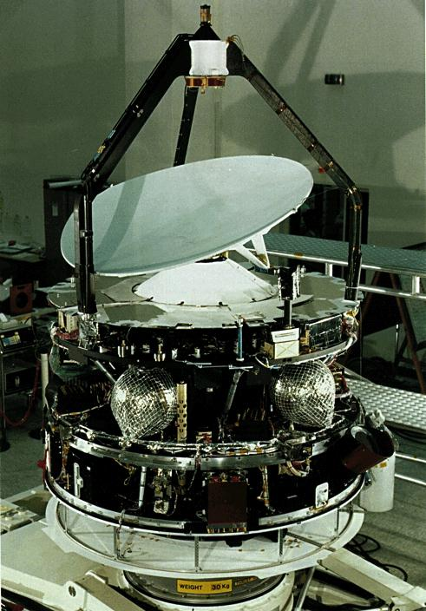


History
comet history is divided into five periods.
Pre 1600: omens
1600 to 1800: motions and orbits
early 1800s: cometary physics
1950: emergence of modern picture – primordial ice and snow
in situ measurement with spacecraft

Slide 5

Pre Spectrographic
(a partial list)
Records go back to 1000 BC in what is now China and Iraq
Tycho Brahe: parallax of comet in 1610.
Johann F. Encke - second person after Halley to predict return of a comet.
P/Encke kept returning 0.1 day earlier than predicted.
Friedrich W. Bessel - 1835 - non-gravitational effect due to asymmetric outflow was causing this.
Notes:
The idea of parallax helps break down the Aristotle point of view that comets existed in the lowest sub lunar sphere of a system of spheres. In other words, they are very close.

Slide 6
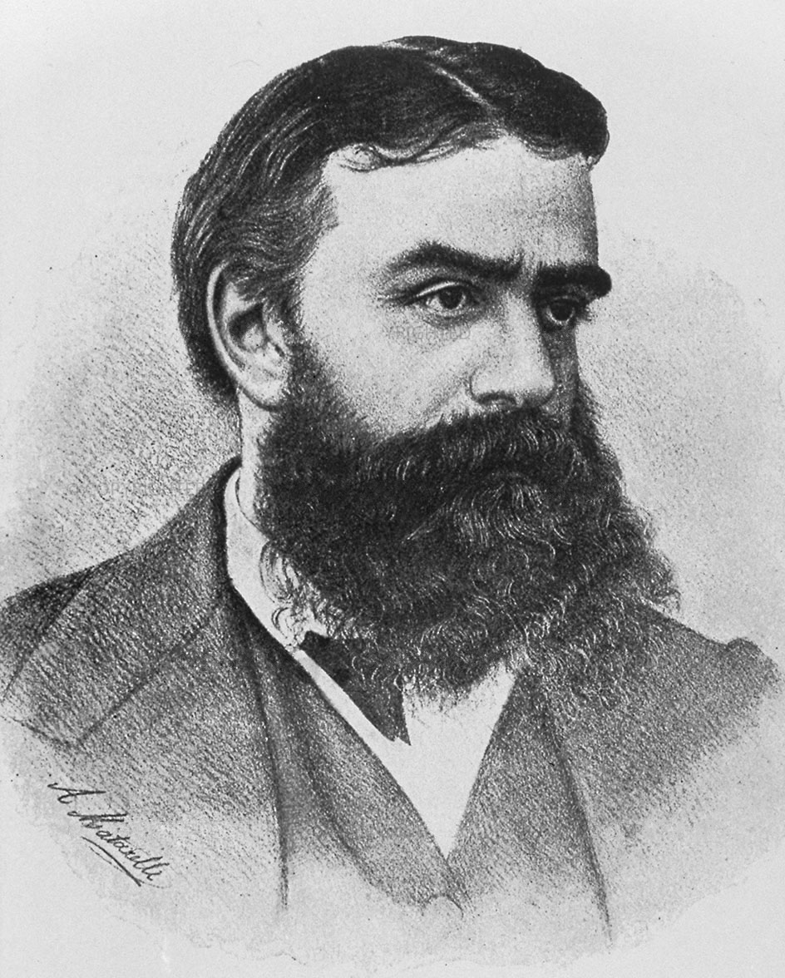
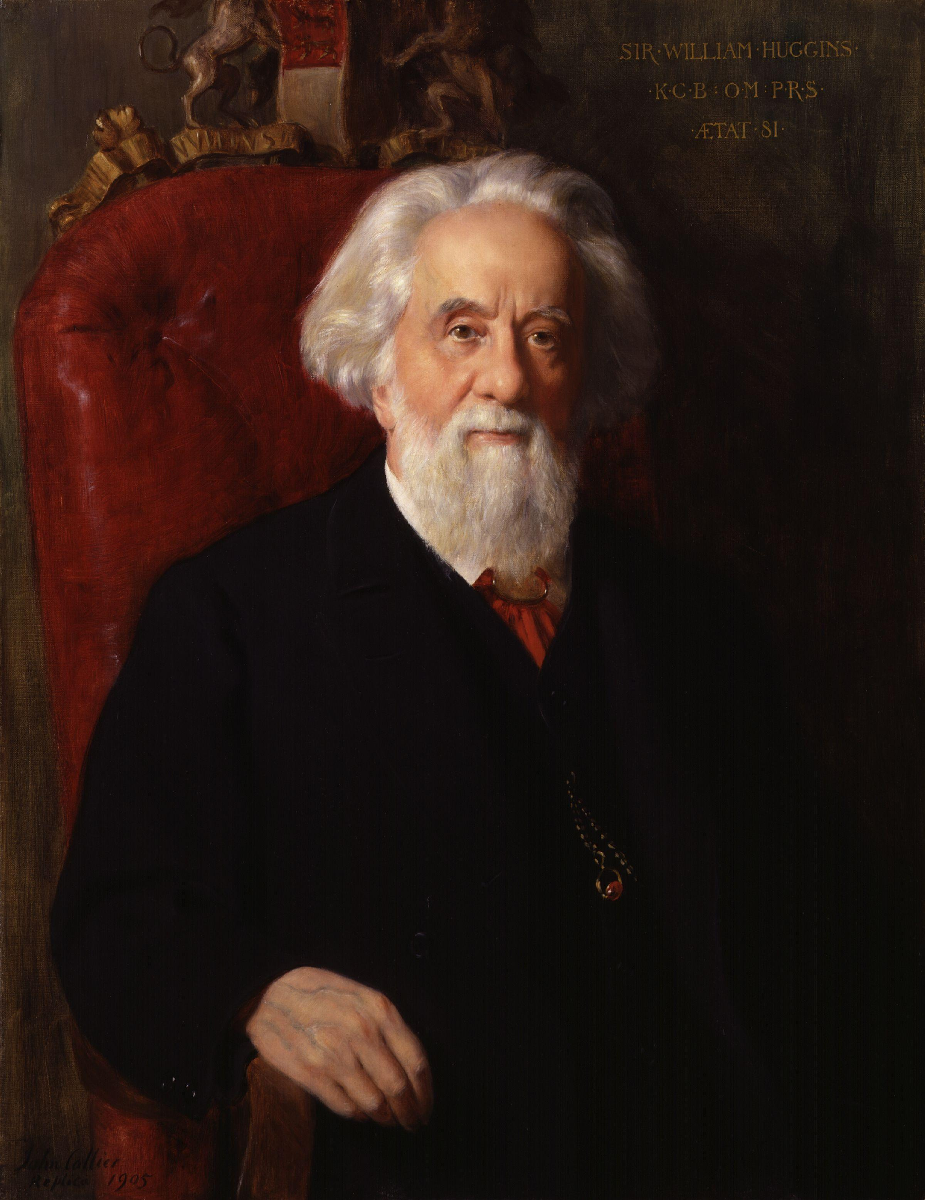
Spectrography
Giovanni Donati (1868),Sir William Huggins (1868)
Compared comet Winnecke spectrum to flame spectrum.
Swan Bands

Slide 7
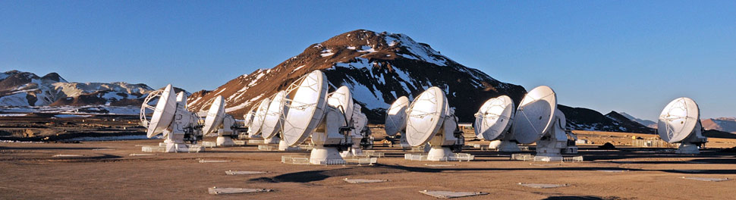

Observing Conditions
Optically thin conditions are optimum – every molecule, ion, and atom is receiving and emitting radiation
Earth's atmosphere blocks sub-millimeter wavelength. Sub-millimeter telescope need to be at high altitude in arid conditions.
Chajnantor plateau, Chilean Andes, ESO, ALMA (Atacama Large Millimeter/submillimeter Array)

Slide 8
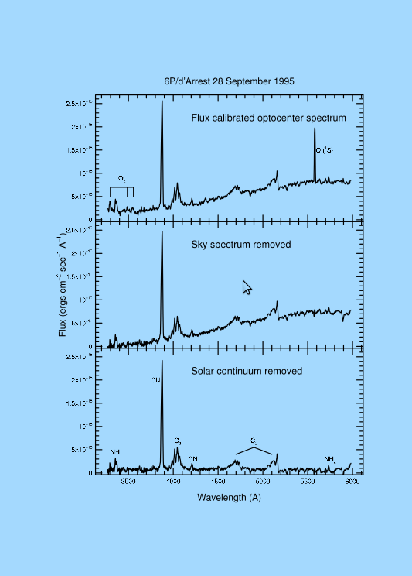
Spectroscopy Issues
Dust/gas – impacts continuum
CCD bias – flat fielding
Telluric night sky emission
Solar continuum-reflected dust
Emission spectrum-Coma gas
Notes:
Individual elements of a CCD can vary in sensitivity. A number of sky shots after sunset can help determine this variance, characterize it, and thus it can be removed in post processing.
Dust/gas ratio is usually from 0.1 to 10. This relates to optical thinness.
Graphic acquired from Icarus article: “Third Years of Cometary Spectroscopy from McDonald Observatory”

Slide 9
Models Used
Haser Model: use to convert observed molecular column densities to production rates
http://asteroid.lowell.edu/comet/gfactor_haser.html
Swings Effect
Notes:
Web page with title: Computing Comet productions Rates from Measured Molecular Fluxes
Involves inputs like r in AU, delta in AU, heliocentric velocity in km/s, aperture radius. Measured fluxes are involved.
Reference to Haser-fraction

Slide 10
Comet Spectroscopic Studies
Third Years of Cometary Spectroscopy from McDonald Observatory
Authors: Anita L. Cochran, Edwin S. Barker, Candace L. Gray
December 2011, Icarus

Slide 11
Research Focus
Explore comet similarity and difference.
Difference due to formation or evolution process.
Observations: 1980 to 2008
130 comets observed
Observe comets to approximately V=19.5
Comets greater than 2.5 AU heliocentric distance were observed although generally less active there.
Observation: observational circumstances, instrument, position of angle of the slit.

Slide 12
Research Conclusion
Comets are very similar
Subset are depleted in carbon chain molecules.
C2 and NH vary with comet family (JFC, LPC).

Slide 13
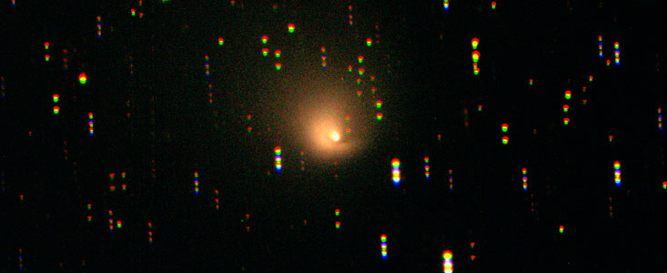
Addendum
Post Perihelion
Some comets can be observed at far distances from the Sun.
Hale-Bopp at 13 AU heliocentric distance.
ESO – La Silla Telescope

