Slide 1
Comets and Spectrography
Raymond Byczko
EPS 530
Planetary Physics
Fall 2015

Slide 2
Definition of Terms
Recovery – the first sighting of a comet predicted to appear from its previous appearances.
Apparition – the sighting of a comet
Kirchhoff's Laws - radiative emission and absorption by a material body in thermodynamic equilibrium

Slide 3
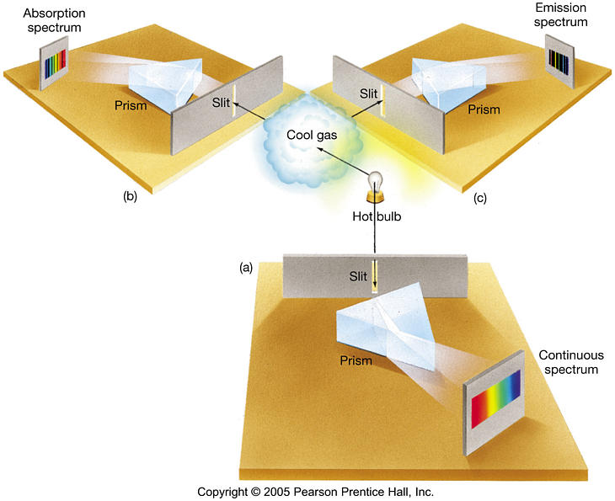
Kirchhoff's Laws
Notes:
Bottom:Solid, liquid, high density gas produces a continuous thermal spectrum
Left: Low density gas directly between hotter source and observer produces absorption spectrum.
Right: When such a gas is viewed from the side, then only emission is observed.

Slide 4

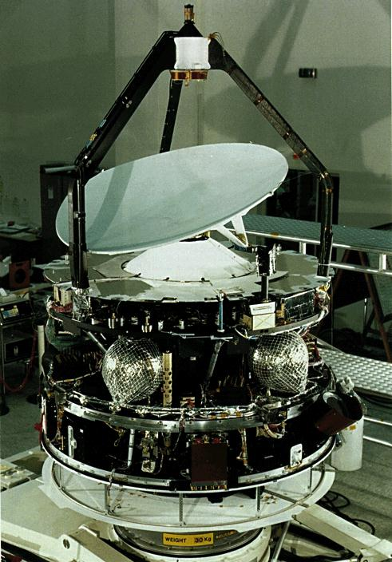


History
comet history is divided into five periods.
Pre 1600: omens
1600 to 1800: motions and orbits
early 1800s: cometary physics
1950: emergence of modern picture – primordial ice and snow
in situ measurement with spacecraft

Slide 5

Pre Spectrographic
(a partial list)
Records go back to 1000 BC in what is now China and Iraq
Tycho Brahe: parallax of comet in 1610.
Johann F. Encke - second person after Halley to predict return of a comet.
P/Encke kept returning 0.1 day earlier than predicted.
Friedrich W. Bessel - 1835 - non-gravitational effect due to asymmetric outflow was causing this.
Notes:
The idea of parallax helps break down the Aristotle point of view that comets existed in the lowest sub lunar sphere of a system of spheres. In other words, they are very close.

Slide 6
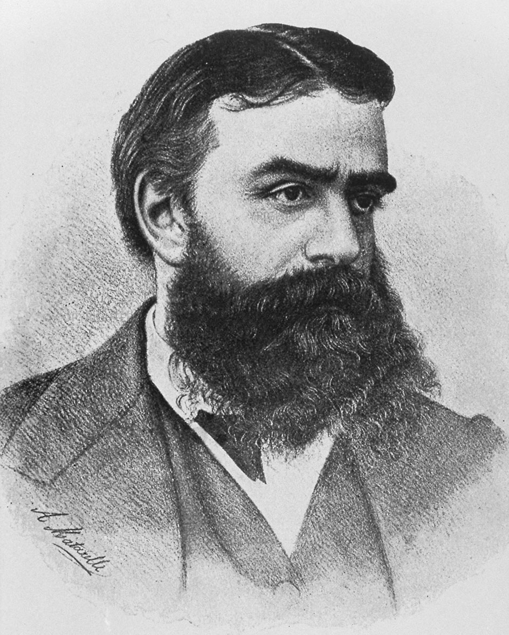
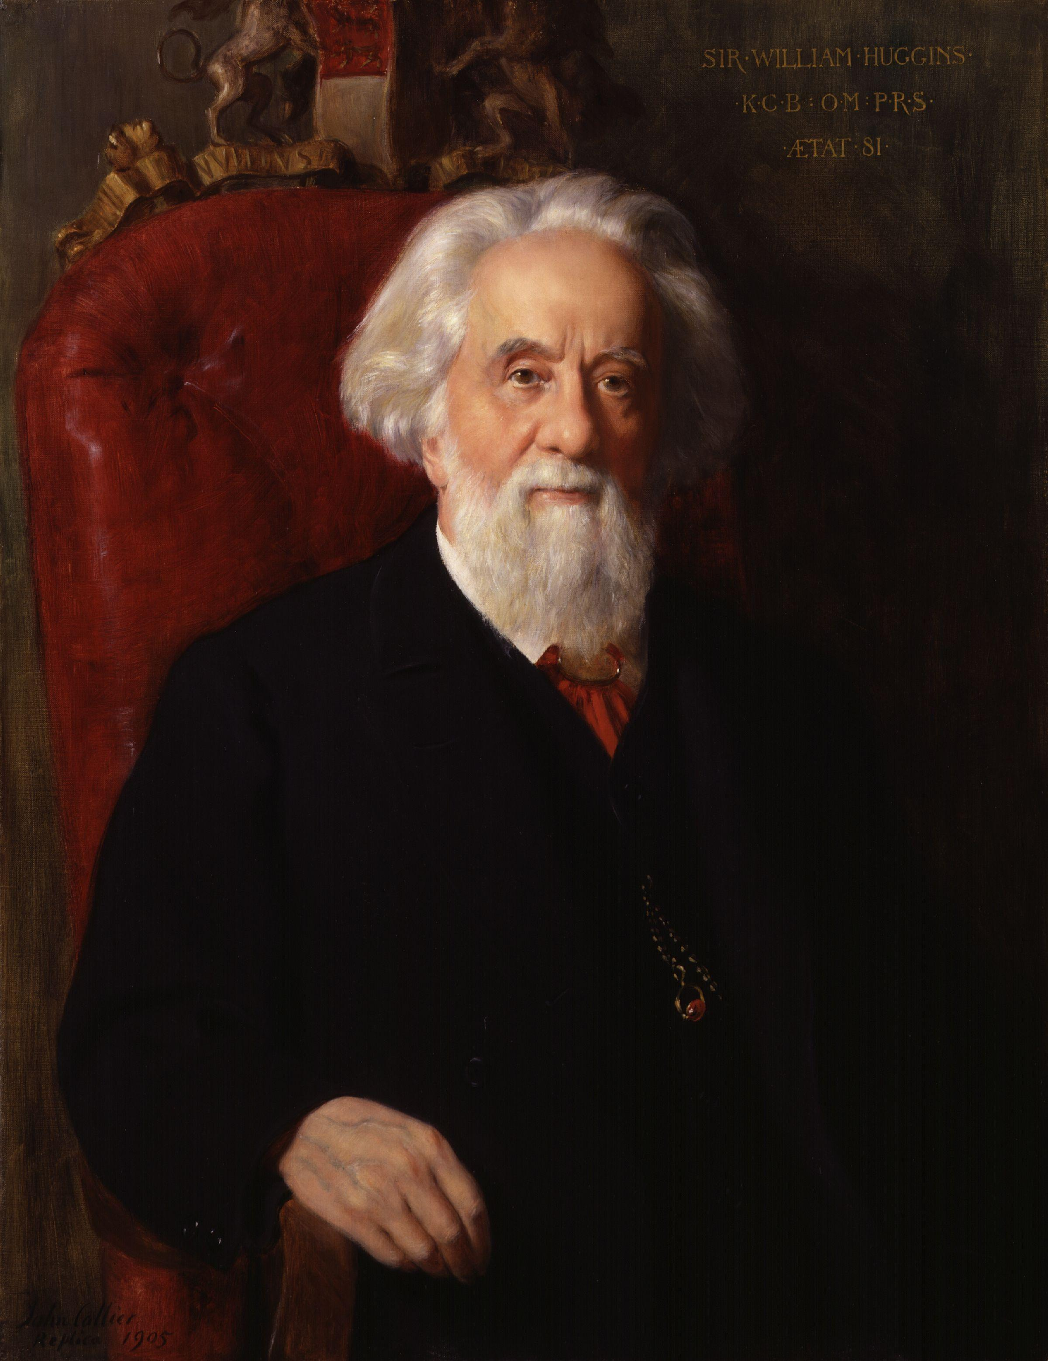
Spectrography
Giovanni Donati (1868),Sir William Huggins (1868)
Compared comet Winnecke spectrum to flame spectrum.
Swan Bands

Slide 7
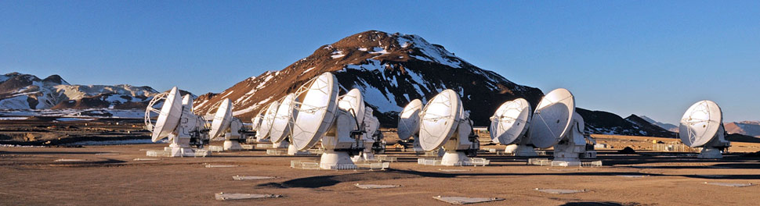

Observing Conditions
Optically thin conditions are optimum – every molecule, ion, and atom is receiving and emitting radiation
Earth's atmosphere blocks sub-millimeter wavelength. Sub-millimeter telescope need to be at high altitude in arid conditions.
Chajnantor plateau, Chilean Andes, ESO, ALMA (Atacama Large Millimeter/submillimeter Array)

Slide 8
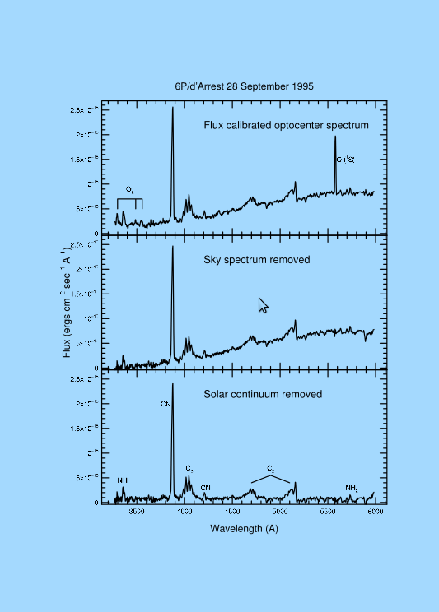
Spectroscopy Issues
Dust/gas – impacts continuum
CCD bias – flat fielding
Telluric night sky emission
Solar continuum-reflected dust
Emission spectrum-Coma gas
Notes:
Individual elements of a CCD can vary in sensitivity. A number of sky shots after sunset can help determine this variance, characterize it, and thus it can be removed in post processing.
Dust/gas ratio is usually from 0.1 to 10. This relates to optical thinness.
Graphic acquired from Icarus article: “Third Years of Cometary Spectroscopy from McDonald Observatory”

Slide 9
Models Used
Haser Model: use to convert observed molecular column densities to production rates
http://asteroid.lowell.edu/comet/gfactor_haser.html
Swings Effect
Notes:
Web page with title: Computing Comet productions Rates from Measured Molecular Fluxes
Involves inputs like r in AU, delta in AU, heliocentric velocity in km/s, aperture radius. Measured fluxes are involved.
Reference to Haser-fraction

Slide 10
Comet Spectroscopic Studies
Third Years of Cometary Spectroscopy from McDonald Observatory
Authors: Anita L. Cochran, Edwin S. Barker, Candace L. Gray
December 2011, Icarus

Slide 11
Research Focus
Explore comet similarity and difference.
Difference due to formation or evolution process.
Observations: 1980 to 2008
130 comets observed
Observe comets to approximately V=19.5
Comets greater than 2.5 AU heliocentric distance were observed although generally less active there.
Observation: observational circumstances, instrument, position of angle of the slit.

Slide 12
Research Conclusion
Comets are very similar
Subset are depleted in carbon chain molecules.
C₂ and NH vary with comet family (JFC, LPC).

Slide 13
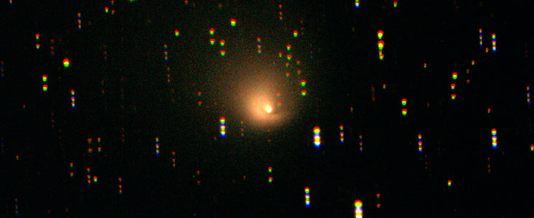
Addendum
Post Perihelion
Some comets can be observed at far distances from the Sun.
Hale-Bopp at 13 AU heliocentric distance.
ESO – La Silla Telescope

