Slide 1
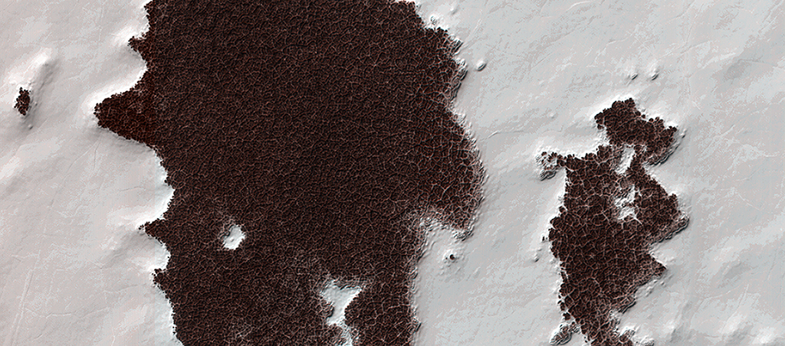

Polygonal Surface Patterns at the South Pole
The white portions of this observation are part of that residual ice cap, and the sunlight is coming from roughly the bottom of this non-map projected image. It is made of solid, frozen carbon dioxide and is very bright relative to the background. This is despite the background terrain having a very high water-ice content, which is darkened by very fine rocky particles, or dust.
uahirise.org/ESP_032487_0895

