Slide 1
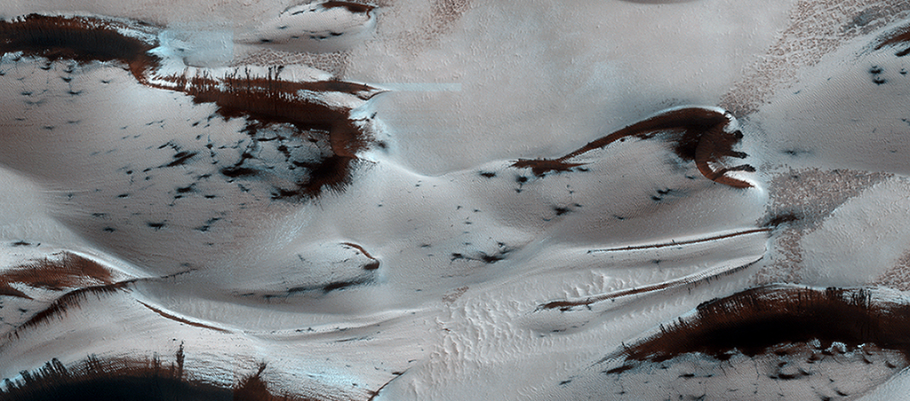

Sand Dunes in Spring
Mars' northern-most sand dunes are beginning to emerge from their winter cover of seasonal carbon dioxide (dry) ice. Dark, bare south-facing slopes are soaking up the warmth of the sun.
uahirise.org/ESP_035033_2635

