Slide 1
Comparison of Martian and Earth Polar Caps
Raymond Byczko
Planetary Physics 530
Fall 2015-Dr. Dawson
Western Connecticut State University

Slide 2
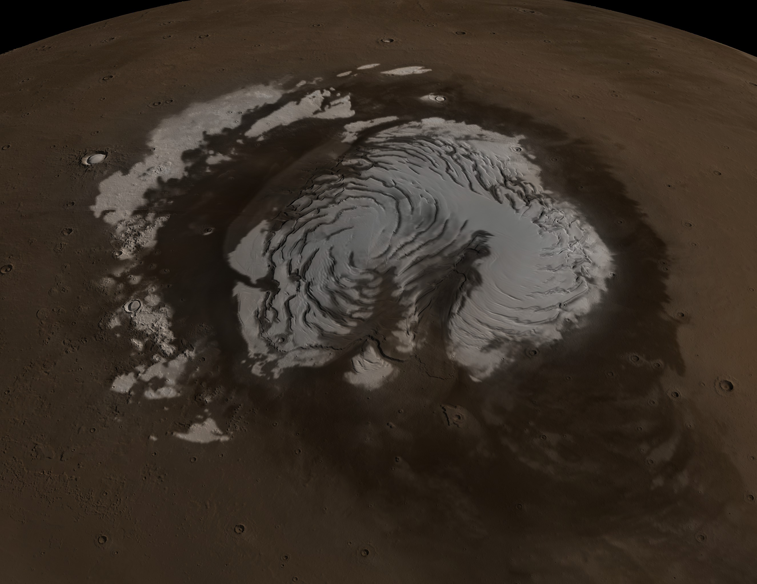
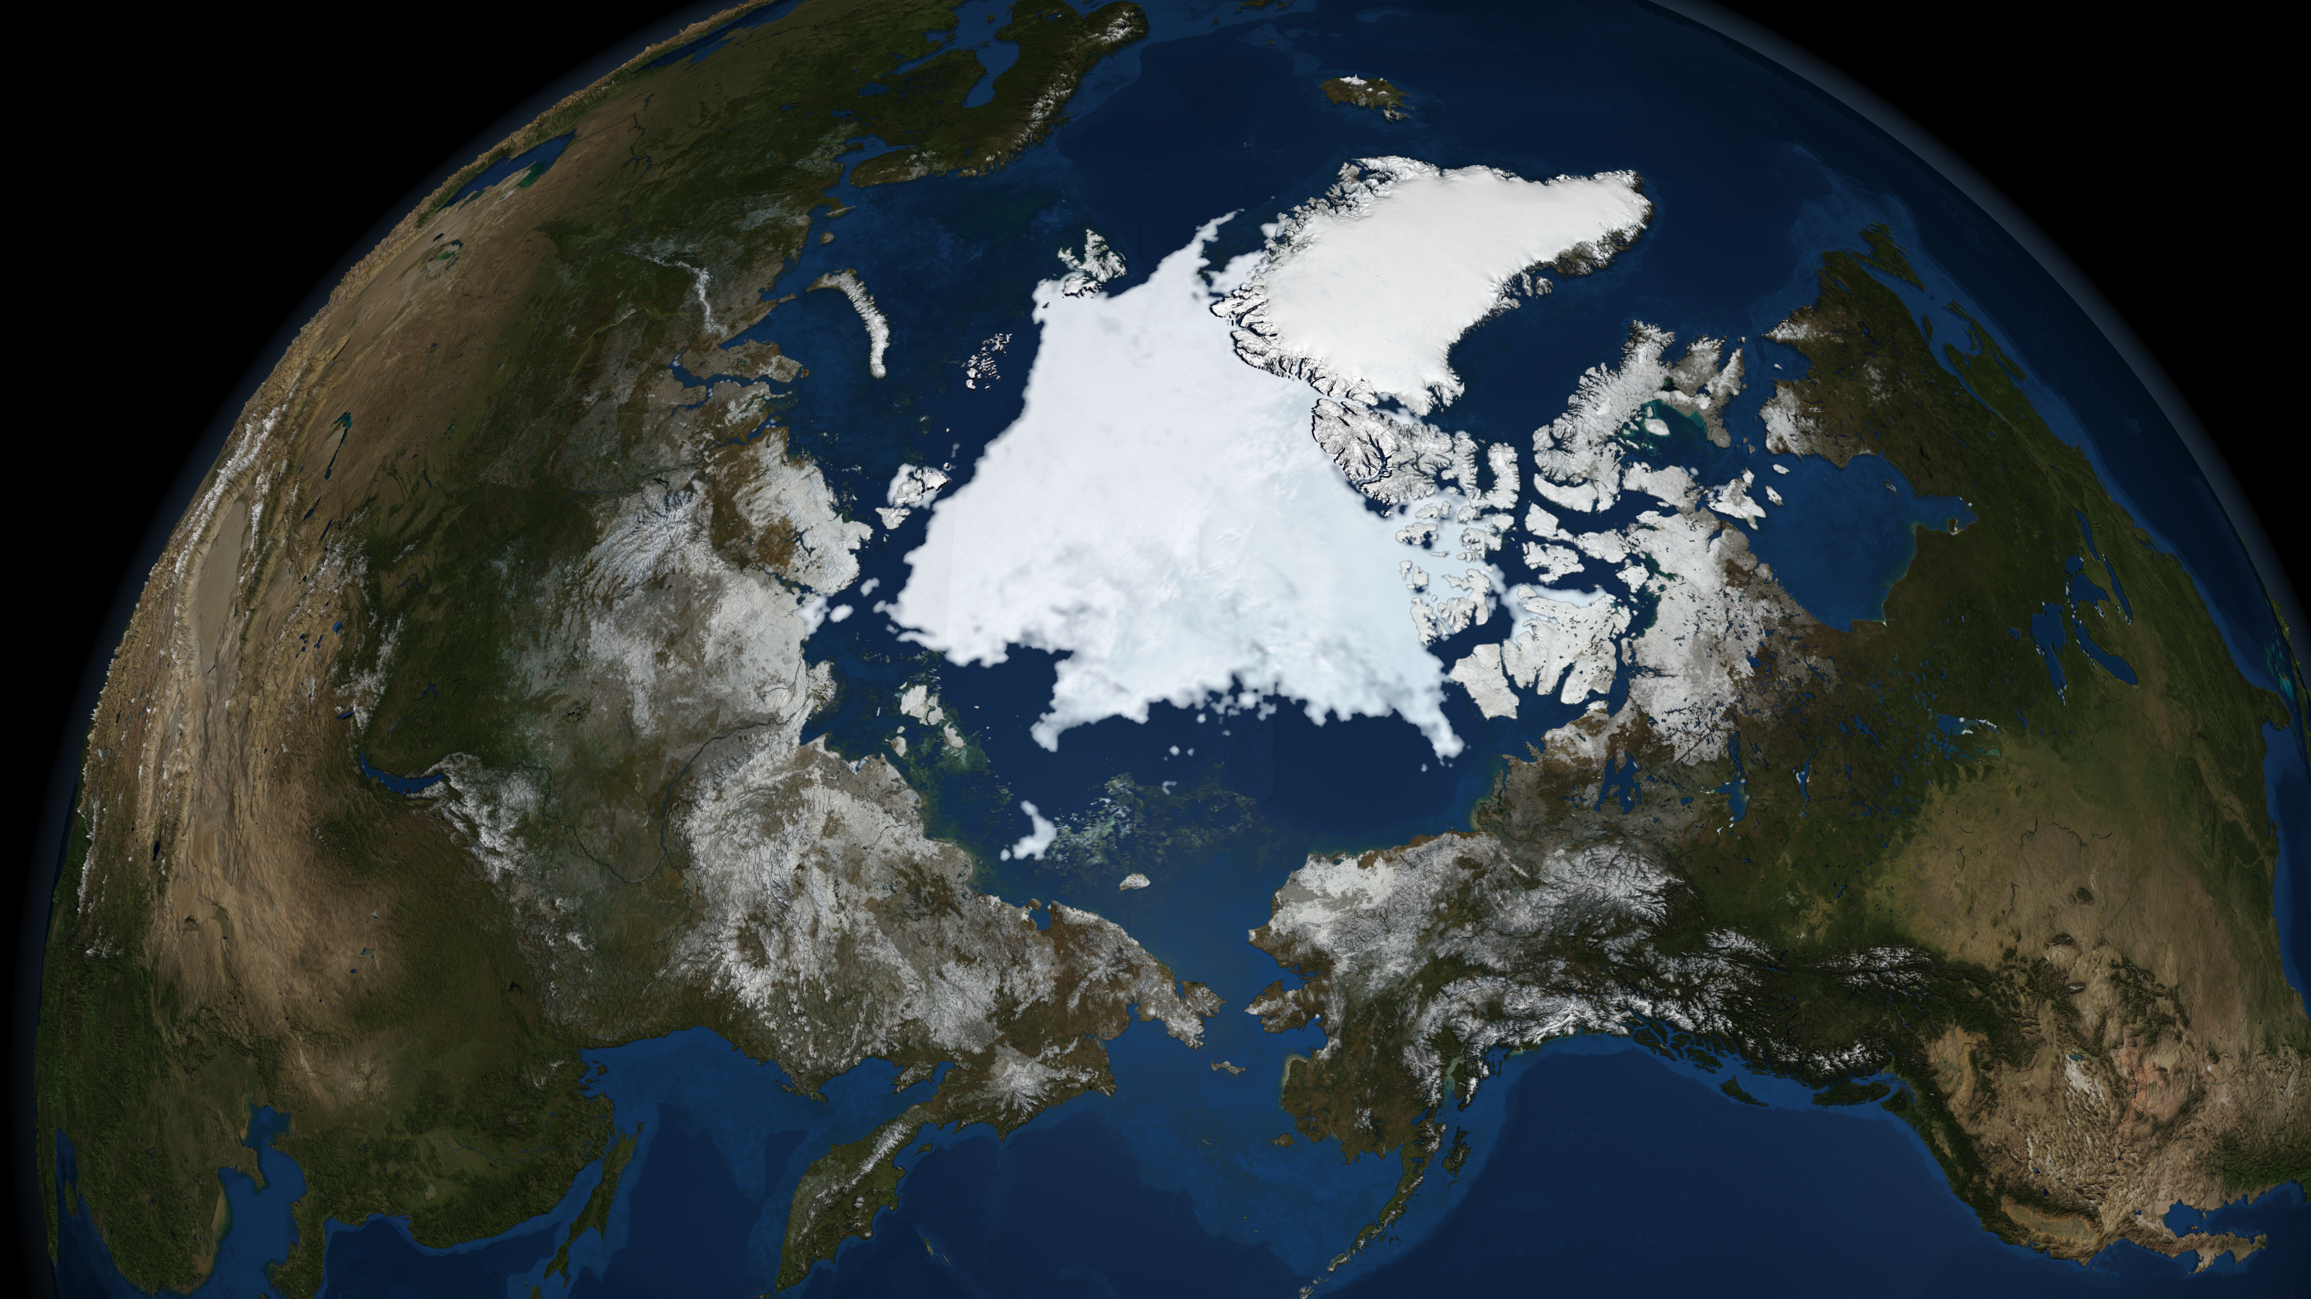
Better Characterization
Comparative planetology allows increased insight into remote worlds where relatively little is known, by comparing them to a better characterized Earth.
(images: [19],[20])

Slide 3
Size
Martian North Pole
1000km diameter, 3.14(10^6) sq km, 2.2 % total surface area
Earth North pole
13.71(10^6) sq km, 2.7 % total surface area

Slide 4
Composition
Background
Martian poles are comprised of three basic units a) layered deposits centered on poles b) seasonal CO2 frost caps c) residual summer caps of frost (H20 north, CO2 south) ([6]). Volatiles include H20 and C02.
Poles on earth are comprised of a) sea ice b) ice sheets. Volatiles include H20.

Slide 5
Composition details
clathrate structure: CO2 molecules fit themselves into spaces between H2O molecules in the loose framework structure of water ice crystals. ([1], p. 37, middle-left)
clathrate: could store CO2 on Mars aiding in the prevention of greenhouse effect. ([1], p. 137)

Slide 6
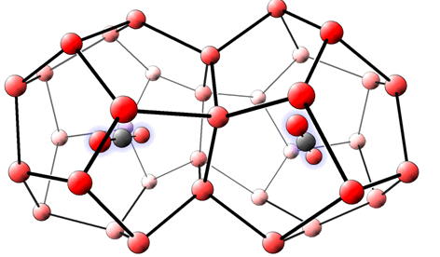
Clathrate (C02 in H2O)[24]

Slide 7
North Poles
Mars: north pole – average 2km thick of water ice and 1m of C02 during northern winter. [11].
Earth: north pole - sea ice floating over Arctic ocean, 3-4 m thick, ridges up to 20 m thick ([10])

Slide 8
South Poles
Mars: south pole – average 3km thick of water ice and 8m of permanent CO2.[11]
Earth: South pole – Antarctic land mass covered by Antarctic ice sheet [10]. Average thickness: 26.5(10^6)cubic km/14(10^6)sq km = 1.89 km (derived from numbers in [11])

Slide 9
Size Conclusion
With the sheer thickness of our own South Pole at 1.89km, its magnitude is comparable to the North and South Martian pole depth, at 2km and 3km respectively.

Slide 10
Seasonal Comparison
What happens as winter approaches?
Mars: “Substantial fraction of the whole atmosphere gets frozen out at the south pole, the atmospheric pressure drops everywhere by one third.” ([1], p. 127, top-right)
Earth: Range of sea ice expands around South Pole.

Slide 11
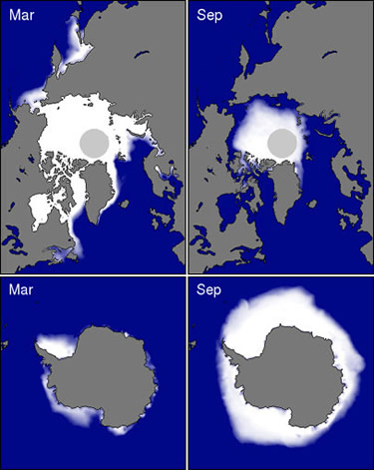
Earth Sea Polar Sea Ice

Slide 12
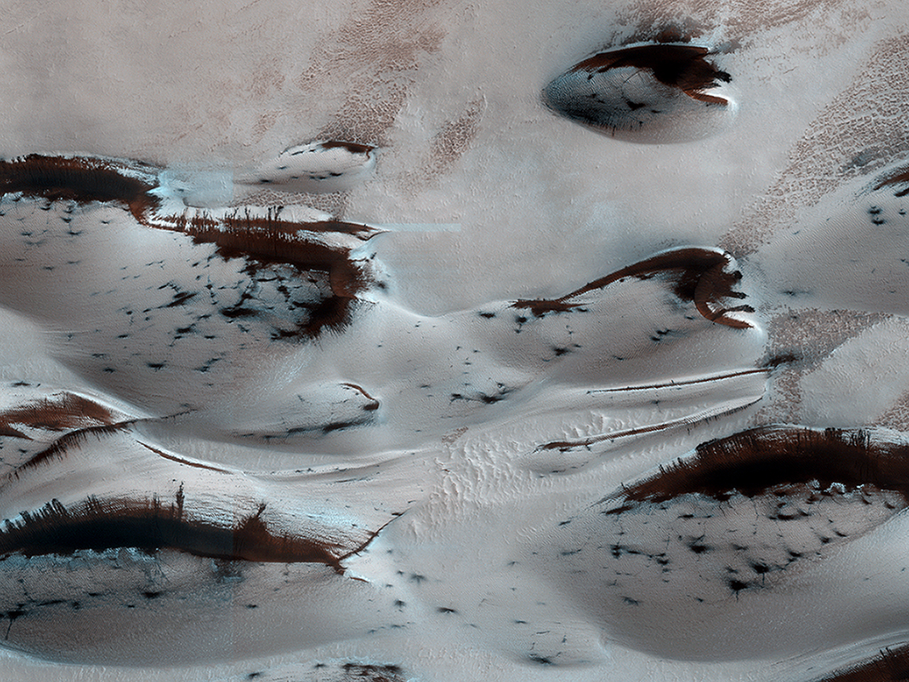

Sand Dunes in Spring
Mars' northern-most sand dunes are beginning to emerge from their winter cover of seasonal carbon dioxide (dry) ice. Dark, bare south-facing slopes are soaking up the warmth of the sun.

Slide 13
Seasonal Conclusion
With Spring the impact of sublimation is greater on Martian weather than the effect of retreating sea ice around Antarctica on Earth weather.

Slide 14
Collapse Dynamics
Edge disintegration
Earth – calving of glaciers
Mars – frozen CO2 avalanche

Slide 15
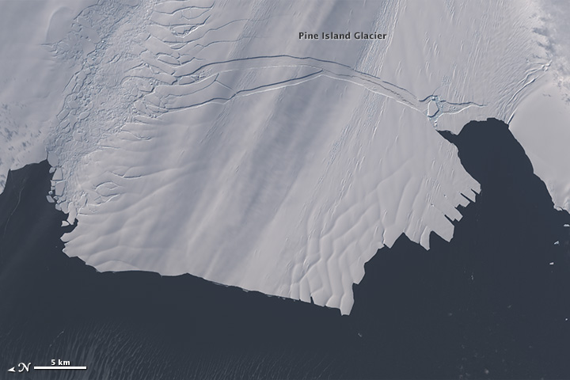
Pine Island Glacier
Rift detected October 2011 [17]
Full crack, pre-seperation July 2013 [17]
Image source: See [15].

Slide 16
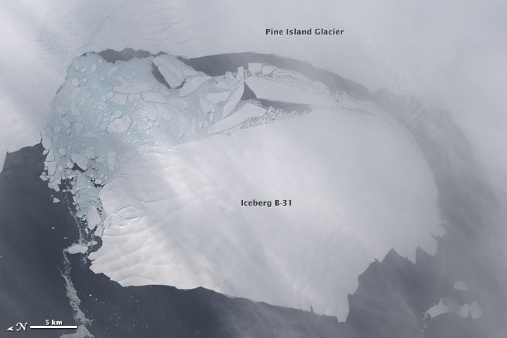
Pine Island Glacier
Separation November 2013
Location: 75 deg 10 min S, 100 deg 0 min W
Image source: See [16].

Slide 17
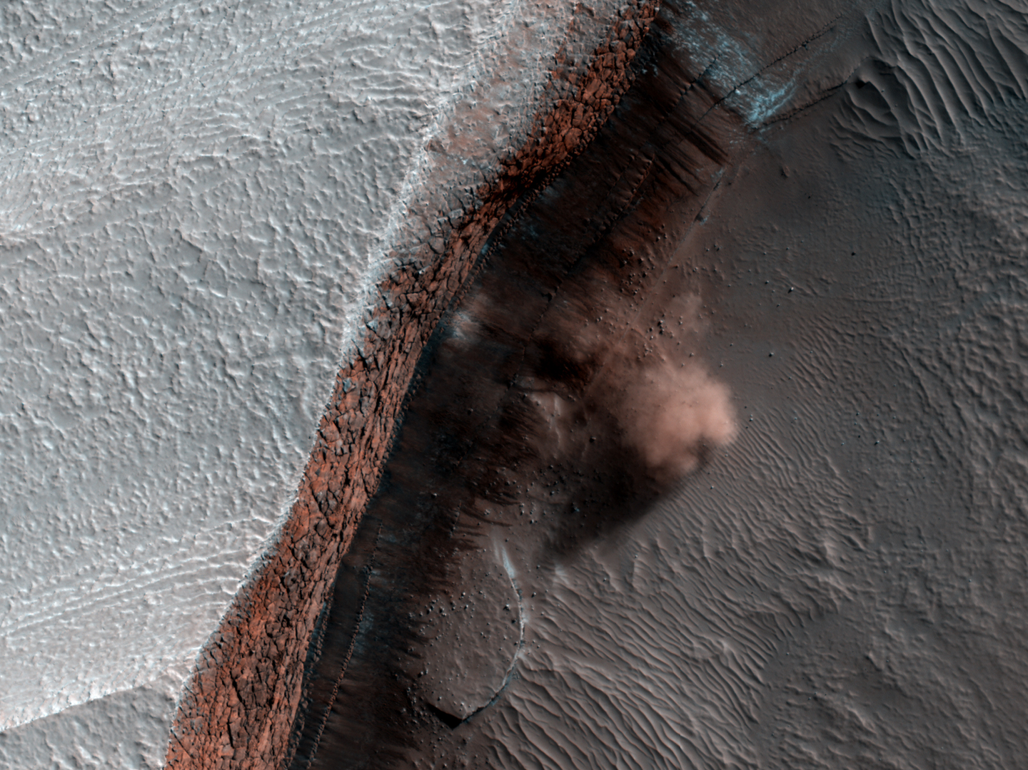
Avalanche Clouds (credit Patrick Russel, 2010, [13])
Cliff: 700m
83.8 deg lat, 253.3 deg long

Slide 18
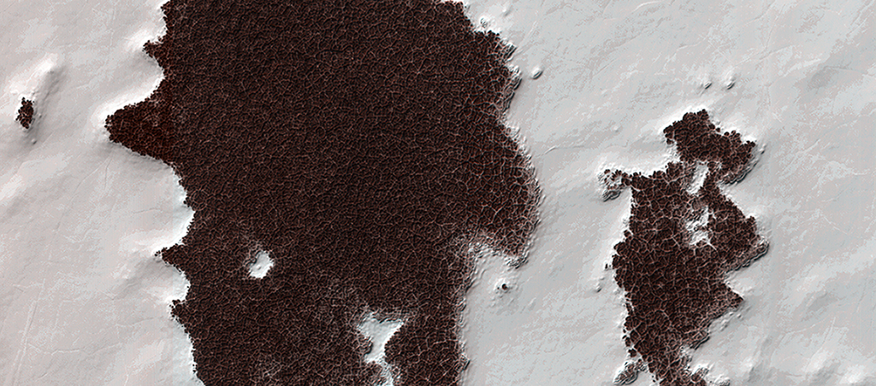
Polygonal Surface Patterns at the South Pole
The white portions of this observation are part of that residual ice cap, and the sunlight is coming from roughly the bottom of this non-map projected image. It is made of solid, frozen carbon dioxide and is very bright relative to the background. This is despite the background terrain having a very high water-ice content, which is darkened by very fine rocky particles, or dust.
uahirise.org/ESP_032487_0895

Slide 19
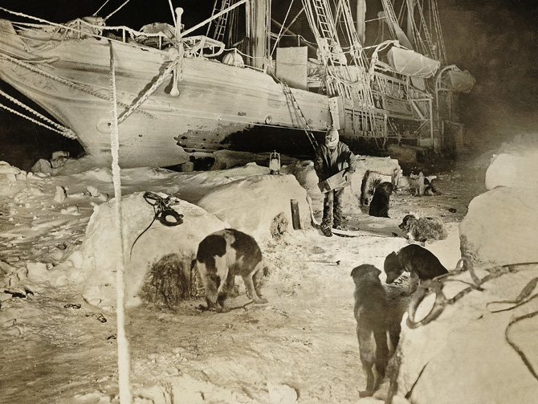
Earth

Slide 20
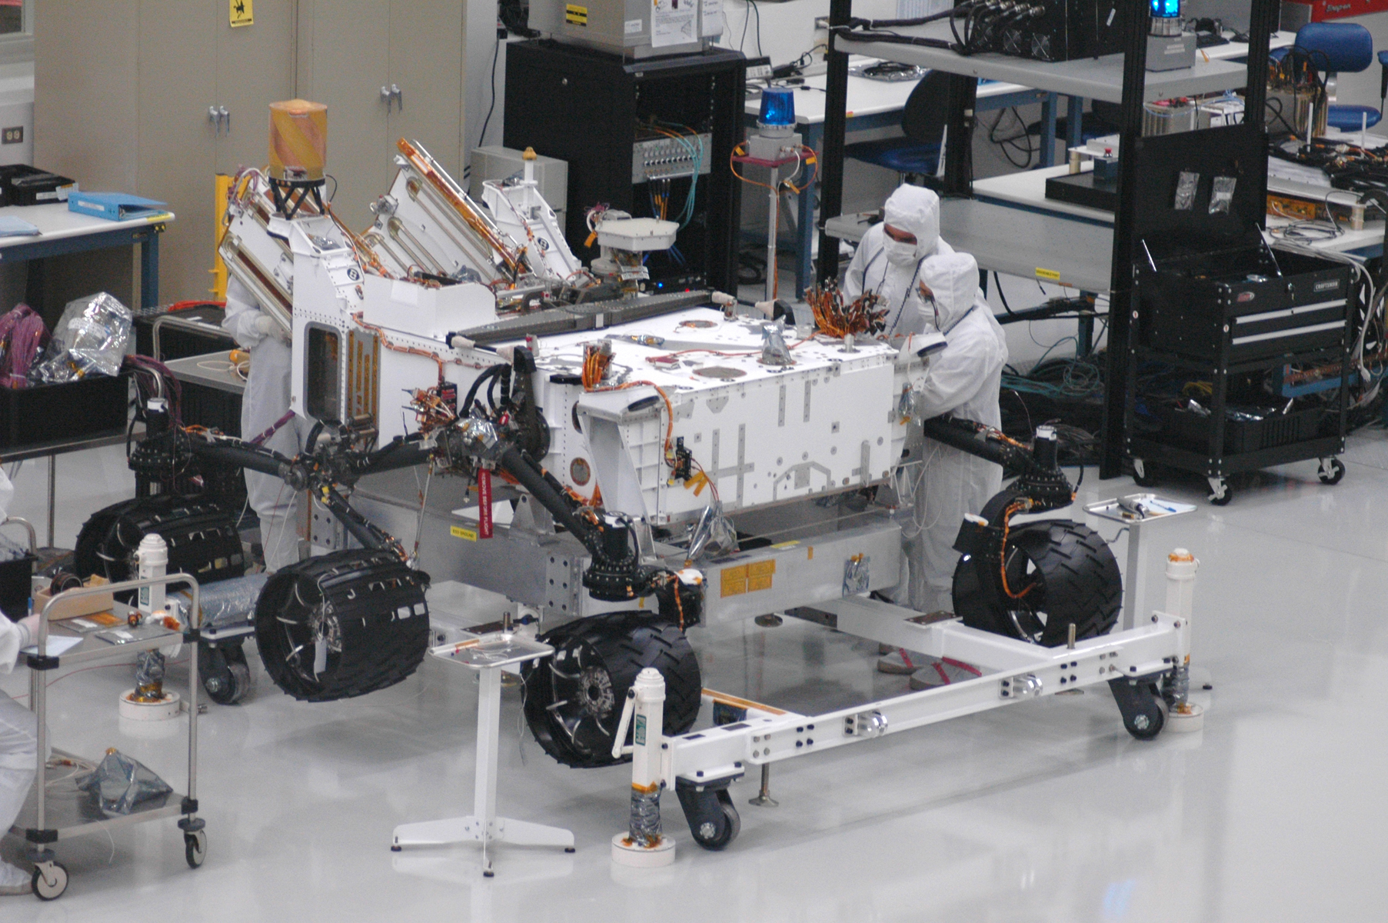
Mars

Slide 21
Bibliography
[1] Worlds Apart: A Textbook in Planetary Sciences
Guy J. Consolmagno, S.J., Martha W. Schaefer
[2] http://hyperphysics.phy-astr.gsu.edu/hbase/solar/mars3.html
[3] http://www.nasa.gov/centers/ames/multimedia/images/2005/marscap.html
[4] “Albedo of the south pole on Mars determined by topographic forcing of atmosphere dynamics”, Nature (Journal), 5/12/2005, Vol. 435 Issue 7039, p184-188. 5p. DOI: 10.1038/nature03561.
[5] https://en.wikipedia.org/wiki/Geyser_(Mars)
[6] Thomas, P. C. et al. North–south geological differences between the residual polar caps on Mars. Nature (Journal),404, 5/9/2000, 161–164
[7]: http://www.universetoday.com/25756/surface-area-of-the-earth/
[8]: https://en.wikipedia.org/wiki/Mars
[9]: https://en.wikipedia.org/wiki/Earth
[10]: https://en.wikipedia.org/wiki/Polar_ice_cap
[11]: https://en.wikipedia.org/wiki/Antarctic_ice_sheet
[12]: https://en.wikipedia.org/wiki/Mars#Polar_caps
[13]: https://nsidc.org/cryosphere/seaice/characteristics/difference.html

Slide 22
Bibliography
[14]: http://www.uahirise.org/ESP_016423_2640
[15] http://eoimages.gsfc.nasa.gov/images/imagerecords/82000/82392/PineIslandGlacier_oli_2013301.jpg
[16]
http://eoimages.gsfc.nasa.gov/images/imagerecords/82000/82392/PineIslandGlacier_oli_2013317.jpg
[17]: http://earthobservatory.nasa.gov/IOTD/view.php?id=82392
[18]: https://en.wikipedia.org/wiki/Pine_Island_Glacier
[19]: http://www.nasa.gov/topics/earth/sea_ice_nsidc.html
[20]: https://svs.gsfc.nasa.gov/vis/a000000/a002200/a002292/marsNPoleTrue.jpg
[21]: http://ngm.nationalgeographic.com/2013/09/failures/img/11-shackleton-south-pole-expedition-670.jpg
[22]: http://mars.jpl.nasa.gov/msl/images/20100701_msl_wheels2.jpg
[23]:
http://casey.brown.edu/research/crp/Research/Projects/P4/home.htm (clathrate structure CO2 in H2O)
[24]: http://casey.brown.edu/research/crp/Research/Projects/P4/main_files/Fig%201.gif (gif of clathrate structure at [23])

