Slide 1



PHP, GIT, and mod_rewrite
Raymond Byczko
raymondbyczko@att.net
https://github.com/RaymondByczko

Slide 2
Goal
A code base is moved from development to production for a web site.
For some reason, one or more web pages might have changed. (deployment mistake, tampering, action outside of strict deployment)
How can this be checked?

Slide 3
One solution
The developer ftp's to the production website, and browses possible files visually.
Ftp (scp) each file and the developer does a unix 'diff'.
Other solutions

Slide 4
Problems
Labor intensive
Error prone
Insufficiently automated
Large number of files

Slide 5
Good Solution Characteristics
Automated
Mathematical – a number allows a 'yes' or 'no' to the question of possible file compromise.
Relatively easy
Non-propriety
Open source
Free or low cost

Slide 6
Automation
1) Apache2
2) php
3a) mod_write
3b) Apache2 handlers
This solution requires setup of 1), 2), and either 3a) or 3b). Basic Apache2, php is assumed knowledge. Lets cover mod_rewrite.

Slide 7
mod_rewrite
"The mod_rewrite module uses a rule-based rewriting engine, based on a PCRE regular-expression parser, to rewrite requested URLs on the fly."
This will work by enabled the module rewrite (a.k.a mod_rewrite)
/usr/sbin/a2enmod
http://httpd.apache.org/docs/2.4/mod/mod_rewrite.html
Verify with phpinfo()

Slide 8
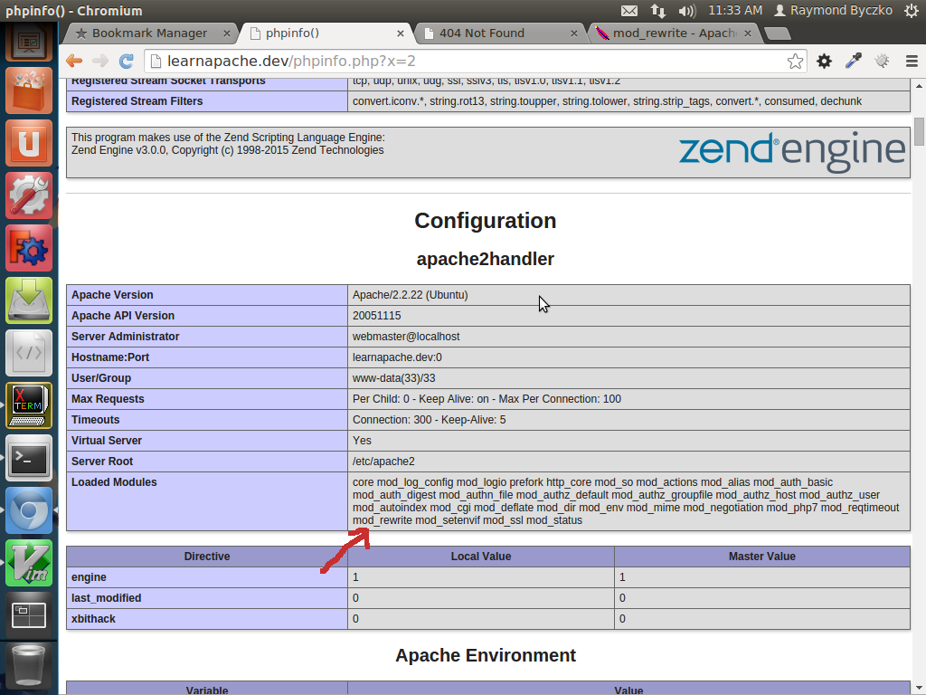
phpinfo()

Slide 9
Apache2 – enabling a module
Here are the steps to remedy:
1) Make sure this exists: /etc/apache2/mods-available/rewrite.load
2) Issue: sudo a2enmod rewrite
3) Issue: sudo service apache2 restart

Slide 10
mod_write configuration
Once the module is enabled, you need to invoke instructions like the
following. Apache is aware of contexts for its instructions.
See:
http://httpd.apache.org/docs/2.4/mod/directive-dict.html#Context
Reviewing the above, we see the contexts are: server config, virtual host,
directory, .htaccess. For my example, I used virtual host.
RewriteEngine on
RewriteRule /*.gitsha1 /cgi-bin/gitsha1.php

Slide 11
URL Forwarding
Any url request ending in 'gitsha1' will be be forwarded to /cgi-bin/gitsha1.php
Call gitsha1.php the 'forwarding target'
Implementing the forwarding target allows a connection between a) installed production file b) git attributes
Provides the basis of verification or lack of, concerning if a file is in version control.

Slide 12
Simple Forwarding Target
$pt = $_SERVER['REQUEST_URI'];
$dr = $_SERVER['DOCUMENT_ROOT'];
$posSuffixStart = strpos($pt, '.gitsha1');
$realFile = substr($pt, 1, $posSuffixStart-1);
$fe = file_exists($dr.'/'.$realFile);
if ($fe == false)
{
echo '<p>';
echo 'This file does not exist: '.$dr.'/'.$realFile;
return;
}
$filecontents = file_get_contents($realFile, FILE_USE_INCLUDE_PATH);
$filesize = strlen($filecontents);
$gitentity = 'blob '.$filesize."\000".$filecontents;
$sha1ge = sha1($gitentity);

Slide 13
Forwarding Target
Get real file.
Get size of real file.
Get contents of real file.
Apply formula using: blob, file_size, file_contents
Obtain sha1.
If the file exists in version control, the sha1 obtained here will be found somewhere in the repository. If not, the file is outside of version control.

Slide 14
Utilizing the Forwarding Target
Issue the regular URL to see the page.
e.g. *http://learnapache.dev/examplestuff/here.php
Append .gitsha1 to the regular URL to see the git hash of the file (production)
e.g.**http://learnapache.dev/examplestuff/here.php.gitsha1
/examplestuff/here.php exists under doc root
/examplestuff/here.php.gitsha1 does not exist under doc root. From rewrite, we get it to map to a file.

Slide 15
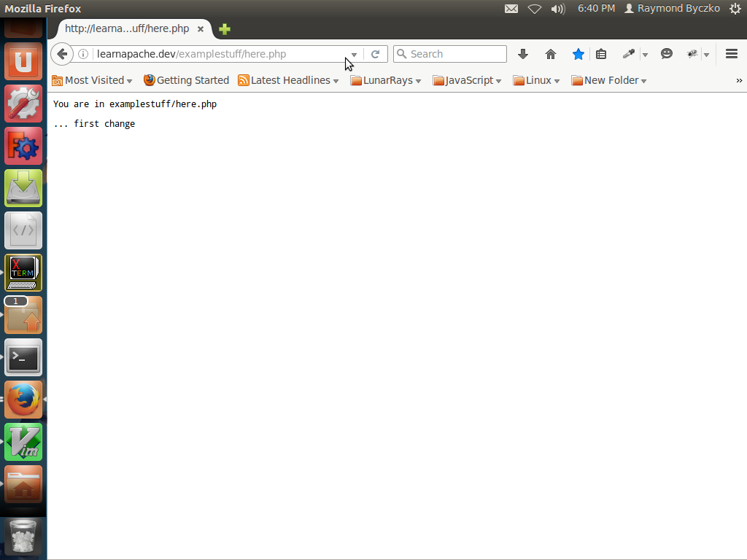
Web content

Slide 16
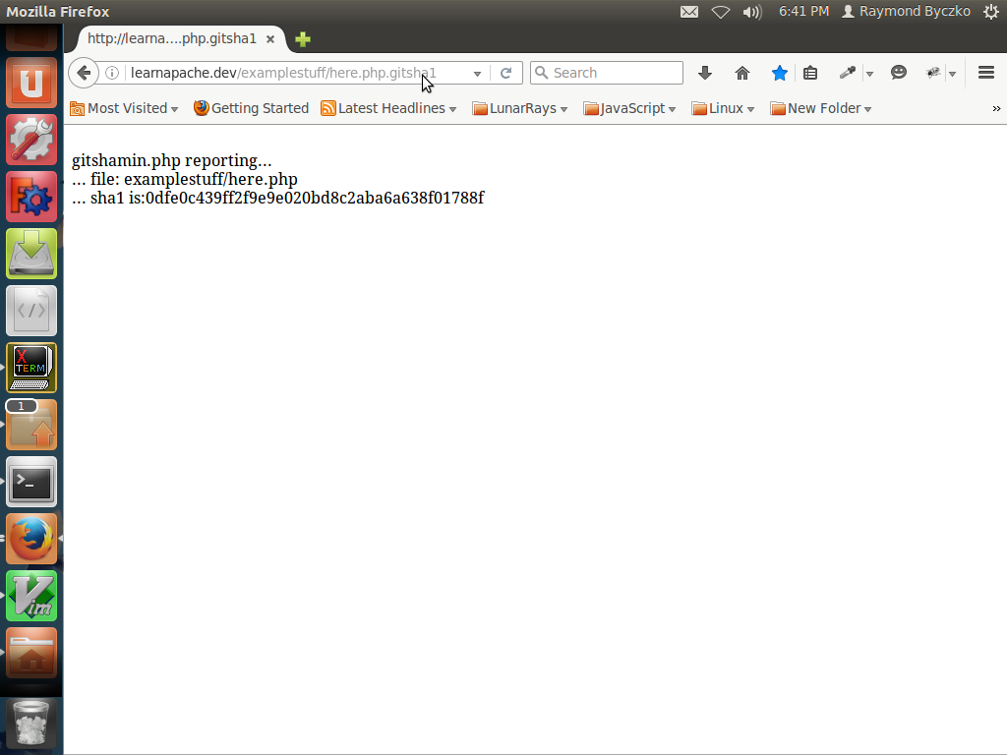
Git hash verify

Slide 17
Repository Check
Generation of git hash for production file.
Does this exist in repository?
Answer is derived from git command line and scripts.
git log
git ls-tree
gitsearch.pm, test_gitfind.pl

Slide 18

Sample Code
https://github.com/RaymondByczko/git-php-rewrite

Slide 19
Usage
GITSEARCH_LIB=`pwd`
export GITSEARCH_LIB
./test_gitfind.pl --githash de4467

Slide 20
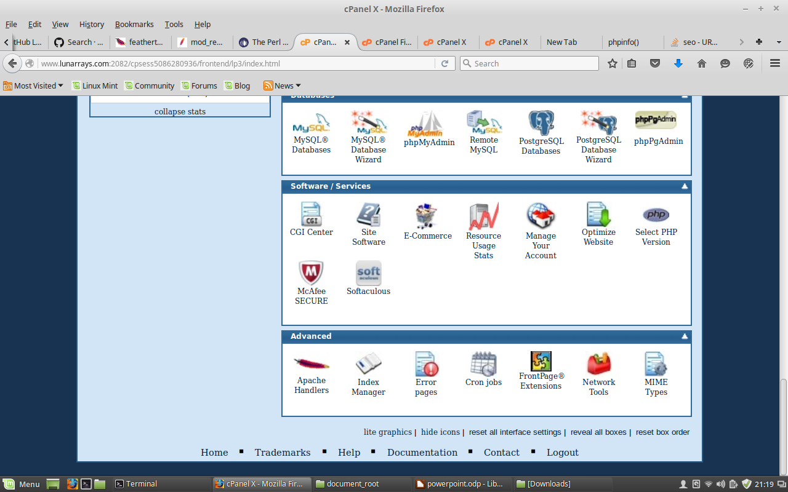
Apache Handler
Used for shared hosting or when mod_rewrite is not available.

Slide 21
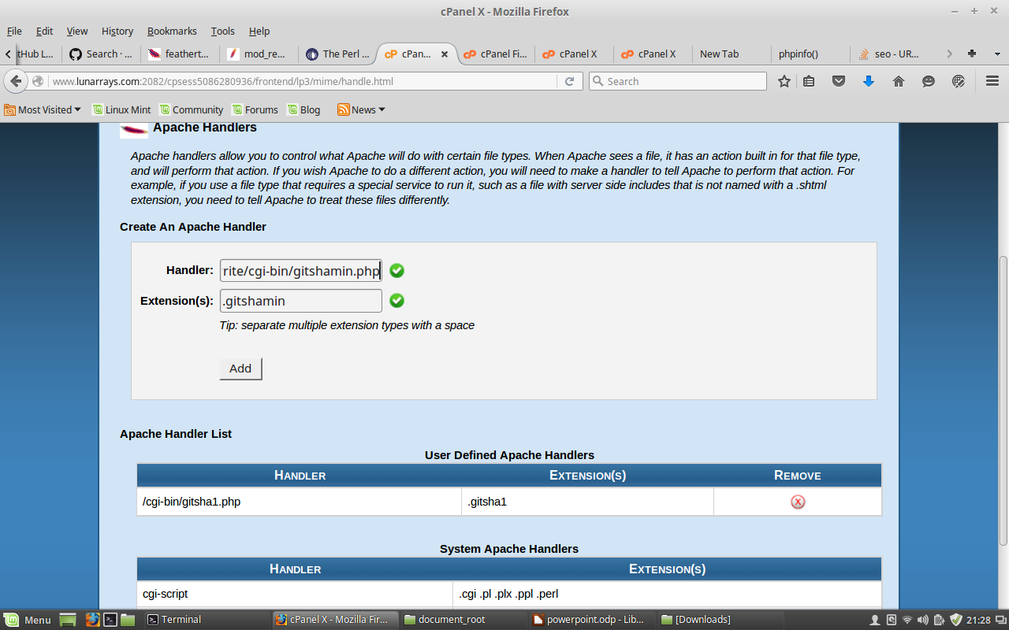
Setting up the Apache Handler

