Slide 1
Pitchify
Bringing startups and investors together

Slide 2
Pitchify
Startups presenting their pitches to the investors on one website
Investors investing into the startups

Slide 3
Requirements
Companies must be able to list their pitches
Companies must be able to edit their pitch, in case of error
Investors must be able to browse pitches and invest in a pitch that they liked for the stocks
Investors must be able to negotiate for the price of stocks with the companies
Investors must be able to see their investments and negotiations with the companies.

Slide 4
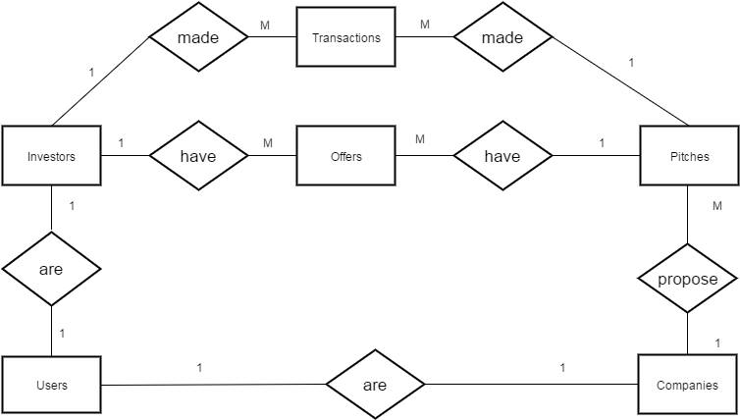
ERD

Slide 5
User Personas: Bob
Meet Bob.
Bob is a founder and a director of recently founded company.
His circumstances:
Bob did a market research and found out, that people would like to use services provided by his company. Unfortunately, Bob has no money for expensive marketing campaign of the services. An investment would allow him to market his company and make money out of offering his services to general public.
What would she use the system for:
Bob would use the system to connect to present his idea to the investors and get the necessary funding for his marketing campaign.

Slide 6
User Personas: Tina
Meet Tina.
Tina is a director of a venture capital (VC) company.
Her circumstances:
Her company invests $20 million a month, but this month there were not enough appealing startup ideas to invest in and they have invested only $ 18 million. Tina is looking to invest $ 2 more million in startups.
What would she use the system for:
Tina would use the system to find startups worth investing in.

Slide 7
User Personas: Simon
Meet Simon.
Simon is an angel investor.
His circumstances:
Simon is a very busy person. He has lots of meetings every day. To generate maximum possible revenue, Simon tries to be very productive.
What would she use the system for:
Simon would use the system to efficiently find startups to invest in between his meetings.

Slide 8
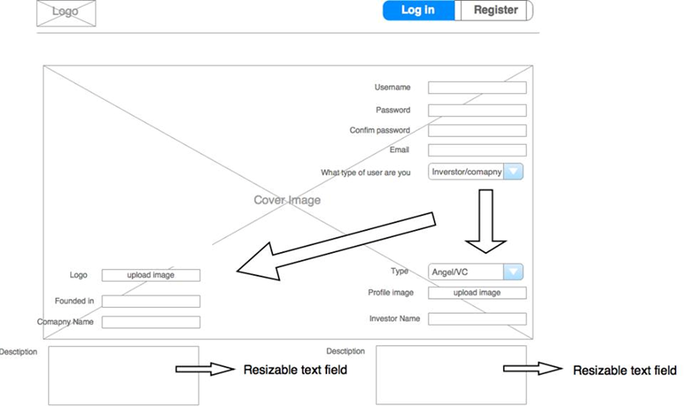
Homepage

Slide 9
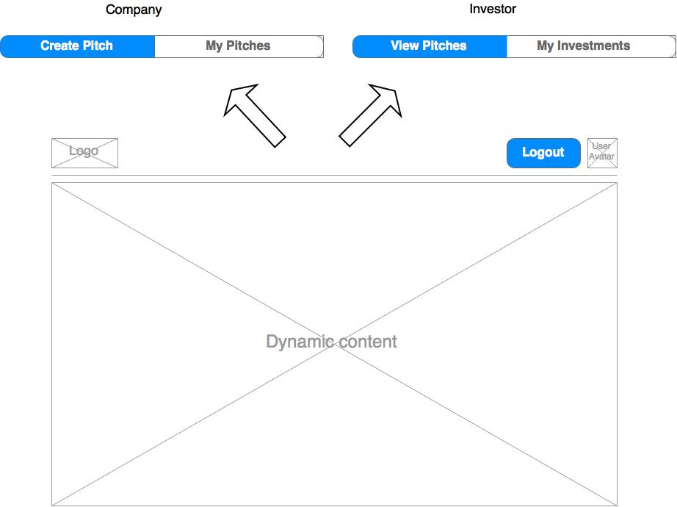
Header

Slide 10
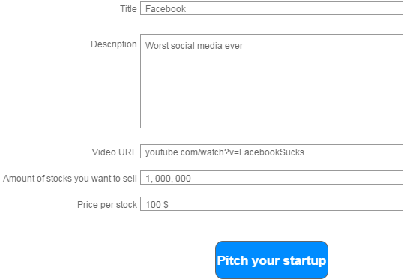
Adding pitch

Slide 11
Companies’ pitches

Slide 12
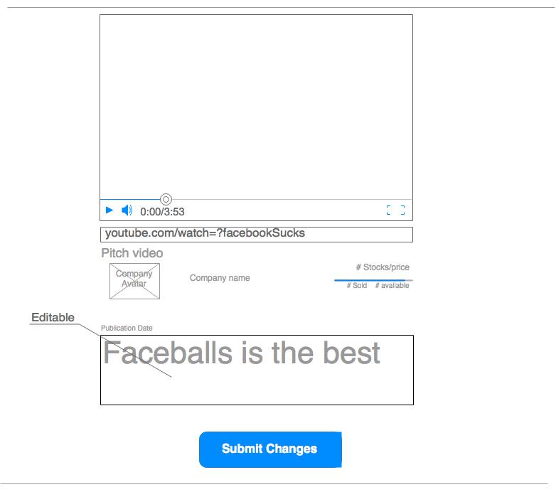
Edit pitch

Slide 13
Pitches available

Slide 14
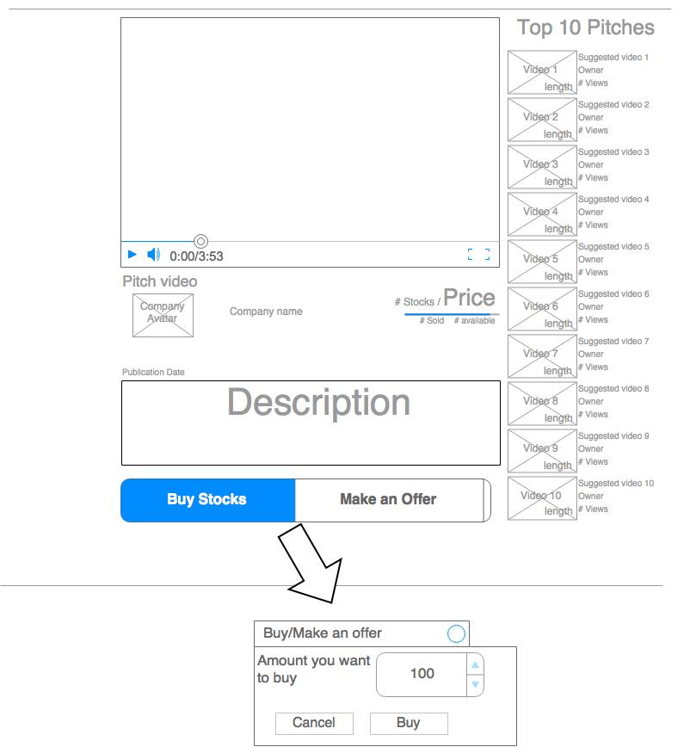
Pitch view

Slide 15
Investors investments

Slide 16
Investors investment history

Slide 17
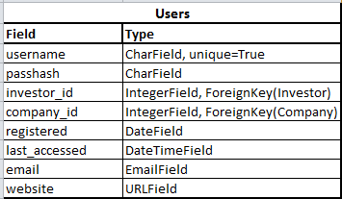
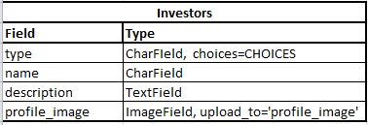
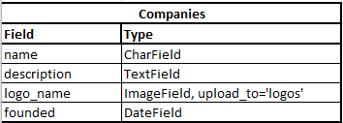
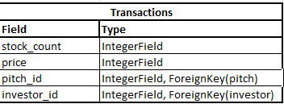
Attributes in entities

Slide 18
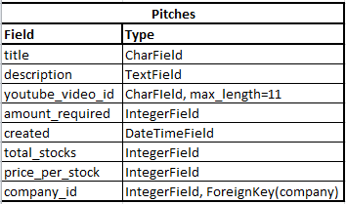
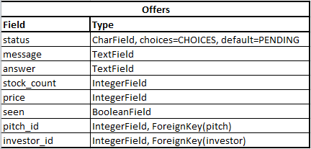
Attributes in entities

Slide 19
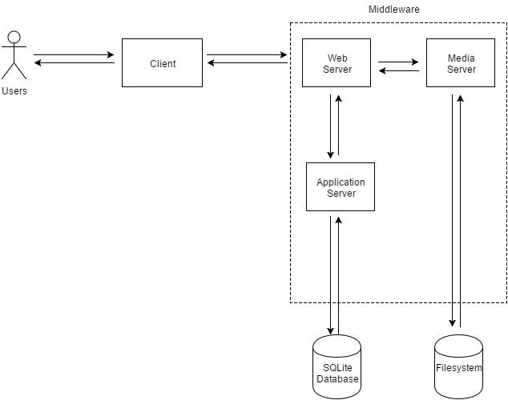
High level system architecture

