Slide 1
Welcome to R!
Notes:
Please number all slides!

Slide 2
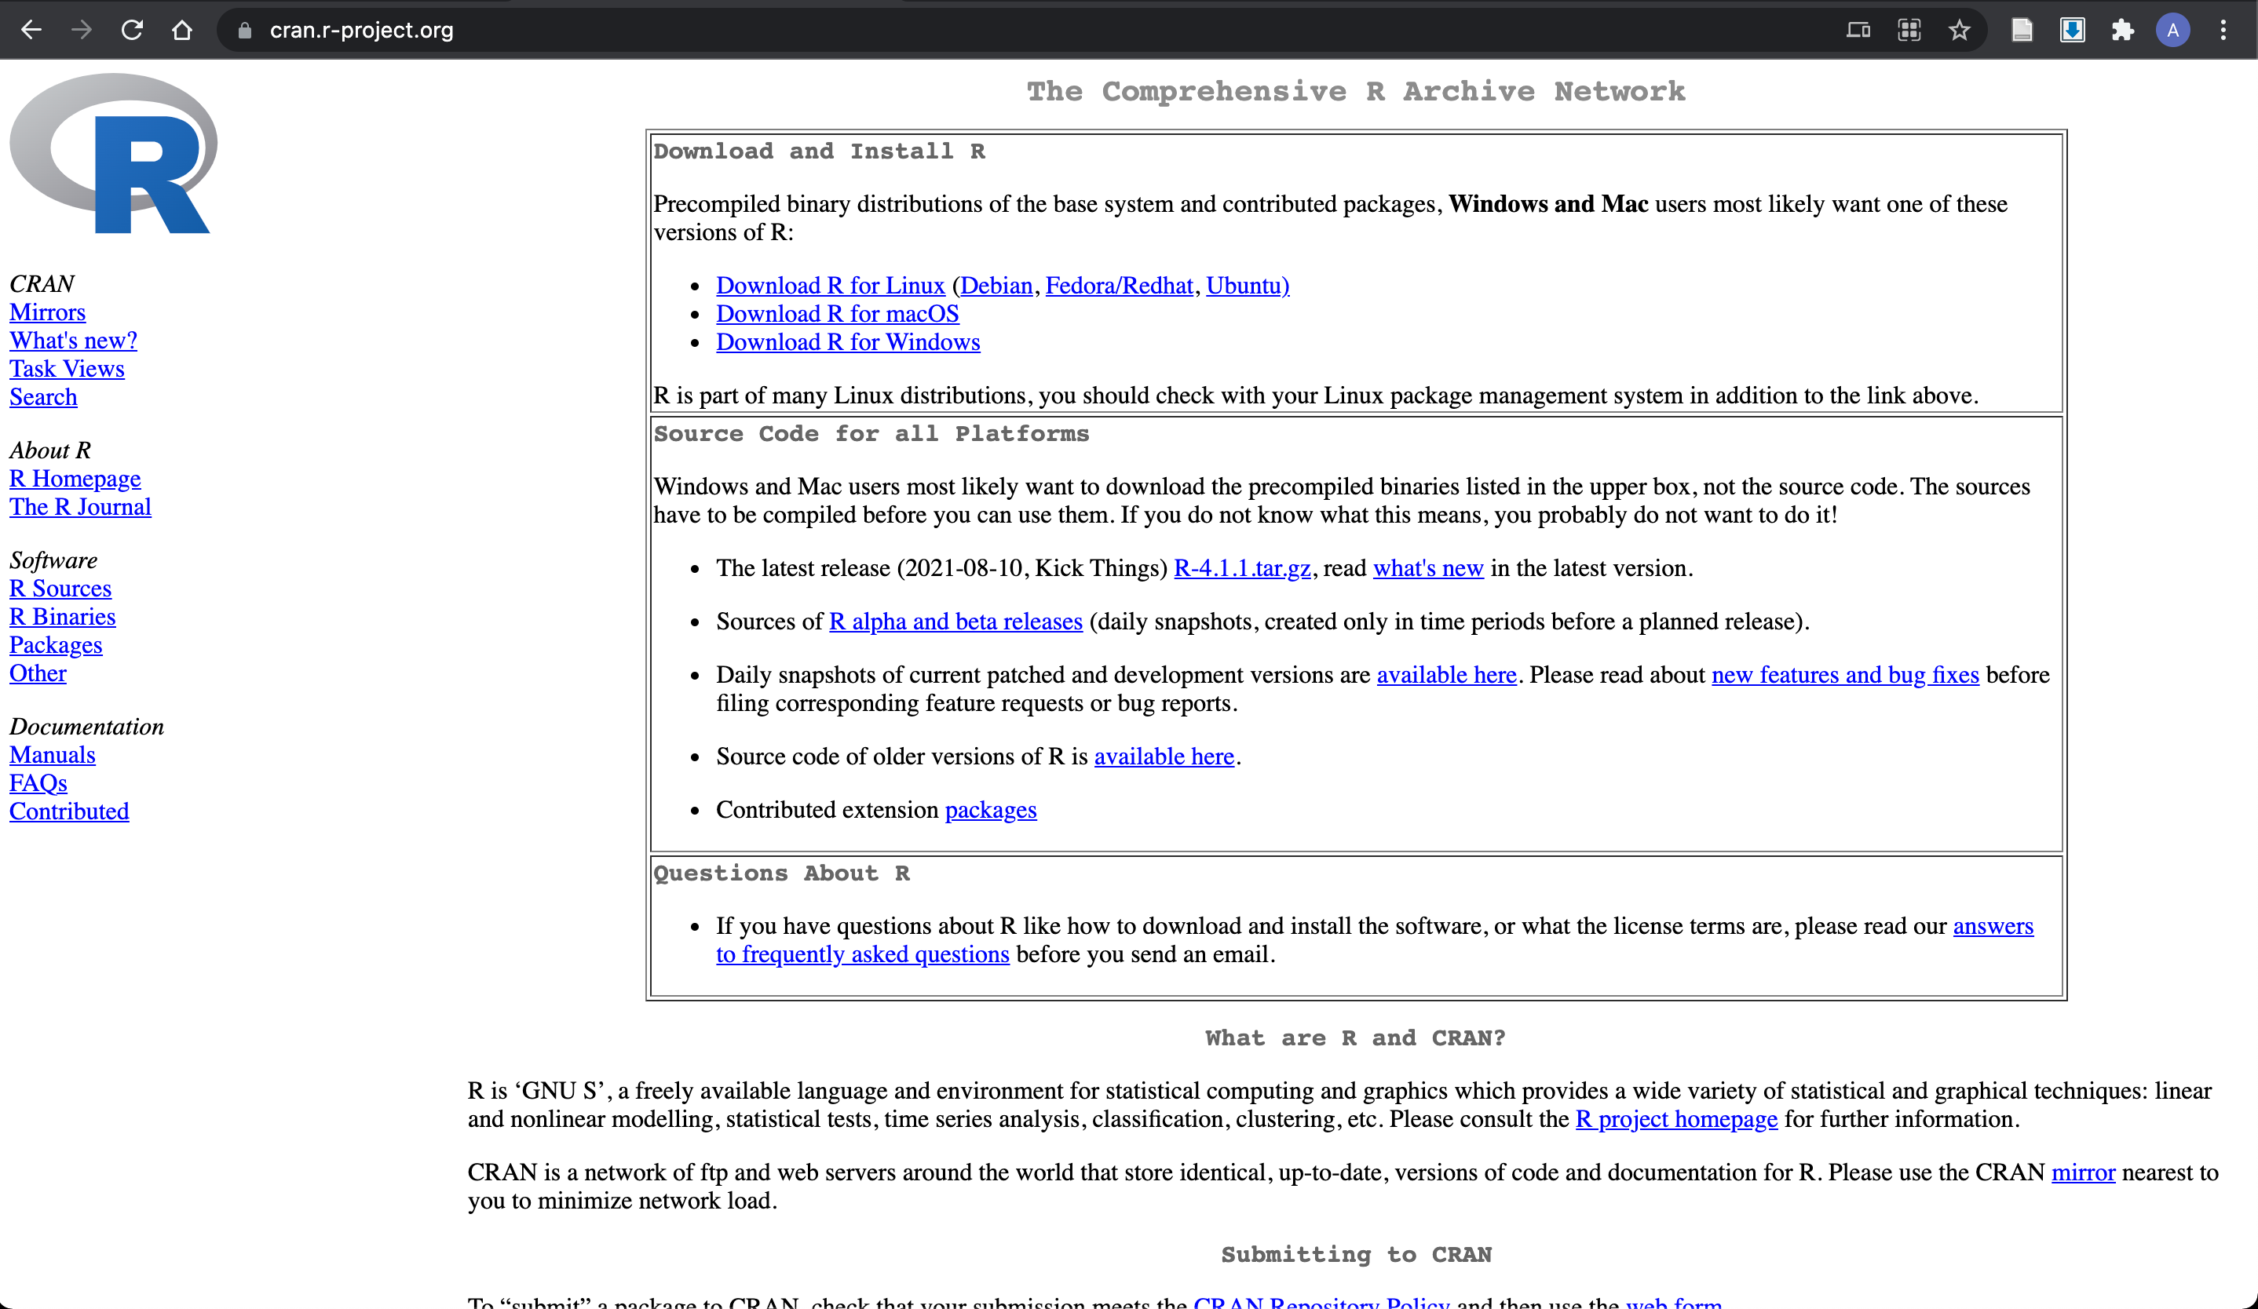
Installing R
R: https://cran.r-project.org/

Slide 3

Installing RStudio
https://www.rstudio.com/products/rstudio/download/

Slide 4
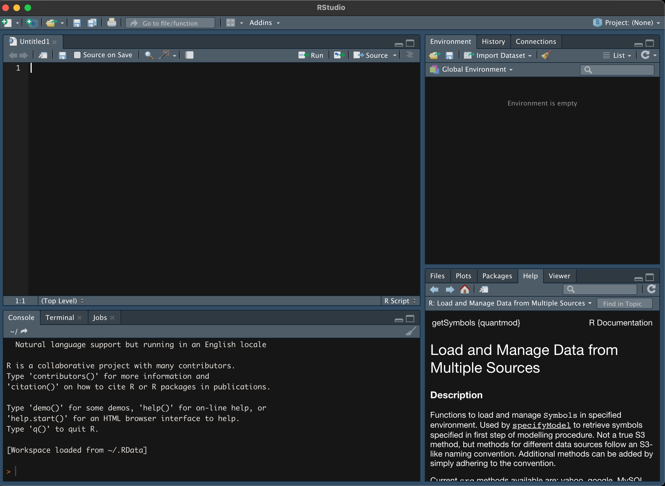
Create New File!
Write Your
Code!
See What You’re Working With!
Watch the
Code run!
Get Help & Look at Plots!

Slide 5
Basic Logic Behind R
R is an object-oriented programming language
We organize code and data into user-defined objects
We interact with these objects via operators (assignment, +, -, /, *) & functions
Functions take in objects, do things, and output another object
Function(object)

Slide 6
Ani’s Naming Prescription
You will have the opportunity to name many things while writing code
It is extremely important to use a consistent naming convention
Snakecase: my_data
Camelcase: myData
Pascalcase: myData
Flatcase: mydata
Kebabcase/Dashcase: my-data

Slide 7
Spacing
Always put a space after a comma, never before, just like in regular English.
Please put spaces around operators (+, -):
Good: 1 + 1
Bad: 1+1
Style Guide: https://style.tidyverse.org/syntax.html

Slide 8
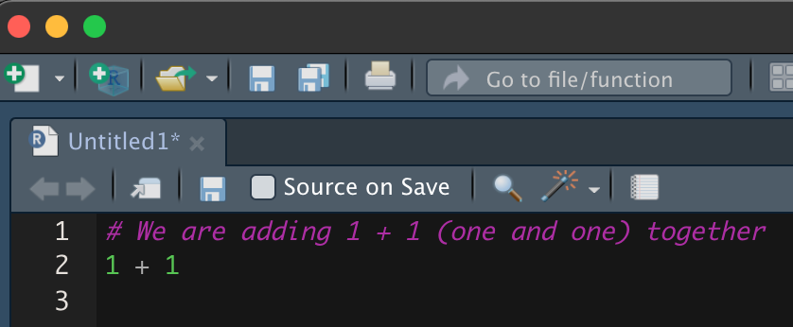
Commenting
You can add comments in your code which R will ignore when executing the code
You can start start a comment with the “#” symbol:
Commenting your code is essential for maintenance and reproducibility
Notes:
Note that one can automate commenting/uncommenting in Rstudio using command + shift + C in macOS or ctrl shift C on windows.

Slide 9
Data Classes
Numeric: 1, 2.3, 4, 5, ….
Character: a, b, cat, epidemiological_methods_4.5, “54342”, …
NOTE: You can represent numbers as characters
Logical: TRUE, FALSE, 0, 1
NOTE: R can use 1/0 as logical values where 1 is TRUE and 0 is FALSE
Missing/Not-a-Number: NaN, NA

Slide 10
Basic Data Structures (Objects)
Variable
Vector
Matrix
Data Frame
List
a/1
a/1
1
1
1/a
1/a
1/a
1/a
a/1
1
1
,
a/1
,
,
a/1
1
1
1/a
1/a
1/a
1/a
a/1
1
1
a/1
a/1

Slide 11
Assignment Operator
We assign values to variables via: <-
Example: my_variable <- 23
You can also use = instead of <- but I recommend you use <- as ”=“ is also used in math. Never ever mix usage!
Notes:
I generally follow advice of not mixing usage, but not sure why it’s important. Just fyi.

Slide 12
Initialization
Initialization: Creating data structures
Vector: my_vector <- c(1, 2, 3, 4, 5)
Data Frame:
my_dataframe <- data.frame(
var1 = c(a, b, c),
var2 = c(1, 2, 3)
)
my_dataframe <- data.frame(
var1 = var1_vector,
var2 = var2_vector,
)

Slide 13
Initialization
Matrix:
my_matrix <- matrix(c(1, 2, 3, 4), nrow = 2, ncol = 2)
List:
my_list <- list(c(1, 2, 3), c(2, 3, 4))
For the scope of this course we will largely focus on vectors and data frames

Slide 14
Packages
Packages are pieces of software that contain a suite of functions
We will extensively work with the dplyr package. This package contains functions that makes working with data frames easier
We have to first install packages and then load them:
install.packages(‘dplyr’)
library(‘dplyr’)
Once you install any package once you only need to run “install.packages” to update it

Slide 15
Dimensions & attributes
Vectors
Single dimension objects: length()
Check class of a vector by: class()
Select elements of a vector: my_vector[element_number]
Data frames
Two dimensional objects: nrow(), ncol()
Making sure a data frame is a data frame: class()
Names of variables in the data frame: names()
Select elements of a dataframe:
my_dataframe[row_number, column_number]

Slide 16
Selecting Variables
my_dataframe[, 1]
my_dataframe$variable_1
my_dataframe[, “variable_1”]
my_dataframe[[“variable_1”]]
dplyr::select(my_dataframe, variable_1)

Slide 17
Selecting Multiple Variables
my_dataframe[, 1:2]
my_dataframe$variable_1
my_dataframe[, c(“variable_1”, “variable_2”]
my_dataframe[[c(“variable_1”, “variable_2”]]
dplyr::select(my_dataframe, variable_1) (this will only select one variable…)

Slide 18
Selecting Observations
my_dataframe[1:24, ]

Slide 19
Selecting Observations by Variable Values
my_dataframe[variable_1 == 1, ]
“==“ operator returns TRUE whenever the two values being compared are equal to each other
my_dataframe[variable_1 == 1 & variable_2 == 0, ]
“&” operator returns TRUE whenever both conditions are TRUE. The OR operator is written as “|”
filter(my_dataframe, variable_1 == 1)
filter(my_dataframe, variable_1 == 1, variable_2 == 0)

Slide 20
Combining filter and select
a <- select(my_dataframe, variable_1, variable_2, variable_3)
b <- filter(a, variable_1 == 1,
variable_2 == 0)
b <- filter(
select(my_dataframe,
variable_1, variable_2, variable_3),
variable_1 == 1, variable_2 == 0
)

Slide 21
Creating new variables in a dataframe
my_dataframe$new_variable <- 4
my_dataframe[, ‘new_variable’] <- 4
my_dataframe[[‘new_variable’]] <- 4
The mutate function allows you to create a new variable in your data frame
mutate(my_dataframe, new_variable = 4)
Mutate can also use existing variables as input for a new variable:
mutate(my_dataframe, new_variable = old_var1 + old_var2)

Slide 22
%>%
“%>%” is a pipe operator. It allows you to chain together commands in R such as:
filter(my_dataframe, variable_1 == 1) %>%
select(variable_2)
The result of the code that comes before the pipe is used as the input for the code that comes after the pipe

Slide 23
group_by() and summarize()
Often we need to do computations in groups by a specific variable. For example: What is the average publication count of current PhD students by epidemiology programs across the country?
My_dataframe %>%
group_by(epi_program) %>%
summarize(mean_pubs = mean(pub_count))
The code above uses “summarize()” which collapses the data to the summary statistic “mean_pubs” by the grouping variable.
My_dataframe %>%
group_by(epi_program) %>%
mutate(mean_pubs = mean(pub_count))
The code above uses “mutate()” which computes the average publication count by school and adds it as a new variable to every observation in the dataset.

Slide 24
Useful functions and operations with vectors
“rep(value, n)”: Create a vector that repeats the value n-times.
E.g.: rep(4, 5)
“seq(start, end, x)”: Create a vector that sequences from the start to the end by x increments
E.g.: seq(1, 10, 2)
“start:end” Create a vector that sequences from the start to the end by 1 increment
E.g.: 20:25

