Slide 1


XÂY DỰNG HỆ THỐNG QUYẾT ĐỊNH CHÍNH SÁCH ĐIỀU KHIỂN TRUY CẬP DỰA TRÊN THUỘC TÍNH BẢO VỆ TÍNH RIÊNG TƯ CHO DỮ LIỆU
NoSQL DOCUMENT STORE
Giảng viên hướng dẫn: TS. Trương Tuấn Anh
ThS. Trần Thị Quế Nguyệt
Giảng viên phản biện: ThS. Lê Thị Kim Tuyến
Sinh viên thực hiện: Lương Vạn Huy

Slide 2
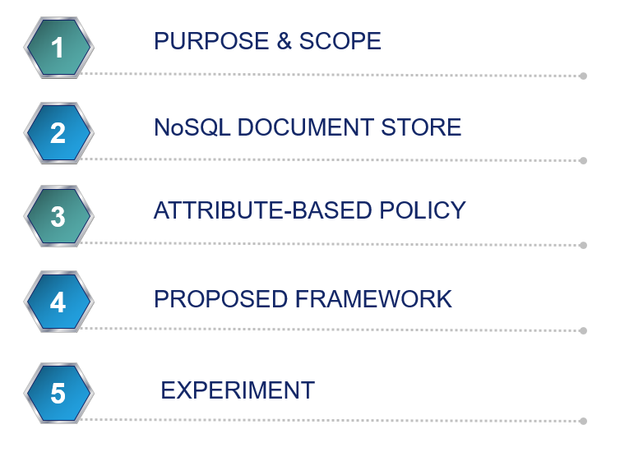
OUTLINE

Slide 3
1. PURPOSE & SCOPE
I
Research about NoSQL document store: MongoDB
II
Attribute-Based Access Control Model
III
Privacy preserving for data
IV
Develop framework & application to define and manage policies

Slide 4
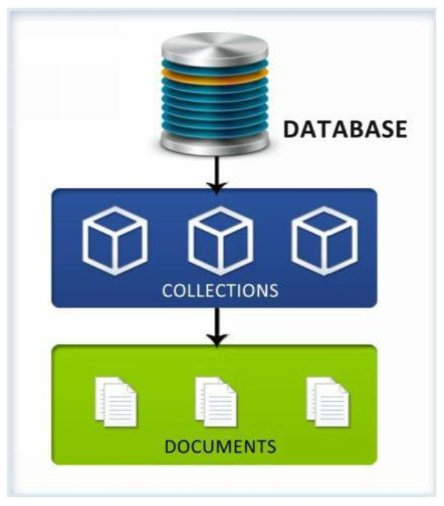
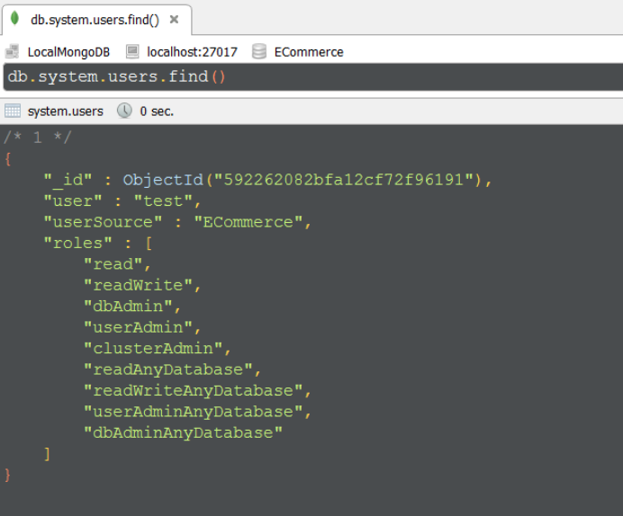
2. NoSQL DOCUMENT STORE
A document store database is a database that uses a document-oriented model to store data.
MongoDB is one of the leading NoSQL document store platform which enables organizations to handle Big Data.
MongoDB Database Model
Access Control in MongoDB

Slide 5
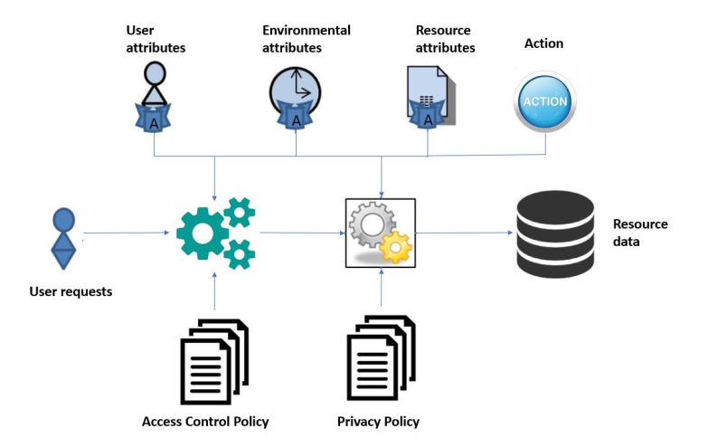
3. ATTRIBUTE-BASED POLICY
General Attribute-based Policy Model

Slide 6
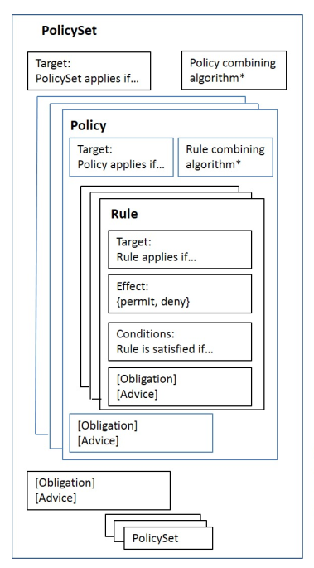
3. ATTRIBUTE-BASED POLICY
Attribute-Based Access Control
+ eXtensive Access Control Markup Language (XACML) is developed by OASIS and the newest version now is 3.0.
XACML components:
PolicySet
Target
Policy Combining Algorithm
Policy
Rule Combining Algorithm
Rule
Obligation

Slide 7
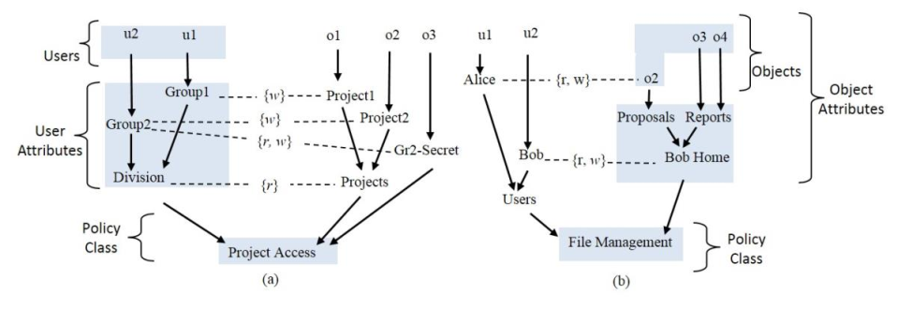
3. ATTRIBUTE-BASED POLICY
Attribute-Based Access Control
+ Next Generation Access Control (NGAC) is defined in terms of a standardized and generic set of relations and functions that are reusable in the expression and enforcement of policies.
NGAC Policy Example

Slide 8
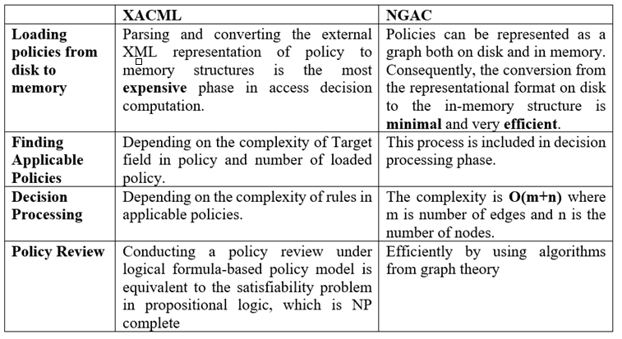
3. ATTRIBUTE-BASED POLICY
Attribute-Based Access Control
Comparison between XACML and NGAC

Slide 9
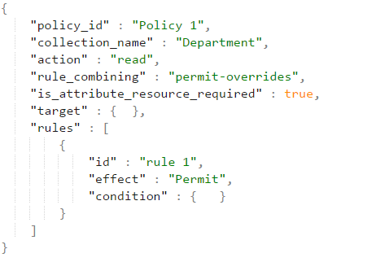
3. ATTRIBUTE-BASED POLICY
Attribute-Based Access Control Policy

Slide 10
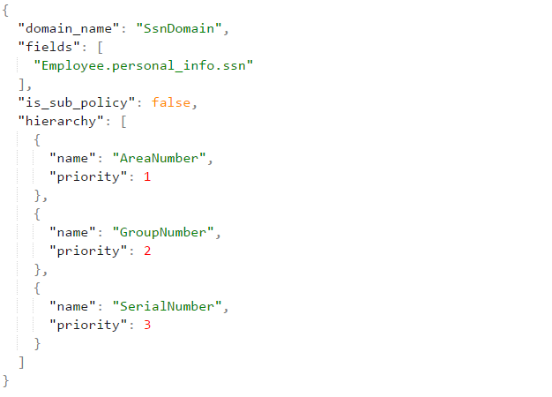
3. ATTRIBUTE-BASED POLICY
Attribute-Based Privacy Policy
Privacy Domain Example

Slide 11
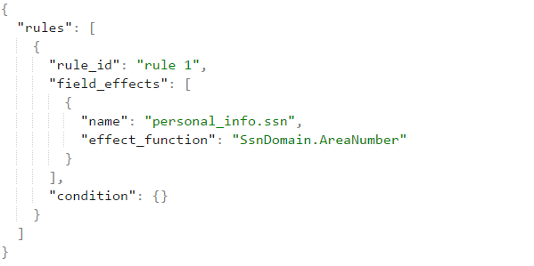
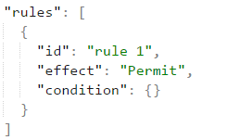
3. ATTRIBUTE-BASED POLICY
Attribute-Based Privacy Policy
Difference between rules in access control and privacy policy

Slide 12
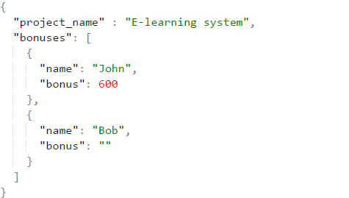
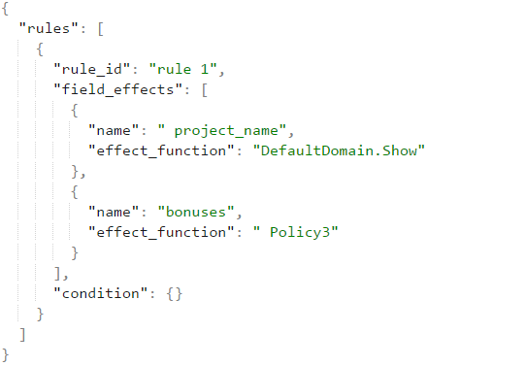
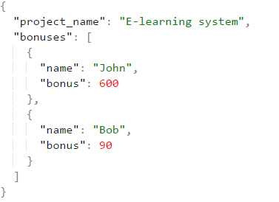
3. ATTRIBUTE-BASED POLICY
Attribute-Based Privacy Policy
A document contains an array of
embedded documents
A privacy policy contains ID of another policy

Slide 13
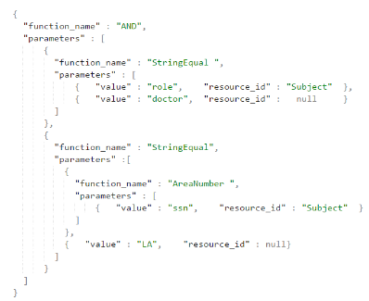
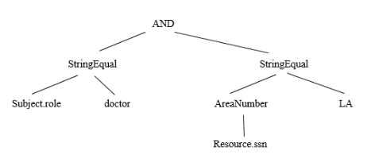
3. ATTRIBUTE-BASED POLICY
Conditional Expression Modeling
Exp=“StringEqual (Subject.role, ‘doctor’) AND StringEqual (AreaNumber (Subject.ssn), ‘LA’)”

Slide 14
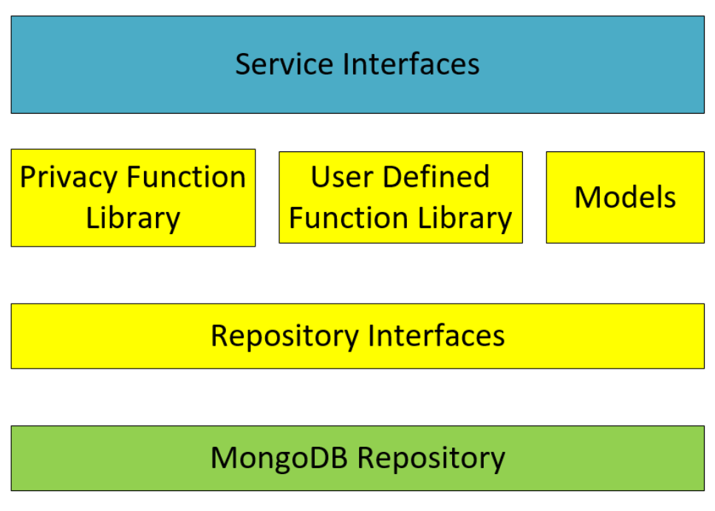
4. PROPOSED FRAMEWORK

Slide 15
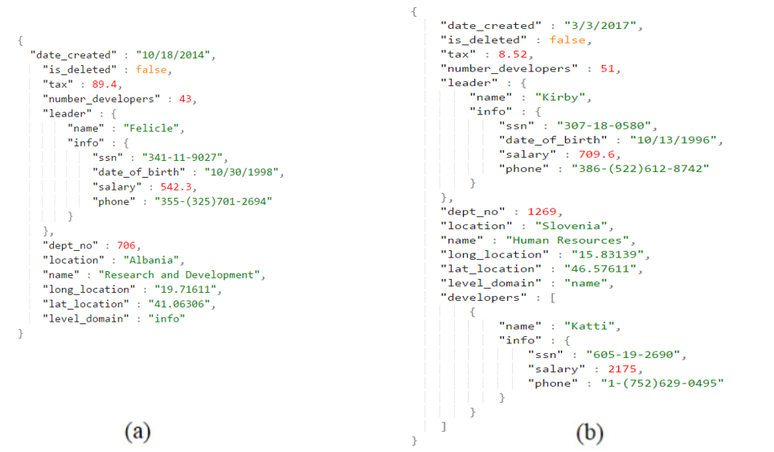
5. EXPERIMENT
All experiment include five access control polices and five privacy policies, each policy contains three rules and each rule required three attributes to evaluate. Each record in resource has to carry out though 2-stage authorization.
Example of resource data for experiment

Slide 16
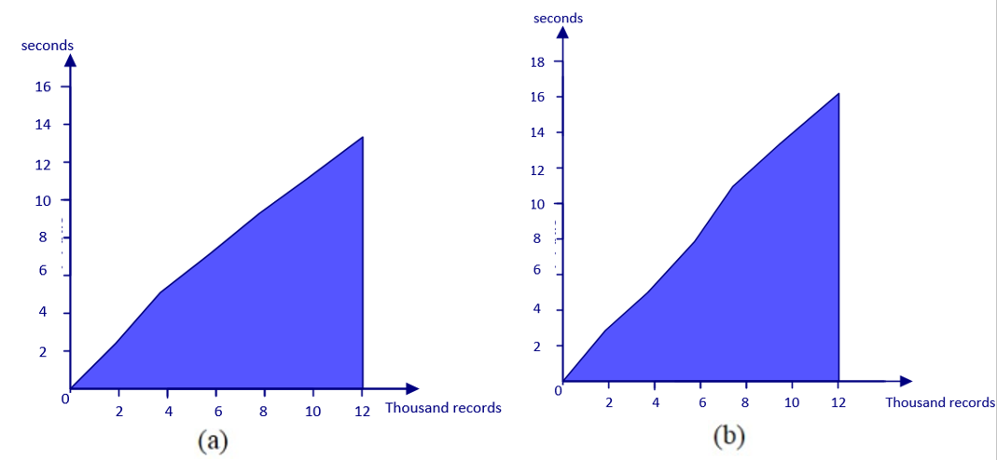
5. EXPERIMENT
Chart of processing time in experiment

Slide 17
Thank you

